Slide 1
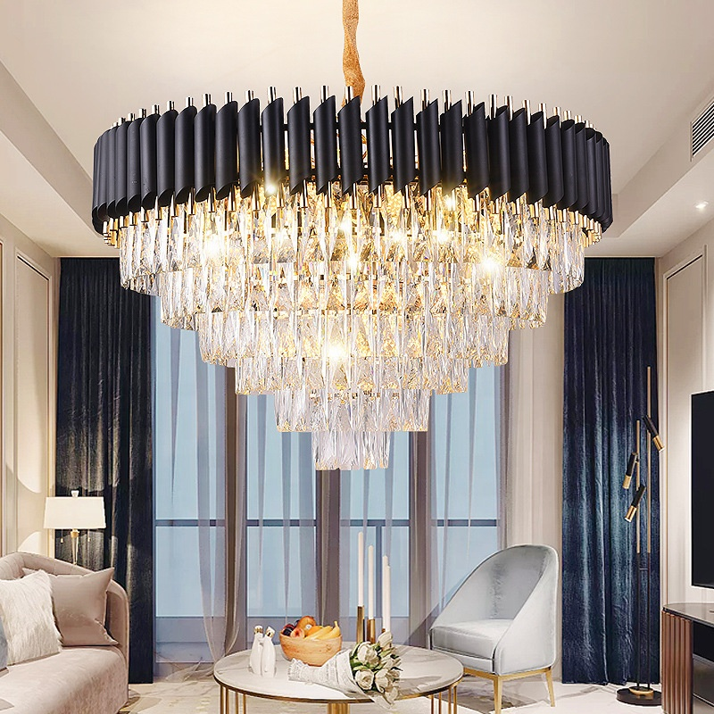
CH01
Crystal Chandelier light
Material:Iron base+ K9
Input Voltage:AC85-265V
IP Rating:IP44 CRI>80 PF>0.9
Color Temperature:3000K/4500K/6000K
Operating Temperature:-25℃ ~50℃
Life Span:50000hours
Certificate:CE ROHS
Item Number | Lamp holder | Light Source | Beam Angle | Size (mm) | WIFI Control Remte control Switch control Dimmer control
CH01 | E14*9 | LED E14 bulb | 120° | 450*550 | No
 | E14*12 |  |  | 600*800
 | E14*18 |  |  | 800*900
 | E14*10 |  |  | 1000*1200
 | E14*8 |  |  | 450*550
 | E14*12 |  |  | 600*400
 | E14*16-40W |  |  | 800*420
 | E14*20-40W |  |  | 1000*550
 | E14*8-40W |  |  | 800*300*320
Modern Ceiling Light Material:Iron base+ PMMA Cover Input Voltage:AC85-265V Led Chip:2835SMD IP Rating:IP44 CRI>80 PF>0.9 Color Temperature:3000K/4500K/6000K Operating Temperature:-25℃ ~50℃ Life Span:50000hours Certificate:CE ROHS
Item Number | Wattage | LedQuantity | LuminousFlux | Beam Angle | Size (mm) | WIFI Control Remte control Switch control Dimmer control
CL-N00 | 24W | 48pcs2835SMD | 1920-2160lm | 120° | 350mm | Yes
 | 36W | 72pcs2835SMD | 2880-3240lm | 120° | 400mm
 | 40W | 80pcs2835SMD | 3200-3600lm | 120° | 450mm
Modern Ceiling Light Material:Iron base+ PMMA Cover Input Voltage:AC85-265V Led Chip:2835SMD IP Rating:IP44 CRI>80 PF>0.9 Color Temperature:3000K/4500K/6000K Operating Temperature:-25℃ ~50℃ Life Span:50000hours Certificate:CE ROHS
Item Number | Wattage | LedQuantity | LuminousFlux | Beam Angle | Size (mm) | WIFI Control Remte control Switch control Dimmer control
CL-N00 | 24W | 48pcs2835SMD | 1920-2160lm | 120° | 350mm | Yes
 | 36W | 72pcs2835SMD | 2880-3240lm | 120° | 400mm
 | 40W | 80pcs2835SMD | 3200-3600lm | 120° | 450mm
Modern Ceiling Light Material:Iron base+ PMMA Cover Input Voltage:AC85-265V Led Chip:2835SMD IP Rating:IP44 CRI>80 PF>0.9 Color Temperature:3000K/4500K/6000K Operating Temperature:-25℃ ~50℃ Life Span:50000hours Certificate:CE ROHS
Item Number | Wattage | LedQuantity | LuminousFlux | Beam Angle | Size (mm) | WIFI Control Remte control Switch control Dimmer control
CL-N00 | 24W | 48pcs2835SMD | 1920-2160lm | 120° | 350mm | Yes
 | 36W | 72pcs2835SMD | 2880-3240lm | 120° | 400mm
 | 40W | 80pcs2835SMD | 3200-3600lm | 120° | 450mm
Modern Ceiling Light Material:Iron base+ PMMA Cover Input Voltage:AC85-265V Led Chip:2835SMD IP Rating:IP44 CRI>80 PF>0.9 Color Temperature:3000K/4500K/6000K Operating Temperature:-25℃ ~50℃ Life Span:50000hours Certificate:CE ROHS
Item Number | Wattage | LedQuantity | LuminousFlux | Beam Angle | Size (mm) | WIFI Control Remte control Switch control Dimmer control
CL-N00 | 24W | 48pcs2835SMD | 1920-2160lm | 120° | 350mm | Yes
 | 36W | 72pcs2835SMD | 2880-3240lm | 120° | 400mm
 | 40W | 80pcs2835SMD | 3200-3600lm | 120° | 450mm

Slide 2
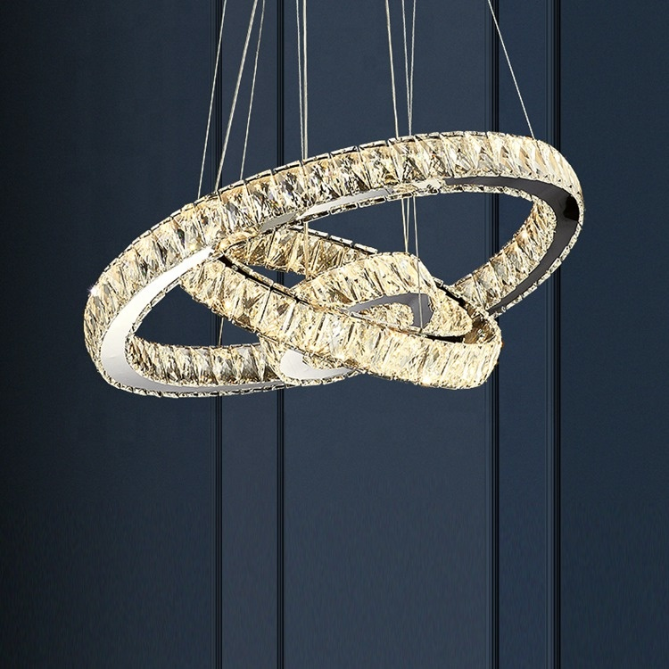
CH02
Crystal Chandelier light
Material: Iron base+K9 +Glass
Input Voltage:AC85-265V
IP Rating:IP44 CRI>80 PF>0.9
Color Temperature:3000K/4500K/6000K
Operating Temperature:-25℃ ~50℃
Life Span:50000hours
Certificate:CE ROHS
Item Number | Wattage | Light Source | Beam Angle | Size (mm) | WIFI Control Remte control Switch control Dimmer control
CH02 | 6W | LED E14 bulb | 120° | D200 H1200 | No
 | 15W |  |  | D400 H1200
 | 24W |  |  | D600 H1200
 | 21W |  |  | D400+D200 H1200
 | 44W |  |  | D600+D400+D200 H1200
 | 69W |  |  | D800+D600+D400 H1500
 | 75W |  |  | D800+D600+D400+D200 H1500
 | 208W |  |  | D1000+D800+D600+D400+D200 H2000
Modern Ceiling Light Material:Iron base+ PMMA Cover Input Voltage:AC85-265V Led Chip:2835SMD IP Rating:IP44 CRI>80 PF>0.9 Color Temperature:3000K/4500K/6000K Operating Temperature:-25℃ ~50℃ Life Span:50000hours Certificate:CE ROHS
Item Number | Wattage | LedQuantity | LuminousFlux | Beam Angle | Size (mm) | WIFI Control Remte control Switch control Dimmer control
CL-N00 | 24W | 48pcs2835SMD | 1920-2160lm | 120° | 350mm | Yes
 | 36W | 72pcs2835SMD | 2880-3240lm | 120° | 400mm
 | 40W | 80pcs2835SMD | 3200-3600lm | 120° | 450mm
Modern Ceiling Light Material:Iron base+ PMMA Cover Input Voltage:AC85-265V Led Chip:2835SMD IP Rating:IP44 CRI>80 PF>0.9 Color Temperature:3000K/4500K/6000K Operating Temperature:-25℃ ~50℃ Life Span:50000hours Certificate:CE ROHS
Item Number | Wattage | LedQuantity | LuminousFlux | Beam Angle | Size (mm) | WIFI Control Remte control Switch control Dimmer control
CL-N00 | 24W | 48pcs2835SMD | 1920-2160lm | 120° | 350mm | Yes
 | 36W | 72pcs2835SMD | 2880-3240lm | 120° | 400mm
 | 40W | 80pcs2835SMD | 3200-3600lm | 120° | 450mm
Modern Ceiling Light Material:Iron base+ PMMA Cover Input Voltage:AC85-265V Led Chip:2835SMD IP Rating:IP44 CRI>80 PF>0.9 Color Temperature:3000K/4500K/6000K Operating Temperature:-25℃ ~50℃ Life Span:50000hours Certificate:CE ROHS
Item Number | Wattage | LedQuantity | LuminousFlux | Beam Angle | Size (mm) | WIFI Control Remte control Switch control Dimmer control
CL-N00 | 24W | 48pcs2835SMD | 1920-2160lm | 120° | 350mm | Yes
 | 36W | 72pcs2835SMD | 2880-3240lm | 120° | 400mm
 | 40W | 80pcs2835SMD | 3200-3600lm | 120° | 450mm
Modern Ceiling Light Material:Iron base+ PMMA Cover Input Voltage:AC85-265V Led Chip:2835SMD IP Rating:IP44 CRI>80 PF>0.9 Color Temperature:3000K/4500K/6000K Operating Temperature:-25℃ ~50℃ Life Span:50000hours Certificate:CE ROHS
Item Number | Wattage | LedQuantity | LuminousFlux | Beam Angle | Size (mm) | WIFI Control Remte control Switch control Dimmer control
CL-N00 | 24W | 48pcs2835SMD | 1920-2160lm | 120° | 350mm | Yes
 | 36W | 72pcs2835SMD | 2880-3240lm | 120° | 400mm
 | 40W | 80pcs2835SMD | 3200-3600lm | 120° | 450mm

Slide 3
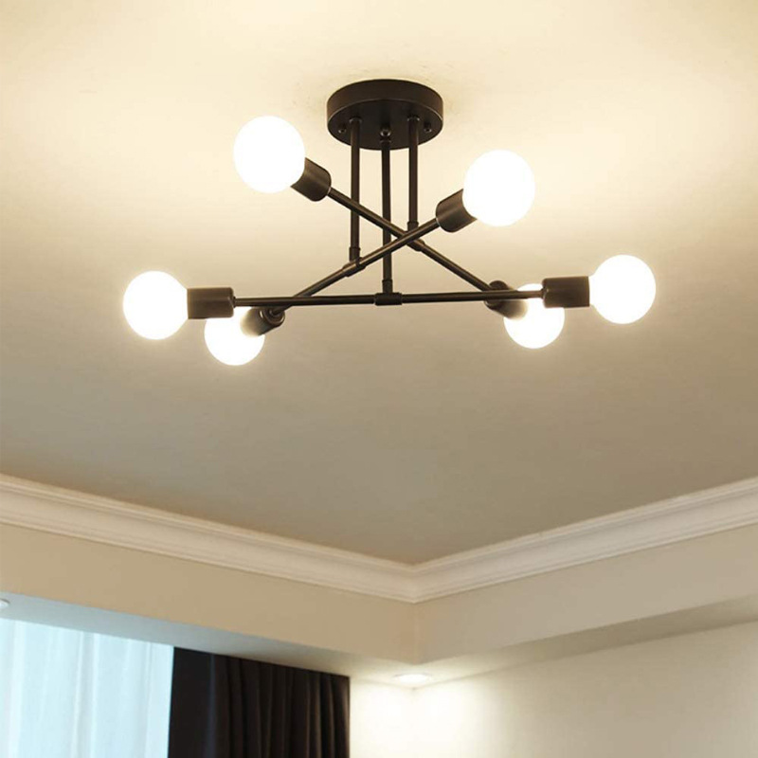
CH03
Crystal Chandelier light
Material:Iron base+ Glass
Input Voltage:AC85-265V
IP Rating:IP44 CRI>80 PF>0.9
Color Temperature:3000K/4500K/6000K
Operating Temperature:-25℃ ~50℃
Life Span:50000hours
Certificate:CE ROHS
Item Number | Wattage | Light Source | Beam Angle | Size (mm) | WIFI Control Remte control Switch control Dimmer control
CH03 | E14*2 | LED E14 bulb | 120° | D750 H210 | No
 | E14*4 |  |  | D750 H270
 | E14*6 |  |  | D1000 H480
 | E14*8 |  |  | D1000 H870
Modern Ceiling Light Material:Iron base+ PMMA Cover Input Voltage:AC85-265V Led Chip:2835SMD IP Rating:IP44 CRI>80 PF>0.9 Color Temperature:3000K/4500K/6000K Operating Temperature:-25℃ ~50℃ Life Span:50000hours Certificate:CE ROHS
Item Number | Wattage | LedQuantity | LuminousFlux | Beam Angle | Size (mm) | WIFI Control Remte control Switch control Dimmer control
CL-N00 | 24W | 48pcs2835SMD | 1920-2160lm | 120° | 350mm | Yes
 | 36W | 72pcs2835SMD | 2880-3240lm | 120° | 400mm
 | 40W | 80pcs2835SMD | 3200-3600lm | 120° | 450mm
Modern Ceiling Light Material:Iron base+ PMMA Cover Input Voltage:AC85-265V Led Chip:2835SMD IP Rating:IP44 CRI>80 PF>0.9 Color Temperature:3000K/4500K/6000K Operating Temperature:-25℃ ~50℃ Life Span:50000hours Certificate:CE ROHS
Item Number | Wattage | LedQuantity | LuminousFlux | Beam Angle | Size (mm) | WIFI Control Remte control Switch control Dimmer control
CL-N00 | 24W | 48pcs2835SMD | 1920-2160lm | 120° | 350mm | Yes
 | 36W | 72pcs2835SMD | 2880-3240lm | 120° | 400mm
 | 40W | 80pcs2835SMD | 3200-3600lm | 120° | 450mm
Modern Ceiling Light Material:Iron base+ PMMA Cover Input Voltage:AC85-265V Led Chip:2835SMD IP Rating:IP44 CRI>80 PF>0.9 Color Temperature:3000K/4500K/6000K Operating Temperature:-25℃ ~50℃ Life Span:50000hours Certificate:CE ROHS
Item Number | Wattage | LedQuantity | LuminousFlux | Beam Angle | Size (mm) | WIFI Control Remte control Switch control Dimmer control
CL-N00 | 24W | 48pcs2835SMD | 1920-2160lm | 120° | 350mm | Yes
 | 36W | 72pcs2835SMD | 2880-3240lm | 120° | 400mm
 | 40W | 80pcs2835SMD | 3200-3600lm | 120° | 450mm
Modern Ceiling Light Material:Iron base+ PMMA Cover Input Voltage:AC85-265V Led Chip:2835SMD IP Rating:IP44 CRI>80 PF>0.9 Color Temperature:3000K/4500K/6000K Operating Temperature:-25℃ ~50℃ Life Span:50000hours Certificate:CE ROHS
Item Number | Wattage | LedQuantity | LuminousFlux | Beam Angle | Size (mm) | WIFI Control Remte control Switch control Dimmer control
CL-N00 | 24W | 48pcs2835SMD | 1920-2160lm | 120° | 350mm | Yes
 | 36W | 72pcs2835SMD | 2880-3240lm | 120° | 400mm
 | 40W | 80pcs2835SMD | 3200-3600lm | 120° | 450mm

Slide 4
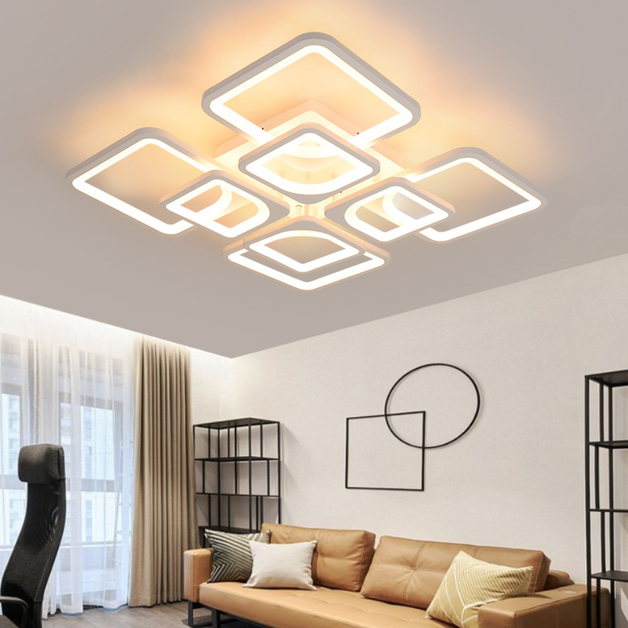
CH05
Crystal Chandelier light
Material: Acrylic + Aluminum alloy
Input Voltage:AC85-265V
IP Rating:IP44 CRI>80 PF>0.9
Color Temperature:3000K/4500K/6000K
Operating Temperature:-25℃ ~50℃
Life Span:50000hours
Certificate:CE ROHS
Item Number | Wattage | Light Source | Beam Angle | Size (mm) | WIFI Control Remte control Switch control Dimmer control
CH05 | 4 Head - 52W | LED | 120° | 450*450*80 | No
 | 4+1 Head - 60W |  |  | 580*580*120
 | 4+4 Head - 75W |  |  | 600*600*110
 | 6+2 Head - 85W |  |  | 900*600*140
Modern Ceiling Light Material:Iron base+ PMMA Cover Input Voltage:AC85-265V Led Chip:2835SMD IP Rating:IP44 CRI>80 PF>0.9 Color Temperature:3000K/4500K/6000K Operating Temperature:-25℃ ~50℃ Life Span:50000hours Certificate:CE ROHS
Item Number | Wattage | LedQuantity | LuminousFlux | Beam Angle | Size (mm) | WIFI Control Remte control Switch control Dimmer control
CL-N00 | 24W | 48pcs2835SMD | 1920-2160lm | 120° | 350mm | Yes
 | 36W | 72pcs2835SMD | 2880-3240lm | 120° | 400mm
 | 40W | 80pcs2835SMD | 3200-3600lm | 120° | 450mm
Modern Ceiling Light Material:Iron base+ PMMA Cover Input Voltage:AC85-265V Led Chip:2835SMD IP Rating:IP44 CRI>80 PF>0.9 Color Temperature:3000K/4500K/6000K Operating Temperature:-25℃ ~50℃ Life Span:50000hours Certificate:CE ROHS
Item Number | Wattage | LedQuantity | LuminousFlux | Beam Angle | Size (mm) | WIFI Control Remte control Switch control Dimmer control
CL-N00 | 24W | 48pcs2835SMD | 1920-2160lm | 120° | 350mm | Yes
 | 36W | 72pcs2835SMD | 2880-3240lm | 120° | 400mm
 | 40W | 80pcs2835SMD | 3200-3600lm | 120° | 450mm
Modern Ceiling Light Material:Iron base+ PMMA Cover Input Voltage:AC85-265V Led Chip:2835SMD IP Rating:IP44 CRI>80 PF>0.9 Color Temperature:3000K/4500K/6000K Operating Temperature:-25℃ ~50℃ Life Span:50000hours Certificate:CE ROHS
Item Number | Wattage | LedQuantity | LuminousFlux | Beam Angle | Size (mm) | WIFI Control Remte control Switch control Dimmer control
CL-N00 | 24W | 48pcs2835SMD | 1920-2160lm | 120° | 350mm | Yes
 | 36W | 72pcs2835SMD | 2880-3240lm | 120° | 400mm
 | 40W | 80pcs2835SMD | 3200-3600lm | 120° | 450mm
Modern Ceiling Light Material:Iron base+ PMMA Cover Input Voltage:AC85-265V Led Chip:2835SMD IP Rating:IP44 CRI>80 PF>0.9 Color Temperature:3000K/4500K/6000K Operating Temperature:-25℃ ~50℃ Life Span:50000hours Certificate:CE ROHS
Item Number | Wattage | LedQuantity | LuminousFlux | Beam Angle | Size (mm) | WIFI Control Remte control Switch control Dimmer control
CL-N00 | 24W | 48pcs2835SMD | 1920-2160lm | 120° | 350mm | Yes
 | 36W | 72pcs2835SMD | 2880-3240lm | 120° | 400mm
 | 40W | 80pcs2835SMD | 3200-3600lm | 120° | 450mm

Slide 5
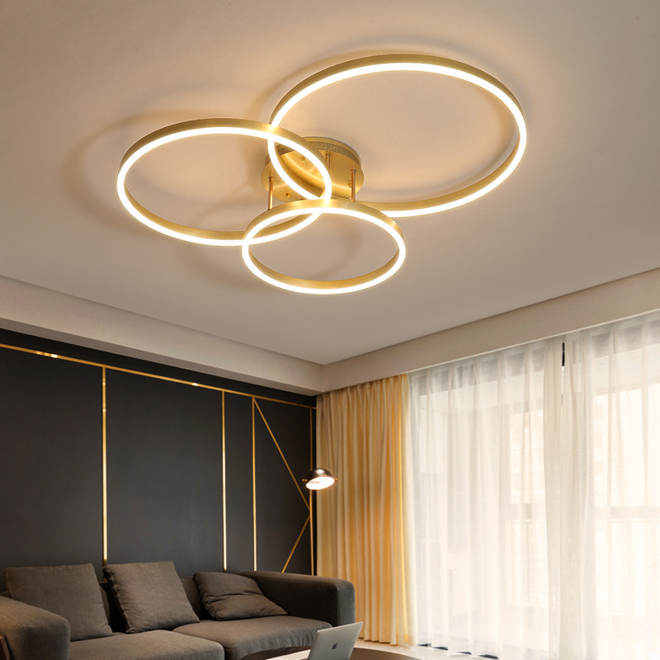
CH06
Crystal Chandelier light
Material: Acrylic+iron
Input Voltage:AC85-265V
IP Rating:IP44 CRI>80 PF>0.9
Color Temperature:3000K/4500K/6000K
Operating Temperature:-25℃ ~50℃
Life Span:50000hours
Certificate:CE ROHS
Item Number | Wattage | Light Source | Beam Angle | Size (mm) | WIFI Control Remte control Switch control Dimmer control
CH06 | 1 Head - 24W | LED | 120° | 550*400*60 | No
 | 2 Head - 35W |  |  | 550*400*60
 | 3 Head - 54W |  |  | 650*500*80
 | 4 Head - 65W |  |  | 620*400*130
 | 5 Head - 72W |  |  | 980*650*120
 | 6 Head - 108W |  |  | 1150*820*120
Modern Ceiling Light Material:Iron base+ PMMA Cover Input Voltage:AC85-265V Led Chip:2835SMD IP Rating:IP44 CRI>80 PF>0.9 Color Temperature:3000K/4500K/6000K Operating Temperature:-25℃ ~50℃ Life Span:50000hours Certificate:CE ROHS
Item Number | Wattage | LedQuantity | LuminousFlux | Beam Angle | Size (mm) | WIFI Control Remte control Switch control Dimmer control
CL-N00 | 24W | 48pcs2835SMD | 1920-2160lm | 120° | 350mm | Yes
 | 36W | 72pcs2835SMD | 2880-3240lm | 120° | 400mm
 | 40W | 80pcs2835SMD | 3200-3600lm | 120° | 450mm
Modern Ceiling Light Material:Iron base+ PMMA Cover Input Voltage:AC85-265V Led Chip:2835SMD IP Rating:IP44 CRI>80 PF>0.9 Color Temperature:3000K/4500K/6000K Operating Temperature:-25℃ ~50℃ Life Span:50000hours Certificate:CE ROHS
Item Number | Wattage | LedQuantity | LuminousFlux | Beam Angle | Size (mm) | WIFI Control Remte control Switch control Dimmer control
CL-N00 | 24W | 48pcs2835SMD | 1920-2160lm | 120° | 350mm | Yes
 | 36W | 72pcs2835SMD | 2880-3240lm | 120° | 400mm
 | 40W | 80pcs2835SMD | 3200-3600lm | 120° | 450mm
Modern Ceiling Light Material:Iron base+ PMMA Cover Input Voltage:AC85-265V Led Chip:2835SMD IP Rating:IP44 CRI>80 PF>0.9 Color Temperature:3000K/4500K/6000K Operating Temperature:-25℃ ~50℃ Life Span:50000hours Certificate:CE ROHS
Item Number | Wattage | LedQuantity | LuminousFlux | Beam Angle | Size (mm) | WIFI Control Remte control Switch control Dimmer control
CL-N00 | 24W | 48pcs2835SMD | 1920-2160lm | 120° | 350mm | Yes
 | 36W | 72pcs2835SMD | 2880-3240lm | 120° | 400mm
 | 40W | 80pcs2835SMD | 3200-3600lm | 120° | 450mm
Modern Ceiling Light Material:Iron base+ PMMA Cover Input Voltage:AC85-265V Led Chip:2835SMD IP Rating:IP44 CRI>80 PF>0.9 Color Temperature:3000K/4500K/6000K Operating Temperature:-25℃ ~50℃ Life Span:50000hours Certificate:CE ROHS
Item Number | Wattage | LedQuantity | LuminousFlux | Beam Angle | Size (mm) | WIFI Control Remte control Switch control Dimmer control
CL-N00 | 24W | 48pcs2835SMD | 1920-2160lm | 120° | 350mm | Yes
 | 36W | 72pcs2835SMD | 2880-3240lm | 120° | 400mm
 | 40W | 80pcs2835SMD | 3200-3600lm | 120° | 450mm

Slide 6
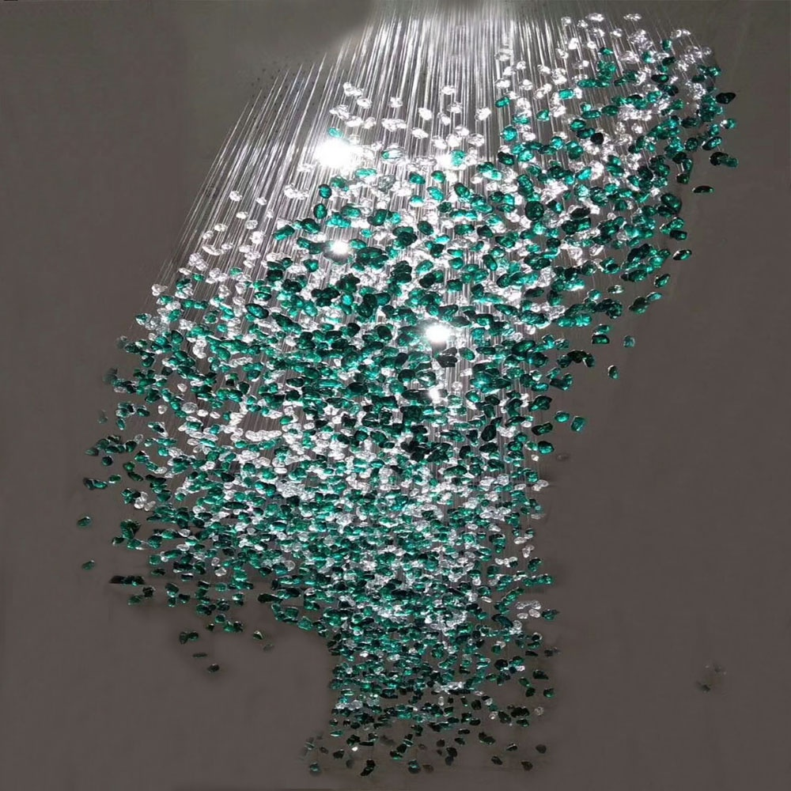
CH07
Crystal Chandelier light
Material: Stainless steel+Crystal
Input Voltage:AC85-265V
IP Rating:IP44 CRI>80 PF>0.9
Color Temperature:3000K/4500K/6000K
Operating Temperature:-25℃ ~50℃
Life Span:50000hours
Certificate:CE ROHS
Item Number | Wattage | Light Source | Beam Angle | Size (mm) | WIFI Control Remte control Switch control Dimmer control
CH07 | 30W | LED SPOT LIGHT | 120° | 1000*200*600 | No
 | 40W |  |  | 1200*300*800
 | 45W |  |  | 1500*300*800
 | 60W |  |  | 2000*400*1000
Modern Ceiling Light Material:Iron base+ PMMA Cover Input Voltage:AC85-265V Led Chip:2835SMD IP Rating:IP44 CRI>80 PF>0.9 Color Temperature:3000K/4500K/6000K Operating Temperature:-25℃ ~50℃ Life Span:50000hours Certificate:CE ROHS
Item Number | Wattage | LedQuantity | LuminousFlux | Beam Angle | Size (mm) | WIFI Control Remte control Switch control Dimmer control
CL-N00 | 24W | 48pcs2835SMD | 1920-2160lm | 120° | 350mm | Yes
 | 36W | 72pcs2835SMD | 2880-3240lm | 120° | 400mm
 | 40W | 80pcs2835SMD | 3200-3600lm | 120° | 450mm
Modern Ceiling Light Material:Iron base+ PMMA Cover Input Voltage:AC85-265V Led Chip:2835SMD IP Rating:IP44 CRI>80 PF>0.9 Color Temperature:3000K/4500K/6000K Operating Temperature:-25℃ ~50℃ Life Span:50000hours Certificate:CE ROHS
Item Number | Wattage | LedQuantity | LuminousFlux | Beam Angle | Size (mm) | WIFI Control Remte control Switch control Dimmer control
CL-N00 | 24W | 48pcs2835SMD | 1920-2160lm | 120° | 350mm | Yes
 | 36W | 72pcs2835SMD | 2880-3240lm | 120° | 400mm
 | 40W | 80pcs2835SMD | 3200-3600lm | 120° | 450mm
Modern Ceiling Light Material:Iron base+ PMMA Cover Input Voltage:AC85-265V Led Chip:2835SMD IP Rating:IP44 CRI>80 PF>0.9 Color Temperature:3000K/4500K/6000K Operating Temperature:-25℃ ~50℃ Life Span:50000hours Certificate:CE ROHS
Item Number | Wattage | LedQuantity | LuminousFlux | Beam Angle | Size (mm) | WIFI Control Remte control Switch control Dimmer control
CL-N00 | 24W | 48pcs2835SMD | 1920-2160lm | 120° | 350mm | Yes
 | 36W | 72pcs2835SMD | 2880-3240lm | 120° | 400mm
 | 40W | 80pcs2835SMD | 3200-3600lm | 120° | 450mm
Modern Ceiling Light Material:Iron base+ PMMA Cover Input Voltage:AC85-265V Led Chip:2835SMD IP Rating:IP44 CRI>80 PF>0.9 Color Temperature:3000K/4500K/6000K Operating Temperature:-25℃ ~50℃ Life Span:50000hours Certificate:CE ROHS
Item Number | Wattage | LedQuantity | LuminousFlux | Beam Angle | Size (mm) | WIFI Control Remte control Switch control Dimmer control
CL-N00 | 24W | 48pcs2835SMD | 1920-2160lm | 120° | 350mm | Yes
 | 36W | 72pcs2835SMD | 2880-3240lm | 120° | 400mm
 | 40W | 80pcs2835SMD | 3200-3600lm | 120° | 450mm

Slide 7
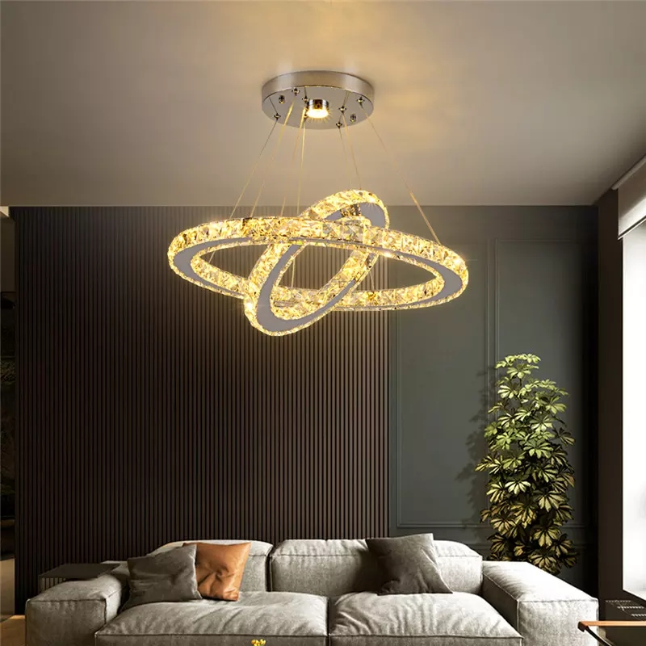
CH08
Crystal Chandelier light
Material: Stainless steel+Crystal
Input Voltage:AC85-265V
IP Rating:IP44 CRI>80 PF>0.9
Color Temperature:3000K/4500K/6000K
Operating Temperature:-25℃ ~50℃
Life Span:50000hours
Certificate:CE ROHS
Item Number | Wattage | Light Source | Beam Angle | Size (mm) | WIFI Control Remte control Switch control Dimmer control
CH08 | 30W | LED SPOT LIGHT | 120° | 1000*200*600 | No
 | 40W |  |  | 1200*300*800
 | 45W |  |  | 1500*300*800
 | 60W |  |  | 2000*400*1000
Modern Ceiling Light Material:Iron base+ PMMA Cover Input Voltage:AC85-265V Led Chip:2835SMD IP Rating:IP44 CRI>80 PF>0.9 Color Temperature:3000K/4500K/6000K Operating Temperature:-25℃ ~50℃ Life Span:50000hours Certificate:CE ROHS
Item Number | Wattage | LedQuantity | LuminousFlux | Beam Angle | Size (mm) | WIFI Control Remte control Switch control Dimmer control
CL-N00 | 24W | 48pcs2835SMD | 1920-2160lm | 120° | 350mm | Yes
 | 36W | 72pcs2835SMD | 2880-3240lm | 120° | 400mm
 | 40W | 80pcs2835SMD | 3200-3600lm | 120° | 450mm
Modern Ceiling Light Material:Iron base+ PMMA Cover Input Voltage:AC85-265V Led Chip:2835SMD IP Rating:IP44 CRI>80 PF>0.9 Color Temperature:3000K/4500K/6000K Operating Temperature:-25℃ ~50℃ Life Span:50000hours Certificate:CE ROHS
Item Number | Wattage | LedQuantity | LuminousFlux | Beam Angle | Size (mm) | WIFI Control Remte control Switch control Dimmer control
CL-N00 | 24W | 48pcs2835SMD | 1920-2160lm | 120° | 350mm | Yes
 | 36W | 72pcs2835SMD | 2880-3240lm | 120° | 400mm
 | 40W | 80pcs2835SMD | 3200-3600lm | 120° | 450mm
Modern Ceiling Light Material:Iron base+ PMMA Cover Input Voltage:AC85-265V Led Chip:2835SMD IP Rating:IP44 CRI>80 PF>0.9 Color Temperature:3000K/4500K/6000K Operating Temperature:-25℃ ~50℃ Life Span:50000hours Certificate:CE ROHS
Item Number | Wattage | LedQuantity | LuminousFlux | Beam Angle | Size (mm) | WIFI Control Remte control Switch control Dimmer control
CL-N00 | 24W | 48pcs2835SMD | 1920-2160lm | 120° | 350mm | Yes
 | 36W | 72pcs2835SMD | 2880-3240lm | 120° | 400mm
 | 40W | 80pcs2835SMD | 3200-3600lm | 120° | 450mm
Modern Ceiling Light Material:Iron base+ PMMA Cover Input Voltage:AC85-265V Led Chip:2835SMD IP Rating:IP44 CRI>80 PF>0.9 Color Temperature:3000K/4500K/6000K Operating Temperature:-25℃ ~50℃ Life Span:50000hours Certificate:CE ROHS
Item Number | Wattage | LedQuantity | LuminousFlux | Beam Angle | Size (mm) | WIFI Control Remte control Switch control Dimmer control
CL-N00 | 24W | 48pcs2835SMD | 1920-2160lm | 120° | 350mm | Yes
 | 36W | 72pcs2835SMD | 2880-3240lm | 120° | 400mm
 | 40W | 80pcs2835SMD | 3200-3600lm | 120° | 450mm

Slide 8
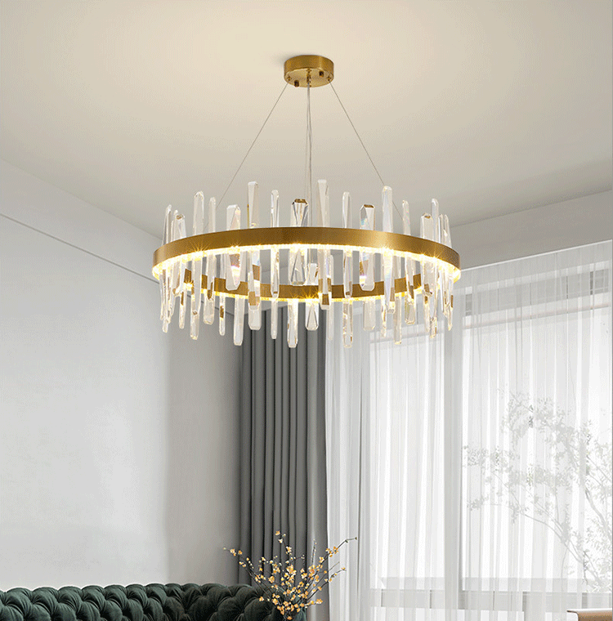
CH09
Crystal Chandelier light
Material:Iron base+ K9
Input Voltage:AC85-265V
IP Rating:IP44 CRI>80 PF>0.9
Color Temperature:3000K/4500K/6000K
Operating Temperature:-25℃ ~50℃
Life Span:50000hours
Certificate:CE ROHS
Item Number | Wattage | Light Source | Beam Angle | Size (mm) | WIFI Control Remte control Switch control Dimmer control
CH09 | 30W | LED SPOT LIGHT | 120° | 1000*200*600 | No
 | 40W |  |  | 1200*300*800
 | 45W |  |  | 1500*300*800
 | 60W |  |  | 2000*400*1000
Modern Ceiling Light Material:Iron base+ PMMA Cover Input Voltage:AC85-265V Led Chip:2835SMD IP Rating:IP44 CRI>80 PF>0.9 Color Temperature:3000K/4500K/6000K Operating Temperature:-25℃ ~50℃ Life Span:50000hours Certificate:CE ROHS
Item Number | Wattage | LedQuantity | LuminousFlux | Beam Angle | Size (mm) | WIFI Control Remte control Switch control Dimmer control
CL-N00 | 24W | 48pcs2835SMD | 1920-2160lm | 120° | 350mm | Yes
 | 36W | 72pcs2835SMD | 2880-3240lm | 120° | 400mm
 | 40W | 80pcs2835SMD | 3200-3600lm | 120° | 450mm
Modern Ceiling Light Material:Iron base+ PMMA Cover Input Voltage:AC85-265V Led Chip:2835SMD IP Rating:IP44 CRI>80 PF>0.9 Color Temperature:3000K/4500K/6000K Operating Temperature:-25℃ ~50℃ Life Span:50000hours Certificate:CE ROHS
Item Number | Wattage | LedQuantity | LuminousFlux | Beam Angle | Size (mm) | WIFI Control Remte control Switch control Dimmer control
CL-N00 | 24W | 48pcs2835SMD | 1920-2160lm | 120° | 350mm | Yes
 | 36W | 72pcs2835SMD | 2880-3240lm | 120° | 400mm
 | 40W | 80pcs2835SMD | 3200-3600lm | 120° | 450mm
Modern Ceiling Light Material:Iron base+ PMMA Cover Input Voltage:AC85-265V Led Chip:2835SMD IP Rating:IP44 CRI>80 PF>0.9 Color Temperature:3000K/4500K/6000K Operating Temperature:-25℃ ~50℃ Life Span:50000hours Certificate:CE ROHS
Item Number | Wattage | LedQuantity | LuminousFlux | Beam Angle | Size (mm) | WIFI Control Remte control Switch control Dimmer control
CL-N00 | 24W | 48pcs2835SMD | 1920-2160lm | 120° | 350mm | Yes
 | 36W | 72pcs2835SMD | 2880-3240lm | 120° | 400mm
 | 40W | 80pcs2835SMD | 3200-3600lm | 120° | 450mm
Modern Ceiling Light Material:Iron base+ PMMA Cover Input Voltage:AC85-265V Led Chip:2835SMD IP Rating:IP44 CRI>80 PF>0.9 Color Temperature:3000K/4500K/6000K Operating Temperature:-25℃ ~50℃ Life Span:50000hours Certificate:CE ROHS
Item Number | Wattage | LedQuantity | LuminousFlux | Beam Angle | Size (mm) | WIFI Control Remte control Switch control Dimmer control
CL-N00 | 24W | 48pcs2835SMD | 1920-2160lm | 120° | 350mm | Yes
 | 36W | 72pcs2835SMD | 2880-3240lm | 120° | 400mm
 | 40W | 80pcs2835SMD | 3200-3600lm | 120° | 450mm

Slide 9
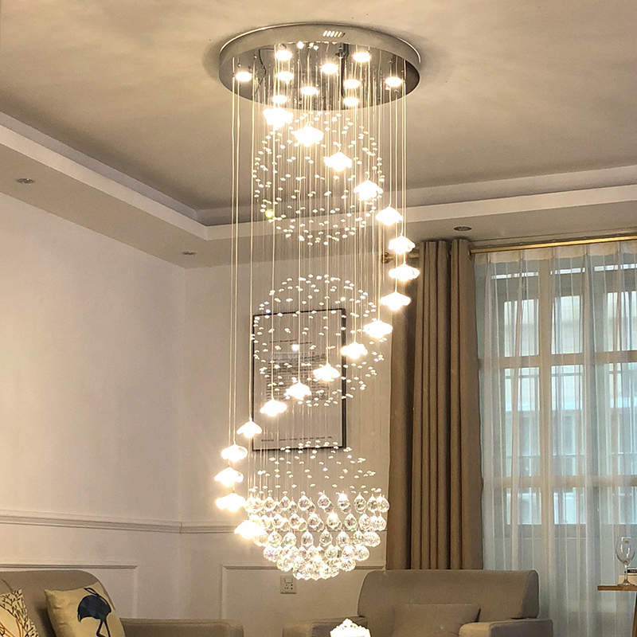
CH10
Crystal Chandelier light
Material: Stainless steel+Crystal
Input Voltage:AC85-265V
IP Rating:IP44 CRI>80 PF>0.9
Color Temperature:3000K/4500K/6000K
Operating Temperature:-25℃ ~50℃
Life Span:50000hours
Certificate:CE ROHS
Item Number | Wattage | Light Source | Beam Angle | Size (mm) | WIFI Control Remte control Switch control Dimmer control
CH10 | Spot light*4 | LED spot light | 120° | φ400*H1200 | No
 | Spot light*7 |  |  | φ600*H1800
 | Spot light*11 |  |  | φ800*H2500
 | Spot light*16 |  |  | φ1000*H3000
Modern Ceiling Light Material:Iron base+ PMMA Cover Input Voltage:AC85-265V Led Chip:2835SMD IP Rating:IP44 CRI>80 PF>0.9 Color Temperature:3000K/4500K/6000K Operating Temperature:-25℃ ~50℃ Life Span:50000hours Certificate:CE ROHS
Item Number | Wattage | LedQuantity | LuminousFlux | Beam Angle | Size (mm) | WIFI Control Remte control Switch control Dimmer control
CL-N00 | 24W | 48pcs2835SMD | 1920-2160lm | 120° | 350mm | Yes
 | 36W | 72pcs2835SMD | 2880-3240lm | 120° | 400mm
 | 40W | 80pcs2835SMD | 3200-3600lm | 120° | 450mm
Modern Ceiling Light Material:Iron base+ PMMA Cover Input Voltage:AC85-265V Led Chip:2835SMD IP Rating:IP44 CRI>80 PF>0.9 Color Temperature:3000K/4500K/6000K Operating Temperature:-25℃ ~50℃ Life Span:50000hours Certificate:CE ROHS
Item Number | Wattage | LedQuantity | LuminousFlux | Beam Angle | Size (mm) | WIFI Control Remte control Switch control Dimmer control
CL-N00 | 24W | 48pcs2835SMD | 1920-2160lm | 120° | 350mm | Yes
 | 36W | 72pcs2835SMD | 2880-3240lm | 120° | 400mm
 | 40W | 80pcs2835SMD | 3200-3600lm | 120° | 450mm
Modern Ceiling Light Material:Iron base+ PMMA Cover Input Voltage:AC85-265V Led Chip:2835SMD IP Rating:IP44 CRI>80 PF>0.9 Color Temperature:3000K/4500K/6000K Operating Temperature:-25℃ ~50℃ Life Span:50000hours Certificate:CE ROHS
Item Number | Wattage | LedQuantity | LuminousFlux | Beam Angle | Size (mm) | WIFI Control Remte control Switch control Dimmer control
CL-N00 | 24W | 48pcs2835SMD | 1920-2160lm | 120° | 350mm | Yes
 | 36W | 72pcs2835SMD | 2880-3240lm | 120° | 400mm
 | 40W | 80pcs2835SMD | 3200-3600lm | 120° | 450mm
Modern Ceiling Light Material:Iron base+ PMMA Cover Input Voltage:AC85-265V Led Chip:2835SMD IP Rating:IP44 CRI>80 PF>0.9 Color Temperature:3000K/4500K/6000K Operating Temperature:-25℃ ~50℃ Life Span:50000hours Certificate:CE ROHS
Item Number | Wattage | LedQuantity | LuminousFlux | Beam Angle | Size (mm) | WIFI Control Remte control Switch control Dimmer control
CL-N00 | 24W | 48pcs2835SMD | 1920-2160lm | 120° | 350mm | Yes
 | 36W | 72pcs2835SMD | 2880-3240lm | 120° | 400mm
 | 40W | 80pcs2835SMD | 3200-3600lm | 120° | 450mm

Slide 10
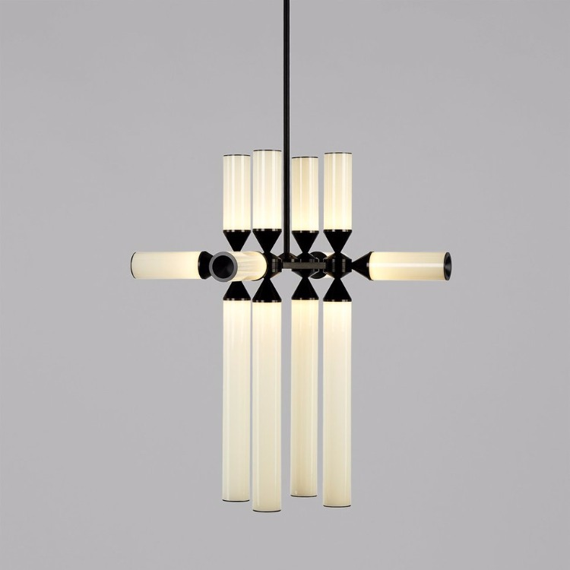
CH11
Crystal Chandelier light
Material: Aluminum + glass
Input Voltage:AC85-265V
IP Rating:IP44 CRI>80 PF>0.9
Color Temperature:3000K/4500K/6000K
Operating Temperature:-25℃ ~50℃
Life Span:50000hours
Certificate:CE ROHS
Item Number | Wattage | Light Source | Beam Angle | Size (mm) | WIFI Control Remte control Switch control Dimmer control
CH11 | 9 Head | LED | 120° | φ500*H420 | No
 | 9 Head |  |  | φ1100*H430
 | 9 Head |  |  | φ1100*H430
 | 12 Head |  |  | φ700*H420
 | 12 Head |  |  | φ1150*H430
 | 12 Head |  |  | φ1150*H430
 | 18 Head |  |  | φ700*H420
 | 18 Head |  |  | φ1200*H430
 | 18 Head |  |  | φ1200*H430
Modern Ceiling Light Material:Iron base+ PMMA Cover Input Voltage:AC85-265V Led Chip:2835SMD IP Rating:IP44 CRI>80 PF>0.9 Color Temperature:3000K/4500K/6000K Operating Temperature:-25℃ ~50℃ Life Span:50000hours Certificate:CE ROHS
Item Number | Wattage | LedQuantity | LuminousFlux | Beam Angle | Size (mm) | WIFI Control Remte control Switch control Dimmer control
CL-N00 | 24W | 48pcs2835SMD | 1920-2160lm | 120° | 350mm | Yes
 | 36W | 72pcs2835SMD | 2880-3240lm | 120° | 400mm
 | 40W | 80pcs2835SMD | 3200-3600lm | 120° | 450mm
Modern Ceiling Light Material:Iron base+ PMMA Cover Input Voltage:AC85-265V Led Chip:2835SMD IP Rating:IP44 CRI>80 PF>0.9 Color Temperature:3000K/4500K/6000K Operating Temperature:-25℃ ~50℃ Life Span:50000hours Certificate:CE ROHS
Item Number | Wattage | LedQuantity | LuminousFlux | Beam Angle | Size (mm) | WIFI Control Remte control Switch control Dimmer control
CL-N00 | 24W | 48pcs2835SMD | 1920-2160lm | 120° | 350mm | Yes
 | 36W | 72pcs2835SMD | 2880-3240lm | 120° | 400mm
 | 40W | 80pcs2835SMD | 3200-3600lm | 120° | 450mm
Modern Ceiling Light Material:Iron base+ PMMA Cover Input Voltage:AC85-265V Led Chip:2835SMD IP Rating:IP44 CRI>80 PF>0.9 Color Temperature:3000K/4500K/6000K Operating Temperature:-25℃ ~50℃ Life Span:50000hours Certificate:CE ROHS
Item Number | Wattage | LedQuantity | LuminousFlux | Beam Angle | Size (mm) | WIFI Control Remte control Switch control Dimmer control
CL-N00 | 24W | 48pcs2835SMD | 1920-2160lm | 120° | 350mm | Yes
 | 36W | 72pcs2835SMD | 2880-3240lm | 120° | 400mm
 | 40W | 80pcs2835SMD | 3200-3600lm | 120° | 450mm
Modern Ceiling Light Material:Iron base+ PMMA Cover Input Voltage:AC85-265V Led Chip:2835SMD IP Rating:IP44 CRI>80 PF>0.9 Color Temperature:3000K/4500K/6000K Operating Temperature:-25℃ ~50℃ Life Span:50000hours Certificate:CE ROHS
Item Number | Wattage | LedQuantity | LuminousFlux | Beam Angle | Size (mm) | WIFI Control Remte control Switch control Dimmer control
CL-N00 | 24W | 48pcs2835SMD | 1920-2160lm | 120° | 350mm | Yes
 | 36W | 72pcs2835SMD | 2880-3240lm | 120° | 400mm
 | 40W | 80pcs2835SMD | 3200-3600lm | 120° | 450mm

Slide 11
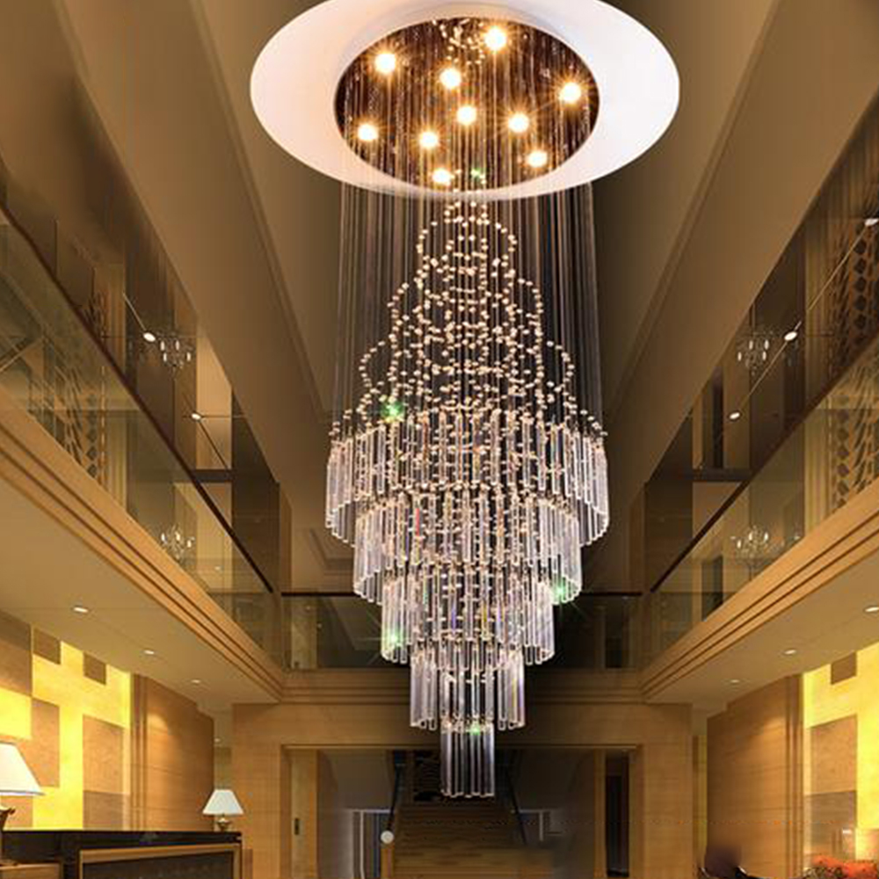
CH12
Crystal Chandelier light
Material: Stainless steel+Crystal
Input Voltage:AC85-265V
IP Rating:IP44 CRI>80 PF>0.9
Color Temperature:3000K/4500K/6000K
Operating Temperature:-25℃ ~50℃
Life Span:50000hours
Certificate:CE ROHS
Item Number | Wattage | Light Source | Beam Angle | Size (mm) | WIFI Control Remte control Switch control Dimmer control
CH12 | GU10*6 | LED | 120° | φ400*H1000 | No
Modern Ceiling Light Material:Iron base+ PMMA Cover Input Voltage:AC85-265V Led Chip:2835SMD IP Rating:IP44 CRI>80 PF>0.9 Color Temperature:3000K/4500K/6000K Operating Temperature:-25℃ ~50℃ Life Span:50000hours Certificate:CE ROHS
Item Number | Wattage | LedQuantity | LuminousFlux | Beam Angle | Size (mm) | WIFI Control Remte control Switch control Dimmer control
CL-N00 | 24W | 48pcs2835SMD | 1920-2160lm | 120° | 350mm | Yes
 | 36W | 72pcs2835SMD | 2880-3240lm | 120° | 400mm
 | 40W | 80pcs2835SMD | 3200-3600lm | 120° | 450mm
Modern Ceiling Light Material:Iron base+ PMMA Cover Input Voltage:AC85-265V Led Chip:2835SMD IP Rating:IP44 CRI>80 PF>0.9 Color Temperature:3000K/4500K/6000K Operating Temperature:-25℃ ~50℃ Life Span:50000hours Certificate:CE ROHS
Item Number | Wattage | LedQuantity | LuminousFlux | Beam Angle | Size (mm) | WIFI Control Remte control Switch control Dimmer control
CL-N00 | 24W | 48pcs2835SMD | 1920-2160lm | 120° | 350mm | Yes
 | 36W | 72pcs2835SMD | 2880-3240lm | 120° | 400mm
 | 40W | 80pcs2835SMD | 3200-3600lm | 120° | 450mm
Modern Ceiling Light Material:Iron base+ PMMA Cover Input Voltage:AC85-265V Led Chip:2835SMD IP Rating:IP44 CRI>80 PF>0.9 Color Temperature:3000K/4500K/6000K Operating Temperature:-25℃ ~50℃ Life Span:50000hours Certificate:CE ROHS
Item Number | Wattage | LedQuantity | LuminousFlux | Beam Angle | Size (mm) | WIFI Control Remte control Switch control Dimmer control
CL-N00 | 24W | 48pcs2835SMD | 1920-2160lm | 120° | 350mm | Yes
 | 36W | 72pcs2835SMD | 2880-3240lm | 120° | 400mm
 | 40W | 80pcs2835SMD | 3200-3600lm | 120° | 450mm
Modern Ceiling Light Material:Iron base+ PMMA Cover Input Voltage:AC85-265V Led Chip:2835SMD IP Rating:IP44 CRI>80 PF>0.9 Color Temperature:3000K/4500K/6000K Operating Temperature:-25℃ ~50℃ Life Span:50000hours Certificate:CE ROHS
Item Number | Wattage | LedQuantity | LuminousFlux | Beam Angle | Size (mm) | WIFI Control Remte control Switch control Dimmer control
CL-N00 | 24W | 48pcs2835SMD | 1920-2160lm | 120° | 350mm | Yes
 | 36W | 72pcs2835SMD | 2880-3240lm | 120° | 400mm
 | 40W | 80pcs2835SMD | 3200-3600lm | 120° | 450mm

Slide 12
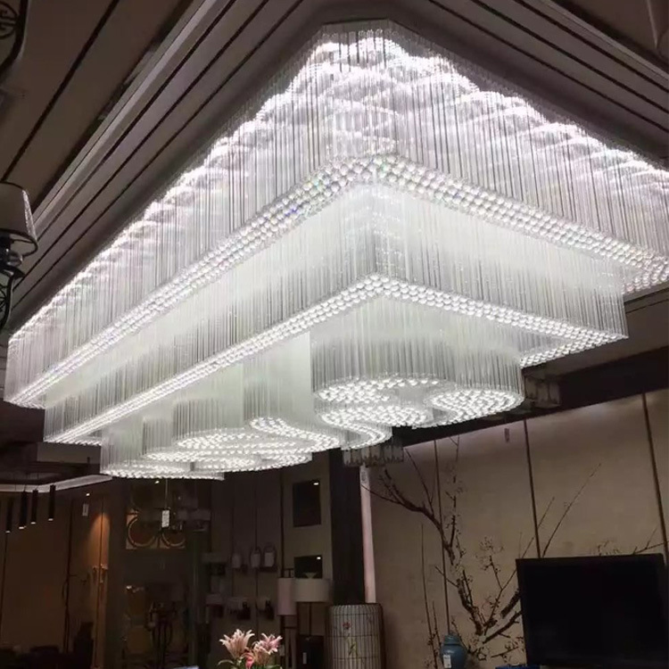
CH13
Crystal Chandelier light
Material: Stainless steel+Crystal
Input Voltage:AC85-265V
IP Rating:IP44 CRI>80 PF>0.9
Color Temperature:3000K/4500K/6000K
Operating Temperature:-25℃ ~50℃
Life Span:50000hours
Certificate:CE ROHS
Item Number | Wattage | Light Source | Beam Angle | Size (mm) | WIFI Control Remte control Switch control Dimmer control
CH13 | E14*9 | LED | 120° | 3050*1220*900 | No
Modern Ceiling Light Material:Iron base+ PMMA Cover Input Voltage:AC85-265V Led Chip:2835SMD IP Rating:IP44 CRI>80 PF>0.9 Color Temperature:3000K/4500K/6000K Operating Temperature:-25℃ ~50℃ Life Span:50000hours Certificate:CE ROHS
Item Number | Wattage | LedQuantity | LuminousFlux | Beam Angle | Size (mm) | WIFI Control Remte control Switch control Dimmer control
CL-N00 | 24W | 48pcs2835SMD | 1920-2160lm | 120° | 350mm | Yes
 | 36W | 72pcs2835SMD | 2880-3240lm | 120° | 400mm
 | 40W | 80pcs2835SMD | 3200-3600lm | 120° | 450mm
Modern Ceiling Light Material:Iron base+ PMMA Cover Input Voltage:AC85-265V Led Chip:2835SMD IP Rating:IP44 CRI>80 PF>0.9 Color Temperature:3000K/4500K/6000K Operating Temperature:-25℃ ~50℃ Life Span:50000hours Certificate:CE ROHS
Item Number | Wattage | LedQuantity | LuminousFlux | Beam Angle | Size (mm) | WIFI Control Remte control Switch control Dimmer control
CL-N00 | 24W | 48pcs2835SMD | 1920-2160lm | 120° | 350mm | Yes
 | 36W | 72pcs2835SMD | 2880-3240lm | 120° | 400mm
 | 40W | 80pcs2835SMD | 3200-3600lm | 120° | 450mm
Modern Ceiling Light Material:Iron base+ PMMA Cover Input Voltage:AC85-265V Led Chip:2835SMD IP Rating:IP44 CRI>80 PF>0.9 Color Temperature:3000K/4500K/6000K Operating Temperature:-25℃ ~50℃ Life Span:50000hours Certificate:CE ROHS
Item Number | Wattage | LedQuantity | LuminousFlux | Beam Angle | Size (mm) | WIFI Control Remte control Switch control Dimmer control
CL-N00 | 24W | 48pcs2835SMD | 1920-2160lm | 120° | 350mm | Yes
 | 36W | 72pcs2835SMD | 2880-3240lm | 120° | 400mm
 | 40W | 80pcs2835SMD | 3200-3600lm | 120° | 450mm
Modern Ceiling Light Material:Iron base+ PMMA Cover Input Voltage:AC85-265V Led Chip:2835SMD IP Rating:IP44 CRI>80 PF>0.9 Color Temperature:3000K/4500K/6000K Operating Temperature:-25℃ ~50℃ Life Span:50000hours Certificate:CE ROHS
Item Number | Wattage | LedQuantity | LuminousFlux | Beam Angle | Size (mm) | WIFI Control Remte control Switch control Dimmer control
CL-N00 | 24W | 48pcs2835SMD | 1920-2160lm | 120° | 350mm | Yes
 | 36W | 72pcs2835SMD | 2880-3240lm | 120° | 400mm
 | 40W | 80pcs2835SMD | 3200-3600lm | 120° | 450mm

Slide 13
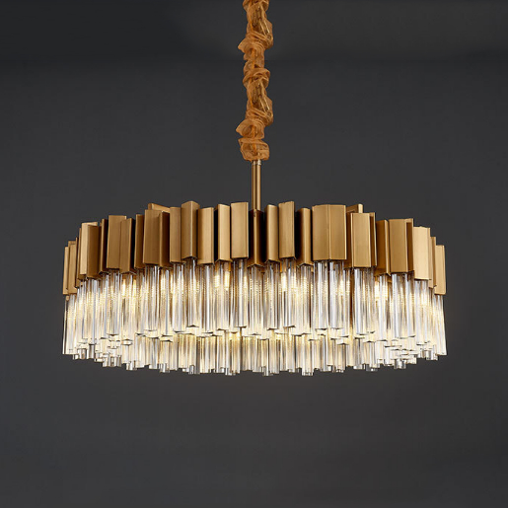
CH15
Crystal Chandelier light
Material: Stainless steel+Crystal
Input Voltage:AC85-265V
IP Rating:IP44 CRI>80 PF>0.9
Color Temperature:3000K/4500K/6000K
Operating Temperature:-25℃ ~50℃
Life Span:50000hours
Certificate:CE ROHS
Item Number | Wattage | Light Source | Beam Angle | Size (mm) | WIFI Control Remte control Switch control Dimmer control
CH15 | Round single layer - E14*6 | LED E14 bulb | 120° | φ400*250 | No
 | Round single layer - E14*9 |  |  | φ500*250
 | Round single layer - E14*12 |  |  | φ620*250
 | Round single layer - E14*18 |  |  | φ750*250
 | Round single layer - E14*26 |  |  | φ980*250
 | Oval single layer - E14*12 |  |  | 850*250
 | Oval single layer - E14*15 |  |  | 1000*250
 | Oval single layer - E14*15 |  |  | 1200*250
 | Round double layer - E14*9 |  |  | φ600*350
 | Round double layer - E14*15 |  |  | φ800*360
Modern Ceiling Light Material:Iron base+ PMMA Cover Input Voltage:AC85-265V Led Chip:2835SMD IP Rating:IP44 CRI>80 PF>0.9 Color Temperature:3000K/4500K/6000K Operating Temperature:-25℃ ~50℃ Life Span:50000hours Certificate:CE ROHS
Item Number | Wattage | LedQuantity | LuminousFlux | Beam Angle | Size (mm) | WIFI Control Remte control Switch control Dimmer control
CL-N00 | 24W | 48pcs2835SMD | 1920-2160lm | 120° | 350mm | Yes
 | 36W | 72pcs2835SMD | 2880-3240lm | 120° | 400mm
 | 40W | 80pcs2835SMD | 3200-3600lm | 120° | 450mm
Modern Ceiling Light Material:Iron base+ PMMA Cover Input Voltage:AC85-265V Led Chip:2835SMD IP Rating:IP44 CRI>80 PF>0.9 Color Temperature:3000K/4500K/6000K Operating Temperature:-25℃ ~50℃ Life Span:50000hours Certificate:CE ROHS
Item Number | Wattage | LedQuantity | LuminousFlux | Beam Angle | Size (mm) | WIFI Control Remte control Switch control Dimmer control
CL-N00 | 24W | 48pcs2835SMD | 1920-2160lm | 120° | 350mm | Yes
 | 36W | 72pcs2835SMD | 2880-3240lm | 120° | 400mm
 | 40W | 80pcs2835SMD | 3200-3600lm | 120° | 450mm
Modern Ceiling Light Material:Iron base+ PMMA Cover Input Voltage:AC85-265V Led Chip:2835SMD IP Rating:IP44 CRI>80 PF>0.9 Color Temperature:3000K/4500K/6000K Operating Temperature:-25℃ ~50℃ Life Span:50000hours Certificate:CE ROHS
Item Number | Wattage | LedQuantity | LuminousFlux | Beam Angle | Size (mm) | WIFI Control Remte control Switch control Dimmer control
CL-N00 | 24W | 48pcs2835SMD | 1920-2160lm | 120° | 350mm | Yes
 | 36W | 72pcs2835SMD | 2880-3240lm | 120° | 400mm
 | 40W | 80pcs2835SMD | 3200-3600lm | 120° | 450mm
Modern Ceiling Light Material:Iron base+ PMMA Cover Input Voltage:AC85-265V Led Chip:2835SMD IP Rating:IP44 CRI>80 PF>0.9 Color Temperature:3000K/4500K/6000K Operating Temperature:-25℃ ~50℃ Life Span:50000hours Certificate:CE ROHS
Item Number | Wattage | LedQuantity | LuminousFlux | Beam Angle | Size (mm) | WIFI Control Remte control Switch control Dimmer control
CL-N00 | 24W | 48pcs2835SMD | 1920-2160lm | 120° | 350mm | Yes
 | 36W | 72pcs2835SMD | 2880-3240lm | 120° | 400mm
 | 40W | 80pcs2835SMD | 3200-3600lm | 120° | 450mm

Slide 14
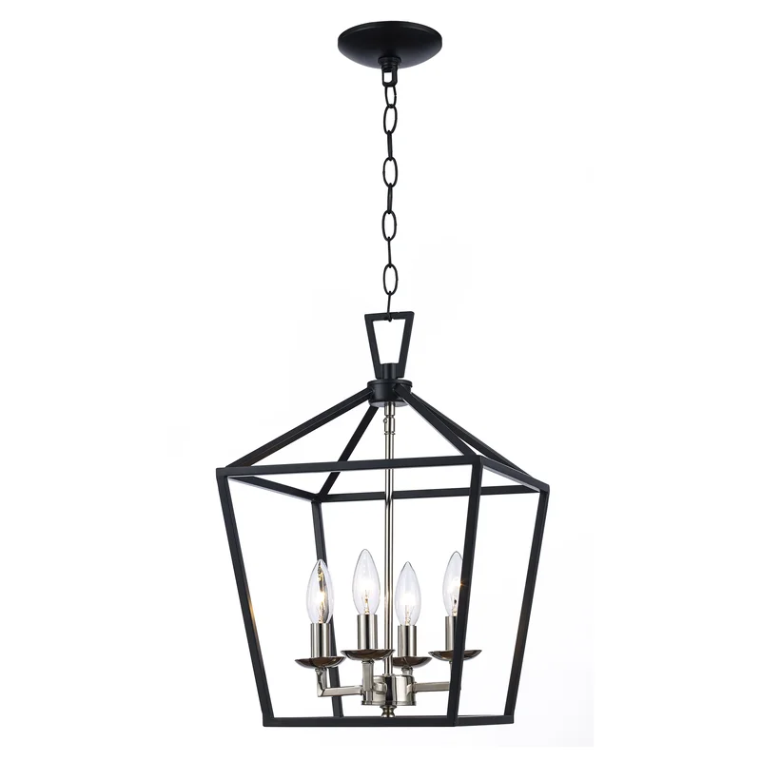
CH16
Crystal Chandelier light
Material: Stainless steel+Crystal
Input Voltage:AC85-265V
IP Rating:IP44 CRI>80 PF>0.9
Color Temperature:3000K/4500K/6000K
Operating Temperature:-25℃ ~50℃
Life Span:50000hours
Certificate:CE ROHS
Item Number | Wattage | Light Source | Beam Angle | Size (mm) | WIFI Control Remte control Switch control Dimmer control
CH16 | Spot light*4 | LED spot light | 120° | φ400*H1200 | No
 | Spot light*7 |  |  | φ600*H1800
Modern Ceiling Light Material:Iron base+ PMMA Cover Input Voltage:AC85-265V Led Chip:2835SMD IP Rating:IP44 CRI>80 PF>0.9 Color Temperature:3000K/4500K/6000K Operating Temperature:-25℃ ~50℃ Life Span:50000hours Certificate:CE ROHS
Item Number | Wattage | LedQuantity | LuminousFlux | Beam Angle | Size (mm) | WIFI Control Remte control Switch control Dimmer control
CL-N00 | 24W | 48pcs2835SMD | 1920-2160lm | 120° | 350mm | Yes
 | 36W | 72pcs2835SMD | 2880-3240lm | 120° | 400mm
 | 40W | 80pcs2835SMD | 3200-3600lm | 120° | 450mm
Modern Ceiling Light Material:Iron base+ PMMA Cover Input Voltage:AC85-265V Led Chip:2835SMD IP Rating:IP44 CRI>80 PF>0.9 Color Temperature:3000K/4500K/6000K Operating Temperature:-25℃ ~50℃ Life Span:50000hours Certificate:CE ROHS
Item Number | Wattage | LedQuantity | LuminousFlux | Beam Angle | Size (mm) | WIFI Control Remte control Switch control Dimmer control
CL-N00 | 24W | 48pcs2835SMD | 1920-2160lm | 120° | 350mm | Yes
 | 36W | 72pcs2835SMD | 2880-3240lm | 120° | 400mm
 | 40W | 80pcs2835SMD | 3200-3600lm | 120° | 450mm
Modern Ceiling Light Material:Iron base+ PMMA Cover Input Voltage:AC85-265V Led Chip:2835SMD IP Rating:IP44 CRI>80 PF>0.9 Color Temperature:3000K/4500K/6000K Operating Temperature:-25℃ ~50℃ Life Span:50000hours Certificate:CE ROHS
Item Number | Wattage | LedQuantity | LuminousFlux | Beam Angle | Size (mm) | WIFI Control Remte control Switch control Dimmer control
CL-N00 | 24W | 48pcs2835SMD | 1920-2160lm | 120° | 350mm | Yes
 | 36W | 72pcs2835SMD | 2880-3240lm | 120° | 400mm
 | 40W | 80pcs2835SMD | 3200-3600lm | 120° | 450mm
Modern Ceiling Light Material:Iron base+ PMMA Cover Input Voltage:AC85-265V Led Chip:2835SMD IP Rating:IP44 CRI>80 PF>0.9 Color Temperature:3000K/4500K/6000K Operating Temperature:-25℃ ~50℃ Life Span:50000hours Certificate:CE ROHS
Item Number | Wattage | LedQuantity | LuminousFlux | Beam Angle | Size (mm) | WIFI Control Remte control Switch control Dimmer control
CL-N00 | 24W | 48pcs2835SMD | 1920-2160lm | 120° | 350mm | Yes
 | 36W | 72pcs2835SMD | 2880-3240lm | 120° | 400mm
 | 40W | 80pcs2835SMD | 3200-3600lm | 120° | 450mm

Slide 15
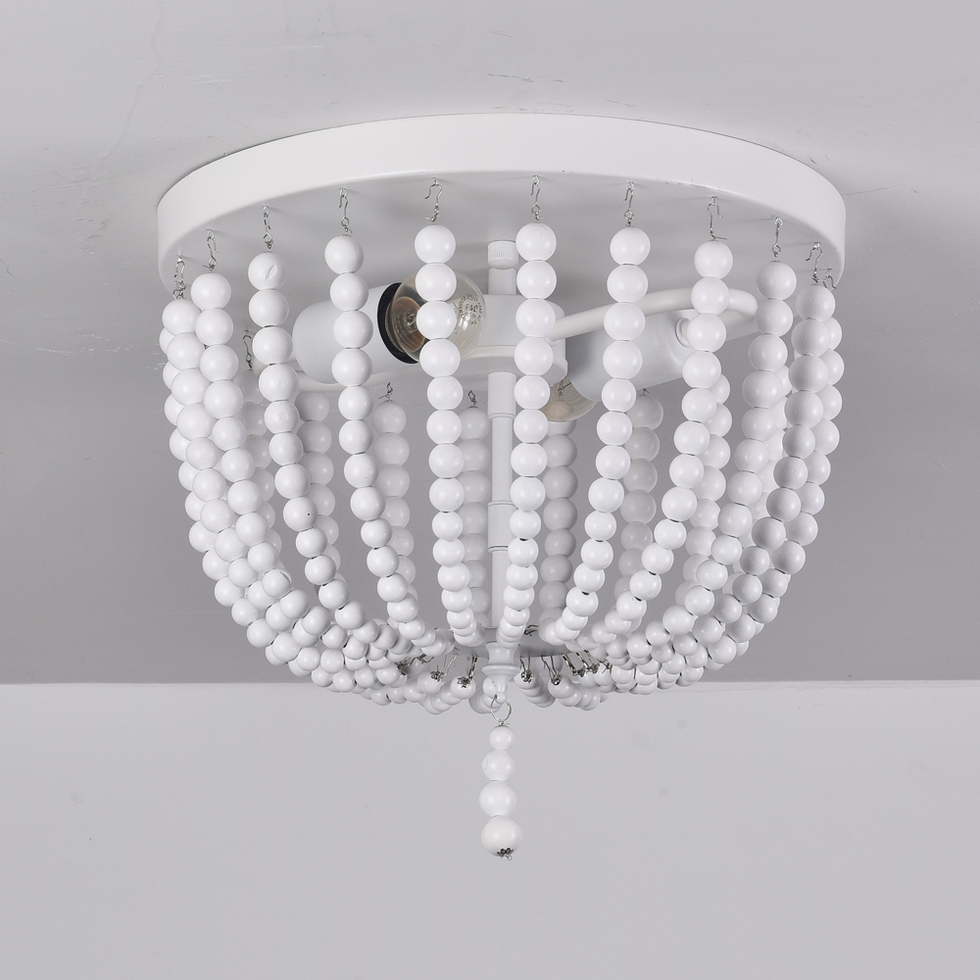
CH17
Crystal Chandelier light
Material: Stainless steel+Crystal
Input Voltage:AC85-265V
IP Rating:IP44 CRI>80 PF>0.9
Color Temperature:3000K/4500K/6000K
Operating Temperature:-25℃ ~50℃
Life Span:50000hours
Certificate:CE ROHS
Item Number | Wattage | Light Source | Beam Angle | Size (mm) | WIFI Control Remte control Switch control Dimmer control
CH16 | E14*2/E12*2 | LED E14/E12 bulb | 120° | φ320*190 | No
Modern Ceiling Light Material:Iron base+ PMMA Cover Input Voltage:AC85-265V Led Chip:2835SMD IP Rating:IP44 CRI>80 PF>0.9 Color Temperature:3000K/4500K/6000K Operating Temperature:-25℃ ~50℃ Life Span:50000hours Certificate:CE ROHS
Item Number | Wattage | LedQuantity | LuminousFlux | Beam Angle | Size (mm) | WIFI Control Remte control Switch control Dimmer control
CL-N00 | 24W | 48pcs2835SMD | 1920-2160lm | 120° | 350mm | Yes
 | 36W | 72pcs2835SMD | 2880-3240lm | 120° | 400mm
 | 40W | 80pcs2835SMD | 3200-3600lm | 120° | 450mm
Modern Ceiling Light Material:Iron base+ PMMA Cover Input Voltage:AC85-265V Led Chip:2835SMD IP Rating:IP44 CRI>80 PF>0.9 Color Temperature:3000K/4500K/6000K Operating Temperature:-25℃ ~50℃ Life Span:50000hours Certificate:CE ROHS
Item Number | Wattage | LedQuantity | LuminousFlux | Beam Angle | Size (mm) | WIFI Control Remte control Switch control Dimmer control
CL-N00 | 24W | 48pcs2835SMD | 1920-2160lm | 120° | 350mm | Yes
 | 36W | 72pcs2835SMD | 2880-3240lm | 120° | 400mm
 | 40W | 80pcs2835SMD | 3200-3600lm | 120° | 450mm
Modern Ceiling Light Material:Iron base+ PMMA Cover Input Voltage:AC85-265V Led Chip:2835SMD IP Rating:IP44 CRI>80 PF>0.9 Color Temperature:3000K/4500K/6000K Operating Temperature:-25℃ ~50℃ Life Span:50000hours Certificate:CE ROHS
Item Number | Wattage | LedQuantity | LuminousFlux | Beam Angle | Size (mm) | WIFI Control Remte control Switch control Dimmer control
CL-N00 | 24W | 48pcs2835SMD | 1920-2160lm | 120° | 350mm | Yes
 | 36W | 72pcs2835SMD | 2880-3240lm | 120° | 400mm
 | 40W | 80pcs2835SMD | 3200-3600lm | 120° | 450mm
Modern Ceiling Light Material:Iron base+ PMMA Cover Input Voltage:AC85-265V Led Chip:2835SMD IP Rating:IP44 CRI>80 PF>0.9 Color Temperature:3000K/4500K/6000K Operating Temperature:-25℃ ~50℃ Life Span:50000hours Certificate:CE ROHS
Item Number | Wattage | LedQuantity | LuminousFlux | Beam Angle | Size (mm) | WIFI Control Remte control Switch control Dimmer control
CL-N00 | 24W | 48pcs2835SMD | 1920-2160lm | 120° | 350mm | Yes
 | 36W | 72pcs2835SMD | 2880-3240lm | 120° | 400mm
 | 40W | 80pcs2835SMD | 3200-3600lm | 120° | 450mm

Slide 16
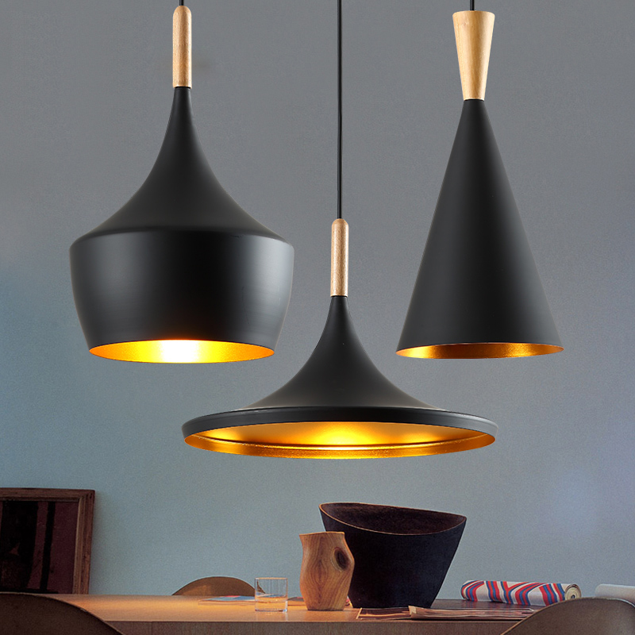
CH18
Crystal Chandelier light
Material: Iron and Aluminum
Input Voltage:AC85-265V
IP Rating:IP44 CRI>80 PF>0.9
Color Temperature:3000K/4500K/6000K
Operating Temperature:-25℃ ~50℃
Life Span:50000hours
Certificate:CE ROHS
Item Number | Wattage | Light Source | Beam Angle | Size (mm) | WIFI Control Remte control Switch control Dimmer control
CH18 | A | LED E27 bulb | 120° | Standard: 1200 Lamp: φ230*300 | No
 | B |  |  | Standard: 1200 Lamp: φ190*400
 | C |  |  | Standard: 1200 Lamp: φ360*170
Modern Ceiling Light Material:Iron base+ PMMA Cover Input Voltage:AC85-265V Led Chip:2835SMD IP Rating:IP44 CRI>80 PF>0.9 Color Temperature:3000K/4500K/6000K Operating Temperature:-25℃ ~50℃ Life Span:50000hours Certificate:CE ROHS
Item Number | Wattage | LedQuantity | LuminousFlux | Beam Angle | Size (mm) | WIFI Control Remte control Switch control Dimmer control
CL-N00 | 24W | 48pcs2835SMD | 1920-2160lm | 120° | 350mm | Yes
 | 36W | 72pcs2835SMD | 2880-3240lm | 120° | 400mm
 | 40W | 80pcs2835SMD | 3200-3600lm | 120° | 450mm
Modern Ceiling Light Material:Iron base+ PMMA Cover Input Voltage:AC85-265V Led Chip:2835SMD IP Rating:IP44 CRI>80 PF>0.9 Color Temperature:3000K/4500K/6000K Operating Temperature:-25℃ ~50℃ Life Span:50000hours Certificate:CE ROHS
Item Number | Wattage | LedQuantity | LuminousFlux | Beam Angle | Size (mm) | WIFI Control Remte control Switch control Dimmer control
CL-N00 | 24W | 48pcs2835SMD | 1920-2160lm | 120° | 350mm | Yes
 | 36W | 72pcs2835SMD | 2880-3240lm | 120° | 400mm
 | 40W | 80pcs2835SMD | 3200-3600lm | 120° | 450mm
Modern Ceiling Light Material:Iron base+ PMMA Cover Input Voltage:AC85-265V Led Chip:2835SMD IP Rating:IP44 CRI>80 PF>0.9 Color Temperature:3000K/4500K/6000K Operating Temperature:-25℃ ~50℃ Life Span:50000hours Certificate:CE ROHS
Item Number | Wattage | LedQuantity | LuminousFlux | Beam Angle | Size (mm) | WIFI Control Remte control Switch control Dimmer control
CL-N00 | 24W | 48pcs2835SMD | 1920-2160lm | 120° | 350mm | Yes
 | 36W | 72pcs2835SMD | 2880-3240lm | 120° | 400mm
 | 40W | 80pcs2835SMD | 3200-3600lm | 120° | 450mm
Modern Ceiling Light Material:Iron base+ PMMA Cover Input Voltage:AC85-265V Led Chip:2835SMD IP Rating:IP44 CRI>80 PF>0.9 Color Temperature:3000K/4500K/6000K Operating Temperature:-25℃ ~50℃ Life Span:50000hours Certificate:CE ROHS
Item Number | Wattage | LedQuantity | LuminousFlux | Beam Angle | Size (mm) | WIFI Control Remte control Switch control Dimmer control
CL-N00 | 24W | 48pcs2835SMD | 1920-2160lm | 120° | 350mm | Yes
 | 36W | 72pcs2835SMD | 2880-3240lm | 120° | 400mm
 | 40W | 80pcs2835SMD | 3200-3600lm | 120° | 450mm

Slide 17
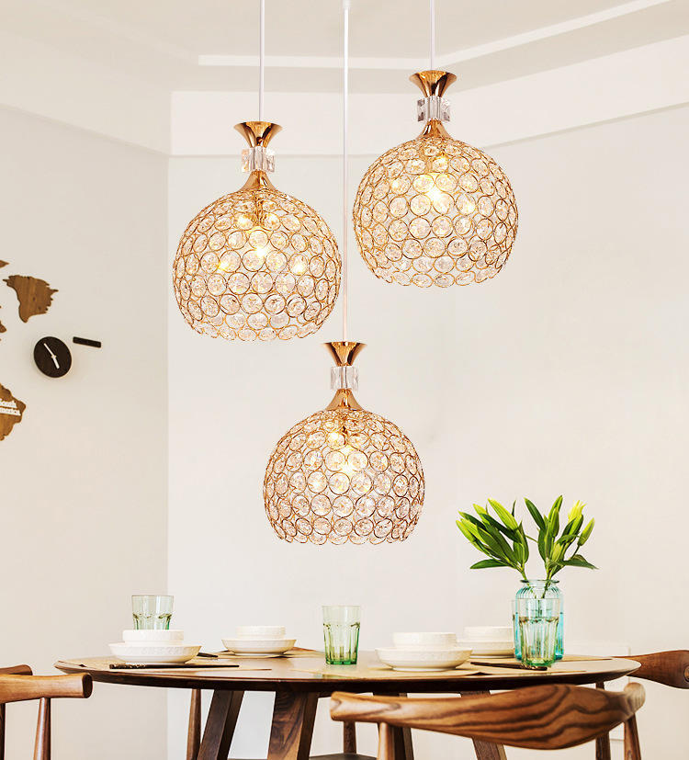
CH19
Crystal Chandelier light
Material: Metal
Input Voltage:AC85-265V
IP Rating:IP44 CRI>80 PF>0.9
Color Temperature:3000K/4500K/6000K
Operating Temperature:-25℃ ~50℃
Life Span:50000hours
Certificate:CE ROHS
Item Number | Wattage | Light Source | Beam Angle | Size (mm) | WIFI Control Remte control Switch control Dimmer control
CH19 | 1 Head - E27*1 | LED E27 bulb | 120° | Lamp size: 290*350 Holder length: 100 | No
 | 3 Head round plate - E27*1 |  |  | Lamp size: 200*240 Holder lenght: 500
 | 3 Head long plate - E27*1 |  |  | Lamp size: 200*240 Holder size: φ300
Modern Ceiling Light Material:Iron base+ PMMA Cover Input Voltage:AC85-265V Led Chip:2835SMD IP Rating:IP44 CRI>80 PF>0.9 Color Temperature:3000K/4500K/6000K Operating Temperature:-25℃ ~50℃ Life Span:50000hours Certificate:CE ROHS
Item Number | Wattage | LedQuantity | LuminousFlux | Beam Angle | Size (mm) | WIFI Control Remte control Switch control Dimmer control
CL-N00 | 24W | 48pcs2835SMD | 1920-2160lm | 120° | 350mm | Yes
 | 36W | 72pcs2835SMD | 2880-3240lm | 120° | 400mm
 | 40W | 80pcs2835SMD | 3200-3600lm | 120° | 450mm
Modern Ceiling Light Material:Iron base+ PMMA Cover Input Voltage:AC85-265V Led Chip:2835SMD IP Rating:IP44 CRI>80 PF>0.9 Color Temperature:3000K/4500K/6000K Operating Temperature:-25℃ ~50℃ Life Span:50000hours Certificate:CE ROHS
Item Number | Wattage | LedQuantity | LuminousFlux | Beam Angle | Size (mm) | WIFI Control Remte control Switch control Dimmer control
CL-N00 | 24W | 48pcs2835SMD | 1920-2160lm | 120° | 350mm | Yes
 | 36W | 72pcs2835SMD | 2880-3240lm | 120° | 400mm
 | 40W | 80pcs2835SMD | 3200-3600lm | 120° | 450mm
Modern Ceiling Light Material:Iron base+ PMMA Cover Input Voltage:AC85-265V Led Chip:2835SMD IP Rating:IP44 CRI>80 PF>0.9 Color Temperature:3000K/4500K/6000K Operating Temperature:-25℃ ~50℃ Life Span:50000hours Certificate:CE ROHS
Item Number | Wattage | LedQuantity | LuminousFlux | Beam Angle | Size (mm) | WIFI Control Remte control Switch control Dimmer control
CL-N00 | 24W | 48pcs2835SMD | 1920-2160lm | 120° | 350mm | Yes
 | 36W | 72pcs2835SMD | 2880-3240lm | 120° | 400mm
 | 40W | 80pcs2835SMD | 3200-3600lm | 120° | 450mm
Modern Ceiling Light Material:Iron base+ PMMA Cover Input Voltage:AC85-265V Led Chip:2835SMD IP Rating:IP44 CRI>80 PF>0.9 Color Temperature:3000K/4500K/6000K Operating Temperature:-25℃ ~50℃ Life Span:50000hours Certificate:CE ROHS
Item Number | Wattage | LedQuantity | LuminousFlux | Beam Angle | Size (mm) | WIFI Control Remte control Switch control Dimmer control
CL-N00 | 24W | 48pcs2835SMD | 1920-2160lm | 120° | 350mm | Yes
 | 36W | 72pcs2835SMD | 2880-3240lm | 120° | 400mm
 | 40W | 80pcs2835SMD | 3200-3600lm | 120° | 450mm

