Slide 1
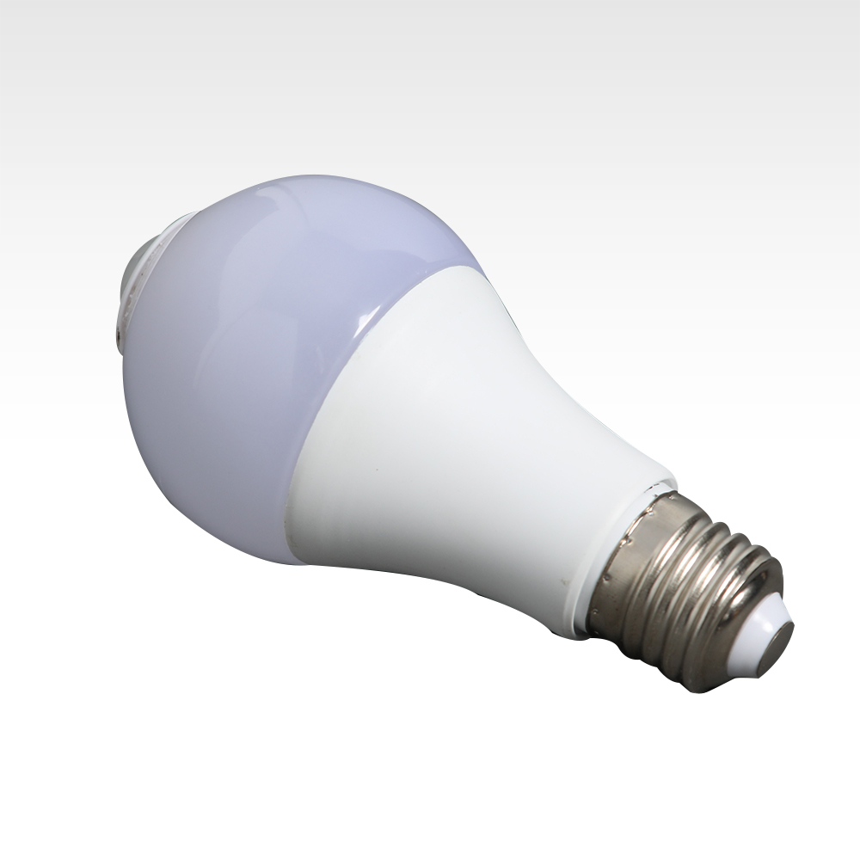
B01
LED Night Star Projection Lamp
Material:ABS Plastic
Input Voltage:DC5V
Power Mode:USB/Battery (Battery not included)
Chip Brand:Epistar
IP Rating:IP44
Color Temperature:7 Colorful Change or 16 Colorful Change
Operating Temperature:-20℃ -50℃
CE ROHS certificate approved
Item Number | Watt | Power | Chip | PF | Ra | Lumen | CCT | Size
B01(PIR) | 5W | 5W±10% | Epistar 3030 | 0.5 | 80 | 450-550LM | 2800~6500K | ¢ 60*H120mm
 | 7W | 7W±10% | Epistar 3030 | 0.5 | 80 | 640-750LM | 2800~6500K | ¢ 60*H120mm
 | 9W | 9W±10% | Epistar 3030 | 0.5 | 80 | 820-950LM | 2800~6500K | ¢ 60*H130mm
 | 12W | 12W±10% | Epistar 3030 | 0.5 | 80 | 1100-1300LM | 2800~6500K | ¢ 60*H130mm
Modern Ceiling Light Material:Iron base+ PMMA Cover Input Voltage:AC85-265V Led Chip:2835SMD IP Rating:IP44 CRI>80 PF>0.9 Color Temperature:3000K/4500K/6000K Operating Temperature:-25℃ ~50℃ Life Span:50000hours Certificate:CE ROHS
Item Number | Wattage | LedQuantity | LuminousFlux | Beam Angle | Size (mm) | WIFI Control Remte control Switch control Dimmer control
CL-N00 | 24W | 48pcs2835SMD | 1920-2160lm | 120° | 350mm | Yes
 | 36W | 72pcs2835SMD | 2880-3240lm | 120° | 400mm
 | 40W | 80pcs2835SMD | 3200-3600lm | 120° | 450mm
Modern Ceiling Light Material:Iron base+ PMMA Cover Input Voltage:AC85-265V Led Chip:2835SMD IP Rating:IP44 CRI>80 PF>0.9 Color Temperature:3000K/4500K/6000K Operating Temperature:-25℃ ~50℃ Life Span:50000hours Certificate:CE ROHS
Item Number | Wattage | LedQuantity | LuminousFlux | Beam Angle | Size (mm) | WIFI Control Remte control Switch control Dimmer control
CL-N00 | 24W | 48pcs2835SMD | 1920-2160lm | 120° | 350mm | Yes
 | 36W | 72pcs2835SMD | 2880-3240lm | 120° | 400mm
 | 40W | 80pcs2835SMD | 3200-3600lm | 120° | 450mm
Modern Ceiling Light Material:Iron base+ PMMA Cover Input Voltage:AC85-265V Led Chip:2835SMD IP Rating:IP44 CRI>80 PF>0.9 Color Temperature:3000K/4500K/6000K Operating Temperature:-25℃ ~50℃ Life Span:50000hours Certificate:CE ROHS
Item Number | Wattage | LedQuantity | LuminousFlux | Beam Angle | Size (mm) | WIFI Control Remte control Switch control Dimmer control
CL-N00 | 24W | 48pcs2835SMD | 1920-2160lm | 120° | 350mm | Yes
 | 36W | 72pcs2835SMD | 2880-3240lm | 120° | 400mm
 | 40W | 80pcs2835SMD | 3200-3600lm | 120° | 450mm
Modern Ceiling Light Material:Iron base+ PMMA Cover Input Voltage:AC85-265V Led Chip:2835SMD IP Rating:IP44 CRI>80 PF>0.9 Color Temperature:3000K/4500K/6000K Operating Temperature:-25℃ ~50℃ Life Span:50000hours Certificate:CE ROHS
Item Number | Wattage | LedQuantity | LuminousFlux | Beam Angle | Size (mm) | WIFI Control Remte control Switch control Dimmer control
CL-N00 | 24W | 48pcs2835SMD | 1920-2160lm | 120° | 350mm | Yes
 | 36W | 72pcs2835SMD | 2880-3240lm | 120° | 400mm
 | 40W | 80pcs2835SMD | 3200-3600lm | 120° | 450mm

Slide 2
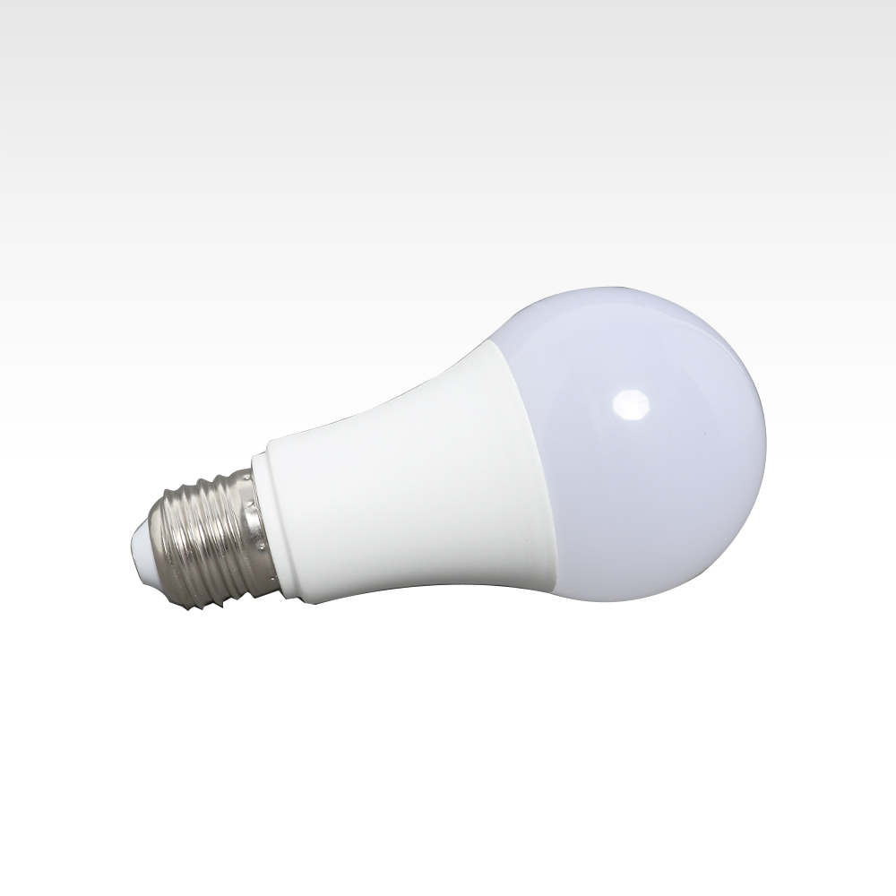
B02
LED Square / Round Night Light
Material:ABS
Product Style: Light Control Series
Lifespan: Up to 100,000 hours
Input voltage: 110V-220V
Colors: LED light color is the same as the shell color (white/ blue/ orange /pink)
Item Number | Wattage | Flux | CRI | Color Temperature | Size
B05 | 5W | 425lm | >80 | 2700-6500K | 50*90
 | 7W | 595lm | >80 | 2700-6500K | 60*112
 | 9W | 765lm | >80 | 2700-6500K | 65*118
 | 12W | 1020lm | >80 | 2700-6500K | 65*124
 | 15W | 1275lm | >80 | 2700-6500K | 70*132
 | 18W | 1530lm | >80 | 2700-6500K | 80*145
 | 25W | 1870lm | >80 | 2700-6500K | 95*160
Modern Ceiling Light Material:Iron base+ PMMA Cover Input Voltage:AC85-265V Led Chip:2835SMD IP Rating:IP44 CRI>80 PF>0.9 Color Temperature:3000K/4500K/6000K Operating Temperature:-25℃ ~50℃ Life Span:50000hours Certificate:CE ROHS
Item Number | Wattage | LedQuantity | LuminousFlux | Beam Angle | Size (mm) | WIFI Control Remte control Switch control Dimmer control
CL-N00 | 24W | 48pcs2835SMD | 1920-2160lm | 120° | 350mm | Yes
 | 36W | 72pcs2835SMD | 2880-3240lm | 120° | 400mm
 | 40W | 80pcs2835SMD | 3200-3600lm | 120° | 450mm
Modern Ceiling Light Material:Iron base+ PMMA Cover Input Voltage:AC85-265V Led Chip:2835SMD IP Rating:IP44 CRI>80 PF>0.9 Color Temperature:3000K/4500K/6000K Operating Temperature:-25℃ ~50℃ Life Span:50000hours Certificate:CE ROHS
Item Number | Wattage | LedQuantity | LuminousFlux | Beam Angle | Size (mm) | WIFI Control Remte control Switch control Dimmer control
CL-N00 | 24W | 48pcs2835SMD | 1920-2160lm | 120° | 350mm | Yes
 | 36W | 72pcs2835SMD | 2880-3240lm | 120° | 400mm
 | 40W | 80pcs2835SMD | 3200-3600lm | 120° | 450mm
Modern Ceiling Light Material:Iron base+ PMMA Cover Input Voltage:AC85-265V Led Chip:2835SMD IP Rating:IP44 CRI>80 PF>0.9 Color Temperature:3000K/4500K/6000K Operating Temperature:-25℃ ~50℃ Life Span:50000hours Certificate:CE ROHS
Item Number | Wattage | LedQuantity | LuminousFlux | Beam Angle | Size (mm) | WIFI Control Remte control Switch control Dimmer control
CL-N00 | 24W | 48pcs2835SMD | 1920-2160lm | 120° | 350mm | Yes
 | 36W | 72pcs2835SMD | 2880-3240lm | 120° | 400mm
 | 40W | 80pcs2835SMD | 3200-3600lm | 120° | 450mm
Modern Ceiling Light Material:Iron base+ PMMA Cover Input Voltage:AC85-265V Led Chip:2835SMD IP Rating:IP44 CRI>80 PF>0.9 Color Temperature:3000K/4500K/6000K Operating Temperature:-25℃ ~50℃ Life Span:50000hours Certificate:CE ROHS
Item Number | Wattage | LedQuantity | LuminousFlux | Beam Angle | Size (mm) | WIFI Control Remte control Switch control Dimmer control
CL-N00 | 24W | 48pcs2835SMD | 1920-2160lm | 120° | 350mm | Yes
 | 36W | 72pcs2835SMD | 2880-3240lm | 120° | 400mm
 | 40W | 80pcs2835SMD | 3200-3600lm | 120° | 450mm

Slide 3
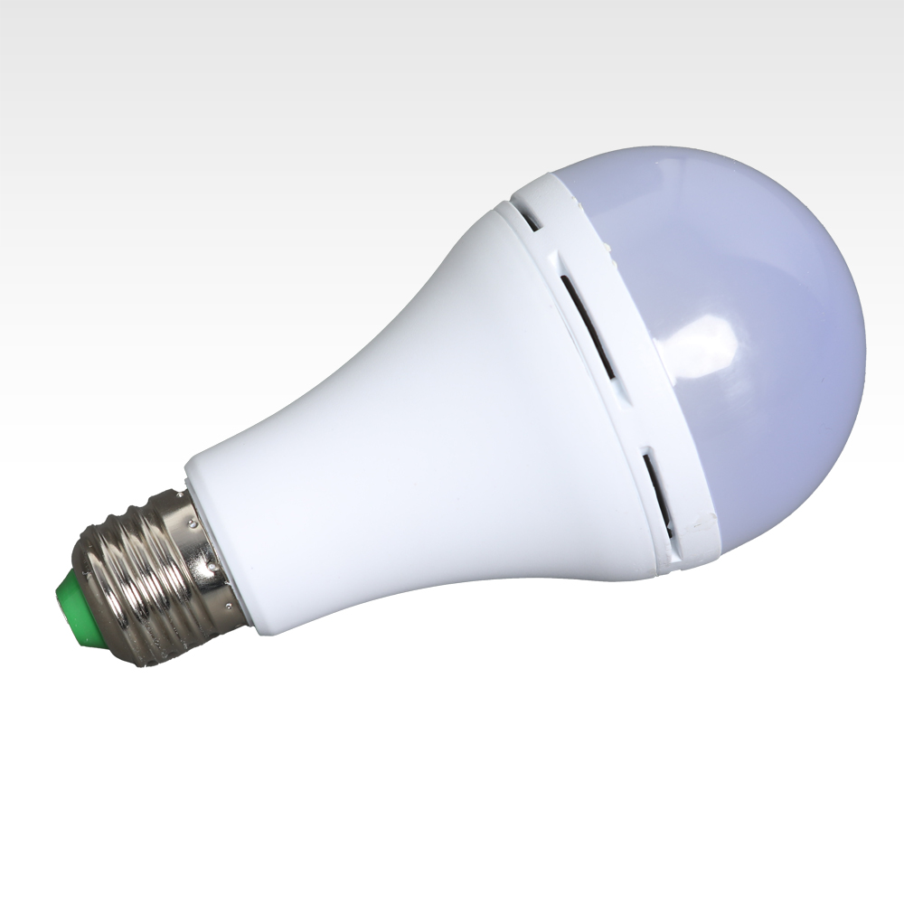
B03
LED Dinosaur Egg Night Light
Material:ABS+PC
Power supply mode: USB
Control method: button, remote control, voice control
The lamp body rotates 360 degrees
Item Number | Wattage | Product Size | Lamp bead model | Number of lamp beads | Voltage
CJR-B03(EMERGENCY) | 9W | φ70*140mm | 2835+5730 | 11+10 | 85-265V
 | 12W | φ70*140mm | 2835+5730 | 14+10 | 85-265V
 | 15W | φ80*150mm | 2835+5730 | 18+10 | 110-265V
 | 18W | φ80*150mm | 2835+5730 | 22+10 | 110-265V
Modern Ceiling Light Material:Iron base+ PMMA Cover Input Voltage:AC85-265V Led Chip:2835SMD IP Rating:IP44 CRI>80 PF>0.9 Color Temperature:3000K/4500K/6000K Operating Temperature:-25℃ ~50℃ Life Span:50000hours Certificate:CE ROHS
Item Number | Wattage | LedQuantity | LuminousFlux | Beam Angle | Size (mm) | WIFI Control Remte control Switch control Dimmer control
CL-N00 | 24W | 48pcs2835SMD | 1920-2160lm | 120° | 350mm | Yes
 | 36W | 72pcs2835SMD | 2880-3240lm | 120° | 400mm
 | 40W | 80pcs2835SMD | 3200-3600lm | 120° | 450mm
Modern Ceiling Light Material:Iron base+ PMMA Cover Input Voltage:AC85-265V Led Chip:2835SMD IP Rating:IP44 CRI>80 PF>0.9 Color Temperature:3000K/4500K/6000K Operating Temperature:-25℃ ~50℃ Life Span:50000hours Certificate:CE ROHS
Item Number | Wattage | LedQuantity | LuminousFlux | Beam Angle | Size (mm) | WIFI Control Remte control Switch control Dimmer control
CL-N00 | 24W | 48pcs2835SMD | 1920-2160lm | 120° | 350mm | Yes
 | 36W | 72pcs2835SMD | 2880-3240lm | 120° | 400mm
 | 40W | 80pcs2835SMD | 3200-3600lm | 120° | 450mm
Modern Ceiling Light Material:Iron base+ PMMA Cover Input Voltage:AC85-265V Led Chip:2835SMD IP Rating:IP44 CRI>80 PF>0.9 Color Temperature:3000K/4500K/6000K Operating Temperature:-25℃ ~50℃ Life Span:50000hours Certificate:CE ROHS
Item Number | Wattage | LedQuantity | LuminousFlux | Beam Angle | Size (mm) | WIFI Control Remte control Switch control Dimmer control
CL-N00 | 24W | 48pcs2835SMD | 1920-2160lm | 120° | 350mm | Yes
 | 36W | 72pcs2835SMD | 2880-3240lm | 120° | 400mm
 | 40W | 80pcs2835SMD | 3200-3600lm | 120° | 450mm
Modern Ceiling Light Material:Iron base+ PMMA Cover Input Voltage:AC85-265V Led Chip:2835SMD IP Rating:IP44 CRI>80 PF>0.9 Color Temperature:3000K/4500K/6000K Operating Temperature:-25℃ ~50℃ Life Span:50000hours Certificate:CE ROHS
Item Number | Wattage | LedQuantity | LuminousFlux | Beam Angle | Size (mm) | WIFI Control Remte control Switch control Dimmer control
CL-N00 | 24W | 48pcs2835SMD | 1920-2160lm | 120° | 350mm | Yes
 | 36W | 72pcs2835SMD | 2880-3240lm | 120° | 400mm
 | 40W | 80pcs2835SMD | 3200-3600lm | 120° | 450mm

Slide 4
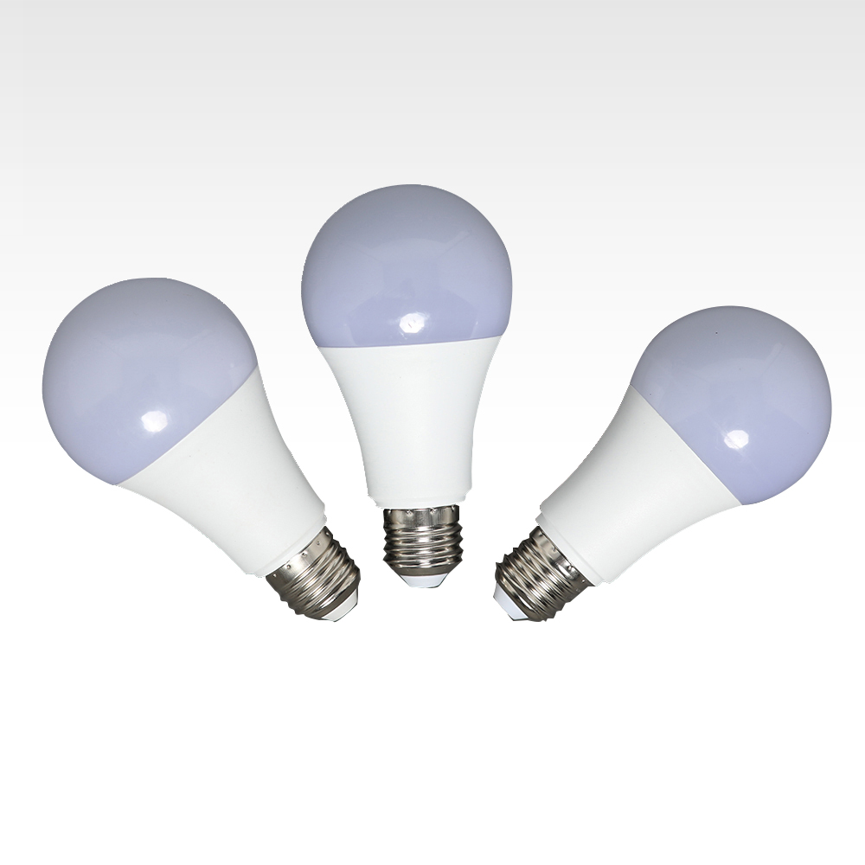
B05
Lumen：810lm
Size：60*108mm 60*112mm
Color temperature：3000k/4000k/6500k
Cap：E27 B22
Warranty：2 years
Volt：12V 24V
Beam：220°
RA：RA>80
PF：0.5
Item Number | Wattage | Flux | CRI | Color Temperature | Size
B05 | 5W | 425lm | >80 | 2700-6500K | 50*90
 | 7W | 595lm | >80 | 2700-6500K | 60*112
 | 9W | 765lm | >80 | 2700-6500K | 65*118
 | 12W | 1020lm | >80 | 2700-6500K | 65*124
 | 15W | 1275lm | >80 | 2700-6500K | 70*132
 | 18W | 1530lm | >80 | 2700-6500K | 80*145
 | 25W | 1870lm | >80 | 2700-6500K | 95*160
Modern Ceiling Light Material:Iron base+ PMMA Cover Input Voltage:AC85-265V Led Chip:2835SMD IP Rating:IP44 CRI>80 PF>0.9 Color Temperature:3000K/4500K/6000K Operating Temperature:-25℃ ~50℃ Life Span:50000hours Certificate:CE ROHS
Item Number | Wattage | LedQuantity | LuminousFlux | Beam Angle | Size (mm) | WIFI Control Remte control Switch control Dimmer control
CL-N00 | 24W | 48pcs2835SMD | 1920-2160lm | 120° | 350mm | Yes
 | 36W | 72pcs2835SMD | 2880-3240lm | 120° | 400mm
 | 40W | 80pcs2835SMD | 3200-3600lm | 120° | 450mm
Modern Ceiling Light Material:Iron base+ PMMA Cover Input Voltage:AC85-265V Led Chip:2835SMD IP Rating:IP44 CRI>80 PF>0.9 Color Temperature:3000K/4500K/6000K Operating Temperature:-25℃ ~50℃ Life Span:50000hours Certificate:CE ROHS
Item Number | Wattage | LedQuantity | LuminousFlux | Beam Angle | Size (mm) | WIFI Control Remte control Switch control Dimmer control
CL-N00 | 24W | 48pcs2835SMD | 1920-2160lm | 120° | 350mm | Yes
 | 36W | 72pcs2835SMD | 2880-3240lm | 120° | 400mm
 | 40W | 80pcs2835SMD | 3200-3600lm | 120° | 450mm
Modern Ceiling Light Material:Iron base+ PMMA Cover Input Voltage:AC85-265V Led Chip:2835SMD IP Rating:IP44 CRI>80 PF>0.9 Color Temperature:3000K/4500K/6000K Operating Temperature:-25℃ ~50℃ Life Span:50000hours Certificate:CE ROHS
Item Number | Wattage | LedQuantity | LuminousFlux | Beam Angle | Size (mm) | WIFI Control Remte control Switch control Dimmer control
CL-N00 | 24W | 48pcs2835SMD | 1920-2160lm | 120° | 350mm | Yes
 | 36W | 72pcs2835SMD | 2880-3240lm | 120° | 400mm
 | 40W | 80pcs2835SMD | 3200-3600lm | 120° | 450mm
Modern Ceiling Light Material:Iron base+ PMMA Cover Input Voltage:AC85-265V Led Chip:2835SMD IP Rating:IP44 CRI>80 PF>0.9 Color Temperature:3000K/4500K/6000K Operating Temperature:-25℃ ~50℃ Life Span:50000hours Certificate:CE ROHS
Item Number | Wattage | LedQuantity | LuminousFlux | Beam Angle | Size (mm) | WIFI Control Remte control Switch control Dimmer control
CL-N00 | 24W | 48pcs2835SMD | 1920-2160lm | 120° | 350mm | Yes
 | 36W | 72pcs2835SMD | 2880-3240lm | 120° | 400mm
 | 40W | 80pcs2835SMD | 3200-3600lm | 120° | 450mm

