Slide 1
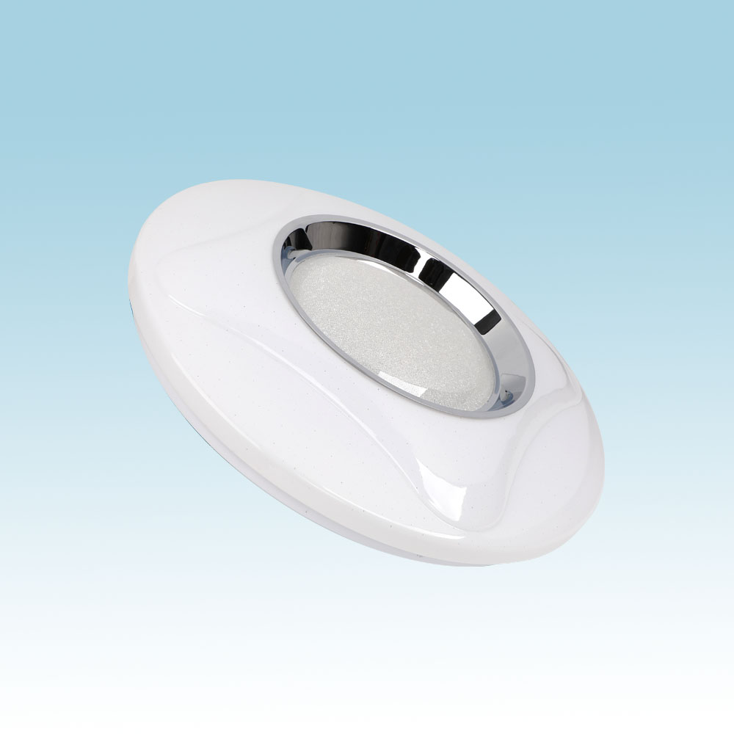
CL01
Modern Ceiling Light
Material:Iron base+ PMMA Cover
Input Voltage:AC85-265V
Led Chip:2835SMD
IP Rating:IP44 CRI>80 PF>0.9
Color Temperature:3000K/4500K/6000K
Operating Temperature:-25℃ ~50℃
Life Span:50000hours
Certificate:CE ROHS
Item Number | Wattage | LedQuantity | LuminousFlux | Beam Angle | Size (mm) | WIFI Control Remte control Switch control Dimmer control
CL01 | 72W | 144pcs2835SMD | 5760-6480lm | 120° | 350mm | Yes
 | 96W | 192pcs2835SMD | 7680-8640lm | 120° | 450mm
Modern Ceiling Light Material:Iron base+ PMMA Cover Input Voltage:AC85-265V Led Chip:2835SMD IP Rating:IP44 CRI>80 PF>0.9 Color Temperature:3000K/4500K/6000K Operating Temperature:-25℃ ~50℃ Life Span:50000hours Certificate:CE ROHS
Item Number | Wattage | LedQuantity | LuminousFlux | Beam Angle | Size (mm) | WIFI Control Remte control Switch control Dimmer control
CL-N00 | 24W | 48pcs2835SMD | 1920-2160lm | 120° | 350mm | Yes
 | 36W | 72pcs2835SMD | 2880-3240lm | 120° | 400mm
 | 40W | 80pcs2835SMD | 3200-3600lm | 120° | 450mm
Modern Ceiling Light Material:Iron base+ PMMA Cover Input Voltage:AC85-265V Led Chip:2835SMD IP Rating:IP44 CRI>80 PF>0.9 Color Temperature:3000K/4500K/6000K Operating Temperature:-25℃ ~50℃ Life Span:50000hours Certificate:CE ROHS
Item Number | Wattage | LedQuantity | LuminousFlux | Beam Angle | Size (mm) | WIFI Control Remte control Switch control Dimmer control
CL-N00 | 24W | 48pcs2835SMD | 1920-2160lm | 120° | 350mm | Yes
 | 36W | 72pcs2835SMD | 2880-3240lm | 120° | 400mm
 | 40W | 80pcs2835SMD | 3200-3600lm | 120° | 450mm
Modern Ceiling Light Material:Iron base+ PMMA Cover Input Voltage:AC85-265V Led Chip:2835SMD IP Rating:IP44 CRI>80 PF>0.9 Color Temperature:3000K/4500K/6000K Operating Temperature:-25℃ ~50℃ Life Span:50000hours Certificate:CE ROHS
Item Number | Wattage | LedQuantity | LuminousFlux | Beam Angle | Size (mm) | WIFI Control Remte control Switch control Dimmer control
CL-N00 | 24W | 48pcs2835SMD | 1920-2160lm | 120° | 350mm | Yes
 | 36W | 72pcs2835SMD | 2880-3240lm | 120° | 400mm
 | 40W | 80pcs2835SMD | 3200-3600lm | 120° | 450mm
Modern Ceiling Light Material:Iron base+ PMMA Cover Input Voltage:AC85-265V Led Chip:2835SMD IP Rating:IP44 CRI>80 PF>0.9 Color Temperature:3000K/4500K/6000K Operating Temperature:-25℃ ~50℃ Life Span:50000hours Certificate:CE ROHS
Item Number | Wattage | LedQuantity | LuminousFlux | Beam Angle | Size (mm) | WIFI Control Remte control Switch control Dimmer control
CL-N00 | 24W | 48pcs2835SMD | 1920-2160lm | 120° | 350mm | Yes
 | 36W | 72pcs2835SMD | 2880-3240lm | 120° | 400mm
 | 40W | 80pcs2835SMD | 3200-3600lm | 120° | 450mm

Slide 2
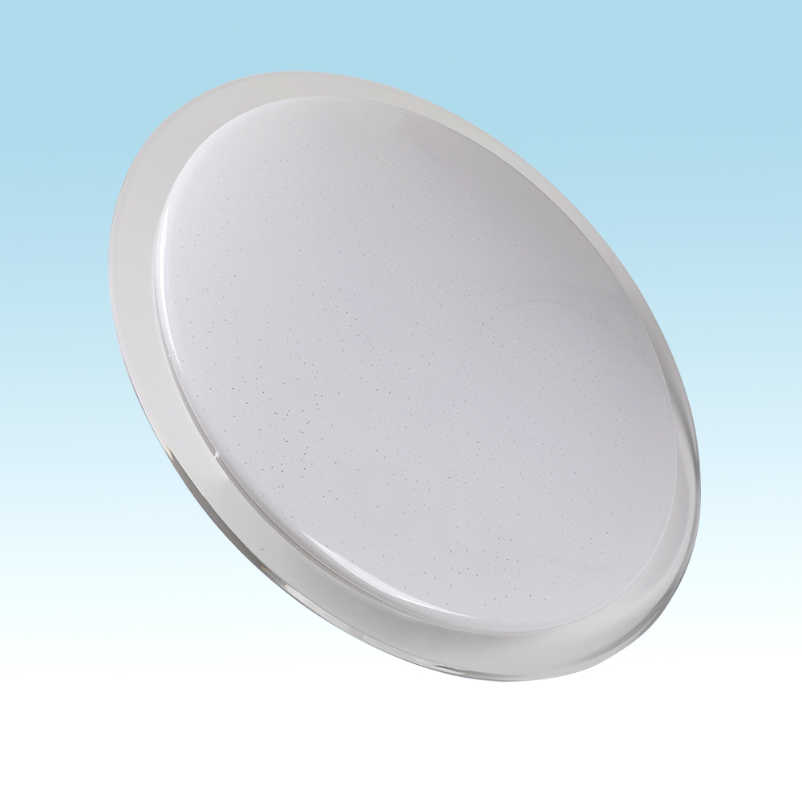
CL03
Modern Ceiling Light
Material:Iron base+ PMMA Cover
Input Voltage:AC85-265V
Led Chip:2835SMD
IP Rating:IP44 CRI>80 PF>0.9
Color Temperature:3000K/4500K/6000K
Operating Temperature:-25℃ ~50℃
Life Span:50000hours
Certificate:CE ROHS
Item Number | Wattage | LedQuantity | LuminousFlux | Beam Angle | Size (mm) | WIFI Control Remte control Switch control Dimmer control
CL03 | 72W | 144pcs2835SMD | 5760-6480lm | 120° | 350mm | Yes
 | 96W | 192pcs2835SMD | 7680-8640lm | 120° | 450mm
Modern Ceiling Light Material:Iron base+ PMMA Cover Input Voltage:AC85-265V Led Chip:2835SMD IP Rating:IP44 CRI>80 PF>0.9 Color Temperature:3000K/4500K/6000K Operating Temperature:-25℃ ~50℃ Life Span:50000hours Certificate:CE ROHS
Item Number | Wattage | LedQuantity | LuminousFlux | Beam Angle | Size (mm) | WIFI Control Remte control Switch control Dimmer control
CL-N00 | 24W | 48pcs2835SMD | 1920-2160lm | 120° | 350mm | Yes
 | 36W | 72pcs2835SMD | 2880-3240lm | 120° | 400mm
 | 40W | 80pcs2835SMD | 3200-3600lm | 120° | 450mm
Modern Ceiling Light Material:Iron base+ PMMA Cover Input Voltage:AC85-265V Led Chip:2835SMD IP Rating:IP44 CRI>80 PF>0.9 Color Temperature:3000K/4500K/6000K Operating Temperature:-25℃ ~50℃ Life Span:50000hours Certificate:CE ROHS
Item Number | Wattage | LedQuantity | LuminousFlux | Beam Angle | Size (mm) | WIFI Control Remte control Switch control Dimmer control
CL-N00 | 24W | 48pcs2835SMD | 1920-2160lm | 120° | 350mm | Yes
 | 36W | 72pcs2835SMD | 2880-3240lm | 120° | 400mm
 | 40W | 80pcs2835SMD | 3200-3600lm | 120° | 450mm
Modern Ceiling Light Material:Iron base+ PMMA Cover Input Voltage:AC85-265V Led Chip:2835SMD IP Rating:IP44 CRI>80 PF>0.9 Color Temperature:3000K/4500K/6000K Operating Temperature:-25℃ ~50℃ Life Span:50000hours Certificate:CE ROHS
Item Number | Wattage | LedQuantity | LuminousFlux | Beam Angle | Size (mm) | WIFI Control Remte control Switch control Dimmer control
CL-N00 | 24W | 48pcs2835SMD | 1920-2160lm | 120° | 350mm | Yes
 | 36W | 72pcs2835SMD | 2880-3240lm | 120° | 400mm
 | 40W | 80pcs2835SMD | 3200-3600lm | 120° | 450mm
Modern Ceiling Light Material:Iron base+ PMMA Cover Input Voltage:AC85-265V Led Chip:2835SMD IP Rating:IP44 CRI>80 PF>0.9 Color Temperature:3000K/4500K/6000K Operating Temperature:-25℃ ~50℃ Life Span:50000hours Certificate:CE ROHS
Item Number | Wattage | LedQuantity | LuminousFlux | Beam Angle | Size (mm) | WIFI Control Remte control Switch control Dimmer control
CL-N00 | 24W | 48pcs2835SMD | 1920-2160lm | 120° | 350mm | Yes
 | 36W | 72pcs2835SMD | 2880-3240lm | 120° | 400mm
 | 40W | 80pcs2835SMD | 3200-3600lm | 120° | 450mm

Slide 3
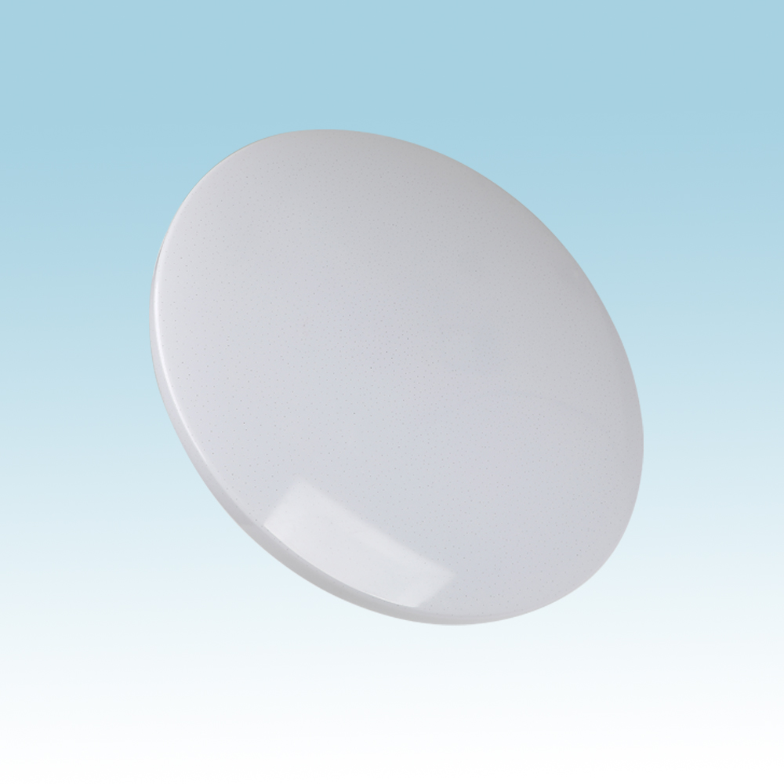
CL08
Modern Ceiling Light
Material:Iron base+ PMMA Cover
Input Voltage:AC85-265V
Led Chip:2835SMD
IP Rating:IP44 CRI>80 PF>0.9
Color Temperature:3000K/4500K/6000K
Operating Temperature:-25℃ ~50℃
Life Span:50000hours
Certificate:CE ROHS
Item Number | Wattage | LedQuantity | LuminousFlux | Beam Angle | Size (mm) | WIFI Control Remte control Switch control Dimmer control
CL08 | 12W | 24pcs2835SMD | 960-1080lm | 120° | Φ260 | Yes
 | 15W | 30pcs2835SMD | 1200-1350lm | 120° | Φ280
 | 18W | 36pcs2835SMD | 1440-1620lm | 120° | Φ300
 | 21W | 42pcs2835SMD | 1680-1890lm | 120° | Φ300
 | 24W | 48pcs2835SMD | 1920-2160lm | 120° | Φ350
 | 27W | 54pcs2835SMD | 2160-2430lm | 120° | Φ350
 | 32W | 64pcs2835SMD | 2560-2880lm | 120° | Φ380
 | 40W | 80pcs2835SMD | 3200-3600lm | 120° | Φ400
 | 48W | 96pcs2835SMD | 3840-4320lm | 120° | Φ400
Modern Ceiling Light Material:Iron base+ PMMA Cover Input Voltage:AC85-265V Led Chip:2835SMD IP Rating:IP44 CRI>80 PF>0.9 Color Temperature:3000K/4500K/6000K Operating Temperature:-25℃ ~50℃ Life Span:50000hours Certificate:CE ROHS
Item Number | Wattage | LedQuantity | LuminousFlux | Beam Angle | Size (mm) | WIFI Control Remte control Switch control Dimmer control
CL-N00 | 24W | 48pcs2835SMD | 1920-2160lm | 120° | 350mm | Yes
 | 36W | 72pcs2835SMD | 2880-3240lm | 120° | 400mm
 | 40W | 80pcs2835SMD | 3200-3600lm | 120° | 450mm
Modern Ceiling Light Material:Iron base+ PMMA Cover Input Voltage:AC85-265V Led Chip:2835SMD IP Rating:IP44 CRI>80 PF>0.9 Color Temperature:3000K/4500K/6000K Operating Temperature:-25℃ ~50℃ Life Span:50000hours Certificate:CE ROHS
Item Number | Wattage | LedQuantity | LuminousFlux | Beam Angle | Size (mm) | WIFI Control Remte control Switch control Dimmer control
CL-N00 | 24W | 48pcs2835SMD | 1920-2160lm | 120° | 350mm | Yes
 | 36W | 72pcs2835SMD | 2880-3240lm | 120° | 400mm
 | 40W | 80pcs2835SMD | 3200-3600lm | 120° | 450mm
Modern Ceiling Light Material:Iron base+ PMMA Cover Input Voltage:AC85-265V Led Chip:2835SMD IP Rating:IP44 CRI>80 PF>0.9 Color Temperature:3000K/4500K/6000K Operating Temperature:-25℃ ~50℃ Life Span:50000hours Certificate:CE ROHS
Item Number | Wattage | LedQuantity | LuminousFlux | Beam Angle | Size (mm) | WIFI Control Remte control Switch control Dimmer control
CL-N00 | 24W | 48pcs2835SMD | 1920-2160lm | 120° | 350mm | Yes
 | 36W | 72pcs2835SMD | 2880-3240lm | 120° | 400mm
 | 40W | 80pcs2835SMD | 3200-3600lm | 120° | 450mm
Modern Ceiling Light Material:Iron base+ PMMA Cover Input Voltage:AC85-265V Led Chip:2835SMD IP Rating:IP44 CRI>80 PF>0.9 Color Temperature:3000K/4500K/6000K Operating Temperature:-25℃ ~50℃ Life Span:50000hours Certificate:CE ROHS
Item Number | Wattage | LedQuantity | LuminousFlux | Beam Angle | Size (mm) | WIFI Control Remte control Switch control Dimmer control
CL-N00 | 24W | 48pcs2835SMD | 1920-2160lm | 120° | 350mm | Yes
 | 36W | 72pcs2835SMD | 2880-3240lm | 120° | 400mm
 | 40W | 80pcs2835SMD | 3200-3600lm | 120° | 450mm

Slide 4
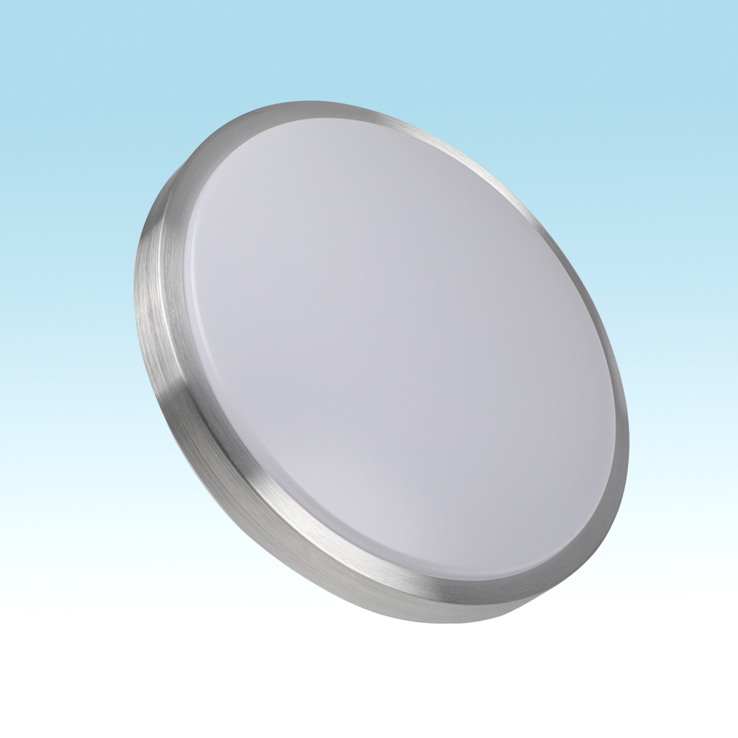
CL15
Modern Ceiling Light
Material:Iron base+ PMMA Cover
Input Voltage:AC85-265V
Led Chip:2835SMD
IP Rating:IP44 CRI>80 PF>0.9
Color Temperature:3000K/4500K/6000K
Operating Temperature:-25℃ ~50℃
Life Span:50000hours
Certificate:CE ROHS
Item Number | Wattage | LedQuantity | LuminousFlux | Beam Angle | Size (mm) | WIFI Control Remte control Switch control Dimmer control
CL15 | 12W | 24pcs2835SMD | 960-1080lm | 120° | Φ260 | Yes
 | 15W | 30pcs2835SMD | 1200-1350lm | 120° | Φ280
 | 18W | 36pcs2835SMD | 1440-1620lm | 120° | Φ300
 | 21W | 42pcs2835SMD | 1680-1890lm | 120° | Φ300
 | 24W | 48pcs2835SMD | 1920-2160lm | 120° | Φ350
 | 27W | 54pcs2835SMD | 2160-2430lm | 120° | Φ350
 | 32W | 64pcs2835SMD | 2560-2880lm | 120° | Φ380
 | 40W | 80pcs2835SMD | 3200-3600lm | 120° | Φ400
 | 48W | 96pcs2835SMD | 3840-4320lm | 120° | Φ400
Modern Ceiling Light Material:Iron base+ PMMA Cover Input Voltage:AC85-265V Led Chip:2835SMD IP Rating:IP44 CRI>80 PF>0.9 Color Temperature:3000K/4500K/6000K Operating Temperature:-25℃ ~50℃ Life Span:50000hours Certificate:CE ROHS
Item Number | Wattage | LedQuantity | LuminousFlux | Beam Angle | Size (mm) | WIFI Control Remte control Switch control Dimmer control
CL-N00 | 24W | 48pcs2835SMD | 1920-2160lm | 120° | 350mm | Yes
 | 36W | 72pcs2835SMD | 2880-3240lm | 120° | 400mm
 | 40W | 80pcs2835SMD | 3200-3600lm | 120° | 450mm
Modern Ceiling Light Material:Iron base+ PMMA Cover Input Voltage:AC85-265V Led Chip:2835SMD IP Rating:IP44 CRI>80 PF>0.9 Color Temperature:3000K/4500K/6000K Operating Temperature:-25℃ ~50℃ Life Span:50000hours Certificate:CE ROHS
Item Number | Wattage | LedQuantity | LuminousFlux | Beam Angle | Size (mm) | WIFI Control Remte control Switch control Dimmer control
CL-N00 | 24W | 48pcs2835SMD | 1920-2160lm | 120° | 350mm | Yes
 | 36W | 72pcs2835SMD | 2880-3240lm | 120° | 400mm
 | 40W | 80pcs2835SMD | 3200-3600lm | 120° | 450mm
Modern Ceiling Light Material:Iron base+ PMMA Cover Input Voltage:AC85-265V Led Chip:2835SMD IP Rating:IP44 CRI>80 PF>0.9 Color Temperature:3000K/4500K/6000K Operating Temperature:-25℃ ~50℃ Life Span:50000hours Certificate:CE ROHS
Item Number | Wattage | LedQuantity | LuminousFlux | Beam Angle | Size (mm) | WIFI Control Remte control Switch control Dimmer control
CL-N00 | 24W | 48pcs2835SMD | 1920-2160lm | 120° | 350mm | Yes
 | 36W | 72pcs2835SMD | 2880-3240lm | 120° | 400mm
 | 40W | 80pcs2835SMD | 3200-3600lm | 120° | 450mm
Modern Ceiling Light Material:Iron base+ PMMA Cover Input Voltage:AC85-265V Led Chip:2835SMD IP Rating:IP44 CRI>80 PF>0.9 Color Temperature:3000K/4500K/6000K Operating Temperature:-25℃ ~50℃ Life Span:50000hours Certificate:CE ROHS
Item Number | Wattage | LedQuantity | LuminousFlux | Beam Angle | Size (mm) | WIFI Control Remte control Switch control Dimmer control
CL-N00 | 24W | 48pcs2835SMD | 1920-2160lm | 120° | 350mm | Yes
 | 36W | 72pcs2835SMD | 2880-3240lm | 120° | 400mm
 | 40W | 80pcs2835SMD | 3200-3600lm | 120° | 450mm

Slide 5
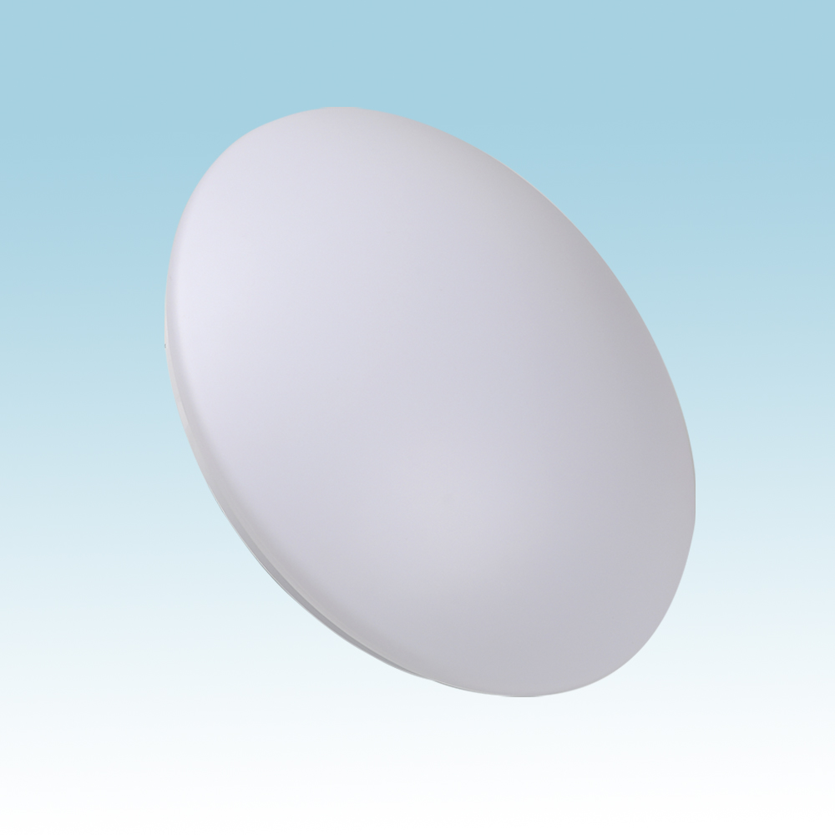
CL20
Modern Ceiling Light
Material:Iron base+ PMMA Cover
Input Voltage:AC85-265V
Led Chip:2835SMD
IP Rating:IP44 CRI>80 PF>0.9
Color Temperature:3000K/4500K/6000K
Operating Temperature:-25℃ ~50℃
Life Span:50000hours
Certificate:CE ROHS
Item Number | Wattage | LedQuantity | LuminousFlux | Beam Angle | Size (mm) | WIFI Control Remte control Switch control Dimmer control
CL20 | 12W | 24pcs2835SMD | 960-1080lm | 120° | Φ260 | Yes
 | 15W | 30pcs2835SMD | 1200-1350lm | 120° | Φ280
 | 18W | 36pcs2835SMD | 1440-1620lm | 120° | Φ300
 | 21W | 42pcs2835SMD | 1680-1890lm | 120° | Φ300
 | 24W | 48pcs2835SMD | 1920-2160lm | 120° | Φ350
 | 27W | 54pcs2835SMD | 2160-2430lm | 120° | Φ350
 | 32W | 64pcs2835SMD | 2560-2880lm | 120° | Φ380
 | 40W | 80pcs2835SMD | 3200-3600lm | 120° | Φ400
 | 48W | 96pcs2835SMD | 3840-4320lm | 120° | Φ400
Modern Ceiling Light Material:Iron base+ PMMA Cover Input Voltage:AC85-265V Led Chip:2835SMD IP Rating:IP44 CRI>80 PF>0.9 Color Temperature:3000K/4500K/6000K Operating Temperature:-25℃ ~50℃ Life Span:50000hours Certificate:CE ROHS
Item Number | Wattage | LedQuantity | LuminousFlux | Beam Angle | Size (mm) | WIFI Control Remte control Switch control Dimmer control
CL-N00 | 24W | 48pcs2835SMD | 1920-2160lm | 120° | 350mm | Yes
 | 36W | 72pcs2835SMD | 2880-3240lm | 120° | 400mm
 | 40W | 80pcs2835SMD | 3200-3600lm | 120° | 450mm
Modern Ceiling Light Material:Iron base+ PMMA Cover Input Voltage:AC85-265V Led Chip:2835SMD IP Rating:IP44 CRI>80 PF>0.9 Color Temperature:3000K/4500K/6000K Operating Temperature:-25℃ ~50℃ Life Span:50000hours Certificate:CE ROHS
Item Number | Wattage | LedQuantity | LuminousFlux | Beam Angle | Size (mm) | WIFI Control Remte control Switch control Dimmer control
CL-N00 | 24W | 48pcs2835SMD | 1920-2160lm | 120° | 350mm | Yes
 | 36W | 72pcs2835SMD | 2880-3240lm | 120° | 400mm
 | 40W | 80pcs2835SMD | 3200-3600lm | 120° | 450mm
Modern Ceiling Light Material:Iron base+ PMMA Cover Input Voltage:AC85-265V Led Chip:2835SMD IP Rating:IP44 CRI>80 PF>0.9 Color Temperature:3000K/4500K/6000K Operating Temperature:-25℃ ~50℃ Life Span:50000hours Certificate:CE ROHS
Item Number | Wattage | LedQuantity | LuminousFlux | Beam Angle | Size (mm) | WIFI Control Remte control Switch control Dimmer control
CL-N00 | 24W | 48pcs2835SMD | 1920-2160lm | 120° | 350mm | Yes
 | 36W | 72pcs2835SMD | 2880-3240lm | 120° | 400mm
 | 40W | 80pcs2835SMD | 3200-3600lm | 120° | 450mm
Modern Ceiling Light Material:Iron base+ PMMA Cover Input Voltage:AC85-265V Led Chip:2835SMD IP Rating:IP44 CRI>80 PF>0.9 Color Temperature:3000K/4500K/6000K Operating Temperature:-25℃ ~50℃ Life Span:50000hours Certificate:CE ROHS
Item Number | Wattage | LedQuantity | LuminousFlux | Beam Angle | Size (mm) | WIFI Control Remte control Switch control Dimmer control
CL-N00 | 24W | 48pcs2835SMD | 1920-2160lm | 120° | 350mm | Yes
 | 36W | 72pcs2835SMD | 2880-3240lm | 120° | 400mm
 | 40W | 80pcs2835SMD | 3200-3600lm | 120° | 450mm

Slide 6
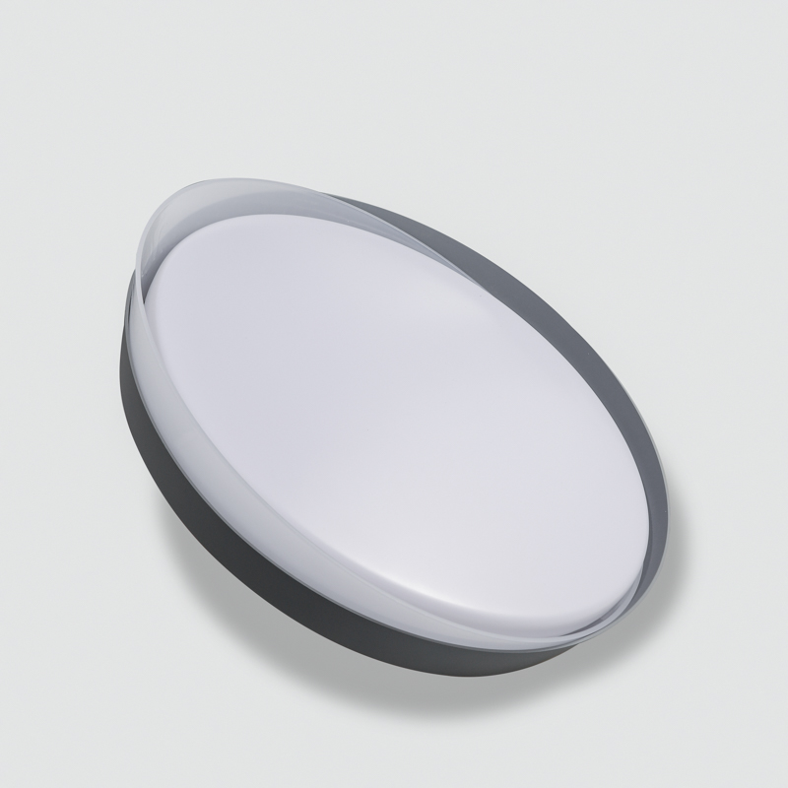
CL-N17
Modern Ceiling Light
Material:Iron base+ PMMA Cover
Input Voltage:AC85-265V
Led Chip:2835SMD
IP Rating:IP44 CRI>80 PF>0.9
Color Temperature:3000K/4500K/6000K
Operating Temperature:-25℃ ~50℃
Life Span:50000hours
Certificate:CE ROHS
Item Number | Wattage | LedQuantity | LuminousFlux | Beam Angle | Size (mm) | WIFI Control Remte Control Switch Control Dimmer Control
CL-N17 | 12W | 24pcs2835SMD | 960-1080lm | 120° | Φ260 | Yes
 | 15W | 30pcs2835SMD | 1200-1350lm | 120° | Φ280
 | 18W | 36pcs2835SMD | 1440-1620lm | 120° | Φ300
 | 21W | 42pcs2835SMD | 1680-1890lm | 120° | Φ300
Modern Ceiling Light Material:Iron base+ PMMA Cover Input Voltage:AC85-265V Led Chip:2835SMD IP Rating:IP44 CRI>80 PF>0.9 Color Temperature:3000K/4500K/6000K Operating Temperature:-25℃ ~50℃ Life Span:50000hours Certificate:CE ROHS
Item Number | Wattage | LedQuantity | LuminousFlux | Beam Angle | Size (mm) | WIFI Control Remte control Switch control Dimmer control
CL-N00 | 24W | 48pcs2835SMD | 1920-2160lm | 120° | 350mm | Yes
 | 36W | 72pcs2835SMD | 2880-3240lm | 120° | 400mm
 | 40W | 80pcs2835SMD | 3200-3600lm | 120° | 450mm
Modern Ceiling Light Material:Iron base+ PMMA Cover Input Voltage:AC85-265V Led Chip:2835SMD IP Rating:IP44 CRI>80 PF>0.9 Color Temperature:3000K/4500K/6000K Operating Temperature:-25℃ ~50℃ Life Span:50000hours Certificate:CE ROHS
Item Number | Wattage | LedQuantity | LuminousFlux | Beam Angle | Size (mm) | WIFI Control Remte control Switch control Dimmer control
CL-N00 | 24W | 48pcs2835SMD | 1920-2160lm | 120° | 350mm | Yes
 | 36W | 72pcs2835SMD | 2880-3240lm | 120° | 400mm
 | 40W | 80pcs2835SMD | 3200-3600lm | 120° | 450mm
Modern Ceiling Light Material:Iron base+ PMMA Cover Input Voltage:AC85-265V Led Chip:2835SMD IP Rating:IP44 CRI>80 PF>0.9 Color Temperature:3000K/4500K/6000K Operating Temperature:-25℃ ~50℃ Life Span:50000hours Certificate:CE ROHS
Item Number | Wattage | LedQuantity | LuminousFlux | Beam Angle | Size (mm) | WIFI Control Remte control Switch control Dimmer control
CL-N00 | 24W | 48pcs2835SMD | 1920-2160lm | 120° | 350mm | Yes
 | 36W | 72pcs2835SMD | 2880-3240lm | 120° | 400mm
 | 40W | 80pcs2835SMD | 3200-3600lm | 120° | 450mm
Modern Ceiling Light Material:Iron base+ PMMA Cover Input Voltage:AC85-265V Led Chip:2835SMD IP Rating:IP44 CRI>80 PF>0.9 Color Temperature:3000K/4500K/6000K Operating Temperature:-25℃ ~50℃ Life Span:50000hours Certificate:CE ROHS
Item Number | Wattage | LedQuantity | LuminousFlux | Beam Angle | Size (mm) | WIFI Control Remte control Switch control Dimmer control
CL-N00 | 24W | 48pcs2835SMD | 1920-2160lm | 120° | 350mm | Yes
 | 36W | 72pcs2835SMD | 2880-3240lm | 120° | 400mm
 | 40W | 80pcs2835SMD | 3200-3600lm | 120° | 450mm

Slide 7
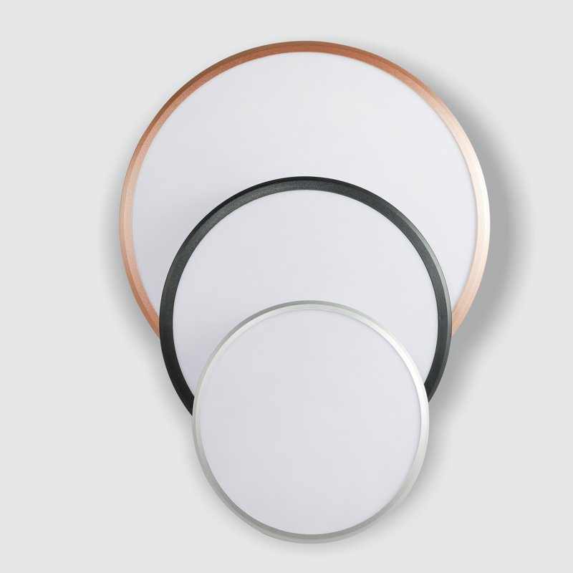
CL-N21
Modern Ceiling Light
Material:Iron base+ PMMA Cover
Input Voltage:AC85-265V
Led Chip:2835SMD
IP Rating:IP44 CRI>80 PF>0.9
Color Temperature:3000K/4500K/6000K
Operating Temperature:-25℃ ~50℃
Life Span:50000hours
Certificate:CE ROHS
Item Number | Wattage | LedQuantity | LuminousFlux | Beam Angle | Size (mm) | WIFI Control Remte Control Switch Control Dimmer Control
CL-N21 | 12W | 24pcs2835SMD | 960-1080lm | 120° | Φ260 | Yes
 | 18W | 36pcs2835SMD | 1440-1620lm | 120° | Φ300
 | 24W | 48pcs2835SMD | 1920-2160lm | 120° | Φ350
 | 36W | 72pcs2835SMD | 2880-3240lm | 120° | Φ380
 | 48w | 96pcs2835SMD | 3840-4320lm | 120° | Φ400
Modern Ceiling Light Material:Iron base+ PMMA Cover Input Voltage:AC85-265V Led Chip:2835SMD IP Rating:IP44 CRI>80 PF>0.9 Color Temperature:3000K/4500K/6000K Operating Temperature:-25℃ ~50℃ Life Span:50000hours Certificate:CE ROHS
Item Number | Wattage | LedQuantity | LuminousFlux | Beam Angle | Size (mm) | WIFI Control Remte control Switch control Dimmer control
CL-N00 | 24W | 48pcs2835SMD | 1920-2160lm | 120° | 350mm | Yes
 | 36W | 72pcs2835SMD | 2880-3240lm | 120° | 400mm
 | 40W | 80pcs2835SMD | 3200-3600lm | 120° | 450mm
Modern Ceiling Light Material:Iron base+ PMMA Cover Input Voltage:AC85-265V Led Chip:2835SMD IP Rating:IP44 CRI>80 PF>0.9 Color Temperature:3000K/4500K/6000K Operating Temperature:-25℃ ~50℃ Life Span:50000hours Certificate:CE ROHS
Item Number | Wattage | LedQuantity | LuminousFlux | Beam Angle | Size (mm) | WIFI Control Remte control Switch control Dimmer control
CL-N00 | 24W | 48pcs2835SMD | 1920-2160lm | 120° | 350mm | Yes
 | 36W | 72pcs2835SMD | 2880-3240lm | 120° | 400mm
 | 40W | 80pcs2835SMD | 3200-3600lm | 120° | 450mm
Modern Ceiling Light Material:Iron base+ PMMA Cover Input Voltage:AC85-265V Led Chip:2835SMD IP Rating:IP44 CRI>80 PF>0.9 Color Temperature:3000K/4500K/6000K Operating Temperature:-25℃ ~50℃ Life Span:50000hours Certificate:CE ROHS
Item Number | Wattage | LedQuantity | LuminousFlux | Beam Angle | Size (mm) | WIFI Control Remte control Switch control Dimmer control
CL-N00 | 24W | 48pcs2835SMD | 1920-2160lm | 120° | 350mm | Yes
 | 36W | 72pcs2835SMD | 2880-3240lm | 120° | 400mm
 | 40W | 80pcs2835SMD | 3200-3600lm | 120° | 450mm
Modern Ceiling Light Material:Iron base+ PMMA Cover Input Voltage:AC85-265V Led Chip:2835SMD IP Rating:IP44 CRI>80 PF>0.9 Color Temperature:3000K/4500K/6000K Operating Temperature:-25℃ ~50℃ Life Span:50000hours Certificate:CE ROHS
Item Number | Wattage | LedQuantity | LuminousFlux | Beam Angle | Size (mm) | WIFI Control Remte control Switch control Dimmer control
CL-N00 | 24W | 48pcs2835SMD | 1920-2160lm | 120° | 350mm | Yes
 | 36W | 72pcs2835SMD | 2880-3240lm | 120° | 400mm
 | 40W | 80pcs2835SMD | 3200-3600lm | 120° | 450mm

Slide 8
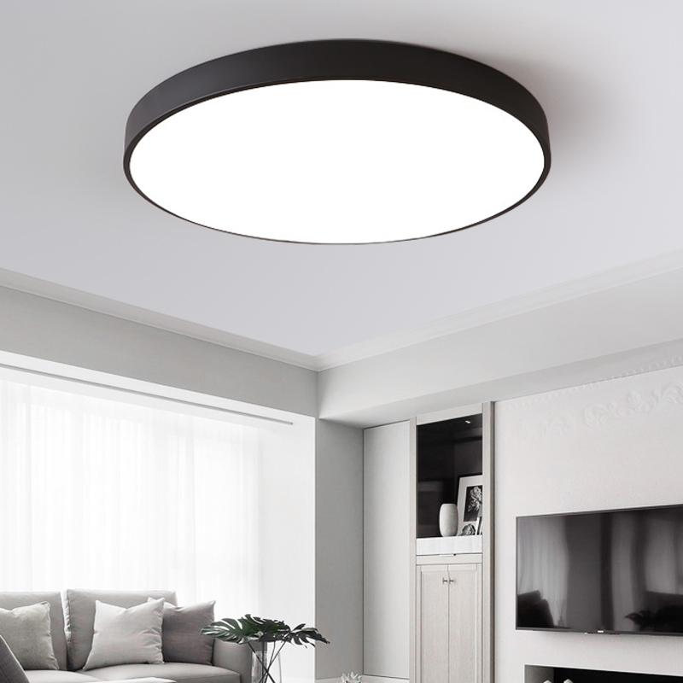
NC01
Modern Ceiling Light
Material:Iron base+ PMMA Cover
Input Voltage:AC85-265V
Led Chip:2835SMD
IP Rating:IP44 CRI>80 PF>0.9
Color Temperature:3000K/4500K/6000K
Operating Temperature:-25℃ ~50℃
Life Span:50000hours
Certificate:CE ROHS
Item Number | Wattage | LedQuantity | LuminousFlux | Beam Angle | Size (mm) | WIFI Control Remte Control Switch Control Dimmer Control
NC01 | 12W | 24pcs2835SMD | 960-1080lm | 120° | Φ260 | Yes
 | 15W | 30pcs2835SMD | 1200-1350lm | 120° | Φ280
 | 18W | 36pcs2835SMD | 1440-1620lm | 120° | Φ300
 | 24w | 48pcs2835SMD | 1920-2160lm | 120° | Φ350
 | 27W | 54pcs2835SMD | 2160-2430lm | 120° | Φ350
 | 36W | 72pcs2835SMD | 2880-3240lm | 120° | Φ380
Modern Ceiling Light Material:Iron base+ PMMA Cover Input Voltage:AC85-265V Led Chip:2835SMD IP Rating:IP44 CRI>80 PF>0.9 Color Temperature:3000K/4500K/6000K Operating Temperature:-25℃ ~50℃ Life Span:50000hours Certificate:CE ROHS
Item Number | Wattage | LedQuantity | LuminousFlux | Beam Angle | Size (mm) | WIFI Control Remte control Switch control Dimmer control
CL-N00 | 24W | 48pcs2835SMD | 1920-2160lm | 120° | 350mm | Yes
 | 36W | 72pcs2835SMD | 2880-3240lm | 120° | 400mm
 | 40W | 80pcs2835SMD | 3200-3600lm | 120° | 450mm
Modern Ceiling Light Material:Iron base+ PMMA Cover Input Voltage:AC85-265V Led Chip:2835SMD IP Rating:IP44 CRI>80 PF>0.9 Color Temperature:3000K/4500K/6000K Operating Temperature:-25℃ ~50℃ Life Span:50000hours Certificate:CE ROHS
Item Number | Wattage | LedQuantity | LuminousFlux | Beam Angle | Size (mm) | WIFI Control Remte control Switch control Dimmer control
CL-N00 | 24W | 48pcs2835SMD | 1920-2160lm | 120° | 350mm | Yes
 | 36W | 72pcs2835SMD | 2880-3240lm | 120° | 400mm
 | 40W | 80pcs2835SMD | 3200-3600lm | 120° | 450mm
Modern Ceiling Light Material:Iron base+ PMMA Cover Input Voltage:AC85-265V Led Chip:2835SMD IP Rating:IP44 CRI>80 PF>0.9 Color Temperature:3000K/4500K/6000K Operating Temperature:-25℃ ~50℃ Life Span:50000hours Certificate:CE ROHS
Item Number | Wattage | LedQuantity | LuminousFlux | Beam Angle | Size (mm) | WIFI Control Remte control Switch control Dimmer control
CL-N00 | 24W | 48pcs2835SMD | 1920-2160lm | 120° | 350mm | Yes
 | 36W | 72pcs2835SMD | 2880-3240lm | 120° | 400mm
 | 40W | 80pcs2835SMD | 3200-3600lm | 120° | 450mm
Modern Ceiling Light Material:Iron base+ PMMA Cover Input Voltage:AC85-265V Led Chip:2835SMD IP Rating:IP44 CRI>80 PF>0.9 Color Temperature:3000K/4500K/6000K Operating Temperature:-25℃ ~50℃ Life Span:50000hours Certificate:CE ROHS
Item Number | Wattage | LedQuantity | LuminousFlux | Beam Angle | Size (mm) | WIFI Control Remte control Switch control Dimmer control
CL-N00 | 24W | 48pcs2835SMD | 1920-2160lm | 120° | 350mm | Yes
 | 36W | 72pcs2835SMD | 2880-3240lm | 120° | 400mm
 | 40W | 80pcs2835SMD | 3200-3600lm | 120° | 450mm

Slide 9
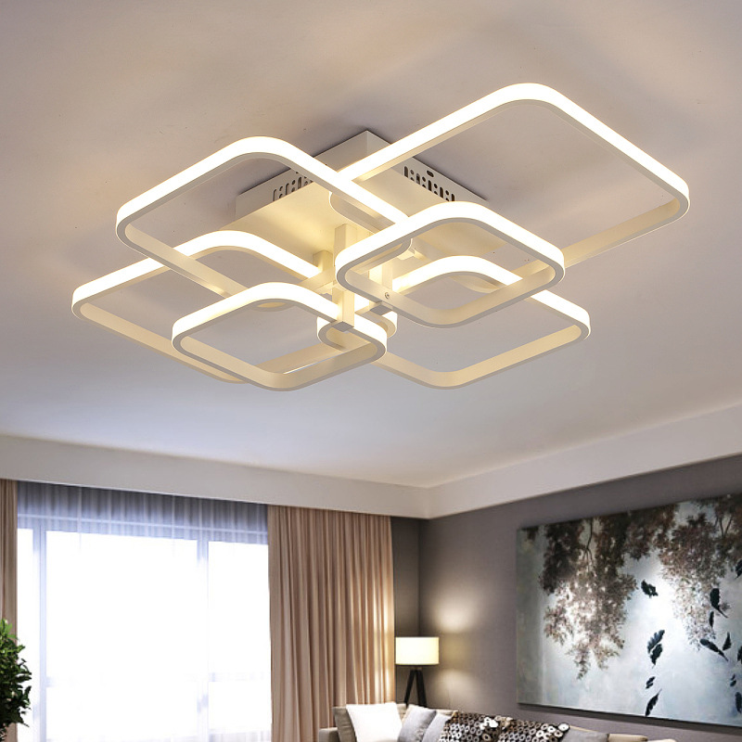
NC03
Modern Ceiling Light
Material:Iron base+ PMMA Cover
Input Voltage:AC85-265V
Led Chip:2835SMD
IP Rating:IP44 CRI>80 PF>0.9
Color Temperature:3000K/4500K/6000K
Operating Temperature:-25℃ ~50℃
Life Span:50000hours
Certificate:CE ROHS
Item Number | Wattage | LedQuantity | LuminousFlux | Beam Angle | Size (mm) | WIFI Control Remte Control Switch Control Dimmer Control
NC03 | 72W | 144pcs2835SMD | 5760-6480lm | 120° | L540xW450xH150 | Yes
 | 96W | 192pcs2835SMD | 7680-8640lm | 120° | L540xW450xH150
Modern Ceiling Light Material:Iron base+ PMMA Cover Input Voltage:AC85-265V Led Chip:2835SMD IP Rating:IP44 CRI>80 PF>0.9 Color Temperature:3000K/4500K/6000K Operating Temperature:-25℃ ~50℃ Life Span:50000hours Certificate:CE ROHS
Item Number | Wattage | LedQuantity | LuminousFlux | Beam Angle | Size (mm) | WIFI Control Remte control Switch control Dimmer control
CL-N00 | 24W | 48pcs2835SMD | 1920-2160lm | 120° | 350mm | Yes
 | 36W | 72pcs2835SMD | 2880-3240lm | 120° | 400mm
 | 40W | 80pcs2835SMD | 3200-3600lm | 120° | 450mm
Modern Ceiling Light Material:Iron base+ PMMA Cover Input Voltage:AC85-265V Led Chip:2835SMD IP Rating:IP44 CRI>80 PF>0.9 Color Temperature:3000K/4500K/6000K Operating Temperature:-25℃ ~50℃ Life Span:50000hours Certificate:CE ROHS
Item Number | Wattage | LedQuantity | LuminousFlux | Beam Angle | Size (mm) | WIFI Control Remte control Switch control Dimmer control
CL-N00 | 24W | 48pcs2835SMD | 1920-2160lm | 120° | 350mm | Yes
 | 36W | 72pcs2835SMD | 2880-3240lm | 120° | 400mm
 | 40W | 80pcs2835SMD | 3200-3600lm | 120° | 450mm
Modern Ceiling Light Material:Iron base+ PMMA Cover Input Voltage:AC85-265V Led Chip:2835SMD IP Rating:IP44 CRI>80 PF>0.9 Color Temperature:3000K/4500K/6000K Operating Temperature:-25℃ ~50℃ Life Span:50000hours Certificate:CE ROHS
Item Number | Wattage | LedQuantity | LuminousFlux | Beam Angle | Size (mm) | WIFI Control Remte control Switch control Dimmer control
CL-N00 | 24W | 48pcs2835SMD | 1920-2160lm | 120° | 350mm | Yes
 | 36W | 72pcs2835SMD | 2880-3240lm | 120° | 400mm
 | 40W | 80pcs2835SMD | 3200-3600lm | 120° | 450mm
Modern Ceiling Light Material:Iron base+ PMMA Cover Input Voltage:AC85-265V Led Chip:2835SMD IP Rating:IP44 CRI>80 PF>0.9 Color Temperature:3000K/4500K/6000K Operating Temperature:-25℃ ~50℃ Life Span:50000hours Certificate:CE ROHS
Item Number | Wattage | LedQuantity | LuminousFlux | Beam Angle | Size (mm) | WIFI Control Remte control Switch control Dimmer control
CL-N00 | 24W | 48pcs2835SMD | 1920-2160lm | 120° | 350mm | Yes
 | 36W | 72pcs2835SMD | 2880-3240lm | 120° | 400mm
 | 40W | 80pcs2835SMD | 3200-3600lm | 120° | 450mm

Slide 10
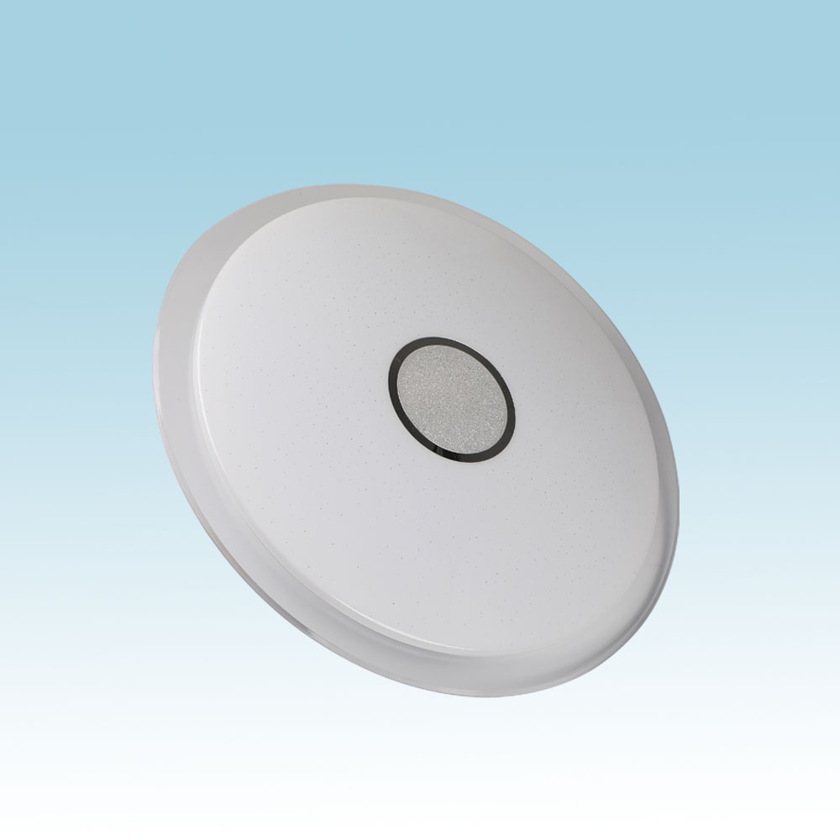
CL02
Modern Ceiling Light
Material:Iron base+ PMMA Cover
Input Voltage:AC85-265V
Led Chip:2835SMD
IP Rating:IP44 CRI>80 PF>0.9
Color Temperature:3000K/4500K/6000K
Operating Temperature:-25℃ ~50℃
Life Span:50000hours
Certificate:CE ROHS
Item Number | Wattage | LedQuantity | LuminousFlux | Beam Angle | Size (mm) | WIFI Control Remte control Switch control Dimmer control
CL02 | 72W | 144pcs2835SMD | 5760-6480lm | 120° | 350mm | Yes
 | 96W | 192pcs2835SMD | 7680-8640lm | 120° | 400mm
Modern Ceiling Light Material:Iron base+ PMMA Cover Input Voltage:AC85-265V Led Chip:2835SMD IP Rating:IP44 CRI>80 PF>0.9 Color Temperature:3000K/4500K/6000K Operating Temperature:-25℃ ~50℃ Life Span:50000hours Certificate:CE ROHS
Item Number | Wattage | LedQuantity | LuminousFlux | Beam Angle | Size (mm) | WIFI Control Remte control Switch control Dimmer control
CL-N00 | 24W | 48pcs2835SMD | 1920-2160lm | 120° | 350mm | Yes
 | 36W | 72pcs2835SMD | 2880-3240lm | 120° | 400mm
 | 40W | 80pcs2835SMD | 3200-3600lm | 120° | 450mm
Modern Ceiling Light Material:Iron base+ PMMA Cover Input Voltage:AC85-265V Led Chip:2835SMD IP Rating:IP44 CRI>80 PF>0.9 Color Temperature:3000K/4500K/6000K Operating Temperature:-25℃ ~50℃ Life Span:50000hours Certificate:CE ROHS
Item Number | Wattage | LedQuantity | LuminousFlux | Beam Angle | Size (mm) | WIFI Control Remte control Switch control Dimmer control
CL-N00 | 24W | 48pcs2835SMD | 1920-2160lm | 120° | 350mm | Yes
 | 36W | 72pcs2835SMD | 2880-3240lm | 120° | 400mm
 | 40W | 80pcs2835SMD | 3200-3600lm | 120° | 450mm
Modern Ceiling Light Material:Iron base+ PMMA Cover Input Voltage:AC85-265V Led Chip:2835SMD IP Rating:IP44 CRI>80 PF>0.9 Color Temperature:3000K/4500K/6000K Operating Temperature:-25℃ ~50℃ Life Span:50000hours Certificate:CE ROHS
Item Number | Wattage | LedQuantity | LuminousFlux | Beam Angle | Size (mm) | WIFI Control Remte control Switch control Dimmer control
CL-N00 | 24W | 48pcs2835SMD | 1920-2160lm | 120° | 350mm | Yes
 | 36W | 72pcs2835SMD | 2880-3240lm | 120° | 400mm
 | 40W | 80pcs2835SMD | 3200-3600lm | 120° | 450mm
Modern Ceiling Light Material:Iron base+ PMMA Cover Input Voltage:AC85-265V Led Chip:2835SMD IP Rating:IP44 CRI>80 PF>0.9 Color Temperature:3000K/4500K/6000K Operating Temperature:-25℃ ~50℃ Life Span:50000hours Certificate:CE ROHS
Item Number | Wattage | LedQuantity | LuminousFlux | Beam Angle | Size (mm) | WIFI Control Remte control Switch control Dimmer control
CL-N00 | 24W | 48pcs2835SMD | 1920-2160lm | 120° | 350mm | Yes
 | 36W | 72pcs2835SMD | 2880-3240lm | 120° | 400mm
 | 40W | 80pcs2835SMD | 3200-3600lm | 120° | 450mm

Slide 11
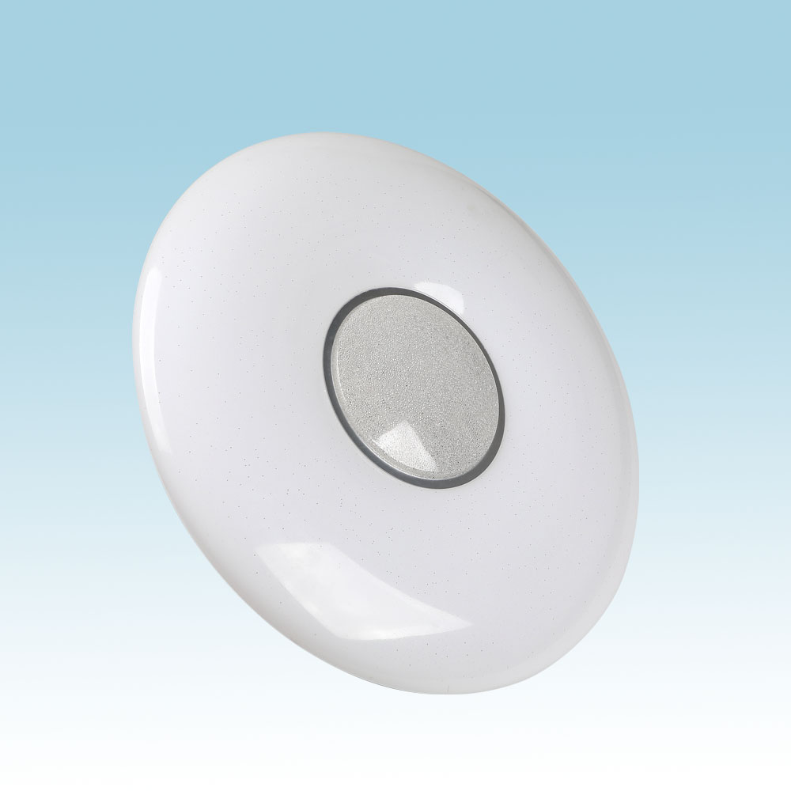
CL05
Modern Ceiling Light
Material:Iron base+ PMMA Cover
Input Voltage:AC85-265V
Led Chip:2835SMD
IP Rating:IP44 CRI>80 PF>0.9
Color Temperature:3000K/4500K/6000K
Operating Temperature:-25℃ ~50℃
Life Span:50000hours
Certificate:CE ROHS
Item Number | Wattage | LedQuantity | LuminousFlux | Beam Angle | Size (mm) | WIFI Control Remte control Switch control Dimmer control
CL05 | 48W | 96pcs2835SMD | 3840-4320lm | 120° | 400mm | Yes
 | 64W | 128pcs2835SMD | 5120-5760lm | 120° | 530mm
 | 72W | 144pcs2835SMD | 5760-6480lm | 120° | 600mm
Modern Ceiling Light Material:Iron base+ PMMA Cover Input Voltage:AC85-265V Led Chip:2835SMD IP Rating:IP44 CRI>80 PF>0.9 Color Temperature:3000K/4500K/6000K Operating Temperature:-25℃ ~50℃ Life Span:50000hours Certificate:CE ROHS
Item Number | Wattage | LedQuantity | LuminousFlux | Beam Angle | Size (mm) | WIFI Control Remte control Switch control Dimmer control
CL-N00 | 24W | 48pcs2835SMD | 1920-2160lm | 120° | 350mm | Yes
 | 36W | 72pcs2835SMD | 2880-3240lm | 120° | 400mm
 | 40W | 80pcs2835SMD | 3200-3600lm | 120° | 450mm
Modern Ceiling Light Material:Iron base+ PMMA Cover Input Voltage:AC85-265V Led Chip:2835SMD IP Rating:IP44 CRI>80 PF>0.9 Color Temperature:3000K/4500K/6000K Operating Temperature:-25℃ ~50℃ Life Span:50000hours Certificate:CE ROHS
Item Number | Wattage | LedQuantity | LuminousFlux | Beam Angle | Size (mm) | WIFI Control Remte control Switch control Dimmer control
CL-N00 | 24W | 48pcs2835SMD | 1920-2160lm | 120° | 350mm | Yes
 | 36W | 72pcs2835SMD | 2880-3240lm | 120° | 400mm
 | 40W | 80pcs2835SMD | 3200-3600lm | 120° | 450mm
Modern Ceiling Light Material:Iron base+ PMMA Cover Input Voltage:AC85-265V Led Chip:2835SMD IP Rating:IP44 CRI>80 PF>0.9 Color Temperature:3000K/4500K/6000K Operating Temperature:-25℃ ~50℃ Life Span:50000hours Certificate:CE ROHS
Item Number | Wattage | LedQuantity | LuminousFlux | Beam Angle | Size (mm) | WIFI Control Remte control Switch control Dimmer control
CL-N00 | 24W | 48pcs2835SMD | 1920-2160lm | 120° | 350mm | Yes
 | 36W | 72pcs2835SMD | 2880-3240lm | 120° | 400mm
 | 40W | 80pcs2835SMD | 3200-3600lm | 120° | 450mm
Modern Ceiling Light Material:Iron base+ PMMA Cover Input Voltage:AC85-265V Led Chip:2835SMD IP Rating:IP44 CRI>80 PF>0.9 Color Temperature:3000K/4500K/6000K Operating Temperature:-25℃ ~50℃ Life Span:50000hours Certificate:CE ROHS
Item Number | Wattage | LedQuantity | LuminousFlux | Beam Angle | Size (mm) | WIFI Control Remte control Switch control Dimmer control
CL-N00 | 24W | 48pcs2835SMD | 1920-2160lm | 120° | 350mm | Yes
 | 36W | 72pcs2835SMD | 2880-3240lm | 120° | 400mm
 | 40W | 80pcs2835SMD | 3200-3600lm | 120° | 450mm

Slide 12
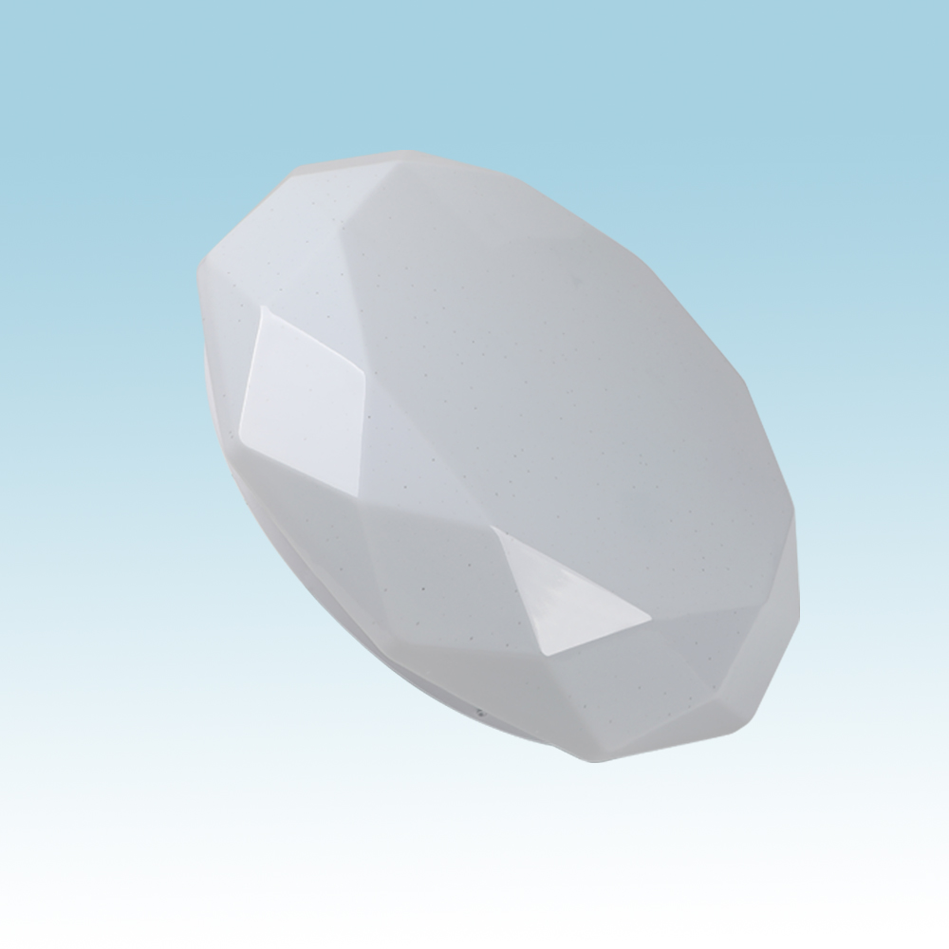
CL07
Modern Ceiling Light
Material:Iron base+ PMMA Cover
Input Voltage:AC85-265V
Led Chip:2835SMD
IP Rating:IP44 CRI>80 PF>0.9
Color Temperature:3000K/4500K/6000K
Operating Temperature:-25℃ ~50℃
Life Span:50000hours
Certificate:CE ROHS
Item Number | Wattage | LedQuantity | LuminousFlux | Beam Angle | Size (mm) | WIFI Control Remte control Switch control Dimmer control
CL07 | 12W | 24pcs2835SMD | 960-1080lm | 120° | Φ260 | Yes
 | 15W | 30pcs2835SMD | 1200-1350lm | 120° | Φ280
 | 18W | 36pcs2835SMD | 1440-1620lm | 120° | Φ300
 | 21W | 42pcs2835SMD | 1680-1890lm | 120° | Φ300
 | 24W | 48pcs2835SMD | 1920-2160lm | 120° | Φ350
 | 27W | 54pcs2835SMD | 2160-2430lm | 120° | Φ350
 | 32W | 64pcs2835SMD | 2560-2880lm | 120° | Φ380
Modern Ceiling Light Material:Iron base+ PMMA Cover Input Voltage:AC85-265V Led Chip:2835SMD IP Rating:IP44 CRI>80 PF>0.9 Color Temperature:3000K/4500K/6000K Operating Temperature:-25℃ ~50℃ Life Span:50000hours Certificate:CE ROHS
Item Number | Wattage | LedQuantity | LuminousFlux | Beam Angle | Size (mm) | WIFI Control Remte control Switch control Dimmer control
CL-N00 | 24W | 48pcs2835SMD | 1920-2160lm | 120° | 350mm | Yes
 | 36W | 72pcs2835SMD | 2880-3240lm | 120° | 400mm
 | 40W | 80pcs2835SMD | 3200-3600lm | 120° | 450mm
Modern Ceiling Light Material:Iron base+ PMMA Cover Input Voltage:AC85-265V Led Chip:2835SMD IP Rating:IP44 CRI>80 PF>0.9 Color Temperature:3000K/4500K/6000K Operating Temperature:-25℃ ~50℃ Life Span:50000hours Certificate:CE ROHS
Item Number | Wattage | LedQuantity | LuminousFlux | Beam Angle | Size (mm) | WIFI Control Remte control Switch control Dimmer control
CL-N00 | 24W | 48pcs2835SMD | 1920-2160lm | 120° | 350mm | Yes
 | 36W | 72pcs2835SMD | 2880-3240lm | 120° | 400mm
 | 40W | 80pcs2835SMD | 3200-3600lm | 120° | 450mm
Modern Ceiling Light Material:Iron base+ PMMA Cover Input Voltage:AC85-265V Led Chip:2835SMD IP Rating:IP44 CRI>80 PF>0.9 Color Temperature:3000K/4500K/6000K Operating Temperature:-25℃ ~50℃ Life Span:50000hours Certificate:CE ROHS
Item Number | Wattage | LedQuantity | LuminousFlux | Beam Angle | Size (mm) | WIFI Control Remte control Switch control Dimmer control
CL-N00 | 24W | 48pcs2835SMD | 1920-2160lm | 120° | 350mm | Yes
 | 36W | 72pcs2835SMD | 2880-3240lm | 120° | 400mm
 | 40W | 80pcs2835SMD | 3200-3600lm | 120° | 450mm
Modern Ceiling Light Material:Iron base+ PMMA Cover Input Voltage:AC85-265V Led Chip:2835SMD IP Rating:IP44 CRI>80 PF>0.9 Color Temperature:3000K/4500K/6000K Operating Temperature:-25℃ ~50℃ Life Span:50000hours Certificate:CE ROHS
Item Number | Wattage | LedQuantity | LuminousFlux | Beam Angle | Size (mm) | WIFI Control Remte control Switch control Dimmer control
CL-N00 | 24W | 48pcs2835SMD | 1920-2160lm | 120° | 350mm | Yes
 | 36W | 72pcs2835SMD | 2880-3240lm | 120° | 400mm
 | 40W | 80pcs2835SMD | 3200-3600lm | 120° | 450mm

Slide 13
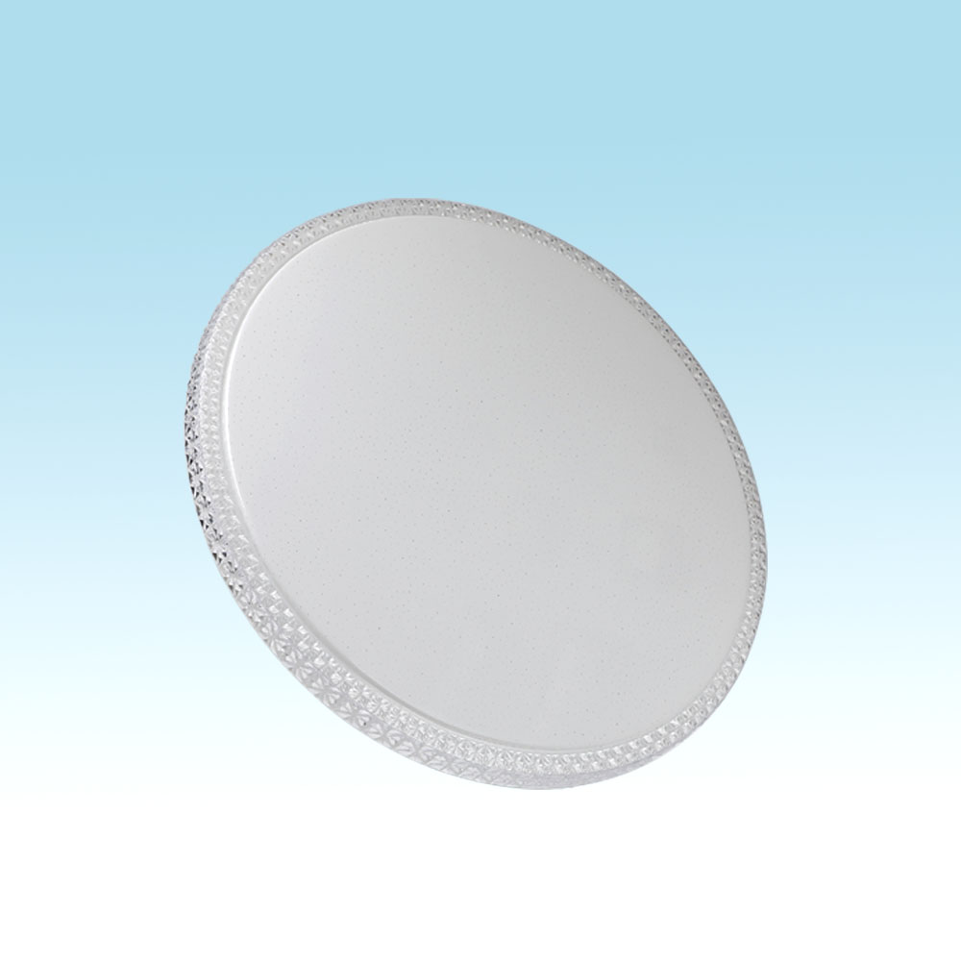
CL11
Modern Ceiling Light
Material:Iron base+ PMMA Cover
Input Voltage:AC85-265V
Led Chip:2835SMD
IP Rating:IP44 CRI>80 PF>0.9
Color Temperature:3000K/4500K/6000K
Operating Temperature:-25℃ ~50℃
Life Span:50000hours
Certificate:CE ROHS
Item Number | Wattage | LedQuantity | LuminousFlux | Beam Angle | Size (mm) | WIFI Control Remte control Switch control Dimmer control
CL11 | 12W | 24pcs2835SMD | 960-1080lm | 120° | Φ260 | Yes
 | 15W | 30pcs2835SMD | 1200-1350lm | 120° | Φ280
 | 18W | 36pcs2835SMD | 1440-1620lm | 120° | Φ300
 | 21W | 42pcs2835SMD | 1680-1890lm | 120° | Φ300
 | 24W | 48pcs2835SMD | 1920-2160lm | 120° | Φ350
 | 27W | 54pcs2835SMD | 2160-2430lm | 120° | Φ350
 | 32W | 64pcs2835SMD | 2560-2880lm | 120° | Φ380
 | 40W | 80pcs2835SMD | 3200-3600lm | 120° | Φ400
 | 48W | 96pcs2835SMD | 3840-4320lm | 120° | Φ400
Modern Ceiling Light Material:Iron base+ PMMA Cover Input Voltage:AC85-265V Led Chip:2835SMD IP Rating:IP44 CRI>80 PF>0.9 Color Temperature:3000K/4500K/6000K Operating Temperature:-25℃ ~50℃ Life Span:50000hours Certificate:CE ROHS
Item Number | Wattage | LedQuantity | LuminousFlux | Beam Angle | Size (mm) | WIFI Control Remte control Switch control Dimmer control
CL-N00 | 24W | 48pcs2835SMD | 1920-2160lm | 120° | 350mm | Yes
 | 36W | 72pcs2835SMD | 2880-3240lm | 120° | 400mm
 | 40W | 80pcs2835SMD | 3200-3600lm | 120° | 450mm
Modern Ceiling Light Material:Iron base+ PMMA Cover Input Voltage:AC85-265V Led Chip:2835SMD IP Rating:IP44 CRI>80 PF>0.9 Color Temperature:3000K/4500K/6000K Operating Temperature:-25℃ ~50℃ Life Span:50000hours Certificate:CE ROHS
Item Number | Wattage | LedQuantity | LuminousFlux | Beam Angle | Size (mm) | WIFI Control Remte control Switch control Dimmer control
CL-N00 | 24W | 48pcs2835SMD | 1920-2160lm | 120° | 350mm | Yes
 | 36W | 72pcs2835SMD | 2880-3240lm | 120° | 400mm
 | 40W | 80pcs2835SMD | 3200-3600lm | 120° | 450mm
Modern Ceiling Light Material:Iron base+ PMMA Cover Input Voltage:AC85-265V Led Chip:2835SMD IP Rating:IP44 CRI>80 PF>0.9 Color Temperature:3000K/4500K/6000K Operating Temperature:-25℃ ~50℃ Life Span:50000hours Certificate:CE ROHS
Item Number | Wattage | LedQuantity | LuminousFlux | Beam Angle | Size (mm) | WIFI Control Remte control Switch control Dimmer control
CL-N00 | 24W | 48pcs2835SMD | 1920-2160lm | 120° | 350mm | Yes
 | 36W | 72pcs2835SMD | 2880-3240lm | 120° | 400mm
 | 40W | 80pcs2835SMD | 3200-3600lm | 120° | 450mm
Modern Ceiling Light Material:Iron base+ PMMA Cover Input Voltage:AC85-265V Led Chip:2835SMD IP Rating:IP44 CRI>80 PF>0.9 Color Temperature:3000K/4500K/6000K Operating Temperature:-25℃ ~50℃ Life Span:50000hours Certificate:CE ROHS
Item Number | Wattage | LedQuantity | LuminousFlux | Beam Angle | Size (mm) | WIFI Control Remte control Switch control Dimmer control
CL-N00 | 24W | 48pcs2835SMD | 1920-2160lm | 120° | 350mm | Yes
 | 36W | 72pcs2835SMD | 2880-3240lm | 120° | 400mm
 | 40W | 80pcs2835SMD | 3200-3600lm | 120° | 450mm

Slide 14
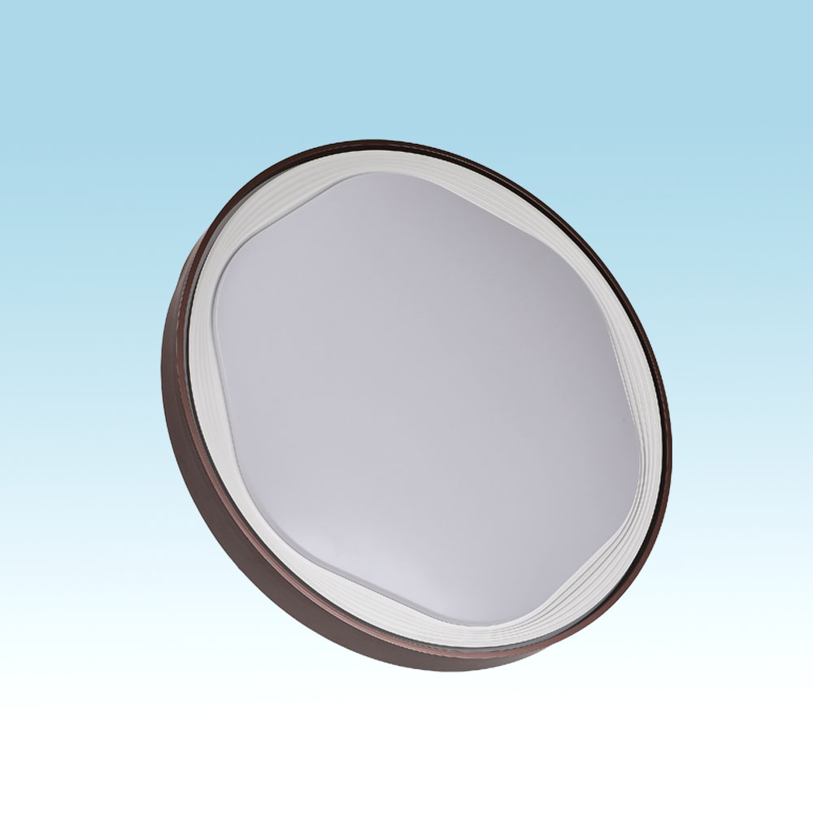
CL13
Modern Ceiling Light
Material:Iron base+ PMMA Cover
Input Voltage:AC85-265V
Led Chip:2835SMD
IP Rating:IP44 CRI>80 PF>0.9
Color Temperature:3000K/4500K/6000K
Operating Temperature:-25℃ ~50℃
Life Span:50000hours
Certificate:CE ROHS
Item Number | Wattage | LedQuantity | LuminousFlux | Beam Angle | Size (mm) | WIFI Control Remte control Switch control Dimmer control
CL13 | 12W | 24pcs2835SMD | 960-1080lm | 120° | Φ260 | Yes
 | 15W | 30pcs2835SMD | 1200-1350lm | 120° | Φ280
 | 18W | 36pcs2835SMD | 1440-1620lm | 120° | Φ300
 | 21W | 42pcs2835SMD | 1680-1890lm | 120° | Φ300
 | 24W | 48pcs2835SMD | 1920-2160lm | 120° | Φ350
 | 27W | 54pcs2835SMD | 2160-2430lm | 120° | Φ350
 | 32W | 64pcs2835SMD | 2560-2880lm | 120° | Φ380
 | 40W | 80pcs2835SMD | 3200-3600lm | 120° | Φ400
 | 48W | 96pcs2835SMD | 3840-4320lm | 120° | Φ400
Modern Ceiling Light Material:Iron base+ PMMA Cover Input Voltage:AC85-265V Led Chip:2835SMD IP Rating:IP44 CRI>80 PF>0.9 Color Temperature:3000K/4500K/6000K Operating Temperature:-25℃ ~50℃ Life Span:50000hours Certificate:CE ROHS
Item Number | Wattage | LedQuantity | LuminousFlux | Beam Angle | Size (mm) | WIFI Control Remte control Switch control Dimmer control
CL-N00 | 24W | 48pcs2835SMD | 1920-2160lm | 120° | 350mm | Yes
 | 36W | 72pcs2835SMD | 2880-3240lm | 120° | 400mm
 | 40W | 80pcs2835SMD | 3200-3600lm | 120° | 450mm
Modern Ceiling Light Material:Iron base+ PMMA Cover Input Voltage:AC85-265V Led Chip:2835SMD IP Rating:IP44 CRI>80 PF>0.9 Color Temperature:3000K/4500K/6000K Operating Temperature:-25℃ ~50℃ Life Span:50000hours Certificate:CE ROHS
Item Number | Wattage | LedQuantity | LuminousFlux | Beam Angle | Size (mm) | WIFI Control Remte control Switch control Dimmer control
CL-N00 | 24W | 48pcs2835SMD | 1920-2160lm | 120° | 350mm | Yes
 | 36W | 72pcs2835SMD | 2880-3240lm | 120° | 400mm
 | 40W | 80pcs2835SMD | 3200-3600lm | 120° | 450mm
Modern Ceiling Light Material:Iron base+ PMMA Cover Input Voltage:AC85-265V Led Chip:2835SMD IP Rating:IP44 CRI>80 PF>0.9 Color Temperature:3000K/4500K/6000K Operating Temperature:-25℃ ~50℃ Life Span:50000hours Certificate:CE ROHS
Item Number | Wattage | LedQuantity | LuminousFlux | Beam Angle | Size (mm) | WIFI Control Remte control Switch control Dimmer control
CL-N00 | 24W | 48pcs2835SMD | 1920-2160lm | 120° | 350mm | Yes
 | 36W | 72pcs2835SMD | 2880-3240lm | 120° | 400mm
 | 40W | 80pcs2835SMD | 3200-3600lm | 120° | 450mm
Modern Ceiling Light Material:Iron base+ PMMA Cover Input Voltage:AC85-265V Led Chip:2835SMD IP Rating:IP44 CRI>80 PF>0.9 Color Temperature:3000K/4500K/6000K Operating Temperature:-25℃ ~50℃ Life Span:50000hours Certificate:CE ROHS
Item Number | Wattage | LedQuantity | LuminousFlux | Beam Angle | Size (mm) | WIFI Control Remte control Switch control Dimmer control
CL-N00 | 24W | 48pcs2835SMD | 1920-2160lm | 120° | 350mm | Yes
 | 36W | 72pcs2835SMD | 2880-3240lm | 120° | 400mm
 | 40W | 80pcs2835SMD | 3200-3600lm | 120° | 450mm

Slide 15
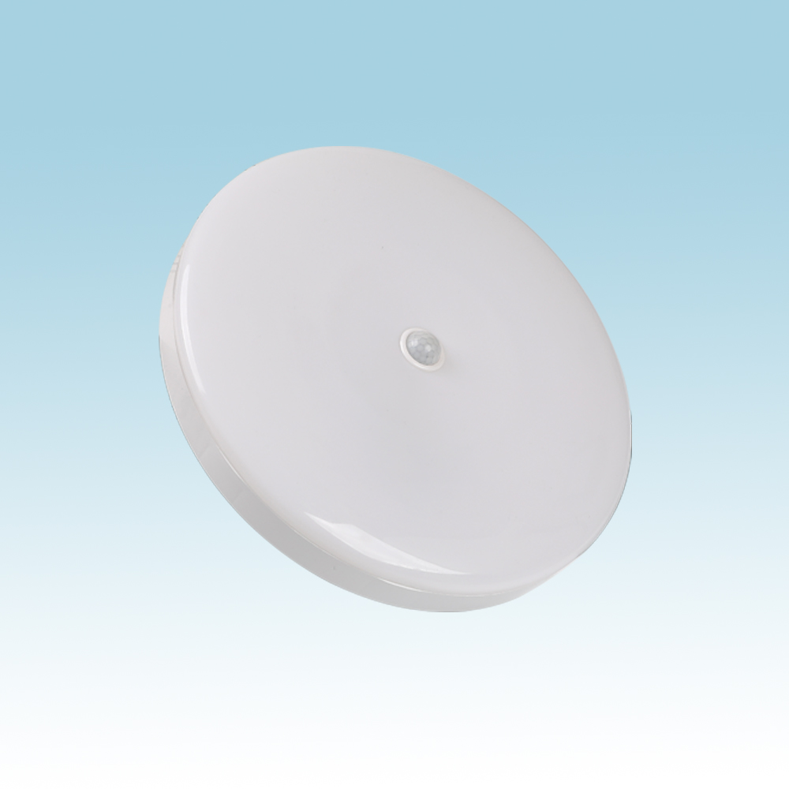
CL19
Modern Ceiling Light
Material:Iron base+ PMMA Cover
Input Voltage:AC85-265V
Led Chip:2835SMD
IP Rating:IP44 CRI>80 PF>0.9
Color Temperature:3000K/4500K/6000K
Operating Temperature:-25℃ ~50℃
Life Span:50000hours
Certificate:CE ROHS
Item Number | Wattage | LedQuantity | LuminousFlux | Beam Angle | Size (mm) | WIFI Control Remte control Switch control Dimmer control
CL-N00 | 12W | 24pcs2835SMD | 960-1080lm | 120° | Φ260 | Yes
 | 18W | 36pcs2835SMD | 1440-1620lm | 120° | Φ300
Modern Ceiling Light Material:Iron base+ PMMA Cover Input Voltage:AC85-265V Led Chip:2835SMD IP Rating:IP44 CRI>80 PF>0.9 Color Temperature:3000K/4500K/6000K Operating Temperature:-25℃ ~50℃ Life Span:50000hours Certificate:CE ROHS
Item Number | Wattage | LedQuantity | LuminousFlux | Beam Angle | Size (mm) | WIFI Control Remte control Switch control Dimmer control
CL-N00 | 24W | 48pcs2835SMD | 1920-2160lm | 120° | 350mm | Yes
 | 36W | 72pcs2835SMD | 2880-3240lm | 120° | 400mm
 | 40W | 80pcs2835SMD | 3200-3600lm | 120° | 450mm
Modern Ceiling Light Material:Iron base+ PMMA Cover Input Voltage:AC85-265V Led Chip:2835SMD IP Rating:IP44 CRI>80 PF>0.9 Color Temperature:3000K/4500K/6000K Operating Temperature:-25℃ ~50℃ Life Span:50000hours Certificate:CE ROHS
Item Number | Wattage | LedQuantity | LuminousFlux | Beam Angle | Size (mm) | WIFI Control Remte control Switch control Dimmer control
CL-N00 | 24W | 48pcs2835SMD | 1920-2160lm | 120° | 350mm | Yes
 | 36W | 72pcs2835SMD | 2880-3240lm | 120° | 400mm
 | 40W | 80pcs2835SMD | 3200-3600lm | 120° | 450mm
Modern Ceiling Light Material:Iron base+ PMMA Cover Input Voltage:AC85-265V Led Chip:2835SMD IP Rating:IP44 CRI>80 PF>0.9 Color Temperature:3000K/4500K/6000K Operating Temperature:-25℃ ~50℃ Life Span:50000hours Certificate:CE ROHS
Item Number | Wattage | LedQuantity | LuminousFlux | Beam Angle | Size (mm) | WIFI Control Remte control Switch control Dimmer control
CL-N00 | 24W | 48pcs2835SMD | 1920-2160lm | 120° | 350mm | Yes
 | 36W | 72pcs2835SMD | 2880-3240lm | 120° | 400mm
 | 40W | 80pcs2835SMD | 3200-3600lm | 120° | 450mm
Modern Ceiling Light Material:Iron base+ PMMA Cover Input Voltage:AC85-265V Led Chip:2835SMD IP Rating:IP44 CRI>80 PF>0.9 Color Temperature:3000K/4500K/6000K Operating Temperature:-25℃ ~50℃ Life Span:50000hours Certificate:CE ROHS
Item Number | Wattage | LedQuantity | LuminousFlux | Beam Angle | Size (mm) | WIFI Control Remte control Switch control Dimmer control
CL-N00 | 24W | 48pcs2835SMD | 1920-2160lm | 120° | 350mm | Yes
 | 36W | 72pcs2835SMD | 2880-3240lm | 120° | 400mm
 | 40W | 80pcs2835SMD | 3200-3600lm | 120° | 450mm

Slide 16
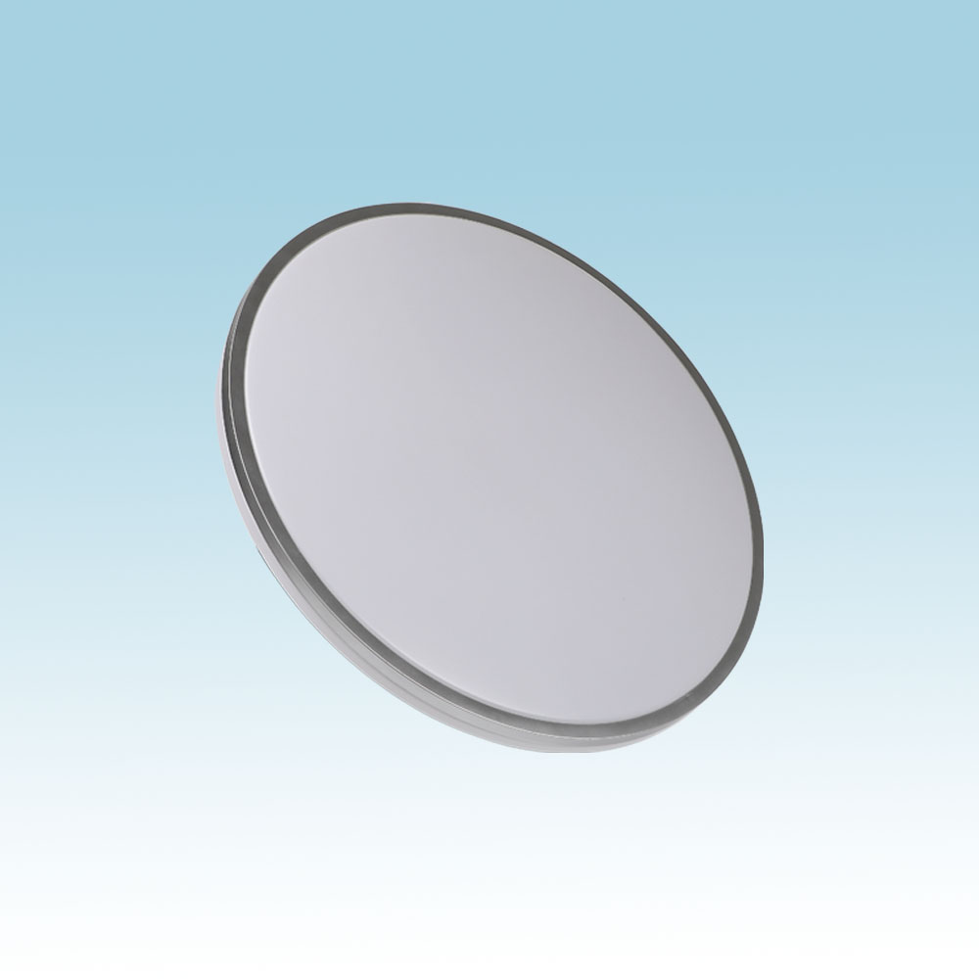
CL06
Modern Ceiling Light
Material:Iron base+ PMMA Cover
Input Voltage:AC85-265V
Led Chip:2835SMD
IP Rating:IP44 CRI>80 PF>0.9
Color Temperature:3000K/4500K/6000K
Operating Temperature:-25℃ ~50℃
Life Span:50000hours
Certificate:CE ROHS
Item Number | Wattage | LedQuantity | LuminousFlux | Beam Angle | Size (mm) | WIFI Control Remte control Switch control Dimmer control
CL06 | 72W | 144pcs2835SMD | 5760-6480lm | 120° | 350mm | Yes
 | 96W | 192pcs2835SMD | 7680-8640lm | 120° | 450mm
Modern Ceiling Light Material:Iron base+ PMMA Cover Input Voltage:AC85-265V Led Chip:2835SMD IP Rating:IP44 CRI>80 PF>0.9 Color Temperature:3000K/4500K/6000K Operating Temperature:-25℃ ~50℃ Life Span:50000hours Certificate:CE ROHS
Item Number | Wattage | LedQuantity | LuminousFlux | Beam Angle | Size (mm) | WIFI Control Remte control Switch control Dimmer control
CL-N00 | 24W | 48pcs2835SMD | 1920-2160lm | 120° | 350mm | Yes
 | 36W | 72pcs2835SMD | 2880-3240lm | 120° | 400mm
 | 40W | 80pcs2835SMD | 3200-3600lm | 120° | 450mm
Modern Ceiling Light Material:Iron base+ PMMA Cover Input Voltage:AC85-265V Led Chip:2835SMD IP Rating:IP44 CRI>80 PF>0.9 Color Temperature:3000K/4500K/6000K Operating Temperature:-25℃ ~50℃ Life Span:50000hours Certificate:CE ROHS
Item Number | Wattage | LedQuantity | LuminousFlux | Beam Angle | Size (mm) | WIFI Control Remte control Switch control Dimmer control
CL-N00 | 24W | 48pcs2835SMD | 1920-2160lm | 120° | 350mm | Yes
 | 36W | 72pcs2835SMD | 2880-3240lm | 120° | 400mm
 | 40W | 80pcs2835SMD | 3200-3600lm | 120° | 450mm
Modern Ceiling Light Material:Iron base+ PMMA Cover Input Voltage:AC85-265V Led Chip:2835SMD IP Rating:IP44 CRI>80 PF>0.9 Color Temperature:3000K/4500K/6000K Operating Temperature:-25℃ ~50℃ Life Span:50000hours Certificate:CE ROHS
Item Number | Wattage | LedQuantity | LuminousFlux | Beam Angle | Size (mm) | WIFI Control Remte control Switch control Dimmer control
CL-N00 | 24W | 48pcs2835SMD | 1920-2160lm | 120° | 350mm | Yes
 | 36W | 72pcs2835SMD | 2880-3240lm | 120° | 400mm
 | 40W | 80pcs2835SMD | 3200-3600lm | 120° | 450mm
Modern Ceiling Light Material:Iron base+ PMMA Cover Input Voltage:AC85-265V Led Chip:2835SMD IP Rating:IP44 CRI>80 PF>0.9 Color Temperature:3000K/4500K/6000K Operating Temperature:-25℃ ~50℃ Life Span:50000hours Certificate:CE ROHS
Item Number | Wattage | LedQuantity | LuminousFlux | Beam Angle | Size (mm) | WIFI Control Remte control Switch control Dimmer control
CL-N00 | 24W | 48pcs2835SMD | 1920-2160lm | 120° | 350mm | Yes
 | 36W | 72pcs2835SMD | 2880-3240lm | 120° | 400mm
 | 40W | 80pcs2835SMD | 3200-3600lm | 120° | 450mm

Slide 17
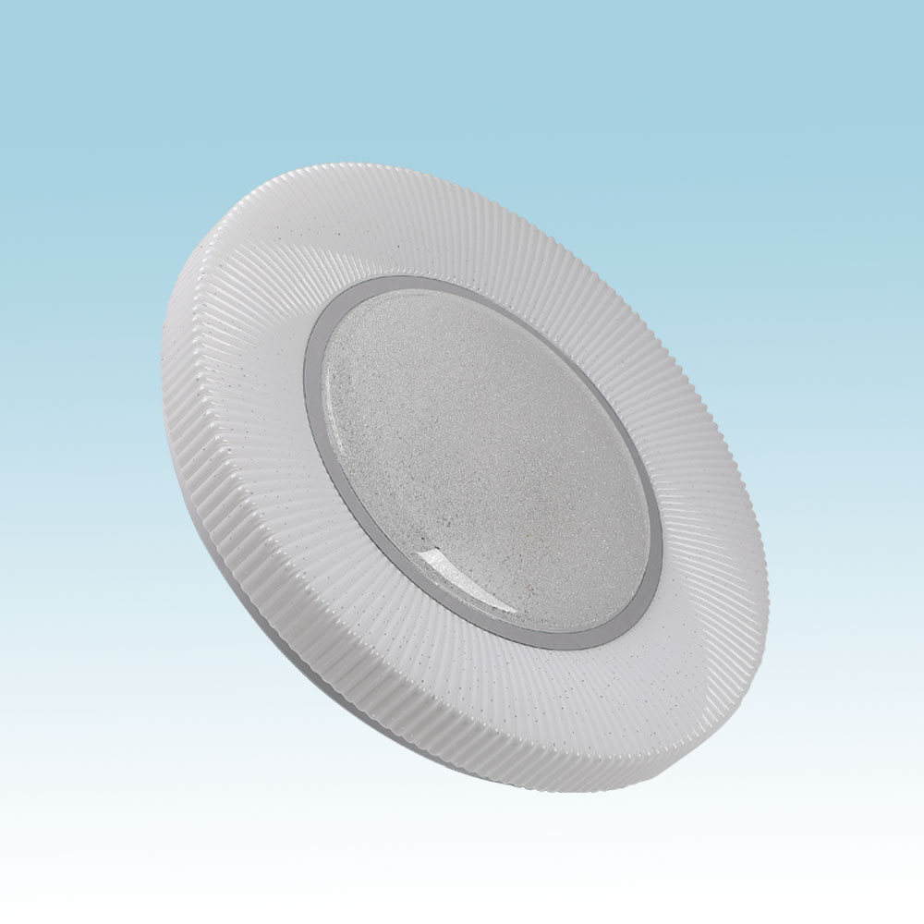
CL09
Modern Ceiling Light
Material:Iron base+ PMMA Cover
Input Voltage:AC85-265V
Led Chip:2835SMD
IP Rating:IP44 CRI>80 PF>0.9
Color Temperature:3000K/4500K/6000K
Operating Temperature:-25℃ ~50℃
Life Span:50000hours
Certificate:CE ROHS
Item Number | Wattage | LedQuantity | LuminousFlux | Beam Angle | Size (mm) | WIFI Control Remte control Switch control Dimmer control
CL09 | 12W | 24pcs2835SMD | 960-1080lm | 120° | Φ260 | Yes
 | 15W | 30pcs2835SMD | 1200-1350lm | 120° | Φ280
 | 18W | 36pcs2835SMD | 1440-1620lm | 120° | Φ300
 | 21W | 42pcs2835SMD | 1680-1890lm | 120° | Φ300
 | 24W | 48pcs2835SMD | 1920-2160lm | 120° | Φ350
 | 27W | 54pcs2835SMD | 2160-2430lm | 120° | Φ350
 | 32W | 64pcs2835SMD | 2560-2880lm | 120° | Φ380
 | 40W | 80pcs2835SMD | 3200-3600lm | 120° | Φ400
 | 48W | 96pcs2835SMD | 3840-4320lm | 120° | Φ400
Modern Ceiling Light Material:Iron base+ PMMA Cover Input Voltage:AC85-265V Led Chip:2835SMD IP Rating:IP44 CRI>80 PF>0.9 Color Temperature:3000K/4500K/6000K Operating Temperature:-25℃ ~50℃ Life Span:50000hours Certificate:CE ROHS
Item Number | Wattage | LedQuantity | LuminousFlux | Beam Angle | Size (mm) | WIFI Control Remte control Switch control Dimmer control
CL-N00 | 24W | 48pcs2835SMD | 1920-2160lm | 120° | 350mm | Yes
 | 36W | 72pcs2835SMD | 2880-3240lm | 120° | 400mm
 | 40W | 80pcs2835SMD | 3200-3600lm | 120° | 450mm
Modern Ceiling Light Material:Iron base+ PMMA Cover Input Voltage:AC85-265V Led Chip:2835SMD IP Rating:IP44 CRI>80 PF>0.9 Color Temperature:3000K/4500K/6000K Operating Temperature:-25℃ ~50℃ Life Span:50000hours Certificate:CE ROHS
Item Number | Wattage | LedQuantity | LuminousFlux | Beam Angle | Size (mm) | WIFI Control Remte control Switch control Dimmer control
CL-N00 | 24W | 48pcs2835SMD | 1920-2160lm | 120° | 350mm | Yes
 | 36W | 72pcs2835SMD | 2880-3240lm | 120° | 400mm
 | 40W | 80pcs2835SMD | 3200-3600lm | 120° | 450mm
Modern Ceiling Light Material:Iron base+ PMMA Cover Input Voltage:AC85-265V Led Chip:2835SMD IP Rating:IP44 CRI>80 PF>0.9 Color Temperature:3000K/4500K/6000K Operating Temperature:-25℃ ~50℃ Life Span:50000hours Certificate:CE ROHS
Item Number | Wattage | LedQuantity | LuminousFlux | Beam Angle | Size (mm) | WIFI Control Remte control Switch control Dimmer control
CL-N00 | 24W | 48pcs2835SMD | 1920-2160lm | 120° | 350mm | Yes
 | 36W | 72pcs2835SMD | 2880-3240lm | 120° | 400mm
 | 40W | 80pcs2835SMD | 3200-3600lm | 120° | 450mm
Modern Ceiling Light Material:Iron base+ PMMA Cover Input Voltage:AC85-265V Led Chip:2835SMD IP Rating:IP44 CRI>80 PF>0.9 Color Temperature:3000K/4500K/6000K Operating Temperature:-25℃ ~50℃ Life Span:50000hours Certificate:CE ROHS
Item Number | Wattage | LedQuantity | LuminousFlux | Beam Angle | Size (mm) | WIFI Control Remte control Switch control Dimmer control
CL-N00 | 24W | 48pcs2835SMD | 1920-2160lm | 120° | 350mm | Yes
 | 36W | 72pcs2835SMD | 2880-3240lm | 120° | 400mm
 | 40W | 80pcs2835SMD | 3200-3600lm | 120° | 450mm

Slide 18
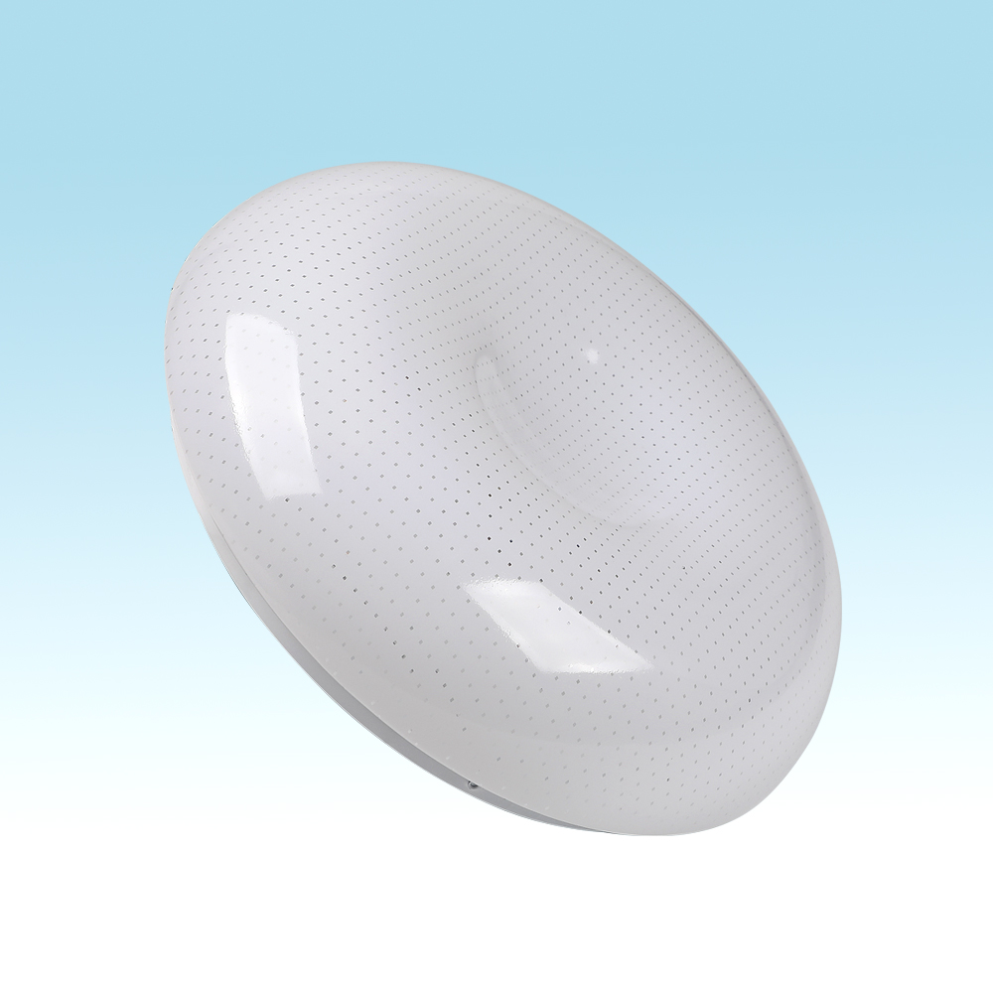
CL21
Modern Ceiling Light
Material:Iron base+ PMMA Cover
Input Voltage:AC85-265V
Led Chip:2835SMD
IP Rating:IP44 CRI>80 PF>0.9
Color Temperature:3000K/4500K/6000K
Operating Temperature:-25℃ ~50℃
Life Span:50000hours
Certificate:CE ROHS
Item Number | Wattage | LedQuantity | LuminousFlux | Beam Angle | Size (mm) | WIFI Control Remte control Switch control Dimmer control
CL21 | 12W | 24pcs2835SMD | 960-1080lm | 120° | Φ260 | Yes
 | 15W | 30pcs2835SMD | 1200-1350lm | 120° | Φ280
 | 18W | 36pcs2835SMD | 1440-1620lm | 120° | Φ300
 | 21W | 42pcs2835SMD | 1680-1890lm | 120° | Φ300
 | 24W | 48pcs2835SMD | 1920-2160lm | 120° | Φ350
 | 27W | 54pcs2835SMD | 2160-2430lm | 120° | Φ350
 | 32W | 64pcs2835SMD | 2560-2880lm | 120° | Φ380
 | 40W | 80pcs2835SMD | 3200-3600lm | 120° | Φ400
 | 48W | 96pcs2835SMD | 3840-4320lm | 120° | Φ400
Modern Ceiling Light Material:Iron base+ PMMA Cover Input Voltage:AC85-265V Led Chip:2835SMD IP Rating:IP44 CRI>80 PF>0.9 Color Temperature:3000K/4500K/6000K Operating Temperature:-25℃ ~50℃ Life Span:50000hours Certificate:CE ROHS
Item Number | Wattage | LedQuantity | LuminousFlux | Beam Angle | Size (mm) | WIFI Control Remte control Switch control Dimmer control
CL-N00 | 24W | 48pcs2835SMD | 1920-2160lm | 120° | 350mm | Yes
 | 36W | 72pcs2835SMD | 2880-3240lm | 120° | 400mm
 | 40W | 80pcs2835SMD | 3200-3600lm | 120° | 450mm
Modern Ceiling Light Material:Iron base+ PMMA Cover Input Voltage:AC85-265V Led Chip:2835SMD IP Rating:IP44 CRI>80 PF>0.9 Color Temperature:3000K/4500K/6000K Operating Temperature:-25℃ ~50℃ Life Span:50000hours Certificate:CE ROHS
Item Number | Wattage | LedQuantity | LuminousFlux | Beam Angle | Size (mm) | WIFI Control Remte control Switch control Dimmer control
CL-N00 | 24W | 48pcs2835SMD | 1920-2160lm | 120° | 350mm | Yes
 | 36W | 72pcs2835SMD | 2880-3240lm | 120° | 400mm
 | 40W | 80pcs2835SMD | 3200-3600lm | 120° | 450mm
Modern Ceiling Light Material:Iron base+ PMMA Cover Input Voltage:AC85-265V Led Chip:2835SMD IP Rating:IP44 CRI>80 PF>0.9 Color Temperature:3000K/4500K/6000K Operating Temperature:-25℃ ~50℃ Life Span:50000hours Certificate:CE ROHS
Item Number | Wattage | LedQuantity | LuminousFlux | Beam Angle | Size (mm) | WIFI Control Remte control Switch control Dimmer control
CL-N00 | 24W | 48pcs2835SMD | 1920-2160lm | 120° | 350mm | Yes
 | 36W | 72pcs2835SMD | 2880-3240lm | 120° | 400mm
 | 40W | 80pcs2835SMD | 3200-3600lm | 120° | 450mm
Modern Ceiling Light Material:Iron base+ PMMA Cover Input Voltage:AC85-265V Led Chip:2835SMD IP Rating:IP44 CRI>80 PF>0.9 Color Temperature:3000K/4500K/6000K Operating Temperature:-25℃ ~50℃ Life Span:50000hours Certificate:CE ROHS
Item Number | Wattage | LedQuantity | LuminousFlux | Beam Angle | Size (mm) | WIFI Control Remte control Switch control Dimmer control
CL-N00 | 24W | 48pcs2835SMD | 1920-2160lm | 120° | 350mm | Yes
 | 36W | 72pcs2835SMD | 2880-3240lm | 120° | 400mm
 | 40W | 80pcs2835SMD | 3200-3600lm | 120° | 450mm

Slide 19
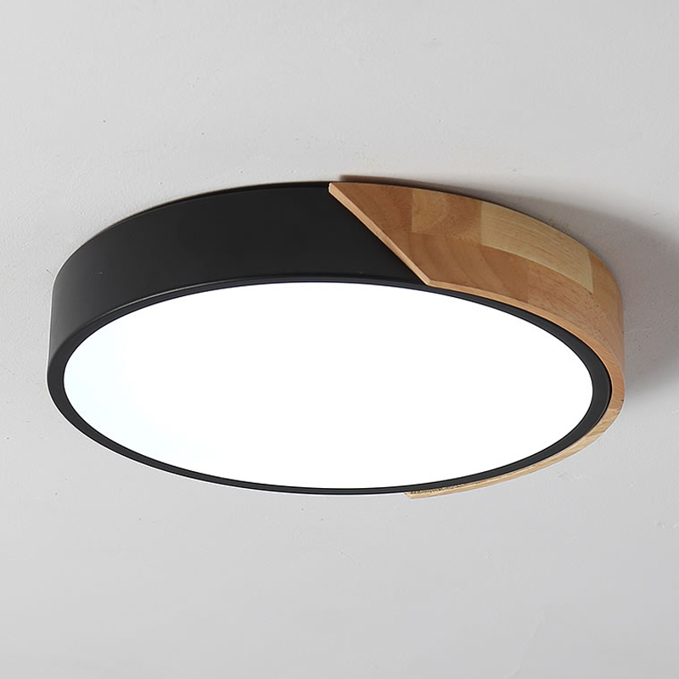
NC05
Modern Ceiling Light
Material:Iron base+ PMMA Cover
Input Voltage:AC85-265V
Led Chip:2835SMD
IP Rating:IP44 CRI>80 PF>0.9
Color Temperature:3000K/4500K/6000K
Operating Temperature:-25℃ ~50℃
Life Span:50000hours
Certificate:CE ROHS
Item Number | Wattage | LedQuantity | LuminousFlux | Beam Angle | Size (mm) | WIFI Control Remte Control Switch Control Dimmer Control
NC05 | 18W | 36pcs2835SMD | 1440-1620lm | 120° | Φ300 | Yes
 | 24W | 48pcs2835SMD | 1920-2160lm | 120° | Φ400
 | 36W | 72pcs2835SMD | 2400-2700lm | 120° | Φ500
Modern Ceiling Light Material:Iron base+ PMMA Cover Input Voltage:AC85-265V Led Chip:2835SMD IP Rating:IP44 CRI>80 PF>0.9 Color Temperature:3000K/4500K/6000K Operating Temperature:-25℃ ~50℃ Life Span:50000hours Certificate:CE ROHS
Item Number | Wattage | LedQuantity | LuminousFlux | Beam Angle | Size (mm) | WIFI Control Remte control Switch control Dimmer control
CL-N00 | 24W | 48pcs2835SMD | 1920-2160lm | 120° | 350mm | Yes
 | 36W | 72pcs2835SMD | 2880-3240lm | 120° | 400mm
 | 40W | 80pcs2835SMD | 3200-3600lm | 120° | 450mm
Modern Ceiling Light Material:Iron base+ PMMA Cover Input Voltage:AC85-265V Led Chip:2835SMD IP Rating:IP44 CRI>80 PF>0.9 Color Temperature:3000K/4500K/6000K Operating Temperature:-25℃ ~50℃ Life Span:50000hours Certificate:CE ROHS
Item Number | Wattage | LedQuantity | LuminousFlux | Beam Angle | Size (mm) | WIFI Control Remte control Switch control Dimmer control
CL-N00 | 24W | 48pcs2835SMD | 1920-2160lm | 120° | 350mm | Yes
 | 36W | 72pcs2835SMD | 2880-3240lm | 120° | 400mm
 | 40W | 80pcs2835SMD | 3200-3600lm | 120° | 450mm
Modern Ceiling Light Material:Iron base+ PMMA Cover Input Voltage:AC85-265V Led Chip:2835SMD IP Rating:IP44 CRI>80 PF>0.9 Color Temperature:3000K/4500K/6000K Operating Temperature:-25℃ ~50℃ Life Span:50000hours Certificate:CE ROHS
Item Number | Wattage | LedQuantity | LuminousFlux | Beam Angle | Size (mm) | WIFI Control Remte control Switch control Dimmer control
CL-N00 | 24W | 48pcs2835SMD | 1920-2160lm | 120° | 350mm | Yes
 | 36W | 72pcs2835SMD | 2880-3240lm | 120° | 400mm
 | 40W | 80pcs2835SMD | 3200-3600lm | 120° | 450mm
Modern Ceiling Light Material:Iron base+ PMMA Cover Input Voltage:AC85-265V Led Chip:2835SMD IP Rating:IP44 CRI>80 PF>0.9 Color Temperature:3000K/4500K/6000K Operating Temperature:-25℃ ~50℃ Life Span:50000hours Certificate:CE ROHS
Item Number | Wattage | LedQuantity | LuminousFlux | Beam Angle | Size (mm) | WIFI Control Remte control Switch control Dimmer control
CL-N00 | 24W | 48pcs2835SMD | 1920-2160lm | 120° | 350mm | Yes
 | 36W | 72pcs2835SMD | 2880-3240lm | 120° | 400mm
 | 40W | 80pcs2835SMD | 3200-3600lm | 120° | 450mm

Slide 20
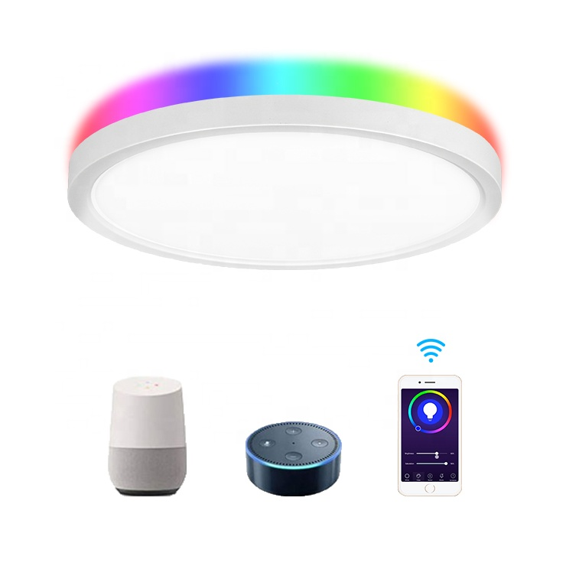
NC06
Modern Ceiling Light
Material:Iron base+ PMMA Cover
Input Voltage:AC85-265V
Led Chip:2835SMD
IP Rating:IP44 CRI>80 PF>0.9
Color Temperature:3000K/4500K/6000K
Operating Temperature:-25℃ ~50℃
Life Span:50000hours
Certificate:CE ROHS
Item Number | Wattage | LedQuantity | LuminousFlux | Beam Angle | Size (mm) | WIFI Control Remte Control Switch Control Dimmer Control
NC06 | 12W | 24pcs2835SMD | 960-1080lm | 120° | Φ260 | Yes
 | 18W | 36pcs2835SMD | 1440-1620lm | 120° | Φ300
 | 24W | 48pcs2835SMD | 1920-2160lm | 120° | Φ350
 | 36W | 72pcs2835SMD | 2880-3240lm | 120° | Φ380
 | 48w | 96pcs2835SMD | 3840-4320lm | 120° | Φ400
Modern Ceiling Light Material:Iron base+ PMMA Cover Input Voltage:AC85-265V Led Chip:2835SMD IP Rating:IP44 CRI>80 PF>0.9 Color Temperature:3000K/4500K/6000K Operating Temperature:-25℃ ~50℃ Life Span:50000hours Certificate:CE ROHS
Item Number | Wattage | LedQuantity | LuminousFlux | Beam Angle | Size (mm) | WIFI Control Remte control Switch control Dimmer control
CL-N00 | 24W | 48pcs2835SMD | 1920-2160lm | 120° | 350mm | Yes
 | 36W | 72pcs2835SMD | 2880-3240lm | 120° | 400mm
 | 40W | 80pcs2835SMD | 3200-3600lm | 120° | 450mm
Modern Ceiling Light Material:Iron base+ PMMA Cover Input Voltage:AC85-265V Led Chip:2835SMD IP Rating:IP44 CRI>80 PF>0.9 Color Temperature:3000K/4500K/6000K Operating Temperature:-25℃ ~50℃ Life Span:50000hours Certificate:CE ROHS
Item Number | Wattage | LedQuantity | LuminousFlux | Beam Angle | Size (mm) | WIFI Control Remte control Switch control Dimmer control
CL-N00 | 24W | 48pcs2835SMD | 1920-2160lm | 120° | 350mm | Yes
 | 36W | 72pcs2835SMD | 2880-3240lm | 120° | 400mm
 | 40W | 80pcs2835SMD | 3200-3600lm | 120° | 450mm
Modern Ceiling Light Material:Iron base+ PMMA Cover Input Voltage:AC85-265V Led Chip:2835SMD IP Rating:IP44 CRI>80 PF>0.9 Color Temperature:3000K/4500K/6000K Operating Temperature:-25℃ ~50℃ Life Span:50000hours Certificate:CE ROHS
Item Number | Wattage | LedQuantity | LuminousFlux | Beam Angle | Size (mm) | WIFI Control Remte control Switch control Dimmer control
CL-N00 | 24W | 48pcs2835SMD | 1920-2160lm | 120° | 350mm | Yes
 | 36W | 72pcs2835SMD | 2880-3240lm | 120° | 400mm
 | 40W | 80pcs2835SMD | 3200-3600lm | 120° | 450mm
Modern Ceiling Light Material:Iron base+ PMMA Cover Input Voltage:AC85-265V Led Chip:2835SMD IP Rating:IP44 CRI>80 PF>0.9 Color Temperature:3000K/4500K/6000K Operating Temperature:-25℃ ~50℃ Life Span:50000hours Certificate:CE ROHS
Item Number | Wattage | LedQuantity | LuminousFlux | Beam Angle | Size (mm) | WIFI Control Remte control Switch control Dimmer control
CL-N00 | 24W | 48pcs2835SMD | 1920-2160lm | 120° | 350mm | Yes
 | 36W | 72pcs2835SMD | 2880-3240lm | 120° | 400mm
 | 40W | 80pcs2835SMD | 3200-3600lm | 120° | 450mm

Slide 21
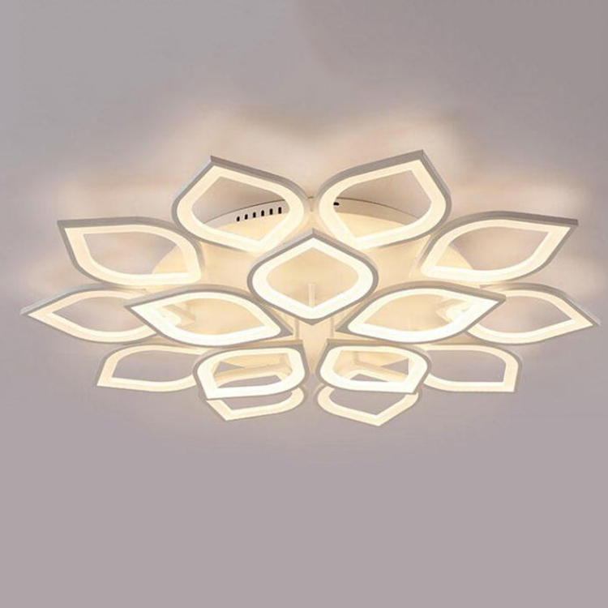
NC07
Modern Ceiling Light
Material:Iron base+ PMMA Cover
Input Voltage:AC85-265V
Led Chip:2835SMD
IP Rating:IP44 CRI>80 PF>0.9
Color Temperature:3000K/4500K/6000K
Operating Temperature:-25℃ ~50℃
Life Span:50000hours
Certificate:CE ROHS
Item Number | Wattage | LedQuantity | LuminousFlux | Beam Angle | Size (mm) | WIFI Control Remte Control Switch Control Dimmer Control
NC07 | 24W | 48pcs2835SMD | 1920-2160lm | 120° | 580*580*80 | Yes
 | 60W | 120pcs2835SMD | 4800-5400lm | 120° | 850*850*110
 | 84W | 168pcs2835SMD | 6720-7560lm | 120° | 1000*1000*110
 | 108W | 216pcs2835SMD | 8640-972lm | 120° | 1200*1200*110
Modern Ceiling Light Material:Iron base+ PMMA Cover Input Voltage:AC85-265V Led Chip:2835SMD IP Rating:IP44 CRI>80 PF>0.9 Color Temperature:3000K/4500K/6000K Operating Temperature:-25℃ ~50℃ Life Span:50000hours Certificate:CE ROHS
Item Number | Wattage | LedQuantity | LuminousFlux | Beam Angle | Size (mm) | WIFI Control Remte control Switch control Dimmer control
CL-N00 | 24W | 48pcs2835SMD | 1920-2160lm | 120° | 350mm | Yes
 | 36W | 72pcs2835SMD | 2880-3240lm | 120° | 400mm
 | 40W | 80pcs2835SMD | 3200-3600lm | 120° | 450mm
Modern Ceiling Light Material:Iron base+ PMMA Cover Input Voltage:AC85-265V Led Chip:2835SMD IP Rating:IP44 CRI>80 PF>0.9 Color Temperature:3000K/4500K/6000K Operating Temperature:-25℃ ~50℃ Life Span:50000hours Certificate:CE ROHS
Item Number | Wattage | LedQuantity | LuminousFlux | Beam Angle | Size (mm) | WIFI Control Remte control Switch control Dimmer control
CL-N00 | 24W | 48pcs2835SMD | 1920-2160lm | 120° | 350mm | Yes
 | 36W | 72pcs2835SMD | 2880-3240lm | 120° | 400mm
 | 40W | 80pcs2835SMD | 3200-3600lm | 120° | 450mm
Modern Ceiling Light Material:Iron base+ PMMA Cover Input Voltage:AC85-265V Led Chip:2835SMD IP Rating:IP44 CRI>80 PF>0.9 Color Temperature:3000K/4500K/6000K Operating Temperature:-25℃ ~50℃ Life Span:50000hours Certificate:CE ROHS
Item Number | Wattage | LedQuantity | LuminousFlux | Beam Angle | Size (mm) | WIFI Control Remte control Switch control Dimmer control
CL-N00 | 24W | 48pcs2835SMD | 1920-2160lm | 120° | 350mm | Yes
 | 36W | 72pcs2835SMD | 2880-3240lm | 120° | 400mm
 | 40W | 80pcs2835SMD | 3200-3600lm | 120° | 450mm
Modern Ceiling Light Material:Iron base+ PMMA Cover Input Voltage:AC85-265V Led Chip:2835SMD IP Rating:IP44 CRI>80 PF>0.9 Color Temperature:3000K/4500K/6000K Operating Temperature:-25℃ ~50℃ Life Span:50000hours Certificate:CE ROHS
Item Number | Wattage | LedQuantity | LuminousFlux | Beam Angle | Size (mm) | WIFI Control Remte control Switch control Dimmer control
CL-N00 | 24W | 48pcs2835SMD | 1920-2160lm | 120° | 350mm | Yes
 | 36W | 72pcs2835SMD | 2880-3240lm | 120° | 400mm
 | 40W | 80pcs2835SMD | 3200-3600lm | 120° | 450mm

Slide 22
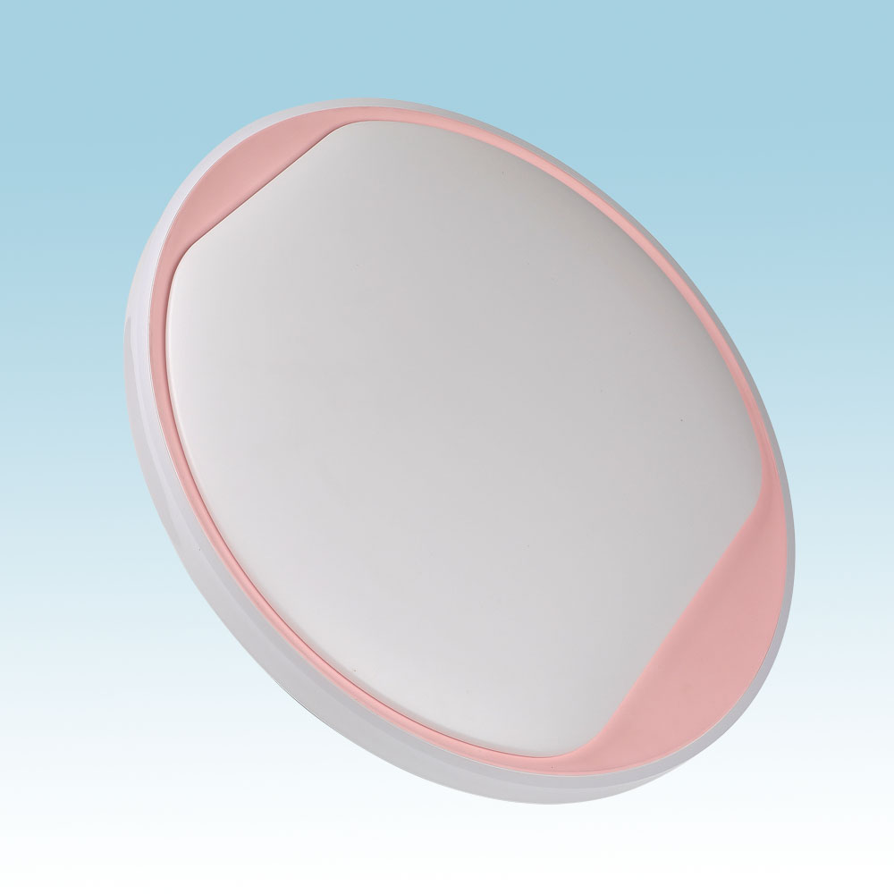
CL10
Modern Ceiling Light
Material:Iron base+ PMMA Cover
Input Voltage:AC85-265V
Led Chip:2835SMD
IP Rating:IP44 CRI>80 PF>0.9
Color Temperature:3000K/4500K/6000K
Operating Temperature:-25℃ ~50℃
Life Span:50000hours
Certificate:CE ROHS
Item Number | Wattage | LedQuantity | LuminousFlux | Beam Angle | Size (mm) | WIFI Control Remte control Switch control Dimmer control
CL10 | 12W | 24pcs2835SMD | 960-1080lm | 120° | Φ260 | Yes
 | 15W | 30pcs2835SMD | 1200-1350lm | 120° | Φ280
 | 18W | 36pcs2835SMD | 1440-1620lm | 120° | Φ300
 | 21W | 42pcs2835SMD | 1680-1890lm | 120° | Φ300
 | 24W | 48pcs2835SMD | 1920-2160lm | 120° | Φ350
 | 27W | 54pcs2835SMD | 2160-2430lm | 120° | Φ350
 | 32W | 64pcs2835SMD | 2560-2880lm | 120° | Φ380
 | 40W | 80pcs2835SMD | 3200-3600lm | 120° | Φ400
 | 48W | 96pcs2835SMD | 3840-4320lm | 120° | Φ400
Modern Ceiling Light Material:Iron base+ PMMA Cover Input Voltage:AC85-265V Led Chip:2835SMD IP Rating:IP44 CRI>80 PF>0.9 Color Temperature:3000K/4500K/6000K Operating Temperature:-25℃ ~50℃ Life Span:50000hours Certificate:CE ROHS
Item Number | Wattage | LedQuantity | LuminousFlux | Beam Angle | Size (mm) | WIFI Control Remte control Switch control Dimmer control
CL-N00 | 24W | 48pcs2835SMD | 1920-2160lm | 120° | 350mm | Yes
 | 36W | 72pcs2835SMD | 2880-3240lm | 120° | 400mm
 | 40W | 80pcs2835SMD | 3200-3600lm | 120° | 450mm
Modern Ceiling Light Material:Iron base+ PMMA Cover Input Voltage:AC85-265V Led Chip:2835SMD IP Rating:IP44 CRI>80 PF>0.9 Color Temperature:3000K/4500K/6000K Operating Temperature:-25℃ ~50℃ Life Span:50000hours Certificate:CE ROHS
Item Number | Wattage | LedQuantity | LuminousFlux | Beam Angle | Size (mm) | WIFI Control Remte control Switch control Dimmer control
CL-N00 | 24W | 48pcs2835SMD | 1920-2160lm | 120° | 350mm | Yes
 | 36W | 72pcs2835SMD | 2880-3240lm | 120° | 400mm
 | 40W | 80pcs2835SMD | 3200-3600lm | 120° | 450mm
Modern Ceiling Light Material:Iron base+ PMMA Cover Input Voltage:AC85-265V Led Chip:2835SMD IP Rating:IP44 CRI>80 PF>0.9 Color Temperature:3000K/4500K/6000K Operating Temperature:-25℃ ~50℃ Life Span:50000hours Certificate:CE ROHS
Item Number | Wattage | LedQuantity | LuminousFlux | Beam Angle | Size (mm) | WIFI Control Remte control Switch control Dimmer control
CL-N00 | 24W | 48pcs2835SMD | 1920-2160lm | 120° | 350mm | Yes
 | 36W | 72pcs2835SMD | 2880-3240lm | 120° | 400mm
 | 40W | 80pcs2835SMD | 3200-3600lm | 120° | 450mm
Modern Ceiling Light Material:Iron base+ PMMA Cover Input Voltage:AC85-265V Led Chip:2835SMD IP Rating:IP44 CRI>80 PF>0.9 Color Temperature:3000K/4500K/6000K Operating Temperature:-25℃ ~50℃ Life Span:50000hours Certificate:CE ROHS
Item Number | Wattage | LedQuantity | LuminousFlux | Beam Angle | Size (mm) | WIFI Control Remte control Switch control Dimmer control
CL-N00 | 24W | 48pcs2835SMD | 1920-2160lm | 120° | 350mm | Yes
 | 36W | 72pcs2835SMD | 2880-3240lm | 120° | 400mm
 | 40W | 80pcs2835SMD | 3200-3600lm | 120° | 450mm

Slide 23
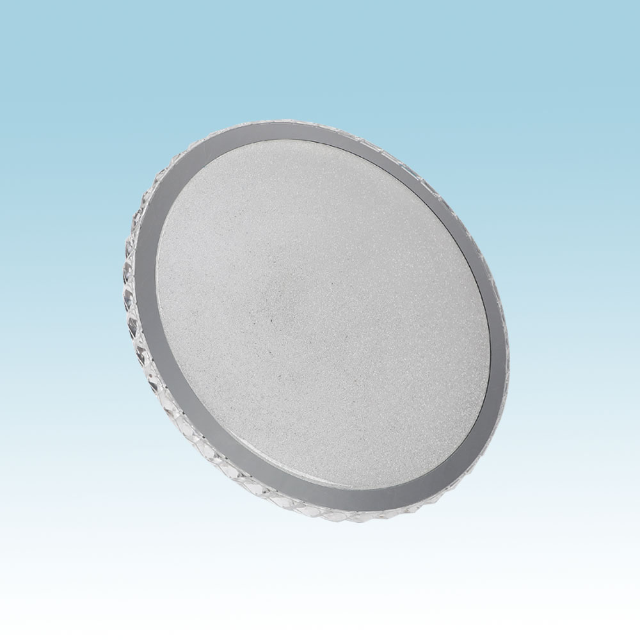
CL12
Modern Ceiling Light
Material:Iron base+ PMMA Cover
Input Voltage:AC85-265V
Led Chip:2835SMD
IP Rating:IP44 CRI>80 PF>0.9
Color Temperature:3000K/4500K/6000K
Operating Temperature:-25℃ ~50℃
Life Span:50000hours
Certificate:CE ROHS
Item Number | Wattage | LedQuantity | LuminousFlux | Beam Angle | Size (mm) | WIFI Control Remte control Switch control Dimmer control
CL12 | 12W | 24pcs2835SMD | 960-1080lm | 120° | Φ260 | Yes
 | 15W | 30pcs2835SMD | 1200-1350lm | 120° | Φ280
 | 18W | 36pcs2835SMD | 1440-1620lm | 120° | Φ300
 | 21W | 42pcs2835SMD | 1680-1890lm | 120° | Φ300
 | 24W | 48pcs2835SMD | 1920-2160lm | 120° | Φ350
 | 27W | 54pcs2835SMD | 2160-2430lm | 120° | Φ350
 | 32W | 64pcs2835SMD | 2560-2880lm | 120° | Φ380
 | 40W | 80pcs2835SMD | 3200-3600lm | 120° | Φ400
 | 48W | 96pcs2835SMD | 3840-4320lm | 120° | Φ400
Modern Ceiling Light Material:Iron base+ PMMA Cover Input Voltage:AC85-265V Led Chip:2835SMD IP Rating:IP44 CRI>80 PF>0.9 Color Temperature:3000K/4500K/6000K Operating Temperature:-25℃ ~50℃ Life Span:50000hours Certificate:CE ROHS
Item Number | Wattage | LedQuantity | LuminousFlux | Beam Angle | Size (mm) | WIFI Control Remte control Switch control Dimmer control
CL-N00 | 24W | 48pcs2835SMD | 1920-2160lm | 120° | 350mm | Yes
 | 36W | 72pcs2835SMD | 2880-3240lm | 120° | 400mm
 | 40W | 80pcs2835SMD | 3200-3600lm | 120° | 450mm
Modern Ceiling Light Material:Iron base+ PMMA Cover Input Voltage:AC85-265V Led Chip:2835SMD IP Rating:IP44 CRI>80 PF>0.9 Color Temperature:3000K/4500K/6000K Operating Temperature:-25℃ ~50℃ Life Span:50000hours Certificate:CE ROHS
Item Number | Wattage | LedQuantity | LuminousFlux | Beam Angle | Size (mm) | WIFI Control Remte control Switch control Dimmer control
CL-N00 | 24W | 48pcs2835SMD | 1920-2160lm | 120° | 350mm | Yes
 | 36W | 72pcs2835SMD | 2880-3240lm | 120° | 400mm
 | 40W | 80pcs2835SMD | 3200-3600lm | 120° | 450mm
Modern Ceiling Light Material:Iron base+ PMMA Cover Input Voltage:AC85-265V Led Chip:2835SMD IP Rating:IP44 CRI>80 PF>0.9 Color Temperature:3000K/4500K/6000K Operating Temperature:-25℃ ~50℃ Life Span:50000hours Certificate:CE ROHS
Item Number | Wattage | LedQuantity | LuminousFlux | Beam Angle | Size (mm) | WIFI Control Remte control Switch control Dimmer control
CL-N00 | 24W | 48pcs2835SMD | 1920-2160lm | 120° | 350mm | Yes
 | 36W | 72pcs2835SMD | 2880-3240lm | 120° | 400mm
 | 40W | 80pcs2835SMD | 3200-3600lm | 120° | 450mm
Modern Ceiling Light Material:Iron base+ PMMA Cover Input Voltage:AC85-265V Led Chip:2835SMD IP Rating:IP44 CRI>80 PF>0.9 Color Temperature:3000K/4500K/6000K Operating Temperature:-25℃ ~50℃ Life Span:50000hours Certificate:CE ROHS
Item Number | Wattage | LedQuantity | LuminousFlux | Beam Angle | Size (mm) | WIFI Control Remte control Switch control Dimmer control
CL-N00 | 24W | 48pcs2835SMD | 1920-2160lm | 120° | 350mm | Yes
 | 36W | 72pcs2835SMD | 2880-3240lm | 120° | 400mm
 | 40W | 80pcs2835SMD | 3200-3600lm | 120° | 450mm

Slide 24
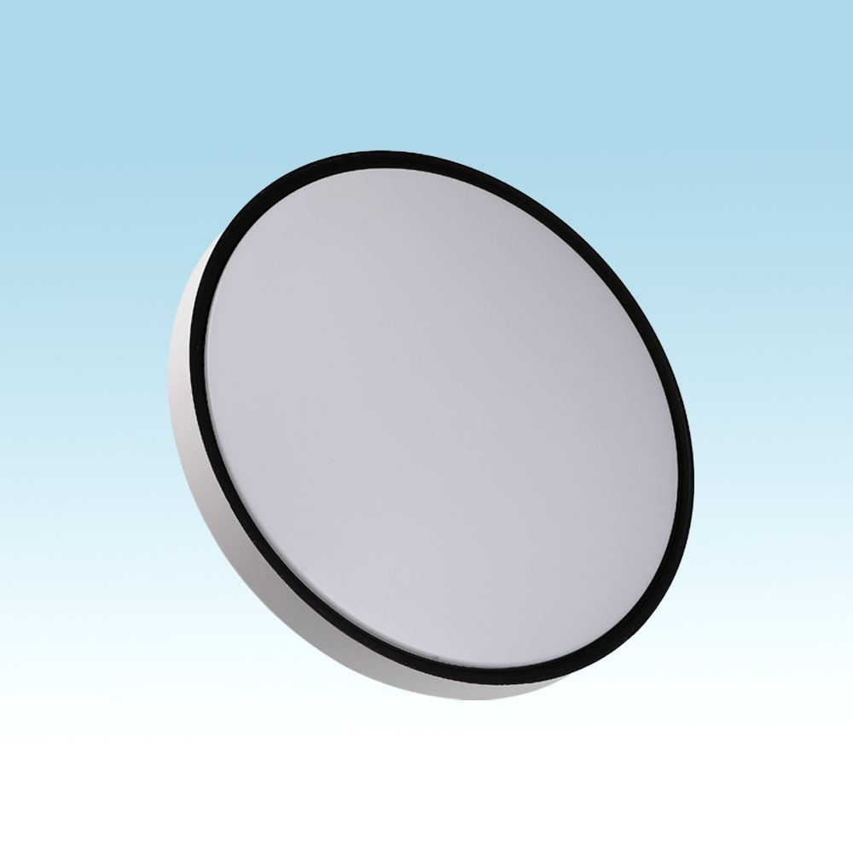
CL16
Modern Ceiling Light
Material:Iron base+ PMMA Cover
Input Voltage:AC85-265V
Led Chip:2835SMD
IP Rating:IP44 CRI>80 PF>0.9
Color Temperature:3000K/4500K/6000K
Operating Temperature:-25℃ ~50℃
Life Span:50000hours
Certificate:CE ROHS
Item Number | Wattage | LedQuantity | LuminousFlux | Beam Angle | Size (mm) | WIFI Control Remte control Switch control Dimmer control
CL16 | 12W | 24pcs2835SMD | 960-1080lm | 120° | Φ260 | Yes
 | 15W | 30pcs2835SMD | 1200-1350lm | 120° | Φ280
 | 18W | 36pcs2835SMD | 1440-1620lm | 120° | Φ300
 | 21W | 42pcs2835SMD | 1680-1890lm | 120° | Φ300
 | 24W | 48pcs2835SMD | 1920-2160lm | 120° | Φ350
 | 27W | 54pcs2835SMD | 2160-2430lm | 120° | Φ350
 | 32W | 64pcs2835SMD | 2560-2880lm | 120° | Φ380
 | 40W | 80pcs2835SMD | 3200-3600lm | 120° | Φ400
 | 48W | 96pcs2835SMD | 3840-4320lm | 120° | Φ400
Modern Ceiling Light Material:Iron base+ PMMA Cover Input Voltage:AC85-265V Led Chip:2835SMD IP Rating:IP44 CRI>80 PF>0.9 Color Temperature:3000K/4500K/6000K Operating Temperature:-25℃ ~50℃ Life Span:50000hours Certificate:CE ROHS
Item Number | Wattage | LedQuantity | LuminousFlux | Beam Angle | Size (mm) | WIFI Control Remte control Switch control Dimmer control
CL-N00 | 24W | 48pcs2835SMD | 1920-2160lm | 120° | 350mm | Yes
 | 36W | 72pcs2835SMD | 2880-3240lm | 120° | 400mm
 | 40W | 80pcs2835SMD | 3200-3600lm | 120° | 450mm
Modern Ceiling Light Material:Iron base+ PMMA Cover Input Voltage:AC85-265V Led Chip:2835SMD IP Rating:IP44 CRI>80 PF>0.9 Color Temperature:3000K/4500K/6000K Operating Temperature:-25℃ ~50℃ Life Span:50000hours Certificate:CE ROHS
Item Number | Wattage | LedQuantity | LuminousFlux | Beam Angle | Size (mm) | WIFI Control Remte control Switch control Dimmer control
CL-N00 | 24W | 48pcs2835SMD | 1920-2160lm | 120° | 350mm | Yes
 | 36W | 72pcs2835SMD | 2880-3240lm | 120° | 400mm
 | 40W | 80pcs2835SMD | 3200-3600lm | 120° | 450mm
Modern Ceiling Light Material:Iron base+ PMMA Cover Input Voltage:AC85-265V Led Chip:2835SMD IP Rating:IP44 CRI>80 PF>0.9 Color Temperature:3000K/4500K/6000K Operating Temperature:-25℃ ~50℃ Life Span:50000hours Certificate:CE ROHS
Item Number | Wattage | LedQuantity | LuminousFlux | Beam Angle | Size (mm) | WIFI Control Remte control Switch control Dimmer control
CL-N00 | 24W | 48pcs2835SMD | 1920-2160lm | 120° | 350mm | Yes
 | 36W | 72pcs2835SMD | 2880-3240lm | 120° | 400mm
 | 40W | 80pcs2835SMD | 3200-3600lm | 120° | 450mm
Modern Ceiling Light Material:Iron base+ PMMA Cover Input Voltage:AC85-265V Led Chip:2835SMD IP Rating:IP44 CRI>80 PF>0.9 Color Temperature:3000K/4500K/6000K Operating Temperature:-25℃ ~50℃ Life Span:50000hours Certificate:CE ROHS
Item Number | Wattage | LedQuantity | LuminousFlux | Beam Angle | Size (mm) | WIFI Control Remte control Switch control Dimmer control
CL-N00 | 24W | 48pcs2835SMD | 1920-2160lm | 120° | 350mm | Yes
 | 36W | 72pcs2835SMD | 2880-3240lm | 120° | 400mm
 | 40W | 80pcs2835SMD | 3200-3600lm | 120° | 450mm

Slide 25
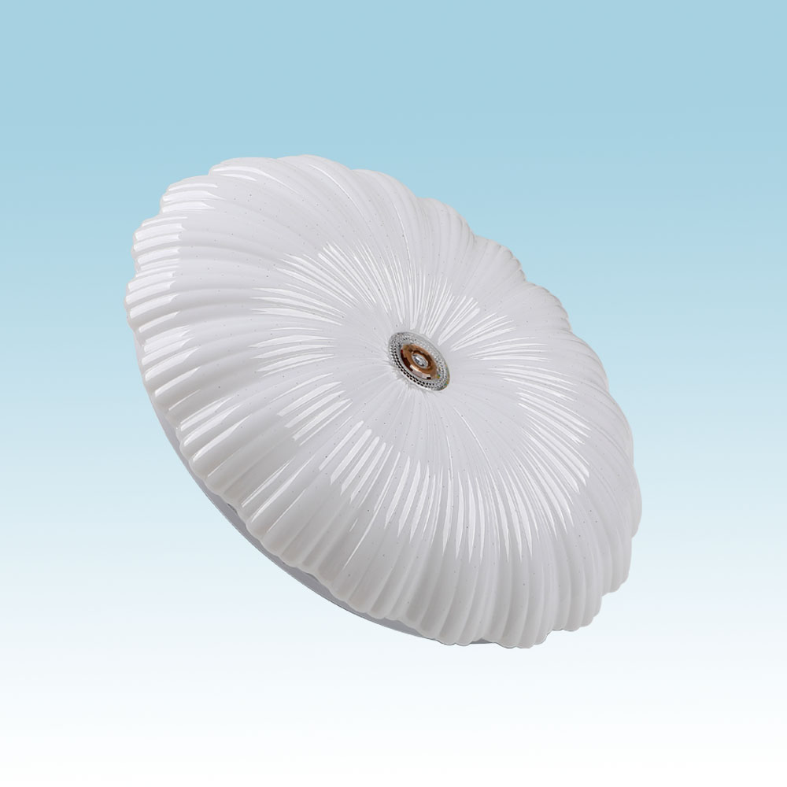
CL17
Modern Ceiling Light
Material:Iron base+ PMMA Cover
Input Voltage:AC85-265V
Led Chip:2835SMD
IP Rating:IP44 CRI>80 PF>0.9
Color Temperature:3000K/4500K/6000K
Operating Temperature:-25℃ ~50℃
Life Span:50000hours
Certificate:CE ROHS
Item Number | Wattage | LedQuantity | LuminousFlux | Beam Angle | Size (mm) | WIFI Control Remte control Switch control Dimmer control
CL17 | 12W | 24pcs2835SMD | 960-1080lm | 120° | Φ260 | Yes
 | 15W | 30pcs2835SMD | 1200-1350lm | 120° | Φ280
 | 18W | 36pcs2835SMD | 1440-1620lm | 120° | Φ300
 | 21W | 42pcs2835SMD | 1680-1890lm | 120° | Φ300
 | 24W | 48pcs2835SMD | 1920-2160lm | 120° | Φ350
 | 27W | 54pcs2835SMD | 2160-2430lm | 120° | Φ350
 | 32W | 64pcs2835SMD | 2560-2880lm | 120° | Φ380
 | 40W | 80pcs2835SMD | 3200-3600lm | 120° | Φ400
 | 48W | 96pcs2835SMD | 3840-4320lm | 120° | Φ400
Modern Ceiling Light Material:Iron base+ PMMA Cover Input Voltage:AC85-265V Led Chip:2835SMD IP Rating:IP44 CRI>80 PF>0.9 Color Temperature:3000K/4500K/6000K Operating Temperature:-25℃ ~50℃ Life Span:50000hours Certificate:CE ROHS
Item Number | Wattage | LedQuantity | LuminousFlux | Beam Angle | Size (mm) | WIFI Control Remte control Switch control Dimmer control
CL-N00 | 24W | 48pcs2835SMD | 1920-2160lm | 120° | 350mm | Yes
 | 36W | 72pcs2835SMD | 2880-3240lm | 120° | 400mm
 | 40W | 80pcs2835SMD | 3200-3600lm | 120° | 450mm
Modern Ceiling Light Material:Iron base+ PMMA Cover Input Voltage:AC85-265V Led Chip:2835SMD IP Rating:IP44 CRI>80 PF>0.9 Color Temperature:3000K/4500K/6000K Operating Temperature:-25℃ ~50℃ Life Span:50000hours Certificate:CE ROHS
Item Number | Wattage | LedQuantity | LuminousFlux | Beam Angle | Size (mm) | WIFI Control Remte control Switch control Dimmer control
CL-N00 | 24W | 48pcs2835SMD | 1920-2160lm | 120° | 350mm | Yes
 | 36W | 72pcs2835SMD | 2880-3240lm | 120° | 400mm
 | 40W | 80pcs2835SMD | 3200-3600lm | 120° | 450mm
Modern Ceiling Light Material:Iron base+ PMMA Cover Input Voltage:AC85-265V Led Chip:2835SMD IP Rating:IP44 CRI>80 PF>0.9 Color Temperature:3000K/4500K/6000K Operating Temperature:-25℃ ~50℃ Life Span:50000hours Certificate:CE ROHS
Item Number | Wattage | LedQuantity | LuminousFlux | Beam Angle | Size (mm) | WIFI Control Remte control Switch control Dimmer control
CL-N00 | 24W | 48pcs2835SMD | 1920-2160lm | 120° | 350mm | Yes
 | 36W | 72pcs2835SMD | 2880-3240lm | 120° | 400mm
 | 40W | 80pcs2835SMD | 3200-3600lm | 120° | 450mm
Modern Ceiling Light Material:Iron base+ PMMA Cover Input Voltage:AC85-265V Led Chip:2835SMD IP Rating:IP44 CRI>80 PF>0.9 Color Temperature:3000K/4500K/6000K Operating Temperature:-25℃ ~50℃ Life Span:50000hours Certificate:CE ROHS
Item Number | Wattage | LedQuantity | LuminousFlux | Beam Angle | Size (mm) | WIFI Control Remte control Switch control Dimmer control
CL-N00 | 24W | 48pcs2835SMD | 1920-2160lm | 120° | 350mm | Yes
 | 36W | 72pcs2835SMD | 2880-3240lm | 120° | 400mm
 | 40W | 80pcs2835SMD | 3200-3600lm | 120° | 450mm

Slide 26
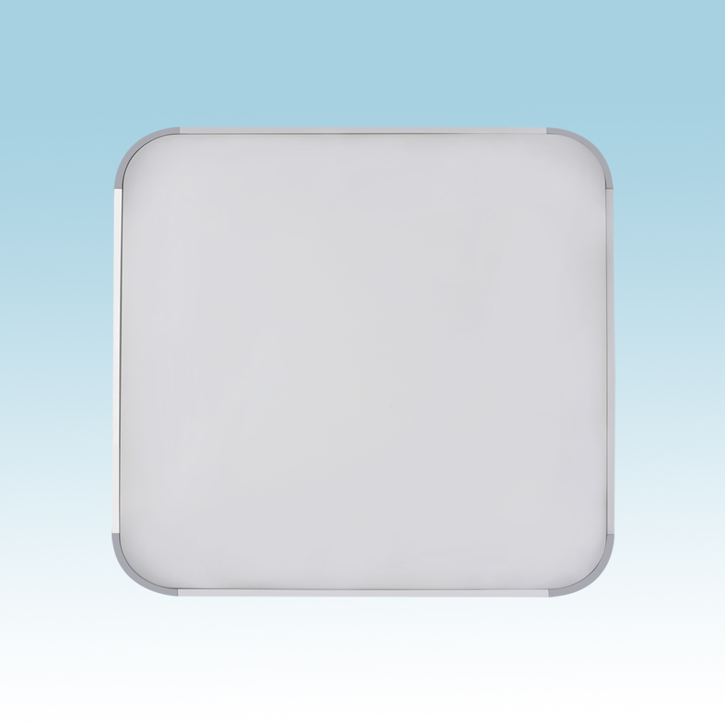
CL18
Modern Ceiling Light
Material:Iron base+ PMMA Cover
Input Voltage:AC85-265V
Led Chip:2835SMD
IP Rating:IP44 CRI>80 PF>0.9
Color Temperature:3000K/4500K/6000K
Operating Temperature:-25℃ ~50℃
Life Span:50000hours
Certificate:CE ROHS
Item Number | Wattage | LedQuantity | LuminousFlux | Beam Angle | Size (mm) | WIFI Control Remte control Switch control Dimmer control
CL18 | 24W | 48pcs2835SMD | 1920-2160lm | 120° | 300*300 | Yes
 | 48W | 96pcs2835SMD | 3840-4320lm | 120° | 450*450
 | 60W | 120pcs2835SMD | 4800-5400lm | 120° | 450*450
 | 96W | 192pcs2835SMD | 7680-8640lm | 120° | 650*650
 | 128W | 256pcs2835SMD | 10240-11520lm | 120° | 800*650
Modern Ceiling Light Material:Iron base+ PMMA Cover Input Voltage:AC85-265V Led Chip:2835SMD IP Rating:IP44 CRI>80 PF>0.9 Color Temperature:3000K/4500K/6000K Operating Temperature:-25℃ ~50℃ Life Span:50000hours Certificate:CE ROHS
Item Number | Wattage | LedQuantity | LuminousFlux | Beam Angle | Size (mm) | WIFI Control Remte control Switch control Dimmer control
CL-N00 | 24W | 48pcs2835SMD | 1920-2160lm | 120° | 350mm | Yes
 | 36W | 72pcs2835SMD | 2880-3240lm | 120° | 400mm
 | 40W | 80pcs2835SMD | 3200-3600lm | 120° | 450mm
Modern Ceiling Light Material:Iron base+ PMMA Cover Input Voltage:AC85-265V Led Chip:2835SMD IP Rating:IP44 CRI>80 PF>0.9 Color Temperature:3000K/4500K/6000K Operating Temperature:-25℃ ~50℃ Life Span:50000hours Certificate:CE ROHS
Item Number | Wattage | LedQuantity | LuminousFlux | Beam Angle | Size (mm) | WIFI Control Remte control Switch control Dimmer control
CL-N00 | 24W | 48pcs2835SMD | 1920-2160lm | 120° | 350mm | Yes
 | 36W | 72pcs2835SMD | 2880-3240lm | 120° | 400mm
 | 40W | 80pcs2835SMD | 3200-3600lm | 120° | 450mm
Modern Ceiling Light Material:Iron base+ PMMA Cover Input Voltage:AC85-265V Led Chip:2835SMD IP Rating:IP44 CRI>80 PF>0.9 Color Temperature:3000K/4500K/6000K Operating Temperature:-25℃ ~50℃ Life Span:50000hours Certificate:CE ROHS
Item Number | Wattage | LedQuantity | LuminousFlux | Beam Angle | Size (mm) | WIFI Control Remte control Switch control Dimmer control
CL-N00 | 24W | 48pcs2835SMD | 1920-2160lm | 120° | 350mm | Yes
 | 36W | 72pcs2835SMD | 2880-3240lm | 120° | 400mm
 | 40W | 80pcs2835SMD | 3200-3600lm | 120° | 450mm
Modern Ceiling Light Material:Iron base+ PMMA Cover Input Voltage:AC85-265V Led Chip:2835SMD IP Rating:IP44 CRI>80 PF>0.9 Color Temperature:3000K/4500K/6000K Operating Temperature:-25℃ ~50℃ Life Span:50000hours Certificate:CE ROHS
Item Number | Wattage | LedQuantity | LuminousFlux | Beam Angle | Size (mm) | WIFI Control Remte control Switch control Dimmer control
CL-N00 | 24W | 48pcs2835SMD | 1920-2160lm | 120° | 350mm | Yes
 | 36W | 72pcs2835SMD | 2880-3240lm | 120° | 400mm
 | 40W | 80pcs2835SMD | 3200-3600lm | 120° | 450mm

Slide 27
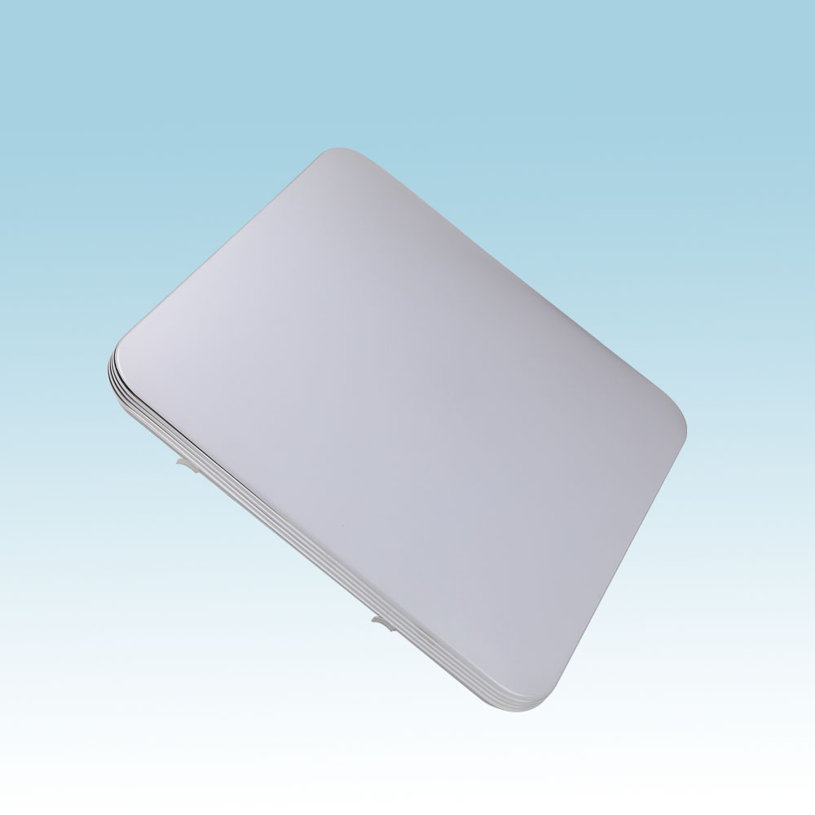
CL22
Modern Ceiling Light
Material:Iron base+ PMMA Cover
Input Voltage:AC85-265V
Led Chip:2835SMD
IP Rating:IP44 CRI>80 PF>0.9
Color Temperature:3000K/4500K/6000K
Operating Temperature:-25℃ ~50℃
Life Span:50000hours
Certificate:CE ROHS
Item Number | Wattage | LedQuantity | LuminousFlux | Beam Angle | Size (mm) | WIFI Control Remte control Switch control Dimmer control
CL22 | 24W | 48pcs2835SMD | 1920-2160lm | 120° | 300*300 | Yes
 | 48W | 96pcs2835SMD | 3840-4320lm | 120° | 450*450
 | 60W | 120pcs2835SMD | 4800-5400lm | 120° | 450*450
 | 96W | 192pcs2835SMD | 7680-8640lm | 120° | 650*650
Modern Ceiling Light Material:Iron base+ PMMA Cover Input Voltage:AC85-265V Led Chip:2835SMD IP Rating:IP44 CRI>80 PF>0.9 Color Temperature:3000K/4500K/6000K Operating Temperature:-25℃ ~50℃ Life Span:50000hours Certificate:CE ROHS
Item Number | Wattage | LedQuantity | LuminousFlux | Beam Angle | Size (mm) | WIFI Control Remte control Switch control Dimmer control
CL-N00 | 24W | 48pcs2835SMD | 1920-2160lm | 120° | 350mm | Yes
 | 36W | 72pcs2835SMD | 2880-3240lm | 120° | 400mm
 | 40W | 80pcs2835SMD | 3200-3600lm | 120° | 450mm
Modern Ceiling Light Material:Iron base+ PMMA Cover Input Voltage:AC85-265V Led Chip:2835SMD IP Rating:IP44 CRI>80 PF>0.9 Color Temperature:3000K/4500K/6000K Operating Temperature:-25℃ ~50℃ Life Span:50000hours Certificate:CE ROHS
Item Number | Wattage | LedQuantity | LuminousFlux | Beam Angle | Size (mm) | WIFI Control Remte control Switch control Dimmer control
CL-N00 | 24W | 48pcs2835SMD | 1920-2160lm | 120° | 350mm | Yes
 | 36W | 72pcs2835SMD | 2880-3240lm | 120° | 400mm
 | 40W | 80pcs2835SMD | 3200-3600lm | 120° | 450mm
Modern Ceiling Light Material:Iron base+ PMMA Cover Input Voltage:AC85-265V Led Chip:2835SMD IP Rating:IP44 CRI>80 PF>0.9 Color Temperature:3000K/4500K/6000K Operating Temperature:-25℃ ~50℃ Life Span:50000hours Certificate:CE ROHS
Item Number | Wattage | LedQuantity | LuminousFlux | Beam Angle | Size (mm) | WIFI Control Remte control Switch control Dimmer control
CL-N00 | 24W | 48pcs2835SMD | 1920-2160lm | 120° | 350mm | Yes
 | 36W | 72pcs2835SMD | 2880-3240lm | 120° | 400mm
 | 40W | 80pcs2835SMD | 3200-3600lm | 120° | 450mm
Modern Ceiling Light Material:Iron base+ PMMA Cover Input Voltage:AC85-265V Led Chip:2835SMD IP Rating:IP44 CRI>80 PF>0.9 Color Temperature:3000K/4500K/6000K Operating Temperature:-25℃ ~50℃ Life Span:50000hours Certificate:CE ROHS
Item Number | Wattage | LedQuantity | LuminousFlux | Beam Angle | Size (mm) | WIFI Control Remte control Switch control Dimmer control
CL-N00 | 24W | 48pcs2835SMD | 1920-2160lm | 120° | 350mm | Yes
 | 36W | 72pcs2835SMD | 2880-3240lm | 120° | 400mm
 | 40W | 80pcs2835SMD | 3200-3600lm | 120° | 450mm

Slide 28
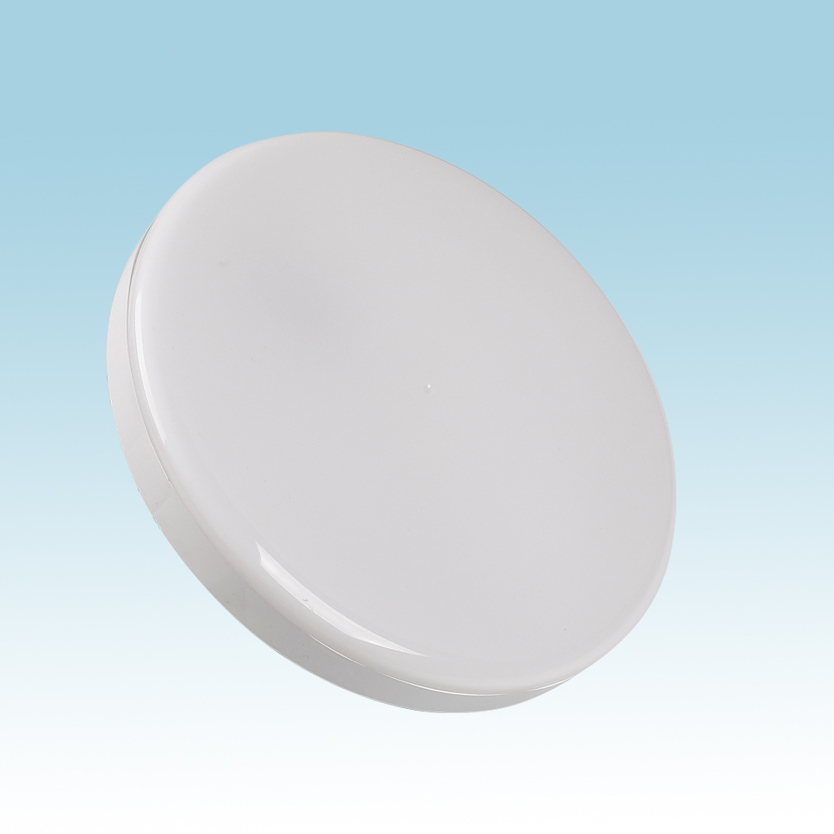
CL23
Modern Ceiling Light
Material:Iron base+ PMMA Cover
Input Voltage:AC85-265V
Led Chip:2835SMD
IP Rating:IP44 CRI>80 PF>0.9
Color Temperature:3000K/4500K/6000K
Operating Temperature:-25℃ ~50℃
Life Span:50000hours
Certificate:CE ROHS
Item Number | Wattage | LedQuantity | LuminousFlux | Beam Angle | Size (mm) | WIFI Control Remte control Switch control Dimmer control
CL23 | 12W | 24pcs2835SMD | 960-1080lm | 120° | Φ260 | Yes
 | 18W | 36pcs2835SMD | 1440-1620lm | 120° | Φ300
 | 24W | 48pcs2835SMD | 1920-2160lm | 120° | Φ350
Modern Ceiling Light Material:Iron base+ PMMA Cover Input Voltage:AC85-265V Led Chip:2835SMD IP Rating:IP44 CRI>80 PF>0.9 Color Temperature:3000K/4500K/6000K Operating Temperature:-25℃ ~50℃ Life Span:50000hours Certificate:CE ROHS
Item Number | Wattage | LedQuantity | LuminousFlux | Beam Angle | Size (mm) | WIFI Control Remte control Switch control Dimmer control
CL-N00 | 24W | 48pcs2835SMD | 1920-2160lm | 120° | 350mm | Yes
 | 36W | 72pcs2835SMD | 2880-3240lm | 120° | 400mm
 | 40W | 80pcs2835SMD | 3200-3600lm | 120° | 450mm
Modern Ceiling Light Material:Iron base+ PMMA Cover Input Voltage:AC85-265V Led Chip:2835SMD IP Rating:IP44 CRI>80 PF>0.9 Color Temperature:3000K/4500K/6000K Operating Temperature:-25℃ ~50℃ Life Span:50000hours Certificate:CE ROHS
Item Number | Wattage | LedQuantity | LuminousFlux | Beam Angle | Size (mm) | WIFI Control Remte control Switch control Dimmer control
CL-N00 | 24W | 48pcs2835SMD | 1920-2160lm | 120° | 350mm | Yes
 | 36W | 72pcs2835SMD | 2880-3240lm | 120° | 400mm
 | 40W | 80pcs2835SMD | 3200-3600lm | 120° | 450mm
Modern Ceiling Light Material:Iron base+ PMMA Cover Input Voltage:AC85-265V Led Chip:2835SMD IP Rating:IP44 CRI>80 PF>0.9 Color Temperature:3000K/4500K/6000K Operating Temperature:-25℃ ~50℃ Life Span:50000hours Certificate:CE ROHS
Item Number | Wattage | LedQuantity | LuminousFlux | Beam Angle | Size (mm) | WIFI Control Remte control Switch control Dimmer control
CL-N00 | 24W | 48pcs2835SMD | 1920-2160lm | 120° | 350mm | Yes
 | 36W | 72pcs2835SMD | 2880-3240lm | 120° | 400mm
 | 40W | 80pcs2835SMD | 3200-3600lm | 120° | 450mm
Modern Ceiling Light Material:Iron base+ PMMA Cover Input Voltage:AC85-265V Led Chip:2835SMD IP Rating:IP44 CRI>80 PF>0.9 Color Temperature:3000K/4500K/6000K Operating Temperature:-25℃ ~50℃ Life Span:50000hours Certificate:CE ROHS
Item Number | Wattage | LedQuantity | LuminousFlux | Beam Angle | Size (mm) | WIFI Control Remte control Switch control Dimmer control
CL-N00 | 24W | 48pcs2835SMD | 1920-2160lm | 120° | 350mm | Yes
 | 36W | 72pcs2835SMD | 2880-3240lm | 120° | 400mm
 | 40W | 80pcs2835SMD | 3200-3600lm | 120° | 450mm

Slide 29
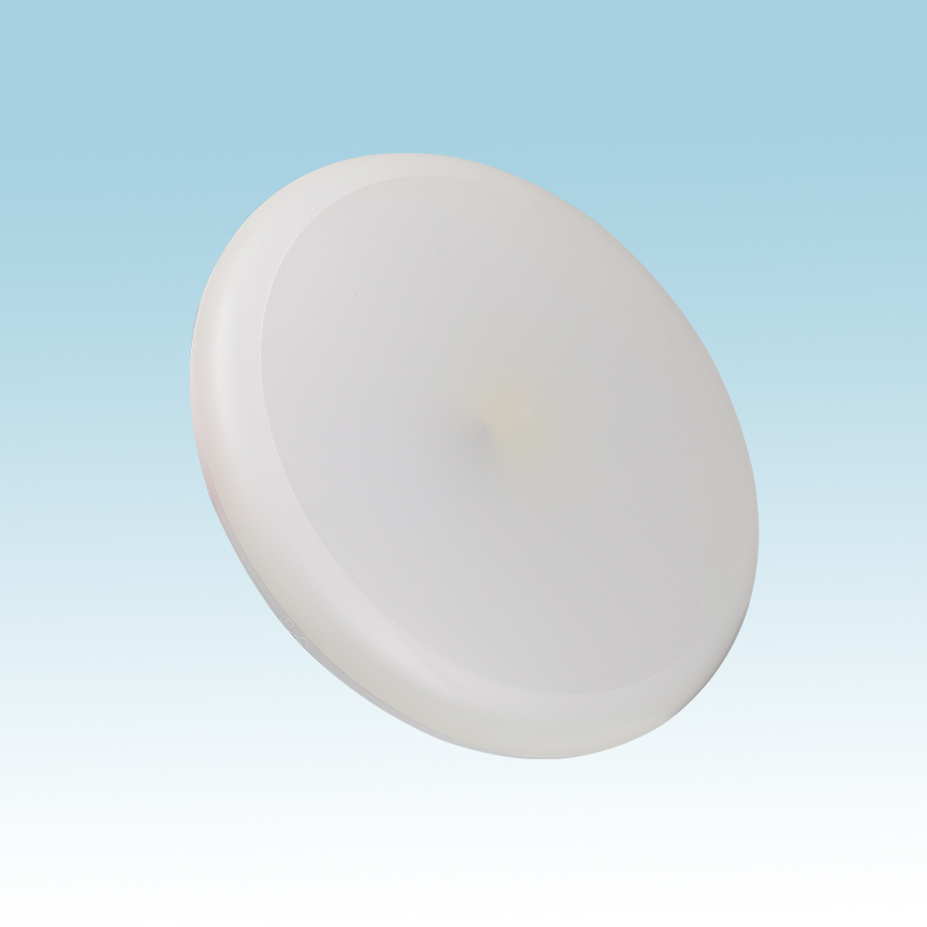
CL25
Modern Ceiling Light
Material:Iron base+ PMMA Cover
Input Voltage:AC85-265V
Led Chip:2835SMD
IP Rating:IP44 CRI>80 PF>0.9
Color Temperature:3000K/4500K/6000K
Operating Temperature:-25℃ ~50℃
Life Span:50000hours
Certificate:CE ROHS
Item Number | Wattage | LedQuantity | LuminousFlux | Beam Angle | Size (mm) | WIFI Control Remte control Switch control Dimmer control
CL25 | 12W | 24pcs2835SMD | 960-1080lm | 120° | Φ260 | Yes
 | 18W | 36pcs2835SMD | 1440-1620lm | 120° | Φ300
 | 24W | 48pcs2835SMD | 1920-2160lm | 120° | Φ350
Modern Ceiling Light Material:Iron base+ PMMA Cover Input Voltage:AC85-265V Led Chip:2835SMD IP Rating:IP44 CRI>80 PF>0.9 Color Temperature:3000K/4500K/6000K Operating Temperature:-25℃ ~50℃ Life Span:50000hours Certificate:CE ROHS
Item Number | Wattage | LedQuantity | LuminousFlux | Beam Angle | Size (mm) | WIFI Control Remte control Switch control Dimmer control
CL-N00 | 24W | 48pcs2835SMD | 1920-2160lm | 120° | 350mm | Yes
 | 36W | 72pcs2835SMD | 2880-3240lm | 120° | 400mm
 | 40W | 80pcs2835SMD | 3200-3600lm | 120° | 450mm
Modern Ceiling Light Material:Iron base+ PMMA Cover Input Voltage:AC85-265V Led Chip:2835SMD IP Rating:IP44 CRI>80 PF>0.9 Color Temperature:3000K/4500K/6000K Operating Temperature:-25℃ ~50℃ Life Span:50000hours Certificate:CE ROHS
Item Number | Wattage | LedQuantity | LuminousFlux | Beam Angle | Size (mm) | WIFI Control Remte control Switch control Dimmer control
CL-N00 | 24W | 48pcs2835SMD | 1920-2160lm | 120° | 350mm | Yes
 | 36W | 72pcs2835SMD | 2880-3240lm | 120° | 400mm
 | 40W | 80pcs2835SMD | 3200-3600lm | 120° | 450mm
Modern Ceiling Light Material:Iron base+ PMMA Cover Input Voltage:AC85-265V Led Chip:2835SMD IP Rating:IP44 CRI>80 PF>0.9 Color Temperature:3000K/4500K/6000K Operating Temperature:-25℃ ~50℃ Life Span:50000hours Certificate:CE ROHS
Item Number | Wattage | LedQuantity | LuminousFlux | Beam Angle | Size (mm) | WIFI Control Remte control Switch control Dimmer control
CL-N00 | 24W | 48pcs2835SMD | 1920-2160lm | 120° | 350mm | Yes
 | 36W | 72pcs2835SMD | 2880-3240lm | 120° | 400mm
 | 40W | 80pcs2835SMD | 3200-3600lm | 120° | 450mm
Modern Ceiling Light Material:Iron base+ PMMA Cover Input Voltage:AC85-265V Led Chip:2835SMD IP Rating:IP44 CRI>80 PF>0.9 Color Temperature:3000K/4500K/6000K Operating Temperature:-25℃ ~50℃ Life Span:50000hours Certificate:CE ROHS
Item Number | Wattage | LedQuantity | LuminousFlux | Beam Angle | Size (mm) | WIFI Control Remte control Switch control Dimmer control
CL-N00 | 24W | 48pcs2835SMD | 1920-2160lm | 120° | 350mm | Yes
 | 36W | 72pcs2835SMD | 2880-3240lm | 120° | 400mm
 | 40W | 80pcs2835SMD | 3200-3600lm | 120° | 450mm

Slide 30
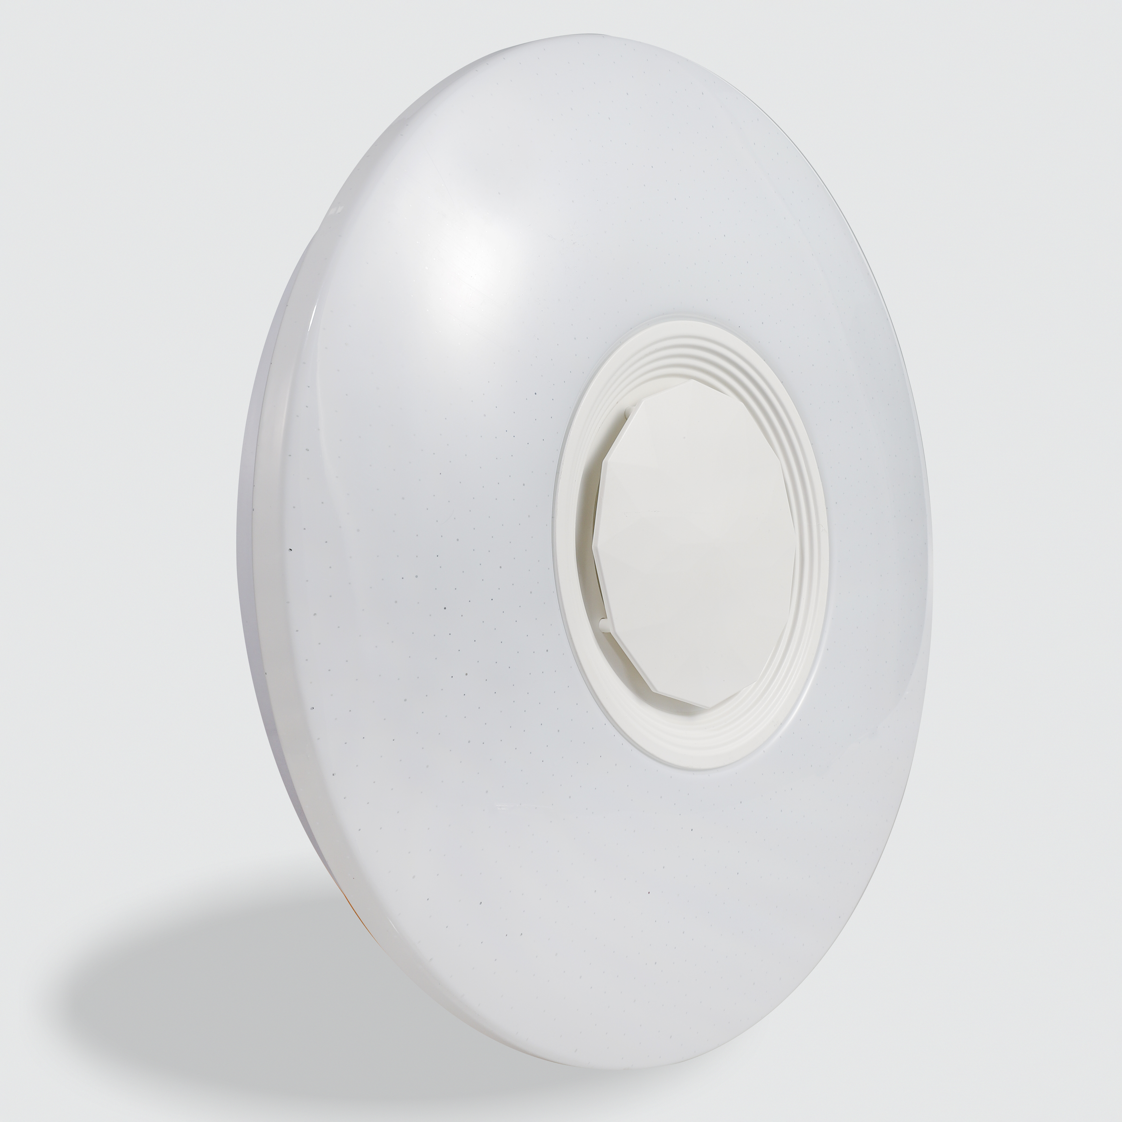
CL-N00
Modern Ceiling Light
Material:Iron base+ PMMA Cover
Input Voltage:AC85-265V
Led Chip:2835SMD
IP Rating:IP44 CRI>80 PF>0.9
Color Temperature:3000K/4500K/6000K
Operating Temperature:-25℃ ~50℃
Life Span:50000hours
Certificate:CE ROHS
Item Number | Wattage | LedQuantity | LuminousFlux | Beam Angle | Size (mm) | WIFI Control Remte control Switch control Dimmer control
CL-N00 | 12W | 24pcs2835SMD | 960-1080lm | 120° | Φ260 | Yes
 | 15W | 30pcs2835SMD | 1200-1350lm | 120° | Φ280
 | 18W | 36pcs2835SMD | 1440-1620lm | 120° | Φ300
 | 21W | 42pcs2835SMD | 1680-1890lm | 120° | Φ300
 | 24w | 48pcs2835SMD | 1920-2160lm | 120° | Φ350
 | 27W | 54pcs2835SMD | 2160-2430lm | 120° | Φ350
 | 32W | 64pcs2835SMD | 2560-2880lm | 120° | Φ380
 | 40W | 80pcs2835SMD | 3200-3600lm | 120° | Φ400
 | 48w | 96pcs2835SMD | 3840-4320lm | 120° | Φ400
Modern Ceiling Light Material:Iron base+ PMMA Cover Input Voltage:AC85-265V Led Chip:2835SMD IP Rating:IP44 CRI>80 PF>0.9 Color Temperature:3000K/4500K/6000K Operating Temperature:-25℃ ~50℃ Life Span:50000hours Certificate:CE ROHS
Item Number | Wattage | LedQuantity | LuminousFlux | Beam Angle | Size (mm) | WIFI Control Remte control Switch control Dimmer control
CL-N00 | 24W | 48pcs2835SMD | 1920-2160lm | 120° | 350mm | Yes
 | 36W | 72pcs2835SMD | 2880-3240lm | 120° | 400mm
 | 40W | 80pcs2835SMD | 3200-3600lm | 120° | 450mm
Modern Ceiling Light Material:Iron base+ PMMA Cover Input Voltage:AC85-265V Led Chip:2835SMD IP Rating:IP44 CRI>80 PF>0.9 Color Temperature:3000K/4500K/6000K Operating Temperature:-25℃ ~50℃ Life Span:50000hours Certificate:CE ROHS
Item Number | Wattage | LedQuantity | LuminousFlux | Beam Angle | Size (mm) | WIFI Control Remte control Switch control Dimmer control
CL-N00 | 24W | 48pcs2835SMD | 1920-2160lm | 120° | 350mm | Yes
 | 36W | 72pcs2835SMD | 2880-3240lm | 120° | 400mm
 | 40W | 80pcs2835SMD | 3200-3600lm | 120° | 450mm
Modern Ceiling Light Material:Iron base+ PMMA Cover Input Voltage:AC85-265V Led Chip:2835SMD IP Rating:IP44 CRI>80 PF>0.9 Color Temperature:3000K/4500K/6000K Operating Temperature:-25℃ ~50℃ Life Span:50000hours Certificate:CE ROHS
Item Number | Wattage | LedQuantity | LuminousFlux | Beam Angle | Size (mm) | WIFI Control Remte control Switch control Dimmer control
CL-N00 | 24W | 48pcs2835SMD | 1920-2160lm | 120° | 350mm | Yes
 | 36W | 72pcs2835SMD | 2880-3240lm | 120° | 400mm
 | 40W | 80pcs2835SMD | 3200-3600lm | 120° | 450mm
Modern Ceiling Light Material:Iron base+ PMMA Cover Input Voltage:AC85-265V Led Chip:2835SMD IP Rating:IP44 CRI>80 PF>0.9 Color Temperature:3000K/4500K/6000K Operating Temperature:-25℃ ~50℃ Life Span:50000hours Certificate:CE ROHS
Item Number | Wattage | LedQuantity | LuminousFlux | Beam Angle | Size (mm) | WIFI Control Remte control Switch control Dimmer control
CL-N00 | 24W | 48pcs2835SMD | 1920-2160lm | 120° | 350mm | Yes
 | 36W | 72pcs2835SMD | 2880-3240lm | 120° | 400mm
 | 40W | 80pcs2835SMD | 3200-3600lm | 120° | 450mm

Slide 31
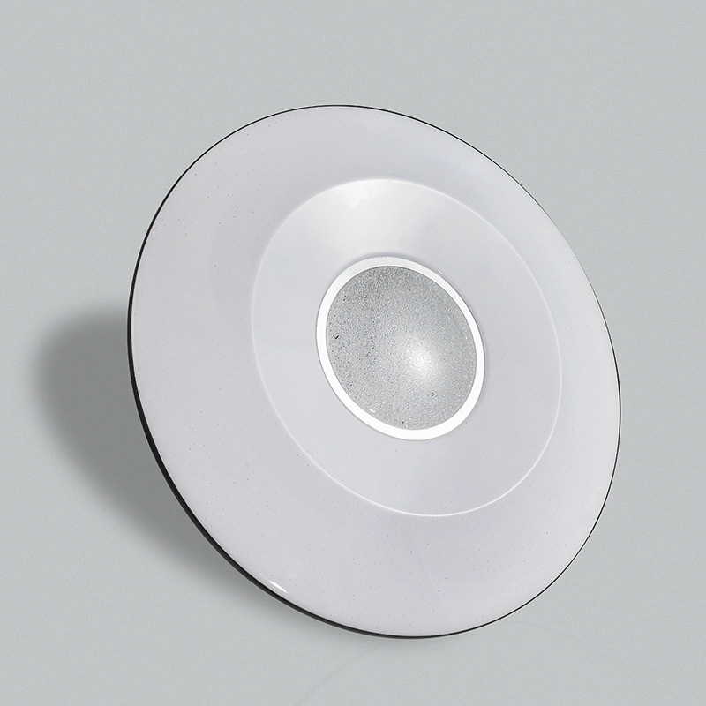
CL-N01
Modern Ceiling Light
Material:Iron base+ PMMA Cover
Input Voltage:AC85-265V
Led Chip:2835SMD
IP Rating:IP44 CRI>80 PF>0.9
Color Temperature:3000K/4500K/6000K
Operating Temperature:-25℃ ~50℃
Life Span:50000hours
Certificate:CE ROHS
Item Number | Wattage | LedQuantity | LuminousFlux | Beam Angle | Size (mm) | WIFI Control Remte control Switch control Dimmer control
CL-N01 | 12W | 24pcs2835SMD | 960-1080lm | 120° | Φ260 | Yes
 | 15W | 30pcs2835SMD | 1200-1350lm | 120° | Φ280
 | 18W | 36pcs2835SMD | 1440-1620lm | 120° | Φ300
 | 21W | 42pcs2835SMD | 1680-1890lm | 120° | Φ300
 | 24w | 48pcs2835SMD | 1920-2160lm | 120° | Φ350
 | 27W | 54pcs2835SMD | 2160-2430lm | 120° | Φ350
 | 32W | 64pcs2835SMD | 2560-2880lm | 120° | Φ380
 | 40W | 80pcs2835SMD | 3200-3600lm | 120° | Φ400
 | 48w | 96pcs2835SMD | 3840-4320lm | 120° | Φ400
Modern Ceiling Light Material:Iron base+ PMMA Cover Input Voltage:AC85-265V Led Chip:2835SMD IP Rating:IP44 CRI>80 PF>0.9 Color Temperature:3000K/4500K/6000K Operating Temperature:-25℃ ~50℃ Life Span:50000hours Certificate:CE ROHS
Item Number | Wattage | LedQuantity | LuminousFlux | Beam Angle | Size (mm) | WIFI Control Remte control Switch control Dimmer control
CL-N00 | 24W | 48pcs2835SMD | 1920-2160lm | 120° | 350mm | Yes
 | 36W | 72pcs2835SMD | 2880-3240lm | 120° | 400mm
 | 40W | 80pcs2835SMD | 3200-3600lm | 120° | 450mm
Modern Ceiling Light Material:Iron base+ PMMA Cover Input Voltage:AC85-265V Led Chip:2835SMD IP Rating:IP44 CRI>80 PF>0.9 Color Temperature:3000K/4500K/6000K Operating Temperature:-25℃ ~50℃ Life Span:50000hours Certificate:CE ROHS
Item Number | Wattage | LedQuantity | LuminousFlux | Beam Angle | Size (mm) | WIFI Control Remte control Switch control Dimmer control
CL-N00 | 24W | 48pcs2835SMD | 1920-2160lm | 120° | 350mm | Yes
 | 36W | 72pcs2835SMD | 2880-3240lm | 120° | 400mm
 | 40W | 80pcs2835SMD | 3200-3600lm | 120° | 450mm
Modern Ceiling Light Material:Iron base+ PMMA Cover Input Voltage:AC85-265V Led Chip:2835SMD IP Rating:IP44 CRI>80 PF>0.9 Color Temperature:3000K/4500K/6000K Operating Temperature:-25℃ ~50℃ Life Span:50000hours Certificate:CE ROHS
Item Number | Wattage | LedQuantity | LuminousFlux | Beam Angle | Size (mm) | WIFI Control Remte control Switch control Dimmer control
CL-N00 | 24W | 48pcs2835SMD | 1920-2160lm | 120° | 350mm | Yes
 | 36W | 72pcs2835SMD | 2880-3240lm | 120° | 400mm
 | 40W | 80pcs2835SMD | 3200-3600lm | 120° | 450mm
Modern Ceiling Light Material:Iron base+ PMMA Cover Input Voltage:AC85-265V Led Chip:2835SMD IP Rating:IP44 CRI>80 PF>0.9 Color Temperature:3000K/4500K/6000K Operating Temperature:-25℃ ~50℃ Life Span:50000hours Certificate:CE ROHS
Item Number | Wattage | LedQuantity | LuminousFlux | Beam Angle | Size (mm) | WIFI Control Remte control Switch control Dimmer control
CL-N00 | 24W | 48pcs2835SMD | 1920-2160lm | 120° | 350mm | Yes
 | 36W | 72pcs2835SMD | 2880-3240lm | 120° | 400mm
 | 40W | 80pcs2835SMD | 3200-3600lm | 120° | 450mm

Slide 32
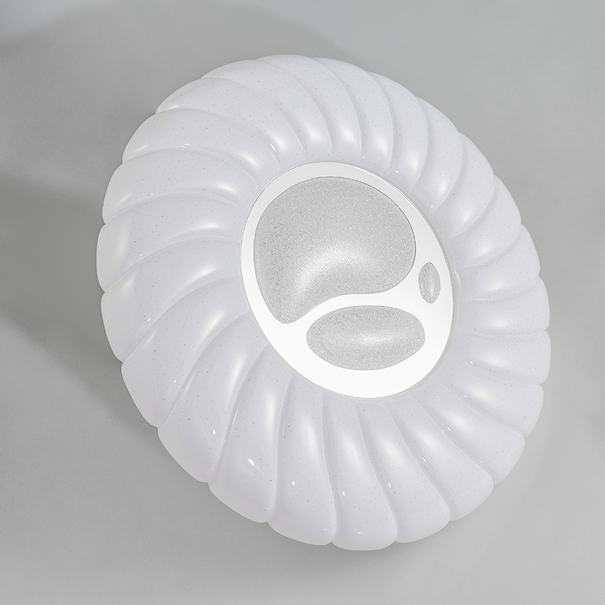
CL-N02
Modern Ceiling Light
Material:Iron base+ PMMA Cover
Input Voltage:AC85-265V
Led Chip:2835SMD
IP Rating:IP44 CRI>80 PF>0.9
Color Temperature:3000K/4500K/6000K
Operating Temperature:-25℃ ~50℃
Life Span:50000hours
Certificate:CE ROHS
Item Number | Wattage | LedQuantity | LuminousFlux | Beam Angle | Size (mm) | WIFI Control Remte Control Switch Control Dimmer Control
CL-N02 | 12W | 24pcs2835SMD | 960-1080lm | 120° | Φ260 | Yes
 | 15W | 30pcs2835SMD | 1200-1350lm | 120° | Φ280
 | 18W | 36pcs2835SMD | 1440-1620lm | 120° | Φ300
 | 21W | 42pcs2835SMD | 1680-1890lm | 120° | Φ300
 | 24w | 48pcs2835SMD | 1920-2160lm | 120° | Φ350
 | 27W | 54pcs2835SMD | 2160-2430lm | 120° | Φ350
 | 32W | 64pcs2835SMD | 2560-2880lm | 120° | Φ380
 | 40W | 80pcs2835SMD | 3200-3600lm | 120° | Φ400
 | 48w | 96pcs2835SMD | 3840-4320lm | 120° | Φ400
Modern Ceiling Light Material:Iron base+ PMMA Cover Input Voltage:AC85-265V Led Chip:2835SMD IP Rating:IP44 CRI>80 PF>0.9 Color Temperature:3000K/4500K/6000K Operating Temperature:-25℃ ~50℃ Life Span:50000hours Certificate:CE ROHS
Item Number | Wattage | LedQuantity | LuminousFlux | Beam Angle | Size (mm) | WIFI Control Remte control Switch control Dimmer control
CL-N00 | 24W | 48pcs2835SMD | 1920-2160lm | 120° | 350mm | Yes
 | 36W | 72pcs2835SMD | 2880-3240lm | 120° | 400mm
 | 40W | 80pcs2835SMD | 3200-3600lm | 120° | 450mm
Modern Ceiling Light Material:Iron base+ PMMA Cover Input Voltage:AC85-265V Led Chip:2835SMD IP Rating:IP44 CRI>80 PF>0.9 Color Temperature:3000K/4500K/6000K Operating Temperature:-25℃ ~50℃ Life Span:50000hours Certificate:CE ROHS
Item Number | Wattage | LedQuantity | LuminousFlux | Beam Angle | Size (mm) | WIFI Control Remte control Switch control Dimmer control
CL-N00 | 24W | 48pcs2835SMD | 1920-2160lm | 120° | 350mm | Yes
 | 36W | 72pcs2835SMD | 2880-3240lm | 120° | 400mm
 | 40W | 80pcs2835SMD | 3200-3600lm | 120° | 450mm
Modern Ceiling Light Material:Iron base+ PMMA Cover Input Voltage:AC85-265V Led Chip:2835SMD IP Rating:IP44 CRI>80 PF>0.9 Color Temperature:3000K/4500K/6000K Operating Temperature:-25℃ ~50℃ Life Span:50000hours Certificate:CE ROHS
Item Number | Wattage | LedQuantity | LuminousFlux | Beam Angle | Size (mm) | WIFI Control Remte control Switch control Dimmer control
CL-N00 | 24W | 48pcs2835SMD | 1920-2160lm | 120° | 350mm | Yes
 | 36W | 72pcs2835SMD | 2880-3240lm | 120° | 400mm
 | 40W | 80pcs2835SMD | 3200-3600lm | 120° | 450mm
Modern Ceiling Light Material:Iron base+ PMMA Cover Input Voltage:AC85-265V Led Chip:2835SMD IP Rating:IP44 CRI>80 PF>0.9 Color Temperature:3000K/4500K/6000K Operating Temperature:-25℃ ~50℃ Life Span:50000hours Certificate:CE ROHS
Item Number | Wattage | LedQuantity | LuminousFlux | Beam Angle | Size (mm) | WIFI Control Remte control Switch control Dimmer control
CL-N00 | 24W | 48pcs2835SMD | 1920-2160lm | 120° | 350mm | Yes
 | 36W | 72pcs2835SMD | 2880-3240lm | 120° | 400mm
 | 40W | 80pcs2835SMD | 3200-3600lm | 120° | 450mm

Slide 33
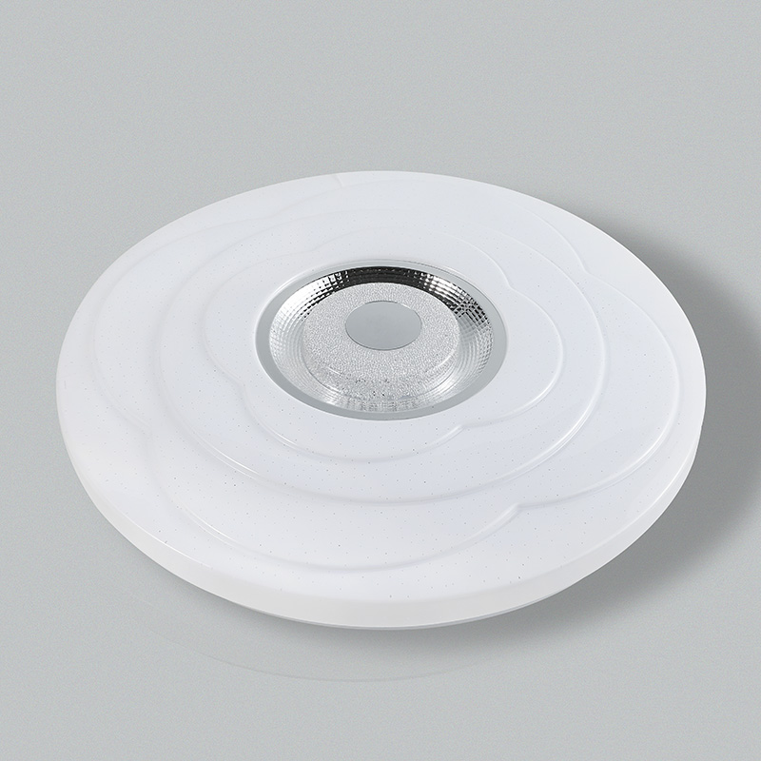
CL-N03
Modern Ceiling Light
Material:Iron base+ PMMA Cover
Input Voltage:AC85-265V
Led Chip:2835SMD
IP Rating:IP44 CRI>80 PF>0.9
Color Temperature:3000K/4500K/6000K
Operating Temperature:-25℃ ~50℃
Life Span:50000hours
Certificate:CE ROHS
Item Number | Wattage | LedQuantity | LuminousFlux | Beam Angle | Size (mm) | WIFI Control Remte Control Switch Control Dimmer Control
CL-N03 | 12W | 24pcs2835SMD | 960-1080lm | 120° | Φ260 | Yes
 | 15W | 30pcs2835SMD | 1200-1350lm | 120° | Φ280
 | 18W | 36pcs2835SMD | 1440-1620lm | 120° | Φ300
 | 21W | 42pcs2835SMD | 1680-1890lm | 120° | Φ300
 | 24w | 48pcs2835SMD | 1920-2160lm | 120° | Φ350
 | 27W | 54pcs2835SMD | 2160-2430lm | 120° | Φ350
 | 32W | 64pcs2835SMD | 2560-2880lm | 120° | Φ380
 | 40W | 80pcs2835SMD | 3200-3600lm | 120° | Φ400
 | 48w | 96pcs2835SMD | 3840-4320lm | 120° | Φ400
Modern Ceiling Light Material:Iron base+ PMMA Cover Input Voltage:AC85-265V Led Chip:2835SMD IP Rating:IP44 CRI>80 PF>0.9 Color Temperature:3000K/4500K/6000K Operating Temperature:-25℃ ~50℃ Life Span:50000hours Certificate:CE ROHS
Item Number | Wattage | LedQuantity | LuminousFlux | Beam Angle | Size (mm) | WIFI Control Remte control Switch control Dimmer control
CL-N00 | 24W | 48pcs2835SMD | 1920-2160lm | 120° | 350mm | Yes
 | 36W | 72pcs2835SMD | 2880-3240lm | 120° | 400mm
 | 40W | 80pcs2835SMD | 3200-3600lm | 120° | 450mm
Modern Ceiling Light Material:Iron base+ PMMA Cover Input Voltage:AC85-265V Led Chip:2835SMD IP Rating:IP44 CRI>80 PF>0.9 Color Temperature:3000K/4500K/6000K Operating Temperature:-25℃ ~50℃ Life Span:50000hours Certificate:CE ROHS
Item Number | Wattage | LedQuantity | LuminousFlux | Beam Angle | Size (mm) | WIFI Control Remte control Switch control Dimmer control
CL-N00 | 24W | 48pcs2835SMD | 1920-2160lm | 120° | 350mm | Yes
 | 36W | 72pcs2835SMD | 2880-3240lm | 120° | 400mm
 | 40W | 80pcs2835SMD | 3200-3600lm | 120° | 450mm
Modern Ceiling Light Material:Iron base+ PMMA Cover Input Voltage:AC85-265V Led Chip:2835SMD IP Rating:IP44 CRI>80 PF>0.9 Color Temperature:3000K/4500K/6000K Operating Temperature:-25℃ ~50℃ Life Span:50000hours Certificate:CE ROHS
Item Number | Wattage | LedQuantity | LuminousFlux | Beam Angle | Size (mm) | WIFI Control Remte control Switch control Dimmer control
CL-N00 | 24W | 48pcs2835SMD | 1920-2160lm | 120° | 350mm | Yes
 | 36W | 72pcs2835SMD | 2880-3240lm | 120° | 400mm
 | 40W | 80pcs2835SMD | 3200-3600lm | 120° | 450mm
Modern Ceiling Light Material:Iron base+ PMMA Cover Input Voltage:AC85-265V Led Chip:2835SMD IP Rating:IP44 CRI>80 PF>0.9 Color Temperature:3000K/4500K/6000K Operating Temperature:-25℃ ~50℃ Life Span:50000hours Certificate:CE ROHS
Item Number | Wattage | LedQuantity | LuminousFlux | Beam Angle | Size (mm) | WIFI Control Remte control Switch control Dimmer control
CL-N00 | 24W | 48pcs2835SMD | 1920-2160lm | 120° | 350mm | Yes
 | 36W | 72pcs2835SMD | 2880-3240lm | 120° | 400mm
 | 40W | 80pcs2835SMD | 3200-3600lm | 120° | 450mm

Slide 34
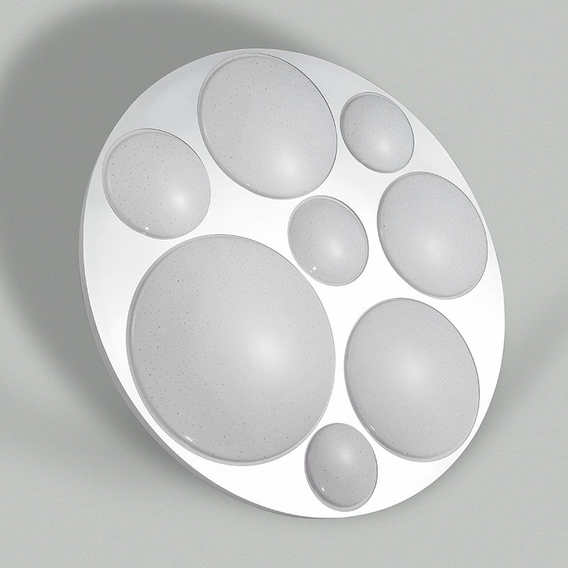
CL-N04
Modern Ceiling Light
Material:Iron base+ PMMA Cover
Input Voltage:AC85-265V
Led Chip:2835SMD
IP Rating:IP44 CRI>80 PF>0.9
Color Temperature:3000K/4500K/6000K
Operating Temperature:-25℃ ~50℃
Life Span:50000hours
Certificate:CE ROHS
Item Number | Wattage | LedQuantity | LuminousFlux | Beam Angle | Size (mm) | WIFI Control Remte Control Switch Control Dimmer Control
CL-N04 | 12W | 24pcs2835SMD | 960-1080lm | 120° | Φ260 | Yes
 | 15W | 30pcs2835SMD | 1200-1350lm | 120° | Φ280
 | 18W | 36pcs2835SMD | 1440-1620lm | 120° | Φ300
 | 21W | 42pcs2835SMD | 1680-1890lm | 120° | Φ300
 | 24w | 48pcs2835SMD | 1920-2160lm | 120° | Φ350
 | 27W | 54pcs2835SMD | 2160-2430lm | 120° | Φ350
 | 32W | 64pcs2835SMD | 2560-2880lm | 120° | Φ380
 | 40W | 80pcs2835SMD | 3200-3600lm | 120° | Φ400
 | 48w | 96pcs2835SMD | 3840-4320lm | 120° | Φ400
Modern Ceiling Light Material:Iron base+ PMMA Cover Input Voltage:AC85-265V Led Chip:2835SMD IP Rating:IP44 CRI>80 PF>0.9 Color Temperature:3000K/4500K/6000K Operating Temperature:-25℃ ~50℃ Life Span:50000hours Certificate:CE ROHS
Item Number | Wattage | LedQuantity | LuminousFlux | Beam Angle | Size (mm) | WIFI Control Remte control Switch control Dimmer control
CL-N00 | 24W | 48pcs2835SMD | 1920-2160lm | 120° | 350mm | Yes
 | 36W | 72pcs2835SMD | 2880-3240lm | 120° | 400mm
 | 40W | 80pcs2835SMD | 3200-3600lm | 120° | 450mm
Modern Ceiling Light Material:Iron base+ PMMA Cover Input Voltage:AC85-265V Led Chip:2835SMD IP Rating:IP44 CRI>80 PF>0.9 Color Temperature:3000K/4500K/6000K Operating Temperature:-25℃ ~50℃ Life Span:50000hours Certificate:CE ROHS
Item Number | Wattage | LedQuantity | LuminousFlux | Beam Angle | Size (mm) | WIFI Control Remte control Switch control Dimmer control
CL-N00 | 24W | 48pcs2835SMD | 1920-2160lm | 120° | 350mm | Yes
 | 36W | 72pcs2835SMD | 2880-3240lm | 120° | 400mm
 | 40W | 80pcs2835SMD | 3200-3600lm | 120° | 450mm
Modern Ceiling Light Material:Iron base+ PMMA Cover Input Voltage:AC85-265V Led Chip:2835SMD IP Rating:IP44 CRI>80 PF>0.9 Color Temperature:3000K/4500K/6000K Operating Temperature:-25℃ ~50℃ Life Span:50000hours Certificate:CE ROHS
Item Number | Wattage | LedQuantity | LuminousFlux | Beam Angle | Size (mm) | WIFI Control Remte control Switch control Dimmer control
CL-N00 | 24W | 48pcs2835SMD | 1920-2160lm | 120° | 350mm | Yes
 | 36W | 72pcs2835SMD | 2880-3240lm | 120° | 400mm
 | 40W | 80pcs2835SMD | 3200-3600lm | 120° | 450mm
Modern Ceiling Light Material:Iron base+ PMMA Cover Input Voltage:AC85-265V Led Chip:2835SMD IP Rating:IP44 CRI>80 PF>0.9 Color Temperature:3000K/4500K/6000K Operating Temperature:-25℃ ~50℃ Life Span:50000hours Certificate:CE ROHS
Item Number | Wattage | LedQuantity | LuminousFlux | Beam Angle | Size (mm) | WIFI Control Remte control Switch control Dimmer control
CL-N00 | 24W | 48pcs2835SMD | 1920-2160lm | 120° | 350mm | Yes
 | 36W | 72pcs2835SMD | 2880-3240lm | 120° | 400mm
 | 40W | 80pcs2835SMD | 3200-3600lm | 120° | 450mm

Slide 35
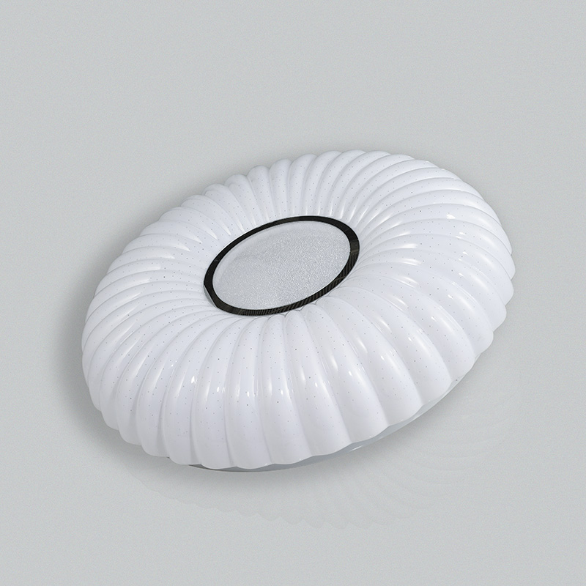
CL-N05
Modern Ceiling Light
Material:Iron base+ PMMA Cover
Input Voltage:AC85-265V
Led Chip:2835SMD
IP Rating:IP44 CRI>80 PF>0.9
Color Temperature:3000K/4500K/6000K
Operating Temperature:-25℃ ~50℃
Life Span:50000hours
Certificate:CE ROHS
Item Number | Wattage | LedQuantity | LuminousFlux | Beam Angle | Size (mm) | WIFI Control Remte Control Switch Control Dimmer Control
CL-N05 | 12W | 24pcs2835SMD | 960-1080lm | 120° | Φ260 | Yes
 | 15W | 30pcs2835SMD | 1200-1350lm | 120° | Φ280
 | 18W | 36pcs2835SMD | 1440-1620lm | 120° | Φ300
 | 21W | 42pcs2835SMD | 1680-1890lm | 120° | Φ300
 | 24w | 48pcs2835SMD | 1920-2160lm | 120° | Φ350
 | 27W | 54pcs2835SMD | 2160-2430lm | 120° | Φ350
 | 32W | 64pcs2835SMD | 2560-2880lm | 120° | Φ380
 | 40W | 80pcs2835SMD | 3200-3600lm | 120° | Φ400
 | 48w | 96pcs2835SMD | 3840-4320lm | 120° | Φ400
Modern Ceiling Light Material:Iron base+ PMMA Cover Input Voltage:AC85-265V Led Chip:2835SMD IP Rating:IP44 CRI>80 PF>0.9 Color Temperature:3000K/4500K/6000K Operating Temperature:-25℃ ~50℃ Life Span:50000hours Certificate:CE ROHS
Item Number | Wattage | LedQuantity | LuminousFlux | Beam Angle | Size (mm) | WIFI Control Remte control Switch control Dimmer control
CL-N00 | 24W | 48pcs2835SMD | 1920-2160lm | 120° | 350mm | Yes
 | 36W | 72pcs2835SMD | 2880-3240lm | 120° | 400mm
 | 40W | 80pcs2835SMD | 3200-3600lm | 120° | 450mm
Modern Ceiling Light Material:Iron base+ PMMA Cover Input Voltage:AC85-265V Led Chip:2835SMD IP Rating:IP44 CRI>80 PF>0.9 Color Temperature:3000K/4500K/6000K Operating Temperature:-25℃ ~50℃ Life Span:50000hours Certificate:CE ROHS
Item Number | Wattage | LedQuantity | LuminousFlux | Beam Angle | Size (mm) | WIFI Control Remte control Switch control Dimmer control
CL-N00 | 24W | 48pcs2835SMD | 1920-2160lm | 120° | 350mm | Yes
 | 36W | 72pcs2835SMD | 2880-3240lm | 120° | 400mm
 | 40W | 80pcs2835SMD | 3200-3600lm | 120° | 450mm
Modern Ceiling Light Material:Iron base+ PMMA Cover Input Voltage:AC85-265V Led Chip:2835SMD IP Rating:IP44 CRI>80 PF>0.9 Color Temperature:3000K/4500K/6000K Operating Temperature:-25℃ ~50℃ Life Span:50000hours Certificate:CE ROHS
Item Number | Wattage | LedQuantity | LuminousFlux | Beam Angle | Size (mm) | WIFI Control Remte control Switch control Dimmer control
CL-N00 | 24W | 48pcs2835SMD | 1920-2160lm | 120° | 350mm | Yes
 | 36W | 72pcs2835SMD | 2880-3240lm | 120° | 400mm
 | 40W | 80pcs2835SMD | 3200-3600lm | 120° | 450mm
Modern Ceiling Light Material:Iron base+ PMMA Cover Input Voltage:AC85-265V Led Chip:2835SMD IP Rating:IP44 CRI>80 PF>0.9 Color Temperature:3000K/4500K/6000K Operating Temperature:-25℃ ~50℃ Life Span:50000hours Certificate:CE ROHS
Item Number | Wattage | LedQuantity | LuminousFlux | Beam Angle | Size (mm) | WIFI Control Remte control Switch control Dimmer control
CL-N00 | 24W | 48pcs2835SMD | 1920-2160lm | 120° | 350mm | Yes
 | 36W | 72pcs2835SMD | 2880-3240lm | 120° | 400mm
 | 40W | 80pcs2835SMD | 3200-3600lm | 120° | 450mm

Slide 36
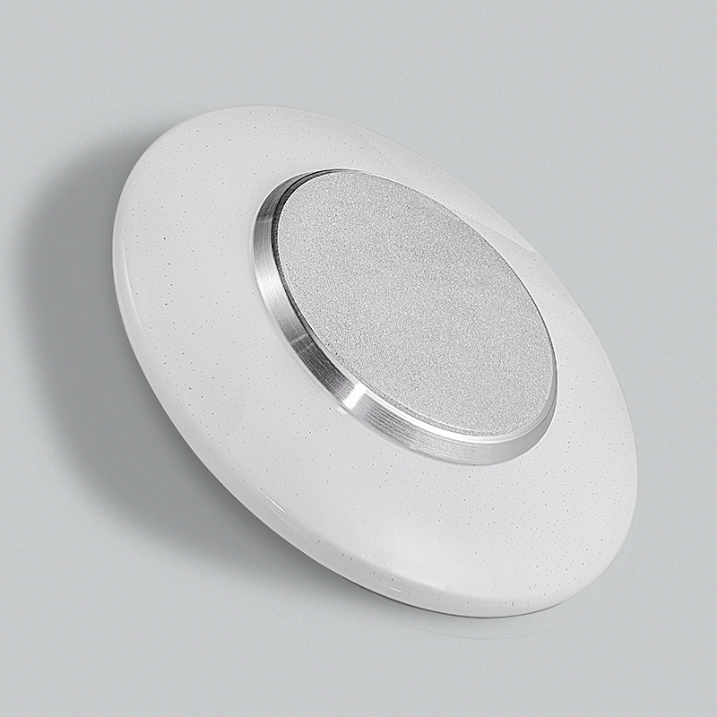
CL-N06
Modern Ceiling Light
Material:Iron base+ PMMA Cover
Input Voltage:AC85-265V
Led Chip:2835SMD
IP Rating:IP44 CRI>80 PF>0.9
Color Temperature:3000K/4500K/6000K
Operating Temperature:-25℃ ~50℃
Life Span:50000hours
Certificate:CE ROHS
Item Number | Wattage | LedQuantity | LuminousFlux | Beam Angle | Size (mm) | WIFI Control Remte Control Switch Control Dimmer Control
CL-N06 | 12W | 24pcs2835SMD | 960-1080lm | 120° | Φ260 | Yes
 | 15W | 30pcs2835SMD | 1200-1350lm | 120° | Φ280
 | 18W | 36pcs2835SMD | 1440-1620lm | 120° | Φ300
 | 21W | 42pcs2835SMD | 1680-1890lm | 120° | Φ300
 | 24w | 48pcs2835SMD | 1920-2160lm | 120° | Φ350
 | 27W | 54pcs2835SMD | 2160-2430lm | 120° | Φ350
 | 32W | 64pcs2835SMD | 2560-2880lm | 120° | Φ380
 | 40W | 80pcs2835SMD | 3200-3600lm | 120° | Φ400
 | 48w | 96pcs2835SMD | 3840-4320lm | 120° | Φ400
Modern Ceiling Light Material:Iron base+ PMMA Cover Input Voltage:AC85-265V Led Chip:2835SMD IP Rating:IP44 CRI>80 PF>0.9 Color Temperature:3000K/4500K/6000K Operating Temperature:-25℃ ~50℃ Life Span:50000hours Certificate:CE ROHS
Item Number | Wattage | LedQuantity | LuminousFlux | Beam Angle | Size (mm) | WIFI Control Remte control Switch control Dimmer control
CL-N00 | 24W | 48pcs2835SMD | 1920-2160lm | 120° | 350mm | Yes
 | 36W | 72pcs2835SMD | 2880-3240lm | 120° | 400mm
 | 40W | 80pcs2835SMD | 3200-3600lm | 120° | 450mm
Modern Ceiling Light Material:Iron base+ PMMA Cover Input Voltage:AC85-265V Led Chip:2835SMD IP Rating:IP44 CRI>80 PF>0.9 Color Temperature:3000K/4500K/6000K Operating Temperature:-25℃ ~50℃ Life Span:50000hours Certificate:CE ROHS
Item Number | Wattage | LedQuantity | LuminousFlux | Beam Angle | Size (mm) | WIFI Control Remte control Switch control Dimmer control
CL-N00 | 24W | 48pcs2835SMD | 1920-2160lm | 120° | 350mm | Yes
 | 36W | 72pcs2835SMD | 2880-3240lm | 120° | 400mm
 | 40W | 80pcs2835SMD | 3200-3600lm | 120° | 450mm
Modern Ceiling Light Material:Iron base+ PMMA Cover Input Voltage:AC85-265V Led Chip:2835SMD IP Rating:IP44 CRI>80 PF>0.9 Color Temperature:3000K/4500K/6000K Operating Temperature:-25℃ ~50℃ Life Span:50000hours Certificate:CE ROHS
Item Number | Wattage | LedQuantity | LuminousFlux | Beam Angle | Size (mm) | WIFI Control Remte control Switch control Dimmer control
CL-N00 | 24W | 48pcs2835SMD | 1920-2160lm | 120° | 350mm | Yes
 | 36W | 72pcs2835SMD | 2880-3240lm | 120° | 400mm
 | 40W | 80pcs2835SMD | 3200-3600lm | 120° | 450mm
Modern Ceiling Light Material:Iron base+ PMMA Cover Input Voltage:AC85-265V Led Chip:2835SMD IP Rating:IP44 CRI>80 PF>0.9 Color Temperature:3000K/4500K/6000K Operating Temperature:-25℃ ~50℃ Life Span:50000hours Certificate:CE ROHS
Item Number | Wattage | LedQuantity | LuminousFlux | Beam Angle | Size (mm) | WIFI Control Remte control Switch control Dimmer control
CL-N00 | 24W | 48pcs2835SMD | 1920-2160lm | 120° | 350mm | Yes
 | 36W | 72pcs2835SMD | 2880-3240lm | 120° | 400mm
 | 40W | 80pcs2835SMD | 3200-3600lm | 120° | 450mm

Slide 37
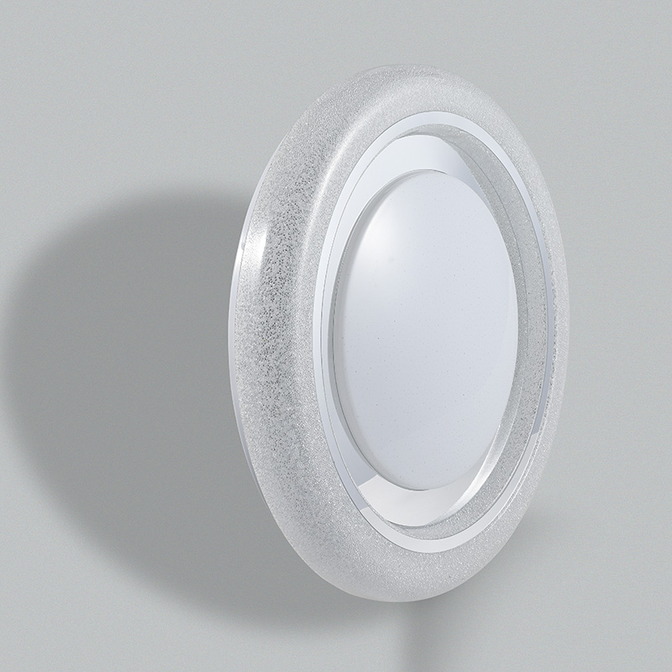
CL-N07
Modern Ceiling Light
Material:Iron base+ PMMA Cover
Input Voltage:AC85-265V
Led Chip:2835SMD
IP Rating:IP44 CRI>80 PF>0.9
Color Temperature:3000K/4500K/6000K
Operating Temperature:-25℃ ~50℃
Life Span:50000hours
Certificate:CE ROHS
Item Number | Wattage | LedQuantity | LuminousFlux | Beam Angle | Size (mm) | WIFI Control Remte Control Switch Control Dimmer Control
CL-N07 | 12W | 24pcs2835SMD | 960-1080lm | 120° | Φ260 | Yes
 | 15W | 30pcs2835SMD | 1200-1350lm | 120° | Φ280
 | 18W | 36pcs2835SMD | 1440-1620lm | 120° | Φ300
 | 21W | 42pcs2835SMD | 1680-1890lm | 120° | Φ300
 | 24w | 48pcs2835SMD | 1920-2160lm | 120° | Φ350
 | 27W | 54pcs2835SMD | 2160-2430lm | 120° | Φ350
 | 32W | 64pcs2835SMD | 2560-2880lm | 120° | Φ380
 | 40W | 80pcs2835SMD | 3200-3600lm | 120° | Φ400
 | 48w | 96pcs2835SMD | 3840-4320lm | 120° | Φ400
Modern Ceiling Light Material:Iron base+ PMMA Cover Input Voltage:AC85-265V Led Chip:2835SMD IP Rating:IP44 CRI>80 PF>0.9 Color Temperature:3000K/4500K/6000K Operating Temperature:-25℃ ~50℃ Life Span:50000hours Certificate:CE ROHS
Item Number | Wattage | LedQuantity | LuminousFlux | Beam Angle | Size (mm) | WIFI Control Remte control Switch control Dimmer control
CL-N00 | 24W | 48pcs2835SMD | 1920-2160lm | 120° | 350mm | Yes
 | 36W | 72pcs2835SMD | 2880-3240lm | 120° | 400mm
 | 40W | 80pcs2835SMD | 3200-3600lm | 120° | 450mm
Modern Ceiling Light Material:Iron base+ PMMA Cover Input Voltage:AC85-265V Led Chip:2835SMD IP Rating:IP44 CRI>80 PF>0.9 Color Temperature:3000K/4500K/6000K Operating Temperature:-25℃ ~50℃ Life Span:50000hours Certificate:CE ROHS
Item Number | Wattage | LedQuantity | LuminousFlux | Beam Angle | Size (mm) | WIFI Control Remte control Switch control Dimmer control
CL-N00 | 24W | 48pcs2835SMD | 1920-2160lm | 120° | 350mm | Yes
 | 36W | 72pcs2835SMD | 2880-3240lm | 120° | 400mm
 | 40W | 80pcs2835SMD | 3200-3600lm | 120° | 450mm
Modern Ceiling Light Material:Iron base+ PMMA Cover Input Voltage:AC85-265V Led Chip:2835SMD IP Rating:IP44 CRI>80 PF>0.9 Color Temperature:3000K/4500K/6000K Operating Temperature:-25℃ ~50℃ Life Span:50000hours Certificate:CE ROHS
Item Number | Wattage | LedQuantity | LuminousFlux | Beam Angle | Size (mm) | WIFI Control Remte control Switch control Dimmer control
CL-N00 | 24W | 48pcs2835SMD | 1920-2160lm | 120° | 350mm | Yes
 | 36W | 72pcs2835SMD | 2880-3240lm | 120° | 400mm
 | 40W | 80pcs2835SMD | 3200-3600lm | 120° | 450mm
Modern Ceiling Light Material:Iron base+ PMMA Cover Input Voltage:AC85-265V Led Chip:2835SMD IP Rating:IP44 CRI>80 PF>0.9 Color Temperature:3000K/4500K/6000K Operating Temperature:-25℃ ~50℃ Life Span:50000hours Certificate:CE ROHS
Item Number | Wattage | LedQuantity | LuminousFlux | Beam Angle | Size (mm) | WIFI Control Remte control Switch control Dimmer control
CL-N00 | 24W | 48pcs2835SMD | 1920-2160lm | 120° | 350mm | Yes
 | 36W | 72pcs2835SMD | 2880-3240lm | 120° | 400mm
 | 40W | 80pcs2835SMD | 3200-3600lm | 120° | 450mm

Slide 38
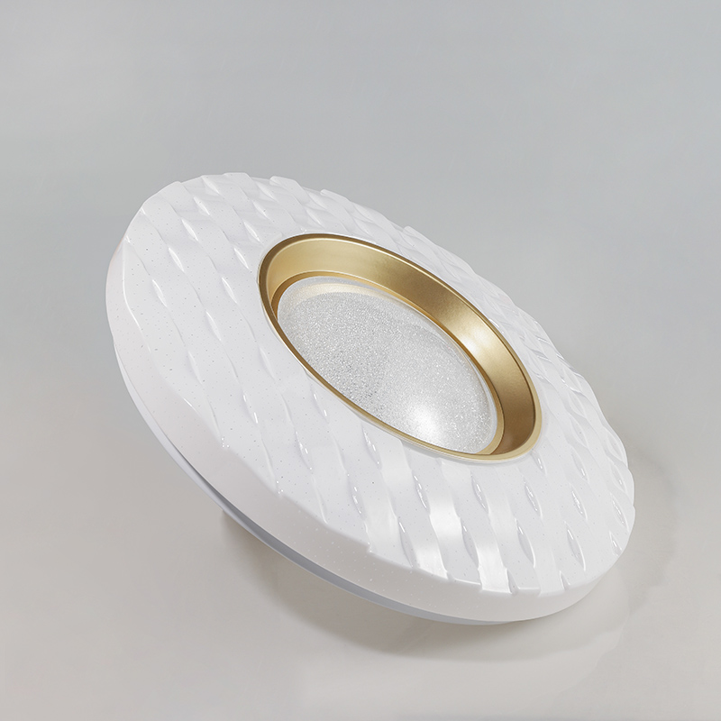
CL-N08
Modern Ceiling Light
Material:Iron base+ PMMA Cover
Input Voltage:AC85-265V
Led Chip:2835SMD
IP Rating:IP44 CRI>80 PF>0.9
Color Temperature:3000K/4500K/6000K
Operating Temperature:-25℃ ~50℃
Life Span:50000hours
Certificate:CE ROHS
Item Number | Wattage | LedQuantity | LuminousFlux | Beam Angle | Size (mm) | WIFI Control Remte Control Switch Control Dimmer Control
CL-N08 | 12W | 24pcs2835SMD | 960-1080lm | 120° | Φ260 | Yes
 | 15W | 30pcs2835SMD | 1200-1350lm | 120° | Φ280
 | 18W | 36pcs2835SMD | 1440-1620lm | 120° | Φ300
 | 21W | 42pcs2835SMD | 1680-1890lm | 120° | Φ300
 | 24W | 48pcs2835SMD | 1920-2160lm | 120° | Φ350
 | 27W | 54pcs2835SMD | 2160-2430lm | 120° | Φ350
 | 32W | 64pcs2835SMD | 2560-2880lm | 120° | Φ380
 | 40W | 80pcs2835SMD | 3200-3600lm | 120° | Φ400
 | 48W | 96pcs2835SMD | 3840-4320lm | 120° | Φ400
Modern Ceiling Light Material:Iron base+ PMMA Cover Input Voltage:AC85-265V Led Chip:2835SMD IP Rating:IP44 CRI>80 PF>0.9 Color Temperature:3000K/4500K/6000K Operating Temperature:-25℃ ~50℃ Life Span:50000hours Certificate:CE ROHS
Item Number | Wattage | LedQuantity | LuminousFlux | Beam Angle | Size (mm) | WIFI Control Remte control Switch control Dimmer control
CL-N00 | 24W | 48pcs2835SMD | 1920-2160lm | 120° | 350mm | Yes
 | 36W | 72pcs2835SMD | 2880-3240lm | 120° | 400mm
 | 40W | 80pcs2835SMD | 3200-3600lm | 120° | 450mm
Modern Ceiling Light Material:Iron base+ PMMA Cover Input Voltage:AC85-265V Led Chip:2835SMD IP Rating:IP44 CRI>80 PF>0.9 Color Temperature:3000K/4500K/6000K Operating Temperature:-25℃ ~50℃ Life Span:50000hours Certificate:CE ROHS
Item Number | Wattage | LedQuantity | LuminousFlux | Beam Angle | Size (mm) | WIFI Control Remte control Switch control Dimmer control
CL-N00 | 24W | 48pcs2835SMD | 1920-2160lm | 120° | 350mm | Yes
 | 36W | 72pcs2835SMD | 2880-3240lm | 120° | 400mm
 | 40W | 80pcs2835SMD | 3200-3600lm | 120° | 450mm
Modern Ceiling Light Material:Iron base+ PMMA Cover Input Voltage:AC85-265V Led Chip:2835SMD IP Rating:IP44 CRI>80 PF>0.9 Color Temperature:3000K/4500K/6000K Operating Temperature:-25℃ ~50℃ Life Span:50000hours Certificate:CE ROHS
Item Number | Wattage | LedQuantity | LuminousFlux | Beam Angle | Size (mm) | WIFI Control Remte control Switch control Dimmer control
CL-N00 | 24W | 48pcs2835SMD | 1920-2160lm | 120° | 350mm | Yes
 | 36W | 72pcs2835SMD | 2880-3240lm | 120° | 400mm
 | 40W | 80pcs2835SMD | 3200-3600lm | 120° | 450mm
Modern Ceiling Light Material:Iron base+ PMMA Cover Input Voltage:AC85-265V Led Chip:2835SMD IP Rating:IP44 CRI>80 PF>0.9 Color Temperature:3000K/4500K/6000K Operating Temperature:-25℃ ~50℃ Life Span:50000hours Certificate:CE ROHS
Item Number | Wattage | LedQuantity | LuminousFlux | Beam Angle | Size (mm) | WIFI Control Remte control Switch control Dimmer control
CL-N00 | 24W | 48pcs2835SMD | 1920-2160lm | 120° | 350mm | Yes
 | 36W | 72pcs2835SMD | 2880-3240lm | 120° | 400mm
 | 40W | 80pcs2835SMD | 3200-3600lm | 120° | 450mm

Slide 39
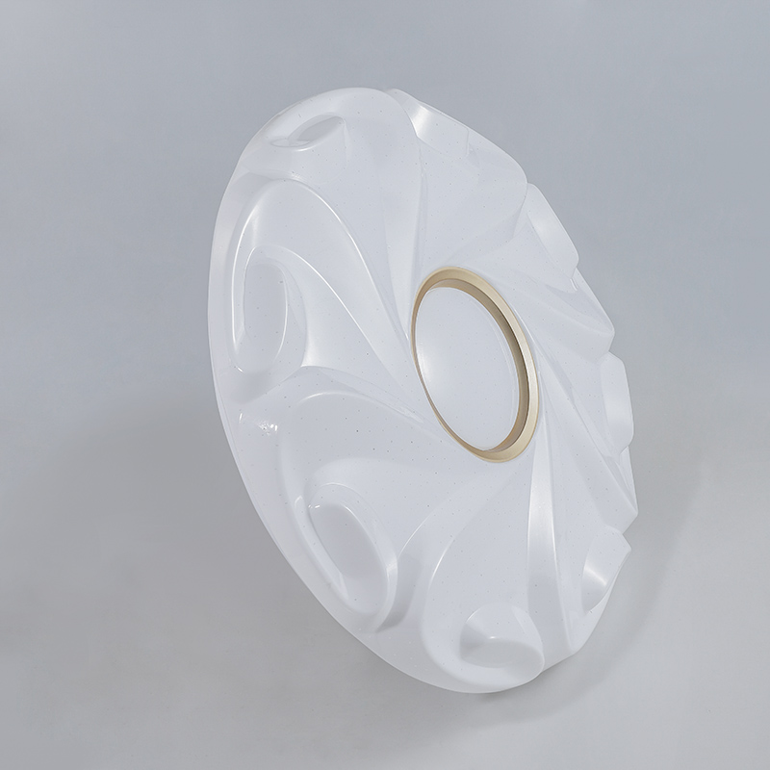
CL-N09
Modern Ceiling Light
Material:Iron base+ PMMA Cover
Input Voltage:AC85-265V
Led Chip:2835SMD
IP Rating:IP44 CRI>80 PF>0.9
Color Temperature:3000K/4500K/6000K
Operating Temperature:-25℃ ~50℃
Life Span:50000hours
Certificate:CE ROHS
Item Number | Wattage | LedQuantity | LuminousFlux | Beam Angle | Size (mm) | WIFI Control Remte Control Switch Control Dimmer Control
CL-N09 | 12W | 24pcs2835SMD | 960-1080lm | 120° | Φ260 | Yes
 | 15W | 30pcs2835SMD | 1200-1350lm | 120° | Φ280
 | 18W | 36pcs2835SMD | 1440-1620lm | 120° | Φ300
 | 21W | 42pcs2835SMD | 1680-1890lm | 120° | Φ300
 | 24W | 48pcs2835SMD | 1920-2160lm | 120° | Φ350
 | 27W | 54pcs2835SMD | 2160-2430lm | 120° | Φ350
 | 32W | 64pcs2835SMD | 2560-2880lm | 120° | Φ380
 | 40W | 80pcs2835SMD | 3200-3600lm | 120° | Φ400
 | 48W | 96pcs2835SMD | 3840-4320lm | 120° | Φ400
Modern Ceiling Light Material:Iron base+ PMMA Cover Input Voltage:AC85-265V Led Chip:2835SMD IP Rating:IP44 CRI>80 PF>0.9 Color Temperature:3000K/4500K/6000K Operating Temperature:-25℃ ~50℃ Life Span:50000hours Certificate:CE ROHS
Item Number | Wattage | LedQuantity | LuminousFlux | Beam Angle | Size (mm) | WIFI Control Remte control Switch control Dimmer control
CL-N00 | 24W | 48pcs2835SMD | 1920-2160lm | 120° | 350mm | Yes
 | 36W | 72pcs2835SMD | 2880-3240lm | 120° | 400mm
 | 40W | 80pcs2835SMD | 3200-3600lm | 120° | 450mm
Modern Ceiling Light Material:Iron base+ PMMA Cover Input Voltage:AC85-265V Led Chip:2835SMD IP Rating:IP44 CRI>80 PF>0.9 Color Temperature:3000K/4500K/6000K Operating Temperature:-25℃ ~50℃ Life Span:50000hours Certificate:CE ROHS
Item Number | Wattage | LedQuantity | LuminousFlux | Beam Angle | Size (mm) | WIFI Control Remte control Switch control Dimmer control
CL-N00 | 24W | 48pcs2835SMD | 1920-2160lm | 120° | 350mm | Yes
 | 36W | 72pcs2835SMD | 2880-3240lm | 120° | 400mm
 | 40W | 80pcs2835SMD | 3200-3600lm | 120° | 450mm
Modern Ceiling Light Material:Iron base+ PMMA Cover Input Voltage:AC85-265V Led Chip:2835SMD IP Rating:IP44 CRI>80 PF>0.9 Color Temperature:3000K/4500K/6000K Operating Temperature:-25℃ ~50℃ Life Span:50000hours Certificate:CE ROHS
Item Number | Wattage | LedQuantity | LuminousFlux | Beam Angle | Size (mm) | WIFI Control Remte control Switch control Dimmer control
CL-N00 | 24W | 48pcs2835SMD | 1920-2160lm | 120° | 350mm | Yes
 | 36W | 72pcs2835SMD | 2880-3240lm | 120° | 400mm
 | 40W | 80pcs2835SMD | 3200-3600lm | 120° | 450mm
Modern Ceiling Light Material:Iron base+ PMMA Cover Input Voltage:AC85-265V Led Chip:2835SMD IP Rating:IP44 CRI>80 PF>0.9 Color Temperature:3000K/4500K/6000K Operating Temperature:-25℃ ~50℃ Life Span:50000hours Certificate:CE ROHS
Item Number | Wattage | LedQuantity | LuminousFlux | Beam Angle | Size (mm) | WIFI Control Remte control Switch control Dimmer control
CL-N00 | 24W | 48pcs2835SMD | 1920-2160lm | 120° | 350mm | Yes
 | 36W | 72pcs2835SMD | 2880-3240lm | 120° | 400mm
 | 40W | 80pcs2835SMD | 3200-3600lm | 120° | 450mm

Slide 40
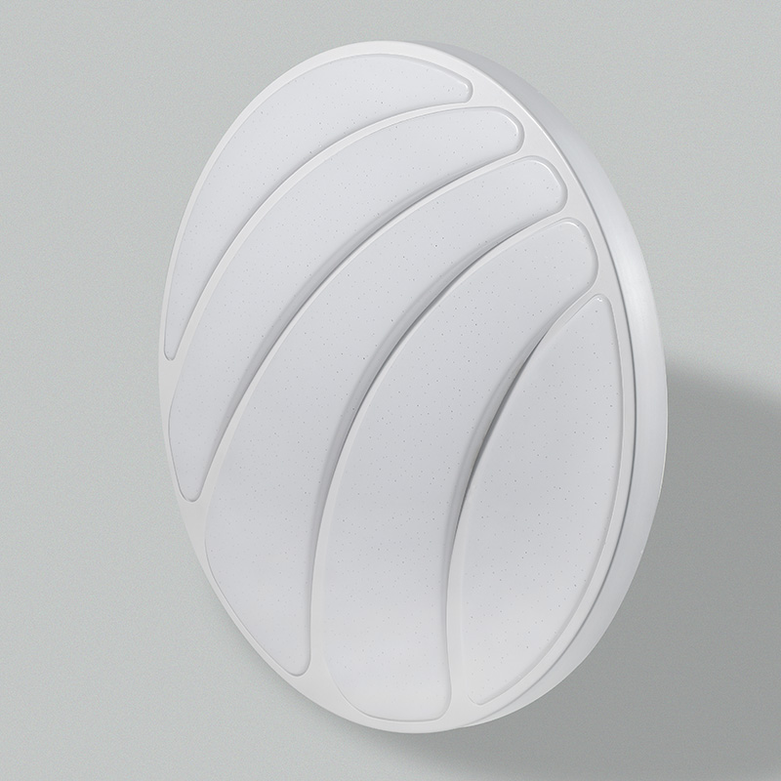
CL-N10
Modern Ceiling Light
Material:Iron base+ PMMA Cover
Input Voltage:AC85-265V
Led Chip:2835SMD
IP Rating:IP44 CRI>80 PF>0.9
Color Temperature:3000K/4500K/6000K
Operating Temperature:-25℃ ~50℃
Life Span:50000hours
Certificate:CE ROHS
Item Number | Wattage | LedQuantity | LuminousFlux | Beam Angle | Size (mm) | WIFI Control Remte Control Switch Control Dimmer Control
CL-N10 | 12W | 24pcs2835SMD | 960-1080lm | 120° | Φ260 | Yes
 | 15W | 30pcs2835SMD | 1200-1350lm | 120° | Φ280
 | 18W | 36pcs2835SMD | 1440-1620lm | 120° | Φ300
 | 21W | 42pcs2835SMD | 1680-1890lm | 120° | Φ300
 | 24W | 48pcs2835SMD | 1920-2160lm | 120° | Φ350
 | 27W | 54pcs2835SMD | 2160-2430lm | 120° | Φ350
 | 32W | 64pcs2835SMD | 2560-2880lm | 120° | Φ380
 | 40W | 80pcs2835SMD | 3200-3600lm | 120° | Φ400
 | 48W | 96pcs2835SMD | 3840-4320lm | 120° | Φ400
Modern Ceiling Light Material:Iron base+ PMMA Cover Input Voltage:AC85-265V Led Chip:2835SMD IP Rating:IP44 CRI>80 PF>0.9 Color Temperature:3000K/4500K/6000K Operating Temperature:-25℃ ~50℃ Life Span:50000hours Certificate:CE ROHS
Item Number | Wattage | LedQuantity | LuminousFlux | Beam Angle | Size (mm) | WIFI Control Remte control Switch control Dimmer control
CL-N00 | 24W | 48pcs2835SMD | 1920-2160lm | 120° | 350mm | Yes
 | 36W | 72pcs2835SMD | 2880-3240lm | 120° | 400mm
 | 40W | 80pcs2835SMD | 3200-3600lm | 120° | 450mm
Modern Ceiling Light Material:Iron base+ PMMA Cover Input Voltage:AC85-265V Led Chip:2835SMD IP Rating:IP44 CRI>80 PF>0.9 Color Temperature:3000K/4500K/6000K Operating Temperature:-25℃ ~50℃ Life Span:50000hours Certificate:CE ROHS
Item Number | Wattage | LedQuantity | LuminousFlux | Beam Angle | Size (mm) | WIFI Control Remte control Switch control Dimmer control
CL-N00 | 24W | 48pcs2835SMD | 1920-2160lm | 120° | 350mm | Yes
 | 36W | 72pcs2835SMD | 2880-3240lm | 120° | 400mm
 | 40W | 80pcs2835SMD | 3200-3600lm | 120° | 450mm
Modern Ceiling Light Material:Iron base+ PMMA Cover Input Voltage:AC85-265V Led Chip:2835SMD IP Rating:IP44 CRI>80 PF>0.9 Color Temperature:3000K/4500K/6000K Operating Temperature:-25℃ ~50℃ Life Span:50000hours Certificate:CE ROHS
Item Number | Wattage | LedQuantity | LuminousFlux | Beam Angle | Size (mm) | WIFI Control Remte control Switch control Dimmer control
CL-N00 | 24W | 48pcs2835SMD | 1920-2160lm | 120° | 350mm | Yes
 | 36W | 72pcs2835SMD | 2880-3240lm | 120° | 400mm
 | 40W | 80pcs2835SMD | 3200-3600lm | 120° | 450mm
Modern Ceiling Light Material:Iron base+ PMMA Cover Input Voltage:AC85-265V Led Chip:2835SMD IP Rating:IP44 CRI>80 PF>0.9 Color Temperature:3000K/4500K/6000K Operating Temperature:-25℃ ~50℃ Life Span:50000hours Certificate:CE ROHS
Item Number | Wattage | LedQuantity | LuminousFlux | Beam Angle | Size (mm) | WIFI Control Remte control Switch control Dimmer control
CL-N00 | 24W | 48pcs2835SMD | 1920-2160lm | 120° | 350mm | Yes
 | 36W | 72pcs2835SMD | 2880-3240lm | 120° | 400mm
 | 40W | 80pcs2835SMD | 3200-3600lm | 120° | 450mm

Slide 41
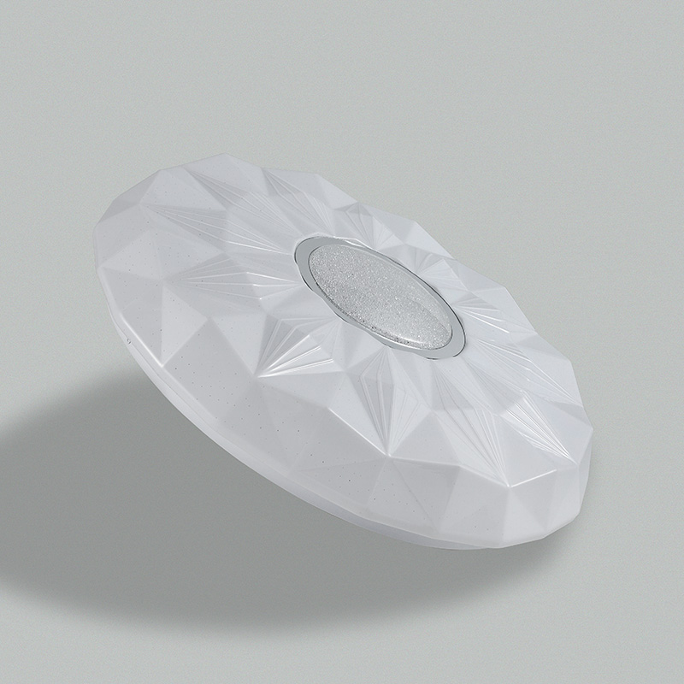
CL-N11
Modern Ceiling Light
Material:Iron base+ PMMA Cover
Input Voltage:AC85-265V
Led Chip:2835SMD
IP Rating:IP44 CRI>80 PF>0.9
Color Temperature:3000K/4500K/6000K
Operating Temperature:-25℃ ~50℃
Life Span:50000hours
Certificate:CE ROHS
Item Number | Wattage | LedQuantity | LuminousFlux | Beam Angle | Size (mm) | WIFI Control Remte Control Switch Control Dimmer Control
CL-N11 | 12W | 24pcs2835SMD | 960-1080lm | 120° | Φ260 | Yes
 | 15W | 30pcs2835SMD | 1200-1350lm | 120° | Φ280
 | 18W | 36pcs2835SMD | 1440-1620lm | 120° | Φ300
 | 21W | 42pcs2835SMD | 1680-1890lm | 120° | Φ300
 | 24W | 48pcs2835SMD | 1920-2160lm | 120° | Φ350
 | 27W | 54pcs2835SMD | 2160-2430lm | 120° | Φ350
 | 32W | 64pcs2835SMD | 2560-2880lm | 120° | Φ380
 | 40W | 80pcs2835SMD | 3200-3600lm | 120° | Φ400
 | 48W | 96pcs2835SMD | 3840-4320lm | 120° | Φ400
Modern Ceiling Light Material:Iron base+ PMMA Cover Input Voltage:AC85-265V Led Chip:2835SMD IP Rating:IP44 CRI>80 PF>0.9 Color Temperature:3000K/4500K/6000K Operating Temperature:-25℃ ~50℃ Life Span:50000hours Certificate:CE ROHS
Item Number | Wattage | LedQuantity | LuminousFlux | Beam Angle | Size (mm) | WIFI Control Remte control Switch control Dimmer control
CL-N00 | 24W | 48pcs2835SMD | 1920-2160lm | 120° | 350mm | Yes
 | 36W | 72pcs2835SMD | 2880-3240lm | 120° | 400mm
 | 40W | 80pcs2835SMD | 3200-3600lm | 120° | 450mm
Modern Ceiling Light Material:Iron base+ PMMA Cover Input Voltage:AC85-265V Led Chip:2835SMD IP Rating:IP44 CRI>80 PF>0.9 Color Temperature:3000K/4500K/6000K Operating Temperature:-25℃ ~50℃ Life Span:50000hours Certificate:CE ROHS
Item Number | Wattage | LedQuantity | LuminousFlux | Beam Angle | Size (mm) | WIFI Control Remte control Switch control Dimmer control
CL-N00 | 24W | 48pcs2835SMD | 1920-2160lm | 120° | 350mm | Yes
 | 36W | 72pcs2835SMD | 2880-3240lm | 120° | 400mm
 | 40W | 80pcs2835SMD | 3200-3600lm | 120° | 450mm
Modern Ceiling Light Material:Iron base+ PMMA Cover Input Voltage:AC85-265V Led Chip:2835SMD IP Rating:IP44 CRI>80 PF>0.9 Color Temperature:3000K/4500K/6000K Operating Temperature:-25℃ ~50℃ Life Span:50000hours Certificate:CE ROHS
Item Number | Wattage | LedQuantity | LuminousFlux | Beam Angle | Size (mm) | WIFI Control Remte control Switch control Dimmer control
CL-N00 | 24W | 48pcs2835SMD | 1920-2160lm | 120° | 350mm | Yes
 | 36W | 72pcs2835SMD | 2880-3240lm | 120° | 400mm
 | 40W | 80pcs2835SMD | 3200-3600lm | 120° | 450mm
Modern Ceiling Light Material:Iron base+ PMMA Cover Input Voltage:AC85-265V Led Chip:2835SMD IP Rating:IP44 CRI>80 PF>0.9 Color Temperature:3000K/4500K/6000K Operating Temperature:-25℃ ~50℃ Life Span:50000hours Certificate:CE ROHS
Item Number | Wattage | LedQuantity | LuminousFlux | Beam Angle | Size (mm) | WIFI Control Remte control Switch control Dimmer control
CL-N00 | 24W | 48pcs2835SMD | 1920-2160lm | 120° | 350mm | Yes
 | 36W | 72pcs2835SMD | 2880-3240lm | 120° | 400mm
 | 40W | 80pcs2835SMD | 3200-3600lm | 120° | 450mm

Slide 42
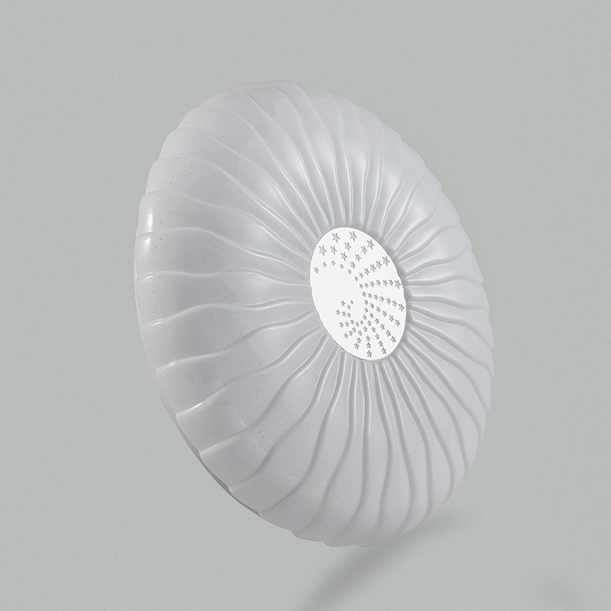
CL-N12
Modern Ceiling Light
Material:Iron base+ PMMA Cover
Input Voltage:AC85-265V
Led Chip:2835SMD
IP Rating:IP44 CRI>80 PF>0.9
Color Temperature:3000K/4500K/6000K
Operating Temperature:-25℃ ~50℃
Life Span:50000hours
Certificate:CE ROHS
Item Number | Wattage | LedQuantity | LuminousFlux | Beam Angle | Size (mm) | WIFI Control Remte Control Switch Control Dimmer Control
CL-N12 | 12W | 24pcs2835SMD | 960-1080lm | 120° | Φ260 | Yes
 | 15W | 30pcs2835SMD | 1200-1350lm | 120° | Φ280
 | 18W | 36pcs2835SMD | 1440-1620lm | 120° | Φ300
 | 21W | 42pcs2835SMD | 1680-1890lm | 120° | Φ300
 | 24W | 48pcs2835SMD | 1920-2160lm | 120° | Φ350
 | 27W | 54pcs2835SMD | 2160-2430lm | 120° | Φ350
 | 32W | 64pcs2835SMD | 2560-2880lm | 120° | Φ380
 | 40W | 80pcs2835SMD | 3200-3600lm | 120° | Φ400
 | 48W | 96pcs2835SMD | 3840-4320lm | 120° | Φ400
Modern Ceiling Light Material:Iron base+ PMMA Cover Input Voltage:AC85-265V Led Chip:2835SMD IP Rating:IP44 CRI>80 PF>0.9 Color Temperature:3000K/4500K/6000K Operating Temperature:-25℃ ~50℃ Life Span:50000hours Certificate:CE ROHS
Item Number | Wattage | LedQuantity | LuminousFlux | Beam Angle | Size (mm) | WIFI Control Remte control Switch control Dimmer control
CL-N00 | 24W | 48pcs2835SMD | 1920-2160lm | 120° | 350mm | Yes
 | 36W | 72pcs2835SMD | 2880-3240lm | 120° | 400mm
 | 40W | 80pcs2835SMD | 3200-3600lm | 120° | 450mm
Modern Ceiling Light Material:Iron base+ PMMA Cover Input Voltage:AC85-265V Led Chip:2835SMD IP Rating:IP44 CRI>80 PF>0.9 Color Temperature:3000K/4500K/6000K Operating Temperature:-25℃ ~50℃ Life Span:50000hours Certificate:CE ROHS
Item Number | Wattage | LedQuantity | LuminousFlux | Beam Angle | Size (mm) | WIFI Control Remte control Switch control Dimmer control
CL-N00 | 24W | 48pcs2835SMD | 1920-2160lm | 120° | 350mm | Yes
 | 36W | 72pcs2835SMD | 2880-3240lm | 120° | 400mm
 | 40W | 80pcs2835SMD | 3200-3600lm | 120° | 450mm
Modern Ceiling Light Material:Iron base+ PMMA Cover Input Voltage:AC85-265V Led Chip:2835SMD IP Rating:IP44 CRI>80 PF>0.9 Color Temperature:3000K/4500K/6000K Operating Temperature:-25℃ ~50℃ Life Span:50000hours Certificate:CE ROHS
Item Number | Wattage | LedQuantity | LuminousFlux | Beam Angle | Size (mm) | WIFI Control Remte control Switch control Dimmer control
CL-N00 | 24W | 48pcs2835SMD | 1920-2160lm | 120° | 350mm | Yes
 | 36W | 72pcs2835SMD | 2880-3240lm | 120° | 400mm
 | 40W | 80pcs2835SMD | 3200-3600lm | 120° | 450mm
Modern Ceiling Light Material:Iron base+ PMMA Cover Input Voltage:AC85-265V Led Chip:2835SMD IP Rating:IP44 CRI>80 PF>0.9 Color Temperature:3000K/4500K/6000K Operating Temperature:-25℃ ~50℃ Life Span:50000hours Certificate:CE ROHS
Item Number | Wattage | LedQuantity | LuminousFlux | Beam Angle | Size (mm) | WIFI Control Remte control Switch control Dimmer control
CL-N00 | 24W | 48pcs2835SMD | 1920-2160lm | 120° | 350mm | Yes
 | 36W | 72pcs2835SMD | 2880-3240lm | 120° | 400mm
 | 40W | 80pcs2835SMD | 3200-3600lm | 120° | 450mm

Slide 43
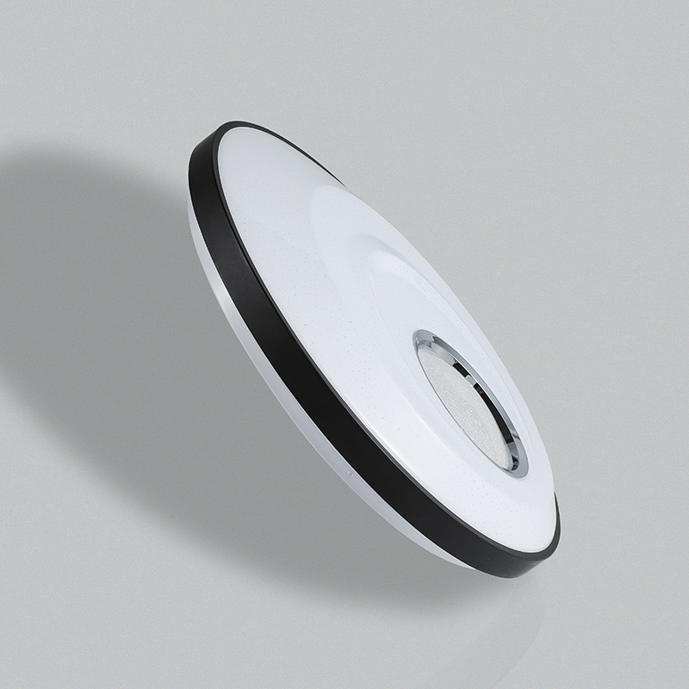
CL-N13
Modern Ceiling Light
Material:Iron base+ PMMA Cover
Input Voltage:AC85-265V
Led Chip:2835SMD
IP Rating:IP44 CRI>80 PF>0.9
Color Temperature:3000K/4500K/6000K
Operating Temperature:-25℃ ~50℃
Life Span:50000hours
Certificate:CE ROHS
Item Number | Wattage | LedQuantity | LuminousFlux | Beam Angle | Size (mm) | WIFI Control Remte Control Switch Control Dimmer Control
CL-N13 | 12W | 24pcs2835SMD | 960-1080lm | 120° | Φ260 | Yes
 | 15W | 30pcs2835SMD | 1200-1350lm | 120° | Φ280
 | 18W | 36pcs2835SMD | 1440-1620lm | 120° | Φ300
 | 21W | 42pcs2835SMD | 1680-1890lm | 120° | Φ300
 | 24W | 48pcs2835SMD | 1920-2160lm | 120° | Φ350
 | 27W | 54pcs2835SMD | 2160-2430lm | 120° | Φ350
 | 32W | 64pcs2835SMD | 2560-2880lm | 120° | Φ380
 | 40W | 80pcs2835SMD | 3200-3600lm | 120° | Φ400
 | 48W | 96pcs2835SMD | 3840-4320lm | 120° | Φ400
Modern Ceiling Light Material:Iron base+ PMMA Cover Input Voltage:AC85-265V Led Chip:2835SMD IP Rating:IP44 CRI>80 PF>0.9 Color Temperature:3000K/4500K/6000K Operating Temperature:-25℃ ~50℃ Life Span:50000hours Certificate:CE ROHS
Item Number | Wattage | LedQuantity | LuminousFlux | Beam Angle | Size (mm) | WIFI Control Remte control Switch control Dimmer control
CL-N00 | 24W | 48pcs2835SMD | 1920-2160lm | 120° | 350mm | Yes
 | 36W | 72pcs2835SMD | 2880-3240lm | 120° | 400mm
 | 40W | 80pcs2835SMD | 3200-3600lm | 120° | 450mm
Modern Ceiling Light Material:Iron base+ PMMA Cover Input Voltage:AC85-265V Led Chip:2835SMD IP Rating:IP44 CRI>80 PF>0.9 Color Temperature:3000K/4500K/6000K Operating Temperature:-25℃ ~50℃ Life Span:50000hours Certificate:CE ROHS
Item Number | Wattage | LedQuantity | LuminousFlux | Beam Angle | Size (mm) | WIFI Control Remte control Switch control Dimmer control
CL-N00 | 24W | 48pcs2835SMD | 1920-2160lm | 120° | 350mm | Yes
 | 36W | 72pcs2835SMD | 2880-3240lm | 120° | 400mm
 | 40W | 80pcs2835SMD | 3200-3600lm | 120° | 450mm
Modern Ceiling Light Material:Iron base+ PMMA Cover Input Voltage:AC85-265V Led Chip:2835SMD IP Rating:IP44 CRI>80 PF>0.9 Color Temperature:3000K/4500K/6000K Operating Temperature:-25℃ ~50℃ Life Span:50000hours Certificate:CE ROHS
Item Number | Wattage | LedQuantity | LuminousFlux | Beam Angle | Size (mm) | WIFI Control Remte control Switch control Dimmer control
CL-N00 | 24W | 48pcs2835SMD | 1920-2160lm | 120° | 350mm | Yes
 | 36W | 72pcs2835SMD | 2880-3240lm | 120° | 400mm
 | 40W | 80pcs2835SMD | 3200-3600lm | 120° | 450mm
Modern Ceiling Light Material:Iron base+ PMMA Cover Input Voltage:AC85-265V Led Chip:2835SMD IP Rating:IP44 CRI>80 PF>0.9 Color Temperature:3000K/4500K/6000K Operating Temperature:-25℃ ~50℃ Life Span:50000hours Certificate:CE ROHS
Item Number | Wattage | LedQuantity | LuminousFlux | Beam Angle | Size (mm) | WIFI Control Remte control Switch control Dimmer control
CL-N00 | 24W | 48pcs2835SMD | 1920-2160lm | 120° | 350mm | Yes
 | 36W | 72pcs2835SMD | 2880-3240lm | 120° | 400mm
 | 40W | 80pcs2835SMD | 3200-3600lm | 120° | 450mm

Slide 44
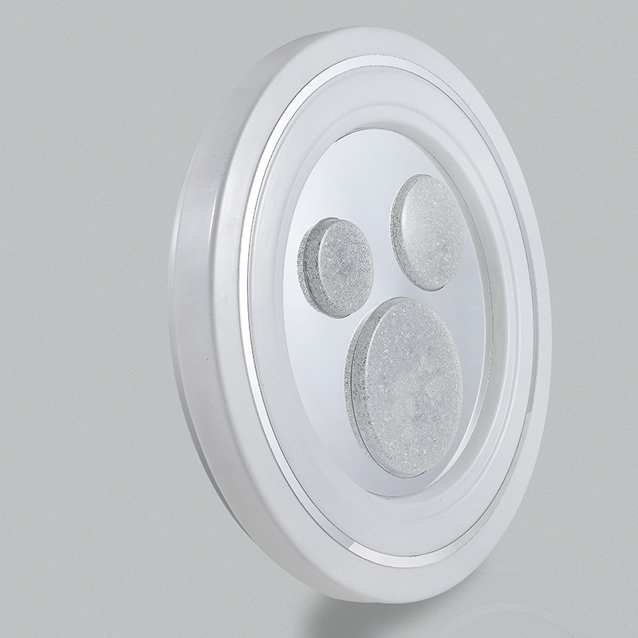
CL-N14
Modern Ceiling Light
Material:Iron base+ PMMA Cover
Input Voltage:AC85-265V
Led Chip:2835SMD
IP Rating:IP44 CRI>80 PF>0.9
Color Temperature:3000K/4500K/6000K
Operating Temperature:-25℃ ~50℃
Life Span:50000hours
Certificate:CE ROHS
Item Number | Wattage | LedQuantity | LuminousFlux | Beam Angle | Size (mm) | WIFI Control Remte Control Switch Control Dimmer Control
CL-N14 | 12W | 24pcs2835SMD | 960-1080lm | 120° | Φ260 | Yes
 | 15W | 30pcs2835SMD | 1200-1350lm | 120° | Φ280
 | 18W | 36pcs2835SMD | 1440-1620lm | 120° | Φ300
 | 21W | 42pcs2835SMD | 1680-1890lm | 120° | Φ300
 | 24W | 48pcs2835SMD | 1920-2160lm | 120° | Φ350
 | 27W | 54pcs2835SMD | 2160-2430lm | 120° | Φ350
 | 32W | 64pcs2835SMD | 2560-2880lm | 120° | Φ380
 | 40W | 80pcs2835SMD | 3200-3600lm | 120° | Φ400
 | 48W | 96pcs2835SMD | 3840-4320lm | 120° | Φ400
Modern Ceiling Light Material:Iron base+ PMMA Cover Input Voltage:AC85-265V Led Chip:2835SMD IP Rating:IP44 CRI>80 PF>0.9 Color Temperature:3000K/4500K/6000K Operating Temperature:-25℃ ~50℃ Life Span:50000hours Certificate:CE ROHS
Item Number | Wattage | LedQuantity | LuminousFlux | Beam Angle | Size (mm) | WIFI Control Remte control Switch control Dimmer control
CL-N00 | 24W | 48pcs2835SMD | 1920-2160lm | 120° | 350mm | Yes
 | 36W | 72pcs2835SMD | 2880-3240lm | 120° | 400mm
 | 40W | 80pcs2835SMD | 3200-3600lm | 120° | 450mm
Modern Ceiling Light Material:Iron base+ PMMA Cover Input Voltage:AC85-265V Led Chip:2835SMD IP Rating:IP44 CRI>80 PF>0.9 Color Temperature:3000K/4500K/6000K Operating Temperature:-25℃ ~50℃ Life Span:50000hours Certificate:CE ROHS
Item Number | Wattage | LedQuantity | LuminousFlux | Beam Angle | Size (mm) | WIFI Control Remte control Switch control Dimmer control
CL-N00 | 24W | 48pcs2835SMD | 1920-2160lm | 120° | 350mm | Yes
 | 36W | 72pcs2835SMD | 2880-3240lm | 120° | 400mm
 | 40W | 80pcs2835SMD | 3200-3600lm | 120° | 450mm
Modern Ceiling Light Material:Iron base+ PMMA Cover Input Voltage:AC85-265V Led Chip:2835SMD IP Rating:IP44 CRI>80 PF>0.9 Color Temperature:3000K/4500K/6000K Operating Temperature:-25℃ ~50℃ Life Span:50000hours Certificate:CE ROHS
Item Number | Wattage | LedQuantity | LuminousFlux | Beam Angle | Size (mm) | WIFI Control Remte control Switch control Dimmer control
CL-N00 | 24W | 48pcs2835SMD | 1920-2160lm | 120° | 350mm | Yes
 | 36W | 72pcs2835SMD | 2880-3240lm | 120° | 400mm
 | 40W | 80pcs2835SMD | 3200-3600lm | 120° | 450mm
Modern Ceiling Light Material:Iron base+ PMMA Cover Input Voltage:AC85-265V Led Chip:2835SMD IP Rating:IP44 CRI>80 PF>0.9 Color Temperature:3000K/4500K/6000K Operating Temperature:-25℃ ~50℃ Life Span:50000hours Certificate:CE ROHS
Item Number | Wattage | LedQuantity | LuminousFlux | Beam Angle | Size (mm) | WIFI Control Remte control Switch control Dimmer control
CL-N00 | 24W | 48pcs2835SMD | 1920-2160lm | 120° | 350mm | Yes
 | 36W | 72pcs2835SMD | 2880-3240lm | 120° | 400mm
 | 40W | 80pcs2835SMD | 3200-3600lm | 120° | 450mm

Slide 45
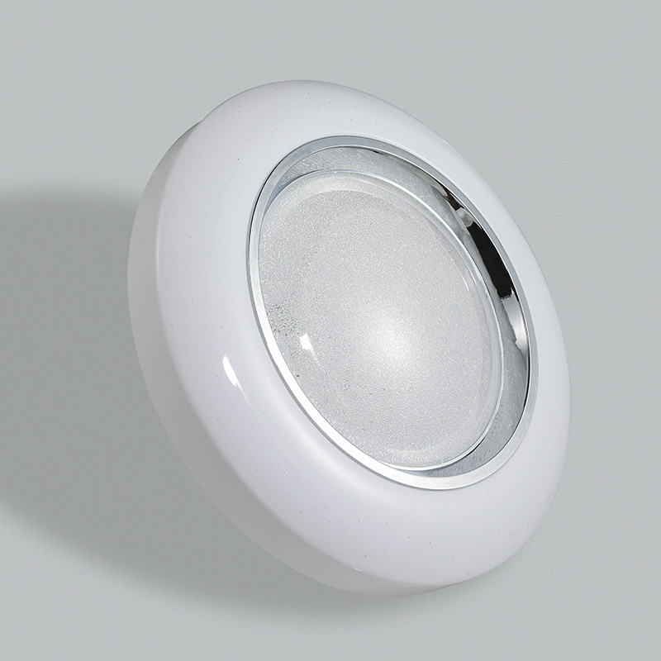
CL-N15
Modern Ceiling Light
Material:Iron base+ PMMA Cover
Input Voltage:AC85-265V
Led Chip:2835SMD
IP Rating:IP44 CRI>80 PF>0.9
Color Temperature:3000K/4500K/6000K
Operating Temperature:-25℃ ~50℃
Life Span:50000hours
Certificate:CE ROHS
Item Number | Wattage | LedQuantity | LuminousFlux | Beam Angle | Size (mm) | WIFI Control Remte Control Switch Control Dimmer Control
CL-N15 | 12W | 24pcs2835SMD | 960-1080lm | 120° | Φ260 | Yes
 | 15W | 30pcs2835SMD | 1200-1350lm | 120° | Φ280
 | 18W | 36pcs2835SMD | 1440-1620lm | 120° | Φ300
 | 21W | 42pcs2835SMD | 1680-1890lm | 120° | Φ300
 | 24W | 48pcs2835SMD | 1920-2160lm | 120° | Φ350
 | 27W | 54pcs2835SMD | 2160-2430lm | 120° | Φ350
 | 32W | 64pcs2835SMD | 2560-2880lm | 120° | Φ380
 | 40W | 80pcs2835SMD | 3200-3600lm | 120° | Φ400
 | 48W | 96pcs2835SMD | 3840-4320lm | 120° | Φ400
Modern Ceiling Light Material:Iron base+ PMMA Cover Input Voltage:AC85-265V Led Chip:2835SMD IP Rating:IP44 CRI>80 PF>0.9 Color Temperature:3000K/4500K/6000K Operating Temperature:-25℃ ~50℃ Life Span:50000hours Certificate:CE ROHS
Item Number | Wattage | LedQuantity | LuminousFlux | Beam Angle | Size (mm) | WIFI Control Remte control Switch control Dimmer control
CL-N00 | 24W | 48pcs2835SMD | 1920-2160lm | 120° | 350mm | Yes
 | 36W | 72pcs2835SMD | 2880-3240lm | 120° | 400mm
 | 40W | 80pcs2835SMD | 3200-3600lm | 120° | 450mm
Modern Ceiling Light Material:Iron base+ PMMA Cover Input Voltage:AC85-265V Led Chip:2835SMD IP Rating:IP44 CRI>80 PF>0.9 Color Temperature:3000K/4500K/6000K Operating Temperature:-25℃ ~50℃ Life Span:50000hours Certificate:CE ROHS
Item Number | Wattage | LedQuantity | LuminousFlux | Beam Angle | Size (mm) | WIFI Control Remte control Switch control Dimmer control
CL-N00 | 24W | 48pcs2835SMD | 1920-2160lm | 120° | 350mm | Yes
 | 36W | 72pcs2835SMD | 2880-3240lm | 120° | 400mm
 | 40W | 80pcs2835SMD | 3200-3600lm | 120° | 450mm
Modern Ceiling Light Material:Iron base+ PMMA Cover Input Voltage:AC85-265V Led Chip:2835SMD IP Rating:IP44 CRI>80 PF>0.9 Color Temperature:3000K/4500K/6000K Operating Temperature:-25℃ ~50℃ Life Span:50000hours Certificate:CE ROHS
Item Number | Wattage | LedQuantity | LuminousFlux | Beam Angle | Size (mm) | WIFI Control Remte control Switch control Dimmer control
CL-N00 | 24W | 48pcs2835SMD | 1920-2160lm | 120° | 350mm | Yes
 | 36W | 72pcs2835SMD | 2880-3240lm | 120° | 400mm
 | 40W | 80pcs2835SMD | 3200-3600lm | 120° | 450mm
Modern Ceiling Light Material:Iron base+ PMMA Cover Input Voltage:AC85-265V Led Chip:2835SMD IP Rating:IP44 CRI>80 PF>0.9 Color Temperature:3000K/4500K/6000K Operating Temperature:-25℃ ~50℃ Life Span:50000hours Certificate:CE ROHS
Item Number | Wattage | LedQuantity | LuminousFlux | Beam Angle | Size (mm) | WIFI Control Remte control Switch control Dimmer control
CL-N00 | 24W | 48pcs2835SMD | 1920-2160lm | 120° | 350mm | Yes
 | 36W | 72pcs2835SMD | 2880-3240lm | 120° | 400mm
 | 40W | 80pcs2835SMD | 3200-3600lm | 120° | 450mm

Slide 46
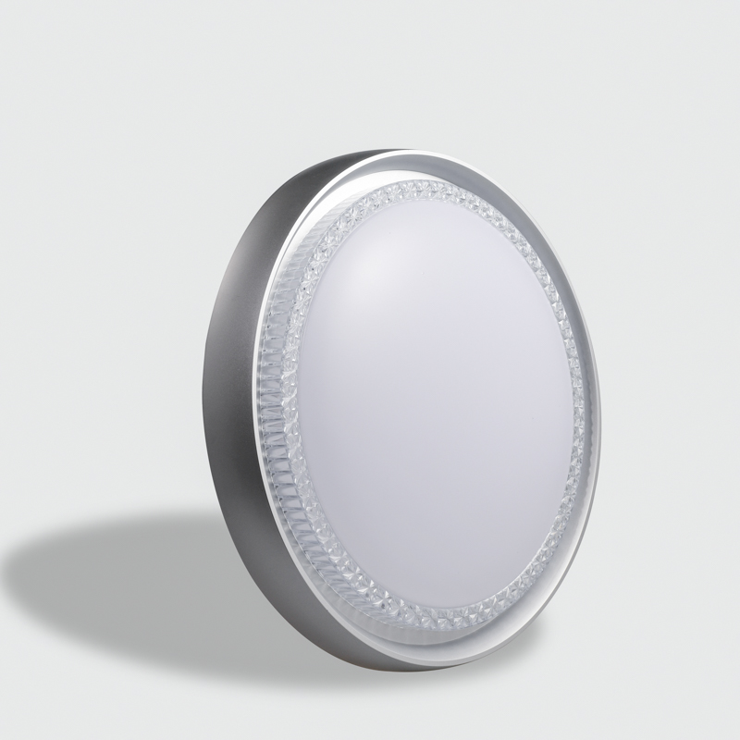
CL-N16
Modern Ceiling Light
Material:Iron base+ PMMA Cover
Input Voltage:AC85-265V
Led Chip:2835SMD
IP Rating:IP44 CRI>80 PF>0.9
Color Temperature:3000K/4500K/6000K
Operating Temperature:-25℃ ~50℃
Life Span:50000hours
Certificate:CE ROHS
Item Number | Wattage | LedQuantity | LuminousFlux | Beam Angle | Size (mm) | WIFI Control Remte Control Switch Control Dimmer Control
CL-N16 | 20W | 40pcs2835SMD | 1600-1800lm | 120° | Φ300 | Yes
 | 24w | 48pcs2835SMD | 1920-2160lm | 120° | Φ380
 | 30W | 54pcs2835SMD | 2400-2700lm | 120° | Φ470
 | 40W | 80pcs2835SMD | 3200-3600lm | 120° | Φ560
Modern Ceiling Light Material:Iron base+ PMMA Cover Input Voltage:AC85-265V Led Chip:2835SMD IP Rating:IP44 CRI>80 PF>0.9 Color Temperature:3000K/4500K/6000K Operating Temperature:-25℃ ~50℃ Life Span:50000hours Certificate:CE ROHS
Item Number | Wattage | LedQuantity | LuminousFlux | Beam Angle | Size (mm) | WIFI Control Remte control Switch control Dimmer control
CL-N00 | 24W | 48pcs2835SMD | 1920-2160lm | 120° | 350mm | Yes
 | 36W | 72pcs2835SMD | 2880-3240lm | 120° | 400mm
 | 40W | 80pcs2835SMD | 3200-3600lm | 120° | 450mm
Modern Ceiling Light Material:Iron base+ PMMA Cover Input Voltage:AC85-265V Led Chip:2835SMD IP Rating:IP44 CRI>80 PF>0.9 Color Temperature:3000K/4500K/6000K Operating Temperature:-25℃ ~50℃ Life Span:50000hours Certificate:CE ROHS
Item Number | Wattage | LedQuantity | LuminousFlux | Beam Angle | Size (mm) | WIFI Control Remte control Switch control Dimmer control
CL-N00 | 24W | 48pcs2835SMD | 1920-2160lm | 120° | 350mm | Yes
 | 36W | 72pcs2835SMD | 2880-3240lm | 120° | 400mm
 | 40W | 80pcs2835SMD | 3200-3600lm | 120° | 450mm
Modern Ceiling Light Material:Iron base+ PMMA Cover Input Voltage:AC85-265V Led Chip:2835SMD IP Rating:IP44 CRI>80 PF>0.9 Color Temperature:3000K/4500K/6000K Operating Temperature:-25℃ ~50℃ Life Span:50000hours Certificate:CE ROHS
Item Number | Wattage | LedQuantity | LuminousFlux | Beam Angle | Size (mm) | WIFI Control Remte control Switch control Dimmer control
CL-N00 | 24W | 48pcs2835SMD | 1920-2160lm | 120° | 350mm | Yes
 | 36W | 72pcs2835SMD | 2880-3240lm | 120° | 400mm
 | 40W | 80pcs2835SMD | 3200-3600lm | 120° | 450mm
Modern Ceiling Light Material:Iron base+ PMMA Cover Input Voltage:AC85-265V Led Chip:2835SMD IP Rating:IP44 CRI>80 PF>0.9 Color Temperature:3000K/4500K/6000K Operating Temperature:-25℃ ~50℃ Life Span:50000hours Certificate:CE ROHS
Item Number | Wattage | LedQuantity | LuminousFlux | Beam Angle | Size (mm) | WIFI Control Remte control Switch control Dimmer control
CL-N00 | 24W | 48pcs2835SMD | 1920-2160lm | 120° | 350mm | Yes
 | 36W | 72pcs2835SMD | 2880-3240lm | 120° | 400mm
 | 40W | 80pcs2835SMD | 3200-3600lm | 120° | 450mm

Slide 47
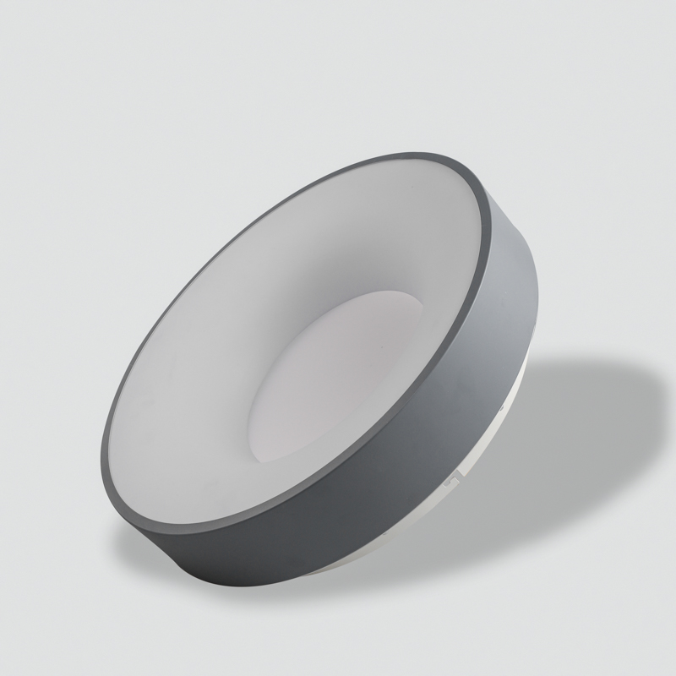
CL-N18
Modern Ceiling Light
Material:Iron base+ PMMA Cover
Input Voltage:AC85-265V
Led Chip:2835SMD
IP Rating:IP44 CRI>80 PF>0.9
Color Temperature:3000K/4500K/6000K
Operating Temperature:-25℃ ~50℃
Life Span:50000hours
Certificate:CE ROHS
Item Number | Wattage | LedQuantity | LuminousFlux | Beam Angle | Size (mm) | WIFI Control Remte Control Switch Control Dimmer Control
CL-N18 | 20W | 40pcs2835SMD | 1600-1800lm | 120° | Φ300 | Yes
 | 24w | 48pcs2835SMD | 1920-2160lm | 120° | Φ380
 | 30W | 60pcs2835SMD | 2400-2700lm | 120° | Φ470
 | 40W | 80pcs2835SMD | 3200-3600lm | 120° | Φ560
Modern Ceiling Light Material:Iron base+ PMMA Cover Input Voltage:AC85-265V Led Chip:2835SMD IP Rating:IP44 CRI>80 PF>0.9 Color Temperature:3000K/4500K/6000K Operating Temperature:-25℃ ~50℃ Life Span:50000hours Certificate:CE ROHS
Item Number | Wattage | LedQuantity | LuminousFlux | Beam Angle | Size (mm) | WIFI Control Remte control Switch control Dimmer control
CL-N00 | 24W | 48pcs2835SMD | 1920-2160lm | 120° | 350mm | Yes
 | 36W | 72pcs2835SMD | 2880-3240lm | 120° | 400mm
 | 40W | 80pcs2835SMD | 3200-3600lm | 120° | 450mm
Modern Ceiling Light Material:Iron base+ PMMA Cover Input Voltage:AC85-265V Led Chip:2835SMD IP Rating:IP44 CRI>80 PF>0.9 Color Temperature:3000K/4500K/6000K Operating Temperature:-25℃ ~50℃ Life Span:50000hours Certificate:CE ROHS
Item Number | Wattage | LedQuantity | LuminousFlux | Beam Angle | Size (mm) | WIFI Control Remte control Switch control Dimmer control
CL-N00 | 24W | 48pcs2835SMD | 1920-2160lm | 120° | 350mm | Yes
 | 36W | 72pcs2835SMD | 2880-3240lm | 120° | 400mm
 | 40W | 80pcs2835SMD | 3200-3600lm | 120° | 450mm
Modern Ceiling Light Material:Iron base+ PMMA Cover Input Voltage:AC85-265V Led Chip:2835SMD IP Rating:IP44 CRI>80 PF>0.9 Color Temperature:3000K/4500K/6000K Operating Temperature:-25℃ ~50℃ Life Span:50000hours Certificate:CE ROHS
Item Number | Wattage | LedQuantity | LuminousFlux | Beam Angle | Size (mm) | WIFI Control Remte control Switch control Dimmer control
CL-N00 | 24W | 48pcs2835SMD | 1920-2160lm | 120° | 350mm | Yes
 | 36W | 72pcs2835SMD | 2880-3240lm | 120° | 400mm
 | 40W | 80pcs2835SMD | 3200-3600lm | 120° | 450mm
Modern Ceiling Light Material:Iron base+ PMMA Cover Input Voltage:AC85-265V Led Chip:2835SMD IP Rating:IP44 CRI>80 PF>0.9 Color Temperature:3000K/4500K/6000K Operating Temperature:-25℃ ~50℃ Life Span:50000hours Certificate:CE ROHS
Item Number | Wattage | LedQuantity | LuminousFlux | Beam Angle | Size (mm) | WIFI Control Remte control Switch control Dimmer control
CL-N00 | 24W | 48pcs2835SMD | 1920-2160lm | 120° | 350mm | Yes
 | 36W | 72pcs2835SMD | 2880-3240lm | 120° | 400mm
 | 40W | 80pcs2835SMD | 3200-3600lm | 120° | 450mm

Slide 48
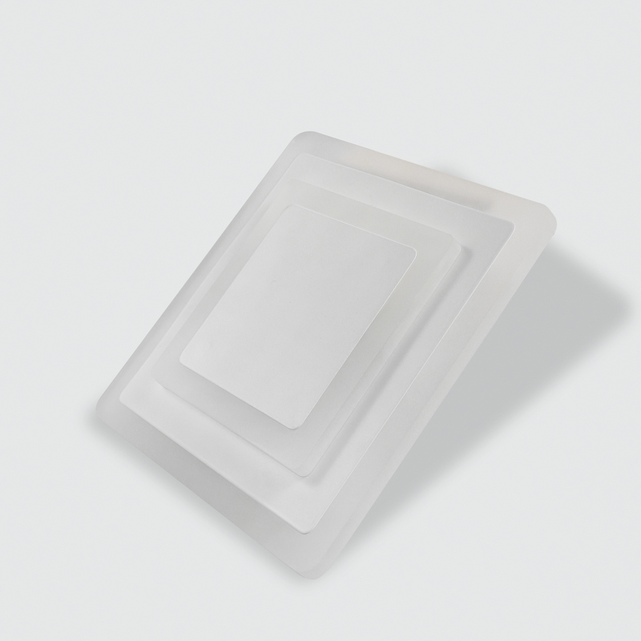
CL-N20
Modern Ceiling Light
Material:Iron base+ PMMA Cover
Input Voltage:AC85-265V
Led Chip:2835SMD
IP Rating:IP44 CRI>80 PF>0.9
Color Temperature:3000K/4500K/6000K
Operating Temperature:-25℃ ~50℃
Life Span:50000hours
Certificate:CE ROHS
Item Number | Wattage | LedQuantity | LuminousFlux | Beam Angle | Size (mm) | WIFI Control Remte Control Switch Control Dimmer Control
CL-N20 | 15W | 30pcs2835SMD | 1200-1440lm | 120° | 200*200*50 | Yes
 | 25W | 50pcs2835SMD | 2000-2250lm | 120° | 300*300*50
Modern Ceiling Light Material:Iron base+ PMMA Cover Input Voltage:AC85-265V Led Chip:2835SMD IP Rating:IP44 CRI>80 PF>0.9 Color Temperature:3000K/4500K/6000K Operating Temperature:-25℃ ~50℃ Life Span:50000hours Certificate:CE ROHS
Item Number | Wattage | LedQuantity | LuminousFlux | Beam Angle | Size (mm) | WIFI Control Remte control Switch control Dimmer control
CL-N00 | 24W | 48pcs2835SMD | 1920-2160lm | 120° | 350mm | Yes
 | 36W | 72pcs2835SMD | 2880-3240lm | 120° | 400mm
 | 40W | 80pcs2835SMD | 3200-3600lm | 120° | 450mm
Modern Ceiling Light Material:Iron base+ PMMA Cover Input Voltage:AC85-265V Led Chip:2835SMD IP Rating:IP44 CRI>80 PF>0.9 Color Temperature:3000K/4500K/6000K Operating Temperature:-25℃ ~50℃ Life Span:50000hours Certificate:CE ROHS
Item Number | Wattage | LedQuantity | LuminousFlux | Beam Angle | Size (mm) | WIFI Control Remte control Switch control Dimmer control
CL-N00 | 24W | 48pcs2835SMD | 1920-2160lm | 120° | 350mm | Yes
 | 36W | 72pcs2835SMD | 2880-3240lm | 120° | 400mm
 | 40W | 80pcs2835SMD | 3200-3600lm | 120° | 450mm
Modern Ceiling Light Material:Iron base+ PMMA Cover Input Voltage:AC85-265V Led Chip:2835SMD IP Rating:IP44 CRI>80 PF>0.9 Color Temperature:3000K/4500K/6000K Operating Temperature:-25℃ ~50℃ Life Span:50000hours Certificate:CE ROHS
Item Number | Wattage | LedQuantity | LuminousFlux | Beam Angle | Size (mm) | WIFI Control Remte control Switch control Dimmer control
CL-N00 | 24W | 48pcs2835SMD | 1920-2160lm | 120° | 350mm | Yes
 | 36W | 72pcs2835SMD | 2880-3240lm | 120° | 400mm
 | 40W | 80pcs2835SMD | 3200-3600lm | 120° | 450mm
Modern Ceiling Light Material:Iron base+ PMMA Cover Input Voltage:AC85-265V Led Chip:2835SMD IP Rating:IP44 CRI>80 PF>0.9 Color Temperature:3000K/4500K/6000K Operating Temperature:-25℃ ~50℃ Life Span:50000hours Certificate:CE ROHS
Item Number | Wattage | LedQuantity | LuminousFlux | Beam Angle | Size (mm) | WIFI Control Remte control Switch control Dimmer control
CL-N00 | 24W | 48pcs2835SMD | 1920-2160lm | 120° | 350mm | Yes
 | 36W | 72pcs2835SMD | 2880-3240lm | 120° | 400mm
 | 40W | 80pcs2835SMD | 3200-3600lm | 120° | 450mm

Slide 49
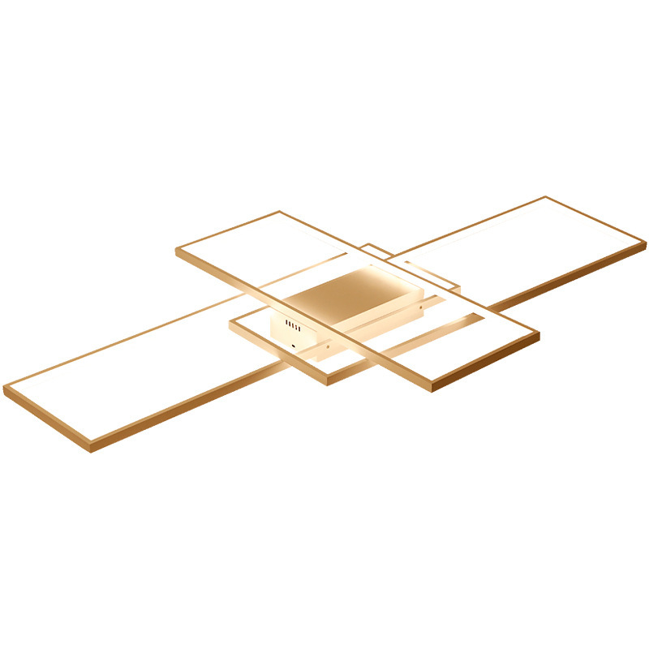
NC02
Modern Ceiling Light
Material:Iron base+ PMMA Cover
Input Voltage:AC85-265V
Led Chip:2835SMD
IP Rating:IP44 CRI>80 PF>0.9
Color Temperature:3000K/4500K/6000K
Operating Temperature:-25℃ ~50℃
Life Span:50000hours
Certificate:CE ROHS
Item Number | Wattage | LedQuantity | LuminousFlux | Beam Angle | Size (mm) | WIFI Control Remte Control Switch Control Dimmer Control
NC02 | 50W | 100pcs2835SMD | 4000-4500lm | 120° | L900*W600*H60 | Yes
 | 65W | 130pcs2835SMD | 5200-5850lm | 120° | L1200*W800*H60
 | 82W | 164pcs2835SMD | 6560-7380lm | 120° | L1400*W900*H60
Modern Ceiling Light Material:Iron base+ PMMA Cover Input Voltage:AC85-265V Led Chip:2835SMD IP Rating:IP44 CRI>80 PF>0.9 Color Temperature:3000K/4500K/6000K Operating Temperature:-25℃ ~50℃ Life Span:50000hours Certificate:CE ROHS
Item Number | Wattage | LedQuantity | LuminousFlux | Beam Angle | Size (mm) | WIFI Control Remte control Switch control Dimmer control
CL-N00 | 24W | 48pcs2835SMD | 1920-2160lm | 120° | 350mm | Yes
 | 36W | 72pcs2835SMD | 2880-3240lm | 120° | 400mm
 | 40W | 80pcs2835SMD | 3200-3600lm | 120° | 450mm
Modern Ceiling Light Material:Iron base+ PMMA Cover Input Voltage:AC85-265V Led Chip:2835SMD IP Rating:IP44 CRI>80 PF>0.9 Color Temperature:3000K/4500K/6000K Operating Temperature:-25℃ ~50℃ Life Span:50000hours Certificate:CE ROHS
Item Number | Wattage | LedQuantity | LuminousFlux | Beam Angle | Size (mm) | WIFI Control Remte control Switch control Dimmer control
CL-N00 | 24W | 48pcs2835SMD | 1920-2160lm | 120° | 350mm | Yes
 | 36W | 72pcs2835SMD | 2880-3240lm | 120° | 400mm
 | 40W | 80pcs2835SMD | 3200-3600lm | 120° | 450mm
Modern Ceiling Light Material:Iron base+ PMMA Cover Input Voltage:AC85-265V Led Chip:2835SMD IP Rating:IP44 CRI>80 PF>0.9 Color Temperature:3000K/4500K/6000K Operating Temperature:-25℃ ~50℃ Life Span:50000hours Certificate:CE ROHS
Item Number | Wattage | LedQuantity | LuminousFlux | Beam Angle | Size (mm) | WIFI Control Remte control Switch control Dimmer control
CL-N00 | 24W | 48pcs2835SMD | 1920-2160lm | 120° | 350mm | Yes
 | 36W | 72pcs2835SMD | 2880-3240lm | 120° | 400mm
 | 40W | 80pcs2835SMD | 3200-3600lm | 120° | 450mm
Modern Ceiling Light Material:Iron base+ PMMA Cover Input Voltage:AC85-265V Led Chip:2835SMD IP Rating:IP44 CRI>80 PF>0.9 Color Temperature:3000K/4500K/6000K Operating Temperature:-25℃ ~50℃ Life Span:50000hours Certificate:CE ROHS
Item Number | Wattage | LedQuantity | LuminousFlux | Beam Angle | Size (mm) | WIFI Control Remte control Switch control Dimmer control
CL-N00 | 24W | 48pcs2835SMD | 1920-2160lm | 120° | 350mm | Yes
 | 36W | 72pcs2835SMD | 2880-3240lm | 120° | 400mm
 | 40W | 80pcs2835SMD | 3200-3600lm | 120° | 450mm

