Slide 1
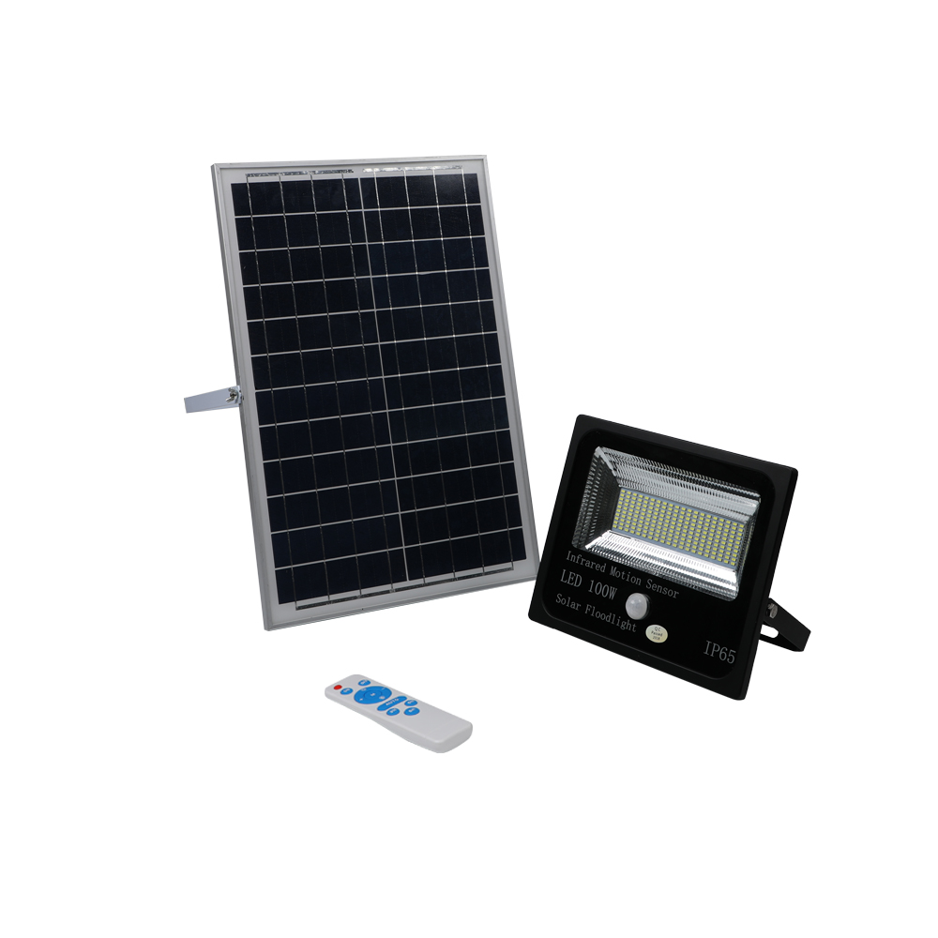
FL01
Material:Iron base+ PMMA Cover
Input Voltage:AC85-265V
Led Chip:2835SMD
IP Rating:IP44 CRI>80 PF>0.9
Color Temperature:3000K/4500K/6000K
Operating Temperature:-25℃ ~50℃
Life Span:50000hours
Certificate:CE ROHS
Item Number | Wattage | LedQuantity | Lamp size | solar panel size | Solar panel power
FL01 | 10W | 20pcs2835SMD | 90-110LM/W | 120° | 135*220*17mm
 | 20W | 40pcs2835SMD |  | 120° | 190*240*17mm
 | 25W | 50pcs2835SMD |  | 120° | 210*280*17mm
 | 30W | 60pcs2835SMD |  | 120° | 230*340*17mm
 | 50W | 100pcs2835SMD |  | 120° | 340*460*17mm
 | 60W | 120pcs2835SMD |  | 120° | 380*500*17mm
 | 100W | 200pcs2835SMD |  | 120° | 420*560*17mm
 | 200W | 400pcs2835SMD |  | 120° | 460*600*17mm
 | 300W | 600pcs2835SMD |  | 120° | 500*650*17mm
Modern Ceiling Light Material:Iron base+ PMMA Cover Input Voltage:AC85-265V Led Chip:2835SMD IP Rating:IP44 CRI>80 PF>0.9 Color Temperature:3000K/4500K/6000K Operating Temperature:-25℃ ~50℃ Life Span:50000hours Certificate:CE ROHS
Item Number | Wattage | LedQuantity | LuminousFlux | Beam Angle | Size (mm) | WIFI Control Remte control Switch control Dimmer control
CL-N00 | 24W | 48pcs2835SMD | 1920-2160lm | 120° | 350mm | Yes
 | 36W | 72pcs2835SMD | 2880-3240lm | 120° | 400mm
 | 40W | 80pcs2835SMD | 3200-3600lm | 120° | 450mm
Modern Ceiling Light Material:Iron base+ PMMA Cover Input Voltage:AC85-265V Led Chip:2835SMD IP Rating:IP44 CRI>80 PF>0.9 Color Temperature:3000K/4500K/6000K Operating Temperature:-25℃ ~50℃ Life Span:50000hours Certificate:CE ROHS
Item Number | Wattage | LedQuantity | LuminousFlux | Beam Angle | Size (mm) | WIFI Control Remte control Switch control Dimmer control
CL-N00 | 24W | 48pcs2835SMD | 1920-2160lm | 120° | 350mm | Yes
 | 36W | 72pcs2835SMD | 2880-3240lm | 120° | 400mm
 | 40W | 80pcs2835SMD | 3200-3600lm | 120° | 450mm
Modern Ceiling Light Material:Iron base+ PMMA Cover Input Voltage:AC85-265V Led Chip:2835SMD IP Rating:IP44 CRI>80 PF>0.9 Color Temperature:3000K/4500K/6000K Operating Temperature:-25℃ ~50℃ Life Span:50000hours Certificate:CE ROHS
Item Number | Wattage | LedQuantity | LuminousFlux | Beam Angle | Size (mm) | WIFI Control Remte control Switch control Dimmer control
CL-N00 | 24W | 48pcs2835SMD | 1920-2160lm | 120° | 350mm | Yes
 | 36W | 72pcs2835SMD | 2880-3240lm | 120° | 400mm
 | 40W | 80pcs2835SMD | 3200-3600lm | 120° | 450mm
Modern Ceiling Light Material:Iron base+ PMMA Cover Input Voltage:AC85-265V Led Chip:2835SMD IP Rating:IP44 CRI>80 PF>0.9 Color Temperature:3000K/4500K/6000K Operating Temperature:-25℃ ~50℃ Life Span:50000hours Certificate:CE ROHS
Item Number | Wattage | LedQuantity | LuminousFlux | Beam Angle | Size (mm) | WIFI Control Remte control Switch control Dimmer control
CL-N00 | 24W | 48pcs2835SMD | 1920-2160lm | 120° | 350mm | Yes
 | 36W | 72pcs2835SMD | 2880-3240lm | 120° | 400mm
 | 40W | 80pcs2835SMD | 3200-3600lm | 120° | 450mm

Slide 2
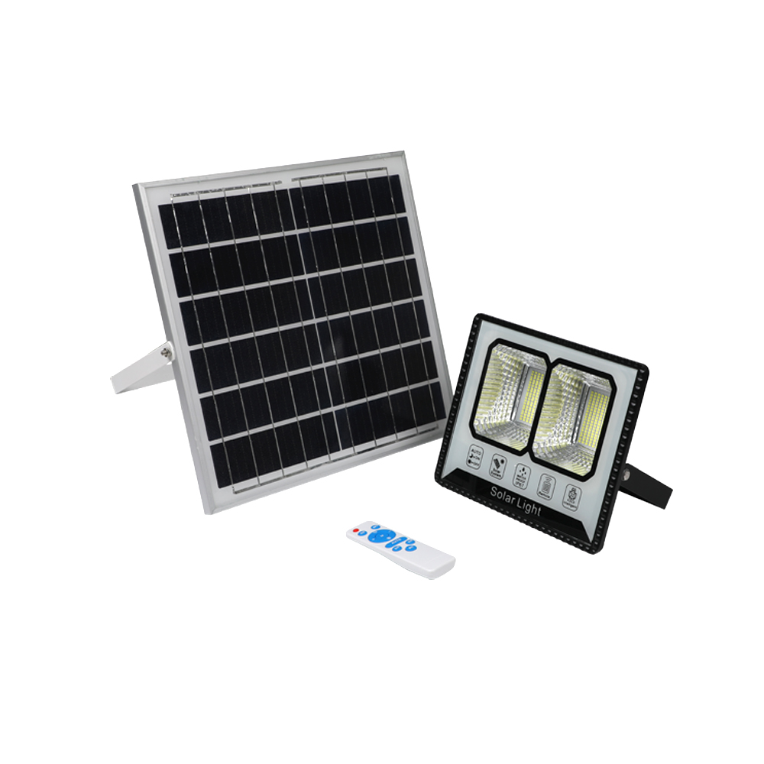
FL02
Material:Iron base+ PMMA Cover
Input Voltage:AC85-265V
Led Chip:2835SMD
IP Rating:IP44 CRI>80 PF>0.9
Color Temperature:3000K/4500K/6000K
Operating Temperature:-25℃ ~50℃
Life Span:50000hours
Certificate:CE ROHS
Item Number | Wattage | LedQuantity | Lamp size | solar panel size | Solar panel power | Battery Capacity | Luminous Flux | Bean Angle
FL02 | 300W | 192pcs2835SMD | 203*156*2mm | 350*350mm | 18W | 12AH | 90-110LM/W | 120°
 | 400W | 260pcs2835SMD | 250*200*2mm | 460*340mm | 22W | 18AH |  | 120°
 | 600W | 300pcs2835SMD | 250*200*2mm | 530*350mm | 28W | 24AH |  | 120°
 | 800W | 384pcs2835SMD | 277*225*2mm | 580*360mm | 30W | 30AH |  | 120°
Modern Ceiling Light Material:Iron base+ PMMA Cover Input Voltage:AC85-265V Led Chip:2835SMD IP Rating:IP44 CRI>80 PF>0.9 Color Temperature:3000K/4500K/6000K Operating Temperature:-25℃ ~50℃ Life Span:50000hours Certificate:CE ROHS
Item Number | Wattage | LedQuantity | LuminousFlux | Beam Angle | Size (mm) | WIFI Control Remte control Switch control Dimmer control
CL-N00 | 24W | 48pcs2835SMD | 1920-2160lm | 120° | 350mm | Yes
 | 36W | 72pcs2835SMD | 2880-3240lm | 120° | 400mm
 | 40W | 80pcs2835SMD | 3200-3600lm | 120° | 450mm
Modern Ceiling Light Material:Iron base+ PMMA Cover Input Voltage:AC85-265V Led Chip:2835SMD IP Rating:IP44 CRI>80 PF>0.9 Color Temperature:3000K/4500K/6000K Operating Temperature:-25℃ ~50℃ Life Span:50000hours Certificate:CE ROHS
Item Number | Wattage | LedQuantity | LuminousFlux | Beam Angle | Size (mm) | WIFI Control Remte control Switch control Dimmer control
CL-N00 | 24W | 48pcs2835SMD | 1920-2160lm | 120° | 350mm | Yes
 | 36W | 72pcs2835SMD | 2880-3240lm | 120° | 400mm
 | 40W | 80pcs2835SMD | 3200-3600lm | 120° | 450mm
Modern Ceiling Light Material:Iron base+ PMMA Cover Input Voltage:AC85-265V Led Chip:2835SMD IP Rating:IP44 CRI>80 PF>0.9 Color Temperature:3000K/4500K/6000K Operating Temperature:-25℃ ~50℃ Life Span:50000hours Certificate:CE ROHS
Item Number | Wattage | LedQuantity | LuminousFlux | Beam Angle | Size (mm) | WIFI Control Remte control Switch control Dimmer control
CL-N00 | 24W | 48pcs2835SMD | 1920-2160lm | 120° | 350mm | Yes
 | 36W | 72pcs2835SMD | 2880-3240lm | 120° | 400mm
 | 40W | 80pcs2835SMD | 3200-3600lm | 120° | 450mm
Modern Ceiling Light Material:Iron base+ PMMA Cover Input Voltage:AC85-265V Led Chip:2835SMD IP Rating:IP44 CRI>80 PF>0.9 Color Temperature:3000K/4500K/6000K Operating Temperature:-25℃ ~50℃ Life Span:50000hours Certificate:CE ROHS
Item Number | Wattage | LedQuantity | LuminousFlux | Beam Angle | Size (mm) | WIFI Control Remte control Switch control Dimmer control
CL-N00 | 24W | 48pcs2835SMD | 1920-2160lm | 120° | 350mm | Yes
 | 36W | 72pcs2835SMD | 2880-3240lm | 120° | 400mm
 | 40W | 80pcs2835SMD | 3200-3600lm | 120° | 450mm

Slide 3
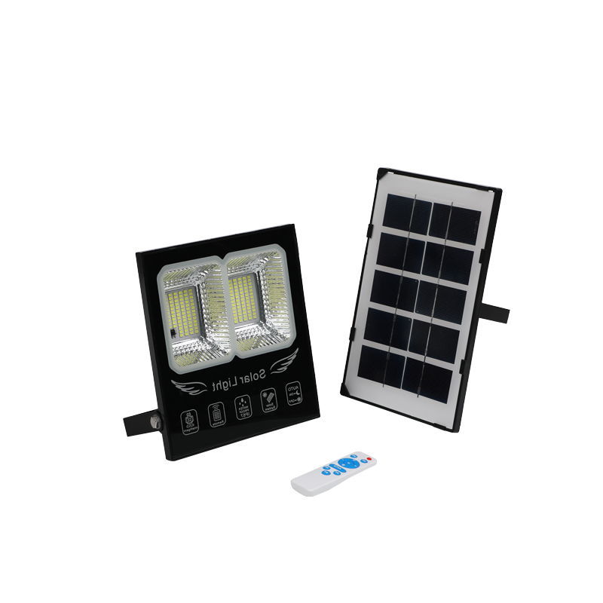
FL03
Material:Iron base+ PMMA Cover
Input Voltage:AC85-265V
Led Chip:2835SMD
IP Rating:IP44 CRI>80 PF>0.9
Color Temperature:3000K/4500K/6000K
Operating Temperature:-25℃ ~50℃
Life Span:50000hours
Certificate:CE ROHS
Item Number | Wattage | LedQuantity | Lamp size | solar panel size | Solar panel power | Battery Capacity | Luminous Flux | Bean Angle
FL03 | 50W | 96pcs2835SMD | 203*156*2mm | 370*305mm | 12W | 12AH | 120-130LM/W | 120°
 | 100W | 140pcs2835SMD | 250*200*2mm | 420*370mm | 18W | 18AH |  | 120°
 | 200W | 176pcs2835SMD | 250*200*2mm | 530*350mm | 25W | 24AH |  | 120°
 | 300W | 208pcs2835SMD | 277*225*2mm | 600*350mm | 30W | 30AH |  | 120°
Modern Ceiling Light Material:Iron base+ PMMA Cover Input Voltage:AC85-265V Led Chip:2835SMD IP Rating:IP44 CRI>80 PF>0.9 Color Temperature:3000K/4500K/6000K Operating Temperature:-25℃ ~50℃ Life Span:50000hours Certificate:CE ROHS
Item Number | Wattage | LedQuantity | LuminousFlux | Beam Angle | Size (mm) | WIFI Control Remte control Switch control Dimmer control
CL-N00 | 24W | 48pcs2835SMD | 1920-2160lm | 120° | 350mm | Yes
 | 36W | 72pcs2835SMD | 2880-3240lm | 120° | 400mm
 | 40W | 80pcs2835SMD | 3200-3600lm | 120° | 450mm
Modern Ceiling Light Material:Iron base+ PMMA Cover Input Voltage:AC85-265V Led Chip:2835SMD IP Rating:IP44 CRI>80 PF>0.9 Color Temperature:3000K/4500K/6000K Operating Temperature:-25℃ ~50℃ Life Span:50000hours Certificate:CE ROHS
Item Number | Wattage | LedQuantity | LuminousFlux | Beam Angle | Size (mm) | WIFI Control Remte control Switch control Dimmer control
CL-N00 | 24W | 48pcs2835SMD | 1920-2160lm | 120° | 350mm | Yes
 | 36W | 72pcs2835SMD | 2880-3240lm | 120° | 400mm
 | 40W | 80pcs2835SMD | 3200-3600lm | 120° | 450mm
Modern Ceiling Light Material:Iron base+ PMMA Cover Input Voltage:AC85-265V Led Chip:2835SMD IP Rating:IP44 CRI>80 PF>0.9 Color Temperature:3000K/4500K/6000K Operating Temperature:-25℃ ~50℃ Life Span:50000hours Certificate:CE ROHS
Item Number | Wattage | LedQuantity | LuminousFlux | Beam Angle | Size (mm) | WIFI Control Remte control Switch control Dimmer control
CL-N00 | 24W | 48pcs2835SMD | 1920-2160lm | 120° | 350mm | Yes
 | 36W | 72pcs2835SMD | 2880-3240lm | 120° | 400mm
 | 40W | 80pcs2835SMD | 3200-3600lm | 120° | 450mm
Modern Ceiling Light Material:Iron base+ PMMA Cover Input Voltage:AC85-265V Led Chip:2835SMD IP Rating:IP44 CRI>80 PF>0.9 Color Temperature:3000K/4500K/6000K Operating Temperature:-25℃ ~50℃ Life Span:50000hours Certificate:CE ROHS
Item Number | Wattage | LedQuantity | LuminousFlux | Beam Angle | Size (mm) | WIFI Control Remte control Switch control Dimmer control
CL-N00 | 24W | 48pcs2835SMD | 1920-2160lm | 120° | 350mm | Yes
 | 36W | 72pcs2835SMD | 2880-3240lm | 120° | 400mm
 | 40W | 80pcs2835SMD | 3200-3600lm | 120° | 450mm

Slide 4
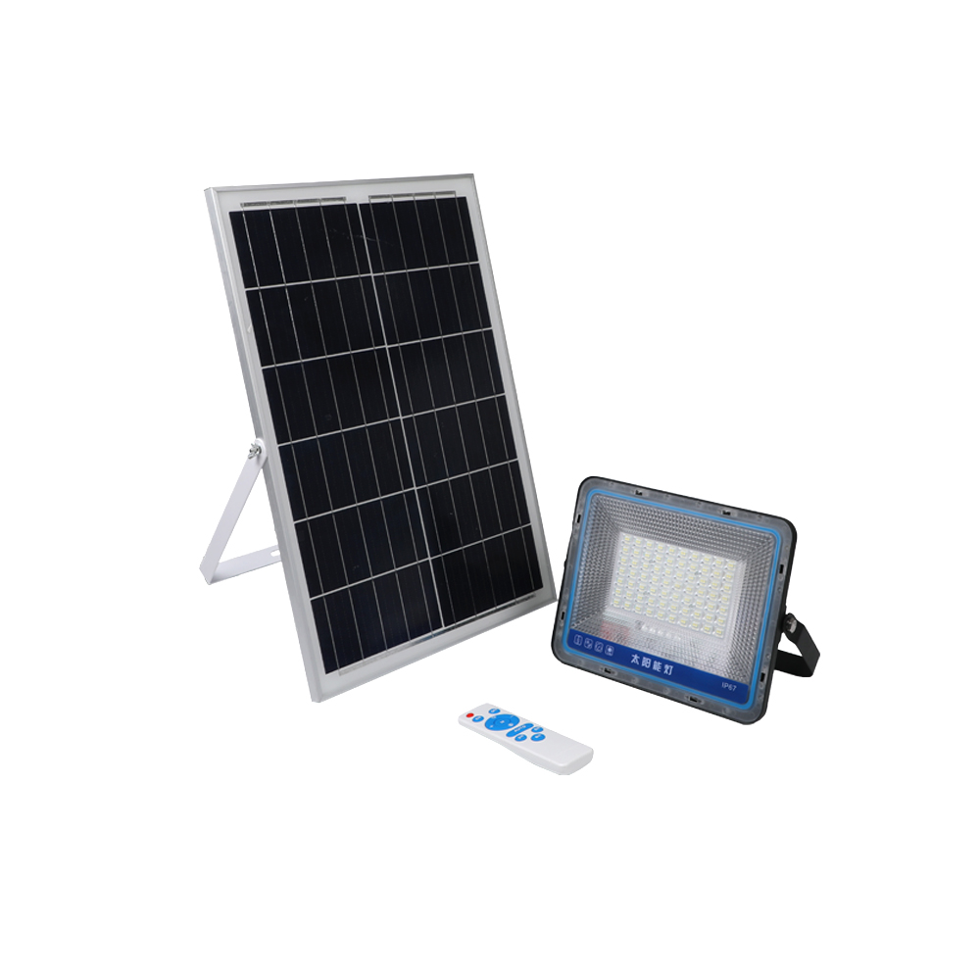
FL05
Material:Iron base+ PMMA Cover
Input Voltage:AC85-265V
Led Chip:2835SMD
IP Rating:IP44 CRI>80 PF>0.9
Color Temperature:3000K/4500K/6000K
Operating Temperature:-25℃ ~50℃
Life Span:50000hours
Certificate:CE ROHS
Item Number | Wattage | LedQuantity | Lamp size | solar panel size | Solar panel power | Battery Capacity | Luminous Flux | Bean Angle
FL05 | 50W | 96pcs2835SMD | 203*156*2mm | 370*305mm | 12W | 12AH | 120-130LM/W | 120°
 | 100W | 140pcs2835SMD | 250*200*2mm | 420*370mm | 18W | 18AH |  | 120°
 | 200W | 176pcs2835SMD | 250*200*2mm | 530*350mm | 25W | 24AH |  | 120°
 | 300W | 208pcs2835SMD | 277*225*2mm | 600*350mm | 30W | 30AH |  | 120°
Modern Ceiling Light Material:Iron base+ PMMA Cover Input Voltage:AC85-265V Led Chip:2835SMD IP Rating:IP44 CRI>80 PF>0.9 Color Temperature:3000K/4500K/6000K Operating Temperature:-25℃ ~50℃ Life Span:50000hours Certificate:CE ROHS
Item Number | Wattage | LedQuantity | LuminousFlux | Beam Angle | Size (mm) | WIFI Control Remte control Switch control Dimmer control
CL-N00 | 24W | 48pcs2835SMD | 1920-2160lm | 120° | 350mm | Yes
 | 36W | 72pcs2835SMD | 2880-3240lm | 120° | 400mm
 | 40W | 80pcs2835SMD | 3200-3600lm | 120° | 450mm
Modern Ceiling Light Material:Iron base+ PMMA Cover Input Voltage:AC85-265V Led Chip:2835SMD IP Rating:IP44 CRI>80 PF>0.9 Color Temperature:3000K/4500K/6000K Operating Temperature:-25℃ ~50℃ Life Span:50000hours Certificate:CE ROHS
Item Number | Wattage | LedQuantity | LuminousFlux | Beam Angle | Size (mm) | WIFI Control Remte control Switch control Dimmer control
CL-N00 | 24W | 48pcs2835SMD | 1920-2160lm | 120° | 350mm | Yes
 | 36W | 72pcs2835SMD | 2880-3240lm | 120° | 400mm
 | 40W | 80pcs2835SMD | 3200-3600lm | 120° | 450mm
Modern Ceiling Light Material:Iron base+ PMMA Cover Input Voltage:AC85-265V Led Chip:2835SMD IP Rating:IP44 CRI>80 PF>0.9 Color Temperature:3000K/4500K/6000K Operating Temperature:-25℃ ~50℃ Life Span:50000hours Certificate:CE ROHS
Item Number | Wattage | LedQuantity | LuminousFlux | Beam Angle | Size (mm) | WIFI Control Remte control Switch control Dimmer control
CL-N00 | 24W | 48pcs2835SMD | 1920-2160lm | 120° | 350mm | Yes
 | 36W | 72pcs2835SMD | 2880-3240lm | 120° | 400mm
 | 40W | 80pcs2835SMD | 3200-3600lm | 120° | 450mm
Modern Ceiling Light Material:Iron base+ PMMA Cover Input Voltage:AC85-265V Led Chip:2835SMD IP Rating:IP44 CRI>80 PF>0.9 Color Temperature:3000K/4500K/6000K Operating Temperature:-25℃ ~50℃ Life Span:50000hours Certificate:CE ROHS
Item Number | Wattage | LedQuantity | LuminousFlux | Beam Angle | Size (mm) | WIFI Control Remte control Switch control Dimmer control
CL-N00 | 24W | 48pcs2835SMD | 1920-2160lm | 120° | 350mm | Yes
 | 36W | 72pcs2835SMD | 2880-3240lm | 120° | 400mm
 | 40W | 80pcs2835SMD | 3200-3600lm | 120° | 450mm

Slide 5
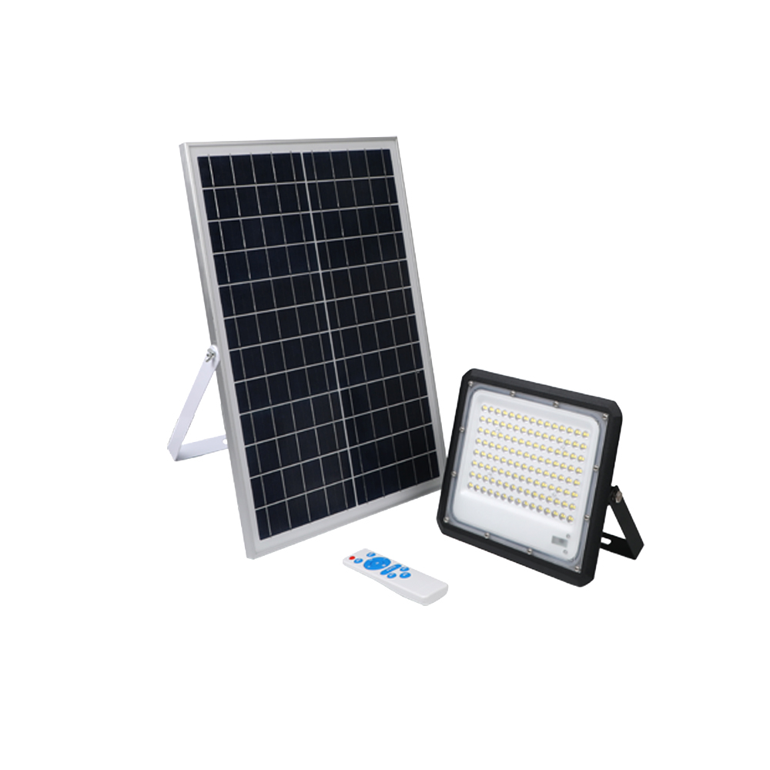
FL06
Material:Iron base+ PMMA Cover
Input Voltage:AC85-265V
Led Chip:2835SMD
IP Rating:IP44 CRI>80 PF>0.9
Color Temperature:3000K/4500K/6000K
Operating Temperature:-25℃ ~50℃
Life Span:50000hours
Certificate:CE ROHS
Item Number | Wattage | LedQuantity | Lamp size | solar panel size | Solar panel power | Battery Capacity | Luminous Flux | Bean Angle
FL06 | 50W | 96pcs2835SMD | 203*156*2mm | 370*305mm | 12W | 12AH | 120-130LM/W | 120°
 | 100W | 140pcs2835SMD | 250*200*2mm | 420*370mm | 18W | 18AH |  | 120°
 | 200W | 176pcs2835SMD | 250*200*2mm | 530*350mm | 25W | 24AH |  | 120°
 | 300W | 208pcs2835SMD | 277*225*2mm | 600*350mm | 30W | 30AH |  | 120°
Modern Ceiling Light Material:Iron base+ PMMA Cover Input Voltage:AC85-265V Led Chip:2835SMD IP Rating:IP44 CRI>80 PF>0.9 Color Temperature:3000K/4500K/6000K Operating Temperature:-25℃ ~50℃ Life Span:50000hours Certificate:CE ROHS
Item Number | Wattage | LedQuantity | LuminousFlux | Beam Angle | Size (mm) | WIFI Control Remte control Switch control Dimmer control
CL-N00 | 24W | 48pcs2835SMD | 1920-2160lm | 120° | 350mm | Yes
 | 36W | 72pcs2835SMD | 2880-3240lm | 120° | 400mm
 | 40W | 80pcs2835SMD | 3200-3600lm | 120° | 450mm
Modern Ceiling Light Material:Iron base+ PMMA Cover Input Voltage:AC85-265V Led Chip:2835SMD IP Rating:IP44 CRI>80 PF>0.9 Color Temperature:3000K/4500K/6000K Operating Temperature:-25℃ ~50℃ Life Span:50000hours Certificate:CE ROHS
Item Number | Wattage | LedQuantity | LuminousFlux | Beam Angle | Size (mm) | WIFI Control Remte control Switch control Dimmer control
CL-N00 | 24W | 48pcs2835SMD | 1920-2160lm | 120° | 350mm | Yes
 | 36W | 72pcs2835SMD | 2880-3240lm | 120° | 400mm
 | 40W | 80pcs2835SMD | 3200-3600lm | 120° | 450mm
Modern Ceiling Light Material:Iron base+ PMMA Cover Input Voltage:AC85-265V Led Chip:2835SMD IP Rating:IP44 CRI>80 PF>0.9 Color Temperature:3000K/4500K/6000K Operating Temperature:-25℃ ~50℃ Life Span:50000hours Certificate:CE ROHS
Item Number | Wattage | LedQuantity | LuminousFlux | Beam Angle | Size (mm) | WIFI Control Remte control Switch control Dimmer control
CL-N00 | 24W | 48pcs2835SMD | 1920-2160lm | 120° | 350mm | Yes
 | 36W | 72pcs2835SMD | 2880-3240lm | 120° | 400mm
 | 40W | 80pcs2835SMD | 3200-3600lm | 120° | 450mm
Modern Ceiling Light Material:Iron base+ PMMA Cover Input Voltage:AC85-265V Led Chip:2835SMD IP Rating:IP44 CRI>80 PF>0.9 Color Temperature:3000K/4500K/6000K Operating Temperature:-25℃ ~50℃ Life Span:50000hours Certificate:CE ROHS
Item Number | Wattage | LedQuantity | LuminousFlux | Beam Angle | Size (mm) | WIFI Control Remte control Switch control Dimmer control
CL-N00 | 24W | 48pcs2835SMD | 1920-2160lm | 120° | 350mm | Yes
 | 36W | 72pcs2835SMD | 2880-3240lm | 120° | 400mm
 | 40W | 80pcs2835SMD | 3200-3600lm | 120° | 450mm

Slide 6
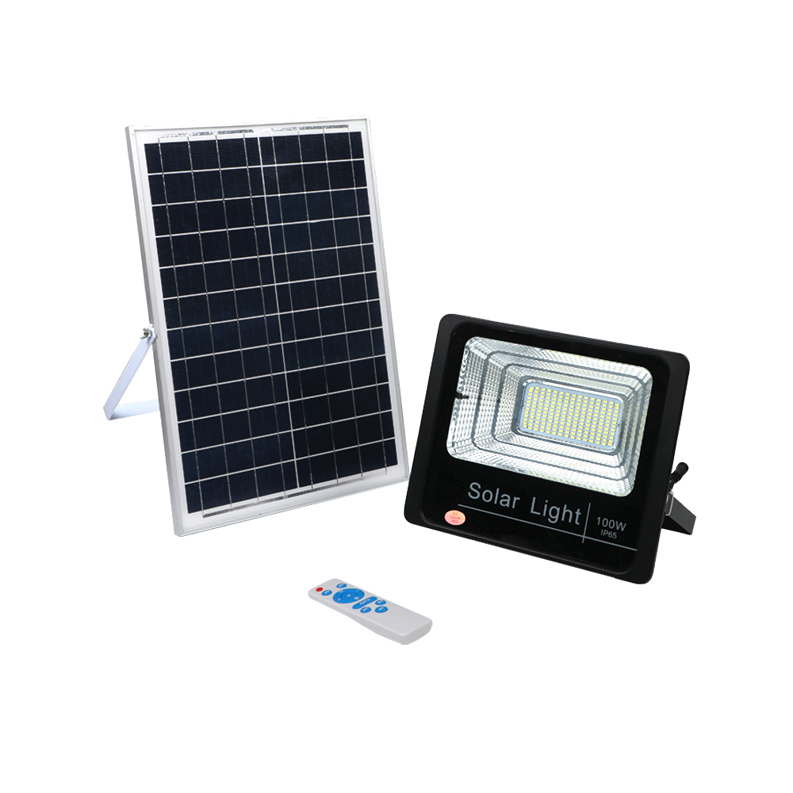
FL07
Material:Iron base+ PMMA Cover
Input Voltage:AC85-265V
Led Chip:2835SMD
IP Rating:IP44 CRI>80 PF>0.9
Color Temperature:3000K/4500K/6000K
Operating Temperature:-25℃ ~50℃
Life Span:50000hours
Certificate:CE ROHS
Item Number | Wattage | LedQuantity | Luminous Flux | Bean Angle
FL07 | 10W | 24pcs2835SMD | 90-110LM/W | 120°
 | 20W | 35pcs2835SMD |  | 120°
 | 25W | 47pcs2835SMD |  | 120°
 | 40W | 83pcs2835SMD |  | 120°
 | 60W | 175pcs2835SMD |  | 120°
 | 100W | 266pcs2835SMD |  | 120°
 | 200W | 312pcs2835SMD |  | 120°
 | 300W | 564pcs2835SMD |  | 120°
Modern Ceiling Light Material:Iron base+ PMMA Cover Input Voltage:AC85-265V Led Chip:2835SMD IP Rating:IP44 CRI>80 PF>0.9 Color Temperature:3000K/4500K/6000K Operating Temperature:-25℃ ~50℃ Life Span:50000hours Certificate:CE ROHS
Item Number | Wattage | LedQuantity | LuminousFlux | Beam Angle | Size (mm) | WIFI Control Remte control Switch control Dimmer control
CL-N00 | 24W | 48pcs2835SMD | 1920-2160lm | 120° | 350mm | Yes
 | 36W | 72pcs2835SMD | 2880-3240lm | 120° | 400mm
 | 40W | 80pcs2835SMD | 3200-3600lm | 120° | 450mm
Modern Ceiling Light Material:Iron base+ PMMA Cover Input Voltage:AC85-265V Led Chip:2835SMD IP Rating:IP44 CRI>80 PF>0.9 Color Temperature:3000K/4500K/6000K Operating Temperature:-25℃ ~50℃ Life Span:50000hours Certificate:CE ROHS
Item Number | Wattage | LedQuantity | LuminousFlux | Beam Angle | Size (mm) | WIFI Control Remte control Switch control Dimmer control
CL-N00 | 24W | 48pcs2835SMD | 1920-2160lm | 120° | 350mm | Yes
 | 36W | 72pcs2835SMD | 2880-3240lm | 120° | 400mm
 | 40W | 80pcs2835SMD | 3200-3600lm | 120° | 450mm
Modern Ceiling Light Material:Iron base+ PMMA Cover Input Voltage:AC85-265V Led Chip:2835SMD IP Rating:IP44 CRI>80 PF>0.9 Color Temperature:3000K/4500K/6000K Operating Temperature:-25℃ ~50℃ Life Span:50000hours Certificate:CE ROHS
Item Number | Wattage | LedQuantity | LuminousFlux | Beam Angle | Size (mm) | WIFI Control Remte control Switch control Dimmer control
CL-N00 | 24W | 48pcs2835SMD | 1920-2160lm | 120° | 350mm | Yes
 | 36W | 72pcs2835SMD | 2880-3240lm | 120° | 400mm
 | 40W | 80pcs2835SMD | 3200-3600lm | 120° | 450mm
Modern Ceiling Light Material:Iron base+ PMMA Cover Input Voltage:AC85-265V Led Chip:2835SMD IP Rating:IP44 CRI>80 PF>0.9 Color Temperature:3000K/4500K/6000K Operating Temperature:-25℃ ~50℃ Life Span:50000hours Certificate:CE ROHS
Item Number | Wattage | LedQuantity | LuminousFlux | Beam Angle | Size (mm) | WIFI Control Remte control Switch control Dimmer control
CL-N00 | 24W | 48pcs2835SMD | 1920-2160lm | 120° | 350mm | Yes
 | 36W | 72pcs2835SMD | 2880-3240lm | 120° | 400mm
 | 40W | 80pcs2835SMD | 3200-3600lm | 120° | 450mm

Slide 7
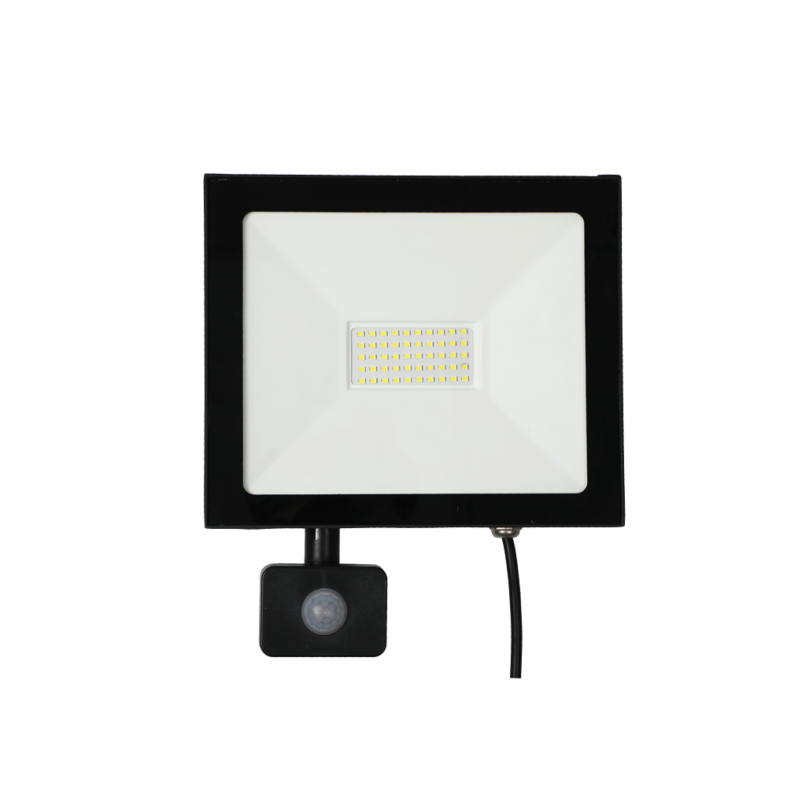
FL08
Material:Iron base+ PMMA Cover
Input Voltage:AC85-265V
Led Chip:2835SMD
IP Rating:IP44 CRI>80 PF>0.9
Color Temperature:3000K/4500K/6000K
Operating Temperature:-25℃ ~50℃
Life Span:50000hours
Certificate:CE ROHS
Item Number | Wattage | LedQuantity | Lamp size | solar panel size | Solar panel power
FL08 | 20W | 40pcs2835SMD | 90-110LM/W | 120° | 140*250*17mm
 | 30W | 60pcs2835SMD |  | 120° | 170*288*17mm
 | 50W | 100pcs2835SMD |  | 120° | 210*300*17mm
 | 100W | 200pcs2835SMD |  | 120° | 240*300*17mm
 | 150W | 300pcs2835SMD |  | 120° | 340*460*17mm
 | 200W | 400pcs2835SMD |  | 120° | 378*278*17mm
 | 300W | 600pcs2835SMD |  | 120° | 450*350*17mm
Modern Ceiling Light Material:Iron base+ PMMA Cover Input Voltage:AC85-265V Led Chip:2835SMD IP Rating:IP44 CRI>80 PF>0.9 Color Temperature:3000K/4500K/6000K Operating Temperature:-25℃ ~50℃ Life Span:50000hours Certificate:CE ROHS
Item Number | Wattage | LedQuantity | LuminousFlux | Beam Angle | Size (mm) | WIFI Control Remte control Switch control Dimmer control
CL-N00 | 24W | 48pcs2835SMD | 1920-2160lm | 120° | 350mm | Yes
 | 36W | 72pcs2835SMD | 2880-3240lm | 120° | 400mm
 | 40W | 80pcs2835SMD | 3200-3600lm | 120° | 450mm
Modern Ceiling Light Material:Iron base+ PMMA Cover Input Voltage:AC85-265V Led Chip:2835SMD IP Rating:IP44 CRI>80 PF>0.9 Color Temperature:3000K/4500K/6000K Operating Temperature:-25℃ ~50℃ Life Span:50000hours Certificate:CE ROHS
Item Number | Wattage | LedQuantity | LuminousFlux | Beam Angle | Size (mm) | WIFI Control Remte control Switch control Dimmer control
CL-N00 | 24W | 48pcs2835SMD | 1920-2160lm | 120° | 350mm | Yes
 | 36W | 72pcs2835SMD | 2880-3240lm | 120° | 400mm
 | 40W | 80pcs2835SMD | 3200-3600lm | 120° | 450mm
Modern Ceiling Light Material:Iron base+ PMMA Cover Input Voltage:AC85-265V Led Chip:2835SMD IP Rating:IP44 CRI>80 PF>0.9 Color Temperature:3000K/4500K/6000K Operating Temperature:-25℃ ~50℃ Life Span:50000hours Certificate:CE ROHS
Item Number | Wattage | LedQuantity | LuminousFlux | Beam Angle | Size (mm) | WIFI Control Remte control Switch control Dimmer control
CL-N00 | 24W | 48pcs2835SMD | 1920-2160lm | 120° | 350mm | Yes
 | 36W | 72pcs2835SMD | 2880-3240lm | 120° | 400mm
 | 40W | 80pcs2835SMD | 3200-3600lm | 120° | 450mm
Modern Ceiling Light Material:Iron base+ PMMA Cover Input Voltage:AC85-265V Led Chip:2835SMD IP Rating:IP44 CRI>80 PF>0.9 Color Temperature:3000K/4500K/6000K Operating Temperature:-25℃ ~50℃ Life Span:50000hours Certificate:CE ROHS
Item Number | Wattage | LedQuantity | LuminousFlux | Beam Angle | Size (mm) | WIFI Control Remte control Switch control Dimmer control
CL-N00 | 24W | 48pcs2835SMD | 1920-2160lm | 120° | 350mm | Yes
 | 36W | 72pcs2835SMD | 2880-3240lm | 120° | 400mm
 | 40W | 80pcs2835SMD | 3200-3600lm | 120° | 450mm

Slide 8
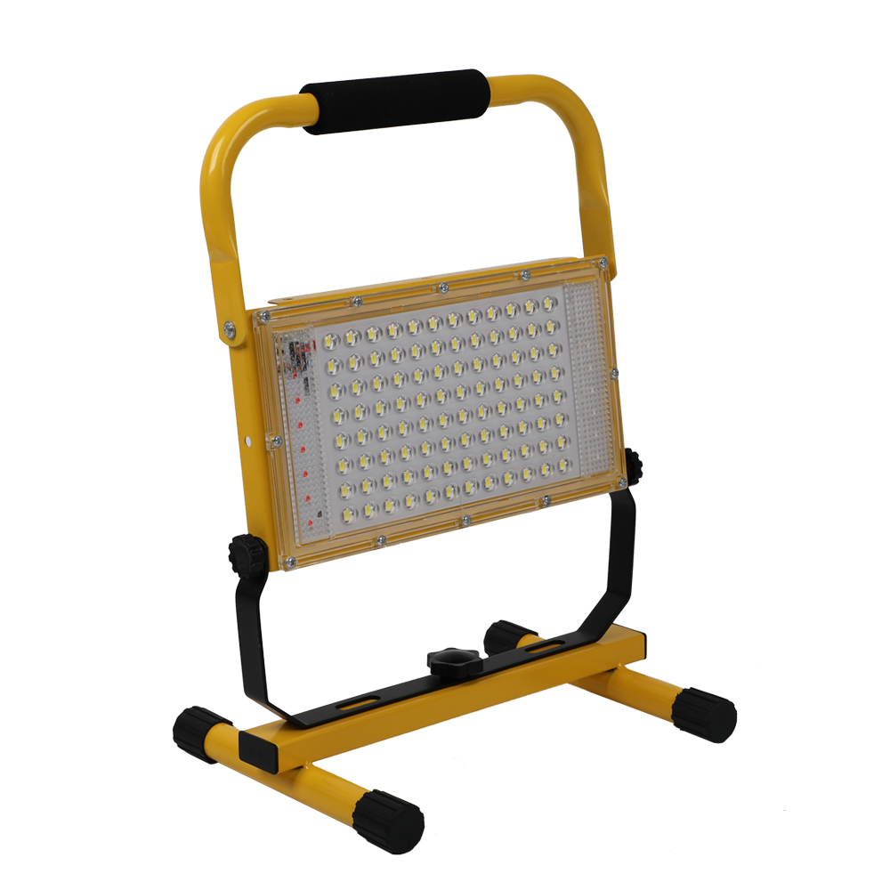
FL09
Material:Iron base+ PMMA Cover
Input Voltage:AC85-265V
Led Chip:2835SMD
IP Rating:IP44 CRI>80 PF>0.9
Color Temperature:3000K/4500K/6000K
Operating Temperature:-25℃ ~50℃
Life Span:50000hours
Certificate:CE ROHS
Item Number | Wattage | LedQuantity | Lamp size | solar panel size | Solar panel power
FL09 | 50W | 100pcs2835SMD | 90-110LM/W | 120° | 185*215*315mm
 | 100W | 200pcs2835SMD |  | 120° | 185*225*350mm
Modern Ceiling Light Material:Iron base+ PMMA Cover Input Voltage:AC85-265V Led Chip:2835SMD IP Rating:IP44 CRI>80 PF>0.9 Color Temperature:3000K/4500K/6000K Operating Temperature:-25℃ ~50℃ Life Span:50000hours Certificate:CE ROHS
Item Number | Wattage | LedQuantity | LuminousFlux | Beam Angle | Size (mm) | WIFI Control Remte control Switch control Dimmer control
CL-N00 | 24W | 48pcs2835SMD | 1920-2160lm | 120° | 350mm | Yes
 | 36W | 72pcs2835SMD | 2880-3240lm | 120° | 400mm
 | 40W | 80pcs2835SMD | 3200-3600lm | 120° | 450mm
Modern Ceiling Light Material:Iron base+ PMMA Cover Input Voltage:AC85-265V Led Chip:2835SMD IP Rating:IP44 CRI>80 PF>0.9 Color Temperature:3000K/4500K/6000K Operating Temperature:-25℃ ~50℃ Life Span:50000hours Certificate:CE ROHS
Item Number | Wattage | LedQuantity | LuminousFlux | Beam Angle | Size (mm) | WIFI Control Remte control Switch control Dimmer control
CL-N00 | 24W | 48pcs2835SMD | 1920-2160lm | 120° | 350mm | Yes
 | 36W | 72pcs2835SMD | 2880-3240lm | 120° | 400mm
 | 40W | 80pcs2835SMD | 3200-3600lm | 120° | 450mm
Modern Ceiling Light Material:Iron base+ PMMA Cover Input Voltage:AC85-265V Led Chip:2835SMD IP Rating:IP44 CRI>80 PF>0.9 Color Temperature:3000K/4500K/6000K Operating Temperature:-25℃ ~50℃ Life Span:50000hours Certificate:CE ROHS
Item Number | Wattage | LedQuantity | LuminousFlux | Beam Angle | Size (mm) | WIFI Control Remte control Switch control Dimmer control
CL-N00 | 24W | 48pcs2835SMD | 1920-2160lm | 120° | 350mm | Yes
 | 36W | 72pcs2835SMD | 2880-3240lm | 120° | 400mm
 | 40W | 80pcs2835SMD | 3200-3600lm | 120° | 450mm
Modern Ceiling Light Material:Iron base+ PMMA Cover Input Voltage:AC85-265V Led Chip:2835SMD IP Rating:IP44 CRI>80 PF>0.9 Color Temperature:3000K/4500K/6000K Operating Temperature:-25℃ ~50℃ Life Span:50000hours Certificate:CE ROHS
Item Number | Wattage | LedQuantity | LuminousFlux | Beam Angle | Size (mm) | WIFI Control Remte control Switch control Dimmer control
CL-N00 | 24W | 48pcs2835SMD | 1920-2160lm | 120° | 350mm | Yes
 | 36W | 72pcs2835SMD | 2880-3240lm | 120° | 400mm
 | 40W | 80pcs2835SMD | 3200-3600lm | 120° | 450mm

Slide 9
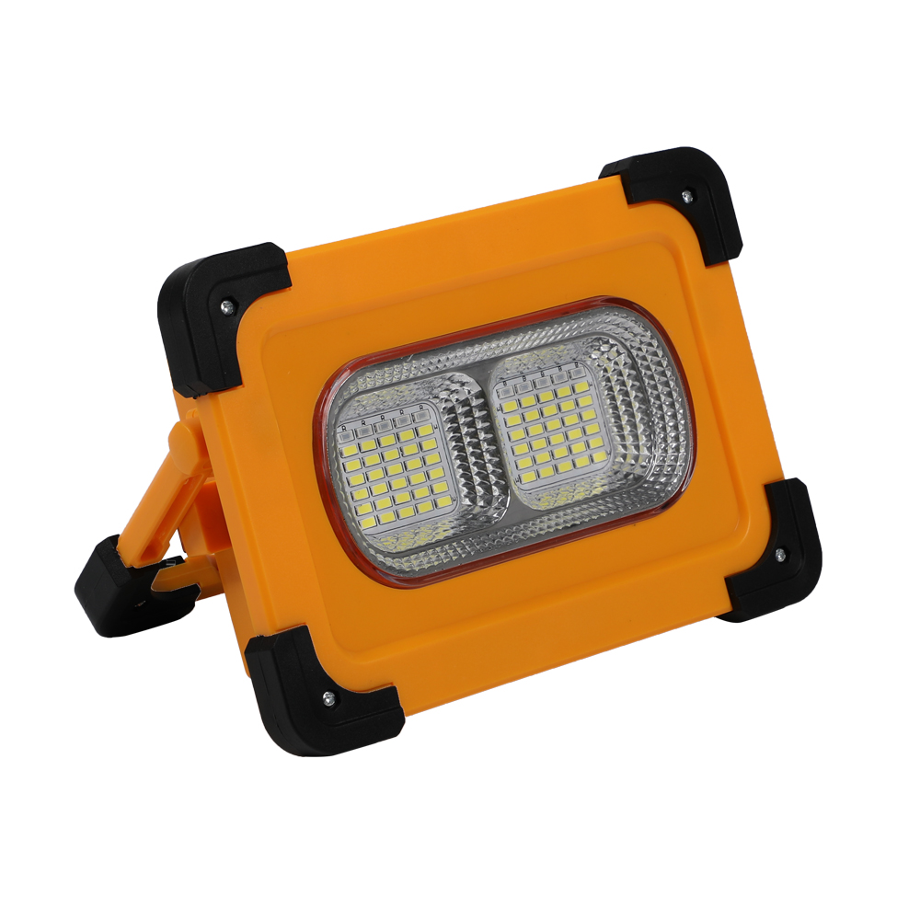
FL10
Material:Iron base+ PMMA Cover
Input Voltage:AC85-265V
Led Chip:2835SMD
IP Rating:IP44 CRI>80 PF>0.9
Color Temperature:3000K/4500K/6000K
Operating Temperature:-25℃ ~50℃
Life Span:50000hours
Certificate:CE ROHS
Item Number | Wattage | LedQuantity | Lamp size | solar panel size | Solar panel power
FL10 | 36W | 6600mah | 90-110LM/W | 120° | 173*132*52mm
 | 65W | 10000mah |  | 120° | 205*248*58mm
Modern Ceiling Light Material:Iron base+ PMMA Cover Input Voltage:AC85-265V Led Chip:2835SMD IP Rating:IP44 CRI>80 PF>0.9 Color Temperature:3000K/4500K/6000K Operating Temperature:-25℃ ~50℃ Life Span:50000hours Certificate:CE ROHS
Item Number | Wattage | LedQuantity | LuminousFlux | Beam Angle | Size (mm) | WIFI Control Remte control Switch control Dimmer control
CL-N00 | 24W | 48pcs2835SMD | 1920-2160lm | 120° | 350mm | Yes
 | 36W | 72pcs2835SMD | 2880-3240lm | 120° | 400mm
 | 40W | 80pcs2835SMD | 3200-3600lm | 120° | 450mm
Modern Ceiling Light Material:Iron base+ PMMA Cover Input Voltage:AC85-265V Led Chip:2835SMD IP Rating:IP44 CRI>80 PF>0.9 Color Temperature:3000K/4500K/6000K Operating Temperature:-25℃ ~50℃ Life Span:50000hours Certificate:CE ROHS
Item Number | Wattage | LedQuantity | LuminousFlux | Beam Angle | Size (mm) | WIFI Control Remte control Switch control Dimmer control
CL-N00 | 24W | 48pcs2835SMD | 1920-2160lm | 120° | 350mm | Yes
 | 36W | 72pcs2835SMD | 2880-3240lm | 120° | 400mm
 | 40W | 80pcs2835SMD | 3200-3600lm | 120° | 450mm
Modern Ceiling Light Material:Iron base+ PMMA Cover Input Voltage:AC85-265V Led Chip:2835SMD IP Rating:IP44 CRI>80 PF>0.9 Color Temperature:3000K/4500K/6000K Operating Temperature:-25℃ ~50℃ Life Span:50000hours Certificate:CE ROHS
Item Number | Wattage | LedQuantity | LuminousFlux | Beam Angle | Size (mm) | WIFI Control Remte control Switch control Dimmer control
CL-N00 | 24W | 48pcs2835SMD | 1920-2160lm | 120° | 350mm | Yes
 | 36W | 72pcs2835SMD | 2880-3240lm | 120° | 400mm
 | 40W | 80pcs2835SMD | 3200-3600lm | 120° | 450mm
Modern Ceiling Light Material:Iron base+ PMMA Cover Input Voltage:AC85-265V Led Chip:2835SMD IP Rating:IP44 CRI>80 PF>0.9 Color Temperature:3000K/4500K/6000K Operating Temperature:-25℃ ~50℃ Life Span:50000hours Certificate:CE ROHS
Item Number | Wattage | LedQuantity | LuminousFlux | Beam Angle | Size (mm) | WIFI Control Remte control Switch control Dimmer control
CL-N00 | 24W | 48pcs2835SMD | 1920-2160lm | 120° | 350mm | Yes
 | 36W | 72pcs2835SMD | 2880-3240lm | 120° | 400mm
 | 40W | 80pcs2835SMD | 3200-3600lm | 120° | 450mm

Slide 10
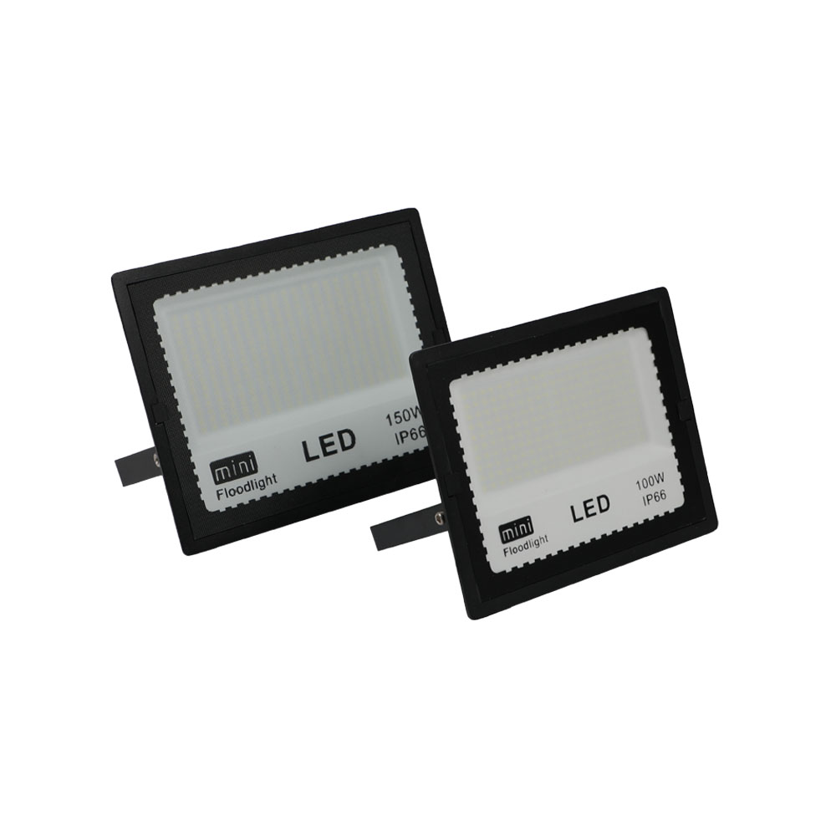
FL11
Material:Iron base+ PMMA Cover
Input Voltage:AC85-265V
Led Chip:2835SMD
IP Rating:IP44 CRI>80 PF>0.9
Color Temperature:3000K/4500K/6000K
Operating Temperature:-25℃ ~50℃
Life Span:50000hours
Certificate:CE ROHS
Item Number | Wattage | LedQuantity | Lamp size | solar panel size | Solar panel power
FL11 | 10W | 20pcs2835SMD | 90-110LM/W | 120° | 110*90*28mm
 | 20W | 40pcs2835SMD |  | 120° | 135*110*30mm
 | 30W | 60pcs2835SMD |  | 120° | 152*124*32mm
 | 50W | 100pcs2835SMD |  | 120° | 172*142*35mm
 | 100W | 200pcs2835SMD |  | 120° | 240*196*42mm
 | 150W | 300pcs2835SMD |  | 120° | 285*235*45mm
 | 200W | 400pcs2835SMD |  | 120° | 335*275*45mm
Modern Ceiling Light Material:Iron base+ PMMA Cover Input Voltage:AC85-265V Led Chip:2835SMD IP Rating:IP44 CRI>80 PF>0.9 Color Temperature:3000K/4500K/6000K Operating Temperature:-25℃ ~50℃ Life Span:50000hours Certificate:CE ROHS
Item Number | Wattage | LedQuantity | LuminousFlux | Beam Angle | Size (mm) | WIFI Control Remte control Switch control Dimmer control
CL-N00 | 24W | 48pcs2835SMD | 1920-2160lm | 120° | 350mm | Yes
 | 36W | 72pcs2835SMD | 2880-3240lm | 120° | 400mm
 | 40W | 80pcs2835SMD | 3200-3600lm | 120° | 450mm
Modern Ceiling Light Material:Iron base+ PMMA Cover Input Voltage:AC85-265V Led Chip:2835SMD IP Rating:IP44 CRI>80 PF>0.9 Color Temperature:3000K/4500K/6000K Operating Temperature:-25℃ ~50℃ Life Span:50000hours Certificate:CE ROHS
Item Number | Wattage | LedQuantity | LuminousFlux | Beam Angle | Size (mm) | WIFI Control Remte control Switch control Dimmer control
CL-N00 | 24W | 48pcs2835SMD | 1920-2160lm | 120° | 350mm | Yes
 | 36W | 72pcs2835SMD | 2880-3240lm | 120° | 400mm
 | 40W | 80pcs2835SMD | 3200-3600lm | 120° | 450mm
Modern Ceiling Light Material:Iron base+ PMMA Cover Input Voltage:AC85-265V Led Chip:2835SMD IP Rating:IP44 CRI>80 PF>0.9 Color Temperature:3000K/4500K/6000K Operating Temperature:-25℃ ~50℃ Life Span:50000hours Certificate:CE ROHS
Item Number | Wattage | LedQuantity | LuminousFlux | Beam Angle | Size (mm) | WIFI Control Remte control Switch control Dimmer control
CL-N00 | 24W | 48pcs2835SMD | 1920-2160lm | 120° | 350mm | Yes
 | 36W | 72pcs2835SMD | 2880-3240lm | 120° | 400mm
 | 40W | 80pcs2835SMD | 3200-3600lm | 120° | 450mm
Modern Ceiling Light Material:Iron base+ PMMA Cover Input Voltage:AC85-265V Led Chip:2835SMD IP Rating:IP44 CRI>80 PF>0.9 Color Temperature:3000K/4500K/6000K Operating Temperature:-25℃ ~50℃ Life Span:50000hours Certificate:CE ROHS
Item Number | Wattage | LedQuantity | LuminousFlux | Beam Angle | Size (mm) | WIFI Control Remte control Switch control Dimmer control
CL-N00 | 24W | 48pcs2835SMD | 1920-2160lm | 120° | 350mm | Yes
 | 36W | 72pcs2835SMD | 2880-3240lm | 120° | 400mm
 | 40W | 80pcs2835SMD | 3200-3600lm | 120° | 450mm

Slide 11
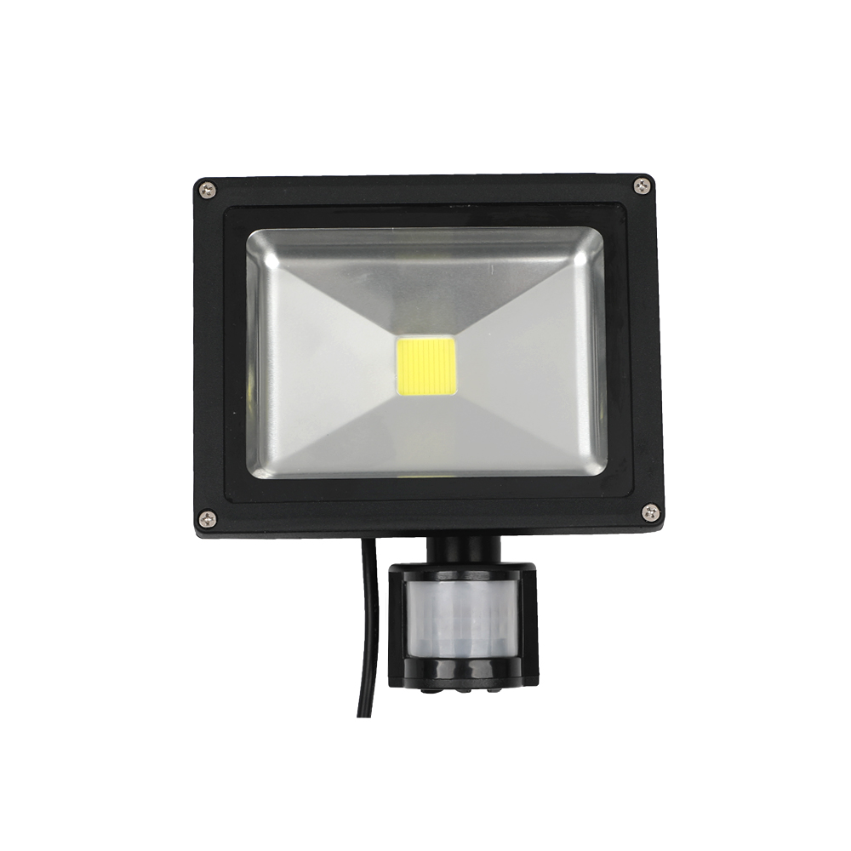
FL12
Material:Iron base+ PMMA Cover
Input Voltage:AC85-265V
Led Chip:2835SMD
IP Rating:IP44 CRI>80 PF>0.9
Color Temperature:3000K/4500K/6000K
Operating Temperature:-25℃ ~50℃
Life Span:50000hours
Certificate:CE ROHS
Item Number | Wattage | LedQuantity | Lamp size | solar panel size | Solar panel power
FL12 | 10W | 20pcs2835SMD | 90-110LM/W | 120° | 115*89*95mm
 | 20W | 40pcs2835SMD |  | 120° | 180*140*110mm
 | 30W | 60pcs2835SMD |  | 120° | 225*185*150mm
 | 50W | 100pcs2835SMD |  | 120° | 285*235*150mm
Modern Ceiling Light Material:Iron base+ PMMA Cover Input Voltage:AC85-265V Led Chip:2835SMD IP Rating:IP44 CRI>80 PF>0.9 Color Temperature:3000K/4500K/6000K Operating Temperature:-25℃ ~50℃ Life Span:50000hours Certificate:CE ROHS
Item Number | Wattage | LedQuantity | LuminousFlux | Beam Angle | Size (mm) | WIFI Control Remte control Switch control Dimmer control
CL-N00 | 24W | 48pcs2835SMD | 1920-2160lm | 120° | 350mm | Yes
 | 36W | 72pcs2835SMD | 2880-3240lm | 120° | 400mm
 | 40W | 80pcs2835SMD | 3200-3600lm | 120° | 450mm
Modern Ceiling Light Material:Iron base+ PMMA Cover Input Voltage:AC85-265V Led Chip:2835SMD IP Rating:IP44 CRI>80 PF>0.9 Color Temperature:3000K/4500K/6000K Operating Temperature:-25℃ ~50℃ Life Span:50000hours Certificate:CE ROHS
Item Number | Wattage | LedQuantity | LuminousFlux | Beam Angle | Size (mm) | WIFI Control Remte control Switch control Dimmer control
CL-N00 | 24W | 48pcs2835SMD | 1920-2160lm | 120° | 350mm | Yes
 | 36W | 72pcs2835SMD | 2880-3240lm | 120° | 400mm
 | 40W | 80pcs2835SMD | 3200-3600lm | 120° | 450mm
Modern Ceiling Light Material:Iron base+ PMMA Cover Input Voltage:AC85-265V Led Chip:2835SMD IP Rating:IP44 CRI>80 PF>0.9 Color Temperature:3000K/4500K/6000K Operating Temperature:-25℃ ~50℃ Life Span:50000hours Certificate:CE ROHS
Item Number | Wattage | LedQuantity | LuminousFlux | Beam Angle | Size (mm) | WIFI Control Remte control Switch control Dimmer control
CL-N00 | 24W | 48pcs2835SMD | 1920-2160lm | 120° | 350mm | Yes
 | 36W | 72pcs2835SMD | 2880-3240lm | 120° | 400mm
 | 40W | 80pcs2835SMD | 3200-3600lm | 120° | 450mm
Modern Ceiling Light Material:Iron base+ PMMA Cover Input Voltage:AC85-265V Led Chip:2835SMD IP Rating:IP44 CRI>80 PF>0.9 Color Temperature:3000K/4500K/6000K Operating Temperature:-25℃ ~50℃ Life Span:50000hours Certificate:CE ROHS
Item Number | Wattage | LedQuantity | LuminousFlux | Beam Angle | Size (mm) | WIFI Control Remte control Switch control Dimmer control
CL-N00 | 24W | 48pcs2835SMD | 1920-2160lm | 120° | 350mm | Yes
 | 36W | 72pcs2835SMD | 2880-3240lm | 120° | 400mm
 | 40W | 80pcs2835SMD | 3200-3600lm | 120° | 450mm

Slide 12
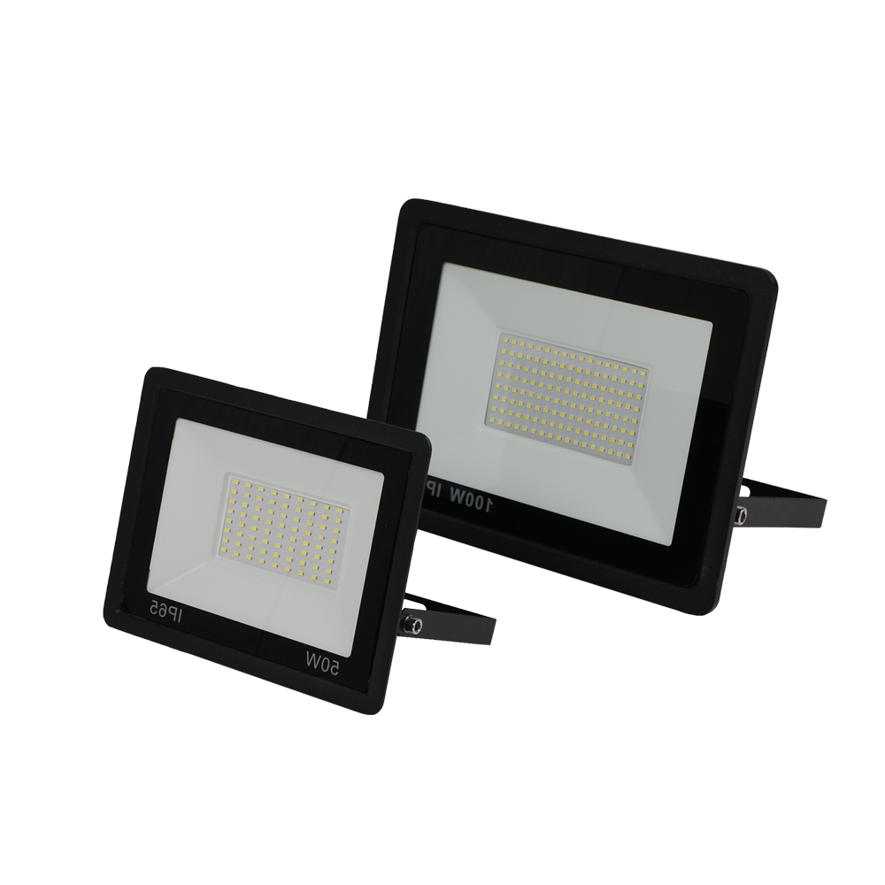
FL13
Material:Iron base+ PMMA Cover
Input Voltage:AC85-265V
Led Chip:2835SMD
IP Rating:IP44 CRI>80 PF>0.9
Color Temperature:3000K/4500K/6000K
Operating Temperature:-25℃ ~50℃
Life Span:50000hours
Certificate:CE ROHS
Item Number | Wattage | LedQuantity | Lamp size | solar panel size | Solar panel power
FL13 | 10W | 20pcs2835SMD | 90-110LM/W | 120° | 100*80*28mm
 | 20W | 40pcs2835SMD |  | 120° | 117*92*29mm
 | 30W | 60pcs2835SMD |  | 120° | 151*116*30mm
 | 50W | 100pcs2835SMD |  | 120° | 207*160*30mm
 | 100W | 200pcs2835SMD |  | 120° | 270*204*30mm
 | 150W | 300pcs2835SMD |  | 120° | 310*234*30mm
 | 200W | 400pcs2835SMD |  | 120° | 355*262*30mm
Modern Ceiling Light Material:Iron base+ PMMA Cover Input Voltage:AC85-265V Led Chip:2835SMD IP Rating:IP44 CRI>80 PF>0.9 Color Temperature:3000K/4500K/6000K Operating Temperature:-25℃ ~50℃ Life Span:50000hours Certificate:CE ROHS
Item Number | Wattage | LedQuantity | LuminousFlux | Beam Angle | Size (mm) | WIFI Control Remte control Switch control Dimmer control
CL-N00 | 24W | 48pcs2835SMD | 1920-2160lm | 120° | 350mm | Yes
 | 36W | 72pcs2835SMD | 2880-3240lm | 120° | 400mm
 | 40W | 80pcs2835SMD | 3200-3600lm | 120° | 450mm
Modern Ceiling Light Material:Iron base+ PMMA Cover Input Voltage:AC85-265V Led Chip:2835SMD IP Rating:IP44 CRI>80 PF>0.9 Color Temperature:3000K/4500K/6000K Operating Temperature:-25℃ ~50℃ Life Span:50000hours Certificate:CE ROHS
Item Number | Wattage | LedQuantity | LuminousFlux | Beam Angle | Size (mm) | WIFI Control Remte control Switch control Dimmer control
CL-N00 | 24W | 48pcs2835SMD | 1920-2160lm | 120° | 350mm | Yes
 | 36W | 72pcs2835SMD | 2880-3240lm | 120° | 400mm
 | 40W | 80pcs2835SMD | 3200-3600lm | 120° | 450mm
Modern Ceiling Light Material:Iron base+ PMMA Cover Input Voltage:AC85-265V Led Chip:2835SMD IP Rating:IP44 CRI>80 PF>0.9 Color Temperature:3000K/4500K/6000K Operating Temperature:-25℃ ~50℃ Life Span:50000hours Certificate:CE ROHS
Item Number | Wattage | LedQuantity | LuminousFlux | Beam Angle | Size (mm) | WIFI Control Remte control Switch control Dimmer control
CL-N00 | 24W | 48pcs2835SMD | 1920-2160lm | 120° | 350mm | Yes
 | 36W | 72pcs2835SMD | 2880-3240lm | 120° | 400mm
 | 40W | 80pcs2835SMD | 3200-3600lm | 120° | 450mm
Modern Ceiling Light Material:Iron base+ PMMA Cover Input Voltage:AC85-265V Led Chip:2835SMD IP Rating:IP44 CRI>80 PF>0.9 Color Temperature:3000K/4500K/6000K Operating Temperature:-25℃ ~50℃ Life Span:50000hours Certificate:CE ROHS
Item Number | Wattage | LedQuantity | LuminousFlux | Beam Angle | Size (mm) | WIFI Control Remte control Switch control Dimmer control
CL-N00 | 24W | 48pcs2835SMD | 1920-2160lm | 120° | 350mm | Yes
 | 36W | 72pcs2835SMD | 2880-3240lm | 120° | 400mm
 | 40W | 80pcs2835SMD | 3200-3600lm | 120° | 450mm

Slide 13
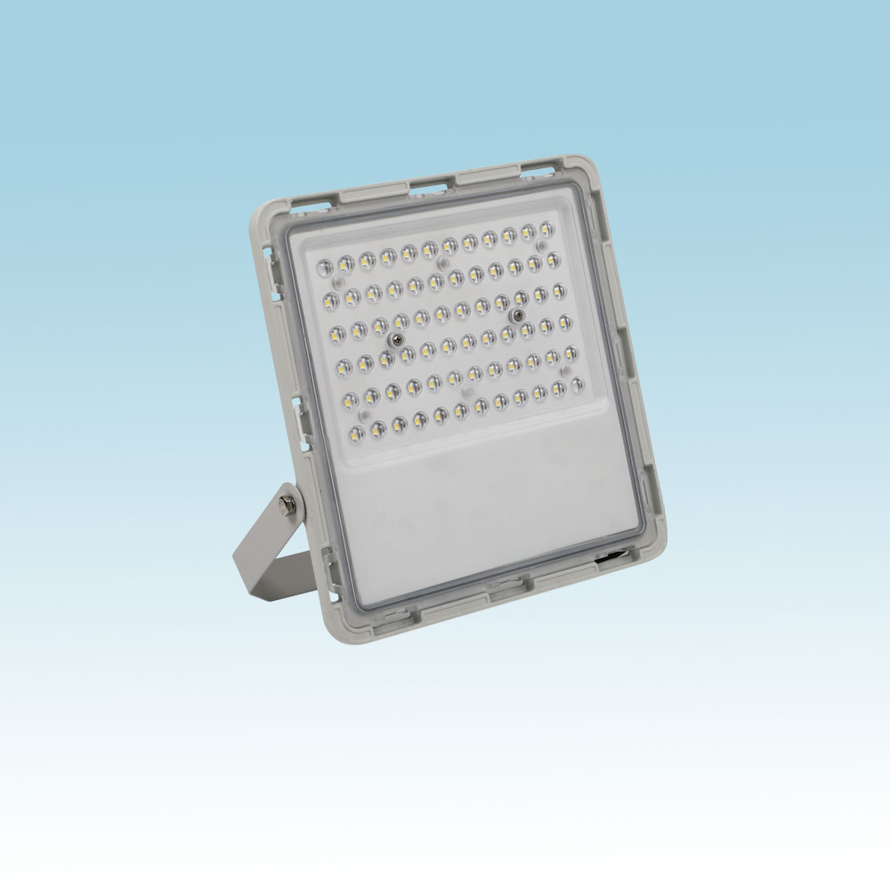
FL15
Material:Iron base+ PMMA Cover
Input Voltage:AC85-265V
Led Chip:2835SMD
IP Rating:IP44 CRI>80 PF>0.9
Color Temperature:3000K/4500K/6000K
Operating Temperature:-25℃ ~50℃
Life Span:50000hours
Certificate:CE ROHS
Item Number | Wattage | LedQuantity | Lamp size | solar panel size | Solar panel power
FL15 | 30W | 60pcs2835SMD | 90-110LM/W | 120° | 199*188*46mm
 | 50W | 100pcs2835SMD |  | 120° | 238*228*35mm
 | 100W | 200pcs2835SMD |  | 120° | 290*280*50mm
 | 150W | 300pcs2835SMD |  | 120° | 330*320*50mm
Modern Ceiling Light Material:Iron base+ PMMA Cover Input Voltage:AC85-265V Led Chip:2835SMD IP Rating:IP44 CRI>80 PF>0.9 Color Temperature:3000K/4500K/6000K Operating Temperature:-25℃ ~50℃ Life Span:50000hours Certificate:CE ROHS
Item Number | Wattage | LedQuantity | LuminousFlux | Beam Angle | Size (mm) | WIFI Control Remte control Switch control Dimmer control
CL-N00 | 24W | 48pcs2835SMD | 1920-2160lm | 120° | 350mm | Yes
 | 36W | 72pcs2835SMD | 2880-3240lm | 120° | 400mm
 | 40W | 80pcs2835SMD | 3200-3600lm | 120° | 450mm
Modern Ceiling Light Material:Iron base+ PMMA Cover Input Voltage:AC85-265V Led Chip:2835SMD IP Rating:IP44 CRI>80 PF>0.9 Color Temperature:3000K/4500K/6000K Operating Temperature:-25℃ ~50℃ Life Span:50000hours Certificate:CE ROHS
Item Number | Wattage | LedQuantity | LuminousFlux | Beam Angle | Size (mm) | WIFI Control Remte control Switch control Dimmer control
CL-N00 | 24W | 48pcs2835SMD | 1920-2160lm | 120° | 350mm | Yes
 | 36W | 72pcs2835SMD | 2880-3240lm | 120° | 400mm
 | 40W | 80pcs2835SMD | 3200-3600lm | 120° | 450mm
Modern Ceiling Light Material:Iron base+ PMMA Cover Input Voltage:AC85-265V Led Chip:2835SMD IP Rating:IP44 CRI>80 PF>0.9 Color Temperature:3000K/4500K/6000K Operating Temperature:-25℃ ~50℃ Life Span:50000hours Certificate:CE ROHS
Item Number | Wattage | LedQuantity | LuminousFlux | Beam Angle | Size (mm) | WIFI Control Remte control Switch control Dimmer control
CL-N00 | 24W | 48pcs2835SMD | 1920-2160lm | 120° | 350mm | Yes
 | 36W | 72pcs2835SMD | 2880-3240lm | 120° | 400mm
 | 40W | 80pcs2835SMD | 3200-3600lm | 120° | 450mm
Modern Ceiling Light Material:Iron base+ PMMA Cover Input Voltage:AC85-265V Led Chip:2835SMD IP Rating:IP44 CRI>80 PF>0.9 Color Temperature:3000K/4500K/6000K Operating Temperature:-25℃ ~50℃ Life Span:50000hours Certificate:CE ROHS
Item Number | Wattage | LedQuantity | LuminousFlux | Beam Angle | Size (mm) | WIFI Control Remte control Switch control Dimmer control
CL-N00 | 24W | 48pcs2835SMD | 1920-2160lm | 120° | 350mm | Yes
 | 36W | 72pcs2835SMD | 2880-3240lm | 120° | 400mm
 | 40W | 80pcs2835SMD | 3200-3600lm | 120° | 450mm

Slide 14
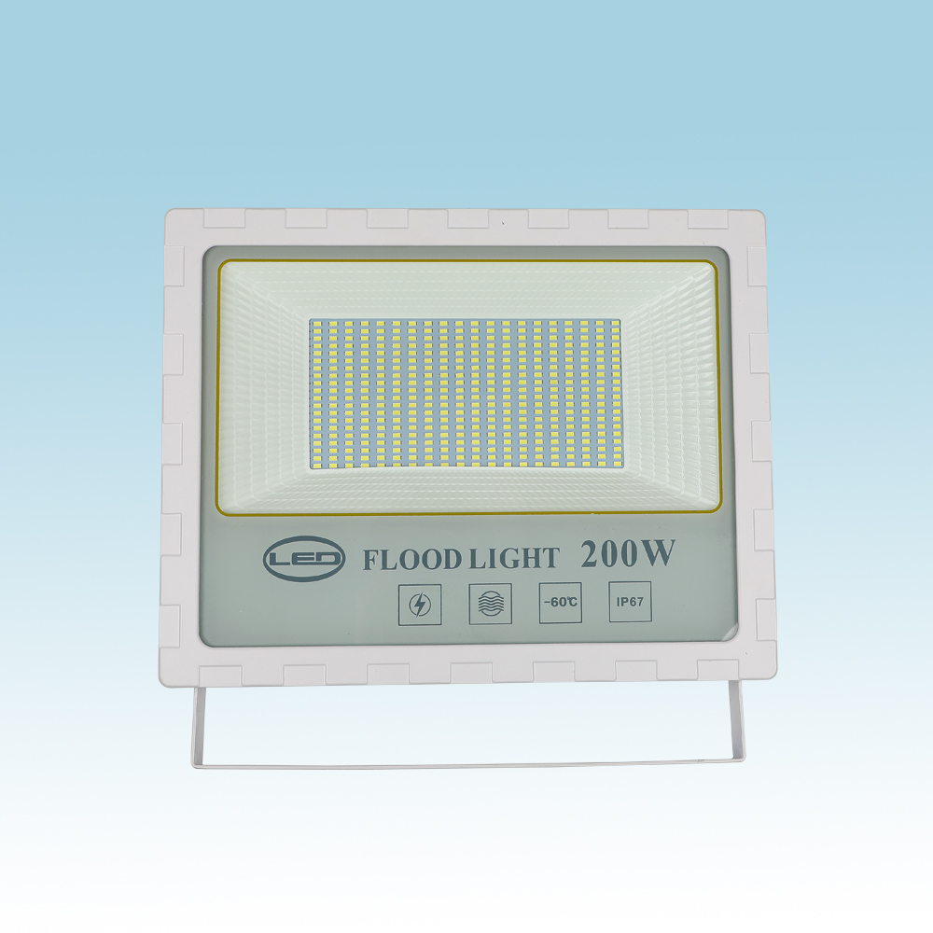
FL16
Material:Iron base+ PMMA Cover
Input Voltage:AC85-265V
Led Chip:2835SMD
IP Rating:IP44 CRI>80 PF>0.9
Color Temperature:3000K/4500K/6000K
Operating Temperature:-25℃ ~50℃
Life Span:50000hours
Certificate:CE ROHS
Item Number | Wattage | LedQuantity | Lamp size | solar panel size | Solar panel power
FL16 | 50W | 100pcs2835SMD | 90-110LM/W | 120° | 165*165*38mm
 | 100W | 200pcs2835SMD |  | 120° | 220*204*39mm
 | 150W | 300pcs2835SMD |  | 120° | 251*241*39mm
 | 200W | 400pcs2835SMD |  | 120° | 300*270*39mm
Modern Ceiling Light Material:Iron base+ PMMA Cover Input Voltage:AC85-265V Led Chip:2835SMD IP Rating:IP44 CRI>80 PF>0.9 Color Temperature:3000K/4500K/6000K Operating Temperature:-25℃ ~50℃ Life Span:50000hours Certificate:CE ROHS
Item Number | Wattage | LedQuantity | LuminousFlux | Beam Angle | Size (mm) | WIFI Control Remte control Switch control Dimmer control
CL-N00 | 24W | 48pcs2835SMD | 1920-2160lm | 120° | 350mm | Yes
 | 36W | 72pcs2835SMD | 2880-3240lm | 120° | 400mm
 | 40W | 80pcs2835SMD | 3200-3600lm | 120° | 450mm
Modern Ceiling Light Material:Iron base+ PMMA Cover Input Voltage:AC85-265V Led Chip:2835SMD IP Rating:IP44 CRI>80 PF>0.9 Color Temperature:3000K/4500K/6000K Operating Temperature:-25℃ ~50℃ Life Span:50000hours Certificate:CE ROHS
Item Number | Wattage | LedQuantity | LuminousFlux | Beam Angle | Size (mm) | WIFI Control Remte control Switch control Dimmer control
CL-N00 | 24W | 48pcs2835SMD | 1920-2160lm | 120° | 350mm | Yes
 | 36W | 72pcs2835SMD | 2880-3240lm | 120° | 400mm
 | 40W | 80pcs2835SMD | 3200-3600lm | 120° | 450mm
Modern Ceiling Light Material:Iron base+ PMMA Cover Input Voltage:AC85-265V Led Chip:2835SMD IP Rating:IP44 CRI>80 PF>0.9 Color Temperature:3000K/4500K/6000K Operating Temperature:-25℃ ~50℃ Life Span:50000hours Certificate:CE ROHS
Item Number | Wattage | LedQuantity | LuminousFlux | Beam Angle | Size (mm) | WIFI Control Remte control Switch control Dimmer control
CL-N00 | 24W | 48pcs2835SMD | 1920-2160lm | 120° | 350mm | Yes
 | 36W | 72pcs2835SMD | 2880-3240lm | 120° | 400mm
 | 40W | 80pcs2835SMD | 3200-3600lm | 120° | 450mm
Modern Ceiling Light Material:Iron base+ PMMA Cover Input Voltage:AC85-265V Led Chip:2835SMD IP Rating:IP44 CRI>80 PF>0.9 Color Temperature:3000K/4500K/6000K Operating Temperature:-25℃ ~50℃ Life Span:50000hours Certificate:CE ROHS
Item Number | Wattage | LedQuantity | LuminousFlux | Beam Angle | Size (mm) | WIFI Control Remte control Switch control Dimmer control
CL-N00 | 24W | 48pcs2835SMD | 1920-2160lm | 120° | 350mm | Yes
 | 36W | 72pcs2835SMD | 2880-3240lm | 120° | 400mm
 | 40W | 80pcs2835SMD | 3200-3600lm | 120° | 450mm

Slide 15
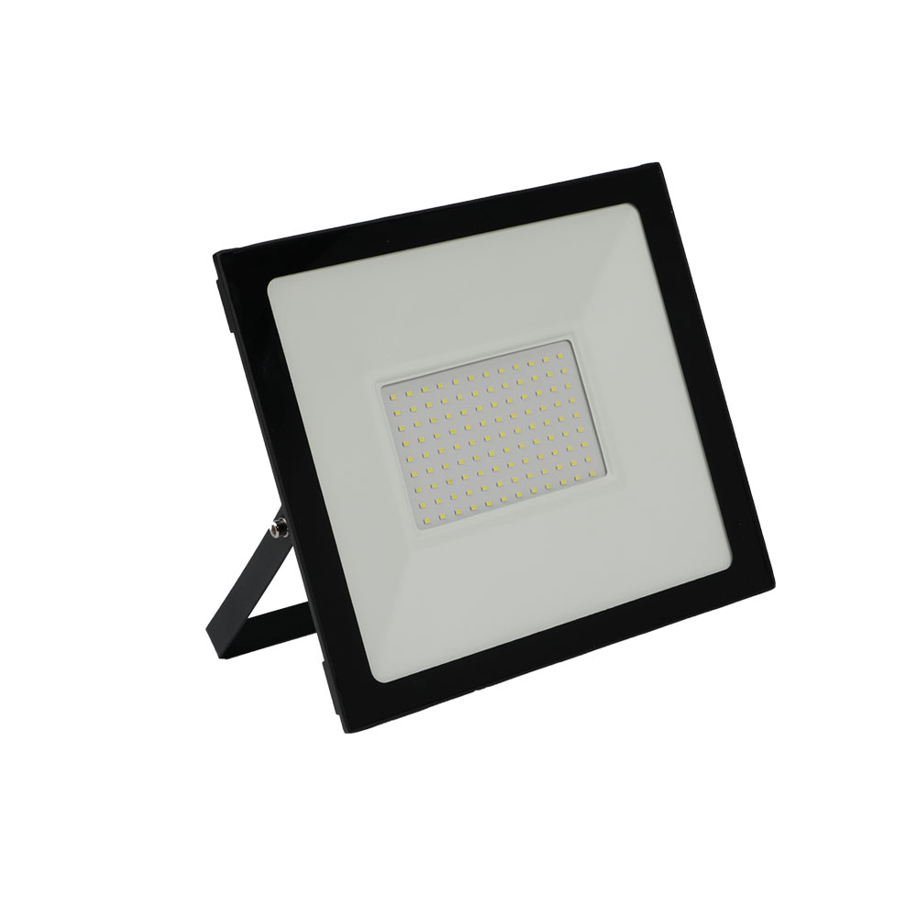
FL17
Material:Iron base+ PMMA Cover
Input Voltage:AC85-265V
Led Chip:2835SMD
IP Rating:IP44 CRI>80 PF>0.9
Color Temperature:3000K/4500K/6000K
Operating Temperature:-25℃ ~50℃
Life Span:50000hours
Certificate:CE ROHS
Item Number | Wattage | LedQuantity | Lamp size | solar panel size | Solar panel power
FL17 | 10W | 20pcs2835SMD | 90-110LM/W | 120° | 90*25*70mm
 | 20W | 40pcs2835SMD |  | 120° | 140*25*120mm
 | 30W | 60pcs2835SMD |  | 120° | 170*28*150mm
 | 50W | 100pcs2835SMD |  | 120° | 210*30*180mm
 | 100W | 200pcs2835SMD |  | 120° | 380*35*250mm
 | 150W | 300pcs2835SMD |  | 120° | 350*42*303mm
 | 200W | 400pcs2835SMD |  | 120° | 380*35*250mm
Modern Ceiling Light Material:Iron base+ PMMA Cover Input Voltage:AC85-265V Led Chip:2835SMD IP Rating:IP44 CRI>80 PF>0.9 Color Temperature:3000K/4500K/6000K Operating Temperature:-25℃ ~50℃ Life Span:50000hours Certificate:CE ROHS
Item Number | Wattage | LedQuantity | LuminousFlux | Beam Angle | Size (mm) | WIFI Control Remte control Switch control Dimmer control
CL-N00 | 24W | 48pcs2835SMD | 1920-2160lm | 120° | 350mm | Yes
 | 36W | 72pcs2835SMD | 2880-3240lm | 120° | 400mm
 | 40W | 80pcs2835SMD | 3200-3600lm | 120° | 450mm
Modern Ceiling Light Material:Iron base+ PMMA Cover Input Voltage:AC85-265V Led Chip:2835SMD IP Rating:IP44 CRI>80 PF>0.9 Color Temperature:3000K/4500K/6000K Operating Temperature:-25℃ ~50℃ Life Span:50000hours Certificate:CE ROHS
Item Number | Wattage | LedQuantity | LuminousFlux | Beam Angle | Size (mm) | WIFI Control Remte control Switch control Dimmer control
CL-N00 | 24W | 48pcs2835SMD | 1920-2160lm | 120° | 350mm | Yes
 | 36W | 72pcs2835SMD | 2880-3240lm | 120° | 400mm
 | 40W | 80pcs2835SMD | 3200-3600lm | 120° | 450mm
Modern Ceiling Light Material:Iron base+ PMMA Cover Input Voltage:AC85-265V Led Chip:2835SMD IP Rating:IP44 CRI>80 PF>0.9 Color Temperature:3000K/4500K/6000K Operating Temperature:-25℃ ~50℃ Life Span:50000hours Certificate:CE ROHS
Item Number | Wattage | LedQuantity | LuminousFlux | Beam Angle | Size (mm) | WIFI Control Remte control Switch control Dimmer control
CL-N00 | 24W | 48pcs2835SMD | 1920-2160lm | 120° | 350mm | Yes
 | 36W | 72pcs2835SMD | 2880-3240lm | 120° | 400mm
 | 40W | 80pcs2835SMD | 3200-3600lm | 120° | 450mm
Modern Ceiling Light Material:Iron base+ PMMA Cover Input Voltage:AC85-265V Led Chip:2835SMD IP Rating:IP44 CRI>80 PF>0.9 Color Temperature:3000K/4500K/6000K Operating Temperature:-25℃ ~50℃ Life Span:50000hours Certificate:CE ROHS
Item Number | Wattage | LedQuantity | LuminousFlux | Beam Angle | Size (mm) | WIFI Control Remte control Switch control Dimmer control
CL-N00 | 24W | 48pcs2835SMD | 1920-2160lm | 120° | 350mm | Yes
 | 36W | 72pcs2835SMD | 2880-3240lm | 120° | 400mm
 | 40W | 80pcs2835SMD | 3200-3600lm | 120° | 450mm

Slide 16
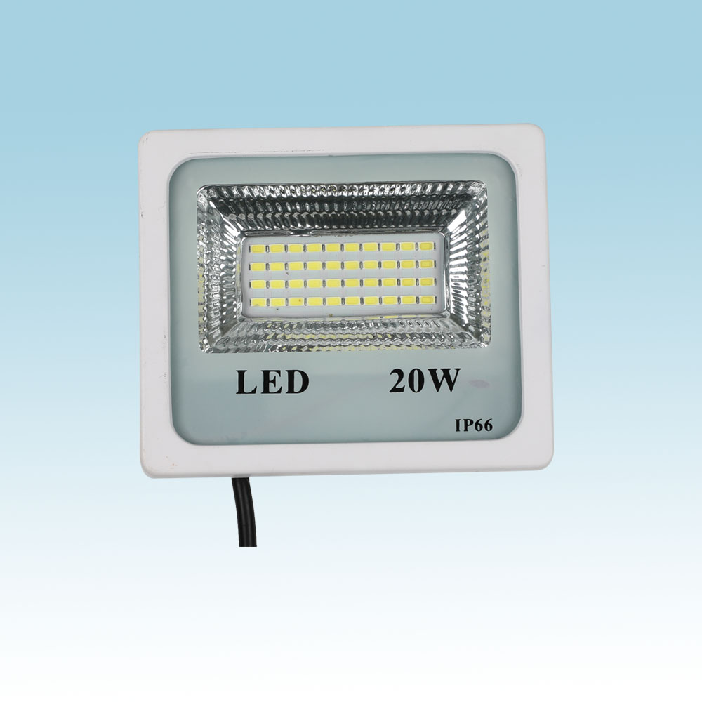
FL18
Material:Iron base+ PMMA Cover
Input Voltage:AC85-265V
Led Chip:2835SMD
IP Rating:IP44 CRI>80 PF>0.9
Color Temperature:3000K/4500K/6000K
Operating Temperature:-25℃ ~50℃
Life Span:50000hours
Certificate:CE ROHS
Item Number | Wattage | LedQuantity | Lamp size | solar panel size | Solar panel power
FL18 | 20W | 40pcs2835SMD | 90-110LM/W | 120° | 135*115*36mm
 | 30W | 60pcs2835SMD |  | 120° | 185*155*44mm
 | 50W | 100pcs2835SMD |  | 120° | 230*195*45mm
 | 100W | 200pcs2835SMD |  | 120° | 285*240*55mm
 | 150W | 300pcs2835SMD |  | 120° | 345*280*70mm
 | 200W | 400pcs2835SMD |  | 120° | 425*325*80mm
Modern Ceiling Light Material:Iron base+ PMMA Cover Input Voltage:AC85-265V Led Chip:2835SMD IP Rating:IP44 CRI>80 PF>0.9 Color Temperature:3000K/4500K/6000K Operating Temperature:-25℃ ~50℃ Life Span:50000hours Certificate:CE ROHS
Item Number | Wattage | LedQuantity | LuminousFlux | Beam Angle | Size (mm) | WIFI Control Remte control Switch control Dimmer control
CL-N00 | 24W | 48pcs2835SMD | 1920-2160lm | 120° | 350mm | Yes
 | 36W | 72pcs2835SMD | 2880-3240lm | 120° | 400mm
 | 40W | 80pcs2835SMD | 3200-3600lm | 120° | 450mm
Modern Ceiling Light Material:Iron base+ PMMA Cover Input Voltage:AC85-265V Led Chip:2835SMD IP Rating:IP44 CRI>80 PF>0.9 Color Temperature:3000K/4500K/6000K Operating Temperature:-25℃ ~50℃ Life Span:50000hours Certificate:CE ROHS
Item Number | Wattage | LedQuantity | LuminousFlux | Beam Angle | Size (mm) | WIFI Control Remte control Switch control Dimmer control
CL-N00 | 24W | 48pcs2835SMD | 1920-2160lm | 120° | 350mm | Yes
 | 36W | 72pcs2835SMD | 2880-3240lm | 120° | 400mm
 | 40W | 80pcs2835SMD | 3200-3600lm | 120° | 450mm
Modern Ceiling Light Material:Iron base+ PMMA Cover Input Voltage:AC85-265V Led Chip:2835SMD IP Rating:IP44 CRI>80 PF>0.9 Color Temperature:3000K/4500K/6000K Operating Temperature:-25℃ ~50℃ Life Span:50000hours Certificate:CE ROHS
Item Number | Wattage | LedQuantity | LuminousFlux | Beam Angle | Size (mm) | WIFI Control Remte control Switch control Dimmer control
CL-N00 | 24W | 48pcs2835SMD | 1920-2160lm | 120° | 350mm | Yes
 | 36W | 72pcs2835SMD | 2880-3240lm | 120° | 400mm
 | 40W | 80pcs2835SMD | 3200-3600lm | 120° | 450mm
Modern Ceiling Light Material:Iron base+ PMMA Cover Input Voltage:AC85-265V Led Chip:2835SMD IP Rating:IP44 CRI>80 PF>0.9 Color Temperature:3000K/4500K/6000K Operating Temperature:-25℃ ~50℃ Life Span:50000hours Certificate:CE ROHS
Item Number | Wattage | LedQuantity | LuminousFlux | Beam Angle | Size (mm) | WIFI Control Remte control Switch control Dimmer control
CL-N00 | 24W | 48pcs2835SMD | 1920-2160lm | 120° | 350mm | Yes
 | 36W | 72pcs2835SMD | 2880-3240lm | 120° | 400mm
 | 40W | 80pcs2835SMD | 3200-3600lm | 120° | 450mm

Slide 17
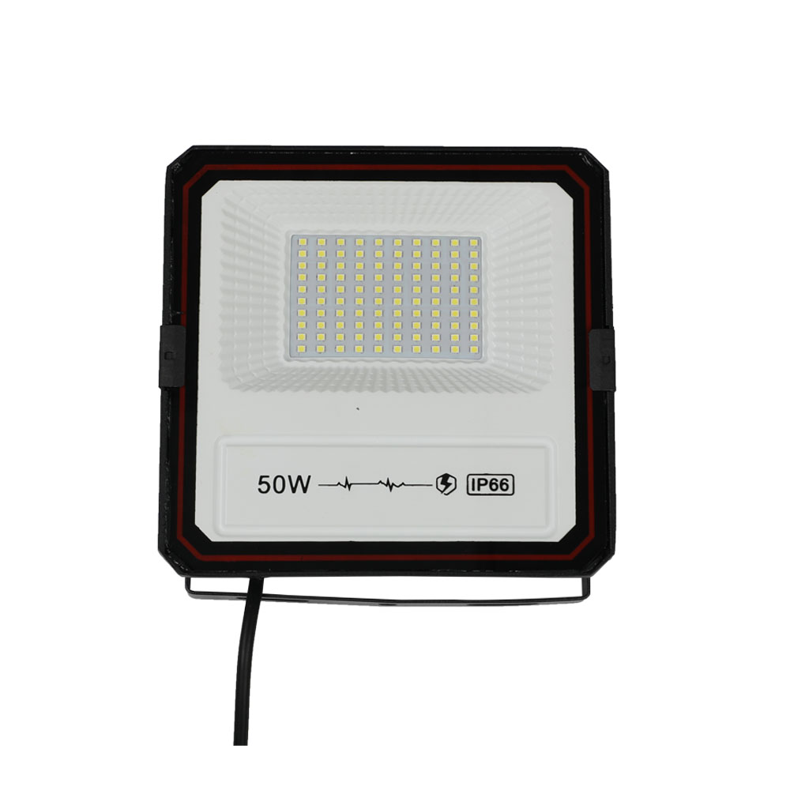
FL19
Material:Iron base+ PMMA Cover
Input Voltage:AC85-265V
Led Chip:2835SMD
IP Rating:IP44 CRI>80 PF>0.9
Color Temperature:3000K/4500K/6000K
Operating Temperature:-25℃ ~50℃
Life Span:50000hours
Certificate:CE ROHS
Item Number | Wattage | LedQuantity | Luminous Flux | Bean Angle | Size(mm)
FL19 | 50W | 100pcs2835SMD | 90-110LM/W | 120° | 180*175*45mm
 | 100W | 200pcs2835SMD |  | 120° | 225*220*50mm
 | 200W | 400pcs2835SMD |  | 120° | 280*270*70mm
Modern Ceiling Light Material:Iron base+ PMMA Cover Input Voltage:AC85-265V Led Chip:2835SMD IP Rating:IP44 CRI>80 PF>0.9 Color Temperature:3000K/4500K/6000K Operating Temperature:-25℃ ~50℃ Life Span:50000hours Certificate:CE ROHS
Item Number | Wattage | LedQuantity | LuminousFlux | Beam Angle | Size (mm) | WIFI Control Remte control Switch control Dimmer control
CL-N00 | 24W | 48pcs2835SMD | 1920-2160lm | 120° | 350mm | Yes
 | 36W | 72pcs2835SMD | 2880-3240lm | 120° | 400mm
 | 40W | 80pcs2835SMD | 3200-3600lm | 120° | 450mm
Modern Ceiling Light Material:Iron base+ PMMA Cover Input Voltage:AC85-265V Led Chip:2835SMD IP Rating:IP44 CRI>80 PF>0.9 Color Temperature:3000K/4500K/6000K Operating Temperature:-25℃ ~50℃ Life Span:50000hours Certificate:CE ROHS
Item Number | Wattage | LedQuantity | LuminousFlux | Beam Angle | Size (mm) | WIFI Control Remte control Switch control Dimmer control
CL-N00 | 24W | 48pcs2835SMD | 1920-2160lm | 120° | 350mm | Yes
 | 36W | 72pcs2835SMD | 2880-3240lm | 120° | 400mm
 | 40W | 80pcs2835SMD | 3200-3600lm | 120° | 450mm
Modern Ceiling Light Material:Iron base+ PMMA Cover Input Voltage:AC85-265V Led Chip:2835SMD IP Rating:IP44 CRI>80 PF>0.9 Color Temperature:3000K/4500K/6000K Operating Temperature:-25℃ ~50℃ Life Span:50000hours Certificate:CE ROHS
Item Number | Wattage | LedQuantity | LuminousFlux | Beam Angle | Size (mm) | WIFI Control Remte control Switch control Dimmer control
CL-N00 | 24W | 48pcs2835SMD | 1920-2160lm | 120° | 350mm | Yes
 | 36W | 72pcs2835SMD | 2880-3240lm | 120° | 400mm
 | 40W | 80pcs2835SMD | 3200-3600lm | 120° | 450mm
Modern Ceiling Light Material:Iron base+ PMMA Cover Input Voltage:AC85-265V Led Chip:2835SMD IP Rating:IP44 CRI>80 PF>0.9 Color Temperature:3000K/4500K/6000K Operating Temperature:-25℃ ~50℃ Life Span:50000hours Certificate:CE ROHS
Item Number | Wattage | LedQuantity | LuminousFlux | Beam Angle | Size (mm) | WIFI Control Remte control Switch control Dimmer control
CL-N00 | 24W | 48pcs2835SMD | 1920-2160lm | 120° | 350mm | Yes
 | 36W | 72pcs2835SMD | 2880-3240lm | 120° | 400mm
 | 40W | 80pcs2835SMD | 3200-3600lm | 120° | 450mm

Slide 18
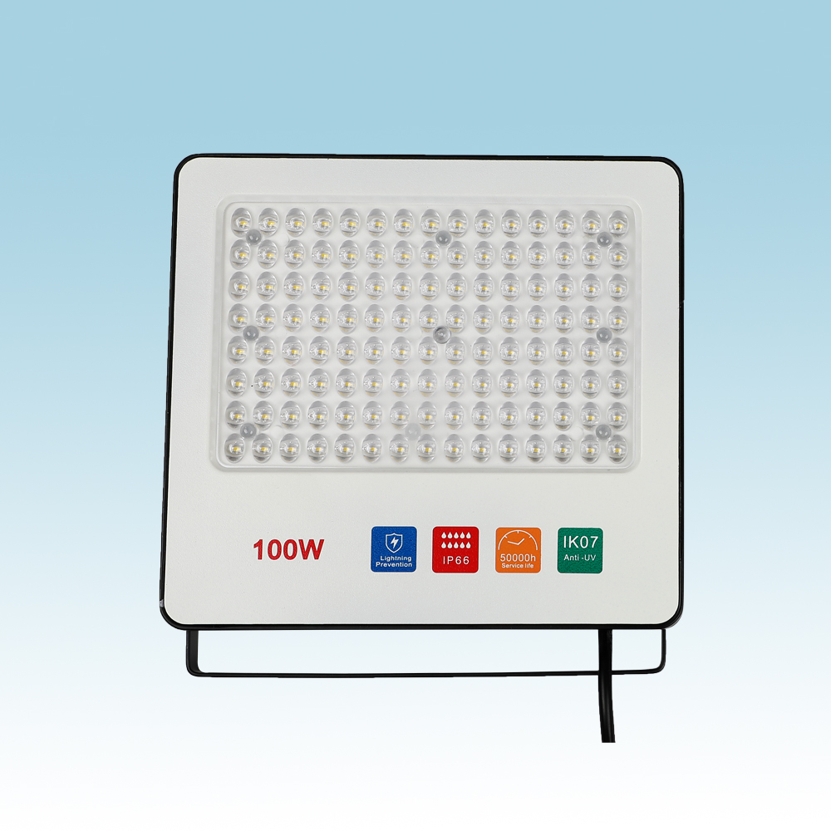
FL20
Material:Iron base+ PMMA Cover
Input Voltage:AC85-265V
Led Chip:2835SMD
IP Rating:IP44 CRI>80 PF>0.9
Color Temperature:3000K/4500K/6000K
Operating Temperature:-25℃ ~50℃
Life Span:50000hours
Certificate:CE ROHS
Item Number | Wattage | LedQuantity | Luminous Flux | Bean Angle | Size(mm)
FL20 | 50W | 100pcs2835SMD | 90-110LM/W | 120° | 240*205*58mm
 | 100W | 200pcs2835SMD |  | 120° | 300*245*70mm
 | 150W | 300pcs2835SMD |  | 120° | 345*290*73mm
 | 200W | 400pcs2835SMD |  | 120° | 400*325*78mm
Modern Ceiling Light Material:Iron base+ PMMA Cover Input Voltage:AC85-265V Led Chip:2835SMD IP Rating:IP44 CRI>80 PF>0.9 Color Temperature:3000K/4500K/6000K Operating Temperature:-25℃ ~50℃ Life Span:50000hours Certificate:CE ROHS
Item Number | Wattage | LedQuantity | LuminousFlux | Beam Angle | Size (mm) | WIFI Control Remte control Switch control Dimmer control
CL-N00 | 24W | 48pcs2835SMD | 1920-2160lm | 120° | 350mm | Yes
 | 36W | 72pcs2835SMD | 2880-3240lm | 120° | 400mm
 | 40W | 80pcs2835SMD | 3200-3600lm | 120° | 450mm
Modern Ceiling Light Material:Iron base+ PMMA Cover Input Voltage:AC85-265V Led Chip:2835SMD IP Rating:IP44 CRI>80 PF>0.9 Color Temperature:3000K/4500K/6000K Operating Temperature:-25℃ ~50℃ Life Span:50000hours Certificate:CE ROHS
Item Number | Wattage | LedQuantity | LuminousFlux | Beam Angle | Size (mm) | WIFI Control Remte control Switch control Dimmer control
CL-N00 | 24W | 48pcs2835SMD | 1920-2160lm | 120° | 350mm | Yes
 | 36W | 72pcs2835SMD | 2880-3240lm | 120° | 400mm
 | 40W | 80pcs2835SMD | 3200-3600lm | 120° | 450mm
Modern Ceiling Light Material:Iron base+ PMMA Cover Input Voltage:AC85-265V Led Chip:2835SMD IP Rating:IP44 CRI>80 PF>0.9 Color Temperature:3000K/4500K/6000K Operating Temperature:-25℃ ~50℃ Life Span:50000hours Certificate:CE ROHS
Item Number | Wattage | LedQuantity | LuminousFlux | Beam Angle | Size (mm) | WIFI Control Remte control Switch control Dimmer control
CL-N00 | 24W | 48pcs2835SMD | 1920-2160lm | 120° | 350mm | Yes
 | 36W | 72pcs2835SMD | 2880-3240lm | 120° | 400mm
 | 40W | 80pcs2835SMD | 3200-3600lm | 120° | 450mm
Modern Ceiling Light Material:Iron base+ PMMA Cover Input Voltage:AC85-265V Led Chip:2835SMD IP Rating:IP44 CRI>80 PF>0.9 Color Temperature:3000K/4500K/6000K Operating Temperature:-25℃ ~50℃ Life Span:50000hours Certificate:CE ROHS
Item Number | Wattage | LedQuantity | LuminousFlux | Beam Angle | Size (mm) | WIFI Control Remte control Switch control Dimmer control
CL-N00 | 24W | 48pcs2835SMD | 1920-2160lm | 120° | 350mm | Yes
 | 36W | 72pcs2835SMD | 2880-3240lm | 120° | 400mm
 | 40W | 80pcs2835SMD | 3200-3600lm | 120° | 450mm

Slide 19
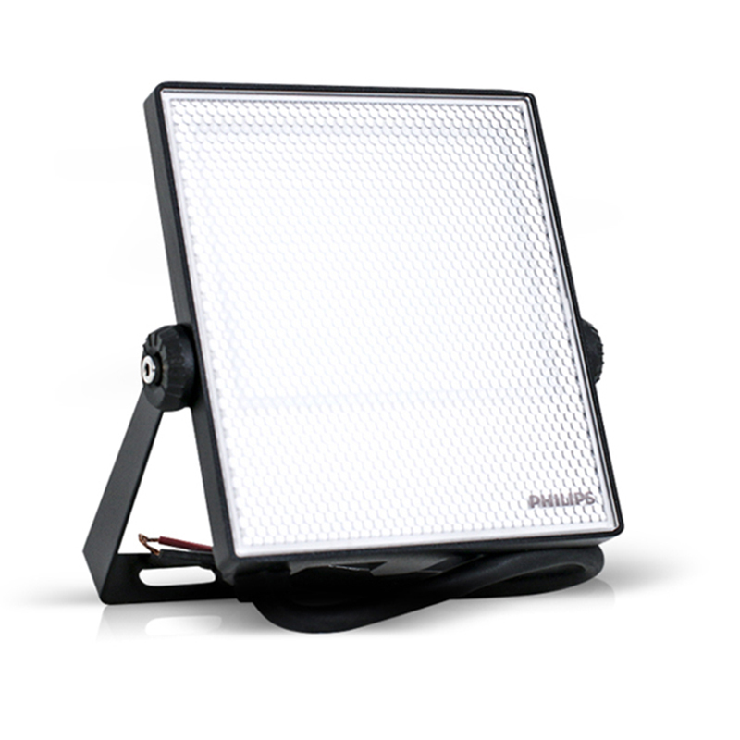
FLN01
Input Voltage:AC85-265V
Material: Aluminum
Led Chip:2835SMD Chip Brand:Epistar
IP Rating:IP65 PF>98%
Color Temperature:2700K-7000K
Operating Temperature:-25℃ ~65℃
Life Span:50000hours
CE ROHS LVD EMC certificate approved
Item Number | Wattage | LedQuantity | LuminousFlux | Beam Angle | Size (mm)
FLN01 | 10W | 20pcs2835SMD | 90-110lm/w | 120° | 117*109*27mm
 | 20W | 40pcs2835SMD | 90-110lm/w | 120° | 134*130*28mm
 | 30W | 60pcs2835SMD | 90-110lm/w | 120° | 167*170*36mm
 | 50W | 100pcs2835SMD | 90-110lm/w | 120° | 222*240*38mm
 | 70W | 140pcs2835SMD | 90-110lm/w | 120° | 222*240*38mm
Modern Ceiling Light Material:Iron base+ PMMA Cover Input Voltage:AC85-265V Led Chip:2835SMD IP Rating:IP44 CRI>80 PF>0.9 Color Temperature:3000K/4500K/6000K Operating Temperature:-25℃ ~50℃ Life Span:50000hours Certificate:CE ROHS
Item Number | Wattage | LedQuantity | LuminousFlux | Beam Angle | Size (mm) | WIFI Control Remte control Switch control Dimmer control
CL-N00 | 24W | 48pcs2835SMD | 1920-2160lm | 120° | 350mm | Yes
 | 36W | 72pcs2835SMD | 2880-3240lm | 120° | 400mm
 | 40W | 80pcs2835SMD | 3200-3600lm | 120° | 450mm
Modern Ceiling Light Material:Iron base+ PMMA Cover Input Voltage:AC85-265V Led Chip:2835SMD IP Rating:IP44 CRI>80 PF>0.9 Color Temperature:3000K/4500K/6000K Operating Temperature:-25℃ ~50℃ Life Span:50000hours Certificate:CE ROHS
Item Number | Wattage | LedQuantity | LuminousFlux | Beam Angle | Size (mm) | WIFI Control Remte control Switch control Dimmer control
CL-N00 | 24W | 48pcs2835SMD | 1920-2160lm | 120° | 350mm | Yes
 | 36W | 72pcs2835SMD | 2880-3240lm | 120° | 400mm
 | 40W | 80pcs2835SMD | 3200-3600lm | 120° | 450mm
Modern Ceiling Light Material:Iron base+ PMMA Cover Input Voltage:AC85-265V Led Chip:2835SMD IP Rating:IP44 CRI>80 PF>0.9 Color Temperature:3000K/4500K/6000K Operating Temperature:-25℃ ~50℃ Life Span:50000hours Certificate:CE ROHS
Item Number | Wattage | LedQuantity | LuminousFlux | Beam Angle | Size (mm) | WIFI Control Remte control Switch control Dimmer control
CL-N00 | 24W | 48pcs2835SMD | 1920-2160lm | 120° | 350mm | Yes
 | 36W | 72pcs2835SMD | 2880-3240lm | 120° | 400mm
 | 40W | 80pcs2835SMD | 3200-3600lm | 120° | 450mm
Modern Ceiling Light Material:Iron base+ PMMA Cover Input Voltage:AC85-265V Led Chip:2835SMD IP Rating:IP44 CRI>80 PF>0.9 Color Temperature:3000K/4500K/6000K Operating Temperature:-25℃ ~50℃ Life Span:50000hours Certificate:CE ROHS
Item Number | Wattage | LedQuantity | LuminousFlux | Beam Angle | Size (mm) | WIFI Control Remte control Switch control Dimmer control
CL-N00 | 24W | 48pcs2835SMD | 1920-2160lm | 120° | 350mm | Yes
 | 36W | 72pcs2835SMD | 2880-3240lm | 120° | 400mm
 | 40W | 80pcs2835SMD | 3200-3600lm | 120° | 450mm

Slide 20
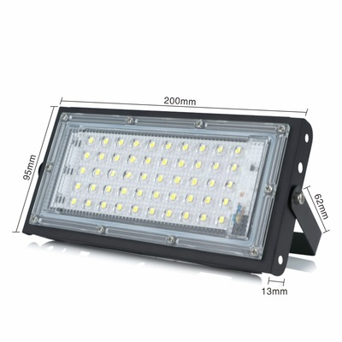
FLN02
Input Voltage:AC85-265V
Material: Aluminum
Led Chip:3030SMD Chip Brand:Epistar
IP Rating:IP65 PF>98%
Color Temperature:2700K-7000K
Operating Temperature:-25℃ ~65℃
Life Span:50000hours
CE ROHS LVD EMC certificate approved
Item Number | Wattage | LedQuantity | LuminousFlux | Beam Angle | Size (mm)
FLN02 | 50W | 48pcs3030SMD | 90-110lm/w | 120° | 315*130*90
 | 100W | 96pcs3030SMD | 90-110lm/w | 120° | 315*121*180
 | 150W | 144pcs3030SMD | 90-110lm/w | 120° | 315*130*270
 | 200W | 192pcs3030SMD | 90-110lm/w | 120° | 315*130*300
 | 250W | 240pcs3030SMD | 90-110lm/w | 120° | 315*130*360
 | 300W | 288pcs3030SMD | 90-110lm/w | 120° | 599*130*270
 | 400W | 384pcs3030SMD | 90-110lm/w | 120° | 599*130*360
 | 500W | 482pcs3030SMD | 90-110lm/w | 120° | 599*130*450
 | 600W | 580pcs3030SMD | 90-110lm/w | 120° | 899*130*270
 | 800W | 778pcs3030SMD | 90-110lm/w | 120° | 899*130*360
 | 1000W | 976pcs3030SMD | 90-110lm/w | 120° | 899*130*450
Modern Ceiling Light Material:Iron base+ PMMA Cover Input Voltage:AC85-265V Led Chip:2835SMD IP Rating:IP44 CRI>80 PF>0.9 Color Temperature:3000K/4500K/6000K Operating Temperature:-25℃ ~50℃ Life Span:50000hours Certificate:CE ROHS
Item Number | Wattage | LedQuantity | LuminousFlux | Beam Angle | Size (mm) | WIFI Control Remte control Switch control Dimmer control
CL-N00 | 24W | 48pcs2835SMD | 1920-2160lm | 120° | 350mm | Yes
 | 36W | 72pcs2835SMD | 2880-3240lm | 120° | 400mm
 | 40W | 80pcs2835SMD | 3200-3600lm | 120° | 450mm
Modern Ceiling Light Material:Iron base+ PMMA Cover Input Voltage:AC85-265V Led Chip:2835SMD IP Rating:IP44 CRI>80 PF>0.9 Color Temperature:3000K/4500K/6000K Operating Temperature:-25℃ ~50℃ Life Span:50000hours Certificate:CE ROHS
Item Number | Wattage | LedQuantity | LuminousFlux | Beam Angle | Size (mm) | WIFI Control Remte control Switch control Dimmer control
CL-N00 | 24W | 48pcs2835SMD | 1920-2160lm | 120° | 350mm | Yes
 | 36W | 72pcs2835SMD | 2880-3240lm | 120° | 400mm
 | 40W | 80pcs2835SMD | 3200-3600lm | 120° | 450mm
Modern Ceiling Light Material:Iron base+ PMMA Cover Input Voltage:AC85-265V Led Chip:2835SMD IP Rating:IP44 CRI>80 PF>0.9 Color Temperature:3000K/4500K/6000K Operating Temperature:-25℃ ~50℃ Life Span:50000hours Certificate:CE ROHS
Item Number | Wattage | LedQuantity | LuminousFlux | Beam Angle | Size (mm) | WIFI Control Remte control Switch control Dimmer control
CL-N00 | 24W | 48pcs2835SMD | 1920-2160lm | 120° | 350mm | Yes
 | 36W | 72pcs2835SMD | 2880-3240lm | 120° | 400mm
 | 40W | 80pcs2835SMD | 3200-3600lm | 120° | 450mm
Modern Ceiling Light Material:Iron base+ PMMA Cover Input Voltage:AC85-265V Led Chip:2835SMD IP Rating:IP44 CRI>80 PF>0.9 Color Temperature:3000K/4500K/6000K Operating Temperature:-25℃ ~50℃ Life Span:50000hours Certificate:CE ROHS
Item Number | Wattage | LedQuantity | LuminousFlux | Beam Angle | Size (mm) | WIFI Control Remte control Switch control Dimmer control
CL-N00 | 24W | 48pcs2835SMD | 1920-2160lm | 120° | 350mm | Yes
 | 36W | 72pcs2835SMD | 2880-3240lm | 120° | 400mm
 | 40W | 80pcs2835SMD | 3200-3600lm | 120° | 450mm

Slide 21
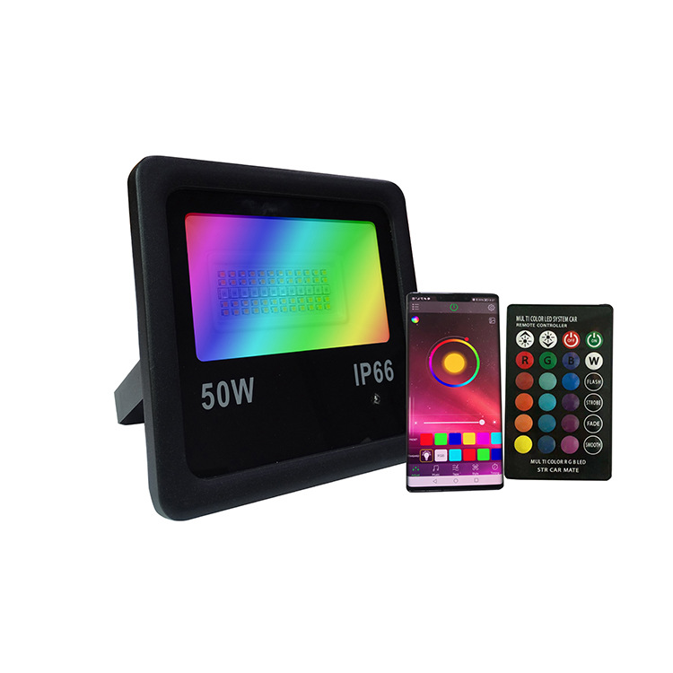
FLN03
Input Voltage:AC85-265V
Material: Aluminum
Led Chip:5730SMD Chip Brand:Epistar
IP Rating:IP65 PF>98%
Color Temperature:RGBW
Operating Temperature:-25℃ ~65℃
Life Span:50000hours
CE ROHS LVD EMC certificate approved
Item Number | Wattage | LedQuantity | LuminousFlux | Beam Angle | Color
FLN03 | 10W | 20pcs2835SMD | 90-110lm/w | 120° | RGBW
 | 20W | 40pcs2835SMD | 90-110lm/w | 120° | RGBW
 | 30W | 60pcs2835SMD | 90-110lm/w | 120° | RGBW
 | 50W | 100pcs2835SMD | 90-110lm/w | 120° | RGBW
Modern Ceiling Light Material:Iron base+ PMMA Cover Input Voltage:AC85-265V Led Chip:2835SMD IP Rating:IP44 CRI>80 PF>0.9 Color Temperature:3000K/4500K/6000K Operating Temperature:-25℃ ~50℃ Life Span:50000hours Certificate:CE ROHS
Item Number | Wattage | LedQuantity | LuminousFlux | Beam Angle | Size (mm) | WIFI Control Remte control Switch control Dimmer control
CL-N00 | 24W | 48pcs2835SMD | 1920-2160lm | 120° | 350mm | Yes
 | 36W | 72pcs2835SMD | 2880-3240lm | 120° | 400mm
 | 40W | 80pcs2835SMD | 3200-3600lm | 120° | 450mm
Modern Ceiling Light Material:Iron base+ PMMA Cover Input Voltage:AC85-265V Led Chip:2835SMD IP Rating:IP44 CRI>80 PF>0.9 Color Temperature:3000K/4500K/6000K Operating Temperature:-25℃ ~50℃ Life Span:50000hours Certificate:CE ROHS
Item Number | Wattage | LedQuantity | LuminousFlux | Beam Angle | Size (mm) | WIFI Control Remte control Switch control Dimmer control
CL-N00 | 24W | 48pcs2835SMD | 1920-2160lm | 120° | 350mm | Yes
 | 36W | 72pcs2835SMD | 2880-3240lm | 120° | 400mm
 | 40W | 80pcs2835SMD | 3200-3600lm | 120° | 450mm
Modern Ceiling Light Material:Iron base+ PMMA Cover Input Voltage:AC85-265V Led Chip:2835SMD IP Rating:IP44 CRI>80 PF>0.9 Color Temperature:3000K/4500K/6000K Operating Temperature:-25℃ ~50℃ Life Span:50000hours Certificate:CE ROHS
Item Number | Wattage | LedQuantity | LuminousFlux | Beam Angle | Size (mm) | WIFI Control Remte control Switch control Dimmer control
CL-N00 | 24W | 48pcs2835SMD | 1920-2160lm | 120° | 350mm | Yes
 | 36W | 72pcs2835SMD | 2880-3240lm | 120° | 400mm
 | 40W | 80pcs2835SMD | 3200-3600lm | 120° | 450mm
Modern Ceiling Light Material:Iron base+ PMMA Cover Input Voltage:AC85-265V Led Chip:2835SMD IP Rating:IP44 CRI>80 PF>0.9 Color Temperature:3000K/4500K/6000K Operating Temperature:-25℃ ~50℃ Life Span:50000hours Certificate:CE ROHS
Item Number | Wattage | LedQuantity | LuminousFlux | Beam Angle | Size (mm) | WIFI Control Remte control Switch control Dimmer control
CL-N00 | 24W | 48pcs2835SMD | 1920-2160lm | 120° | 350mm | Yes
 | 36W | 72pcs2835SMD | 2880-3240lm | 120° | 400mm
 | 40W | 80pcs2835SMD | 3200-3600lm | 120° | 450mm

Slide 22
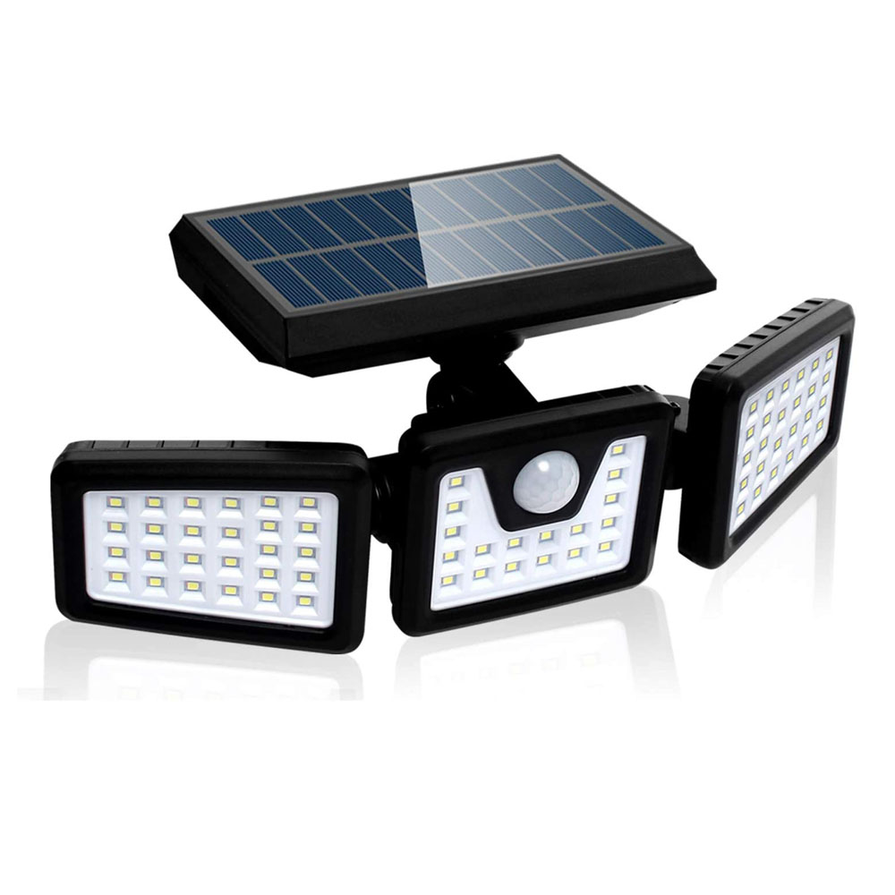
FLN05
Input Voltage:AC85-265V
Material: ABS+PC
Led Chip:5730SMD Chip Brand:Epistar
IP Rating:IP65 PF>98%
Color Temperature:2700K-7000K
Operating Temperature:-25℃ ~65℃
Life Span:50000hours
CE ROHS LVD EMC certificate approved
Item Number | Wattage | LedQuantity | LuminousFlux | Beam Angle | Size (mm)
FLN05 | 1.8W | 70LED | 4-6 Hours | 3.7V/1800mAh | 282*130*105MM
 | 3.6W | 118LED | 4-6 Hours | 3.7V/1800mAh | 282*130*105MM
 | 5.5W | 128LED | 4-6 Hours | 3.7V/1800mAh | 282*130*105MM
 | 6.5W | 192LED | 4-6 Hours | 3.7V/1800mAh | 282*130*105MM
 | 9W | 256LED | 4-6 Hours | 3.7V/1800mAh | 282*130*105MM
Modern Ceiling Light Material:Iron base+ PMMA Cover Input Voltage:AC85-265V Led Chip:2835SMD IP Rating:IP44 CRI>80 PF>0.9 Color Temperature:3000K/4500K/6000K Operating Temperature:-25℃ ~50℃ Life Span:50000hours Certificate:CE ROHS
Item Number | Wattage | LedQuantity | LuminousFlux | Beam Angle | Size (mm) | WIFI Control Remte control Switch control Dimmer control
CL-N00 | 24W | 48pcs2835SMD | 1920-2160lm | 120° | 350mm | Yes
 | 36W | 72pcs2835SMD | 2880-3240lm | 120° | 400mm
 | 40W | 80pcs2835SMD | 3200-3600lm | 120° | 450mm
Modern Ceiling Light Material:Iron base+ PMMA Cover Input Voltage:AC85-265V Led Chip:2835SMD IP Rating:IP44 CRI>80 PF>0.9 Color Temperature:3000K/4500K/6000K Operating Temperature:-25℃ ~50℃ Life Span:50000hours Certificate:CE ROHS
Item Number | Wattage | LedQuantity | LuminousFlux | Beam Angle | Size (mm) | WIFI Control Remte control Switch control Dimmer control
CL-N00 | 24W | 48pcs2835SMD | 1920-2160lm | 120° | 350mm | Yes
 | 36W | 72pcs2835SMD | 2880-3240lm | 120° | 400mm
 | 40W | 80pcs2835SMD | 3200-3600lm | 120° | 450mm
Modern Ceiling Light Material:Iron base+ PMMA Cover Input Voltage:AC85-265V Led Chip:2835SMD IP Rating:IP44 CRI>80 PF>0.9 Color Temperature:3000K/4500K/6000K Operating Temperature:-25℃ ~50℃ Life Span:50000hours Certificate:CE ROHS
Item Number | Wattage | LedQuantity | LuminousFlux | Beam Angle | Size (mm) | WIFI Control Remte control Switch control Dimmer control
CL-N00 | 24W | 48pcs2835SMD | 1920-2160lm | 120° | 350mm | Yes
 | 36W | 72pcs2835SMD | 2880-3240lm | 120° | 400mm
 | 40W | 80pcs2835SMD | 3200-3600lm | 120° | 450mm
Modern Ceiling Light Material:Iron base+ PMMA Cover Input Voltage:AC85-265V Led Chip:2835SMD IP Rating:IP44 CRI>80 PF>0.9 Color Temperature:3000K/4500K/6000K Operating Temperature:-25℃ ~50℃ Life Span:50000hours Certificate:CE ROHS
Item Number | Wattage | LedQuantity | LuminousFlux | Beam Angle | Size (mm) | WIFI Control Remte control Switch control Dimmer control
CL-N00 | 24W | 48pcs2835SMD | 1920-2160lm | 120° | 350mm | Yes
 | 36W | 72pcs2835SMD | 2880-3240lm | 120° | 400mm
 | 40W | 80pcs2835SMD | 3200-3600lm | 120° | 450mm

Slide 23
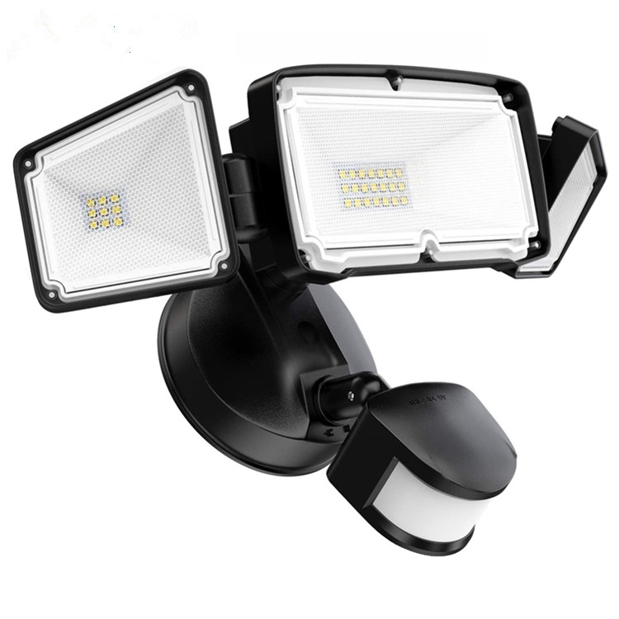
FLN06
Frameless panel light
Material:Aluminum+PMMA/PS/MS Cover
Input Voltage:AC85- 265V
Led Chip:2835SMD
Chip Brand :Epistar
IP Rating:IP44 CRI>80 PF>0.9
Color Temperature:3000K/4500K/6000K
Operating Temperature:-20℃ -50℃
Life Span：50000hours
Certificate：CE,ROHS
Item Number | Wattage | LedQuantity | LuminousFlux | Beam Angle | Size (mm)
FLN06 | 20W | single-head | 40pcs5730SMD | 1600Lm | 120°
 | 28W | double-heads | 56pcs5730SMD | 2400Lm | 120°
 | 39W | three-heads | 78pcs5730SMD | 3600Lm | 120°
Modern Ceiling Light Material:Iron base+ PMMA Cover Input Voltage:AC85-265V Led Chip:2835SMD IP Rating:IP44 CRI>80 PF>0.9 Color Temperature:3000K/4500K/6000K Operating Temperature:-25℃ ~50℃ Life Span:50000hours Certificate:CE ROHS
Item Number | Wattage | LedQuantity | LuminousFlux | Beam Angle | Size (mm) | WIFI Control Remte control Switch control Dimmer control
CL-N00 | 24W | 48pcs2835SMD | 1920-2160lm | 120° | 350mm | Yes
 | 36W | 72pcs2835SMD | 2880-3240lm | 120° | 400mm
 | 40W | 80pcs2835SMD | 3200-3600lm | 120° | 450mm
Modern Ceiling Light Material:Iron base+ PMMA Cover Input Voltage:AC85-265V Led Chip:2835SMD IP Rating:IP44 CRI>80 PF>0.9 Color Temperature:3000K/4500K/6000K Operating Temperature:-25℃ ~50℃ Life Span:50000hours Certificate:CE ROHS
Item Number | Wattage | LedQuantity | LuminousFlux | Beam Angle | Size (mm) | WIFI Control Remte control Switch control Dimmer control
CL-N00 | 24W | 48pcs2835SMD | 1920-2160lm | 120° | 350mm | Yes
 | 36W | 72pcs2835SMD | 2880-3240lm | 120° | 400mm
 | 40W | 80pcs2835SMD | 3200-3600lm | 120° | 450mm
Modern Ceiling Light Material:Iron base+ PMMA Cover Input Voltage:AC85-265V Led Chip:2835SMD IP Rating:IP44 CRI>80 PF>0.9 Color Temperature:3000K/4500K/6000K Operating Temperature:-25℃ ~50℃ Life Span:50000hours Certificate:CE ROHS
Item Number | Wattage | LedQuantity | LuminousFlux | Beam Angle | Size (mm) | WIFI Control Remte control Switch control Dimmer control
CL-N00 | 24W | 48pcs2835SMD | 1920-2160lm | 120° | 350mm | Yes
 | 36W | 72pcs2835SMD | 2880-3240lm | 120° | 400mm
 | 40W | 80pcs2835SMD | 3200-3600lm | 120° | 450mm
Modern Ceiling Light Material:Iron base+ PMMA Cover Input Voltage:AC85-265V Led Chip:2835SMD IP Rating:IP44 CRI>80 PF>0.9 Color Temperature:3000K/4500K/6000K Operating Temperature:-25℃ ~50℃ Life Span:50000hours Certificate:CE ROHS
Item Number | Wattage | LedQuantity | LuminousFlux | Beam Angle | Size (mm) | WIFI Control Remte control Switch control Dimmer control
CL-N00 | 24W | 48pcs2835SMD | 1920-2160lm | 120° | 350mm | Yes
 | 36W | 72pcs2835SMD | 2880-3240lm | 120° | 400mm
 | 40W | 80pcs2835SMD | 3200-3600lm | 120° | 450mm

Slide 24
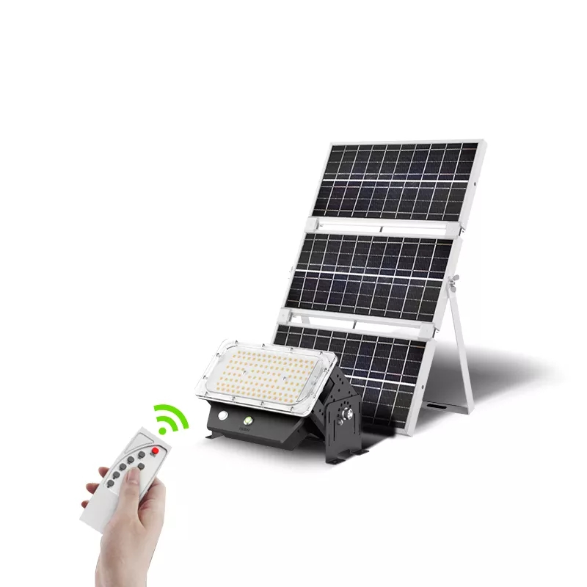
FLN07
Frameless panel light
Material:Aluminum+PMMA/PS/MS Cover
Input Voltage:AC85- 265V
Led Chip:2835SMD
Chip Brand :Epistar
IP Rating:IP44 CRI>80 PF>0.9
Color Temperature:3000K/4500K/6000K
Operating Temperature:-20℃ -50℃
Life Span：50000hours
Certificate：CE,ROHS
Item Number | Wattage | LedQuantity | LuminousFlux | Beam Angle | Size (mm)
FLN07 | 10W | 20pcs5730SMD | 3.7V/ 18650, 1200mAh lithium battery | 120° | 90*25*70mm
 | 50W | 100pcs5730SMD | 3.7V/ 18650, 1200mAh lithium battery | 120° | 210*30*180mm
Modern Ceiling Light Material:Iron base+ PMMA Cover Input Voltage:AC85-265V Led Chip:2835SMD IP Rating:IP44 CRI>80 PF>0.9 Color Temperature:3000K/4500K/6000K Operating Temperature:-25℃ ~50℃ Life Span:50000hours Certificate:CE ROHS
Item Number | Wattage | LedQuantity | LuminousFlux | Beam Angle | Size (mm) | WIFI Control Remte control Switch control Dimmer control
CL-N00 | 24W | 48pcs2835SMD | 1920-2160lm | 120° | 350mm | Yes
 | 36W | 72pcs2835SMD | 2880-3240lm | 120° | 400mm
 | 40W | 80pcs2835SMD | 3200-3600lm | 120° | 450mm
Modern Ceiling Light Material:Iron base+ PMMA Cover Input Voltage:AC85-265V Led Chip:2835SMD IP Rating:IP44 CRI>80 PF>0.9 Color Temperature:3000K/4500K/6000K Operating Temperature:-25℃ ~50℃ Life Span:50000hours Certificate:CE ROHS
Item Number | Wattage | LedQuantity | LuminousFlux | Beam Angle | Size (mm) | WIFI Control Remte control Switch control Dimmer control
CL-N00 | 24W | 48pcs2835SMD | 1920-2160lm | 120° | 350mm | Yes
 | 36W | 72pcs2835SMD | 2880-3240lm | 120° | 400mm
 | 40W | 80pcs2835SMD | 3200-3600lm | 120° | 450mm
Modern Ceiling Light Material:Iron base+ PMMA Cover Input Voltage:AC85-265V Led Chip:2835SMD IP Rating:IP44 CRI>80 PF>0.9 Color Temperature:3000K/4500K/6000K Operating Temperature:-25℃ ~50℃ Life Span:50000hours Certificate:CE ROHS
Item Number | Wattage | LedQuantity | LuminousFlux | Beam Angle | Size (mm) | WIFI Control Remte control Switch control Dimmer control
CL-N00 | 24W | 48pcs2835SMD | 1920-2160lm | 120° | 350mm | Yes
 | 36W | 72pcs2835SMD | 2880-3240lm | 120° | 400mm
 | 40W | 80pcs2835SMD | 3200-3600lm | 120° | 450mm
Modern Ceiling Light Material:Iron base+ PMMA Cover Input Voltage:AC85-265V Led Chip:2835SMD IP Rating:IP44 CRI>80 PF>0.9 Color Temperature:3000K/4500K/6000K Operating Temperature:-25℃ ~50℃ Life Span:50000hours Certificate:CE ROHS
Item Number | Wattage | LedQuantity | LuminousFlux | Beam Angle | Size (mm) | WIFI Control Remte control Switch control Dimmer control
CL-N00 | 24W | 48pcs2835SMD | 1920-2160lm | 120° | 350mm | Yes
 | 36W | 72pcs2835SMD | 2880-3240lm | 120° | 400mm
 | 40W | 80pcs2835SMD | 3200-3600lm | 120° | 450mm

Slide 25
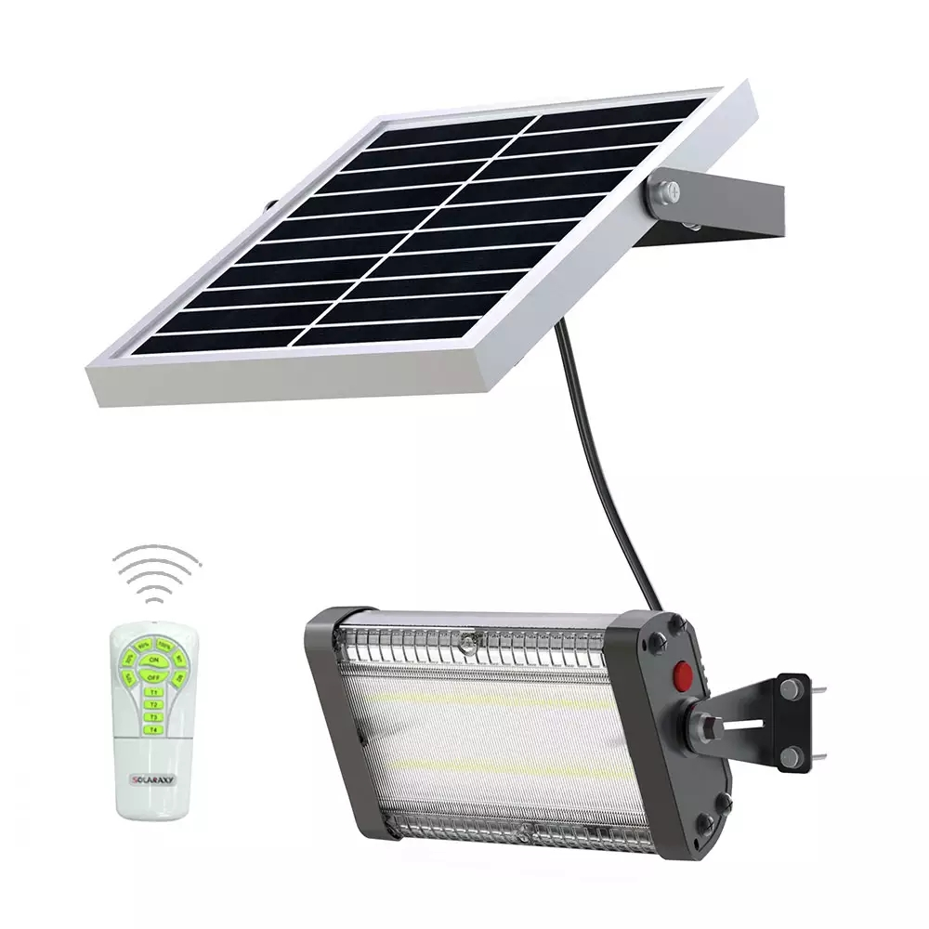
FLN08
Input Voltage:AC85-265V
Material:Aluminium alloy
Led Chip:5730SMD Chip Brand:Epistar
IP Rating:IP65 PF>98%
Color Temperature:2700K-7000K
Operating Temperature:-25℃ ~65℃
Life Span:50000hours
CE ROHS LVD EMC certificate approved
Item Number | Wattage | LedQuantity | Battery | Beam Angle | Solar Panel
FLN08 | 10W | 20pcs5730SMD | 1500 cycle Li-ion battery | 120° | Monocrystalline silicon
 | 15W | 30pcs5730SMD |  | 120°
 | 20W | 40pcs5730SMD |  | 120°
 | 40W | 80pcs5730SMD |  | 120°
 | 50W | 100pcs5730SMD |  | 120°
Modern Ceiling Light Material:Iron base+ PMMA Cover Input Voltage:AC85-265V Led Chip:2835SMD IP Rating:IP44 CRI>80 PF>0.9 Color Temperature:3000K/4500K/6000K Operating Temperature:-25℃ ~50℃ Life Span:50000hours Certificate:CE ROHS
Item Number | Wattage | LedQuantity | LuminousFlux | Beam Angle | Size (mm) | WIFI Control Remte control Switch control Dimmer control
CL-N00 | 24W | 48pcs2835SMD | 1920-2160lm | 120° | 350mm | Yes
 | 36W | 72pcs2835SMD | 2880-3240lm | 120° | 400mm
 | 40W | 80pcs2835SMD | 3200-3600lm | 120° | 450mm
Modern Ceiling Light Material:Iron base+ PMMA Cover Input Voltage:AC85-265V Led Chip:2835SMD IP Rating:IP44 CRI>80 PF>0.9 Color Temperature:3000K/4500K/6000K Operating Temperature:-25℃ ~50℃ Life Span:50000hours Certificate:CE ROHS
Item Number | Wattage | LedQuantity | LuminousFlux | Beam Angle | Size (mm) | WIFI Control Remte control Switch control Dimmer control
CL-N00 | 24W | 48pcs2835SMD | 1920-2160lm | 120° | 350mm | Yes
 | 36W | 72pcs2835SMD | 2880-3240lm | 120° | 400mm
 | 40W | 80pcs2835SMD | 3200-3600lm | 120° | 450mm
Modern Ceiling Light Material:Iron base+ PMMA Cover Input Voltage:AC85-265V Led Chip:2835SMD IP Rating:IP44 CRI>80 PF>0.9 Color Temperature:3000K/4500K/6000K Operating Temperature:-25℃ ~50℃ Life Span:50000hours Certificate:CE ROHS
Item Number | Wattage | LedQuantity | LuminousFlux | Beam Angle | Size (mm) | WIFI Control Remte control Switch control Dimmer control
CL-N00 | 24W | 48pcs2835SMD | 1920-2160lm | 120° | 350mm | Yes
 | 36W | 72pcs2835SMD | 2880-3240lm | 120° | 400mm
 | 40W | 80pcs2835SMD | 3200-3600lm | 120° | 450mm
Modern Ceiling Light Material:Iron base+ PMMA Cover Input Voltage:AC85-265V Led Chip:2835SMD IP Rating:IP44 CRI>80 PF>0.9 Color Temperature:3000K/4500K/6000K Operating Temperature:-25℃ ~50℃ Life Span:50000hours Certificate:CE ROHS
Item Number | Wattage | LedQuantity | LuminousFlux | Beam Angle | Size (mm) | WIFI Control Remte control Switch control Dimmer control
CL-N00 | 24W | 48pcs2835SMD | 1920-2160lm | 120° | 350mm | Yes
 | 36W | 72pcs2835SMD | 2880-3240lm | 120° | 400mm
 | 40W | 80pcs2835SMD | 3200-3600lm | 120° | 450mm

Slide 26
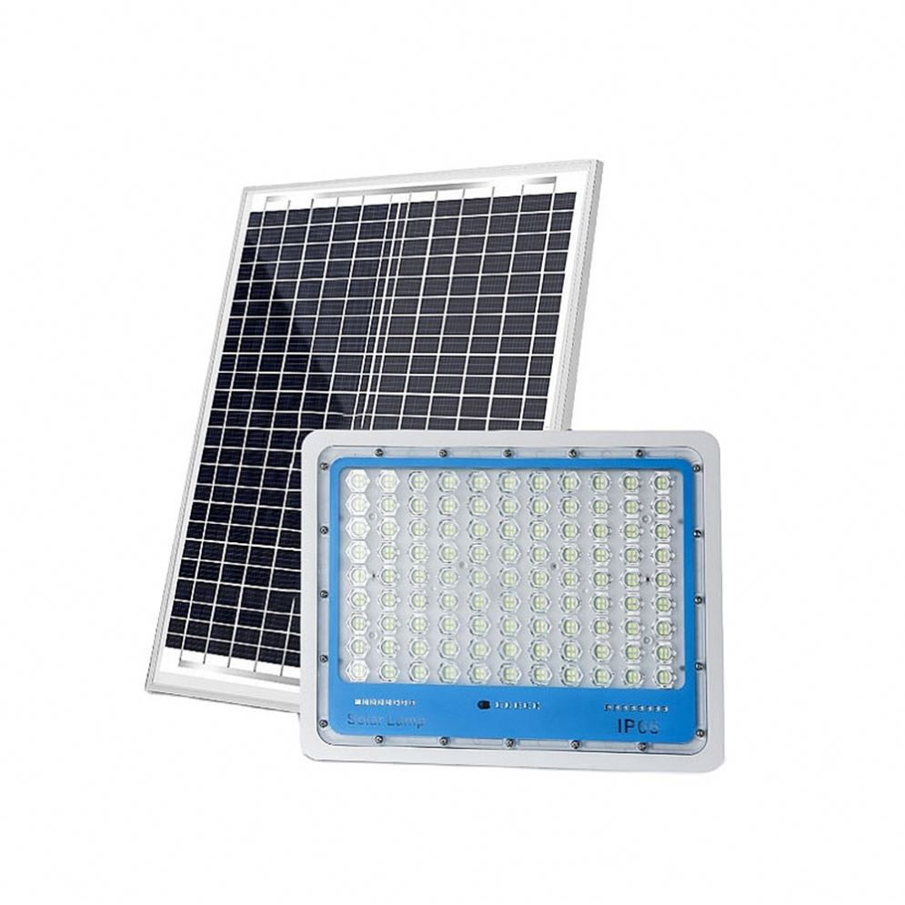
FLN09
Frameless panel light
Material:Aluminum+PMMA/PS/MS Cover
Input Voltage:AC85- 265V
Led Chip:2835SMD
Chip Brand :Epistar
IP Rating:IP44 CRI>80 PF>0.9
Color Temperature:3000K/4500K/6000K
Operating Temperature:-20℃ -50℃
Life Span：50000hours
Certificate：CE,ROHS
Item Number | Wattage | LedQuantity | Battery | Beam Angle | Solar Panel
FLN09 | 50W | 100pcs5730SMD | 3.7V/1800mAh | 120° | Monocrystalline silicon
 | 60W | 120pcs5730SMD | 3.7V/1800mAh | 120°
 | 80W | 160pcs5730SMD | 3.7V/1800mAh | 120°
 | 100W | 200pcs5730SMD | 3.7V/1800mAh | 120°
 | 120W | 240pcs5730SMD | 3.7V/1800mAh | 120°
 | 140W | 280pcs5730SMD | 3.7V/1800mAh | 120°
 | 160W | 320pcs5730SMD | 3.7V/1800mAh | 120°
 | 180W | 360pcs5730SMD | 3.7V/1800mAh | 120°
 | 200W | 400pcs5730SMD | 3.7V/1800mAh | 120°
Modern Ceiling Light Material:Iron base+ PMMA Cover Input Voltage:AC85-265V Led Chip:2835SMD IP Rating:IP44 CRI>80 PF>0.9 Color Temperature:3000K/4500K/6000K Operating Temperature:-25℃ ~50℃ Life Span:50000hours Certificate:CE ROHS
Item Number | Wattage | LedQuantity | LuminousFlux | Beam Angle | Size (mm) | WIFI Control Remte control Switch control Dimmer control
CL-N00 | 24W | 48pcs2835SMD | 1920-2160lm | 120° | 350mm | Yes
 | 36W | 72pcs2835SMD | 2880-3240lm | 120° | 400mm
 | 40W | 80pcs2835SMD | 3200-3600lm | 120° | 450mm
Modern Ceiling Light Material:Iron base+ PMMA Cover Input Voltage:AC85-265V Led Chip:2835SMD IP Rating:IP44 CRI>80 PF>0.9 Color Temperature:3000K/4500K/6000K Operating Temperature:-25℃ ~50℃ Life Span:50000hours Certificate:CE ROHS
Item Number | Wattage | LedQuantity | LuminousFlux | Beam Angle | Size (mm) | WIFI Control Remte control Switch control Dimmer control
CL-N00 | 24W | 48pcs2835SMD | 1920-2160lm | 120° | 350mm | Yes
 | 36W | 72pcs2835SMD | 2880-3240lm | 120° | 400mm
 | 40W | 80pcs2835SMD | 3200-3600lm | 120° | 450mm
Modern Ceiling Light Material:Iron base+ PMMA Cover Input Voltage:AC85-265V Led Chip:2835SMD IP Rating:IP44 CRI>80 PF>0.9 Color Temperature:3000K/4500K/6000K Operating Temperature:-25℃ ~50℃ Life Span:50000hours Certificate:CE ROHS
Item Number | Wattage | LedQuantity | LuminousFlux | Beam Angle | Size (mm) | WIFI Control Remte control Switch control Dimmer control
CL-N00 | 24W | 48pcs2835SMD | 1920-2160lm | 120° | 350mm | Yes
 | 36W | 72pcs2835SMD | 2880-3240lm | 120° | 400mm
 | 40W | 80pcs2835SMD | 3200-3600lm | 120° | 450mm
Modern Ceiling Light Material:Iron base+ PMMA Cover Input Voltage:AC85-265V Led Chip:2835SMD IP Rating:IP44 CRI>80 PF>0.9 Color Temperature:3000K/4500K/6000K Operating Temperature:-25℃ ~50℃ Life Span:50000hours Certificate:CE ROHS
Item Number | Wattage | LedQuantity | LuminousFlux | Beam Angle | Size (mm) | WIFI Control Remte control Switch control Dimmer control
CL-N00 | 24W | 48pcs2835SMD | 1920-2160lm | 120° | 350mm | Yes
 | 36W | 72pcs2835SMD | 2880-3240lm | 120° | 400mm
 | 40W | 80pcs2835SMD | 3200-3600lm | 120° | 450mm

Slide 27
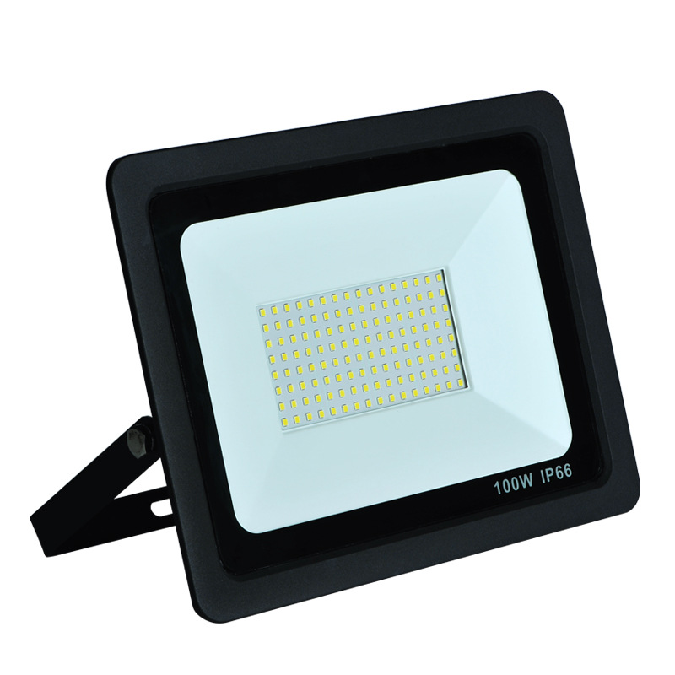
FLN10
Input Voltage:AC85-265V
Material: Aluminum
Led Chip:5730SMD Chip Brand:Epistar
IP Rating:IP65 PF>98%
Color Temperature:2700K-7000K
Operating Temperature:-25℃ ~65℃
Life Span:50000hours
CE ROHS LVD EMC certificate approved
Item Number | Wattage | LedQuantity | LuminousFlux | Beam Angle | Size (mm)
FLN10 | 10W | 20pcs5730SMD | 90-100lm/w | 120° | 39.5*32*25
 | 20W | 40pcs5730SMD | 90-100lm/w | 120° | 37*32.5*27.5
 | 30W | 60pcs5730SMD | 90-100lm/w | 120° | 40.5*37*35
 | 50W | 400pcs5730SMD | 90-100lm/w | 120° | 45.5*39*35.5
 | 100W | 200pcs5730SMD | 90-100lm/w | 120° | 45.5*42*29.5
 | 150W | 300pcs5730SMD | 90-100lm/w | 120° | 42.5*34*25
 | 200W | 400pcs5730SMD | 90-100lm/w | 120° | 47.5*40*30
Modern Ceiling Light Material:Iron base+ PMMA Cover Input Voltage:AC85-265V Led Chip:2835SMD IP Rating:IP44 CRI>80 PF>0.9 Color Temperature:3000K/4500K/6000K Operating Temperature:-25℃ ~50℃ Life Span:50000hours Certificate:CE ROHS
Item Number | Wattage | LedQuantity | LuminousFlux | Beam Angle | Size (mm) | WIFI Control Remte control Switch control Dimmer control
CL-N00 | 24W | 48pcs2835SMD | 1920-2160lm | 120° | 350mm | Yes
 | 36W | 72pcs2835SMD | 2880-3240lm | 120° | 400mm
 | 40W | 80pcs2835SMD | 3200-3600lm | 120° | 450mm
Modern Ceiling Light Material:Iron base+ PMMA Cover Input Voltage:AC85-265V Led Chip:2835SMD IP Rating:IP44 CRI>80 PF>0.9 Color Temperature:3000K/4500K/6000K Operating Temperature:-25℃ ~50℃ Life Span:50000hours Certificate:CE ROHS
Item Number | Wattage | LedQuantity | LuminousFlux | Beam Angle | Size (mm) | WIFI Control Remte control Switch control Dimmer control
CL-N00 | 24W | 48pcs2835SMD | 1920-2160lm | 120° | 350mm | Yes
 | 36W | 72pcs2835SMD | 2880-3240lm | 120° | 400mm
 | 40W | 80pcs2835SMD | 3200-3600lm | 120° | 450mm
Modern Ceiling Light Material:Iron base+ PMMA Cover Input Voltage:AC85-265V Led Chip:2835SMD IP Rating:IP44 CRI>80 PF>0.9 Color Temperature:3000K/4500K/6000K Operating Temperature:-25℃ ~50℃ Life Span:50000hours Certificate:CE ROHS
Item Number | Wattage | LedQuantity | LuminousFlux | Beam Angle | Size (mm) | WIFI Control Remte control Switch control Dimmer control
CL-N00 | 24W | 48pcs2835SMD | 1920-2160lm | 120° | 350mm | Yes
 | 36W | 72pcs2835SMD | 2880-3240lm | 120° | 400mm
 | 40W | 80pcs2835SMD | 3200-3600lm | 120° | 450mm
Modern Ceiling Light Material:Iron base+ PMMA Cover Input Voltage:AC85-265V Led Chip:2835SMD IP Rating:IP44 CRI>80 PF>0.9 Color Temperature:3000K/4500K/6000K Operating Temperature:-25℃ ~50℃ Life Span:50000hours Certificate:CE ROHS
Item Number | Wattage | LedQuantity | LuminousFlux | Beam Angle | Size (mm) | WIFI Control Remte control Switch control Dimmer control
CL-N00 | 24W | 48pcs2835SMD | 1920-2160lm | 120° | 350mm | Yes
 | 36W | 72pcs2835SMD | 2880-3240lm | 120° | 400mm
 | 40W | 80pcs2835SMD | 3200-3600lm | 120° | 450mm

Slide 28
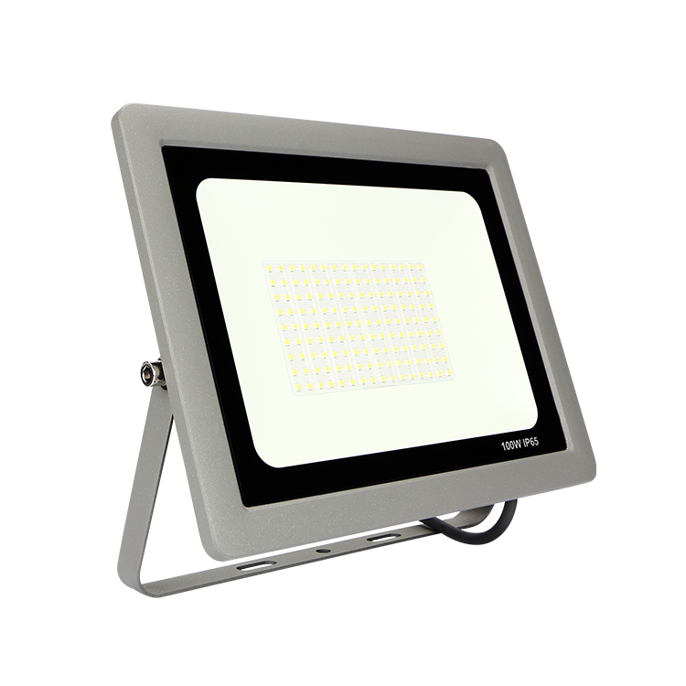
FLN11
Input Voltage:AC85-265V
Material: Aluminum
Led Chip:5730SMD Chip Brand:Epistar
IP Rating:IP65 PF>98%
Color Temperature:2700K-7000K
Operating Temperature:-25℃ ~65℃
Life Span:50000hours
CE ROHS LVD EMC certificate approved
Item Number | Wattage | LedQuantity | LuminousFlux | Beam Angle | Size (mm)
FLN11 | 20w | 20w | 20w | 20w | 20w
 | 30w | 30w | 30w | 30w | 30w
 | 50W | 50W | 50W | 50W | 50W
 | 100W | 100W | 100W | 100W | 100W
 | 150W | 150W | 150W | 150W | 150W
 | 200W | 200W | 200W | 200W | 200W
Modern Ceiling Light Material:Iron base+ PMMA Cover Input Voltage:AC85-265V Led Chip:2835SMD IP Rating:IP44 CRI>80 PF>0.9 Color Temperature:3000K/4500K/6000K Operating Temperature:-25℃ ~50℃ Life Span:50000hours Certificate:CE ROHS
Item Number | Wattage | LedQuantity | LuminousFlux | Beam Angle | Size (mm) | WIFI Control Remte control Switch control Dimmer control
CL-N00 | 24W | 48pcs2835SMD | 1920-2160lm | 120° | 350mm | Yes
 | 36W | 72pcs2835SMD | 2880-3240lm | 120° | 400mm
 | 40W | 80pcs2835SMD | 3200-3600lm | 120° | 450mm
Modern Ceiling Light Material:Iron base+ PMMA Cover Input Voltage:AC85-265V Led Chip:2835SMD IP Rating:IP44 CRI>80 PF>0.9 Color Temperature:3000K/4500K/6000K Operating Temperature:-25℃ ~50℃ Life Span:50000hours Certificate:CE ROHS
Item Number | Wattage | LedQuantity | LuminousFlux | Beam Angle | Size (mm) | WIFI Control Remte control Switch control Dimmer control
CL-N00 | 24W | 48pcs2835SMD | 1920-2160lm | 120° | 350mm | Yes
 | 36W | 72pcs2835SMD | 2880-3240lm | 120° | 400mm
 | 40W | 80pcs2835SMD | 3200-3600lm | 120° | 450mm
Modern Ceiling Light Material:Iron base+ PMMA Cover Input Voltage:AC85-265V Led Chip:2835SMD IP Rating:IP44 CRI>80 PF>0.9 Color Temperature:3000K/4500K/6000K Operating Temperature:-25℃ ~50℃ Life Span:50000hours Certificate:CE ROHS
Item Number | Wattage | LedQuantity | LuminousFlux | Beam Angle | Size (mm) | WIFI Control Remte control Switch control Dimmer control
CL-N00 | 24W | 48pcs2835SMD | 1920-2160lm | 120° | 350mm | Yes
 | 36W | 72pcs2835SMD | 2880-3240lm | 120° | 400mm
 | 40W | 80pcs2835SMD | 3200-3600lm | 120° | 450mm
Modern Ceiling Light Material:Iron base+ PMMA Cover Input Voltage:AC85-265V Led Chip:2835SMD IP Rating:IP44 CRI>80 PF>0.9 Color Temperature:3000K/4500K/6000K Operating Temperature:-25℃ ~50℃ Life Span:50000hours Certificate:CE ROHS
Item Number | Wattage | LedQuantity | LuminousFlux | Beam Angle | Size (mm) | WIFI Control Remte control Switch control Dimmer control
CL-N00 | 24W | 48pcs2835SMD | 1920-2160lm | 120° | 350mm | Yes
 | 36W | 72pcs2835SMD | 2880-3240lm | 120° | 400mm
 | 40W | 80pcs2835SMD | 3200-3600lm | 120° | 450mm

Slide 29
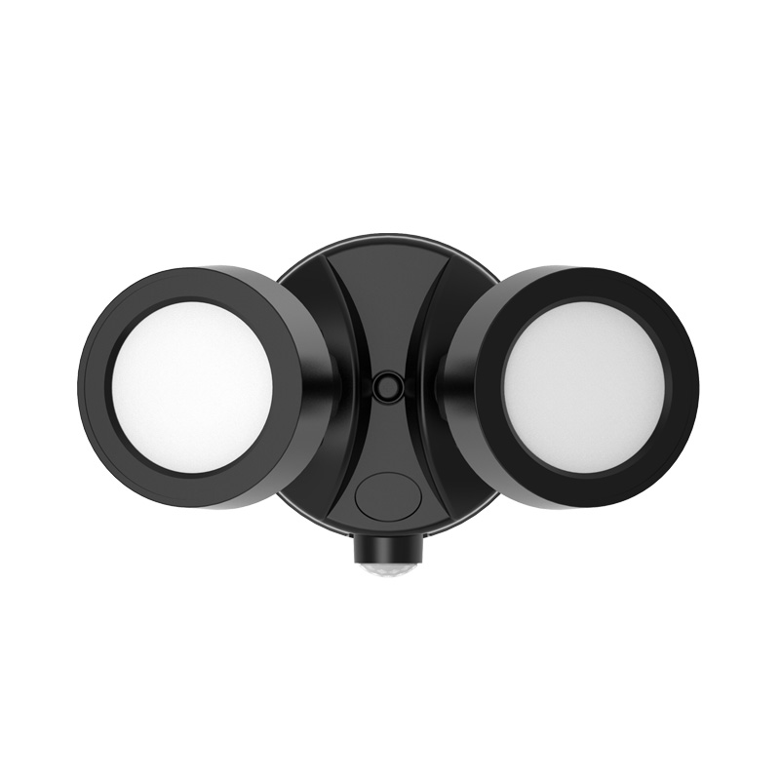
FLN12
Input Voltage:AC85-265V
Material: PC +Heavy duty die-cast aluminum
Led Chip:5730SMD Chip Brand:Epistar
IP Rating:IP65 PF>98%
Color Temperature:2700K-7000K
Operating Temperature:-25℃ ~65℃
Life Span:50000hours
CE ROHS LVD EMC certificate approved
Item Number | Wattage | LedQuantity | LuminousFlux | Detection Range | Detection distance
FLN12 | 22W | 44pcs5730SMD | 1600LM | 180 | 15M
Modern Ceiling Light Material:Iron base+ PMMA Cover Input Voltage:AC85-265V Led Chip:2835SMD IP Rating:IP44 CRI>80 PF>0.9 Color Temperature:3000K/4500K/6000K Operating Temperature:-25℃ ~50℃ Life Span:50000hours Certificate:CE ROHS
Item Number | Wattage | LedQuantity | LuminousFlux | Beam Angle | Size (mm) | WIFI Control Remte control Switch control Dimmer control
CL-N00 | 24W | 48pcs2835SMD | 1920-2160lm | 120° | 350mm | Yes
 | 36W | 72pcs2835SMD | 2880-3240lm | 120° | 400mm
 | 40W | 80pcs2835SMD | 3200-3600lm | 120° | 450mm
Modern Ceiling Light Material:Iron base+ PMMA Cover Input Voltage:AC85-265V Led Chip:2835SMD IP Rating:IP44 CRI>80 PF>0.9 Color Temperature:3000K/4500K/6000K Operating Temperature:-25℃ ~50℃ Life Span:50000hours Certificate:CE ROHS
Item Number | Wattage | LedQuantity | LuminousFlux | Beam Angle | Size (mm) | WIFI Control Remte control Switch control Dimmer control
CL-N00 | 24W | 48pcs2835SMD | 1920-2160lm | 120° | 350mm | Yes
 | 36W | 72pcs2835SMD | 2880-3240lm | 120° | 400mm
 | 40W | 80pcs2835SMD | 3200-3600lm | 120° | 450mm
Modern Ceiling Light Material:Iron base+ PMMA Cover Input Voltage:AC85-265V Led Chip:2835SMD IP Rating:IP44 CRI>80 PF>0.9 Color Temperature:3000K/4500K/6000K Operating Temperature:-25℃ ~50℃ Life Span:50000hours Certificate:CE ROHS
Item Number | Wattage | LedQuantity | LuminousFlux | Beam Angle | Size (mm) | WIFI Control Remte control Switch control Dimmer control
CL-N00 | 24W | 48pcs2835SMD | 1920-2160lm | 120° | 350mm | Yes
 | 36W | 72pcs2835SMD | 2880-3240lm | 120° | 400mm
 | 40W | 80pcs2835SMD | 3200-3600lm | 120° | 450mm
Modern Ceiling Light Material:Iron base+ PMMA Cover Input Voltage:AC85-265V Led Chip:2835SMD IP Rating:IP44 CRI>80 PF>0.9 Color Temperature:3000K/4500K/6000K Operating Temperature:-25℃ ~50℃ Life Span:50000hours Certificate:CE ROHS
Item Number | Wattage | LedQuantity | LuminousFlux | Beam Angle | Size (mm) | WIFI Control Remte control Switch control Dimmer control
CL-N00 | 24W | 48pcs2835SMD | 1920-2160lm | 120° | 350mm | Yes
 | 36W | 72pcs2835SMD | 2880-3240lm | 120° | 400mm
 | 40W | 80pcs2835SMD | 3200-3600lm | 120° | 450mm

Slide 30
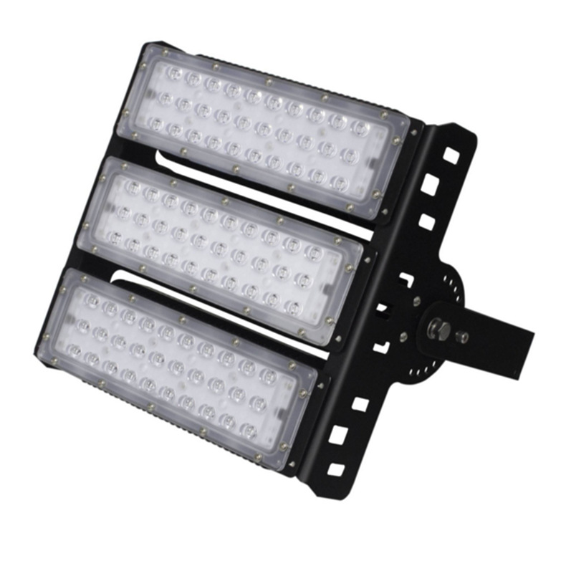
FLN13
Input Voltage:AC85-265V
Material: Aluminum+PC Tens
Driver MEANWELL/DOMESTIC
IP Rating:IP65 PF>98%
Color Temperature:2700K-7000K
Operating Temperature:-25℃ ~65℃
Life Span:50000hours
CE ROHS LVD EMC certificate approved
Item Number | Wattage | LedQuantity | LuminousFlux | Beam Angle | Size (mm)
FLN13 | 250W | 96PCSSMD5050 | 90-100lm/w | 120° | 645*255*240mm
 | 500W | 192PCSSMD5050 | 90-100lm/w | 120° | 645*390*275mm
 | 750W | 288PCSSMD5050 | 90-100lm/w | 120° | 645*545*275mm
 | 1000W | 384PCSSMD5050 | 90-100lm/w | 120° | 645*700*275mm
 | 1250W | 480PCSSMD5050 | 90-100lm/w | 120° | 645*855*275mm
 | 1500W | 576PCSSMD5050 | 90-100lm/w | 120° | 645*1010*275mm
Modern Ceiling Light Material:Iron base+ PMMA Cover Input Voltage:AC85-265V Led Chip:2835SMD IP Rating:IP44 CRI>80 PF>0.9 Color Temperature:3000K/4500K/6000K Operating Temperature:-25℃ ~50℃ Life Span:50000hours Certificate:CE ROHS
Item Number | Wattage | LedQuantity | LuminousFlux | Beam Angle | Size (mm) | WIFI Control Remte control Switch control Dimmer control
CL-N00 | 24W | 48pcs2835SMD | 1920-2160lm | 120° | 350mm | Yes
 | 36W | 72pcs2835SMD | 2880-3240lm | 120° | 400mm
 | 40W | 80pcs2835SMD | 3200-3600lm | 120° | 450mm
Modern Ceiling Light Material:Iron base+ PMMA Cover Input Voltage:AC85-265V Led Chip:2835SMD IP Rating:IP44 CRI>80 PF>0.9 Color Temperature:3000K/4500K/6000K Operating Temperature:-25℃ ~50℃ Life Span:50000hours Certificate:CE ROHS
Item Number | Wattage | LedQuantity | LuminousFlux | Beam Angle | Size (mm) | WIFI Control Remte control Switch control Dimmer control
CL-N00 | 24W | 48pcs2835SMD | 1920-2160lm | 120° | 350mm | Yes
 | 36W | 72pcs2835SMD | 2880-3240lm | 120° | 400mm
 | 40W | 80pcs2835SMD | 3200-3600lm | 120° | 450mm
Modern Ceiling Light Material:Iron base+ PMMA Cover Input Voltage:AC85-265V Led Chip:2835SMD IP Rating:IP44 CRI>80 PF>0.9 Color Temperature:3000K/4500K/6000K Operating Temperature:-25℃ ~50℃ Life Span:50000hours Certificate:CE ROHS
Item Number | Wattage | LedQuantity | LuminousFlux | Beam Angle | Size (mm) | WIFI Control Remte control Switch control Dimmer control
CL-N00 | 24W | 48pcs2835SMD | 1920-2160lm | 120° | 350mm | Yes
 | 36W | 72pcs2835SMD | 2880-3240lm | 120° | 400mm
 | 40W | 80pcs2835SMD | 3200-3600lm | 120° | 450mm
Modern Ceiling Light Material:Iron base+ PMMA Cover Input Voltage:AC85-265V Led Chip:2835SMD IP Rating:IP44 CRI>80 PF>0.9 Color Temperature:3000K/4500K/6000K Operating Temperature:-25℃ ~50℃ Life Span:50000hours Certificate:CE ROHS
Item Number | Wattage | LedQuantity | LuminousFlux | Beam Angle | Size (mm) | WIFI Control Remte control Switch control Dimmer control
CL-N00 | 24W | 48pcs2835SMD | 1920-2160lm | 120° | 350mm | Yes
 | 36W | 72pcs2835SMD | 2880-3240lm | 120° | 400mm
 | 40W | 80pcs2835SMD | 3200-3600lm | 120° | 450mm

Slide 31
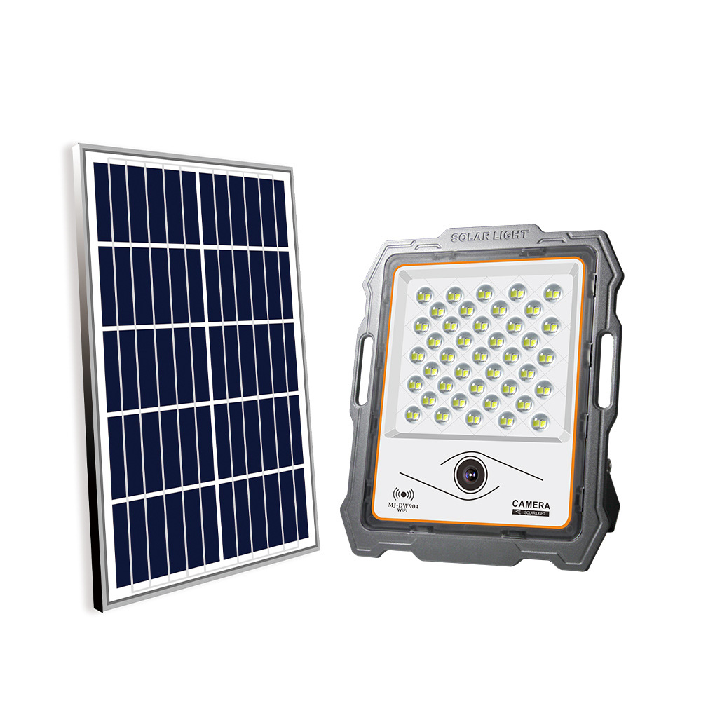
FLN15
Input Voltage:AC85-265V
Material: Aluminum+PC Tens
Driver MEANWELL/DOMESTIC
IP Rating:IP65 PF>98%
Color Temperature:2700K-7000K
Operating Temperature:-25℃ ~65℃
Life Span:50000hours
CE ROHS LVD EMC certificate approved
Item Number | Wattage | LedQuantity | LuminousFlux | Beam Angle | Size (mm)
FLN15 | 20W | single-head | 40pcs5730SMD | 1600Lm | L12.4*W11.2*H15.1
 | 28W | double-heads | 56pcs5730SMD | 2400Lm | L14.7*W14.7*H15.1
 | 39W | three-heads | 78pcs5730SMD | 3600Lm | L22.6*W14.7*H15.1
Modern Ceiling Light Material:Iron base+ PMMA Cover Input Voltage:AC85-265V Led Chip:2835SMD IP Rating:IP44 CRI>80 PF>0.9 Color Temperature:3000K/4500K/6000K Operating Temperature:-25℃ ~50℃ Life Span:50000hours Certificate:CE ROHS
Item Number | Wattage | LedQuantity | LuminousFlux | Beam Angle | Size (mm) | WIFI Control Remte control Switch control Dimmer control
CL-N00 | 24W | 48pcs2835SMD | 1920-2160lm | 120° | 350mm | Yes
 | 36W | 72pcs2835SMD | 2880-3240lm | 120° | 400mm
 | 40W | 80pcs2835SMD | 3200-3600lm | 120° | 450mm
Modern Ceiling Light Material:Iron base+ PMMA Cover Input Voltage:AC85-265V Led Chip:2835SMD IP Rating:IP44 CRI>80 PF>0.9 Color Temperature:3000K/4500K/6000K Operating Temperature:-25℃ ~50℃ Life Span:50000hours Certificate:CE ROHS
Item Number | Wattage | LedQuantity | LuminousFlux | Beam Angle | Size (mm) | WIFI Control Remte control Switch control Dimmer control
CL-N00 | 24W | 48pcs2835SMD | 1920-2160lm | 120° | 350mm | Yes
 | 36W | 72pcs2835SMD | 2880-3240lm | 120° | 400mm
 | 40W | 80pcs2835SMD | 3200-3600lm | 120° | 450mm
Modern Ceiling Light Material:Iron base+ PMMA Cover Input Voltage:AC85-265V Led Chip:2835SMD IP Rating:IP44 CRI>80 PF>0.9 Color Temperature:3000K/4500K/6000K Operating Temperature:-25℃ ~50℃ Life Span:50000hours Certificate:CE ROHS
Item Number | Wattage | LedQuantity | LuminousFlux | Beam Angle | Size (mm) | WIFI Control Remte control Switch control Dimmer control
CL-N00 | 24W | 48pcs2835SMD | 1920-2160lm | 120° | 350mm | Yes
 | 36W | 72pcs2835SMD | 2880-3240lm | 120° | 400mm
 | 40W | 80pcs2835SMD | 3200-3600lm | 120° | 450mm
Modern Ceiling Light Material:Iron base+ PMMA Cover Input Voltage:AC85-265V Led Chip:2835SMD IP Rating:IP44 CRI>80 PF>0.9 Color Temperature:3000K/4500K/6000K Operating Temperature:-25℃ ~50℃ Life Span:50000hours Certificate:CE ROHS
Item Number | Wattage | LedQuantity | LuminousFlux | Beam Angle | Size (mm) | WIFI Control Remte control Switch control Dimmer control
CL-N00 | 24W | 48pcs2835SMD | 1920-2160lm | 120° | 350mm | Yes
 | 36W | 72pcs2835SMD | 2880-3240lm | 120° | 400mm
 | 40W | 80pcs2835SMD | 3200-3600lm | 120° | 450mm

