Slide 1
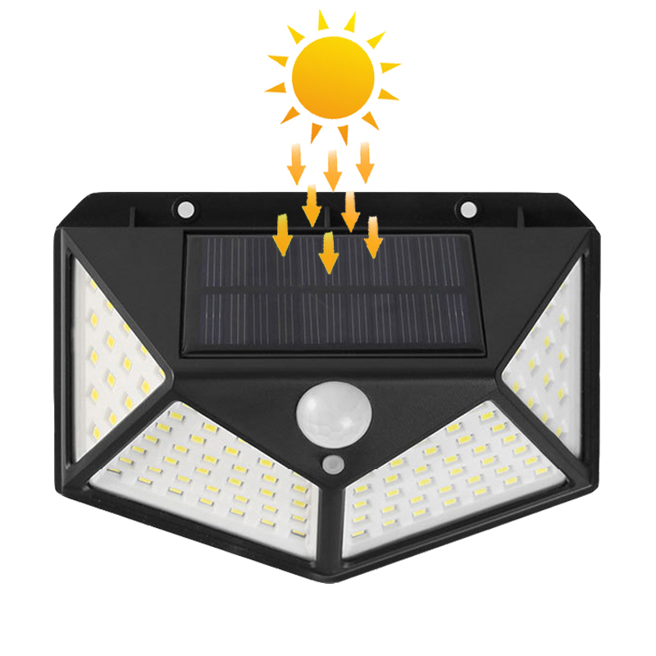
YL01
LED specification:100SMD2835 0.2W/PCS
PIR induction Angle:120 degrees
Induction distance:8-10 meters
Power:7W
LED Qty:100PCS
Input:AC85-265V
IP Rating:IP65
Item Number | Wattage | Led Quantity | Luminous Flux | Beam Angle | Size (mm) | WIFI Control Remte Control Switch Control Dimmer Control
YL01 | 7W | 36pcs 2835SMD | 1440-1620lm | 120° | 300*300mm | YES
 | 12W | 42pcs 2835SMD | 1440-1620lm |  | 230*340mm
 | 15W | 60pcs 2835SMD | 1440-1620lm |  | 290*340mm
 | 20W | 80pcs 2835SMD | 1620-1980lm |  | 350*350mm
 | 25W | 100pcs 2835SMD | 1620-1980lm |  | 350*450mm
 | 30W | 120pcs 2835SMD | 1620-1980lm |  | 350*560mm
 | 40W | 160pcs 2835SMD | 1980-2150lm |  | 350*650mm
Modern Ceiling Light Material:Iron base+ PMMA Cover Input Voltage:AC85-265V Led Chip:2835SMD IP Rating:IP44 CRI>80 PF>0.9 Color Temperature:3000K/4500K/6000K Operating Temperature:-25℃ ~50℃ Life Span:50000hours Certificate:CE ROHS
Item Number | Wattage | LedQuantity | LuminousFlux | Beam Angle | Size (mm) | WIFI Control Remte control Switch control Dimmer control
CL-N00 | 24W | 48pcs2835SMD | 1920-2160lm | 120° | 350mm | Yes
 | 36W | 72pcs2835SMD | 2880-3240lm | 120° | 400mm
 | 40W | 80pcs2835SMD | 3200-3600lm | 120° | 450mm
Modern Ceiling Light Material:Iron base+ PMMA Cover Input Voltage:AC85-265V Led Chip:2835SMD IP Rating:IP44 CRI>80 PF>0.9 Color Temperature:3000K/4500K/6000K Operating Temperature:-25℃ ~50℃ Life Span:50000hours Certificate:CE ROHS
Item Number | Wattage | LedQuantity | LuminousFlux | Beam Angle | Size (mm) | WIFI Control Remte control Switch control Dimmer control
CL-N00 | 24W | 48pcs2835SMD | 1920-2160lm | 120° | 350mm | Yes
 | 36W | 72pcs2835SMD | 2880-3240lm | 120° | 400mm
 | 40W | 80pcs2835SMD | 3200-3600lm | 120° | 450mm
Modern Ceiling Light Material:Iron base+ PMMA Cover Input Voltage:AC85-265V Led Chip:2835SMD IP Rating:IP44 CRI>80 PF>0.9 Color Temperature:3000K/4500K/6000K Operating Temperature:-25℃ ~50℃ Life Span:50000hours Certificate:CE ROHS
Item Number | Wattage | LedQuantity | LuminousFlux | Beam Angle | Size (mm) | WIFI Control Remte control Switch control Dimmer control
CL-N00 | 24W | 48pcs2835SMD | 1920-2160lm | 120° | 350mm | Yes
 | 36W | 72pcs2835SMD | 2880-3240lm | 120° | 400mm
 | 40W | 80pcs2835SMD | 3200-3600lm | 120° | 450mm
Modern Ceiling Light Material:Iron base+ PMMA Cover Input Voltage:AC85-265V Led Chip:2835SMD IP Rating:IP44 CRI>80 PF>0.9 Color Temperature:3000K/4500K/6000K Operating Temperature:-25℃ ~50℃ Life Span:50000hours Certificate:CE ROHS
Item Number | Wattage | LedQuantity | LuminousFlux | Beam Angle | Size (mm) | WIFI Control Remte control Switch control Dimmer control
CL-N00 | 24W | 48pcs2835SMD | 1920-2160lm | 120° | 350mm | Yes
 | 36W | 72pcs2835SMD | 2880-3240lm | 120° | 400mm
 | 40W | 80pcs2835SMD | 3200-3600lm | 120° | 450mm

Slide 2
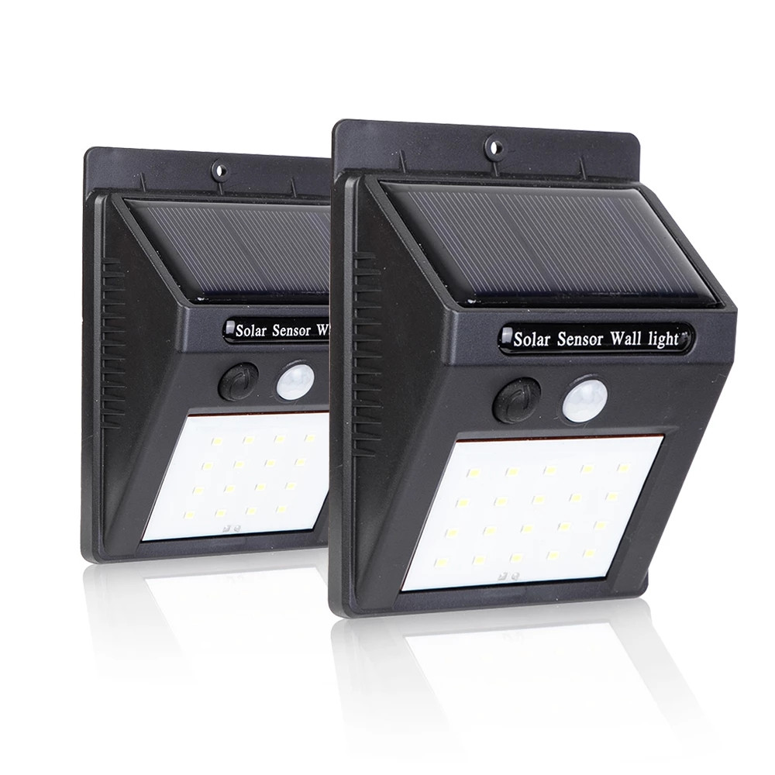
YL02
Emitted Color: White (6000K-6500K)
Power:1W/2W/3W /4W/5W
Solar Panel: 0.44W/0.65W/0.65W, 17% efficienc
Li-ion Battery: 2.22WH / 1200mAh
LED Type: 2835 SMD
Lumens: 180LM/360LM/460LM
Delay Time: 10s
Night Sensor: <10Lux
Switch: OFF/AUTO
LED Span Life: 50,000 hrs
Solar Charging Time: 8 hrs
Lighting Mode: OFF/High Light
Item Number | Wattage | Led Quantity | Luminous Flux | Beam Angle | Size (mm) | WIFI Control Remte Control Switch Control Dimmer Control
YL02 | 1W | 48pcs2835SMD | 180LM | 120° | 300*1200mm | YES
 | 2W | 72pcs2835SMD | 240LM | 120° | 600*1200mm
 | 3W | 96pcs2835SMD | 300LM | 120° | 600*1200mm
 | 5W | 120pcs2835SMD | 360LM | 120° | 900*1500mm
Modern Ceiling Light Material:Iron base+ PMMA Cover Input Voltage:AC85-265V Led Chip:2835SMD IP Rating:IP44 CRI>80 PF>0.9 Color Temperature:3000K/4500K/6000K Operating Temperature:-25℃ ~50℃ Life Span:50000hours Certificate:CE ROHS
Item Number | Wattage | LedQuantity | LuminousFlux | Beam Angle | Size (mm) | WIFI Control Remte control Switch control Dimmer control
CL-N00 | 24W | 48pcs2835SMD | 1920-2160lm | 120° | 350mm | Yes
 | 36W | 72pcs2835SMD | 2880-3240lm | 120° | 400mm
 | 40W | 80pcs2835SMD | 3200-3600lm | 120° | 450mm
Modern Ceiling Light Material:Iron base+ PMMA Cover Input Voltage:AC85-265V Led Chip:2835SMD IP Rating:IP44 CRI>80 PF>0.9 Color Temperature:3000K/4500K/6000K Operating Temperature:-25℃ ~50℃ Life Span:50000hours Certificate:CE ROHS
Item Number | Wattage | LedQuantity | LuminousFlux | Beam Angle | Size (mm) | WIFI Control Remte control Switch control Dimmer control
CL-N00 | 24W | 48pcs2835SMD | 1920-2160lm | 120° | 350mm | Yes
 | 36W | 72pcs2835SMD | 2880-3240lm | 120° | 400mm
 | 40W | 80pcs2835SMD | 3200-3600lm | 120° | 450mm
Modern Ceiling Light Material:Iron base+ PMMA Cover Input Voltage:AC85-265V Led Chip:2835SMD IP Rating:IP44 CRI>80 PF>0.9 Color Temperature:3000K/4500K/6000K Operating Temperature:-25℃ ~50℃ Life Span:50000hours Certificate:CE ROHS
Item Number | Wattage | LedQuantity | LuminousFlux | Beam Angle | Size (mm) | WIFI Control Remte control Switch control Dimmer control
CL-N00 | 24W | 48pcs2835SMD | 1920-2160lm | 120° | 350mm | Yes
 | 36W | 72pcs2835SMD | 2880-3240lm | 120° | 400mm
 | 40W | 80pcs2835SMD | 3200-3600lm | 120° | 450mm
Modern Ceiling Light Material:Iron base+ PMMA Cover Input Voltage:AC85-265V Led Chip:2835SMD IP Rating:IP44 CRI>80 PF>0.9 Color Temperature:3000K/4500K/6000K Operating Temperature:-25℃ ~50℃ Life Span:50000hours Certificate:CE ROHS
Item Number | Wattage | LedQuantity | LuminousFlux | Beam Angle | Size (mm) | WIFI Control Remte control Switch control Dimmer control
CL-N00 | 24W | 48pcs2835SMD | 1920-2160lm | 120° | 350mm | Yes
 | 36W | 72pcs2835SMD | 2880-3240lm | 120° | 400mm
 | 40W | 80pcs2835SMD | 3200-3600lm | 120° | 450mm

Slide 3
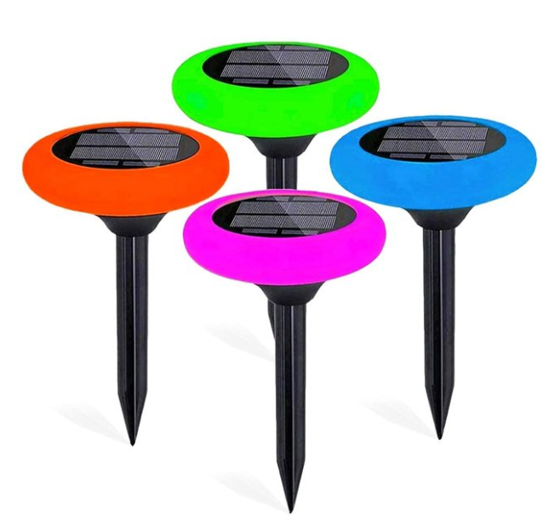
YL04
Color:RGB/White
Body material:ABS+PC plastic
Solar Panel:5.5V/0.9W monocrystalline silicon
Charging time:8 hours under sunshine
Special Feature:Multi Color, Color Change
LED:5050RGB
Style:Modern
Power Source:Solar Powered
Type of Bulb:LED
Item Number | Wattage | Led Quantity | Luminous Flux | Beam Angle | Size (mm) | WIFI Control Remte Control Switch Control Dimmer Control
YL04 | 9W | 18pcs 2835SMD | 720-810lm | 120° | φ93 | 50-80
 | 18W | 36pcs 2835SMD | 1440-1620lm | 120° | φ123 | 50-110
 | 24W | 48pcs 2835SMD | 1620-1980lm | 120° | φ150 | 50-150
 | 30W | 60pcs 2835SMD | 1980-2150lm | 120° | φ180 | 50-180
Modern Ceiling Light Material:Iron base+ PMMA Cover Input Voltage:AC85-265V Led Chip:2835SMD IP Rating:IP44 CRI>80 PF>0.9 Color Temperature:3000K/4500K/6000K Operating Temperature:-25℃ ~50℃ Life Span:50000hours Certificate:CE ROHS
Item Number | Wattage | LedQuantity | LuminousFlux | Beam Angle | Size (mm) | WIFI Control Remte control Switch control Dimmer control
CL-N00 | 24W | 48pcs2835SMD | 1920-2160lm | 120° | 350mm | Yes
 | 36W | 72pcs2835SMD | 2880-3240lm | 120° | 400mm
 | 40W | 80pcs2835SMD | 3200-3600lm | 120° | 450mm
Modern Ceiling Light Material:Iron base+ PMMA Cover Input Voltage:AC85-265V Led Chip:2835SMD IP Rating:IP44 CRI>80 PF>0.9 Color Temperature:3000K/4500K/6000K Operating Temperature:-25℃ ~50℃ Life Span:50000hours Certificate:CE ROHS
Item Number | Wattage | LedQuantity | LuminousFlux | Beam Angle | Size (mm) | WIFI Control Remte control Switch control Dimmer control
CL-N00 | 24W | 48pcs2835SMD | 1920-2160lm | 120° | 350mm | Yes
 | 36W | 72pcs2835SMD | 2880-3240lm | 120° | 400mm
 | 40W | 80pcs2835SMD | 3200-3600lm | 120° | 450mm
Modern Ceiling Light Material:Iron base+ PMMA Cover Input Voltage:AC85-265V Led Chip:2835SMD IP Rating:IP44 CRI>80 PF>0.9 Color Temperature:3000K/4500K/6000K Operating Temperature:-25℃ ~50℃ Life Span:50000hours Certificate:CE ROHS
Item Number | Wattage | LedQuantity | LuminousFlux | Beam Angle | Size (mm) | WIFI Control Remte control Switch control Dimmer control
CL-N00 | 24W | 48pcs2835SMD | 1920-2160lm | 120° | 350mm | Yes
 | 36W | 72pcs2835SMD | 2880-3240lm | 120° | 400mm
 | 40W | 80pcs2835SMD | 3200-3600lm | 120° | 450mm
Modern Ceiling Light Material:Iron base+ PMMA Cover Input Voltage:AC85-265V Led Chip:2835SMD IP Rating:IP44 CRI>80 PF>0.9 Color Temperature:3000K/4500K/6000K Operating Temperature:-25℃ ~50℃ Life Span:50000hours Certificate:CE ROHS
Item Number | Wattage | LedQuantity | LuminousFlux | Beam Angle | Size (mm) | WIFI Control Remte control Switch control Dimmer control
CL-N00 | 24W | 48pcs2835SMD | 1920-2160lm | 120° | 350mm | Yes
 | 36W | 72pcs2835SMD | 2880-3240lm | 120° | 400mm
 | 40W | 80pcs2835SMD | 3200-3600lm | 120° | 450mm

Slide 4
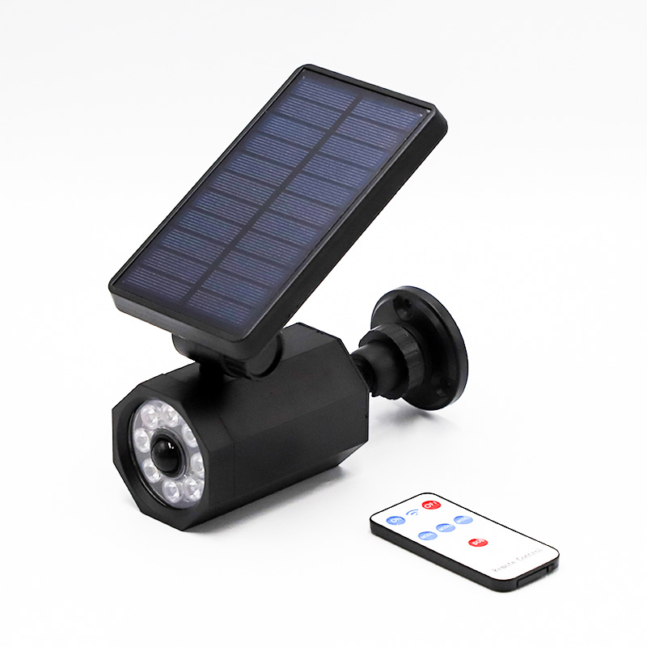
YL05
Material:ABS plastic
Size:168*68*67mm
Net Weight:300g
Bulb:8*SMD+1*RED LED
Lumen:600
Solar Rechargeable Battery:Built-in Li-ion 2400mAh
Induction distance 3-5 meters:Induction angle 120 degree
Lighting area:80-100 square meters
Item Number | Wattage | LedQuantity | LuminousFlux | Beam Angle | Size (mm) | Open size（mm)
YL05 | 3W | 6pcs2835SMD | 240-270lm | 120° | Φ85 | Φ68
 | 6W | 12pcs2835SMD | 480-540lm | 120° | Φ120 | Φ105
 | 9W | 18pcs2835SMD | 480-540lm | 120° | Φ150 | Φ135
 | 12W | 24pcs2835SMD | 480-540lm | 120° | Φ200 | Φ155
Modern Ceiling Light Material:Iron base+ PMMA Cover Input Voltage:AC85-265V Led Chip:2835SMD IP Rating:IP44 CRI>80 PF>0.9 Color Temperature:3000K/4500K/6000K Operating Temperature:-25℃ ~50℃ Life Span:50000hours Certificate:CE ROHS
Item Number | Wattage | LedQuantity | LuminousFlux | Beam Angle | Size (mm) | WIFI Control Remte control Switch control Dimmer control
CL-N00 | 24W | 48pcs2835SMD | 1920-2160lm | 120° | 350mm | Yes
 | 36W | 72pcs2835SMD | 2880-3240lm | 120° | 400mm
 | 40W | 80pcs2835SMD | 3200-3600lm | 120° | 450mm
Modern Ceiling Light Material:Iron base+ PMMA Cover Input Voltage:AC85-265V Led Chip:2835SMD IP Rating:IP44 CRI>80 PF>0.9 Color Temperature:3000K/4500K/6000K Operating Temperature:-25℃ ~50℃ Life Span:50000hours Certificate:CE ROHS
Item Number | Wattage | LedQuantity | LuminousFlux | Beam Angle | Size (mm) | WIFI Control Remte control Switch control Dimmer control
CL-N00 | 24W | 48pcs2835SMD | 1920-2160lm | 120° | 350mm | Yes
 | 36W | 72pcs2835SMD | 2880-3240lm | 120° | 400mm
 | 40W | 80pcs2835SMD | 3200-3600lm | 120° | 450mm
Modern Ceiling Light Material:Iron base+ PMMA Cover Input Voltage:AC85-265V Led Chip:2835SMD IP Rating:IP44 CRI>80 PF>0.9 Color Temperature:3000K/4500K/6000K Operating Temperature:-25℃ ~50℃ Life Span:50000hours Certificate:CE ROHS
Item Number | Wattage | LedQuantity | LuminousFlux | Beam Angle | Size (mm) | WIFI Control Remte control Switch control Dimmer control
CL-N00 | 24W | 48pcs2835SMD | 1920-2160lm | 120° | 350mm | Yes
 | 36W | 72pcs2835SMD | 2880-3240lm | 120° | 400mm
 | 40W | 80pcs2835SMD | 3200-3600lm | 120° | 450mm
Modern Ceiling Light Material:Iron base+ PMMA Cover Input Voltage:AC85-265V Led Chip:2835SMD IP Rating:IP44 CRI>80 PF>0.9 Color Temperature:3000K/4500K/6000K Operating Temperature:-25℃ ~50℃ Life Span:50000hours Certificate:CE ROHS
Item Number | Wattage | LedQuantity | LuminousFlux | Beam Angle | Size (mm) | WIFI Control Remte control Switch control Dimmer control
CL-N00 | 24W | 48pcs2835SMD | 1920-2160lm | 120° | 350mm | Yes
 | 36W | 72pcs2835SMD | 2880-3240lm | 120° | 400mm
 | 40W | 80pcs2835SMD | 3200-3600lm | 120° | 450mm

Slide 5
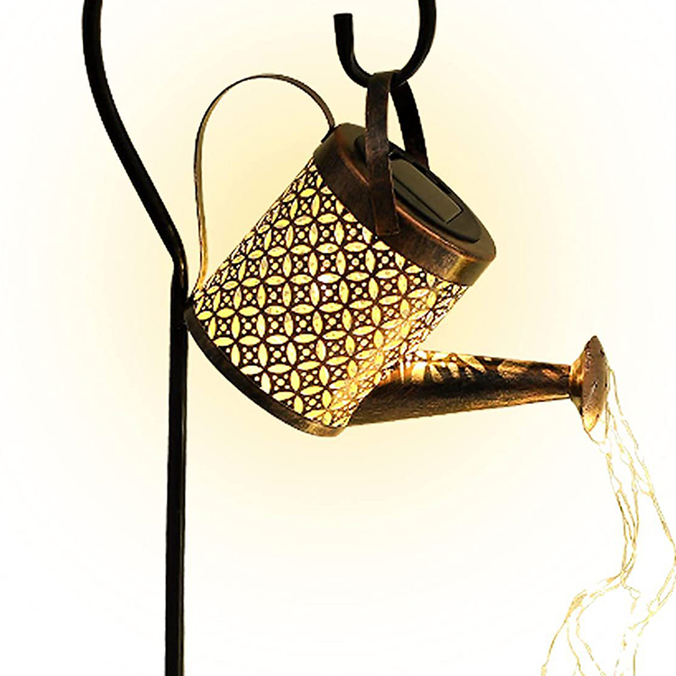
YL06
Color Temperature(CCT):2700K (Soft Warm White)
Lamp Luminous Efficiency(lm/w):50
Color Rendering Index(Ra):50
Support Dimmer:NO
Lighting solutions service:Project Installation:Lifespan (hours):10000
Working Time (hours):10000
Product Weight（kg）:400
Input Voltage(V):DC1.2V
Lamp Luminous Flux(lm):6
CRI (Ra>):80
Beam Angle(°):360
Item Number | Wattage | LedQuantity | LuminousFlux | Beam Angle | Size (mm)
YL06 | 6W | 12pcs2835SMD | 480-540lm | 360° | Φ110
 | 12W | 24pcs2835SMD | 960-1080lm | 360° | Φ160
Modern Ceiling Light Material:Iron base+ PMMA Cover Input Voltage:AC85-265V Led Chip:2835SMD IP Rating:IP44 CRI>80 PF>0.9 Color Temperature:3000K/4500K/6000K Operating Temperature:-25℃ ~50℃ Life Span:50000hours Certificate:CE ROHS
Item Number | Wattage | LedQuantity | LuminousFlux | Beam Angle | Size (mm) | WIFI Control Remte control Switch control Dimmer control
CL-N00 | 24W | 48pcs2835SMD | 1920-2160lm | 120° | 350mm | Yes
 | 36W | 72pcs2835SMD | 2880-3240lm | 120° | 400mm
 | 40W | 80pcs2835SMD | 3200-3600lm | 120° | 450mm
Modern Ceiling Light Material:Iron base+ PMMA Cover Input Voltage:AC85-265V Led Chip:2835SMD IP Rating:IP44 CRI>80 PF>0.9 Color Temperature:3000K/4500K/6000K Operating Temperature:-25℃ ~50℃ Life Span:50000hours Certificate:CE ROHS
Item Number | Wattage | LedQuantity | LuminousFlux | Beam Angle | Size (mm) | WIFI Control Remte control Switch control Dimmer control
CL-N00 | 24W | 48pcs2835SMD | 1920-2160lm | 120° | 350mm | Yes
 | 36W | 72pcs2835SMD | 2880-3240lm | 120° | 400mm
 | 40W | 80pcs2835SMD | 3200-3600lm | 120° | 450mm
Modern Ceiling Light Material:Iron base+ PMMA Cover Input Voltage:AC85-265V Led Chip:2835SMD IP Rating:IP44 CRI>80 PF>0.9 Color Temperature:3000K/4500K/6000K Operating Temperature:-25℃ ~50℃ Life Span:50000hours Certificate:CE ROHS
Item Number | Wattage | LedQuantity | LuminousFlux | Beam Angle | Size (mm) | WIFI Control Remte control Switch control Dimmer control
CL-N00 | 24W | 48pcs2835SMD | 1920-2160lm | 120° | 350mm | Yes
 | 36W | 72pcs2835SMD | 2880-3240lm | 120° | 400mm
 | 40W | 80pcs2835SMD | 3200-3600lm | 120° | 450mm
Modern Ceiling Light Material:Iron base+ PMMA Cover Input Voltage:AC85-265V Led Chip:2835SMD IP Rating:IP44 CRI>80 PF>0.9 Color Temperature:3000K/4500K/6000K Operating Temperature:-25℃ ~50℃ Life Span:50000hours Certificate:CE ROHS
Item Number | Wattage | LedQuantity | LuminousFlux | Beam Angle | Size (mm) | WIFI Control Remte control Switch control Dimmer control
CL-N00 | 24W | 48pcs2835SMD | 1920-2160lm | 120° | 350mm | Yes
 | 36W | 72pcs2835SMD | 2880-3240lm | 120° | 400mm
 | 40W | 80pcs2835SMD | 3200-3600lm | 120° | 450mm

Slide 6
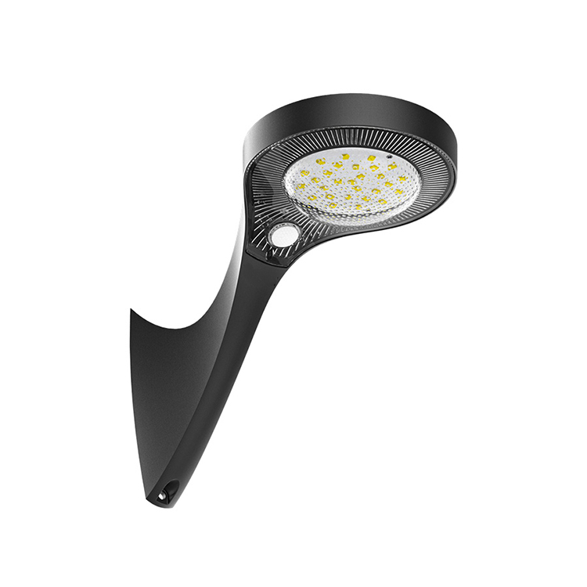
YL07
Capacity:3.7V 7.46WH 2AH/PC
Charging/Discharging Temp:0~45℃/-20~60℃
Charging Time:15H
LED (OSRAM):2835 21pcs
Color Temp:3000K,Ra 80+
Efficiency:190lm/W
Item Number | Wattage | Led Quantity | Luminous Flux | Beam Angle | Size (mm)
YL07 | 6W | 12pcs2835SMD | 480-540lm | 120° | Φ110
 | 12W | 24pcs2835SMD | 960-1080lm | 120° | Φ160
 | 15W | 30pcs2835SMD | 1080-1920lm | 120° | Φ210
 | 18W | 36pcs2835SMD | 1920-2650lm | 120° | Φ260
Modern Ceiling Light Material:Iron base+ PMMA Cover Input Voltage:AC85-265V Led Chip:2835SMD IP Rating:IP44 CRI>80 PF>0.9 Color Temperature:3000K/4500K/6000K Operating Temperature:-25℃ ~50℃ Life Span:50000hours Certificate:CE ROHS
Item Number | Wattage | LedQuantity | LuminousFlux | Beam Angle | Size (mm) | WIFI Control Remte control Switch control Dimmer control
CL-N00 | 24W | 48pcs2835SMD | 1920-2160lm | 120° | 350mm | Yes
 | 36W | 72pcs2835SMD | 2880-3240lm | 120° | 400mm
 | 40W | 80pcs2835SMD | 3200-3600lm | 120° | 450mm
Modern Ceiling Light Material:Iron base+ PMMA Cover Input Voltage:AC85-265V Led Chip:2835SMD IP Rating:IP44 CRI>80 PF>0.9 Color Temperature:3000K/4500K/6000K Operating Temperature:-25℃ ~50℃ Life Span:50000hours Certificate:CE ROHS
Item Number | Wattage | LedQuantity | LuminousFlux | Beam Angle | Size (mm) | WIFI Control Remte control Switch control Dimmer control
CL-N00 | 24W | 48pcs2835SMD | 1920-2160lm | 120° | 350mm | Yes
 | 36W | 72pcs2835SMD | 2880-3240lm | 120° | 400mm
 | 40W | 80pcs2835SMD | 3200-3600lm | 120° | 450mm
Modern Ceiling Light Material:Iron base+ PMMA Cover Input Voltage:AC85-265V Led Chip:2835SMD IP Rating:IP44 CRI>80 PF>0.9 Color Temperature:3000K/4500K/6000K Operating Temperature:-25℃ ~50℃ Life Span:50000hours Certificate:CE ROHS
Item Number | Wattage | LedQuantity | LuminousFlux | Beam Angle | Size (mm) | WIFI Control Remte control Switch control Dimmer control
CL-N00 | 24W | 48pcs2835SMD | 1920-2160lm | 120° | 350mm | Yes
 | 36W | 72pcs2835SMD | 2880-3240lm | 120° | 400mm
 | 40W | 80pcs2835SMD | 3200-3600lm | 120° | 450mm
Modern Ceiling Light Material:Iron base+ PMMA Cover Input Voltage:AC85-265V Led Chip:2835SMD IP Rating:IP44 CRI>80 PF>0.9 Color Temperature:3000K/4500K/6000K Operating Temperature:-25℃ ~50℃ Life Span:50000hours Certificate:CE ROHS
Item Number | Wattage | LedQuantity | LuminousFlux | Beam Angle | Size (mm) | WIFI Control Remte control Switch control Dimmer control
CL-N00 | 24W | 48pcs2835SMD | 1920-2160lm | 120° | 350mm | Yes
 | 36W | 72pcs2835SMD | 2880-3240lm | 120° | 400mm
 | 40W | 80pcs2835SMD | 3200-3600lm | 120° | 450mm

Slide 7
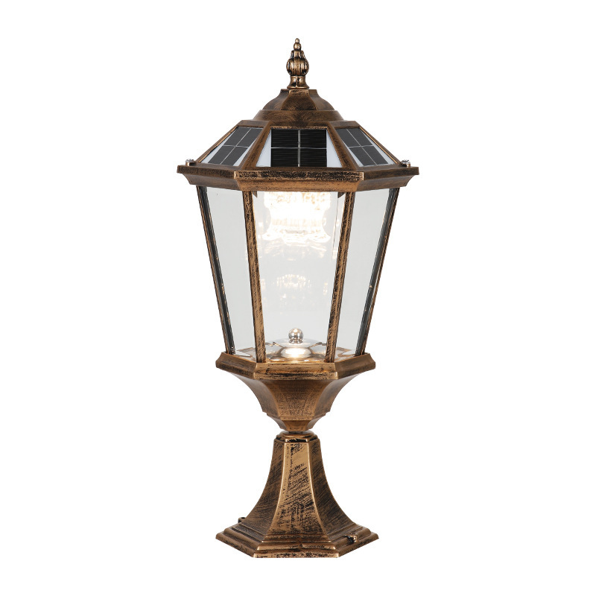
YL08
Material:Iron base+ PMMA Cover
Input Voltage:AC85-265V
Led Chip:2835SMD
IP Rating:IP44 CRI>80 PF>0.9
Color Temperature:3000K/4500K/6000K
Operating Temperature:-25℃ ~50℃
Life Span:50000hours
Certificate:CE ROHS
Item Number | Wattage | Led Quantity | Luminous Flux | Beam Angle | Size (mm)
YL08 | 3+3W | 12pcs2835SMD | 480-540lm | 120° | 105*105
 | 6+3W | 18pcs2835SMD | 960-1080lm | 120° | 145*145
 | 6+6W | 24pcs2835SMD | 1080-1560lm | 120° | 185*185
 | 9+6W | 30pcs2835SMD | 1560-1920lm | 120° | 215*215
Modern Ceiling Light Material:Iron base+ PMMA Cover Input Voltage:AC85-265V Led Chip:2835SMD IP Rating:IP44 CRI>80 PF>0.9 Color Temperature:3000K/4500K/6000K Operating Temperature:-25℃ ~50℃ Life Span:50000hours Certificate:CE ROHS
Item Number | Wattage | LedQuantity | LuminousFlux | Beam Angle | Size (mm) | WIFI Control Remte control Switch control Dimmer control
CL-N00 | 24W | 48pcs2835SMD | 1920-2160lm | 120° | 350mm | Yes
 | 36W | 72pcs2835SMD | 2880-3240lm | 120° | 400mm
 | 40W | 80pcs2835SMD | 3200-3600lm | 120° | 450mm
Modern Ceiling Light Material:Iron base+ PMMA Cover Input Voltage:AC85-265V Led Chip:2835SMD IP Rating:IP44 CRI>80 PF>0.9 Color Temperature:3000K/4500K/6000K Operating Temperature:-25℃ ~50℃ Life Span:50000hours Certificate:CE ROHS
Item Number | Wattage | LedQuantity | LuminousFlux | Beam Angle | Size (mm) | WIFI Control Remte control Switch control Dimmer control
CL-N00 | 24W | 48pcs2835SMD | 1920-2160lm | 120° | 350mm | Yes
 | 36W | 72pcs2835SMD | 2880-3240lm | 120° | 400mm
 | 40W | 80pcs2835SMD | 3200-3600lm | 120° | 450mm
Modern Ceiling Light Material:Iron base+ PMMA Cover Input Voltage:AC85-265V Led Chip:2835SMD IP Rating:IP44 CRI>80 PF>0.9 Color Temperature:3000K/4500K/6000K Operating Temperature:-25℃ ~50℃ Life Span:50000hours Certificate:CE ROHS
Item Number | Wattage | LedQuantity | LuminousFlux | Beam Angle | Size (mm) | WIFI Control Remte control Switch control Dimmer control
CL-N00 | 24W | 48pcs2835SMD | 1920-2160lm | 120° | 350mm | Yes
 | 36W | 72pcs2835SMD | 2880-3240lm | 120° | 400mm
 | 40W | 80pcs2835SMD | 3200-3600lm | 120° | 450mm
Modern Ceiling Light Material:Iron base+ PMMA Cover Input Voltage:AC85-265V Led Chip:2835SMD IP Rating:IP44 CRI>80 PF>0.9 Color Temperature:3000K/4500K/6000K Operating Temperature:-25℃ ~50℃ Life Span:50000hours Certificate:CE ROHS
Item Number | Wattage | LedQuantity | LuminousFlux | Beam Angle | Size (mm) | WIFI Control Remte control Switch control Dimmer control
CL-N00 | 24W | 48pcs2835SMD | 1920-2160lm | 120° | 350mm | Yes
 | 36W | 72pcs2835SMD | 2880-3240lm | 120° | 400mm
 | 40W | 80pcs2835SMD | 3200-3600lm | 120° | 450mm

Slide 8
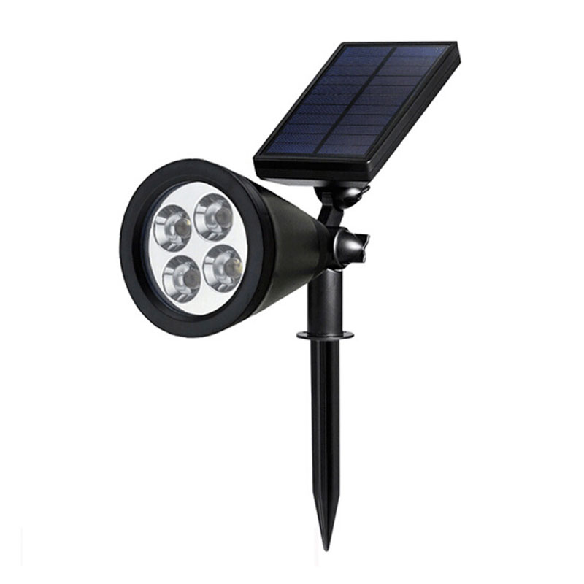
YL09
Product power: 3W 5W
Working voltage: AC85-265v DC12V
Luminous color: White light 6500k, Warm white 3000k R/G/B
Shell material: Aluminum
Color index: 110LM/W
Service life: 50,000 hours
Protection grade: IP65
Item Number | Wattage | Led Quantity | Luminous Flux | Beam Angle | Size (mm)
YL09 | 3+3W | 12pcs2835SMD | 480-540lm | 120° | Φ105
 | 6+3W | 24pcs2835SMD | 960-1080lm | 120° | Φ145
 | 6+6W | 36pcs2835SMD | 1080-1920lm | 120° | Φ185
 | 9+6W | 48pcs2835SMD | 1920-2650lm | 120° | Φ215
Modern Ceiling Light Material:Iron base+ PMMA Cover Input Voltage:AC85-265V Led Chip:2835SMD IP Rating:IP44 CRI>80 PF>0.9 Color Temperature:3000K/4500K/6000K Operating Temperature:-25℃ ~50℃ Life Span:50000hours Certificate:CE ROHS
Item Number | Wattage | LedQuantity | LuminousFlux | Beam Angle | Size (mm) | WIFI Control Remte control Switch control Dimmer control
CL-N00 | 24W | 48pcs2835SMD | 1920-2160lm | 120° | 350mm | Yes
 | 36W | 72pcs2835SMD | 2880-3240lm | 120° | 400mm
 | 40W | 80pcs2835SMD | 3200-3600lm | 120° | 450mm
Modern Ceiling Light Material:Iron base+ PMMA Cover Input Voltage:AC85-265V Led Chip:2835SMD IP Rating:IP44 CRI>80 PF>0.9 Color Temperature:3000K/4500K/6000K Operating Temperature:-25℃ ~50℃ Life Span:50000hours Certificate:CE ROHS
Item Number | Wattage | LedQuantity | LuminousFlux | Beam Angle | Size (mm) | WIFI Control Remte control Switch control Dimmer control
CL-N00 | 24W | 48pcs2835SMD | 1920-2160lm | 120° | 350mm | Yes
 | 36W | 72pcs2835SMD | 2880-3240lm | 120° | 400mm
 | 40W | 80pcs2835SMD | 3200-3600lm | 120° | 450mm
Modern Ceiling Light Material:Iron base+ PMMA Cover Input Voltage:AC85-265V Led Chip:2835SMD IP Rating:IP44 CRI>80 PF>0.9 Color Temperature:3000K/4500K/6000K Operating Temperature:-25℃ ~50℃ Life Span:50000hours Certificate:CE ROHS
Item Number | Wattage | LedQuantity | LuminousFlux | Beam Angle | Size (mm) | WIFI Control Remte control Switch control Dimmer control
CL-N00 | 24W | 48pcs2835SMD | 1920-2160lm | 120° | 350mm | Yes
 | 36W | 72pcs2835SMD | 2880-3240lm | 120° | 400mm
 | 40W | 80pcs2835SMD | 3200-3600lm | 120° | 450mm
Modern Ceiling Light Material:Iron base+ PMMA Cover Input Voltage:AC85-265V Led Chip:2835SMD IP Rating:IP44 CRI>80 PF>0.9 Color Temperature:3000K/4500K/6000K Operating Temperature:-25℃ ~50℃ Life Span:50000hours Certificate:CE ROHS
Item Number | Wattage | LedQuantity | LuminousFlux | Beam Angle | Size (mm) | WIFI Control Remte control Switch control Dimmer control
CL-N00 | 24W | 48pcs2835SMD | 1920-2160lm | 120° | 350mm | Yes
 | 36W | 72pcs2835SMD | 2880-3240lm | 120° | 400mm
 | 40W | 80pcs2835SMD | 3200-3600lm | 120° | 450mm

Slide 9
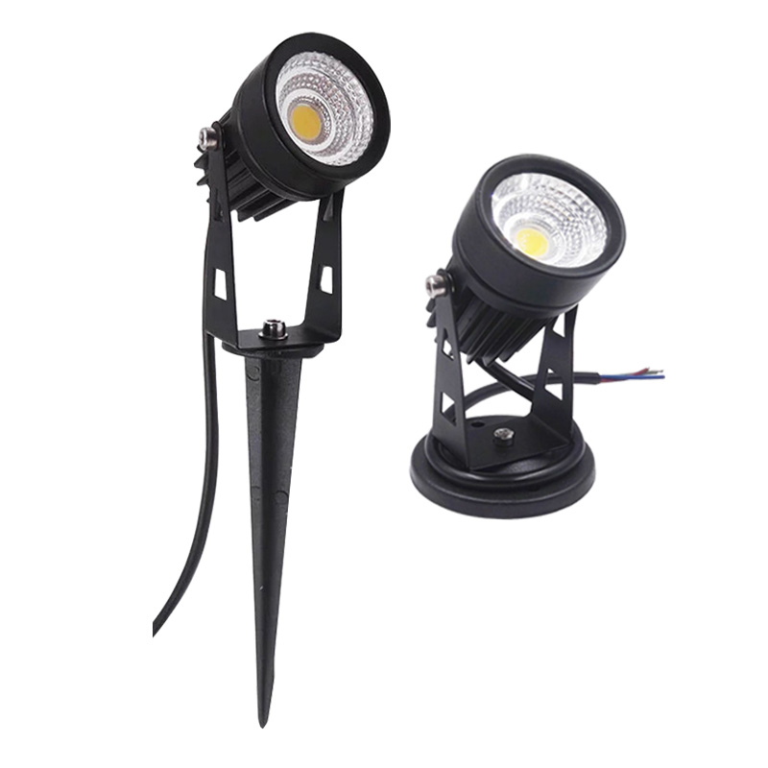
YL10
Material:Iron base+ PMMA Cover
Input Voltage:AC85-265V
Led Chip:2835SMD
IP Rating:IP44 CRI>80 PF>0.9
Color Temperature:3000K/4500K/6000K
Operating Temperature:-25℃ ~50℃
Life Span:50000hours
Certificate:CE ROHS
Item Number | Wattage | Led Quantity | Luminous Flux | Beam Angle | Size (mm)
YL10 | 3+3W | 12pcs2835SMD | 480-540lm | 120° | 105*105
 | 6+3W | 24pcs2835SMD | 960-1080lm | 120° | 145*145
 | 6+6W | 36pcs2835SMD | 1080-1920lm | 120° | 185*185
 | 9+6W | 48pcs2835SMD | 1920-2650lm | 120° | 215*215
Modern Ceiling Light Material:Iron base+ PMMA Cover Input Voltage:AC85-265V Led Chip:2835SMD IP Rating:IP44 CRI>80 PF>0.9 Color Temperature:3000K/4500K/6000K Operating Temperature:-25℃ ~50℃ Life Span:50000hours Certificate:CE ROHS
Item Number | Wattage | LedQuantity | LuminousFlux | Beam Angle | Size (mm) | WIFI Control Remte control Switch control Dimmer control
CL-N00 | 24W | 48pcs2835SMD | 1920-2160lm | 120° | 350mm | Yes
 | 36W | 72pcs2835SMD | 2880-3240lm | 120° | 400mm
 | 40W | 80pcs2835SMD | 3200-3600lm | 120° | 450mm
Modern Ceiling Light Material:Iron base+ PMMA Cover Input Voltage:AC85-265V Led Chip:2835SMD IP Rating:IP44 CRI>80 PF>0.9 Color Temperature:3000K/4500K/6000K Operating Temperature:-25℃ ~50℃ Life Span:50000hours Certificate:CE ROHS
Item Number | Wattage | LedQuantity | LuminousFlux | Beam Angle | Size (mm) | WIFI Control Remte control Switch control Dimmer control
CL-N00 | 24W | 48pcs2835SMD | 1920-2160lm | 120° | 350mm | Yes
 | 36W | 72pcs2835SMD | 2880-3240lm | 120° | 400mm
 | 40W | 80pcs2835SMD | 3200-3600lm | 120° | 450mm
Modern Ceiling Light Material:Iron base+ PMMA Cover Input Voltage:AC85-265V Led Chip:2835SMD IP Rating:IP44 CRI>80 PF>0.9 Color Temperature:3000K/4500K/6000K Operating Temperature:-25℃ ~50℃ Life Span:50000hours Certificate:CE ROHS
Item Number | Wattage | LedQuantity | LuminousFlux | Beam Angle | Size (mm) | WIFI Control Remte control Switch control Dimmer control
CL-N00 | 24W | 48pcs2835SMD | 1920-2160lm | 120° | 350mm | Yes
 | 36W | 72pcs2835SMD | 2880-3240lm | 120° | 400mm
 | 40W | 80pcs2835SMD | 3200-3600lm | 120° | 450mm
Modern Ceiling Light Material:Iron base+ PMMA Cover Input Voltage:AC85-265V Led Chip:2835SMD IP Rating:IP44 CRI>80 PF>0.9 Color Temperature:3000K/4500K/6000K Operating Temperature:-25℃ ~50℃ Life Span:50000hours Certificate:CE ROHS
Item Number | Wattage | LedQuantity | LuminousFlux | Beam Angle | Size (mm) | WIFI Control Remte control Switch control Dimmer control
CL-N00 | 24W | 48pcs2835SMD | 1920-2160lm | 120° | 350mm | Yes
 | 36W | 72pcs2835SMD | 2880-3240lm | 120° | 400mm
 | 40W | 80pcs2835SMD | 3200-3600lm | 120° | 450mm

