Slide 1
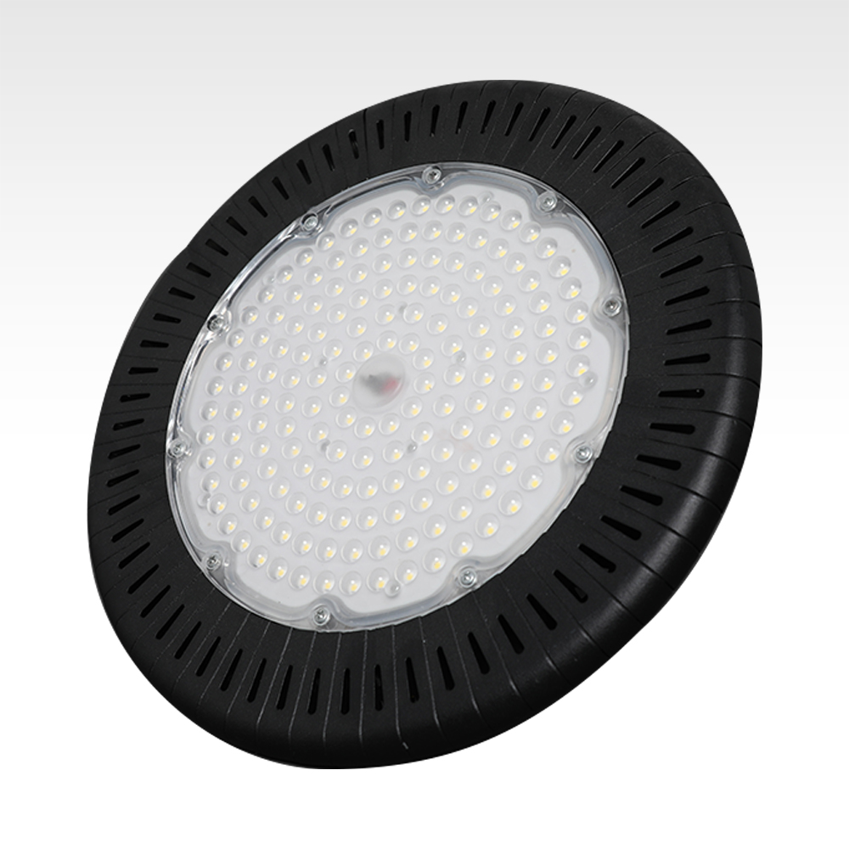
HB01
High Bay Light
Driver:Penel driver or Sosen driver
Light source:SMD 3030 chips
CRI:>70 or >80
Power factor:> 0.95,THD:<=10% at full load
beam angle:4 Options : 120°clear /frosted glass cover, 60°/ 90°lens
Heat sink:Aluminum (heat-sink can be black or white)
IP Rating:IP65
Driver efficiency :>90%
Resist Lightning surge voltage :4KV
Item Number | Wattage | Lumen | LED Type | Size | Package | Warranty | NW
HB01 | 100W | 14000LM | SMD 3030 LED | 280*280*135mm | 345*345*155mm | 5 years | 2500g
 | 150W | 21000LM | SMD 3030 LED | 340*340*125mm | 370*370*135mm |  | 3200g
 | 200W | 28000LM | SMD 3030 LED | 400*400*135mm | 410*410*145mm |  | 4800g
 | 240W | 33600LM | SMD 3030 LED | 400*400*135mm | 410*410*145mm |  | 4800g
Modern Ceiling Light Material:Iron base+ PMMA Cover Input Voltage:AC85-265V Led Chip:2835SMD IP Rating:IP44 CRI>80 PF>0.9 Color Temperature:3000K/4500K/6000K Operating Temperature:-25℃ ~50℃ Life Span:50000hours Certificate:CE ROHS
Item Number | Wattage | LedQuantity | LuminousFlux | Beam Angle | Size (mm) | WIFI Control Remte control Switch control Dimmer control
CL-N00 | 24W | 48pcs2835SMD | 1920-2160lm | 120° | 350mm | Yes
 | 36W | 72pcs2835SMD | 2880-3240lm | 120° | 400mm
 | 40W | 80pcs2835SMD | 3200-3600lm | 120° | 450mm
Modern Ceiling Light Material:Iron base+ PMMA Cover Input Voltage:AC85-265V Led Chip:2835SMD IP Rating:IP44 CRI>80 PF>0.9 Color Temperature:3000K/4500K/6000K Operating Temperature:-25℃ ~50℃ Life Span:50000hours Certificate:CE ROHS
Item Number | Wattage | LedQuantity | LuminousFlux | Beam Angle | Size (mm) | WIFI Control Remte control Switch control Dimmer control
CL-N00 | 24W | 48pcs2835SMD | 1920-2160lm | 120° | 350mm | Yes
 | 36W | 72pcs2835SMD | 2880-3240lm | 120° | 400mm
 | 40W | 80pcs2835SMD | 3200-3600lm | 120° | 450mm
Modern Ceiling Light Material:Iron base+ PMMA Cover Input Voltage:AC85-265V Led Chip:2835SMD IP Rating:IP44 CRI>80 PF>0.9 Color Temperature:3000K/4500K/6000K Operating Temperature:-25℃ ~50℃ Life Span:50000hours Certificate:CE ROHS
Item Number | Wattage | LedQuantity | LuminousFlux | Beam Angle | Size (mm) | WIFI Control Remte control Switch control Dimmer control
CL-N00 | 24W | 48pcs2835SMD | 1920-2160lm | 120° | 350mm | Yes
 | 36W | 72pcs2835SMD | 2880-3240lm | 120° | 400mm
 | 40W | 80pcs2835SMD | 3200-3600lm | 120° | 450mm
Modern Ceiling Light Material:Iron base+ PMMA Cover Input Voltage:AC85-265V Led Chip:2835SMD IP Rating:IP44 CRI>80 PF>0.9 Color Temperature:3000K/4500K/6000K Operating Temperature:-25℃ ~50℃ Life Span:50000hours Certificate:CE ROHS
Item Number | Wattage | LedQuantity | LuminousFlux | Beam Angle | Size (mm) | WIFI Control Remte control Switch control Dimmer control
CL-N00 | 24W | 48pcs2835SMD | 1920-2160lm | 120° | 350mm | Yes
 | 36W | 72pcs2835SMD | 2880-3240lm | 120° | 400mm
 | 40W | 80pcs2835SMD | 3200-3600lm | 120° | 450mm

Slide 2
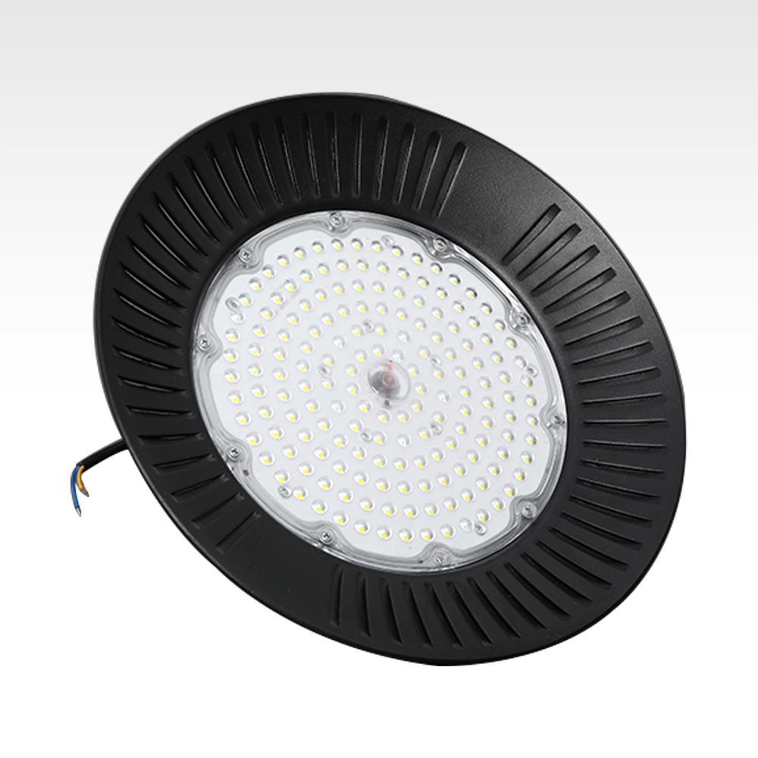
HB02
High Bay Light
Driver:Penel driver or Sosen driver
Light source:SMD 3030 chips
CRI:>70 or >80
Power factor:> 0.95,THD:<=10% at full load
beam angle:4 Options : 120°clear /frosted glass cover, 60°/ 90°lens
Heat sink:Aluminum (heat-sink can be black or white)
IP Rating:IP65
Driver efficiency :>90%
Resist Lightning surge voltage :4KV
Item Number | Wattage | Lumen | LED Type | Size | Package | Warranty | NW
HB02 | 100W | 14000LM | SMD 3030 LED | 280*280*135mm | 345*345*155mm | 5 years | 2100g
 | 150W | 21000LM | SMD 3030 LED | 340*340*125mm | 370*370*135mm |  | 2800g
 | 200W | 28000LM | SMD 3030 LED | 400*400*135mm | 410*410*145mm |  | 3500g
 | 240W | 33600LM | SMD 3030 LED | 400*400*135mm | 410*410*145mm |  | 3500g
Modern Ceiling Light Material:Iron base+ PMMA Cover Input Voltage:AC85-265V Led Chip:2835SMD IP Rating:IP44 CRI>80 PF>0.9 Color Temperature:3000K/4500K/6000K Operating Temperature:-25℃ ~50℃ Life Span:50000hours Certificate:CE ROHS
Item Number | Wattage | LedQuantity | LuminousFlux | Beam Angle | Size (mm) | WIFI Control Remte control Switch control Dimmer control
CL-N00 | 24W | 48pcs2835SMD | 1920-2160lm | 120° | 350mm | Yes
 | 36W | 72pcs2835SMD | 2880-3240lm | 120° | 400mm
 | 40W | 80pcs2835SMD | 3200-3600lm | 120° | 450mm
Modern Ceiling Light Material:Iron base+ PMMA Cover Input Voltage:AC85-265V Led Chip:2835SMD IP Rating:IP44 CRI>80 PF>0.9 Color Temperature:3000K/4500K/6000K Operating Temperature:-25℃ ~50℃ Life Span:50000hours Certificate:CE ROHS
Item Number | Wattage | LedQuantity | LuminousFlux | Beam Angle | Size (mm) | WIFI Control Remte control Switch control Dimmer control
CL-N00 | 24W | 48pcs2835SMD | 1920-2160lm | 120° | 350mm | Yes
 | 36W | 72pcs2835SMD | 2880-3240lm | 120° | 400mm
 | 40W | 80pcs2835SMD | 3200-3600lm | 120° | 450mm
Modern Ceiling Light Material:Iron base+ PMMA Cover Input Voltage:AC85-265V Led Chip:2835SMD IP Rating:IP44 CRI>80 PF>0.9 Color Temperature:3000K/4500K/6000K Operating Temperature:-25℃ ~50℃ Life Span:50000hours Certificate:CE ROHS
Item Number | Wattage | LedQuantity | LuminousFlux | Beam Angle | Size (mm) | WIFI Control Remte control Switch control Dimmer control
CL-N00 | 24W | 48pcs2835SMD | 1920-2160lm | 120° | 350mm | Yes
 | 36W | 72pcs2835SMD | 2880-3240lm | 120° | 400mm
 | 40W | 80pcs2835SMD | 3200-3600lm | 120° | 450mm
Modern Ceiling Light Material:Iron base+ PMMA Cover Input Voltage:AC85-265V Led Chip:2835SMD IP Rating:IP44 CRI>80 PF>0.9 Color Temperature:3000K/4500K/6000K Operating Temperature:-25℃ ~50℃ Life Span:50000hours Certificate:CE ROHS
Item Number | Wattage | LedQuantity | LuminousFlux | Beam Angle | Size (mm) | WIFI Control Remte control Switch control Dimmer control
CL-N00 | 24W | 48pcs2835SMD | 1920-2160lm | 120° | 350mm | Yes
 | 36W | 72pcs2835SMD | 2880-3240lm | 120° | 400mm
 | 40W | 80pcs2835SMD | 3200-3600lm | 120° | 450mm

Slide 3
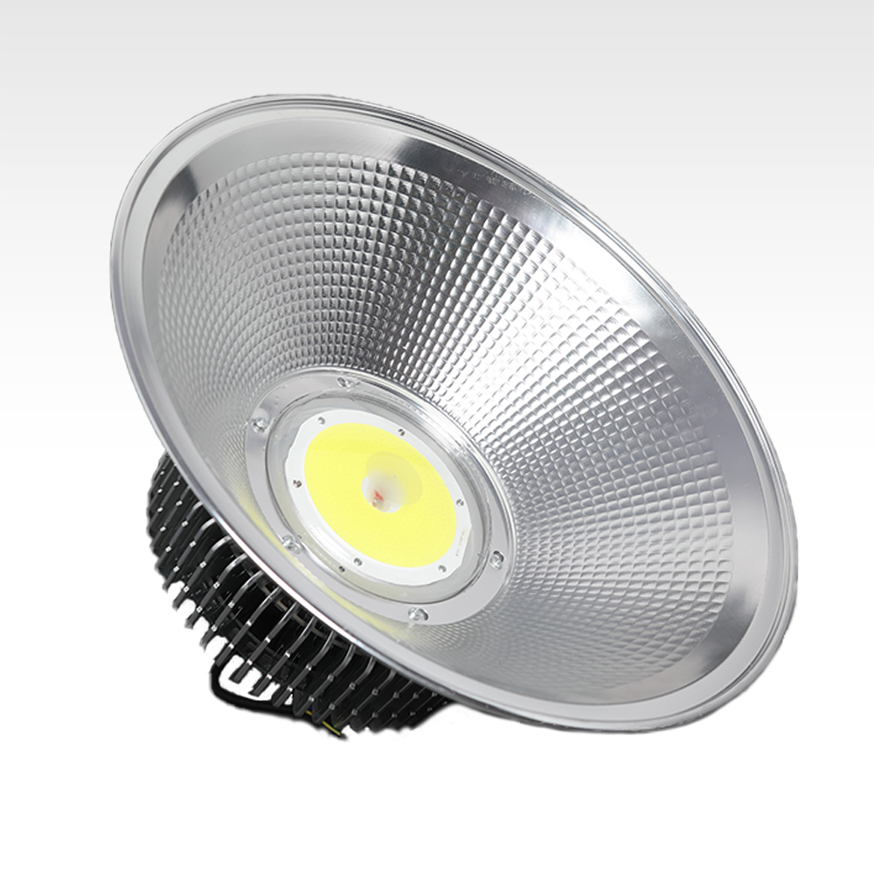
HB03
High Bay Light
Material: Aluminum
Color: silver
Light source: Epistar chipColor temperature: 6500K
Light angle: 120
Waterproof rating: IP65Voltage: 85-265V
LED service life: 50000 hours
Item Number | Wattage | Diameter | Height | Connection | Use Height
HB03 | 50W | 350 | 190 | Chain / rod | 300*240*55
 | 100W | 450 | 300 |  | 600*240*55
 | 150W | 450 | 310 |  | 600*460*55
 | 200W | 500 | 380 |  | 720*600*55
Modern Ceiling Light Material:Iron base+ PMMA Cover Input Voltage:AC85-265V Led Chip:2835SMD IP Rating:IP44 CRI>80 PF>0.9 Color Temperature:3000K/4500K/6000K Operating Temperature:-25℃ ~50℃ Life Span:50000hours Certificate:CE ROHS
Item Number | Wattage | LedQuantity | LuminousFlux | Beam Angle | Size (mm) | WIFI Control Remte control Switch control Dimmer control
CL-N00 | 24W | 48pcs2835SMD | 1920-2160lm | 120° | 350mm | Yes
 | 36W | 72pcs2835SMD | 2880-3240lm | 120° | 400mm
 | 40W | 80pcs2835SMD | 3200-3600lm | 120° | 450mm
Modern Ceiling Light Material:Iron base+ PMMA Cover Input Voltage:AC85-265V Led Chip:2835SMD IP Rating:IP44 CRI>80 PF>0.9 Color Temperature:3000K/4500K/6000K Operating Temperature:-25℃ ~50℃ Life Span:50000hours Certificate:CE ROHS
Item Number | Wattage | LedQuantity | LuminousFlux | Beam Angle | Size (mm) | WIFI Control Remte control Switch control Dimmer control
CL-N00 | 24W | 48pcs2835SMD | 1920-2160lm | 120° | 350mm | Yes
 | 36W | 72pcs2835SMD | 2880-3240lm | 120° | 400mm
 | 40W | 80pcs2835SMD | 3200-3600lm | 120° | 450mm
Modern Ceiling Light Material:Iron base+ PMMA Cover Input Voltage:AC85-265V Led Chip:2835SMD IP Rating:IP44 CRI>80 PF>0.9 Color Temperature:3000K/4500K/6000K Operating Temperature:-25℃ ~50℃ Life Span:50000hours Certificate:CE ROHS
Item Number | Wattage | LedQuantity | LuminousFlux | Beam Angle | Size (mm) | WIFI Control Remte control Switch control Dimmer control
CL-N00 | 24W | 48pcs2835SMD | 1920-2160lm | 120° | 350mm | Yes
 | 36W | 72pcs2835SMD | 2880-3240lm | 120° | 400mm
 | 40W | 80pcs2835SMD | 3200-3600lm | 120° | 450mm
Modern Ceiling Light Material:Iron base+ PMMA Cover Input Voltage:AC85-265V Led Chip:2835SMD IP Rating:IP44 CRI>80 PF>0.9 Color Temperature:3000K/4500K/6000K Operating Temperature:-25℃ ~50℃ Life Span:50000hours Certificate:CE ROHS
Item Number | Wattage | LedQuantity | LuminousFlux | Beam Angle | Size (mm) | WIFI Control Remte control Switch control Dimmer control
CL-N00 | 24W | 48pcs2835SMD | 1920-2160lm | 120° | 350mm | Yes
 | 36W | 72pcs2835SMD | 2880-3240lm | 120° | 400mm
 | 40W | 80pcs2835SMD | 3200-3600lm | 120° | 450mm

Slide 4
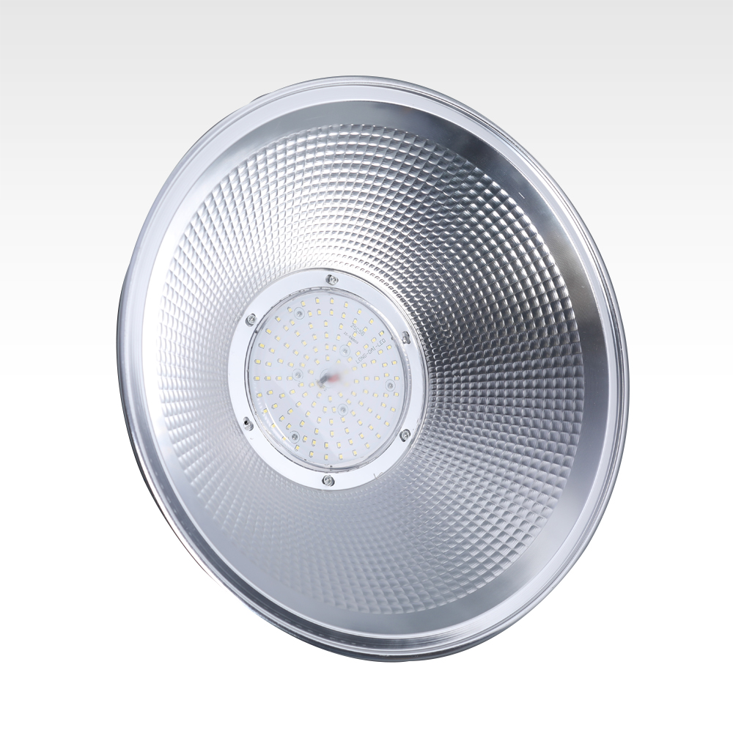
HB05
High Bay Light
Material: Aluminum
Color: silver
Light source: Epistar chipColor temperature: 6500K
Light angle: 120
Waterproof rating: IP65Voltage: 85-265V
LED service life: 50000 hours
Item Number | Wattage | Diameter | Height | Connection | Use Height
HB05 | 50W | 350 | 190 | Chain / rod | 300*240*55
 | 100W | 450 | 300 |  | 600*240*55
 | 150W | 450 | 310 |  | 600*460*55
 | 200W | 500 | 380 |  | 720*600*55
Modern Ceiling Light Material:Iron base+ PMMA Cover Input Voltage:AC85-265V Led Chip:2835SMD IP Rating:IP44 CRI>80 PF>0.9 Color Temperature:3000K/4500K/6000K Operating Temperature:-25℃ ~50℃ Life Span:50000hours Certificate:CE ROHS
Item Number | Wattage | LedQuantity | LuminousFlux | Beam Angle | Size (mm) | WIFI Control Remte control Switch control Dimmer control
CL-N00 | 24W | 48pcs2835SMD | 1920-2160lm | 120° | 350mm | Yes
 | 36W | 72pcs2835SMD | 2880-3240lm | 120° | 400mm
 | 40W | 80pcs2835SMD | 3200-3600lm | 120° | 450mm
Modern Ceiling Light Material:Iron base+ PMMA Cover Input Voltage:AC85-265V Led Chip:2835SMD IP Rating:IP44 CRI>80 PF>0.9 Color Temperature:3000K/4500K/6000K Operating Temperature:-25℃ ~50℃ Life Span:50000hours Certificate:CE ROHS
Item Number | Wattage | LedQuantity | LuminousFlux | Beam Angle | Size (mm) | WIFI Control Remte control Switch control Dimmer control
CL-N00 | 24W | 48pcs2835SMD | 1920-2160lm | 120° | 350mm | Yes
 | 36W | 72pcs2835SMD | 2880-3240lm | 120° | 400mm
 | 40W | 80pcs2835SMD | 3200-3600lm | 120° | 450mm
Modern Ceiling Light Material:Iron base+ PMMA Cover Input Voltage:AC85-265V Led Chip:2835SMD IP Rating:IP44 CRI>80 PF>0.9 Color Temperature:3000K/4500K/6000K Operating Temperature:-25℃ ~50℃ Life Span:50000hours Certificate:CE ROHS
Item Number | Wattage | LedQuantity | LuminousFlux | Beam Angle | Size (mm) | WIFI Control Remte control Switch control Dimmer control
CL-N00 | 24W | 48pcs2835SMD | 1920-2160lm | 120° | 350mm | Yes
 | 36W | 72pcs2835SMD | 2880-3240lm | 120° | 400mm
 | 40W | 80pcs2835SMD | 3200-3600lm | 120° | 450mm
Modern Ceiling Light Material:Iron base+ PMMA Cover Input Voltage:AC85-265V Led Chip:2835SMD IP Rating:IP44 CRI>80 PF>0.9 Color Temperature:3000K/4500K/6000K Operating Temperature:-25℃ ~50℃ Life Span:50000hours Certificate:CE ROHS
Item Number | Wattage | LedQuantity | LuminousFlux | Beam Angle | Size (mm) | WIFI Control Remte control Switch control Dimmer control
CL-N00 | 24W | 48pcs2835SMD | 1920-2160lm | 120° | 350mm | Yes
 | 36W | 72pcs2835SMD | 2880-3240lm | 120° | 400mm
 | 40W | 80pcs2835SMD | 3200-3600lm | 120° | 450mm

Slide 5
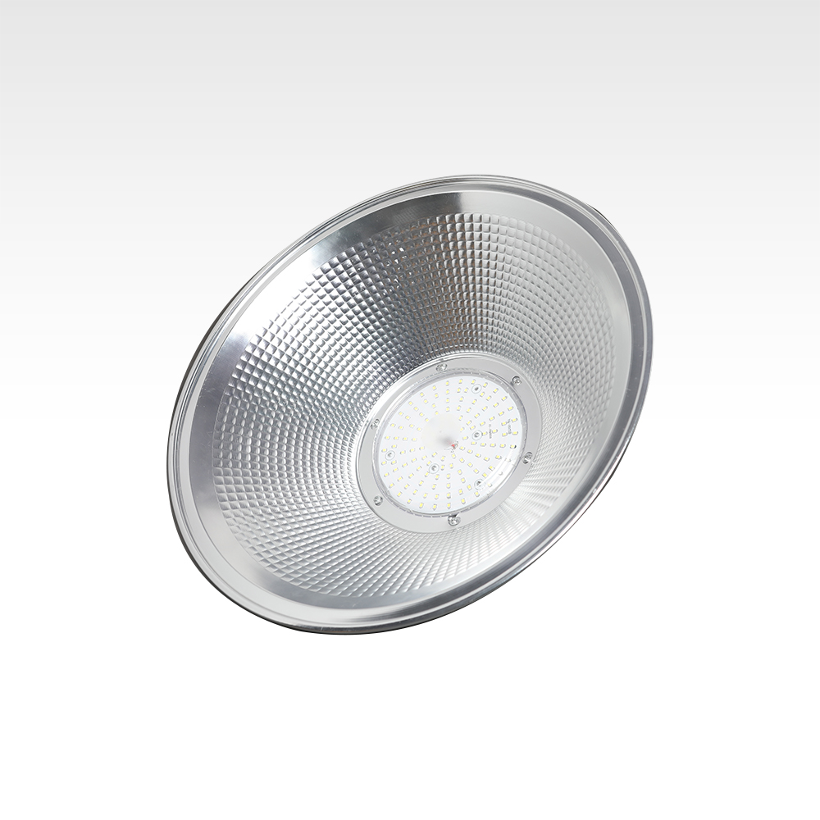
HB06
High Bay Light
Material: Aluminum
Color: silver
Light source: Epistar chipColor temperature: 6500K
Light angle: 120
Waterproof rating: IP65Voltage: 85-265V
LED service life: 50000 hours
Item Number | Wattage | Led Quantity | Luminous Flux | Beam Angle
HB06 | 9W | 2.8umol/j | Full spectrum | Can be customized
 | 18W | 2.8umol/j
 | 36W | 2.8umol/j
 | 60W | 2.8umol/j
Modern Ceiling Light Material:Iron base+ PMMA Cover Input Voltage:AC85-265V Led Chip:2835SMD IP Rating:IP44 CRI>80 PF>0.9 Color Temperature:3000K/4500K/6000K Operating Temperature:-25℃ ~50℃ Life Span:50000hours Certificate:CE ROHS
Item Number | Wattage | LedQuantity | LuminousFlux | Beam Angle | Size (mm) | WIFI Control Remte control Switch control Dimmer control
CL-N00 | 24W | 48pcs2835SMD | 1920-2160lm | 120° | 350mm | Yes
 | 36W | 72pcs2835SMD | 2880-3240lm | 120° | 400mm
 | 40W | 80pcs2835SMD | 3200-3600lm | 120° | 450mm
Modern Ceiling Light Material:Iron base+ PMMA Cover Input Voltage:AC85-265V Led Chip:2835SMD IP Rating:IP44 CRI>80 PF>0.9 Color Temperature:3000K/4500K/6000K Operating Temperature:-25℃ ~50℃ Life Span:50000hours Certificate:CE ROHS
Item Number | Wattage | LedQuantity | LuminousFlux | Beam Angle | Size (mm) | WIFI Control Remte control Switch control Dimmer control
CL-N00 | 24W | 48pcs2835SMD | 1920-2160lm | 120° | 350mm | Yes
 | 36W | 72pcs2835SMD | 2880-3240lm | 120° | 400mm
 | 40W | 80pcs2835SMD | 3200-3600lm | 120° | 450mm
Modern Ceiling Light Material:Iron base+ PMMA Cover Input Voltage:AC85-265V Led Chip:2835SMD IP Rating:IP44 CRI>80 PF>0.9 Color Temperature:3000K/4500K/6000K Operating Temperature:-25℃ ~50℃ Life Span:50000hours Certificate:CE ROHS
Item Number | Wattage | LedQuantity | LuminousFlux | Beam Angle | Size (mm) | WIFI Control Remte control Switch control Dimmer control
CL-N00 | 24W | 48pcs2835SMD | 1920-2160lm | 120° | 350mm | Yes
 | 36W | 72pcs2835SMD | 2880-3240lm | 120° | 400mm
 | 40W | 80pcs2835SMD | 3200-3600lm | 120° | 450mm
Modern Ceiling Light Material:Iron base+ PMMA Cover Input Voltage:AC85-265V Led Chip:2835SMD IP Rating:IP44 CRI>80 PF>0.9 Color Temperature:3000K/4500K/6000K Operating Temperature:-25℃ ~50℃ Life Span:50000hours Certificate:CE ROHS
Item Number | Wattage | LedQuantity | LuminousFlux | Beam Angle | Size (mm) | WIFI Control Remte control Switch control Dimmer control
CL-N00 | 24W | 48pcs2835SMD | 1920-2160lm | 120° | 350mm | Yes
 | 36W | 72pcs2835SMD | 2880-3240lm | 120° | 400mm
 | 40W | 80pcs2835SMD | 3200-3600lm | 120° | 450mm

Slide 6
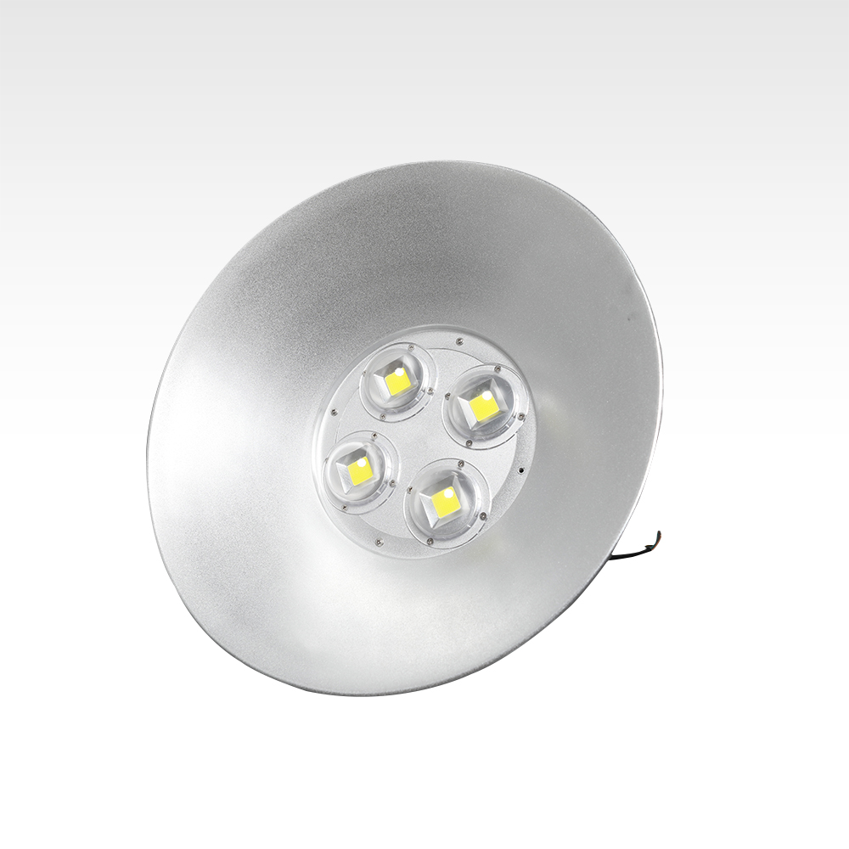
HB07
High Bay Light
Material: Aluminum
Color: silver
Light source: Epistar chipColor temperature: 6500K
Light angle: 120
Waterproof rating: IP65Voltage: 85-265V
LED service life: 50000 hours
Item Number7 | Wattage | Led Quantity | Luminous Flux | Beam Angle
HB07 | 15W | 2.8umol/j | Full spectrum | 550*280*120
 | 30W | 2.8umol/j |  | 550*280*120
 | 45W | 2.8umol/j |  | 550*280*120
 | 60W | 2.8umol/j |  | 550*280*120
Modern Ceiling Light Material:Iron base+ PMMA Cover Input Voltage:AC85-265V Led Chip:2835SMD IP Rating:IP44 CRI>80 PF>0.9 Color Temperature:3000K/4500K/6000K Operating Temperature:-25℃ ~50℃ Life Span:50000hours Certificate:CE ROHS
Item Number | Wattage | LedQuantity | LuminousFlux | Beam Angle | Size (mm) | WIFI Control Remte control Switch control Dimmer control
CL-N00 | 24W | 48pcs2835SMD | 1920-2160lm | 120° | 350mm | Yes
 | 36W | 72pcs2835SMD | 2880-3240lm | 120° | 400mm
 | 40W | 80pcs2835SMD | 3200-3600lm | 120° | 450mm
Modern Ceiling Light Material:Iron base+ PMMA Cover Input Voltage:AC85-265V Led Chip:2835SMD IP Rating:IP44 CRI>80 PF>0.9 Color Temperature:3000K/4500K/6000K Operating Temperature:-25℃ ~50℃ Life Span:50000hours Certificate:CE ROHS
Item Number | Wattage | LedQuantity | LuminousFlux | Beam Angle | Size (mm) | WIFI Control Remte control Switch control Dimmer control
CL-N00 | 24W | 48pcs2835SMD | 1920-2160lm | 120° | 350mm | Yes
 | 36W | 72pcs2835SMD | 2880-3240lm | 120° | 400mm
 | 40W | 80pcs2835SMD | 3200-3600lm | 120° | 450mm
Modern Ceiling Light Material:Iron base+ PMMA Cover Input Voltage:AC85-265V Led Chip:2835SMD IP Rating:IP44 CRI>80 PF>0.9 Color Temperature:3000K/4500K/6000K Operating Temperature:-25℃ ~50℃ Life Span:50000hours Certificate:CE ROHS
Item Number | Wattage | LedQuantity | LuminousFlux | Beam Angle | Size (mm) | WIFI Control Remte control Switch control Dimmer control
CL-N00 | 24W | 48pcs2835SMD | 1920-2160lm | 120° | 350mm | Yes
 | 36W | 72pcs2835SMD | 2880-3240lm | 120° | 400mm
 | 40W | 80pcs2835SMD | 3200-3600lm | 120° | 450mm
Modern Ceiling Light Material:Iron base+ PMMA Cover Input Voltage:AC85-265V Led Chip:2835SMD IP Rating:IP44 CRI>80 PF>0.9 Color Temperature:3000K/4500K/6000K Operating Temperature:-25℃ ~50℃ Life Span:50000hours Certificate:CE ROHS
Item Number | Wattage | LedQuantity | LuminousFlux | Beam Angle | Size (mm) | WIFI Control Remte control Switch control Dimmer control
CL-N00 | 24W | 48pcs2835SMD | 1920-2160lm | 120° | 350mm | Yes
 | 36W | 72pcs2835SMD | 2880-3240lm | 120° | 400mm
 | 40W | 80pcs2835SMD | 3200-3600lm | 120° | 450mm

