Slide 1
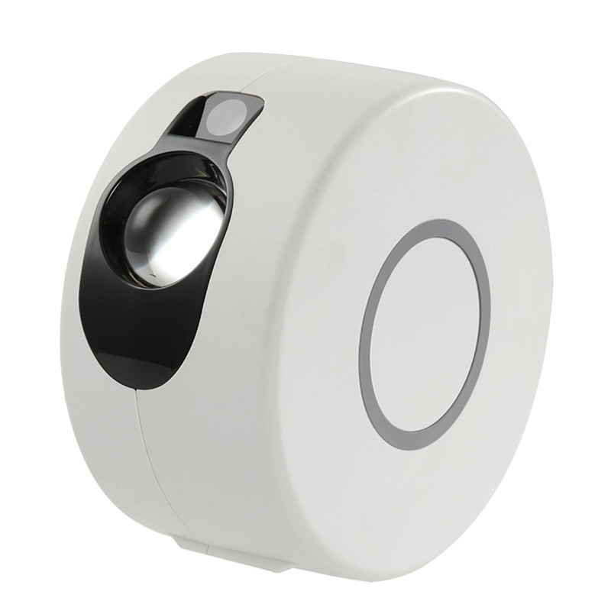
NL01S
LED Night Star Projection Lamp
Material:ABS Plastic
Input Voltage:DC5V
Power Mode:USB/Battery (Battery not included)
Chip Brand:Epistar
IP Rating:IP44
Color Temperature:7 Colorful Change or 16 Colorful Change
Operating Temperature:-20℃ -50℃
CE ROHS certificate approved
Item Number | Wattage | Power supply | Material | Beam Angle | Size (mm)
NL01S | 5W | USB 5V 2A | ABS Plastic | 270° | 170X170X90
Modern Ceiling Light Material:Iron base+ PMMA Cover Input Voltage:AC85-265V Led Chip:2835SMD IP Rating:IP44 CRI>80 PF>0.9 Color Temperature:3000K/4500K/6000K Operating Temperature:-25℃ ~50℃ Life Span:50000hours Certificate:CE ROHS
Item Number | Wattage | LedQuantity | LuminousFlux | Beam Angle | Size (mm) | WIFI Control Remte control Switch control Dimmer control
CL-N00 | 24W | 48pcs2835SMD | 1920-2160lm | 120° | 350mm | Yes
 | 36W | 72pcs2835SMD | 2880-3240lm | 120° | 400mm
 | 40W | 80pcs2835SMD | 3200-3600lm | 120° | 450mm
Modern Ceiling Light Material:Iron base+ PMMA Cover Input Voltage:AC85-265V Led Chip:2835SMD IP Rating:IP44 CRI>80 PF>0.9 Color Temperature:3000K/4500K/6000K Operating Temperature:-25℃ ~50℃ Life Span:50000hours Certificate:CE ROHS
Item Number | Wattage | LedQuantity | LuminousFlux | Beam Angle | Size (mm) | WIFI Control Remte control Switch control Dimmer control
CL-N00 | 24W | 48pcs2835SMD | 1920-2160lm | 120° | 350mm | Yes
 | 36W | 72pcs2835SMD | 2880-3240lm | 120° | 400mm
 | 40W | 80pcs2835SMD | 3200-3600lm | 120° | 450mm
Modern Ceiling Light Material:Iron base+ PMMA Cover Input Voltage:AC85-265V Led Chip:2835SMD IP Rating:IP44 CRI>80 PF>0.9 Color Temperature:3000K/4500K/6000K Operating Temperature:-25℃ ~50℃ Life Span:50000hours Certificate:CE ROHS
Item Number | Wattage | LedQuantity | LuminousFlux | Beam Angle | Size (mm) | WIFI Control Remte control Switch control Dimmer control
CL-N00 | 24W | 48pcs2835SMD | 1920-2160lm | 120° | 350mm | Yes
 | 36W | 72pcs2835SMD | 2880-3240lm | 120° | 400mm
 | 40W | 80pcs2835SMD | 3200-3600lm | 120° | 450mm
Modern Ceiling Light Material:Iron base+ PMMA Cover Input Voltage:AC85-265V Led Chip:2835SMD IP Rating:IP44 CRI>80 PF>0.9 Color Temperature:3000K/4500K/6000K Operating Temperature:-25℃ ~50℃ Life Span:50000hours Certificate:CE ROHS
Item Number | Wattage | LedQuantity | LuminousFlux | Beam Angle | Size (mm) | WIFI Control Remte control Switch control Dimmer control
CL-N00 | 24W | 48pcs2835SMD | 1920-2160lm | 120° | 350mm | Yes
 | 36W | 72pcs2835SMD | 2880-3240lm | 120° | 400mm
 | 40W | 80pcs2835SMD | 3200-3600lm | 120° | 450mm

Slide 2
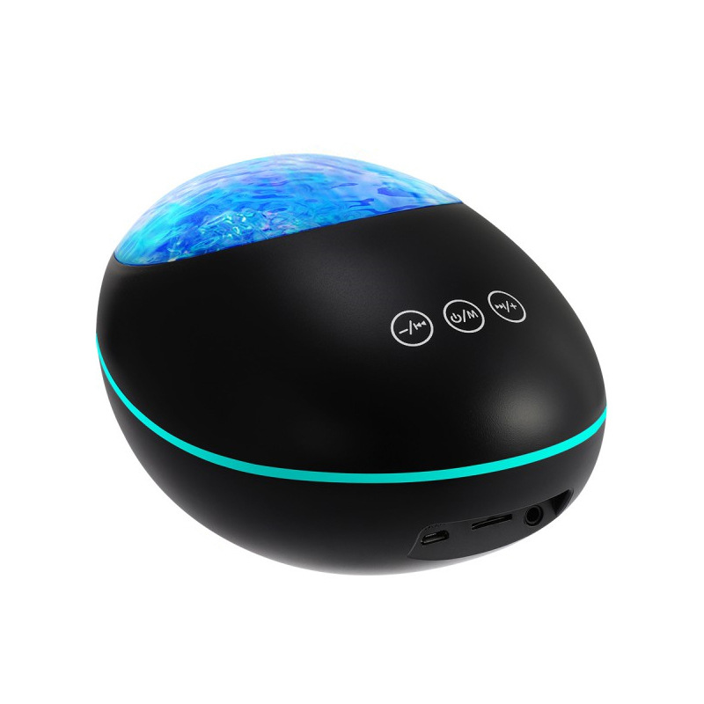
NL02S
LED Night Projection Lamp
Material:ABS+AS
Input Voltage:DC5V
Product standard configuration: host × 1 + USB cable × 1 +
audio cable × 1 + remote control × 1 + English manual × 1
Power supply mode: host USB cable plug in /
remote control 2 AAA batteries (not delivered)
Bluetooth version: 5.0
Item Number | Wattage | Power supply | Material | Beam Angle | Size (mm)
NL02S | 2W | USB 5V 1A | ABS+AS | 270° | 165×119×95
Modern Ceiling Light Material:Iron base+ PMMA Cover Input Voltage:AC85-265V Led Chip:2835SMD IP Rating:IP44 CRI>80 PF>0.9 Color Temperature:3000K/4500K/6000K Operating Temperature:-25℃ ~50℃ Life Span:50000hours Certificate:CE ROHS
Item Number | Wattage | LedQuantity | LuminousFlux | Beam Angle | Size (mm) | WIFI Control Remte control Switch control Dimmer control
CL-N00 | 24W | 48pcs2835SMD | 1920-2160lm | 120° | 350mm | Yes
 | 36W | 72pcs2835SMD | 2880-3240lm | 120° | 400mm
 | 40W | 80pcs2835SMD | 3200-3600lm | 120° | 450mm
Modern Ceiling Light Material:Iron base+ PMMA Cover Input Voltage:AC85-265V Led Chip:2835SMD IP Rating:IP44 CRI>80 PF>0.9 Color Temperature:3000K/4500K/6000K Operating Temperature:-25℃ ~50℃ Life Span:50000hours Certificate:CE ROHS
Item Number | Wattage | LedQuantity | LuminousFlux | Beam Angle | Size (mm) | WIFI Control Remte control Switch control Dimmer control
CL-N00 | 24W | 48pcs2835SMD | 1920-2160lm | 120° | 350mm | Yes
 | 36W | 72pcs2835SMD | 2880-3240lm | 120° | 400mm
 | 40W | 80pcs2835SMD | 3200-3600lm | 120° | 450mm
Modern Ceiling Light Material:Iron base+ PMMA Cover Input Voltage:AC85-265V Led Chip:2835SMD IP Rating:IP44 CRI>80 PF>0.9 Color Temperature:3000K/4500K/6000K Operating Temperature:-25℃ ~50℃ Life Span:50000hours Certificate:CE ROHS
Item Number | Wattage | LedQuantity | LuminousFlux | Beam Angle | Size (mm) | WIFI Control Remte control Switch control Dimmer control
CL-N00 | 24W | 48pcs2835SMD | 1920-2160lm | 120° | 350mm | Yes
 | 36W | 72pcs2835SMD | 2880-3240lm | 120° | 400mm
 | 40W | 80pcs2835SMD | 3200-3600lm | 120° | 450mm
Modern Ceiling Light Material:Iron base+ PMMA Cover Input Voltage:AC85-265V Led Chip:2835SMD IP Rating:IP44 CRI>80 PF>0.9 Color Temperature:3000K/4500K/6000K Operating Temperature:-25℃ ~50℃ Life Span:50000hours Certificate:CE ROHS
Item Number | Wattage | LedQuantity | LuminousFlux | Beam Angle | Size (mm) | WIFI Control Remte control Switch control Dimmer control
CL-N00 | 24W | 48pcs2835SMD | 1920-2160lm | 120° | 350mm | Yes
 | 36W | 72pcs2835SMD | 2880-3240lm | 120° | 400mm
 | 40W | 80pcs2835SMD | 3200-3600lm | 120° | 450mm

Slide 3
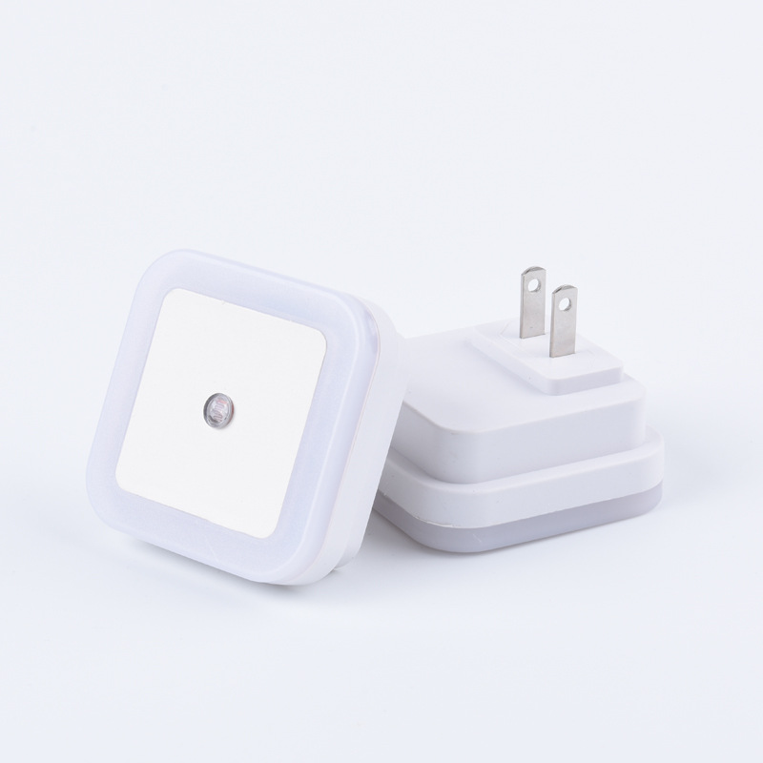
NL03S
LED Square / Round Night Light
Material:ABS
Product Style: Light Control Series
Lifespan: Up to 100,000 hours
Input voltage: 110V-220V
Colors: LED light color is the same as the shell color (white/ blue/ orange /pink)
Item Number | Wattage | Power supply | Material | Beam Angle | Size (mm)
NL03S | 0.5W | 110V-220V | ABS+AS | 120° | 64*50*64MM (US ) 64*70*64MM (EU)
Modern Ceiling Light Material:Iron base+ PMMA Cover Input Voltage:AC85-265V Led Chip:2835SMD IP Rating:IP44 CRI>80 PF>0.9 Color Temperature:3000K/4500K/6000K Operating Temperature:-25℃ ~50℃ Life Span:50000hours Certificate:CE ROHS
Item Number | Wattage | LedQuantity | LuminousFlux | Beam Angle | Size (mm) | WIFI Control Remte control Switch control Dimmer control
CL-N00 | 24W | 48pcs2835SMD | 1920-2160lm | 120° | 350mm | Yes
 | 36W | 72pcs2835SMD | 2880-3240lm | 120° | 400mm
 | 40W | 80pcs2835SMD | 3200-3600lm | 120° | 450mm
Modern Ceiling Light Material:Iron base+ PMMA Cover Input Voltage:AC85-265V Led Chip:2835SMD IP Rating:IP44 CRI>80 PF>0.9 Color Temperature:3000K/4500K/6000K Operating Temperature:-25℃ ~50℃ Life Span:50000hours Certificate:CE ROHS
Item Number | Wattage | LedQuantity | LuminousFlux | Beam Angle | Size (mm) | WIFI Control Remte control Switch control Dimmer control
CL-N00 | 24W | 48pcs2835SMD | 1920-2160lm | 120° | 350mm | Yes
 | 36W | 72pcs2835SMD | 2880-3240lm | 120° | 400mm
 | 40W | 80pcs2835SMD | 3200-3600lm | 120° | 450mm
Modern Ceiling Light Material:Iron base+ PMMA Cover Input Voltage:AC85-265V Led Chip:2835SMD IP Rating:IP44 CRI>80 PF>0.9 Color Temperature:3000K/4500K/6000K Operating Temperature:-25℃ ~50℃ Life Span:50000hours Certificate:CE ROHS
Item Number | Wattage | LedQuantity | LuminousFlux | Beam Angle | Size (mm) | WIFI Control Remte control Switch control Dimmer control
CL-N00 | 24W | 48pcs2835SMD | 1920-2160lm | 120° | 350mm | Yes
 | 36W | 72pcs2835SMD | 2880-3240lm | 120° | 400mm
 | 40W | 80pcs2835SMD | 3200-3600lm | 120° | 450mm
Modern Ceiling Light Material:Iron base+ PMMA Cover Input Voltage:AC85-265V Led Chip:2835SMD IP Rating:IP44 CRI>80 PF>0.9 Color Temperature:3000K/4500K/6000K Operating Temperature:-25℃ ~50℃ Life Span:50000hours Certificate:CE ROHS
Item Number | Wattage | LedQuantity | LuminousFlux | Beam Angle | Size (mm) | WIFI Control Remte control Switch control Dimmer control
CL-N00 | 24W | 48pcs2835SMD | 1920-2160lm | 120° | 350mm | Yes
 | 36W | 72pcs2835SMD | 2880-3240lm | 120° | 400mm
 | 40W | 80pcs2835SMD | 3200-3600lm | 120° | 450mm

Slide 4
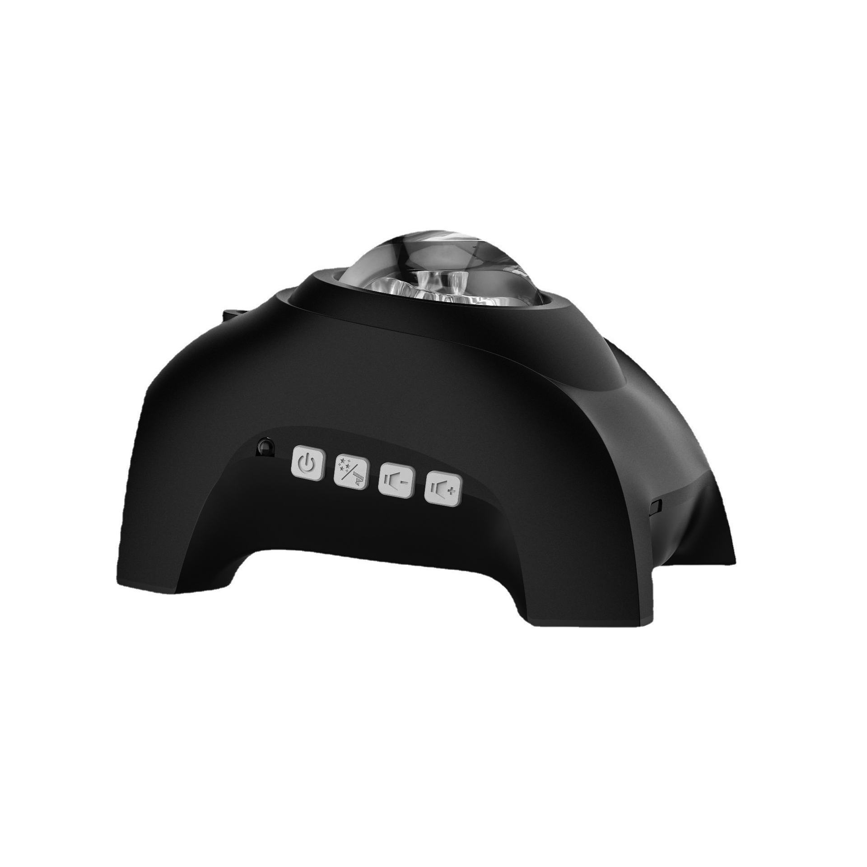
NL06S
LED Night Projection Lamp
Material:ABS+AS
Input Voltage:DC5V
Product standard configuration: host × 1 + USB cable × 1 +
audio cable × 1 + remote control × 1 + English manual × 1
Power supply mode: host USB cable plug in /
remote control 2 AAA batteries (not delivered)
Bluetooth version: 5.0
Item Number | Wattage | Power supply | Material | Beam Angle | Size (mm)
NL06S | 14W | 100-240V | ABS+AS | 120° | 150*120*110
Modern Ceiling Light Material:Iron base+ PMMA Cover Input Voltage:AC85-265V Led Chip:2835SMD IP Rating:IP44 CRI>80 PF>0.9 Color Temperature:3000K/4500K/6000K Operating Temperature:-25℃ ~50℃ Life Span:50000hours Certificate:CE ROHS
Item Number | Wattage | LedQuantity | LuminousFlux | Beam Angle | Size (mm) | WIFI Control Remte control Switch control Dimmer control
CL-N00 | 24W | 48pcs2835SMD | 1920-2160lm | 120° | 350mm | Yes
 | 36W | 72pcs2835SMD | 2880-3240lm | 120° | 400mm
 | 40W | 80pcs2835SMD | 3200-3600lm | 120° | 450mm
Modern Ceiling Light Material:Iron base+ PMMA Cover Input Voltage:AC85-265V Led Chip:2835SMD IP Rating:IP44 CRI>80 PF>0.9 Color Temperature:3000K/4500K/6000K Operating Temperature:-25℃ ~50℃ Life Span:50000hours Certificate:CE ROHS
Item Number | Wattage | LedQuantity | LuminousFlux | Beam Angle | Size (mm) | WIFI Control Remte control Switch control Dimmer control
CL-N00 | 24W | 48pcs2835SMD | 1920-2160lm | 120° | 350mm | Yes
 | 36W | 72pcs2835SMD | 2880-3240lm | 120° | 400mm
 | 40W | 80pcs2835SMD | 3200-3600lm | 120° | 450mm
Modern Ceiling Light Material:Iron base+ PMMA Cover Input Voltage:AC85-265V Led Chip:2835SMD IP Rating:IP44 CRI>80 PF>0.9 Color Temperature:3000K/4500K/6000K Operating Temperature:-25℃ ~50℃ Life Span:50000hours Certificate:CE ROHS
Item Number | Wattage | LedQuantity | LuminousFlux | Beam Angle | Size (mm) | WIFI Control Remte control Switch control Dimmer control
CL-N00 | 24W | 48pcs2835SMD | 1920-2160lm | 120° | 350mm | Yes
 | 36W | 72pcs2835SMD | 2880-3240lm | 120° | 400mm
 | 40W | 80pcs2835SMD | 3200-3600lm | 120° | 450mm
Modern Ceiling Light Material:Iron base+ PMMA Cover Input Voltage:AC85-265V Led Chip:2835SMD IP Rating:IP44 CRI>80 PF>0.9 Color Temperature:3000K/4500K/6000K Operating Temperature:-25℃ ~50℃ Life Span:50000hours Certificate:CE ROHS
Item Number | Wattage | LedQuantity | LuminousFlux | Beam Angle | Size (mm) | WIFI Control Remte control Switch control Dimmer control
CL-N00 | 24W | 48pcs2835SMD | 1920-2160lm | 120° | 350mm | Yes
 | 36W | 72pcs2835SMD | 2880-3240lm | 120° | 400mm
 | 40W | 80pcs2835SMD | 3200-3600lm | 120° | 450mm

Slide 5
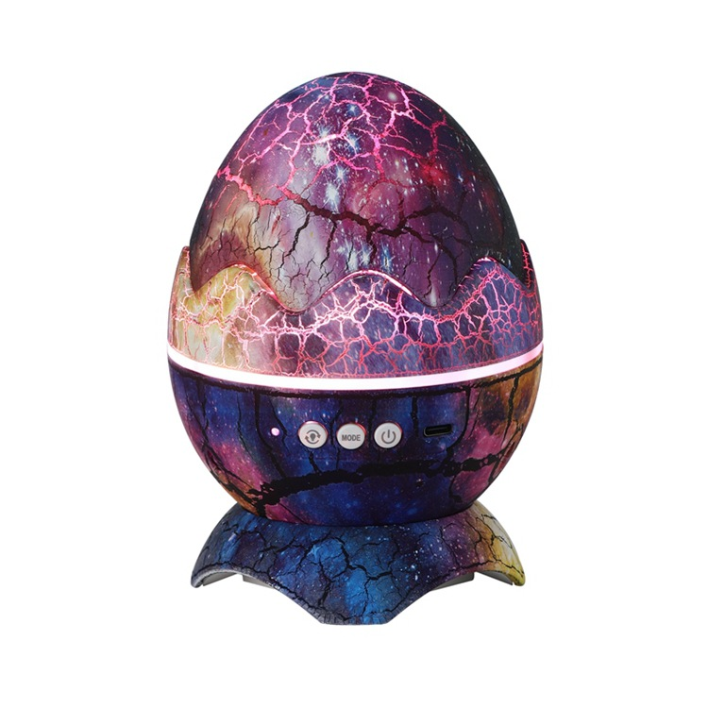
NL07S
LED Dinosaur Egg Night Light
Material:ABS+PC
Power supply mode: USB
Control method: button, remote control, voice control
The lamp body rotates 360 degrees
Item Number | Wattage | Power supply | Material | Beam Angle | Size (mm)
NL07S | 10W | 5V/2A | ABS+AS | 270° | 120*140
Modern Ceiling Light Material:Iron base+ PMMA Cover Input Voltage:AC85-265V Led Chip:2835SMD IP Rating:IP44 CRI>80 PF>0.9 Color Temperature:3000K/4500K/6000K Operating Temperature:-25℃ ~50℃ Life Span:50000hours Certificate:CE ROHS
Item Number | Wattage | LedQuantity | LuminousFlux | Beam Angle | Size (mm) | WIFI Control Remte control Switch control Dimmer control
CL-N00 | 24W | 48pcs2835SMD | 1920-2160lm | 120° | 350mm | Yes
 | 36W | 72pcs2835SMD | 2880-3240lm | 120° | 400mm
 | 40W | 80pcs2835SMD | 3200-3600lm | 120° | 450mm
Modern Ceiling Light Material:Iron base+ PMMA Cover Input Voltage:AC85-265V Led Chip:2835SMD IP Rating:IP44 CRI>80 PF>0.9 Color Temperature:3000K/4500K/6000K Operating Temperature:-25℃ ~50℃ Life Span:50000hours Certificate:CE ROHS
Item Number | Wattage | LedQuantity | LuminousFlux | Beam Angle | Size (mm) | WIFI Control Remte control Switch control Dimmer control
CL-N00 | 24W | 48pcs2835SMD | 1920-2160lm | 120° | 350mm | Yes
 | 36W | 72pcs2835SMD | 2880-3240lm | 120° | 400mm
 | 40W | 80pcs2835SMD | 3200-3600lm | 120° | 450mm
Modern Ceiling Light Material:Iron base+ PMMA Cover Input Voltage:AC85-265V Led Chip:2835SMD IP Rating:IP44 CRI>80 PF>0.9 Color Temperature:3000K/4500K/6000K Operating Temperature:-25℃ ~50℃ Life Span:50000hours Certificate:CE ROHS
Item Number | Wattage | LedQuantity | LuminousFlux | Beam Angle | Size (mm) | WIFI Control Remte control Switch control Dimmer control
CL-N00 | 24W | 48pcs2835SMD | 1920-2160lm | 120° | 350mm | Yes
 | 36W | 72pcs2835SMD | 2880-3240lm | 120° | 400mm
 | 40W | 80pcs2835SMD | 3200-3600lm | 120° | 450mm
Modern Ceiling Light Material:Iron base+ PMMA Cover Input Voltage:AC85-265V Led Chip:2835SMD IP Rating:IP44 CRI>80 PF>0.9 Color Temperature:3000K/4500K/6000K Operating Temperature:-25℃ ~50℃ Life Span:50000hours Certificate:CE ROHS
Item Number | Wattage | LedQuantity | LuminousFlux | Beam Angle | Size (mm) | WIFI Control Remte control Switch control Dimmer control
CL-N00 | 24W | 48pcs2835SMD | 1920-2160lm | 120° | 350mm | Yes
 | 36W | 72pcs2835SMD | 2880-3240lm | 120° | 400mm
 | 40W | 80pcs2835SMD | 3200-3600lm | 120° | 450mm

Slide 6
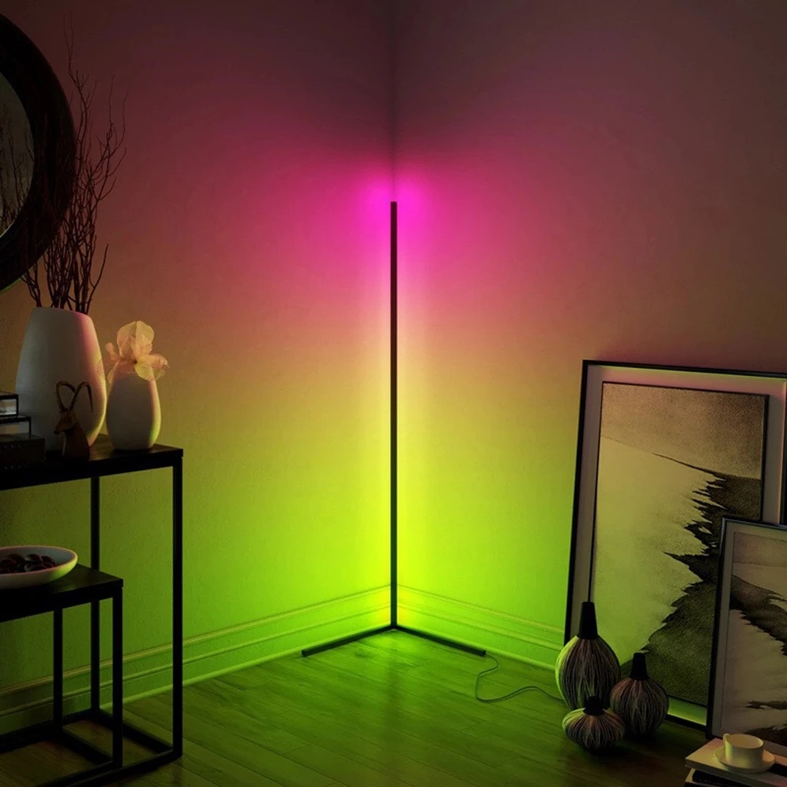
NL09S
LED Floor Corner Night Light
Material:PMMA+Metal
Power :85-265v
Color temperature: RBG
Item Number | Wattage | Power supply | Material | Beam Angle | Size (mm)
NL09S | 24W | 85-265v | ABS+AS | 1.remote control 2.TUYA APP control | 140*40
Modern Ceiling Light Material:Iron base+ PMMA Cover Input Voltage:AC85-265V Led Chip:2835SMD IP Rating:IP44 CRI>80 PF>0.9 Color Temperature:3000K/4500K/6000K Operating Temperature:-25℃ ~50℃ Life Span:50000hours Certificate:CE ROHS
Item Number | Wattage | LedQuantity | LuminousFlux | Beam Angle | Size (mm) | WIFI Control Remte control Switch control Dimmer control
CL-N00 | 24W | 48pcs2835SMD | 1920-2160lm | 120° | 350mm | Yes
 | 36W | 72pcs2835SMD | 2880-3240lm | 120° | 400mm
 | 40W | 80pcs2835SMD | 3200-3600lm | 120° | 450mm
Modern Ceiling Light Material:Iron base+ PMMA Cover Input Voltage:AC85-265V Led Chip:2835SMD IP Rating:IP44 CRI>80 PF>0.9 Color Temperature:3000K/4500K/6000K Operating Temperature:-25℃ ~50℃ Life Span:50000hours Certificate:CE ROHS
Item Number | Wattage | LedQuantity | LuminousFlux | Beam Angle | Size (mm) | WIFI Control Remte control Switch control Dimmer control
CL-N00 | 24W | 48pcs2835SMD | 1920-2160lm | 120° | 350mm | Yes
 | 36W | 72pcs2835SMD | 2880-3240lm | 120° | 400mm
 | 40W | 80pcs2835SMD | 3200-3600lm | 120° | 450mm
Modern Ceiling Light Material:Iron base+ PMMA Cover Input Voltage:AC85-265V Led Chip:2835SMD IP Rating:IP44 CRI>80 PF>0.9 Color Temperature:3000K/4500K/6000K Operating Temperature:-25℃ ~50℃ Life Span:50000hours Certificate:CE ROHS
Item Number | Wattage | LedQuantity | LuminousFlux | Beam Angle | Size (mm) | WIFI Control Remte control Switch control Dimmer control
CL-N00 | 24W | 48pcs2835SMD | 1920-2160lm | 120° | 350mm | Yes
 | 36W | 72pcs2835SMD | 2880-3240lm | 120° | 400mm
 | 40W | 80pcs2835SMD | 3200-3600lm | 120° | 450mm
Modern Ceiling Light Material:Iron base+ PMMA Cover Input Voltage:AC85-265V Led Chip:2835SMD IP Rating:IP44 CRI>80 PF>0.9 Color Temperature:3000K/4500K/6000K Operating Temperature:-25℃ ~50℃ Life Span:50000hours Certificate:CE ROHS
Item Number | Wattage | LedQuantity | LuminousFlux | Beam Angle | Size (mm) | WIFI Control Remte control Switch control Dimmer control
CL-N00 | 24W | 48pcs2835SMD | 1920-2160lm | 120° | 350mm | Yes
 | 36W | 72pcs2835SMD | 2880-3240lm | 120° | 400mm
 | 40W | 80pcs2835SMD | 3200-3600lm | 120° | 450mm

Slide 7
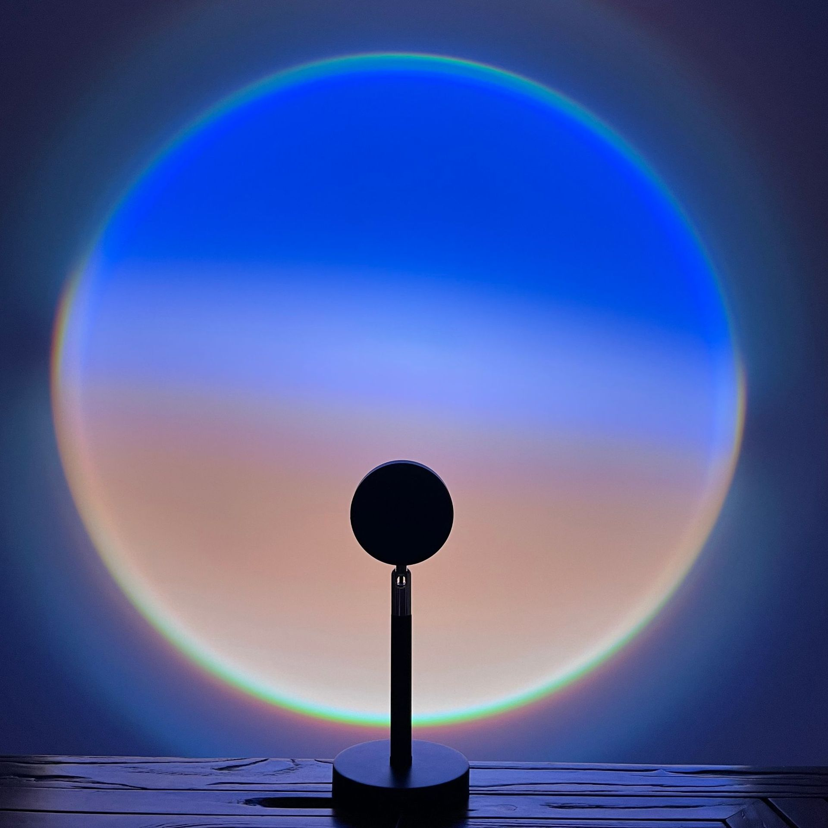
NL10S
LED Dinosaur Egg Night Light
Material:ABS+PC
Power supply mode: USB
Control method: button, remote control, voice control
The lamp body rotates 360 degrees
Item Number | Wattage | Power supply | Material | Beam Angle | Size (mm)
NL10S | 5W | 5V2A | Metal/Plastic | Multiple halo options | φ10*27
Modern Ceiling Light Material:Iron base+ PMMA Cover Input Voltage:AC85-265V Led Chip:2835SMD IP Rating:IP44 CRI>80 PF>0.9 Color Temperature:3000K/4500K/6000K Operating Temperature:-25℃ ~50℃ Life Span:50000hours Certificate:CE ROHS
Item Number | Wattage | LedQuantity | LuminousFlux | Beam Angle | Size (mm) | WIFI Control Remte control Switch control Dimmer control
CL-N00 | 24W | 48pcs2835SMD | 1920-2160lm | 120° | 350mm | Yes
 | 36W | 72pcs2835SMD | 2880-3240lm | 120° | 400mm
 | 40W | 80pcs2835SMD | 3200-3600lm | 120° | 450mm
Modern Ceiling Light Material:Iron base+ PMMA Cover Input Voltage:AC85-265V Led Chip:2835SMD IP Rating:IP44 CRI>80 PF>0.9 Color Temperature:3000K/4500K/6000K Operating Temperature:-25℃ ~50℃ Life Span:50000hours Certificate:CE ROHS
Item Number | Wattage | LedQuantity | LuminousFlux | Beam Angle | Size (mm) | WIFI Control Remte control Switch control Dimmer control
CL-N00 | 24W | 48pcs2835SMD | 1920-2160lm | 120° | 350mm | Yes
 | 36W | 72pcs2835SMD | 2880-3240lm | 120° | 400mm
 | 40W | 80pcs2835SMD | 3200-3600lm | 120° | 450mm
Modern Ceiling Light Material:Iron base+ PMMA Cover Input Voltage:AC85-265V Led Chip:2835SMD IP Rating:IP44 CRI>80 PF>0.9 Color Temperature:3000K/4500K/6000K Operating Temperature:-25℃ ~50℃ Life Span:50000hours Certificate:CE ROHS
Item Number | Wattage | LedQuantity | LuminousFlux | Beam Angle | Size (mm) | WIFI Control Remte control Switch control Dimmer control
CL-N00 | 24W | 48pcs2835SMD | 1920-2160lm | 120° | 350mm | Yes
 | 36W | 72pcs2835SMD | 2880-3240lm | 120° | 400mm
 | 40W | 80pcs2835SMD | 3200-3600lm | 120° | 450mm
Modern Ceiling Light Material:Iron base+ PMMA Cover Input Voltage:AC85-265V Led Chip:2835SMD IP Rating:IP44 CRI>80 PF>0.9 Color Temperature:3000K/4500K/6000K Operating Temperature:-25℃ ~50℃ Life Span:50000hours Certificate:CE ROHS
Item Number | Wattage | LedQuantity | LuminousFlux | Beam Angle | Size (mm) | WIFI Control Remte control Switch control Dimmer control
CL-N00 | 24W | 48pcs2835SMD | 1920-2160lm | 120° | 350mm | Yes
 | 36W | 72pcs2835SMD | 2880-3240lm | 120° | 400mm
 | 40W | 80pcs2835SMD | 3200-3600lm | 120° | 450mm

Slide 8
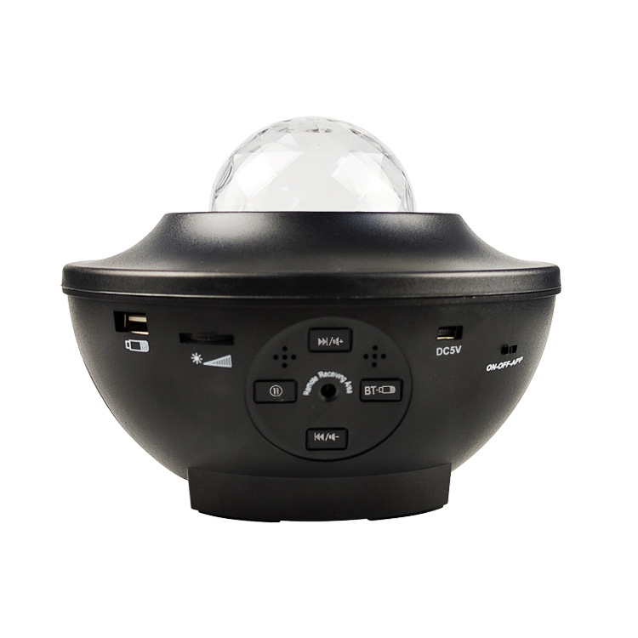
NL13S
LED Dinosaur Egg Night Light
Material:ABS+PC
Power supply mode: USB
Control method: button, remote control, voice control
The lamp body rotates 360 degrees
Item Number | Wattage | Power supply | Material | Beam Angle | Size (mm)
NL13S | 2*4W | 110-265V | ABS+PC | Remote control, bluetooth/wifi control | 16.2*16.2*13
Modern Ceiling Light Material:Iron base+ PMMA Cover Input Voltage:AC85-265V Led Chip:2835SMD IP Rating:IP44 CRI>80 PF>0.9 Color Temperature:3000K/4500K/6000K Operating Temperature:-25℃ ~50℃ Life Span:50000hours Certificate:CE ROHS
Item Number | Wattage | LedQuantity | LuminousFlux | Beam Angle | Size (mm) | WIFI Control Remte control Switch control Dimmer control
CL-N00 | 24W | 48pcs2835SMD | 1920-2160lm | 120° | 350mm | Yes
 | 36W | 72pcs2835SMD | 2880-3240lm | 120° | 400mm
 | 40W | 80pcs2835SMD | 3200-3600lm | 120° | 450mm
Modern Ceiling Light Material:Iron base+ PMMA Cover Input Voltage:AC85-265V Led Chip:2835SMD IP Rating:IP44 CRI>80 PF>0.9 Color Temperature:3000K/4500K/6000K Operating Temperature:-25℃ ~50℃ Life Span:50000hours Certificate:CE ROHS
Item Number | Wattage | LedQuantity | LuminousFlux | Beam Angle | Size (mm) | WIFI Control Remte control Switch control Dimmer control
CL-N00 | 24W | 48pcs2835SMD | 1920-2160lm | 120° | 350mm | Yes
 | 36W | 72pcs2835SMD | 2880-3240lm | 120° | 400mm
 | 40W | 80pcs2835SMD | 3200-3600lm | 120° | 450mm
Modern Ceiling Light Material:Iron base+ PMMA Cover Input Voltage:AC85-265V Led Chip:2835SMD IP Rating:IP44 CRI>80 PF>0.9 Color Temperature:3000K/4500K/6000K Operating Temperature:-25℃ ~50℃ Life Span:50000hours Certificate:CE ROHS
Item Number | Wattage | LedQuantity | LuminousFlux | Beam Angle | Size (mm) | WIFI Control Remte control Switch control Dimmer control
CL-N00 | 24W | 48pcs2835SMD | 1920-2160lm | 120° | 350mm | Yes
 | 36W | 72pcs2835SMD | 2880-3240lm | 120° | 400mm
 | 40W | 80pcs2835SMD | 3200-3600lm | 120° | 450mm
Modern Ceiling Light Material:Iron base+ PMMA Cover Input Voltage:AC85-265V Led Chip:2835SMD IP Rating:IP44 CRI>80 PF>0.9 Color Temperature:3000K/4500K/6000K Operating Temperature:-25℃ ~50℃ Life Span:50000hours Certificate:CE ROHS
Item Number | Wattage | LedQuantity | LuminousFlux | Beam Angle | Size (mm) | WIFI Control Remte control Switch control Dimmer control
CL-N00 | 24W | 48pcs2835SMD | 1920-2160lm | 120° | 350mm | Yes
 | 36W | 72pcs2835SMD | 2880-3240lm | 120° | 400mm
 | 40W | 80pcs2835SMD | 3200-3600lm | 120° | 450mm

Slide 9
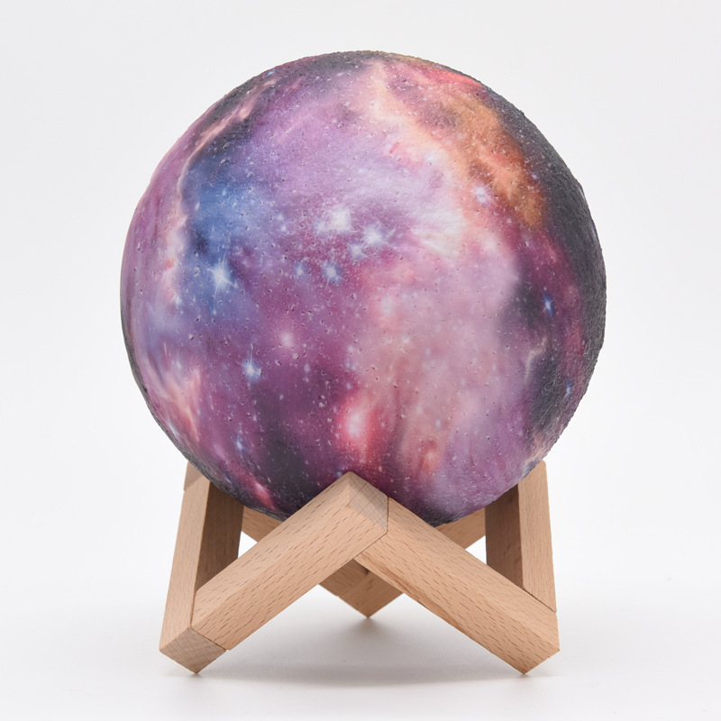
NL15S
LED Moon Night Lights
Material:PVC
Power :DC 5V/1A /USB Connection
Color temperature: Touch multicolor
Lighting time: 12 hours
Item Number | Wattage | Power supply | Material | Beam Angle | Size (mm)
NL15S | 5w | DC 5V/1A | PVC | Remote control | 8-24cm
Modern Ceiling Light Material:Iron base+ PMMA Cover Input Voltage:AC85-265V Led Chip:2835SMD IP Rating:IP44 CRI>80 PF>0.9 Color Temperature:3000K/4500K/6000K Operating Temperature:-25℃ ~50℃ Life Span:50000hours Certificate:CE ROHS
Item Number | Wattage | LedQuantity | LuminousFlux | Beam Angle | Size (mm) | WIFI Control Remte control Switch control Dimmer control
CL-N00 | 24W | 48pcs2835SMD | 1920-2160lm | 120° | 350mm | Yes
 | 36W | 72pcs2835SMD | 2880-3240lm | 120° | 400mm
 | 40W | 80pcs2835SMD | 3200-3600lm | 120° | 450mm
Modern Ceiling Light Material:Iron base+ PMMA Cover Input Voltage:AC85-265V Led Chip:2835SMD IP Rating:IP44 CRI>80 PF>0.9 Color Temperature:3000K/4500K/6000K Operating Temperature:-25℃ ~50℃ Life Span:50000hours Certificate:CE ROHS
Item Number | Wattage | LedQuantity | LuminousFlux | Beam Angle | Size (mm) | WIFI Control Remte control Switch control Dimmer control
CL-N00 | 24W | 48pcs2835SMD | 1920-2160lm | 120° | 350mm | Yes
 | 36W | 72pcs2835SMD | 2880-3240lm | 120° | 400mm
 | 40W | 80pcs2835SMD | 3200-3600lm | 120° | 450mm
Modern Ceiling Light Material:Iron base+ PMMA Cover Input Voltage:AC85-265V Led Chip:2835SMD IP Rating:IP44 CRI>80 PF>0.9 Color Temperature:3000K/4500K/6000K Operating Temperature:-25℃ ~50℃ Life Span:50000hours Certificate:CE ROHS
Item Number | Wattage | LedQuantity | LuminousFlux | Beam Angle | Size (mm) | WIFI Control Remte control Switch control Dimmer control
CL-N00 | 24W | 48pcs2835SMD | 1920-2160lm | 120° | 350mm | Yes
 | 36W | 72pcs2835SMD | 2880-3240lm | 120° | 400mm
 | 40W | 80pcs2835SMD | 3200-3600lm | 120° | 450mm
Modern Ceiling Light Material:Iron base+ PMMA Cover Input Voltage:AC85-265V Led Chip:2835SMD IP Rating:IP44 CRI>80 PF>0.9 Color Temperature:3000K/4500K/6000K Operating Temperature:-25℃ ~50℃ Life Span:50000hours Certificate:CE ROHS
Item Number | Wattage | LedQuantity | LuminousFlux | Beam Angle | Size (mm) | WIFI Control Remte control Switch control Dimmer control
CL-N00 | 24W | 48pcs2835SMD | 1920-2160lm | 120° | 350mm | Yes
 | 36W | 72pcs2835SMD | 2880-3240lm | 120° | 400mm
 | 40W | 80pcs2835SMD | 3200-3600lm | 120° | 450mm

Slide 10
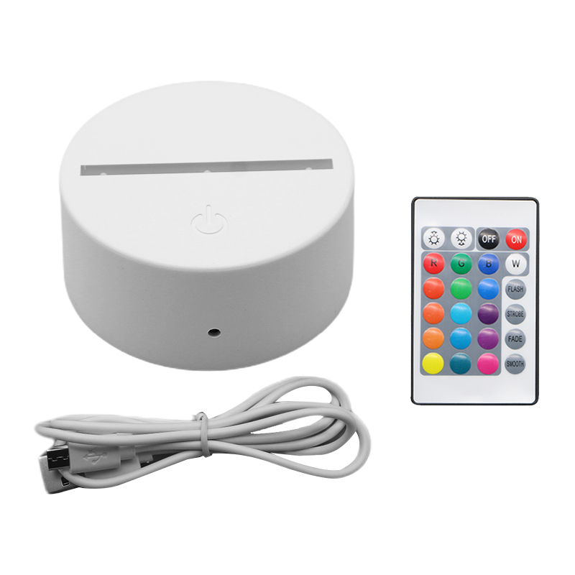
NL16S
LED Night Lights
Material:ABS+PC
Power :DC 5V/1A /USB Connection
Color temperature: multicolor
Lighting time: 12 hours
Item Number | Wattage | Power supply | Material | Beam Angle | Size (mm)
NL16S | 3w | DC 5V/1A | ABS+PC | Remote control | 4*9.5cm
Modern Ceiling Light Material:Iron base+ PMMA Cover Input Voltage:AC85-265V Led Chip:2835SMD IP Rating:IP44 CRI>80 PF>0.9 Color Temperature:3000K/4500K/6000K Operating Temperature:-25℃ ~50℃ Life Span:50000hours Certificate:CE ROHS
Item Number | Wattage | LedQuantity | LuminousFlux | Beam Angle | Size (mm) | WIFI Control Remte control Switch control Dimmer control
CL-N00 | 24W | 48pcs2835SMD | 1920-2160lm | 120° | 350mm | Yes
 | 36W | 72pcs2835SMD | 2880-3240lm | 120° | 400mm
 | 40W | 80pcs2835SMD | 3200-3600lm | 120° | 450mm
Modern Ceiling Light Material:Iron base+ PMMA Cover Input Voltage:AC85-265V Led Chip:2835SMD IP Rating:IP44 CRI>80 PF>0.9 Color Temperature:3000K/4500K/6000K Operating Temperature:-25℃ ~50℃ Life Span:50000hours Certificate:CE ROHS
Item Number | Wattage | LedQuantity | LuminousFlux | Beam Angle | Size (mm) | WIFI Control Remte control Switch control Dimmer control
CL-N00 | 24W | 48pcs2835SMD | 1920-2160lm | 120° | 350mm | Yes
 | 36W | 72pcs2835SMD | 2880-3240lm | 120° | 400mm
 | 40W | 80pcs2835SMD | 3200-3600lm | 120° | 450mm
Modern Ceiling Light Material:Iron base+ PMMA Cover Input Voltage:AC85-265V Led Chip:2835SMD IP Rating:IP44 CRI>80 PF>0.9 Color Temperature:3000K/4500K/6000K Operating Temperature:-25℃ ~50℃ Life Span:50000hours Certificate:CE ROHS
Item Number | Wattage | LedQuantity | LuminousFlux | Beam Angle | Size (mm) | WIFI Control Remte control Switch control Dimmer control
CL-N00 | 24W | 48pcs2835SMD | 1920-2160lm | 120° | 350mm | Yes
 | 36W | 72pcs2835SMD | 2880-3240lm | 120° | 400mm
 | 40W | 80pcs2835SMD | 3200-3600lm | 120° | 450mm
Modern Ceiling Light Material:Iron base+ PMMA Cover Input Voltage:AC85-265V Led Chip:2835SMD IP Rating:IP44 CRI>80 PF>0.9 Color Temperature:3000K/4500K/6000K Operating Temperature:-25℃ ~50℃ Life Span:50000hours Certificate:CE ROHS
Item Number | Wattage | LedQuantity | LuminousFlux | Beam Angle | Size (mm) | WIFI Control Remte control Switch control Dimmer control
CL-N00 | 24W | 48pcs2835SMD | 1920-2160lm | 120° | 350mm | Yes
 | 36W | 72pcs2835SMD | 2880-3240lm | 120° | 400mm
 | 40W | 80pcs2835SMD | 3200-3600lm | 120° | 450mm

Slide 11
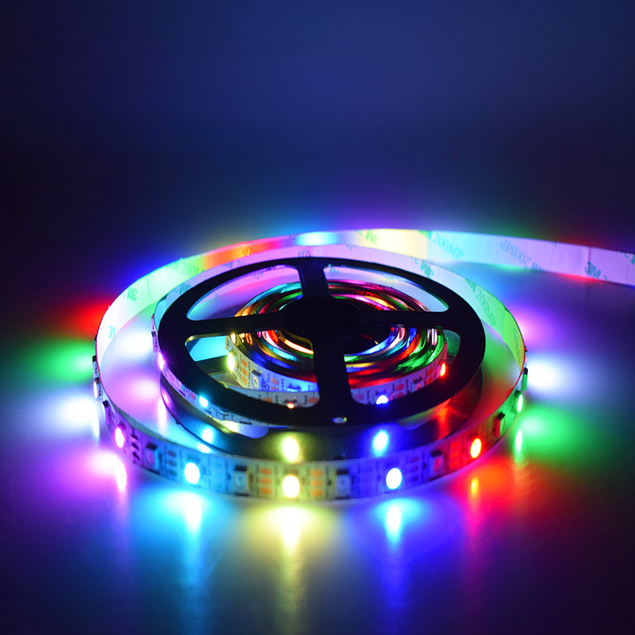
NL19S
LED RGB Strip Light
30 leds/meter,5V,
IP65- Waterproof
24 keys remote control,
W/USB plug
Item Number | Wattage | Power supply | Material | Beam Angle | Size (mm)
NL19S | 5w | DC 5V/1A | ABS+PC | Remote control/APP bluetooth control | 5 meters/ roll 3 meters/ roll OEM
Modern Ceiling Light Material:Iron base+ PMMA Cover Input Voltage:AC85-265V Led Chip:2835SMD IP Rating:IP44 CRI>80 PF>0.9 Color Temperature:3000K/4500K/6000K Operating Temperature:-25℃ ~50℃ Life Span:50000hours Certificate:CE ROHS
Item Number | Wattage | LedQuantity | LuminousFlux | Beam Angle | Size (mm) | WIFI Control Remte control Switch control Dimmer control
CL-N00 | 24W | 48pcs2835SMD | 1920-2160lm | 120° | 350mm | Yes
 | 36W | 72pcs2835SMD | 2880-3240lm | 120° | 400mm
 | 40W | 80pcs2835SMD | 3200-3600lm | 120° | 450mm
Modern Ceiling Light Material:Iron base+ PMMA Cover Input Voltage:AC85-265V Led Chip:2835SMD IP Rating:IP44 CRI>80 PF>0.9 Color Temperature:3000K/4500K/6000K Operating Temperature:-25℃ ~50℃ Life Span:50000hours Certificate:CE ROHS
Item Number | Wattage | LedQuantity | LuminousFlux | Beam Angle | Size (mm) | WIFI Control Remte control Switch control Dimmer control
CL-N00 | 24W | 48pcs2835SMD | 1920-2160lm | 120° | 350mm | Yes
 | 36W | 72pcs2835SMD | 2880-3240lm | 120° | 400mm
 | 40W | 80pcs2835SMD | 3200-3600lm | 120° | 450mm
Modern Ceiling Light Material:Iron base+ PMMA Cover Input Voltage:AC85-265V Led Chip:2835SMD IP Rating:IP44 CRI>80 PF>0.9 Color Temperature:3000K/4500K/6000K Operating Temperature:-25℃ ~50℃ Life Span:50000hours Certificate:CE ROHS
Item Number | Wattage | LedQuantity | LuminousFlux | Beam Angle | Size (mm) | WIFI Control Remte control Switch control Dimmer control
CL-N00 | 24W | 48pcs2835SMD | 1920-2160lm | 120° | 350mm | Yes
 | 36W | 72pcs2835SMD | 2880-3240lm | 120° | 400mm
 | 40W | 80pcs2835SMD | 3200-3600lm | 120° | 450mm
Modern Ceiling Light Material:Iron base+ PMMA Cover Input Voltage:AC85-265V Led Chip:2835SMD IP Rating:IP44 CRI>80 PF>0.9 Color Temperature:3000K/4500K/6000K Operating Temperature:-25℃ ~50℃ Life Span:50000hours Certificate:CE ROHS
Item Number | Wattage | LedQuantity | LuminousFlux | Beam Angle | Size (mm) | WIFI Control Remte control Switch control Dimmer control
CL-N00 | 24W | 48pcs2835SMD | 1920-2160lm | 120° | 350mm | Yes
 | 36W | 72pcs2835SMD | 2880-3240lm | 120° | 400mm
 | 40W | 80pcs2835SMD | 3200-3600lm | 120° | 450mm

