Slide 1
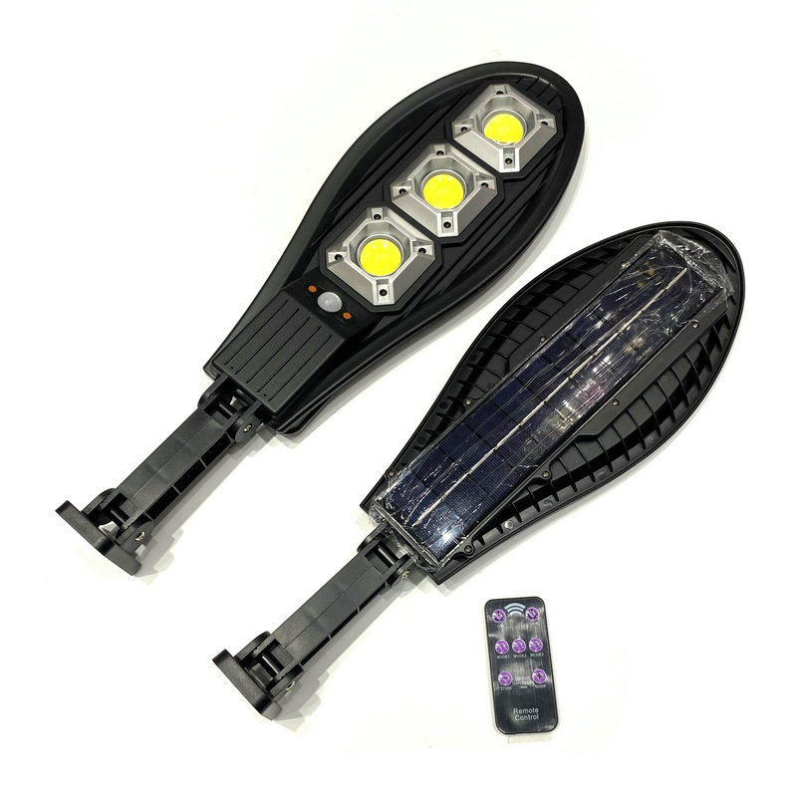
SL01
Input Voltage:AC85-265V
Material: Aluminum die casting
Led Chip:2835SMD Chip Brand:Epistar
IP Rating:IP65 PF>98%
Color Temperature:2700K-7000K
Operating Temperature:-25℃ ~65℃
Life Span:50000hours
CE ROHS LVD EMC certificate approved
Item Number | Wattage | Led Chip | Lamp size | Solar Panel Power | Battery Capacity | Luminous Flux | Bean Angle
SLN01 | 30W | 1*COB | 350*150*70MM | 5.5V/1.8W | 1200MAH | 120-130LM/W | 120°
 | 50W | 2*COB | 510*225*75MM | 5.5V/1.8W | 2400MAH |  | 120°
 | 100W | 3*COB | 720*275*75MM | 5.5V/1.8W | 3600MAH |  | 120°
 | 150W | 4*COB | 850*325*75MM | 5.5V/1.8W | 4800MAH |  | 120°
 | 200W | 5*COB | 940*345*80MM | 5.5V/1.8W | 6000MAH |  | 120°
 | 250W | 6*COB | 1100*355*80MM | 5.5V/1.8W | 7200MAH |  | 120°
Modern Ceiling Light Material:Iron base+ PMMA Cover Input Voltage:AC85-265V Led Chip:2835SMD IP Rating:IP44 CRI>80 PF>0.9 Color Temperature:3000K/4500K/6000K Operating Temperature:-25℃ ~50℃ Life Span:50000hours Certificate:CE ROHS
Item Number | Wattage | LedQuantity | LuminousFlux | Beam Angle | Size (mm) | WIFI Control Remte control Switch control Dimmer control
CL-N00 | 24W | 48pcs2835SMD | 1920-2160lm | 120° | 350mm | Yes
 | 36W | 72pcs2835SMD | 2880-3240lm | 120° | 400mm
 | 40W | 80pcs2835SMD | 3200-3600lm | 120° | 450mm
Modern Ceiling Light Material:Iron base+ PMMA Cover Input Voltage:AC85-265V Led Chip:2835SMD IP Rating:IP44 CRI>80 PF>0.9 Color Temperature:3000K/4500K/6000K Operating Temperature:-25℃ ~50℃ Life Span:50000hours Certificate:CE ROHS
Item Number | Wattage | LedQuantity | LuminousFlux | Beam Angle | Size (mm) | WIFI Control Remte control Switch control Dimmer control
CL-N00 | 24W | 48pcs2835SMD | 1920-2160lm | 120° | 350mm | Yes
 | 36W | 72pcs2835SMD | 2880-3240lm | 120° | 400mm
 | 40W | 80pcs2835SMD | 3200-3600lm | 120° | 450mm
Modern Ceiling Light Material:Iron base+ PMMA Cover Input Voltage:AC85-265V Led Chip:2835SMD IP Rating:IP44 CRI>80 PF>0.9 Color Temperature:3000K/4500K/6000K Operating Temperature:-25℃ ~50℃ Life Span:50000hours Certificate:CE ROHS
Item Number | Wattage | LedQuantity | LuminousFlux | Beam Angle | Size (mm) | WIFI Control Remte control Switch control Dimmer control
CL-N00 | 24W | 48pcs2835SMD | 1920-2160lm | 120° | 350mm | Yes
 | 36W | 72pcs2835SMD | 2880-3240lm | 120° | 400mm
 | 40W | 80pcs2835SMD | 3200-3600lm | 120° | 450mm
Modern Ceiling Light Material:Iron base+ PMMA Cover Input Voltage:AC85-265V Led Chip:2835SMD IP Rating:IP44 CRI>80 PF>0.9 Color Temperature:3000K/4500K/6000K Operating Temperature:-25℃ ~50℃ Life Span:50000hours Certificate:CE ROHS
Item Number | Wattage | LedQuantity | LuminousFlux | Beam Angle | Size (mm) | WIFI Control Remte control Switch control Dimmer control
CL-N00 | 24W | 48pcs2835SMD | 1920-2160lm | 120° | 350mm | Yes
 | 36W | 72pcs2835SMD | 2880-3240lm | 120° | 400mm
 | 40W | 80pcs2835SMD | 3200-3600lm | 120° | 450mm

Slide 2
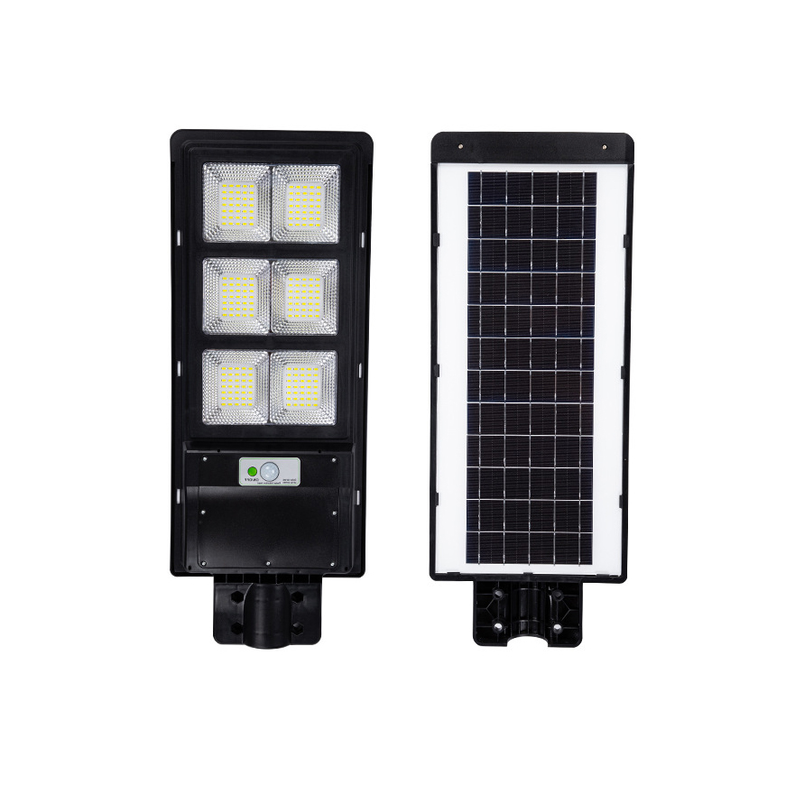
SL02
Input Voltage:AC85-265V
Material: Aluminum
Led Chip:2835SMD Chip Brand:Epistar
IP Rating:IP65 PF>98%
Color Temperature:2700K-7000K
Operating Temperature:-25℃ ~65℃
Life Span:50000hours
CE ROHS LVD EMC certificate approved
Item Number | Wattage | Led Chip | Lamp size | Solar Panel Size | Solar Panel Power | Battery Capacity | Luminous Flux | Bean Angle
SL02 | 60W | 60PCS | 390*194*58mm | 310*170mm | 6V/6W | 3.2V/3.5AH | 120-130LM/W | 120°
 | 100W | 100PCS | 485*218*58mm | 400*180mm | 6V/6W | 3.2V/3.5AH |  | 120°
 | 120W | 120PCS | 485*218*58mm | 400*180mm | 6V/8W | 3.2V/5AH |  | 120°
 | 180W | 180PCS | 624**230*58mm | 540*180mm | 6V/12W | 3.2V/10AH |  | 120°
 | 200W | 200PCS | 725*240*58mm | 540*180mm | 6V/12W | 3.2V/12AH |  | 120°
 | 240W | 240PCS | 725*240*58mm | 640*185mm | 6V/15W | 3.2V/12AH |  | 120°
Modern Ceiling Light Material:Iron base+ PMMA Cover Input Voltage:AC85-265V Led Chip:2835SMD IP Rating:IP44 CRI>80 PF>0.9 Color Temperature:3000K/4500K/6000K Operating Temperature:-25℃ ~50℃ Life Span:50000hours Certificate:CE ROHS
Item Number | Wattage | LedQuantity | LuminousFlux | Beam Angle | Size (mm) | WIFI Control Remte control Switch control Dimmer control
CL-N00 | 24W | 48pcs2835SMD | 1920-2160lm | 120° | 350mm | Yes
 | 36W | 72pcs2835SMD | 2880-3240lm | 120° | 400mm
 | 40W | 80pcs2835SMD | 3200-3600lm | 120° | 450mm
Modern Ceiling Light Material:Iron base+ PMMA Cover Input Voltage:AC85-265V Led Chip:2835SMD IP Rating:IP44 CRI>80 PF>0.9 Color Temperature:3000K/4500K/6000K Operating Temperature:-25℃ ~50℃ Life Span:50000hours Certificate:CE ROHS
Item Number | Wattage | LedQuantity | LuminousFlux | Beam Angle | Size (mm) | WIFI Control Remte control Switch control Dimmer control
CL-N00 | 24W | 48pcs2835SMD | 1920-2160lm | 120° | 350mm | Yes
 | 36W | 72pcs2835SMD | 2880-3240lm | 120° | 400mm
 | 40W | 80pcs2835SMD | 3200-3600lm | 120° | 450mm
Modern Ceiling Light Material:Iron base+ PMMA Cover Input Voltage:AC85-265V Led Chip:2835SMD IP Rating:IP44 CRI>80 PF>0.9 Color Temperature:3000K/4500K/6000K Operating Temperature:-25℃ ~50℃ Life Span:50000hours Certificate:CE ROHS
Item Number | Wattage | LedQuantity | LuminousFlux | Beam Angle | Size (mm) | WIFI Control Remte control Switch control Dimmer control
CL-N00 | 24W | 48pcs2835SMD | 1920-2160lm | 120° | 350mm | Yes
 | 36W | 72pcs2835SMD | 2880-3240lm | 120° | 400mm
 | 40W | 80pcs2835SMD | 3200-3600lm | 120° | 450mm
Modern Ceiling Light Material:Iron base+ PMMA Cover Input Voltage:AC85-265V Led Chip:2835SMD IP Rating:IP44 CRI>80 PF>0.9 Color Temperature:3000K/4500K/6000K Operating Temperature:-25℃ ~50℃ Life Span:50000hours Certificate:CE ROHS
Item Number | Wattage | LedQuantity | LuminousFlux | Beam Angle | Size (mm) | WIFI Control Remte control Switch control Dimmer control
CL-N00 | 24W | 48pcs2835SMD | 1920-2160lm | 120° | 350mm | Yes
 | 36W | 72pcs2835SMD | 2880-3240lm | 120° | 400mm
 | 40W | 80pcs2835SMD | 3200-3600lm | 120° | 450mm

Slide 3
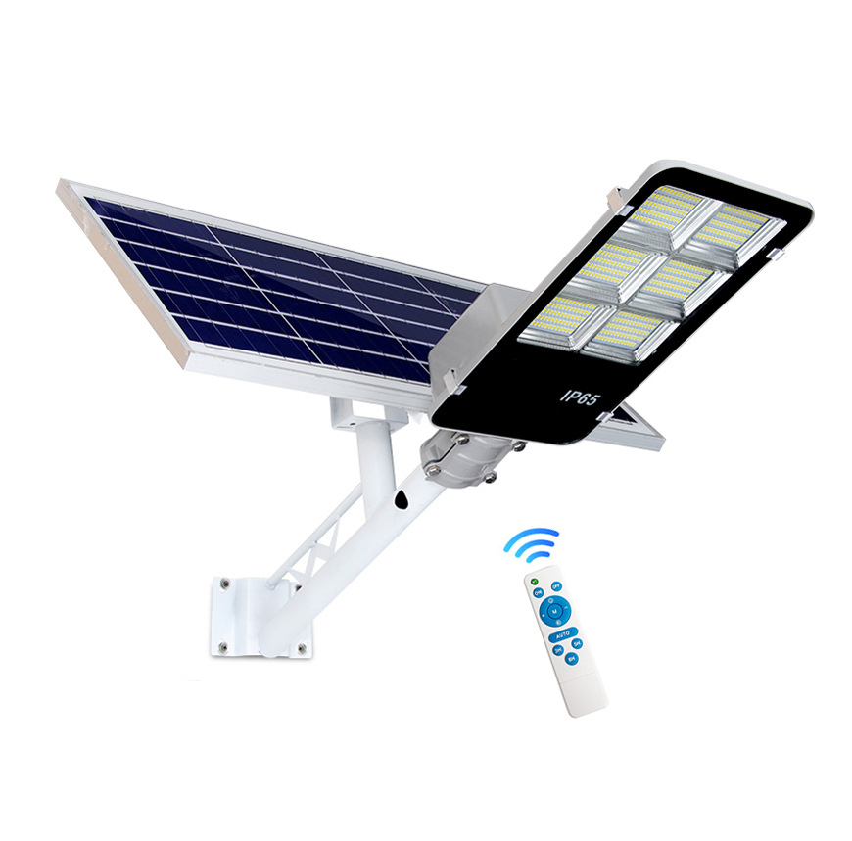
SL03
Input Voltage:AC85-265V
Material: Aluminum die casting
Led Chip:2835SMD Chip Brand:Epistar
IP Rating:IP65 PF>98%
Color Temperature:2700K-7000K
Operating Temperature:-25℃ ~65℃
Life Span:50000hours
CE ROHS LVD EMC certificate approved
Item Number | Wattage | Led Chip | Lamp size | Solar Panel Size | Solar Panel Power | Battery Capacity | Luminous Flux | Bean Angle
SL03 | 50W | 112PCS | 500*250*65mm | Yes | 6V/12W | 3.2V/10AH | 120-130LM/W | 120°
 | 100W | 228PCS | 500*210*75mm |  | 6V/15W | 3.2V/15AH |  | 120°
 | 150W | 200PCS | 500*210*75mm |  | 6V/20W | 3.2V/20AH |  | 120°
 | 200W | 256PCS | 500*210*75mm |  | 6V/20W | 3.2V/25AH |  | 120°
 | 250W | 269PCS | 500*210*75mm |  | 6V/25W | 3.2V/25AH |  | 120°
 | 300W | 360PCS | 500*210*75mm |  | 6V/30W | 3.2V/30AH |  | 120°
Modern Ceiling Light Material:Iron base+ PMMA Cover Input Voltage:AC85-265V Led Chip:2835SMD IP Rating:IP44 CRI>80 PF>0.9 Color Temperature:3000K/4500K/6000K Operating Temperature:-25℃ ~50℃ Life Span:50000hours Certificate:CE ROHS
Item Number | Wattage | LedQuantity | LuminousFlux | Beam Angle | Size (mm) | WIFI Control Remte control Switch control Dimmer control
CL-N00 | 24W | 48pcs2835SMD | 1920-2160lm | 120° | 350mm | Yes
 | 36W | 72pcs2835SMD | 2880-3240lm | 120° | 400mm
 | 40W | 80pcs2835SMD | 3200-3600lm | 120° | 450mm
Modern Ceiling Light Material:Iron base+ PMMA Cover Input Voltage:AC85-265V Led Chip:2835SMD IP Rating:IP44 CRI>80 PF>0.9 Color Temperature:3000K/4500K/6000K Operating Temperature:-25℃ ~50℃ Life Span:50000hours Certificate:CE ROHS
Item Number | Wattage | LedQuantity | LuminousFlux | Beam Angle | Size (mm) | WIFI Control Remte control Switch control Dimmer control
CL-N00 | 24W | 48pcs2835SMD | 1920-2160lm | 120° | 350mm | Yes
 | 36W | 72pcs2835SMD | 2880-3240lm | 120° | 400mm
 | 40W | 80pcs2835SMD | 3200-3600lm | 120° | 450mm
Modern Ceiling Light Material:Iron base+ PMMA Cover Input Voltage:AC85-265V Led Chip:2835SMD IP Rating:IP44 CRI>80 PF>0.9 Color Temperature:3000K/4500K/6000K Operating Temperature:-25℃ ~50℃ Life Span:50000hours Certificate:CE ROHS
Item Number | Wattage | LedQuantity | LuminousFlux | Beam Angle | Size (mm) | WIFI Control Remte control Switch control Dimmer control
CL-N00 | 24W | 48pcs2835SMD | 1920-2160lm | 120° | 350mm | Yes
 | 36W | 72pcs2835SMD | 2880-3240lm | 120° | 400mm
 | 40W | 80pcs2835SMD | 3200-3600lm | 120° | 450mm
Modern Ceiling Light Material:Iron base+ PMMA Cover Input Voltage:AC85-265V Led Chip:2835SMD IP Rating:IP44 CRI>80 PF>0.9 Color Temperature:3000K/4500K/6000K Operating Temperature:-25℃ ~50℃ Life Span:50000hours Certificate:CE ROHS
Item Number | Wattage | LedQuantity | LuminousFlux | Beam Angle | Size (mm) | WIFI Control Remte control Switch control Dimmer control
CL-N00 | 24W | 48pcs2835SMD | 1920-2160lm | 120° | 350mm | Yes
 | 36W | 72pcs2835SMD | 2880-3240lm | 120° | 400mm
 | 40W | 80pcs2835SMD | 3200-3600lm | 120° | 450mm

Slide 4
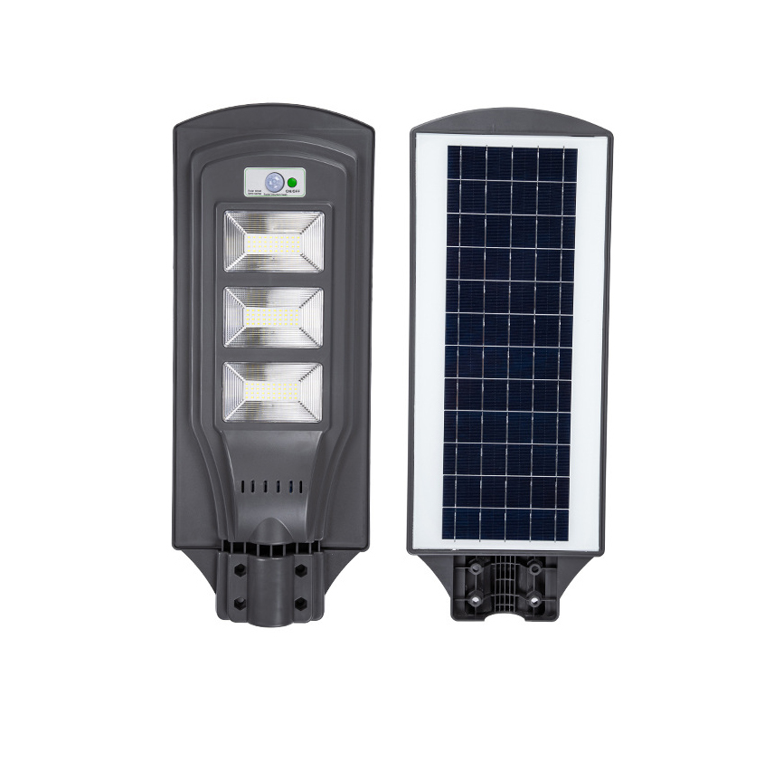
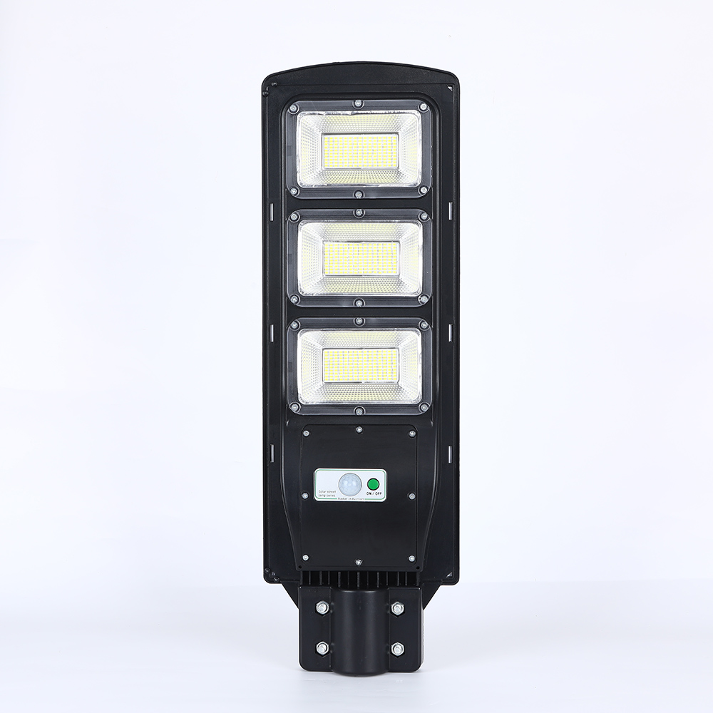
SL04
Input Voltage:AC85-265V
Material: Aluminum
Led Chip:2835SMD Chip Brand:Epistar
IP Rating:IP65 PF>98%
Color Temperature:2700K-7000K
Operating Temperature:-25℃ ~65℃
Life Span:50000hours
CE ROHS LVD EMC certificate approved
Item Number | Wattage | Led Chip | Lamp size | Solar Panel Size | Solar Panel Power | Battery Capacity | Luminous Flux | Bean Angle
SL04 | 60W | 60PCS | 390*194*58mm | 310*170mm | 6V/6W | 3.2V/3.5AH | 120-130LM/W | 120°
 | 120W | 120PCS | 485*218*58mm | 400*180mm | 6V/8W | 3.2V/5AH |  | 120°
 | 180W | 180PCS | 624**230*58mm | 540*180mm | 6V/12W | 3.2V/10AH |  | 120°
 | 240W | 240PCS | 725*240*58mm | 640*185mm | 6V/15W | 3.2V/12AH |  | 120°
Modern Ceiling Light Material:Iron base+ PMMA Cover Input Voltage:AC85-265V Led Chip:2835SMD IP Rating:IP44 CRI>80 PF>0.9 Color Temperature:3000K/4500K/6000K Operating Temperature:-25℃ ~50℃ Life Span:50000hours Certificate:CE ROHS
Item Number | Wattage | LedQuantity | LuminousFlux | Beam Angle | Size (mm) | WIFI Control Remte control Switch control Dimmer control
CL-N00 | 24W | 48pcs2835SMD | 1920-2160lm | 120° | 350mm | Yes
 | 36W | 72pcs2835SMD | 2880-3240lm | 120° | 400mm
 | 40W | 80pcs2835SMD | 3200-3600lm | 120° | 450mm
Modern Ceiling Light Material:Iron base+ PMMA Cover Input Voltage:AC85-265V Led Chip:2835SMD IP Rating:IP44 CRI>80 PF>0.9 Color Temperature:3000K/4500K/6000K Operating Temperature:-25℃ ~50℃ Life Span:50000hours Certificate:CE ROHS
Item Number | Wattage | LedQuantity | LuminousFlux | Beam Angle | Size (mm) | WIFI Control Remte control Switch control Dimmer control
CL-N00 | 24W | 48pcs2835SMD | 1920-2160lm | 120° | 350mm | Yes
 | 36W | 72pcs2835SMD | 2880-3240lm | 120° | 400mm
 | 40W | 80pcs2835SMD | 3200-3600lm | 120° | 450mm
Modern Ceiling Light Material:Iron base+ PMMA Cover Input Voltage:AC85-265V Led Chip:2835SMD IP Rating:IP44 CRI>80 PF>0.9 Color Temperature:3000K/4500K/6000K Operating Temperature:-25℃ ~50℃ Life Span:50000hours Certificate:CE ROHS
Item Number | Wattage | LedQuantity | LuminousFlux | Beam Angle | Size (mm) | WIFI Control Remte control Switch control Dimmer control
CL-N00 | 24W | 48pcs2835SMD | 1920-2160lm | 120° | 350mm | Yes
 | 36W | 72pcs2835SMD | 2880-3240lm | 120° | 400mm
 | 40W | 80pcs2835SMD | 3200-3600lm | 120° | 450mm
Modern Ceiling Light Material:Iron base+ PMMA Cover Input Voltage:AC85-265V Led Chip:2835SMD IP Rating:IP44 CRI>80 PF>0.9 Color Temperature:3000K/4500K/6000K Operating Temperature:-25℃ ~50℃ Life Span:50000hours Certificate:CE ROHS
Item Number | Wattage | LedQuantity | LuminousFlux | Beam Angle | Size (mm) | WIFI Control Remte control Switch control Dimmer control
CL-N00 | 24W | 48pcs2835SMD | 1920-2160lm | 120° | 350mm | Yes
 | 36W | 72pcs2835SMD | 2880-3240lm | 120° | 400mm
 | 40W | 80pcs2835SMD | 3200-3600lm | 120° | 450mm

Slide 5
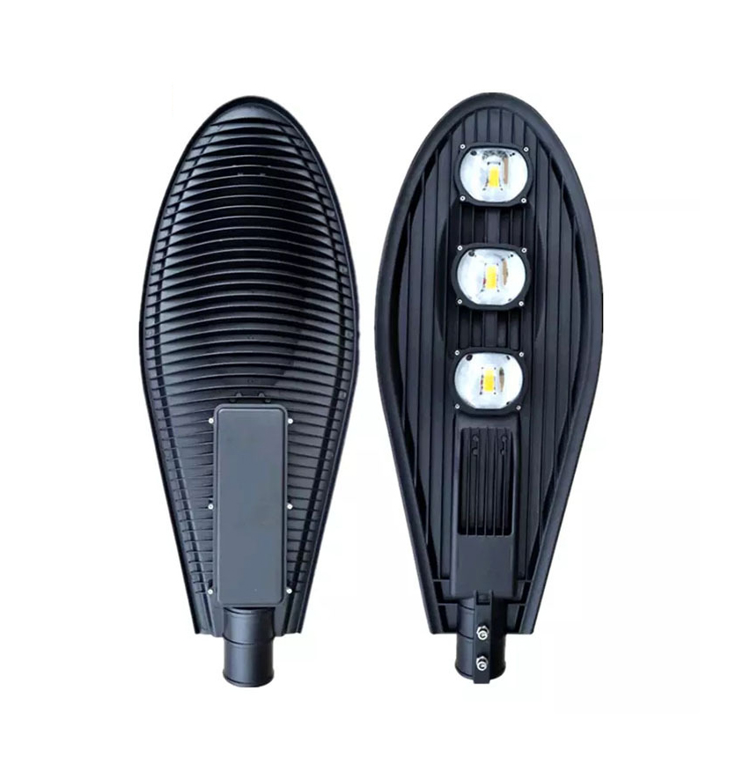
SL05
Input Voltage:AC85-265V
Material: Aluminum die casting
Led Chip:2835SMD Chip Brand:Epistar
IP Rating:IP65 PF>98%
Color Temperature:2700K-7000K
Operating Temperature:-25℃ ~65℃
Life Span:50000hours
CE ROHS LVD EMC certificate approved
Item Number | Wattage | Led Chip | Lamp size | Solar Panel Size | Solar Panel Power | Battery Capacity | Luminous Flux | Bean Angle
SLN05 | 50W | 1*COB | 500*220*80mm | 420*350*17mm | 6V/22W | 3.2V/20AH | 120-130LM/W | 120°
 | 100W | 2*COB | 728*280*100mm | 530*350*17mm | 6V/30W | 3.2V/26AH |  | 120°
 | 150W | 3*COB | 860*315*100mm | 610*350*17mm | 6V/40W | 3.2V/39AH |  | 120°
 | 200W | 4*COB | 955*310*100mm | 630*350*17mm | 6V/50W | 3.2V/40AH |  | 120°
Modern Ceiling Light Material:Iron base+ PMMA Cover Input Voltage:AC85-265V Led Chip:2835SMD IP Rating:IP44 CRI>80 PF>0.9 Color Temperature:3000K/4500K/6000K Operating Temperature:-25℃ ~50℃ Life Span:50000hours Certificate:CE ROHS
Item Number | Wattage | LedQuantity | LuminousFlux | Beam Angle | Size (mm) | WIFI Control Remte control Switch control Dimmer control
CL-N00 | 24W | 48pcs2835SMD | 1920-2160lm | 120° | 350mm | Yes
 | 36W | 72pcs2835SMD | 2880-3240lm | 120° | 400mm
 | 40W | 80pcs2835SMD | 3200-3600lm | 120° | 450mm
Modern Ceiling Light Material:Iron base+ PMMA Cover Input Voltage:AC85-265V Led Chip:2835SMD IP Rating:IP44 CRI>80 PF>0.9 Color Temperature:3000K/4500K/6000K Operating Temperature:-25℃ ~50℃ Life Span:50000hours Certificate:CE ROHS
Item Number | Wattage | LedQuantity | LuminousFlux | Beam Angle | Size (mm) | WIFI Control Remte control Switch control Dimmer control
CL-N00 | 24W | 48pcs2835SMD | 1920-2160lm | 120° | 350mm | Yes
 | 36W | 72pcs2835SMD | 2880-3240lm | 120° | 400mm
 | 40W | 80pcs2835SMD | 3200-3600lm | 120° | 450mm
Modern Ceiling Light Material:Iron base+ PMMA Cover Input Voltage:AC85-265V Led Chip:2835SMD IP Rating:IP44 CRI>80 PF>0.9 Color Temperature:3000K/4500K/6000K Operating Temperature:-25℃ ~50℃ Life Span:50000hours Certificate:CE ROHS
Item Number | Wattage | LedQuantity | LuminousFlux | Beam Angle | Size (mm) | WIFI Control Remte control Switch control Dimmer control
CL-N00 | 24W | 48pcs2835SMD | 1920-2160lm | 120° | 350mm | Yes
 | 36W | 72pcs2835SMD | 2880-3240lm | 120° | 400mm
 | 40W | 80pcs2835SMD | 3200-3600lm | 120° | 450mm
Modern Ceiling Light Material:Iron base+ PMMA Cover Input Voltage:AC85-265V Led Chip:2835SMD IP Rating:IP44 CRI>80 PF>0.9 Color Temperature:3000K/4500K/6000K Operating Temperature:-25℃ ~50℃ Life Span:50000hours Certificate:CE ROHS
Item Number | Wattage | LedQuantity | LuminousFlux | Beam Angle | Size (mm) | WIFI Control Remte control Switch control Dimmer control
CL-N00 | 24W | 48pcs2835SMD | 1920-2160lm | 120° | 350mm | Yes
 | 36W | 72pcs2835SMD | 2880-3240lm | 120° | 400mm
 | 40W | 80pcs2835SMD | 3200-3600lm | 120° | 450mm

Slide 6
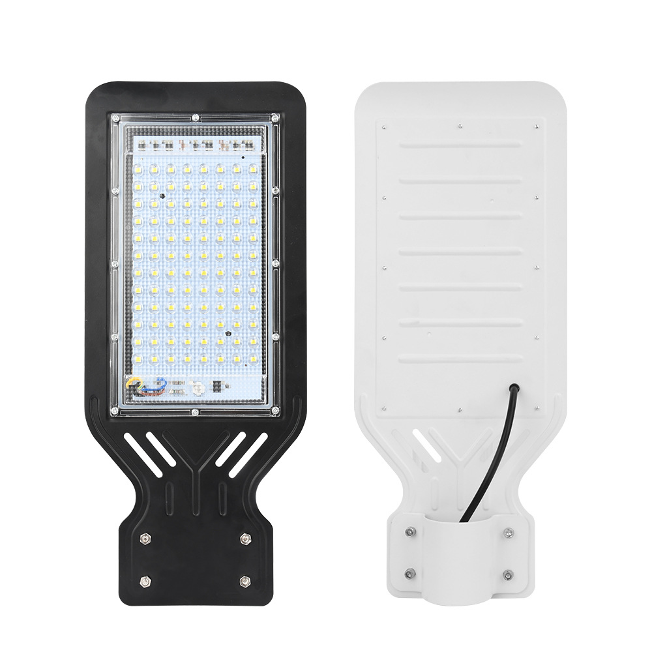
SL06
Input Voltage:AC85-265V
Material: Aluminum
Led Chip:2835SMD Chip Brand:Epistar
IP Rating:IP65 PF>98%
Color Temperature:2700K-7000K
Operating Temperature:-25℃ ~65℃
Life Span:50000hours
CE ROHS LVD EMC certificate approved
Item Number | Wattage | Led Chip | Lamp size | Solar Panel Size | Solar Panel Power | Battery Capacity | Luminous Flux | Bean Angle
SL06 | 50W | 96PCS | 350*156*2mm | Yes | 12W | 12AH | 120-130LM/W | 120°
 | 100W | 140PCS | 260*155*2mm |  | 18W | 18AH |  | 120°
 | 150W | 176PCS | 510*240*2mm |  | 25W | 24AH |  | 120°
 | 200W | 256PCS | 650*280*2mm |  | 30W | 36AH |  | 120°
 | 300W | 362PCS | 720*360*2mm |  | 36W | 48AH |  | 120°
Modern Ceiling Light Material:Iron base+ PMMA Cover Input Voltage:AC85-265V Led Chip:2835SMD IP Rating:IP44 CRI>80 PF>0.9 Color Temperature:3000K/4500K/6000K Operating Temperature:-25℃ ~50℃ Life Span:50000hours Certificate:CE ROHS
Item Number | Wattage | LedQuantity | LuminousFlux | Beam Angle | Size (mm) | WIFI Control Remte control Switch control Dimmer control
CL-N00 | 24W | 48pcs2835SMD | 1920-2160lm | 120° | 350mm | Yes
 | 36W | 72pcs2835SMD | 2880-3240lm | 120° | 400mm
 | 40W | 80pcs2835SMD | 3200-3600lm | 120° | 450mm
Modern Ceiling Light Material:Iron base+ PMMA Cover Input Voltage:AC85-265V Led Chip:2835SMD IP Rating:IP44 CRI>80 PF>0.9 Color Temperature:3000K/4500K/6000K Operating Temperature:-25℃ ~50℃ Life Span:50000hours Certificate:CE ROHS
Item Number | Wattage | LedQuantity | LuminousFlux | Beam Angle | Size (mm) | WIFI Control Remte control Switch control Dimmer control
CL-N00 | 24W | 48pcs2835SMD | 1920-2160lm | 120° | 350mm | Yes
 | 36W | 72pcs2835SMD | 2880-3240lm | 120° | 400mm
 | 40W | 80pcs2835SMD | 3200-3600lm | 120° | 450mm
Modern Ceiling Light Material:Iron base+ PMMA Cover Input Voltage:AC85-265V Led Chip:2835SMD IP Rating:IP44 CRI>80 PF>0.9 Color Temperature:3000K/4500K/6000K Operating Temperature:-25℃ ~50℃ Life Span:50000hours Certificate:CE ROHS
Item Number | Wattage | LedQuantity | LuminousFlux | Beam Angle | Size (mm) | WIFI Control Remte control Switch control Dimmer control
CL-N00 | 24W | 48pcs2835SMD | 1920-2160lm | 120° | 350mm | Yes
 | 36W | 72pcs2835SMD | 2880-3240lm | 120° | 400mm
 | 40W | 80pcs2835SMD | 3200-3600lm | 120° | 450mm
Modern Ceiling Light Material:Iron base+ PMMA Cover Input Voltage:AC85-265V Led Chip:2835SMD IP Rating:IP44 CRI>80 PF>0.9 Color Temperature:3000K/4500K/6000K Operating Temperature:-25℃ ~50℃ Life Span:50000hours Certificate:CE ROHS
Item Number | Wattage | LedQuantity | LuminousFlux | Beam Angle | Size (mm) | WIFI Control Remte control Switch control Dimmer control
CL-N00 | 24W | 48pcs2835SMD | 1920-2160lm | 120° | 350mm | Yes
 | 36W | 72pcs2835SMD | 2880-3240lm | 120° | 400mm
 | 40W | 80pcs2835SMD | 3200-3600lm | 120° | 450mm

Slide 7
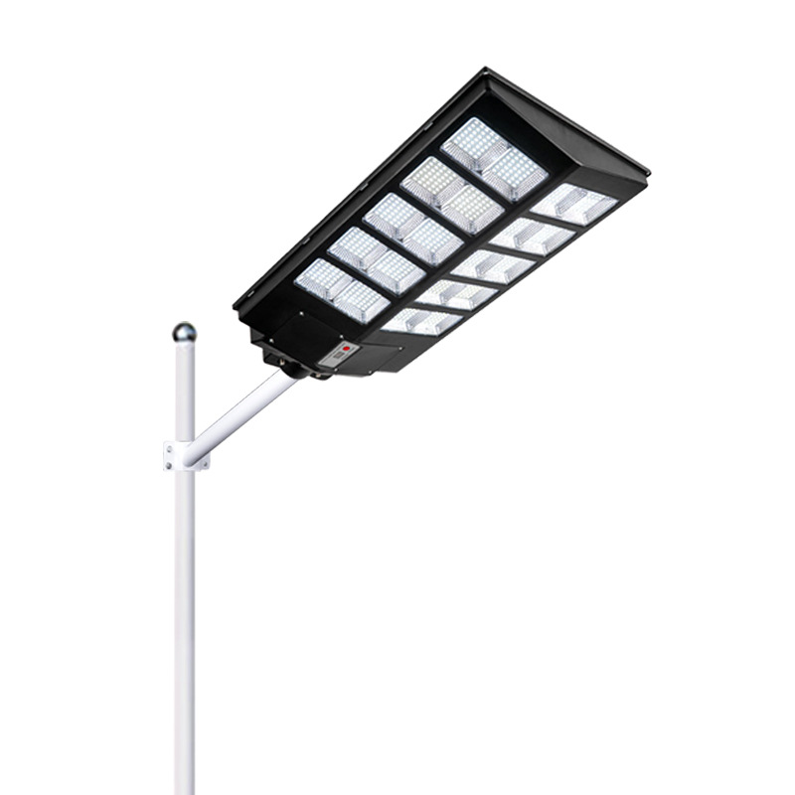
SL07
Input Voltage:AC85-265V
Material: Aluminum die casting
Led Chip:2835SMD Chip Brand:Epistar
IP Rating:IP65 PF>98%
Color Temperature:2700K-7000K
Operating Temperature:-25℃ ~65℃
Life Span:50000hours
CE ROHS LVD EMC certificate approved
Item Number | Wattage | Led Chip | Lamp size | Solar Panel Size | Solar Panel Power | Battery Capacity | Luminous Flux | Bean Angle
SL07 | 100W | 240PCS | 260*155*2mm | Yes | 10W | 8AH | 120-130LM/W | 270°
 | 200W | 360PCS | 392*210*2mm |  | 12W | 12AH
 | 300W | 480PCS | 448*340*2mm |  | 16W | 18AH
 | 400W | 640PCS | 484*260*2mm |  | 18W | 24AH
 | 500W | 800PCS | 510*240*2mm |  | 25W | 30AH
Modern Ceiling Light Material:Iron base+ PMMA Cover Input Voltage:AC85-265V Led Chip:2835SMD IP Rating:IP44 CRI>80 PF>0.9 Color Temperature:3000K/4500K/6000K Operating Temperature:-25℃ ~50℃ Life Span:50000hours Certificate:CE ROHS
Item Number | Wattage | LedQuantity | LuminousFlux | Beam Angle | Size (mm) | WIFI Control Remte control Switch control Dimmer control
CL-N00 | 24W | 48pcs2835SMD | 1920-2160lm | 120° | 350mm | Yes
 | 36W | 72pcs2835SMD | 2880-3240lm | 120° | 400mm
 | 40W | 80pcs2835SMD | 3200-3600lm | 120° | 450mm
Modern Ceiling Light Material:Iron base+ PMMA Cover Input Voltage:AC85-265V Led Chip:2835SMD IP Rating:IP44 CRI>80 PF>0.9 Color Temperature:3000K/4500K/6000K Operating Temperature:-25℃ ~50℃ Life Span:50000hours Certificate:CE ROHS
Item Number | Wattage | LedQuantity | LuminousFlux | Beam Angle | Size (mm) | WIFI Control Remte control Switch control Dimmer control
CL-N00 | 24W | 48pcs2835SMD | 1920-2160lm | 120° | 350mm | Yes
 | 36W | 72pcs2835SMD | 2880-3240lm | 120° | 400mm
 | 40W | 80pcs2835SMD | 3200-3600lm | 120° | 450mm
Modern Ceiling Light Material:Iron base+ PMMA Cover Input Voltage:AC85-265V Led Chip:2835SMD IP Rating:IP44 CRI>80 PF>0.9 Color Temperature:3000K/4500K/6000K Operating Temperature:-25℃ ~50℃ Life Span:50000hours Certificate:CE ROHS
Item Number | Wattage | LedQuantity | LuminousFlux | Beam Angle | Size (mm) | WIFI Control Remte control Switch control Dimmer control
CL-N00 | 24W | 48pcs2835SMD | 1920-2160lm | 120° | 350mm | Yes
 | 36W | 72pcs2835SMD | 2880-3240lm | 120° | 400mm
 | 40W | 80pcs2835SMD | 3200-3600lm | 120° | 450mm
Modern Ceiling Light Material:Iron base+ PMMA Cover Input Voltage:AC85-265V Led Chip:2835SMD IP Rating:IP44 CRI>80 PF>0.9 Color Temperature:3000K/4500K/6000K Operating Temperature:-25℃ ~50℃ Life Span:50000hours Certificate:CE ROHS
Item Number | Wattage | LedQuantity | LuminousFlux | Beam Angle | Size (mm) | WIFI Control Remte control Switch control Dimmer control
CL-N00 | 24W | 48pcs2835SMD | 1920-2160lm | 120° | 350mm | Yes
 | 36W | 72pcs2835SMD | 2880-3240lm | 120° | 400mm
 | 40W | 80pcs2835SMD | 3200-3600lm | 120° | 450mm

Slide 8
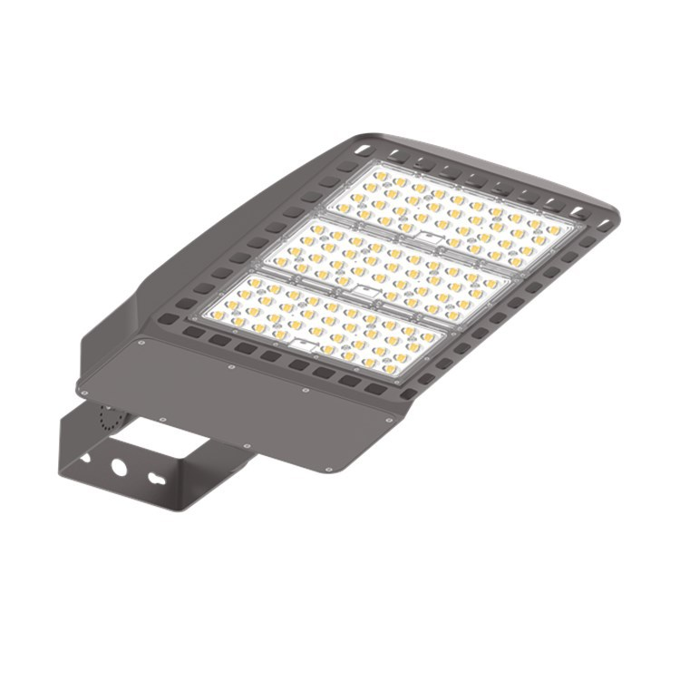
SL08
Input Voltage:AC85-265V
Material: Aluminum
Led Chip:2835SMD Chip Brand:Epistar
IP Rating:IP65 PF>98%
Color Temperature:2700K-7000K
Operating Temperature:-25℃ ~65℃
Life Span:50000hours
CE ROHS LVD EMC certificate approved
Item Number | Wattage | Led Chip | Lamp size | Solar Panel Size | Solar Panel Power | Battery Capacity | Luminous Flux | Bean Angle
SL08 | 100W | 108PCS | 550*320*80mm | Yes | Wire | >80 | 120-130LM/W | 270°
 | 150W | 192PCS | 550*320*80mm
 | 200W | 216PCS | 550*320*80mm
 | 300W | 324PCS | 550*320*80mm
Modern Ceiling Light Material:Iron base+ PMMA Cover Input Voltage:AC85-265V Led Chip:2835SMD IP Rating:IP44 CRI>80 PF>0.9 Color Temperature:3000K/4500K/6000K Operating Temperature:-25℃ ~50℃ Life Span:50000hours Certificate:CE ROHS
Item Number | Wattage | LedQuantity | LuminousFlux | Beam Angle | Size (mm) | WIFI Control Remte control Switch control Dimmer control
CL-N00 | 24W | 48pcs2835SMD | 1920-2160lm | 120° | 350mm | Yes
 | 36W | 72pcs2835SMD | 2880-3240lm | 120° | 400mm
 | 40W | 80pcs2835SMD | 3200-3600lm | 120° | 450mm
Modern Ceiling Light Material:Iron base+ PMMA Cover Input Voltage:AC85-265V Led Chip:2835SMD IP Rating:IP44 CRI>80 PF>0.9 Color Temperature:3000K/4500K/6000K Operating Temperature:-25℃ ~50℃ Life Span:50000hours Certificate:CE ROHS
Item Number | Wattage | LedQuantity | LuminousFlux | Beam Angle | Size (mm) | WIFI Control Remte control Switch control Dimmer control
CL-N00 | 24W | 48pcs2835SMD | 1920-2160lm | 120° | 350mm | Yes
 | 36W | 72pcs2835SMD | 2880-3240lm | 120° | 400mm
 | 40W | 80pcs2835SMD | 3200-3600lm | 120° | 450mm
Modern Ceiling Light Material:Iron base+ PMMA Cover Input Voltage:AC85-265V Led Chip:2835SMD IP Rating:IP44 CRI>80 PF>0.9 Color Temperature:3000K/4500K/6000K Operating Temperature:-25℃ ~50℃ Life Span:50000hours Certificate:CE ROHS
Item Number | Wattage | LedQuantity | LuminousFlux | Beam Angle | Size (mm) | WIFI Control Remte control Switch control Dimmer control
CL-N00 | 24W | 48pcs2835SMD | 1920-2160lm | 120° | 350mm | Yes
 | 36W | 72pcs2835SMD | 2880-3240lm | 120° | 400mm
 | 40W | 80pcs2835SMD | 3200-3600lm | 120° | 450mm
Modern Ceiling Light Material:Iron base+ PMMA Cover Input Voltage:AC85-265V Led Chip:2835SMD IP Rating:IP44 CRI>80 PF>0.9 Color Temperature:3000K/4500K/6000K Operating Temperature:-25℃ ~50℃ Life Span:50000hours Certificate:CE ROHS
Item Number | Wattage | LedQuantity | LuminousFlux | Beam Angle | Size (mm) | WIFI Control Remte control Switch control Dimmer control
CL-N00 | 24W | 48pcs2835SMD | 1920-2160lm | 120° | 350mm | Yes
 | 36W | 72pcs2835SMD | 2880-3240lm | 120° | 400mm
 | 40W | 80pcs2835SMD | 3200-3600lm | 120° | 450mm

Slide 9
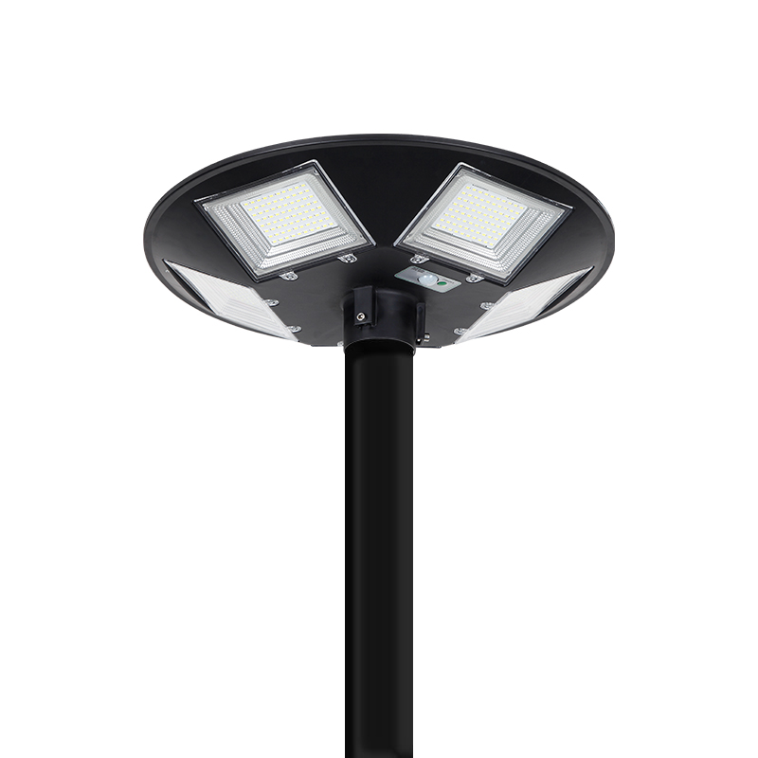
SL09
Input Voltage:AC85-265V
Material: Aluminum
Led Chip:5730SMD Chip Brand:Epistar
IP Rating:IP65 PF>98%
Color Temperature:2700K-7000K
Operating Temperature:-25℃ ~65℃
Life Span:50000hours
CE ROHS LVD EMC certificate approved
Item Number | Wattage | LedQuantity | Battery | Beam Angle | Size (mm)
SL09 | 20W | 48PCS* 3030SMD | LiFePO4 battery 32AH | 120° | 900*385*43mm
 | 30W | 72PCS* 3030SMD | LiFePO4 battery 65AH | 120° | 1060*385*43mm
 | 40W | 96PCS* 3030SMD | LiFePO4 battery 78AH | 120° | 1210*385*43mm
 | 50W | 120PCS* 3030SMD | LiFePO4 battery 91AH | 120° | 1390*385*43mm
 | 80W | 192PCS* 3030SMD | LiFePO4 battery 156AH | 120° | 1805*385*60mm
Modern Ceiling Light Material:Iron base+ PMMA Cover Input Voltage:AC85-265V Led Chip:2835SMD IP Rating:IP44 CRI>80 PF>0.9 Color Temperature:3000K/4500K/6000K Operating Temperature:-25℃ ~50℃ Life Span:50000hours Certificate:CE ROHS
Item Number | Wattage | LedQuantity | LuminousFlux | Beam Angle | Size (mm) | WIFI Control Remte control Switch control Dimmer control
CL-N00 | 24W | 48pcs2835SMD | 1920-2160lm | 120° | 350mm | Yes
 | 36W | 72pcs2835SMD | 2880-3240lm | 120° | 400mm
 | 40W | 80pcs2835SMD | 3200-3600lm | 120° | 450mm
Modern Ceiling Light Material:Iron base+ PMMA Cover Input Voltage:AC85-265V Led Chip:2835SMD IP Rating:IP44 CRI>80 PF>0.9 Color Temperature:3000K/4500K/6000K Operating Temperature:-25℃ ~50℃ Life Span:50000hours Certificate:CE ROHS
Item Number | Wattage | LedQuantity | LuminousFlux | Beam Angle | Size (mm) | WIFI Control Remte control Switch control Dimmer control
CL-N00 | 24W | 48pcs2835SMD | 1920-2160lm | 120° | 350mm | Yes
 | 36W | 72pcs2835SMD | 2880-3240lm | 120° | 400mm
 | 40W | 80pcs2835SMD | 3200-3600lm | 120° | 450mm
Modern Ceiling Light Material:Iron base+ PMMA Cover Input Voltage:AC85-265V Led Chip:2835SMD IP Rating:IP44 CRI>80 PF>0.9 Color Temperature:3000K/4500K/6000K Operating Temperature:-25℃ ~50℃ Life Span:50000hours Certificate:CE ROHS
Item Number | Wattage | LedQuantity | LuminousFlux | Beam Angle | Size (mm) | WIFI Control Remte control Switch control Dimmer control
CL-N00 | 24W | 48pcs2835SMD | 1920-2160lm | 120° | 350mm | Yes
 | 36W | 72pcs2835SMD | 2880-3240lm | 120° | 400mm
 | 40W | 80pcs2835SMD | 3200-3600lm | 120° | 450mm
Modern Ceiling Light Material:Iron base+ PMMA Cover Input Voltage:AC85-265V Led Chip:2835SMD IP Rating:IP44 CRI>80 PF>0.9 Color Temperature:3000K/4500K/6000K Operating Temperature:-25℃ ~50℃ Life Span:50000hours Certificate:CE ROHS
Item Number | Wattage | LedQuantity | LuminousFlux | Beam Angle | Size (mm) | WIFI Control Remte control Switch control Dimmer control
CL-N00 | 24W | 48pcs2835SMD | 1920-2160lm | 120° | 350mm | Yes
 | 36W | 72pcs2835SMD | 2880-3240lm | 120° | 400mm
 | 40W | 80pcs2835SMD | 3200-3600lm | 120° | 450mm

Slide 10
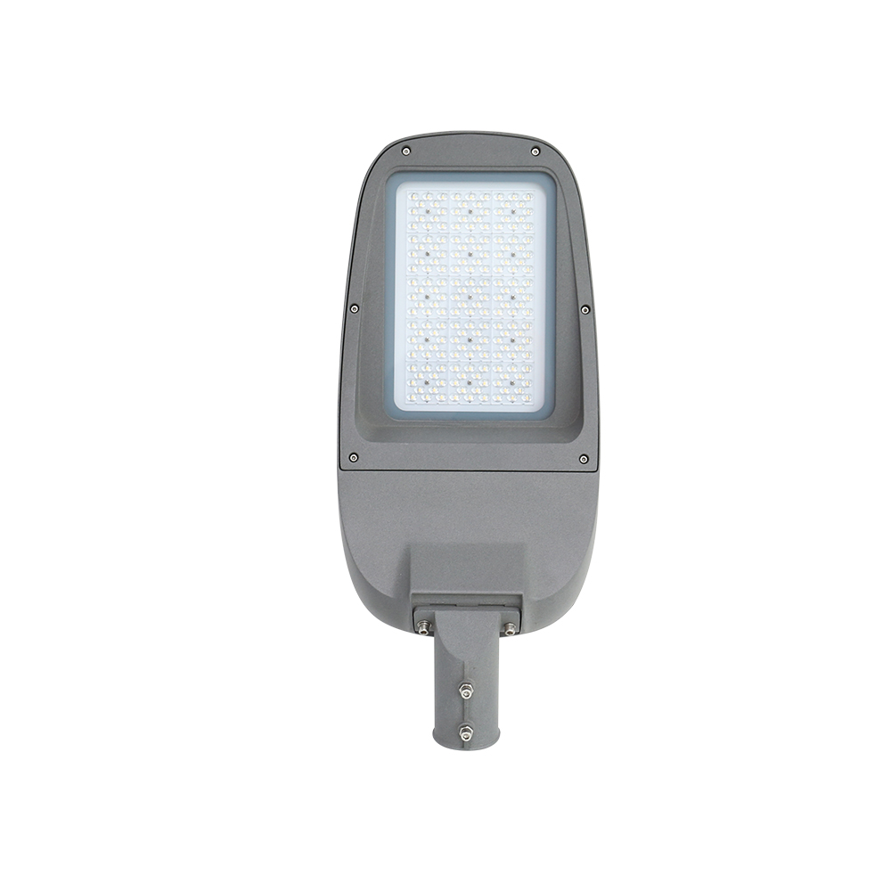
SL10
Input Voltage:AC85-265V
Material: Aluminum alloy
Led Chip:3030SMD Chip Brand:Epistar
IP Rating:IP65 PF>98%
Color Temperature:2700K-7000K
Operating Temperature:-25℃ ~65℃
Life Span:50000hours
CE ROHS LVD EMC certificate approved
Item Number | Wattage | LedQuantity | Battery | Beam Angle | Size (mm)
SL10 | 50W | Polysilicon 4.5V 4.5W | LiFePO4 battery 32AH | 120° | 300*210*60
 | 100W | Polysilicon 4.5V 7W | LiFePO4 battery 65AH | 120° | 395*205*60
 | 150W | Polysilicon 4.5V 9W | LiFePO4 battery 78AH | 120° | 500*235*80
 | 200W | Polysilicon 4.5V 12.5W | LiFePO4 battery 91AH | 120° | 635*255*70
 | 250W | Polysilicon 4.5V 16W | LiFePO4 battery 104AH | 120° | 740*255*70
 | 300W | Polysilicon 4.5V 18W | LiFePO4 battery 130AH | 120° | 820*245*75
Modern Ceiling Light Material:Iron base+ PMMA Cover Input Voltage:AC85-265V Led Chip:2835SMD IP Rating:IP44 CRI>80 PF>0.9 Color Temperature:3000K/4500K/6000K Operating Temperature:-25℃ ~50℃ Life Span:50000hours Certificate:CE ROHS
Item Number | Wattage | LedQuantity | LuminousFlux | Beam Angle | Size (mm) | WIFI Control Remte control Switch control Dimmer control
CL-N00 | 24W | 48pcs2835SMD | 1920-2160lm | 120° | 350mm | Yes
 | 36W | 72pcs2835SMD | 2880-3240lm | 120° | 400mm
 | 40W | 80pcs2835SMD | 3200-3600lm | 120° | 450mm
Modern Ceiling Light Material:Iron base+ PMMA Cover Input Voltage:AC85-265V Led Chip:2835SMD IP Rating:IP44 CRI>80 PF>0.9 Color Temperature:3000K/4500K/6000K Operating Temperature:-25℃ ~50℃ Life Span:50000hours Certificate:CE ROHS
Item Number | Wattage | LedQuantity | LuminousFlux | Beam Angle | Size (mm) | WIFI Control Remte control Switch control Dimmer control
CL-N00 | 24W | 48pcs2835SMD | 1920-2160lm | 120° | 350mm | Yes
 | 36W | 72pcs2835SMD | 2880-3240lm | 120° | 400mm
 | 40W | 80pcs2835SMD | 3200-3600lm | 120° | 450mm
Modern Ceiling Light Material:Iron base+ PMMA Cover Input Voltage:AC85-265V Led Chip:2835SMD IP Rating:IP44 CRI>80 PF>0.9 Color Temperature:3000K/4500K/6000K Operating Temperature:-25℃ ~50℃ Life Span:50000hours Certificate:CE ROHS
Item Number | Wattage | LedQuantity | LuminousFlux | Beam Angle | Size (mm) | WIFI Control Remte control Switch control Dimmer control
CL-N00 | 24W | 48pcs2835SMD | 1920-2160lm | 120° | 350mm | Yes
 | 36W | 72pcs2835SMD | 2880-3240lm | 120° | 400mm
 | 40W | 80pcs2835SMD | 3200-3600lm | 120° | 450mm
Modern Ceiling Light Material:Iron base+ PMMA Cover Input Voltage:AC85-265V Led Chip:2835SMD IP Rating:IP44 CRI>80 PF>0.9 Color Temperature:3000K/4500K/6000K Operating Temperature:-25℃ ~50℃ Life Span:50000hours Certificate:CE ROHS
Item Number | Wattage | LedQuantity | LuminousFlux | Beam Angle | Size (mm) | WIFI Control Remte control Switch control Dimmer control
CL-N00 | 24W | 48pcs2835SMD | 1920-2160lm | 120° | 350mm | Yes
 | 36W | 72pcs2835SMD | 2880-3240lm | 120° | 400mm
 | 40W | 80pcs2835SMD | 3200-3600lm | 120° | 450mm

Slide 11
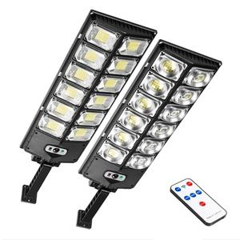
SL11
Input Voltage:AC85-265V
Material: Aluminum
Led Chip:5730SMD Chip Brand:Epistar
IP Rating:IP65 PF>98%
Color Temperature:2700K-7000K
Operating Temperature:-25℃ ~65℃
Life Span:50000hours
CE ROHS LVD EMC certificate approved
Item Number | Wattage | LedQuantity | Battery | Beam Angle | Size (mm)
SL11 | 20W | 48PCS* 3030SMD | LiFePO4 battery 32AH | 120° | 900*385*43mm
 | 30W | 72PCS* 3030SMD | LiFePO4 battery 65AH | 120° | 1060*385*43mm
 | 40W | 96PCS* 3030SMD | LiFePO4 battery 78AH | 120° | 1210*385*43mm
 | 50W | 120PCS* 3030SMD | LiFePO4 battery 91AH | 120° | 1390*385*43mm
 | 80W | 192PCS* 3030SMD | LiFePO4 battery 156AH | 120° | 1805*385*60mm
Modern Ceiling Light Material:Iron base+ PMMA Cover Input Voltage:AC85-265V Led Chip:2835SMD IP Rating:IP44 CRI>80 PF>0.9 Color Temperature:3000K/4500K/6000K Operating Temperature:-25℃ ~50℃ Life Span:50000hours Certificate:CE ROHS
Item Number | Wattage | LedQuantity | LuminousFlux | Beam Angle | Size (mm) | WIFI Control Remte control Switch control Dimmer control
CL-N00 | 24W | 48pcs2835SMD | 1920-2160lm | 120° | 350mm | Yes
 | 36W | 72pcs2835SMD | 2880-3240lm | 120° | 400mm
 | 40W | 80pcs2835SMD | 3200-3600lm | 120° | 450mm
Modern Ceiling Light Material:Iron base+ PMMA Cover Input Voltage:AC85-265V Led Chip:2835SMD IP Rating:IP44 CRI>80 PF>0.9 Color Temperature:3000K/4500K/6000K Operating Temperature:-25℃ ~50℃ Life Span:50000hours Certificate:CE ROHS
Item Number | Wattage | LedQuantity | LuminousFlux | Beam Angle | Size (mm) | WIFI Control Remte control Switch control Dimmer control
CL-N00 | 24W | 48pcs2835SMD | 1920-2160lm | 120° | 350mm | Yes
 | 36W | 72pcs2835SMD | 2880-3240lm | 120° | 400mm
 | 40W | 80pcs2835SMD | 3200-3600lm | 120° | 450mm
Modern Ceiling Light Material:Iron base+ PMMA Cover Input Voltage:AC85-265V Led Chip:2835SMD IP Rating:IP44 CRI>80 PF>0.9 Color Temperature:3000K/4500K/6000K Operating Temperature:-25℃ ~50℃ Life Span:50000hours Certificate:CE ROHS
Item Number | Wattage | LedQuantity | LuminousFlux | Beam Angle | Size (mm) | WIFI Control Remte control Switch control Dimmer control
CL-N00 | 24W | 48pcs2835SMD | 1920-2160lm | 120° | 350mm | Yes
 | 36W | 72pcs2835SMD | 2880-3240lm | 120° | 400mm
 | 40W | 80pcs2835SMD | 3200-3600lm | 120° | 450mm
Modern Ceiling Light Material:Iron base+ PMMA Cover Input Voltage:AC85-265V Led Chip:2835SMD IP Rating:IP44 CRI>80 PF>0.9 Color Temperature:3000K/4500K/6000K Operating Temperature:-25℃ ~50℃ Life Span:50000hours Certificate:CE ROHS
Item Number | Wattage | LedQuantity | LuminousFlux | Beam Angle | Size (mm) | WIFI Control Remte control Switch control Dimmer control
CL-N00 | 24W | 48pcs2835SMD | 1920-2160lm | 120° | 350mm | Yes
 | 36W | 72pcs2835SMD | 2880-3240lm | 120° | 400mm
 | 40W | 80pcs2835SMD | 3200-3600lm | 120° | 450mm

Slide 12
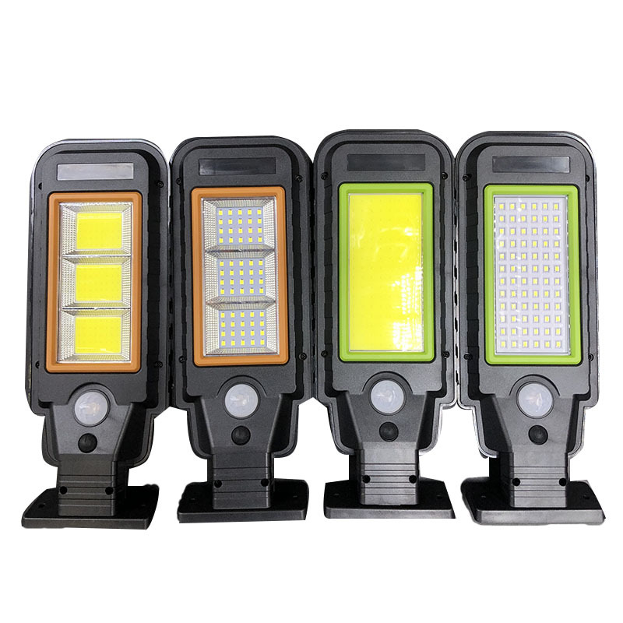
SLN01
Input Voltage:AC85-265V
Material: Aluminum
Led Chip:2835SMD Chip Brand:Epistar
IP Rating:IP65 PF>98%
Color Temperature:2700K-7000K
Operating Temperature:-25℃ ~65℃
Life Span:50000hours
CE ROHS LVD EMC certificate approved
Item Number | LedQuantity | Modes | Induction distance: | Beam Angle | Size (mm)
SLN01 | 60Led | Sensor on/off | 4-6M | 120° | 176*102*31
 | 72Led |  |  | 120° | 176*102*31
 | 120COB |  |  | 120° | 176*102*31
 | 128COB |  |  | 120° | 176*102*31
 | 192COB |  |  | 120° | 176*102*31
 | 256COB |  |  | 120° | 176*102*31
Modern Ceiling Light Material:Iron base+ PMMA Cover Input Voltage:AC85-265V Led Chip:2835SMD IP Rating:IP44 CRI>80 PF>0.9 Color Temperature:3000K/4500K/6000K Operating Temperature:-25℃ ~50℃ Life Span:50000hours Certificate:CE ROHS
Item Number | Wattage | LedQuantity | LuminousFlux | Beam Angle | Size (mm) | WIFI Control Remte control Switch control Dimmer control
CL-N00 | 24W | 48pcs2835SMD | 1920-2160lm | 120° | 350mm | Yes
 | 36W | 72pcs2835SMD | 2880-3240lm | 120° | 400mm
 | 40W | 80pcs2835SMD | 3200-3600lm | 120° | 450mm
Modern Ceiling Light Material:Iron base+ PMMA Cover Input Voltage:AC85-265V Led Chip:2835SMD IP Rating:IP44 CRI>80 PF>0.9 Color Temperature:3000K/4500K/6000K Operating Temperature:-25℃ ~50℃ Life Span:50000hours Certificate:CE ROHS
Item Number | Wattage | LedQuantity | LuminousFlux | Beam Angle | Size (mm) | WIFI Control Remte control Switch control Dimmer control
CL-N00 | 24W | 48pcs2835SMD | 1920-2160lm | 120° | 350mm | Yes
 | 36W | 72pcs2835SMD | 2880-3240lm | 120° | 400mm
 | 40W | 80pcs2835SMD | 3200-3600lm | 120° | 450mm
Modern Ceiling Light Material:Iron base+ PMMA Cover Input Voltage:AC85-265V Led Chip:2835SMD IP Rating:IP44 CRI>80 PF>0.9 Color Temperature:3000K/4500K/6000K Operating Temperature:-25℃ ~50℃ Life Span:50000hours Certificate:CE ROHS
Item Number | Wattage | LedQuantity | LuminousFlux | Beam Angle | Size (mm) | WIFI Control Remte control Switch control Dimmer control
CL-N00 | 24W | 48pcs2835SMD | 1920-2160lm | 120° | 350mm | Yes
 | 36W | 72pcs2835SMD | 2880-3240lm | 120° | 400mm
 | 40W | 80pcs2835SMD | 3200-3600lm | 120° | 450mm
Modern Ceiling Light Material:Iron base+ PMMA Cover Input Voltage:AC85-265V Led Chip:2835SMD IP Rating:IP44 CRI>80 PF>0.9 Color Temperature:3000K/4500K/6000K Operating Temperature:-25℃ ~50℃ Life Span:50000hours Certificate:CE ROHS
Item Number | Wattage | LedQuantity | LuminousFlux | Beam Angle | Size (mm) | WIFI Control Remte control Switch control Dimmer control
CL-N00 | 24W | 48pcs2835SMD | 1920-2160lm | 120° | 350mm | Yes
 | 36W | 72pcs2835SMD | 2880-3240lm | 120° | 400mm
 | 40W | 80pcs2835SMD | 3200-3600lm | 120° | 450mm

Slide 13
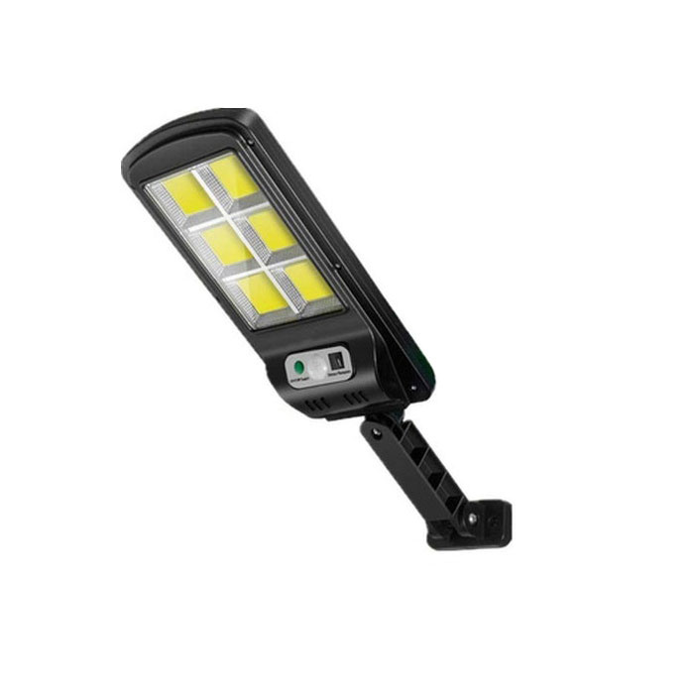
SLN02
Input Voltage:AC85-265V
Material: ABS
Led Chip:3030SMD Chip Brand:Epistar
IP Rating:IP65 PF>98%
Color Temperature:2700K-7000K
Operating Temperature:-25℃ ~65℃
Life Span:50000hours
CE ROHS LVD EMC certificate approved
Item Number | LedQuantity | Modes | Induction distance: | Beam Angle | Size (mm)
SLN02 | 100COB | 18650*1 1500mAh | Daylight Control + Remote Control | 120° | 395*102*45
 | 108COB |  |  | 120° | 395*102*45
 | 128COB |  |  | 120° | 395*102*45
 | 120COB |  |  | 120° | 395*102*45
 | 160COB |  |  | 120° | 395*102*45
 | 120COB |  |  | 120° | 395*102*45
Modern Ceiling Light Material:Iron base+ PMMA Cover Input Voltage:AC85-265V Led Chip:2835SMD IP Rating:IP44 CRI>80 PF>0.9 Color Temperature:3000K/4500K/6000K Operating Temperature:-25℃ ~50℃ Life Span:50000hours Certificate:CE ROHS
Item Number | Wattage | LedQuantity | LuminousFlux | Beam Angle | Size (mm) | WIFI Control Remte control Switch control Dimmer control
CL-N00 | 24W | 48pcs2835SMD | 1920-2160lm | 120° | 350mm | Yes
 | 36W | 72pcs2835SMD | 2880-3240lm | 120° | 400mm
 | 40W | 80pcs2835SMD | 3200-3600lm | 120° | 450mm
Modern Ceiling Light Material:Iron base+ PMMA Cover Input Voltage:AC85-265V Led Chip:2835SMD IP Rating:IP44 CRI>80 PF>0.9 Color Temperature:3000K/4500K/6000K Operating Temperature:-25℃ ~50℃ Life Span:50000hours Certificate:CE ROHS
Item Number | Wattage | LedQuantity | LuminousFlux | Beam Angle | Size (mm) | WIFI Control Remte control Switch control Dimmer control
CL-N00 | 24W | 48pcs2835SMD | 1920-2160lm | 120° | 350mm | Yes
 | 36W | 72pcs2835SMD | 2880-3240lm | 120° | 400mm
 | 40W | 80pcs2835SMD | 3200-3600lm | 120° | 450mm
Modern Ceiling Light Material:Iron base+ PMMA Cover Input Voltage:AC85-265V Led Chip:2835SMD IP Rating:IP44 CRI>80 PF>0.9 Color Temperature:3000K/4500K/6000K Operating Temperature:-25℃ ~50℃ Life Span:50000hours Certificate:CE ROHS
Item Number | Wattage | LedQuantity | LuminousFlux | Beam Angle | Size (mm) | WIFI Control Remte control Switch control Dimmer control
CL-N00 | 24W | 48pcs2835SMD | 1920-2160lm | 120° | 350mm | Yes
 | 36W | 72pcs2835SMD | 2880-3240lm | 120° | 400mm
 | 40W | 80pcs2835SMD | 3200-3600lm | 120° | 450mm
Modern Ceiling Light Material:Iron base+ PMMA Cover Input Voltage:AC85-265V Led Chip:2835SMD IP Rating:IP44 CRI>80 PF>0.9 Color Temperature:3000K/4500K/6000K Operating Temperature:-25℃ ~50℃ Life Span:50000hours Certificate:CE ROHS
Item Number | Wattage | LedQuantity | LuminousFlux | Beam Angle | Size (mm) | WIFI Control Remte control Switch control Dimmer control
CL-N00 | 24W | 48pcs2835SMD | 1920-2160lm | 120° | 350mm | Yes
 | 36W | 72pcs2835SMD | 2880-3240lm | 120° | 400mm
 | 40W | 80pcs2835SMD | 3200-3600lm | 120° | 450mm

Slide 14
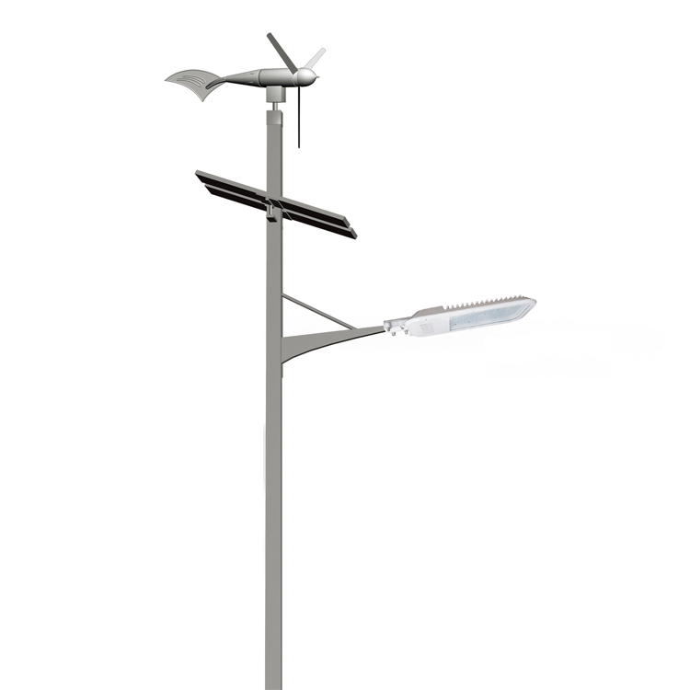
SLN03
Input Voltage:AC85-265V
Material: Aluminum
Led Chip:5730SMD Chip Brand:Epistar
IP Rating:IP65 PF>98%
Color Temperature:RGBW
Operating Temperature:-25℃ ~65℃
Life Span:50000hours
CE ROHS LVD EMC certificate approved
Item Number | LedQuantity | Modes | Induction distance: | Beam Angle | Size (mm)
SLN03 | 30W | 60pcs5730SMD | 20Ah~250Ah | 120° | 3m~15m
 | 40W | 80pcs5730SMD |  | 120°
 | 50W | 100pcs5730SMD |  | 120°
 | 60W | 120pcs5730SMD |  | 120°
 | 70W | 140pcs5730SMD |  | 120°
 | 80W | 160pcs5730SMD |  | 120°
 | 90W | 180pcs5730SMD |  | 120°
 | 100W | 200pcs5730SMD |  | 120°
 | 120W | 240pcs5730SMD |  | 120°
Modern Ceiling Light Material:Iron base+ PMMA Cover Input Voltage:AC85-265V Led Chip:2835SMD IP Rating:IP44 CRI>80 PF>0.9 Color Temperature:3000K/4500K/6000K Operating Temperature:-25℃ ~50℃ Life Span:50000hours Certificate:CE ROHS
Item Number | Wattage | LedQuantity | LuminousFlux | Beam Angle | Size (mm) | WIFI Control Remte control Switch control Dimmer control
CL-N00 | 24W | 48pcs2835SMD | 1920-2160lm | 120° | 350mm | Yes
 | 36W | 72pcs2835SMD | 2880-3240lm | 120° | 400mm
 | 40W | 80pcs2835SMD | 3200-3600lm | 120° | 450mm
Modern Ceiling Light Material:Iron base+ PMMA Cover Input Voltage:AC85-265V Led Chip:2835SMD IP Rating:IP44 CRI>80 PF>0.9 Color Temperature:3000K/4500K/6000K Operating Temperature:-25℃ ~50℃ Life Span:50000hours Certificate:CE ROHS
Item Number | Wattage | LedQuantity | LuminousFlux | Beam Angle | Size (mm) | WIFI Control Remte control Switch control Dimmer control
CL-N00 | 24W | 48pcs2835SMD | 1920-2160lm | 120° | 350mm | Yes
 | 36W | 72pcs2835SMD | 2880-3240lm | 120° | 400mm
 | 40W | 80pcs2835SMD | 3200-3600lm | 120° | 450mm
Modern Ceiling Light Material:Iron base+ PMMA Cover Input Voltage:AC85-265V Led Chip:2835SMD IP Rating:IP44 CRI>80 PF>0.9 Color Temperature:3000K/4500K/6000K Operating Temperature:-25℃ ~50℃ Life Span:50000hours Certificate:CE ROHS
Item Number | Wattage | LedQuantity | LuminousFlux | Beam Angle | Size (mm) | WIFI Control Remte control Switch control Dimmer control
CL-N00 | 24W | 48pcs2835SMD | 1920-2160lm | 120° | 350mm | Yes
 | 36W | 72pcs2835SMD | 2880-3240lm | 120° | 400mm
 | 40W | 80pcs2835SMD | 3200-3600lm | 120° | 450mm
Modern Ceiling Light Material:Iron base+ PMMA Cover Input Voltage:AC85-265V Led Chip:2835SMD IP Rating:IP44 CRI>80 PF>0.9 Color Temperature:3000K/4500K/6000K Operating Temperature:-25℃ ~50℃ Life Span:50000hours Certificate:CE ROHS
Item Number | Wattage | LedQuantity | LuminousFlux | Beam Angle | Size (mm) | WIFI Control Remte control Switch control Dimmer control
CL-N00 | 24W | 48pcs2835SMD | 1920-2160lm | 120° | 350mm | Yes
 | 36W | 72pcs2835SMD | 2880-3240lm | 120° | 400mm
 | 40W | 80pcs2835SMD | 3200-3600lm | 120° | 450mm

Slide 15
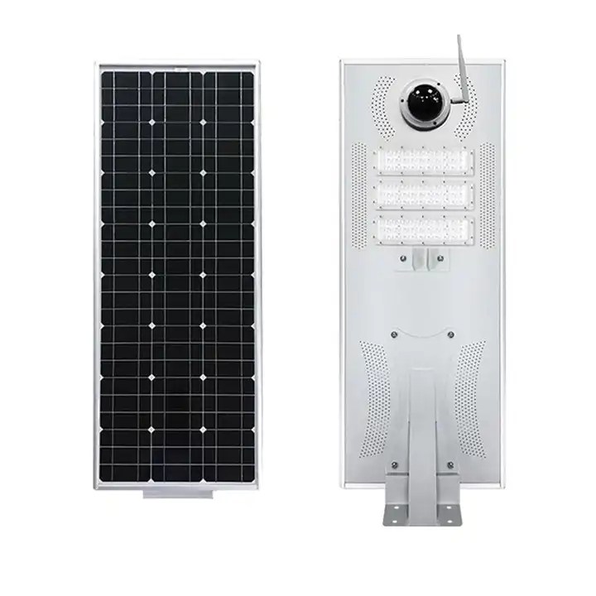
SLN05
Solar panel:18v 70w
Battery:LiFePO4 lithium battery 12.8v 60ah
Light source:60w 3030 LED
Product warranty:3 years
Lumen(lm):150-160lm/w
PIR motion sensor:Enabled
Charging time:6-7 hours(with enough strong sunshine)
Working time:3-5 rainy days(12 hours per day)
Item Number | LedQuantity | Top diameter for pole | Working temperature | Product size | Net weight
SLN05 | 60W | 76-105mm | ~-30℃~+70℃ | 930*320*135mm | 8.7kg
Modern Ceiling Light Material:Iron base+ PMMA Cover Input Voltage:AC85-265V Led Chip:2835SMD IP Rating:IP44 CRI>80 PF>0.9 Color Temperature:3000K/4500K/6000K Operating Temperature:-25℃ ~50℃ Life Span:50000hours Certificate:CE ROHS
Item Number | Wattage | LedQuantity | LuminousFlux | Beam Angle | Size (mm) | WIFI Control Remte control Switch control Dimmer control
CL-N00 | 24W | 48pcs2835SMD | 1920-2160lm | 120° | 350mm | Yes
 | 36W | 72pcs2835SMD | 2880-3240lm | 120° | 400mm
 | 40W | 80pcs2835SMD | 3200-3600lm | 120° | 450mm
Modern Ceiling Light Material:Iron base+ PMMA Cover Input Voltage:AC85-265V Led Chip:2835SMD IP Rating:IP44 CRI>80 PF>0.9 Color Temperature:3000K/4500K/6000K Operating Temperature:-25℃ ~50℃ Life Span:50000hours Certificate:CE ROHS
Item Number | Wattage | LedQuantity | LuminousFlux | Beam Angle | Size (mm) | WIFI Control Remte control Switch control Dimmer control
CL-N00 | 24W | 48pcs2835SMD | 1920-2160lm | 120° | 350mm | Yes
 | 36W | 72pcs2835SMD | 2880-3240lm | 120° | 400mm
 | 40W | 80pcs2835SMD | 3200-3600lm | 120° | 450mm
Modern Ceiling Light Material:Iron base+ PMMA Cover Input Voltage:AC85-265V Led Chip:2835SMD IP Rating:IP44 CRI>80 PF>0.9 Color Temperature:3000K/4500K/6000K Operating Temperature:-25℃ ~50℃ Life Span:50000hours Certificate:CE ROHS
Item Number | Wattage | LedQuantity | LuminousFlux | Beam Angle | Size (mm) | WIFI Control Remte control Switch control Dimmer control
CL-N00 | 24W | 48pcs2835SMD | 1920-2160lm | 120° | 350mm | Yes
 | 36W | 72pcs2835SMD | 2880-3240lm | 120° | 400mm
 | 40W | 80pcs2835SMD | 3200-3600lm | 120° | 450mm
Modern Ceiling Light Material:Iron base+ PMMA Cover Input Voltage:AC85-265V Led Chip:2835SMD IP Rating:IP44 CRI>80 PF>0.9 Color Temperature:3000K/4500K/6000K Operating Temperature:-25℃ ~50℃ Life Span:50000hours Certificate:CE ROHS
Item Number | Wattage | LedQuantity | LuminousFlux | Beam Angle | Size (mm) | WIFI Control Remte control Switch control Dimmer control
CL-N00 | 24W | 48pcs2835SMD | 1920-2160lm | 120° | 350mm | Yes
 | 36W | 72pcs2835SMD | 2880-3240lm | 120° | 400mm
 | 40W | 80pcs2835SMD | 3200-3600lm | 120° | 450mm

Slide 16
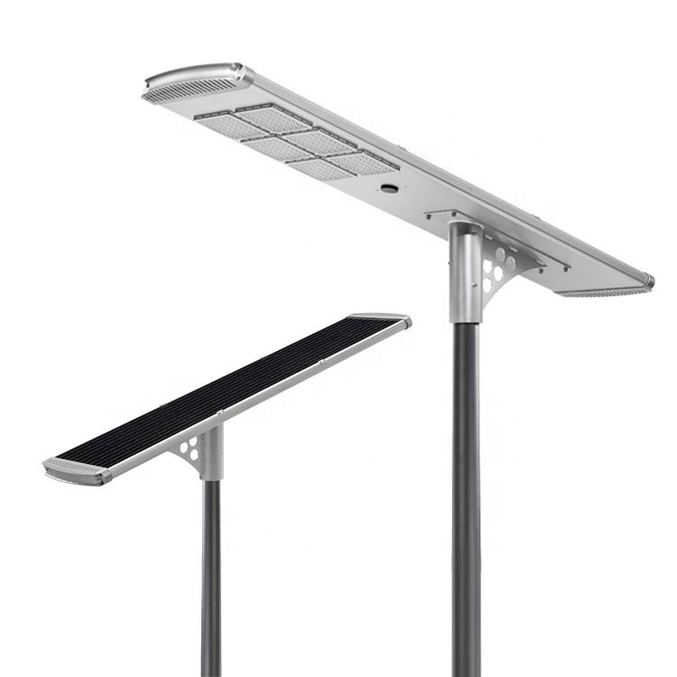
SLN07
Input Voltage:AC85-265V
Material: Aluminum alloy
Led Chip:3030SMD Chip Brand:Epistar
IP Rating:IP65 PF>98%
Color Temperature:2700K-7000K
Operating Temperature:-25℃ ~65℃
Life Span:50000hours
CE ROHS LVD EMC certificate approved
Item Number | LedQuantity | Modes | Induction distance: | Beam Angle | Size (mm)
SLN07 | 30W | 72PCS* 3030SMD | 100LM/W | 120° | 385*180*820
 | 40W | 96PCS* 3030SMD |  | 120° | 385*180*960
 | 50W | 120PCS* 3030SMD |  | 120° | 385*180*1190
 | 60W | 144PCS* 3030SMD |  | 120° | 385*180*1190
 | 80W | 192PCS* 3030SMD |  | 120° | 385*1630*55
 | 100W | 240PCS* 3030SMD |  | 120° | 385*1950*55
Modern Ceiling Light Material:Iron base+ PMMA Cover Input Voltage:AC85-265V Led Chip:2835SMD IP Rating:IP44 CRI>80 PF>0.9 Color Temperature:3000K/4500K/6000K Operating Temperature:-25℃ ~50℃ Life Span:50000hours Certificate:CE ROHS
Item Number | Wattage | LedQuantity | LuminousFlux | Beam Angle | Size (mm) | WIFI Control Remte control Switch control Dimmer control
CL-N00 | 24W | 48pcs2835SMD | 1920-2160lm | 120° | 350mm | Yes
 | 36W | 72pcs2835SMD | 2880-3240lm | 120° | 400mm
 | 40W | 80pcs2835SMD | 3200-3600lm | 120° | 450mm
Modern Ceiling Light Material:Iron base+ PMMA Cover Input Voltage:AC85-265V Led Chip:2835SMD IP Rating:IP44 CRI>80 PF>0.9 Color Temperature:3000K/4500K/6000K Operating Temperature:-25℃ ~50℃ Life Span:50000hours Certificate:CE ROHS
Item Number | Wattage | LedQuantity | LuminousFlux | Beam Angle | Size (mm) | WIFI Control Remte control Switch control Dimmer control
CL-N00 | 24W | 48pcs2835SMD | 1920-2160lm | 120° | 350mm | Yes
 | 36W | 72pcs2835SMD | 2880-3240lm | 120° | 400mm
 | 40W | 80pcs2835SMD | 3200-3600lm | 120° | 450mm
Modern Ceiling Light Material:Iron base+ PMMA Cover Input Voltage:AC85-265V Led Chip:2835SMD IP Rating:IP44 CRI>80 PF>0.9 Color Temperature:3000K/4500K/6000K Operating Temperature:-25℃ ~50℃ Life Span:50000hours Certificate:CE ROHS
Item Number | Wattage | LedQuantity | LuminousFlux | Beam Angle | Size (mm) | WIFI Control Remte control Switch control Dimmer control
CL-N00 | 24W | 48pcs2835SMD | 1920-2160lm | 120° | 350mm | Yes
 | 36W | 72pcs2835SMD | 2880-3240lm | 120° | 400mm
 | 40W | 80pcs2835SMD | 3200-3600lm | 120° | 450mm
Modern Ceiling Light Material:Iron base+ PMMA Cover Input Voltage:AC85-265V Led Chip:2835SMD IP Rating:IP44 CRI>80 PF>0.9 Color Temperature:3000K/4500K/6000K Operating Temperature:-25℃ ~50℃ Life Span:50000hours Certificate:CE ROHS
Item Number | Wattage | LedQuantity | LuminousFlux | Beam Angle | Size (mm) | WIFI Control Remte control Switch control Dimmer control
CL-N00 | 24W | 48pcs2835SMD | 1920-2160lm | 120° | 350mm | Yes
 | 36W | 72pcs2835SMD | 2880-3240lm | 120° | 400mm
 | 40W | 80pcs2835SMD | 3200-3600lm | 120° | 450mm

Slide 17
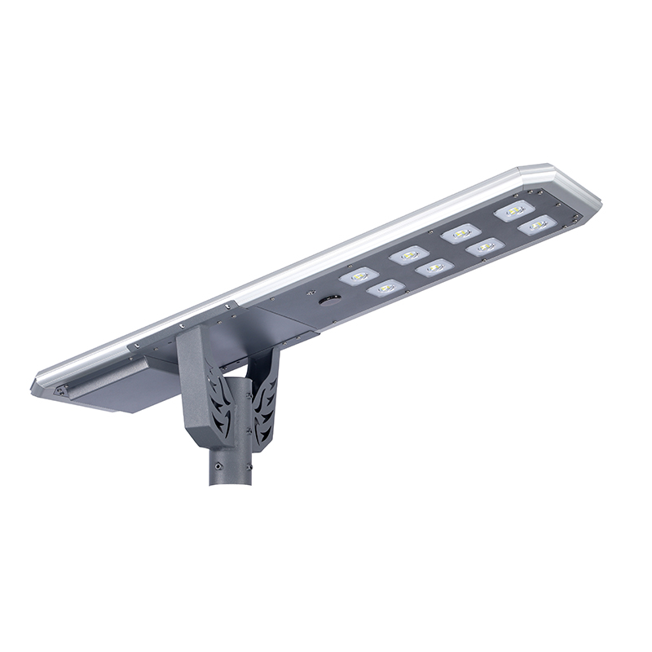
SLN08
Input Voltage:AC85-265V
Material: Aluminum alloy
Led Chip:3030SMD Chip Brand:Epistar
IP Rating:IP65 PF>98%
Color Temperature:2700K-7000K
Operating Temperature:-25℃ ~65℃
Life Span:50000hours
CE ROHS LVD EMC certificate approved
Item Number | Wattage | LedQuantity | Battery | Beam Angle | Size (mm)
SLN08 | 20W | 48PCS* 3030SMD | LiFePO4 battery 32AH | 120° | 900*385*43mm
 | 30W | 72PCS* 3030SMD | LiFePO4 battery 65AH | 120° | 1060*385*43mm
 | 40W | 96PCS* 3030SMD | LiFePO4 battery 78AH | 120° | 1210*385*43mm
 | 50W | 120PCS* 3030SMD | LiFePO4 battery 91AH | 120° | 1390*385*43mm
 | 60W | 144PCS* 3030SMD | LiFePO4 battery 104AH | 120° | 1535*385*43mm
 | 70W | 168PCS* 3030SMD | LiFePO4 battery 130AH | 120° | 1690*385*43mm
 | 80W | 192PCS* 3030SMD | LiFePO4 battery 156AH | 120° | 1805*385*60mm
Modern Ceiling Light Material:Iron base+ PMMA Cover Input Voltage:AC85-265V Led Chip:2835SMD IP Rating:IP44 CRI>80 PF>0.9 Color Temperature:3000K/4500K/6000K Operating Temperature:-25℃ ~50℃ Life Span:50000hours Certificate:CE ROHS
Item Number | Wattage | LedQuantity | LuminousFlux | Beam Angle | Size (mm) | WIFI Control Remte control Switch control Dimmer control
CL-N00 | 24W | 48pcs2835SMD | 1920-2160lm | 120° | 350mm | Yes
 | 36W | 72pcs2835SMD | 2880-3240lm | 120° | 400mm
 | 40W | 80pcs2835SMD | 3200-3600lm | 120° | 450mm
Modern Ceiling Light Material:Iron base+ PMMA Cover Input Voltage:AC85-265V Led Chip:2835SMD IP Rating:IP44 CRI>80 PF>0.9 Color Temperature:3000K/4500K/6000K Operating Temperature:-25℃ ~50℃ Life Span:50000hours Certificate:CE ROHS
Item Number | Wattage | LedQuantity | LuminousFlux | Beam Angle | Size (mm) | WIFI Control Remte control Switch control Dimmer control
CL-N00 | 24W | 48pcs2835SMD | 1920-2160lm | 120° | 350mm | Yes
 | 36W | 72pcs2835SMD | 2880-3240lm | 120° | 400mm
 | 40W | 80pcs2835SMD | 3200-3600lm | 120° | 450mm
Modern Ceiling Light Material:Iron base+ PMMA Cover Input Voltage:AC85-265V Led Chip:2835SMD IP Rating:IP44 CRI>80 PF>0.9 Color Temperature:3000K/4500K/6000K Operating Temperature:-25℃ ~50℃ Life Span:50000hours Certificate:CE ROHS
Item Number | Wattage | LedQuantity | LuminousFlux | Beam Angle | Size (mm) | WIFI Control Remte control Switch control Dimmer control
CL-N00 | 24W | 48pcs2835SMD | 1920-2160lm | 120° | 350mm | Yes
 | 36W | 72pcs2835SMD | 2880-3240lm | 120° | 400mm
 | 40W | 80pcs2835SMD | 3200-3600lm | 120° | 450mm
Modern Ceiling Light Material:Iron base+ PMMA Cover Input Voltage:AC85-265V Led Chip:2835SMD IP Rating:IP44 CRI>80 PF>0.9 Color Temperature:3000K/4500K/6000K Operating Temperature:-25℃ ~50℃ Life Span:50000hours Certificate:CE ROHS
Item Number | Wattage | LedQuantity | LuminousFlux | Beam Angle | Size (mm) | WIFI Control Remte control Switch control Dimmer control
CL-N00 | 24W | 48pcs2835SMD | 1920-2160lm | 120° | 350mm | Yes
 | 36W | 72pcs2835SMD | 2880-3240lm | 120° | 400mm
 | 40W | 80pcs2835SMD | 3200-3600lm | 120° | 450mm

Slide 18
SLN09
Input Voltage:AC85-265V
Material: Aluminum
Led Chip:5730SMD Chip Brand:Epistar
IP Rating:IP65 PF>98%
Color Temperature:2700K-7000K
Operating Temperature:-25℃ ~65℃
Life Span:50000hours
CE ROHS LVD EMC certificate approved
Item Number | Wattage | LedQuantity | Battery | Beam Angle | Size (mm)
SLN09 | 20W | 48PCS* 3030SMD | LiFePO4 battery 32AH | 120° | 900*385*43mm
 | 30W | 72PCS* 3030SMD | LiFePO4 battery 65AH | 120° | 1060*385*43mm
 | 40W | 96PCS* 3030SMD | LiFePO4 battery 78AH | 120° | 1210*385*43mm
 | 50W | 120PCS* 3030SMD | LiFePO4 battery 91AH | 120° | 1390*385*43mm
 | 80W | 192PCS* 3030SMD | LiFePO4 battery 156AH | 120° | 1805*385*60mm
Modern Ceiling Light Material:Iron base+ PMMA Cover Input Voltage:AC85-265V Led Chip:2835SMD IP Rating:IP44 CRI>80 PF>0.9 Color Temperature:3000K/4500K/6000K Operating Temperature:-25℃ ~50℃ Life Span:50000hours Certificate:CE ROHS
Item Number | Wattage | LedQuantity | LuminousFlux | Beam Angle | Size (mm) | WIFI Control Remte control Switch control Dimmer control
CL-N00 | 24W | 48pcs2835SMD | 1920-2160lm | 120° | 350mm | Yes
 | 36W | 72pcs2835SMD | 2880-3240lm | 120° | 400mm
 | 40W | 80pcs2835SMD | 3200-3600lm | 120° | 450mm
Modern Ceiling Light Material:Iron base+ PMMA Cover Input Voltage:AC85-265V Led Chip:2835SMD IP Rating:IP44 CRI>80 PF>0.9 Color Temperature:3000K/4500K/6000K Operating Temperature:-25℃ ~50℃ Life Span:50000hours Certificate:CE ROHS
Item Number | Wattage | LedQuantity | LuminousFlux | Beam Angle | Size (mm) | WIFI Control Remte control Switch control Dimmer control
CL-N00 | 24W | 48pcs2835SMD | 1920-2160lm | 120° | 350mm | Yes
 | 36W | 72pcs2835SMD | 2880-3240lm | 120° | 400mm
 | 40W | 80pcs2835SMD | 3200-3600lm | 120° | 450mm
Modern Ceiling Light Material:Iron base+ PMMA Cover Input Voltage:AC85-265V Led Chip:2835SMD IP Rating:IP44 CRI>80 PF>0.9 Color Temperature:3000K/4500K/6000K Operating Temperature:-25℃ ~50℃ Life Span:50000hours Certificate:CE ROHS
Item Number | Wattage | LedQuantity | LuminousFlux | Beam Angle | Size (mm) | WIFI Control Remte control Switch control Dimmer control
CL-N00 | 24W | 48pcs2835SMD | 1920-2160lm | 120° | 350mm | Yes
 | 36W | 72pcs2835SMD | 2880-3240lm | 120° | 400mm
 | 40W | 80pcs2835SMD | 3200-3600lm | 120° | 450mm
Modern Ceiling Light Material:Iron base+ PMMA Cover Input Voltage:AC85-265V Led Chip:2835SMD IP Rating:IP44 CRI>80 PF>0.9 Color Temperature:3000K/4500K/6000K Operating Temperature:-25℃ ~50℃ Life Span:50000hours Certificate:CE ROHS
Item Number | Wattage | LedQuantity | LuminousFlux | Beam Angle | Size (mm) | WIFI Control Remte control Switch control Dimmer control
CL-N00 | 24W | 48pcs2835SMD | 1920-2160lm | 120° | 350mm | Yes
 | 36W | 72pcs2835SMD | 2880-3240lm | 120° | 400mm
 | 40W | 80pcs2835SMD | 3200-3600lm | 120° | 450mm

Slide 19
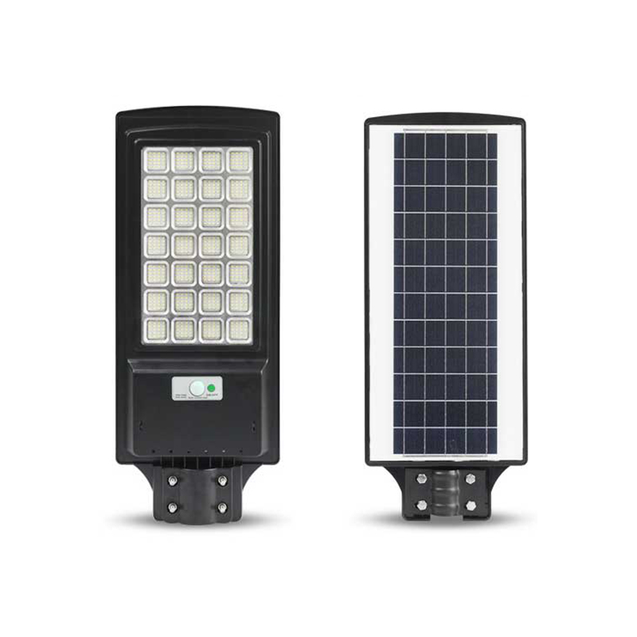
SLN10
Input Voltage:AC85-265V
Material: Aluminum alloy
Led Chip:3030SMD Chip Brand:Epistar
IP Rating:IP65 PF>98%
Color Temperature:2700K-7000K
Operating Temperature:-25℃ ~65℃
Life Span:50000hours
CE ROHS LVD EMC certificate approved
Item Number | Wattage | LedQuantity | Battery | Beam Angle | Size (mm)
SLN10 | 50W | Polysilicon 4.5V 4.5W | LiFePO4 battery 32AH | 120° | 300*210*60
 | 100W | Polysilicon 4.5V 7W | LiFePO4 battery 65AH | 120° | 395*205*60
 | 150W | Polysilicon 4.5V 9W | LiFePO4 battery 78AH | 120° | 500*235*80
 | 200W | Polysilicon 4.5V 12.5W | LiFePO4 battery 91AH | 120° | 635*255*70
 | 250W | Polysilicon 4.5V 16W | LiFePO4 battery 104AH | 120° | 740*255*70
 | 300W | Polysilicon 4.5V 18W | LiFePO4 battery 130AH | 120° | 820*245*75
Modern Ceiling Light Material:Iron base+ PMMA Cover Input Voltage:AC85-265V Led Chip:2835SMD IP Rating:IP44 CRI>80 PF>0.9 Color Temperature:3000K/4500K/6000K Operating Temperature:-25℃ ~50℃ Life Span:50000hours Certificate:CE ROHS
Item Number | Wattage | LedQuantity | LuminousFlux | Beam Angle | Size (mm) | WIFI Control Remte control Switch control Dimmer control
CL-N00 | 24W | 48pcs2835SMD | 1920-2160lm | 120° | 350mm | Yes
 | 36W | 72pcs2835SMD | 2880-3240lm | 120° | 400mm
 | 40W | 80pcs2835SMD | 3200-3600lm | 120° | 450mm
Modern Ceiling Light Material:Iron base+ PMMA Cover Input Voltage:AC85-265V Led Chip:2835SMD IP Rating:IP44 CRI>80 PF>0.9 Color Temperature:3000K/4500K/6000K Operating Temperature:-25℃ ~50℃ Life Span:50000hours Certificate:CE ROHS
Item Number | Wattage | LedQuantity | LuminousFlux | Beam Angle | Size (mm) | WIFI Control Remte control Switch control Dimmer control
CL-N00 | 24W | 48pcs2835SMD | 1920-2160lm | 120° | 350mm | Yes
 | 36W | 72pcs2835SMD | 2880-3240lm | 120° | 400mm
 | 40W | 80pcs2835SMD | 3200-3600lm | 120° | 450mm
Modern Ceiling Light Material:Iron base+ PMMA Cover Input Voltage:AC85-265V Led Chip:2835SMD IP Rating:IP44 CRI>80 PF>0.9 Color Temperature:3000K/4500K/6000K Operating Temperature:-25℃ ~50℃ Life Span:50000hours Certificate:CE ROHS
Item Number | Wattage | LedQuantity | LuminousFlux | Beam Angle | Size (mm) | WIFI Control Remte control Switch control Dimmer control
CL-N00 | 24W | 48pcs2835SMD | 1920-2160lm | 120° | 350mm | Yes
 | 36W | 72pcs2835SMD | 2880-3240lm | 120° | 400mm
 | 40W | 80pcs2835SMD | 3200-3600lm | 120° | 450mm
Modern Ceiling Light Material:Iron base+ PMMA Cover Input Voltage:AC85-265V Led Chip:2835SMD IP Rating:IP44 CRI>80 PF>0.9 Color Temperature:3000K/4500K/6000K Operating Temperature:-25℃ ~50℃ Life Span:50000hours Certificate:CE ROHS
Item Number | Wattage | LedQuantity | LuminousFlux | Beam Angle | Size (mm) | WIFI Control Remte control Switch control Dimmer control
CL-N00 | 24W | 48pcs2835SMD | 1920-2160lm | 120° | 350mm | Yes
 | 36W | 72pcs2835SMD | 2880-3240lm | 120° | 400mm
 | 40W | 80pcs2835SMD | 3200-3600lm | 120° | 450mm

