Slide 1
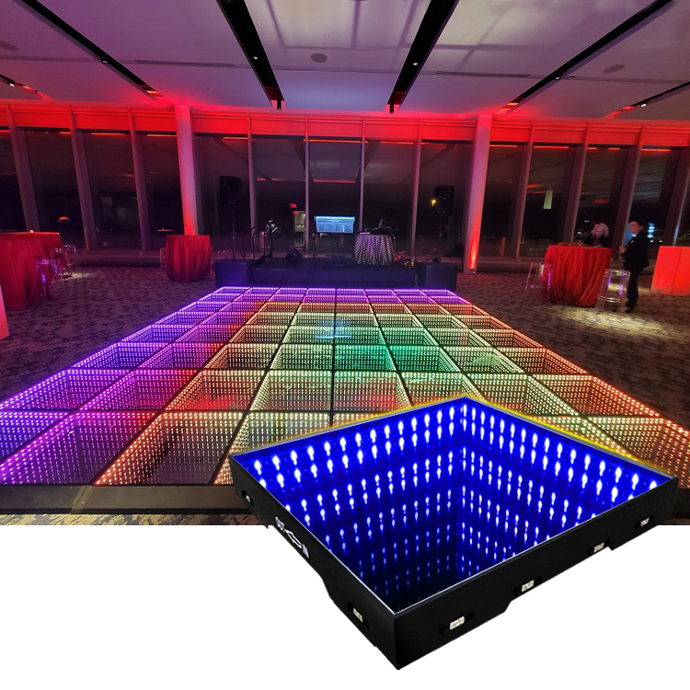
DJL01
Wireless Magnet 3D Mirror Led Dance Floor
Input Voltage: 90-240VAC, 50/60 hz
Output Voltage: DC12V
Product Size: 500*500*70mm
Power: 15 w
Led QTY: 60 pcs 5050smd
Color: RGB 3IN1
Life Span: ≥100000 hours
Surface Board: 12mm tempered glass
Packing size:560*560*130mm
Load-bearing: 500kg/pc
NW/GW: 11KG/12KG
Item Number | Wattage | Lamp Source | Control mode | Lamp Luminous Efficiency(lm/w) | Size（mm） | Wattage
DJL01 | 20W | SMD5050 RGB 64PCS | Easy Remote to change pixel effect, starlit effect, solid color effect. | 150 | 500*500*70/ 500*500*60 | 20W
Modern Ceiling Light Material:Iron base+ PMMA Cover Input Voltage:AC85-265V Led Chip:2835SMD IP Rating:IP44 CRI>80 PF>0.9 Color Temperature:3000K/4500K/6000K Operating Temperature:-25℃ ~50℃ Life Span:50000hours Certificate:CE ROHS
Item Number | Wattage | LedQuantity | LuminousFlux | Beam Angle | Size (mm) | WIFI Control Remte control Switch control Dimmer control
CL-N00 | 24W | 48pcs2835SMD | 1920-2160lm | 120° | 350mm | Yes
 | 36W | 72pcs2835SMD | 2880-3240lm | 120° | 400mm
 | 40W | 80pcs2835SMD | 3200-3600lm | 120° | 450mm
Modern Ceiling Light Material:Iron base+ PMMA Cover Input Voltage:AC85-265V Led Chip:2835SMD IP Rating:IP44 CRI>80 PF>0.9 Color Temperature:3000K/4500K/6000K Operating Temperature:-25℃ ~50℃ Life Span:50000hours Certificate:CE ROHS
Item Number | Wattage | LedQuantity | LuminousFlux | Beam Angle | Size (mm) | WIFI Control Remte control Switch control Dimmer control
CL-N00 | 24W | 48pcs2835SMD | 1920-2160lm | 120° | 350mm | Yes
 | 36W | 72pcs2835SMD | 2880-3240lm | 120° | 400mm
 | 40W | 80pcs2835SMD | 3200-3600lm | 120° | 450mm
Modern Ceiling Light Material:Iron base+ PMMA Cover Input Voltage:AC85-265V Led Chip:2835SMD IP Rating:IP44 CRI>80 PF>0.9 Color Temperature:3000K/4500K/6000K Operating Temperature:-25℃ ~50℃ Life Span:50000hours Certificate:CE ROHS
Item Number | Wattage | LedQuantity | LuminousFlux | Beam Angle | Size (mm) | WIFI Control Remte control Switch control Dimmer control
CL-N00 | 24W | 48pcs2835SMD | 1920-2160lm | 120° | 350mm | Yes
 | 36W | 72pcs2835SMD | 2880-3240lm | 120° | 400mm
 | 40W | 80pcs2835SMD | 3200-3600lm | 120° | 450mm
Modern Ceiling Light Material:Iron base+ PMMA Cover Input Voltage:AC85-265V Led Chip:2835SMD IP Rating:IP44 CRI>80 PF>0.9 Color Temperature:3000K/4500K/6000K Operating Temperature:-25℃ ~50℃ Life Span:50000hours Certificate:CE ROHS
Item Number | Wattage | LedQuantity | LuminousFlux | Beam Angle | Size (mm) | WIFI Control Remte control Switch control Dimmer control
CL-N00 | 24W | 48pcs2835SMD | 1920-2160lm | 120° | 350mm | Yes
 | 36W | 72pcs2835SMD | 2880-3240lm | 120° | 400mm
 | 40W | 80pcs2835SMD | 3200-3600lm | 120° | 450mm

Slide 2
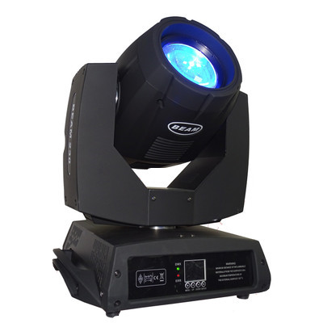
DJL02
Stage Beam Light
Input Voltage: AC100-240V,50/60 Hz
Pan: 540 degree + fine Tilt: 270 degree + fine Zoom range: 7-21°
Dimmer: 0-100% dimmer, from dark to bright
Color Wheel: 9 colors + open, with rainbow effect Static Gobo Wheel: 10 gobos + open, with rotation and running water effect
Rotation gobo wheel: 7 gobos+open Environment temp: -20℃-40℃
Lifespan:50000Hours
Item Number | Wattage | Lamp Source | DMX Channels | Operation Mode | Size（mm）
DJL02 | 230w | 230W 7R lamp | 16CH | DMX512, Sound actived, Auto,Master/slave | 480*480*600
 | 380w
 | 500w
Modern Ceiling Light Material:Iron base+ PMMA Cover Input Voltage:AC85-265V Led Chip:2835SMD IP Rating:IP44 CRI>80 PF>0.9 Color Temperature:3000K/4500K/6000K Operating Temperature:-25℃ ~50℃ Life Span:50000hours Certificate:CE ROHS
Item Number | Wattage | LedQuantity | LuminousFlux | Beam Angle | Size (mm) | WIFI Control Remte control Switch control Dimmer control
CL-N00 | 24W | 48pcs2835SMD | 1920-2160lm | 120° | 350mm | Yes
 | 36W | 72pcs2835SMD | 2880-3240lm | 120° | 400mm
 | 40W | 80pcs2835SMD | 3200-3600lm | 120° | 450mm
Modern Ceiling Light Material:Iron base+ PMMA Cover Input Voltage:AC85-265V Led Chip:2835SMD IP Rating:IP44 CRI>80 PF>0.9 Color Temperature:3000K/4500K/6000K Operating Temperature:-25℃ ~50℃ Life Span:50000hours Certificate:CE ROHS
Item Number | Wattage | LedQuantity | LuminousFlux | Beam Angle | Size (mm) | WIFI Control Remte control Switch control Dimmer control
CL-N00 | 24W | 48pcs2835SMD | 1920-2160lm | 120° | 350mm | Yes
 | 36W | 72pcs2835SMD | 2880-3240lm | 120° | 400mm
 | 40W | 80pcs2835SMD | 3200-3600lm | 120° | 450mm
Modern Ceiling Light Material:Iron base+ PMMA Cover Input Voltage:AC85-265V Led Chip:2835SMD IP Rating:IP44 CRI>80 PF>0.9 Color Temperature:3000K/4500K/6000K Operating Temperature:-25℃ ~50℃ Life Span:50000hours Certificate:CE ROHS
Item Number | Wattage | LedQuantity | LuminousFlux | Beam Angle | Size (mm) | WIFI Control Remte control Switch control Dimmer control
CL-N00 | 24W | 48pcs2835SMD | 1920-2160lm | 120° | 350mm | Yes
 | 36W | 72pcs2835SMD | 2880-3240lm | 120° | 400mm
 | 40W | 80pcs2835SMD | 3200-3600lm | 120° | 450mm
Modern Ceiling Light Material:Iron base+ PMMA Cover Input Voltage:AC85-265V Led Chip:2835SMD IP Rating:IP44 CRI>80 PF>0.9 Color Temperature:3000K/4500K/6000K Operating Temperature:-25℃ ~50℃ Life Span:50000hours Certificate:CE ROHS
Item Number | Wattage | LedQuantity | LuminousFlux | Beam Angle | Size (mm) | WIFI Control Remte control Switch control Dimmer control
CL-N00 | 24W | 48pcs2835SMD | 1920-2160lm | 120° | 350mm | Yes
 | 36W | 72pcs2835SMD | 2880-3240lm | 120° | 400mm
 | 40W | 80pcs2835SMD | 3200-3600lm | 120° | 450mm

Slide 3
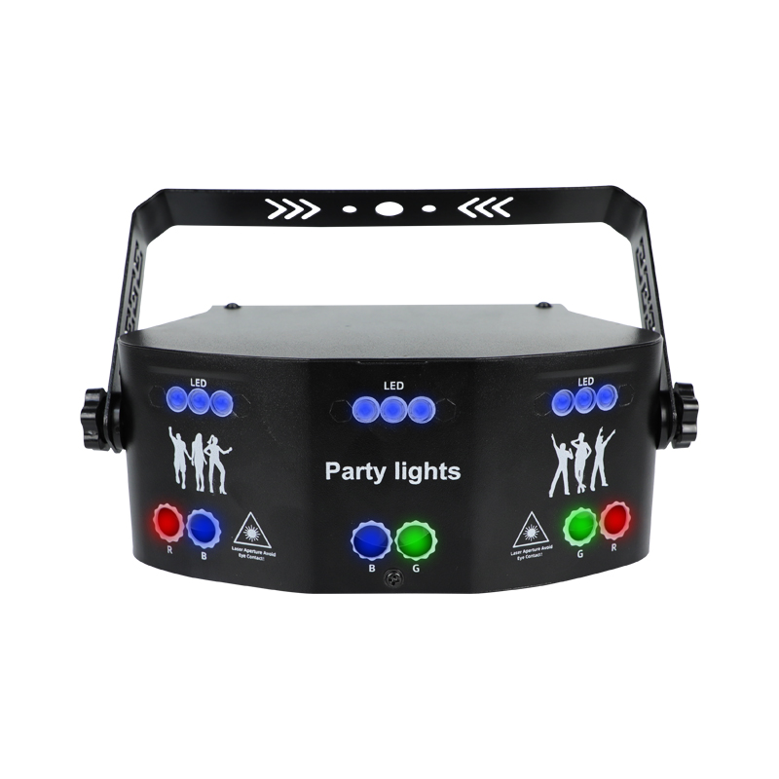
DJL03
15 Eyes LED Laser Effect Party Light
Input Voltage: AC110-240V,50/60 Hz Power adaptor: DC5V，1A-2A Color Temperature(CCT): 2700K (Soft Warm White) Color:White/Black
Control Modes: Voice Control/Strobe Mode/DMX512 Environment temp: -20℃-40℃ Single Weight: 1.15KG Box Weight: 14.85 KG
Lifespan:50000Hours
Item Number | Wattage | Lamp Source | Laser | Play mode | Size（mm）
DJL03 | 15w | RGB White UV Purple | red 650 nm/ green 532 nm | Automatic，Sound active, Strobe | 245*153*141
Modern Ceiling Light Material:Iron base+ PMMA Cover Input Voltage:AC85-265V Led Chip:2835SMD IP Rating:IP44 CRI>80 PF>0.9 Color Temperature:3000K/4500K/6000K Operating Temperature:-25℃ ~50℃ Life Span:50000hours Certificate:CE ROHS
Item Number | Wattage | LedQuantity | LuminousFlux | Beam Angle | Size (mm) | WIFI Control Remte control Switch control Dimmer control
CL-N00 | 24W | 48pcs2835SMD | 1920-2160lm | 120° | 350mm | Yes
 | 36W | 72pcs2835SMD | 2880-3240lm | 120° | 400mm
 | 40W | 80pcs2835SMD | 3200-3600lm | 120° | 450mm
Modern Ceiling Light Material:Iron base+ PMMA Cover Input Voltage:AC85-265V Led Chip:2835SMD IP Rating:IP44 CRI>80 PF>0.9 Color Temperature:3000K/4500K/6000K Operating Temperature:-25℃ ~50℃ Life Span:50000hours Certificate:CE ROHS
Item Number | Wattage | LedQuantity | LuminousFlux | Beam Angle | Size (mm) | WIFI Control Remte control Switch control Dimmer control
CL-N00 | 24W | 48pcs2835SMD | 1920-2160lm | 120° | 350mm | Yes
 | 36W | 72pcs2835SMD | 2880-3240lm | 120° | 400mm
 | 40W | 80pcs2835SMD | 3200-3600lm | 120° | 450mm
Modern Ceiling Light Material:Iron base+ PMMA Cover Input Voltage:AC85-265V Led Chip:2835SMD IP Rating:IP44 CRI>80 PF>0.9 Color Temperature:3000K/4500K/6000K Operating Temperature:-25℃ ~50℃ Life Span:50000hours Certificate:CE ROHS
Item Number | Wattage | LedQuantity | LuminousFlux | Beam Angle | Size (mm) | WIFI Control Remte control Switch control Dimmer control
CL-N00 | 24W | 48pcs2835SMD | 1920-2160lm | 120° | 350mm | Yes
 | 36W | 72pcs2835SMD | 2880-3240lm | 120° | 400mm
 | 40W | 80pcs2835SMD | 3200-3600lm | 120° | 450mm
Modern Ceiling Light Material:Iron base+ PMMA Cover Input Voltage:AC85-265V Led Chip:2835SMD IP Rating:IP44 CRI>80 PF>0.9 Color Temperature:3000K/4500K/6000K Operating Temperature:-25℃ ~50℃ Life Span:50000hours Certificate:CE ROHS
Item Number | Wattage | LedQuantity | LuminousFlux | Beam Angle | Size (mm) | WIFI Control Remte control Switch control Dimmer control
CL-N00 | 24W | 48pcs2835SMD | 1920-2160lm | 120° | 350mm | Yes
 | 36W | 72pcs2835SMD | 2880-3240lm | 120° | 400mm
 | 40W | 80pcs2835SMD | 3200-3600lm | 120° | 450mm

Slide 4
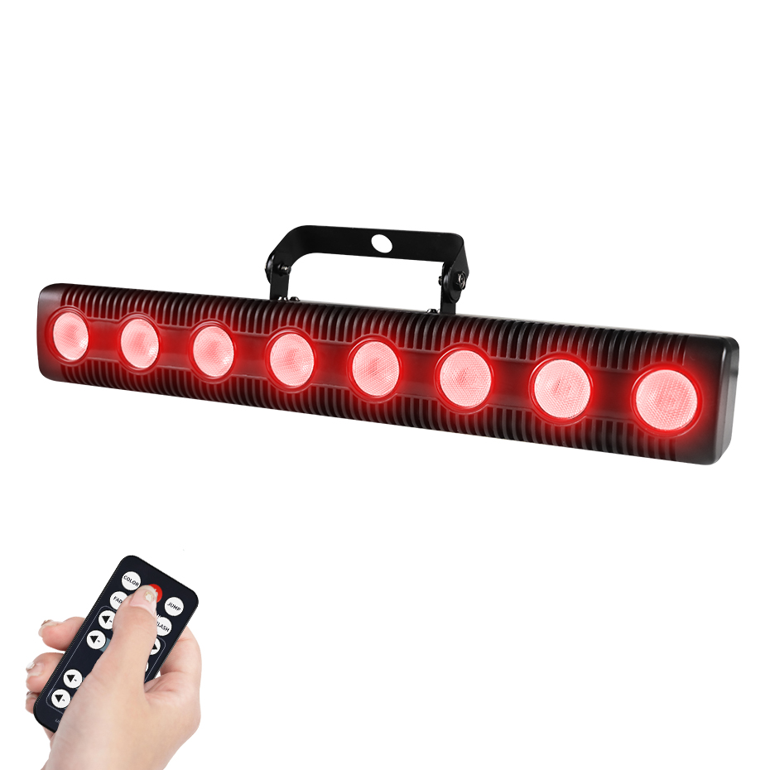
DJL12
Move Head Wash Lights
Input Voltage: AC 100-240V, 50-60HZ Material: PVC Reflector Beam Angle: 360 Degree Light Color: RGB +W (3 in 1) Red Laser: 100mw*2pcs Green Laser 500mw*2pcs Control mode: DMX512, Master/Slave, Auto, Sound Active IP: 20 Net Wight: 5.5 KG
Environment temp: -20℃-40℃
Lifespan:50000Hours
Item Number | Wattage | Led Quantity | Luminous Flux | Beam Angle | Size (mm)
DJL12 | 120w | 3W*16pcs | 15W*4pcs | 16/18 CH | 310*215*390
Modern Ceiling Light Material:Iron base+ PMMA Cover Input Voltage:AC85-265V Led Chip:2835SMD IP Rating:IP44 CRI>80 PF>0.9 Color Temperature:3000K/4500K/6000K Operating Temperature:-25℃ ~50℃ Life Span:50000hours Certificate:CE ROHS
Item Number | Wattage | LedQuantity | LuminousFlux | Beam Angle | Size (mm) | WIFI Control Remte control Switch control Dimmer control
CL-N00 | 24W | 48pcs2835SMD | 1920-2160lm | 120° | 350mm | Yes
 | 36W | 72pcs2835SMD | 2880-3240lm | 120° | 400mm
 | 40W | 80pcs2835SMD | 3200-3600lm | 120° | 450mm
Modern Ceiling Light Material:Iron base+ PMMA Cover Input Voltage:AC85-265V Led Chip:2835SMD IP Rating:IP44 CRI>80 PF>0.9 Color Temperature:3000K/4500K/6000K Operating Temperature:-25℃ ~50℃ Life Span:50000hours Certificate:CE ROHS
Item Number | Wattage | LedQuantity | LuminousFlux | Beam Angle | Size (mm) | WIFI Control Remte control Switch control Dimmer control
CL-N00 | 24W | 48pcs2835SMD | 1920-2160lm | 120° | 350mm | Yes
 | 36W | 72pcs2835SMD | 2880-3240lm | 120° | 400mm
 | 40W | 80pcs2835SMD | 3200-3600lm | 120° | 450mm
Modern Ceiling Light Material:Iron base+ PMMA Cover Input Voltage:AC85-265V Led Chip:2835SMD IP Rating:IP44 CRI>80 PF>0.9 Color Temperature:3000K/4500K/6000K Operating Temperature:-25℃ ~50℃ Life Span:50000hours Certificate:CE ROHS
Item Number | Wattage | LedQuantity | LuminousFlux | Beam Angle | Size (mm) | WIFI Control Remte control Switch control Dimmer control
CL-N00 | 24W | 48pcs2835SMD | 1920-2160lm | 120° | 350mm | Yes
 | 36W | 72pcs2835SMD | 2880-3240lm | 120° | 400mm
 | 40W | 80pcs2835SMD | 3200-3600lm | 120° | 450mm
Modern Ceiling Light Material:Iron base+ PMMA Cover Input Voltage:AC85-265V Led Chip:2835SMD IP Rating:IP44 CRI>80 PF>0.9 Color Temperature:3000K/4500K/6000K Operating Temperature:-25℃ ~50℃ Life Span:50000hours Certificate:CE ROHS
Item Number | Wattage | LedQuantity | LuminousFlux | Beam Angle | Size (mm) | WIFI Control Remte control Switch control Dimmer control
CL-N00 | 24W | 48pcs2835SMD | 1920-2160lm | 120° | 350mm | Yes
 | 36W | 72pcs2835SMD | 2880-3240lm | 120° | 400mm
 | 40W | 80pcs2835SMD | 3200-3600lm | 120° | 450mm

Slide 5
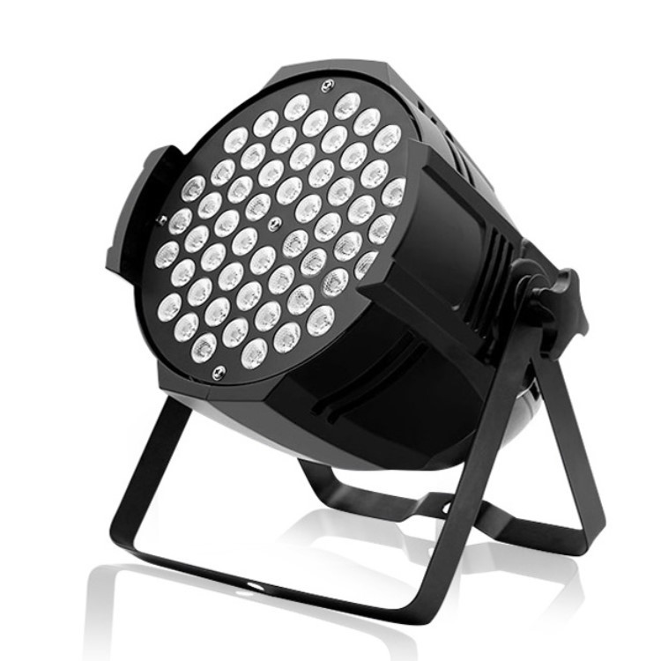
DJL06
Led Par Light
Input Voltage: AC 90-240V, 50-60HZ Material: High quantity ABS
Lens angle: 15*45 degree Color: RGBWA UV (6 in 1) Control Modes: DMX512, Master/Slave, Auto, Sound Active, WIFI , Wireless
Environment temp: -20℃-40℃
Lifespan:50000Hours
Item Number | Wattage | Led Quantity | Luminous Flux | Beam Angle | Size (mm)
DJL06 | 15w | RGB White UV Purple | red 650 nm/ green 532 nm | Automatic，Sound active, Strobe | 245*153*141
Modern Ceiling Light Material:Iron base+ PMMA Cover Input Voltage:AC85-265V Led Chip:2835SMD IP Rating:IP44 CRI>80 PF>0.9 Color Temperature:3000K/4500K/6000K Operating Temperature:-25℃ ~50℃ Life Span:50000hours Certificate:CE ROHS
Item Number | Wattage | LedQuantity | LuminousFlux | Beam Angle | Size (mm) | WIFI Control Remte control Switch control Dimmer control
CL-N00 | 24W | 48pcs2835SMD | 1920-2160lm | 120° | 350mm | Yes
 | 36W | 72pcs2835SMD | 2880-3240lm | 120° | 400mm
 | 40W | 80pcs2835SMD | 3200-3600lm | 120° | 450mm
Modern Ceiling Light Material:Iron base+ PMMA Cover Input Voltage:AC85-265V Led Chip:2835SMD IP Rating:IP44 CRI>80 PF>0.9 Color Temperature:3000K/4500K/6000K Operating Temperature:-25℃ ~50℃ Life Span:50000hours Certificate:CE ROHS
Item Number | Wattage | LedQuantity | LuminousFlux | Beam Angle | Size (mm) | WIFI Control Remte control Switch control Dimmer control
CL-N00 | 24W | 48pcs2835SMD | 1920-2160lm | 120° | 350mm | Yes
 | 36W | 72pcs2835SMD | 2880-3240lm | 120° | 400mm
 | 40W | 80pcs2835SMD | 3200-3600lm | 120° | 450mm
Modern Ceiling Light Material:Iron base+ PMMA Cover Input Voltage:AC85-265V Led Chip:2835SMD IP Rating:IP44 CRI>80 PF>0.9 Color Temperature:3000K/4500K/6000K Operating Temperature:-25℃ ~50℃ Life Span:50000hours Certificate:CE ROHS
Item Number | Wattage | LedQuantity | LuminousFlux | Beam Angle | Size (mm) | WIFI Control Remte control Switch control Dimmer control
CL-N00 | 24W | 48pcs2835SMD | 1920-2160lm | 120° | 350mm | Yes
 | 36W | 72pcs2835SMD | 2880-3240lm | 120° | 400mm
 | 40W | 80pcs2835SMD | 3200-3600lm | 120° | 450mm
Modern Ceiling Light Material:Iron base+ PMMA Cover Input Voltage:AC85-265V Led Chip:2835SMD IP Rating:IP44 CRI>80 PF>0.9 Color Temperature:3000K/4500K/6000K Operating Temperature:-25℃ ~50℃ Life Span:50000hours Certificate:CE ROHS
Item Number | Wattage | LedQuantity | LuminousFlux | Beam Angle | Size (mm) | WIFI Control Remte control Switch control Dimmer control
CL-N00 | 24W | 48pcs2835SMD | 1920-2160lm | 120° | 350mm | Yes
 | 36W | 72pcs2835SMD | 2880-3240lm | 120° | 400mm
 | 40W | 80pcs2835SMD | 3200-3600lm | 120° | 450mm

Slide 6
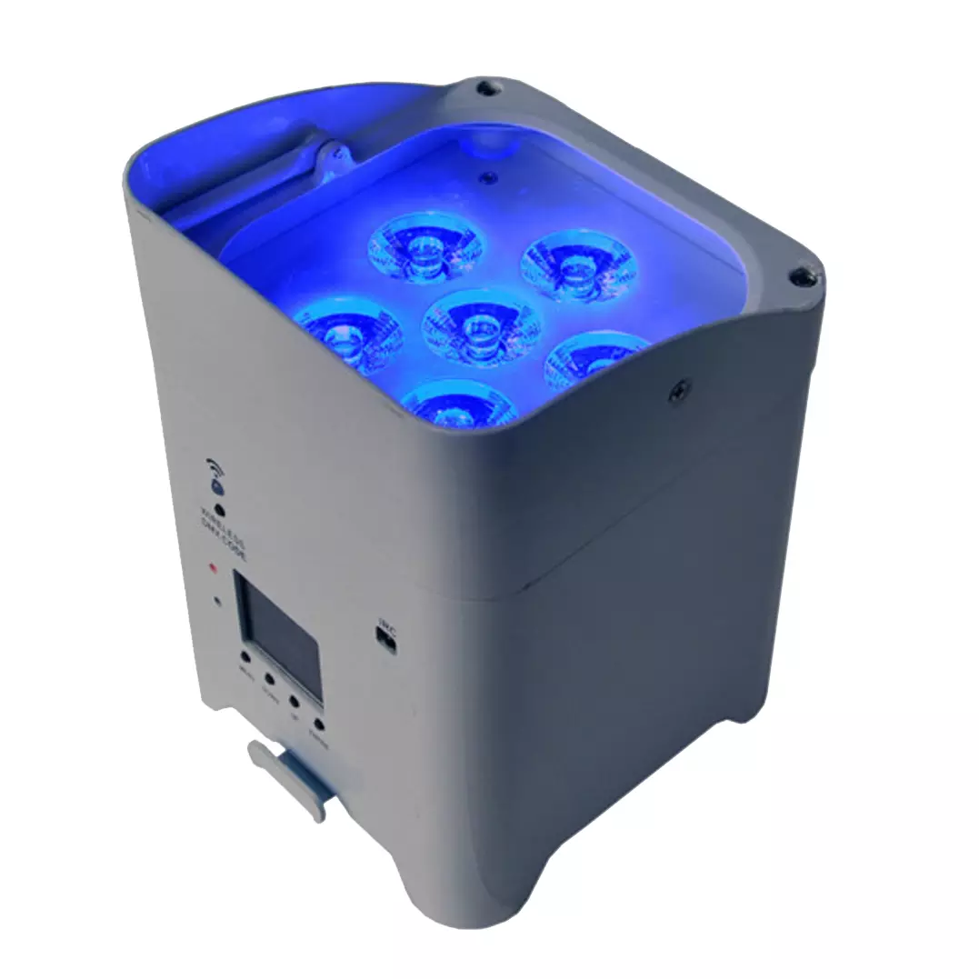
DJL05
Frameless panel light
Material:Aluminum+PMMA/PS/MS Cover
Input Voltage:AC85- 265V
Led Chip:2835SMD
Chip Brand :Epistar
IP Rating:IP44 CRI>80 PF>0.9
Color Temperature:3000K/4500K/6000K
Operating Temperature:-20℃ -50℃
Life Span：50000hours
Certificate：CE,ROHS
Item Number | Wattage | Lamp Source | Led Color | Control channels | Size（mm）
DJL05 | 75w | 6pcs 18W high brightness 6 in 1 leds | RGBWA UV 6 in 1 | 6/10 CH | 140*140*240
 | 110w
Modern Ceiling Light Material:Iron base+ PMMA Cover Input Voltage:AC85-265V Led Chip:2835SMD IP Rating:IP44 CRI>80 PF>0.9 Color Temperature:3000K/4500K/6000K Operating Temperature:-25℃ ~50℃ Life Span:50000hours Certificate:CE ROHS
Item Number | Wattage | LedQuantity | LuminousFlux | Beam Angle | Size (mm) | WIFI Control Remte control Switch control Dimmer control
CL-N00 | 24W | 48pcs2835SMD | 1920-2160lm | 120° | 350mm | Yes
 | 36W | 72pcs2835SMD | 2880-3240lm | 120° | 400mm
 | 40W | 80pcs2835SMD | 3200-3600lm | 120° | 450mm
Modern Ceiling Light Material:Iron base+ PMMA Cover Input Voltage:AC85-265V Led Chip:2835SMD IP Rating:IP44 CRI>80 PF>0.9 Color Temperature:3000K/4500K/6000K Operating Temperature:-25℃ ~50℃ Life Span:50000hours Certificate:CE ROHS
Item Number | Wattage | LedQuantity | LuminousFlux | Beam Angle | Size (mm) | WIFI Control Remte control Switch control Dimmer control
CL-N00 | 24W | 48pcs2835SMD | 1920-2160lm | 120° | 350mm | Yes
 | 36W | 72pcs2835SMD | 2880-3240lm | 120° | 400mm
 | 40W | 80pcs2835SMD | 3200-3600lm | 120° | 450mm
Modern Ceiling Light Material:Iron base+ PMMA Cover Input Voltage:AC85-265V Led Chip:2835SMD IP Rating:IP44 CRI>80 PF>0.9 Color Temperature:3000K/4500K/6000K Operating Temperature:-25℃ ~50℃ Life Span:50000hours Certificate:CE ROHS
Item Number | Wattage | LedQuantity | LuminousFlux | Beam Angle | Size (mm) | WIFI Control Remte control Switch control Dimmer control
CL-N00 | 24W | 48pcs2835SMD | 1920-2160lm | 120° | 350mm | Yes
 | 36W | 72pcs2835SMD | 2880-3240lm | 120° | 400mm
 | 40W | 80pcs2835SMD | 3200-3600lm | 120° | 450mm
Modern Ceiling Light Material:Iron base+ PMMA Cover Input Voltage:AC85-265V Led Chip:2835SMD IP Rating:IP44 CRI>80 PF>0.9 Color Temperature:3000K/4500K/6000K Operating Temperature:-25℃ ~50℃ Life Span:50000hours Certificate:CE ROHS
Item Number | Wattage | LedQuantity | LuminousFlux | Beam Angle | Size (mm) | WIFI Control Remte control Switch control Dimmer control
CL-N00 | 24W | 48pcs2835SMD | 1920-2160lm | 120° | 350mm | Yes
 | 36W | 72pcs2835SMD | 2880-3240lm | 120° | 400mm
 | 40W | 80pcs2835SMD | 3200-3600lm | 120° | 450mm

Slide 7
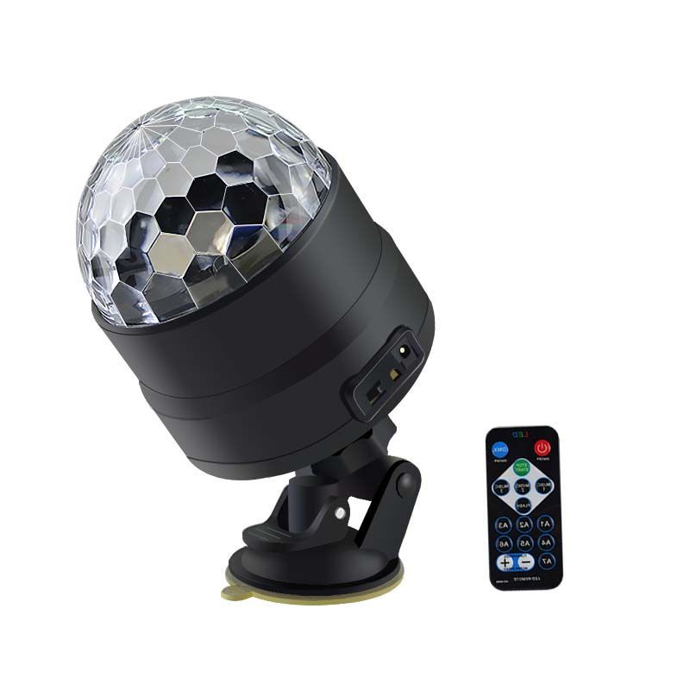
DJL09
Led Magic Ball DJ Lights
Input Voltage: AC 100-240V, 50-60HZ Material: ABS + PC Beam Angle: 180 Degree Light Color: RGB Color Mixture Control mode: DMX 512 , Master-Slave, Auto-Running, Sound Control IP: 22 Net Wight: 185 G
Environment temp: -20℃-40℃
Lifespan:50000Hours
Item Number | Wattage | Led Quantity | Luminous Flux | Beam Angle | Size (mm)
DJL09 | 3*1w | RGB LED | Red, green, blue, red/green, red/blue, green/blue and RGB. | EU plug( Other plug is available) | 85*85*96
Modern Ceiling Light Material:Iron base+ PMMA Cover Input Voltage:AC85-265V Led Chip:2835SMD IP Rating:IP44 CRI>80 PF>0.9 Color Temperature:3000K/4500K/6000K Operating Temperature:-25℃ ~50℃ Life Span:50000hours Certificate:CE ROHS
Item Number | Wattage | LedQuantity | LuminousFlux | Beam Angle | Size (mm) | WIFI Control Remte control Switch control Dimmer control
CL-N00 | 24W | 48pcs2835SMD | 1920-2160lm | 120° | 350mm | Yes
 | 36W | 72pcs2835SMD | 2880-3240lm | 120° | 400mm
 | 40W | 80pcs2835SMD | 3200-3600lm | 120° | 450mm
Modern Ceiling Light Material:Iron base+ PMMA Cover Input Voltage:AC85-265V Led Chip:2835SMD IP Rating:IP44 CRI>80 PF>0.9 Color Temperature:3000K/4500K/6000K Operating Temperature:-25℃ ~50℃ Life Span:50000hours Certificate:CE ROHS
Item Number | Wattage | LedQuantity | LuminousFlux | Beam Angle | Size (mm) | WIFI Control Remte control Switch control Dimmer control
CL-N00 | 24W | 48pcs2835SMD | 1920-2160lm | 120° | 350mm | Yes
 | 36W | 72pcs2835SMD | 2880-3240lm | 120° | 400mm
 | 40W | 80pcs2835SMD | 3200-3600lm | 120° | 450mm
Modern Ceiling Light Material:Iron base+ PMMA Cover Input Voltage:AC85-265V Led Chip:2835SMD IP Rating:IP44 CRI>80 PF>0.9 Color Temperature:3000K/4500K/6000K Operating Temperature:-25℃ ~50℃ Life Span:50000hours Certificate:CE ROHS
Item Number | Wattage | LedQuantity | LuminousFlux | Beam Angle | Size (mm) | WIFI Control Remte control Switch control Dimmer control
CL-N00 | 24W | 48pcs2835SMD | 1920-2160lm | 120° | 350mm | Yes
 | 36W | 72pcs2835SMD | 2880-3240lm | 120° | 400mm
 | 40W | 80pcs2835SMD | 3200-3600lm | 120° | 450mm
Modern Ceiling Light Material:Iron base+ PMMA Cover Input Voltage:AC85-265V Led Chip:2835SMD IP Rating:IP44 CRI>80 PF>0.9 Color Temperature:3000K/4500K/6000K Operating Temperature:-25℃ ~50℃ Life Span:50000hours Certificate:CE ROHS
Item Number | Wattage | LedQuantity | LuminousFlux | Beam Angle | Size (mm) | WIFI Control Remte control Switch control Dimmer control
CL-N00 | 24W | 48pcs2835SMD | 1920-2160lm | 120° | 350mm | Yes
 | 36W | 72pcs2835SMD | 2880-3240lm | 120° | 400mm
 | 40W | 80pcs2835SMD | 3200-3600lm | 120° | 450mm

Slide 8
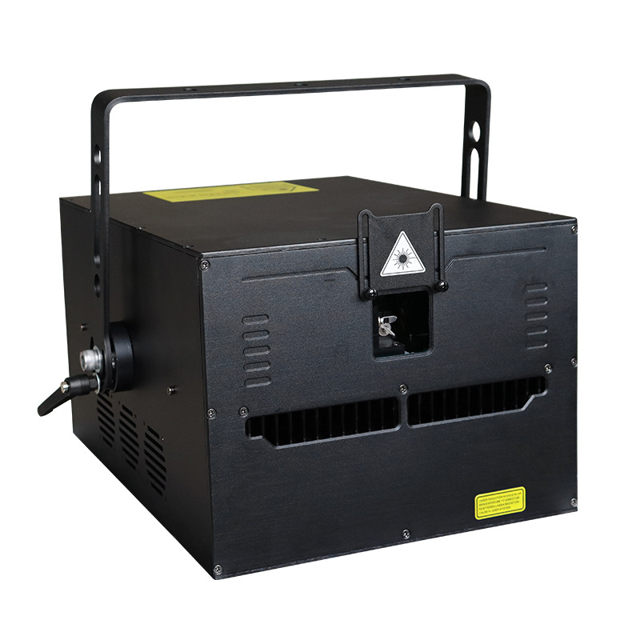
DJL08
Animation Laser Light
Input Voltage: AC 110-240V, 50-60HZ Laser diode type: TTL/ analog modulation Laser power: R638nm-300mw, G530nm-150mw, B445nm-600mw Control Modes: Remote Control,Sound, Auto, DMX512(5CH/34CH),Master/Slave IP: 25 Net Wight: 3.5KG
Environment temp: -20℃-40℃
Lifespan:50000Hours
Item Number | Wattage | Led Quantity | Luminous Flux | Beam Angle | Size (mm) | Open size（mm）
DJL08 | 5w | LED+Laser | 15kppswith +/-20°scan angle. | 2000 patterns | 200*200*90 | 5w
 | 10w |  |  |  |  | 10w
 | 15w |  |  |  |  | 15w
 | 20w |  |  |  |  | 20w
Modern Ceiling Light Material:Iron base+ PMMA Cover Input Voltage:AC85-265V Led Chip:2835SMD IP Rating:IP44 CRI>80 PF>0.9 Color Temperature:3000K/4500K/6000K Operating Temperature:-25℃ ~50℃ Life Span:50000hours Certificate:CE ROHS
Item Number | Wattage | LedQuantity | LuminousFlux | Beam Angle | Size (mm) | WIFI Control Remte control Switch control Dimmer control
CL-N00 | 24W | 48pcs2835SMD | 1920-2160lm | 120° | 350mm | Yes
 | 36W | 72pcs2835SMD | 2880-3240lm | 120° | 400mm
 | 40W | 80pcs2835SMD | 3200-3600lm | 120° | 450mm
Modern Ceiling Light Material:Iron base+ PMMA Cover Input Voltage:AC85-265V Led Chip:2835SMD IP Rating:IP44 CRI>80 PF>0.9 Color Temperature:3000K/4500K/6000K Operating Temperature:-25℃ ~50℃ Life Span:50000hours Certificate:CE ROHS
Item Number | Wattage | LedQuantity | LuminousFlux | Beam Angle | Size (mm) | WIFI Control Remte control Switch control Dimmer control
CL-N00 | 24W | 48pcs2835SMD | 1920-2160lm | 120° | 350mm | Yes
 | 36W | 72pcs2835SMD | 2880-3240lm | 120° | 400mm
 | 40W | 80pcs2835SMD | 3200-3600lm | 120° | 450mm
Modern Ceiling Light Material:Iron base+ PMMA Cover Input Voltage:AC85-265V Led Chip:2835SMD IP Rating:IP44 CRI>80 PF>0.9 Color Temperature:3000K/4500K/6000K Operating Temperature:-25℃ ~50℃ Life Span:50000hours Certificate:CE ROHS
Item Number | Wattage | LedQuantity | LuminousFlux | Beam Angle | Size (mm) | WIFI Control Remte control Switch control Dimmer control
CL-N00 | 24W | 48pcs2835SMD | 1920-2160lm | 120° | 350mm | Yes
 | 36W | 72pcs2835SMD | 2880-3240lm | 120° | 400mm
 | 40W | 80pcs2835SMD | 3200-3600lm | 120° | 450mm
Modern Ceiling Light Material:Iron base+ PMMA Cover Input Voltage:AC85-265V Led Chip:2835SMD IP Rating:IP44 CRI>80 PF>0.9 Color Temperature:3000K/4500K/6000K Operating Temperature:-25℃ ~50℃ Life Span:50000hours Certificate:CE ROHS
Item Number | Wattage | LedQuantity | LuminousFlux | Beam Angle | Size (mm) | WIFI Control Remte control Switch control Dimmer control
CL-N00 | 24W | 48pcs2835SMD | 1920-2160lm | 120° | 350mm | Yes
 | 36W | 72pcs2835SMD | 2880-3240lm | 120° | 400mm
 | 40W | 80pcs2835SMD | 3200-3600lm | 120° | 450mm

Slide 9
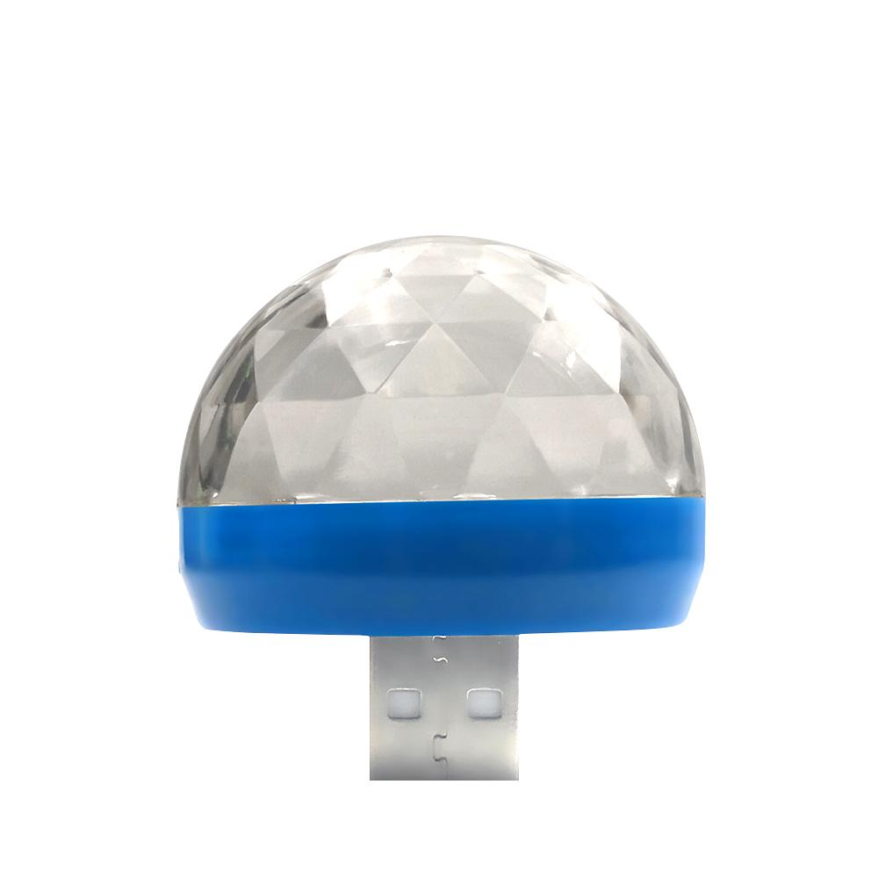
DJL10
USB Party Lights Mini Disco Ball
Input Voltage: DC 5V Material: PVC Reflector Beam Angle: 180 Degree Light Color: RGB Color Mixture Control mode: Voice Control light/Sound Control IP: 22 Net Wight: 15 G
Environment temp: -20℃-40℃
Lifespan:50000Hours
Item Number | Wattage | Led Quantity | Luminous Flux | Beam Angle | Size (mm)
DJL10 | 4*1w | RGB LED | Red, green, blue, red/green, red/blue, green/blue and RGB. | USB interface power | 41*37
Modern Ceiling Light Material:Iron base+ PMMA Cover Input Voltage:AC85-265V Led Chip:2835SMD IP Rating:IP44 CRI>80 PF>0.9 Color Temperature:3000K/4500K/6000K Operating Temperature:-25℃ ~50℃ Life Span:50000hours Certificate:CE ROHS
Item Number | Wattage | LedQuantity | LuminousFlux | Beam Angle | Size (mm) | WIFI Control Remte control Switch control Dimmer control
CL-N00 | 24W | 48pcs2835SMD | 1920-2160lm | 120° | 350mm | Yes
 | 36W | 72pcs2835SMD | 2880-3240lm | 120° | 400mm
 | 40W | 80pcs2835SMD | 3200-3600lm | 120° | 450mm
Modern Ceiling Light Material:Iron base+ PMMA Cover Input Voltage:AC85-265V Led Chip:2835SMD IP Rating:IP44 CRI>80 PF>0.9 Color Temperature:3000K/4500K/6000K Operating Temperature:-25℃ ~50℃ Life Span:50000hours Certificate:CE ROHS
Item Number | Wattage | LedQuantity | LuminousFlux | Beam Angle | Size (mm) | WIFI Control Remte control Switch control Dimmer control
CL-N00 | 24W | 48pcs2835SMD | 1920-2160lm | 120° | 350mm | Yes
 | 36W | 72pcs2835SMD | 2880-3240lm | 120° | 400mm
 | 40W | 80pcs2835SMD | 3200-3600lm | 120° | 450mm
Modern Ceiling Light Material:Iron base+ PMMA Cover Input Voltage:AC85-265V Led Chip:2835SMD IP Rating:IP44 CRI>80 PF>0.9 Color Temperature:3000K/4500K/6000K Operating Temperature:-25℃ ~50℃ Life Span:50000hours Certificate:CE ROHS
Item Number | Wattage | LedQuantity | LuminousFlux | Beam Angle | Size (mm) | WIFI Control Remte control Switch control Dimmer control
CL-N00 | 24W | 48pcs2835SMD | 1920-2160lm | 120° | 350mm | Yes
 | 36W | 72pcs2835SMD | 2880-3240lm | 120° | 400mm
 | 40W | 80pcs2835SMD | 3200-3600lm | 120° | 450mm
Modern Ceiling Light Material:Iron base+ PMMA Cover Input Voltage:AC85-265V Led Chip:2835SMD IP Rating:IP44 CRI>80 PF>0.9 Color Temperature:3000K/4500K/6000K Operating Temperature:-25℃ ~50℃ Life Span:50000hours Certificate:CE ROHS
Item Number | Wattage | LedQuantity | LuminousFlux | Beam Angle | Size (mm) | WIFI Control Remte control Switch control Dimmer control
CL-N00 | 24W | 48pcs2835SMD | 1920-2160lm | 120° | 350mm | Yes
 | 36W | 72pcs2835SMD | 2880-3240lm | 120° | 400mm
 | 40W | 80pcs2835SMD | 3200-3600lm | 120° | 450mm

Slide 10
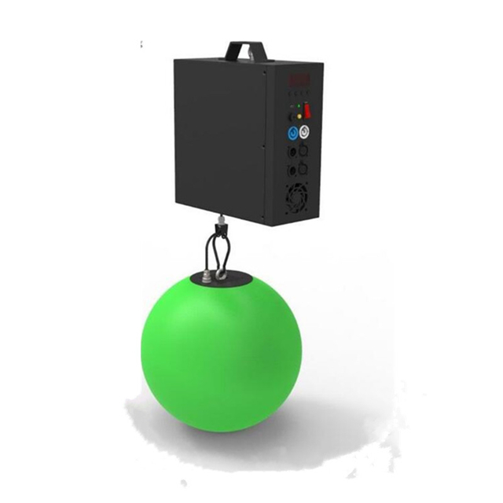
DJL07
Frameless panel light
Material:Aluminum+PMMA/PS/MS Cover
Input Voltage:AC85- 265V
Led Chip:2835SMD
Chip Brand :Epistar
IP Rating:IP44 CRI>80 PF>0.9
Color Temperature:3000K/4500K/6000K
Operating Temperature:-20℃ -50℃
Life Span：50000hours
Certificate：CE,ROHS
Item Number | Wattage | Led Quantity | Luminous Flux | Beam Angle | Size (mm) | Open size（mm）
DJL07 | 100w | SMD 5050 | 15/20/25/30/35cm,can be customized | 9 CH | 10.5kg | 100w
 | 120w | SMD 5050 |  |  |  | 120w
Modern Ceiling Light Material:Iron base+ PMMA Cover Input Voltage:AC85-265V Led Chip:2835SMD IP Rating:IP44 CRI>80 PF>0.9 Color Temperature:3000K/4500K/6000K Operating Temperature:-25℃ ~50℃ Life Span:50000hours Certificate:CE ROHS
Item Number | Wattage | LedQuantity | LuminousFlux | Beam Angle | Size (mm) | WIFI Control Remte control Switch control Dimmer control
CL-N00 | 24W | 48pcs2835SMD | 1920-2160lm | 120° | 350mm | Yes
 | 36W | 72pcs2835SMD | 2880-3240lm | 120° | 400mm
 | 40W | 80pcs2835SMD | 3200-3600lm | 120° | 450mm
Modern Ceiling Light Material:Iron base+ PMMA Cover Input Voltage:AC85-265V Led Chip:2835SMD IP Rating:IP44 CRI>80 PF>0.9 Color Temperature:3000K/4500K/6000K Operating Temperature:-25℃ ~50℃ Life Span:50000hours Certificate:CE ROHS
Item Number | Wattage | LedQuantity | LuminousFlux | Beam Angle | Size (mm) | WIFI Control Remte control Switch control Dimmer control
CL-N00 | 24W | 48pcs2835SMD | 1920-2160lm | 120° | 350mm | Yes
 | 36W | 72pcs2835SMD | 2880-3240lm | 120° | 400mm
 | 40W | 80pcs2835SMD | 3200-3600lm | 120° | 450mm
Modern Ceiling Light Material:Iron base+ PMMA Cover Input Voltage:AC85-265V Led Chip:2835SMD IP Rating:IP44 CRI>80 PF>0.9 Color Temperature:3000K/4500K/6000K Operating Temperature:-25℃ ~50℃ Life Span:50000hours Certificate:CE ROHS
Item Number | Wattage | LedQuantity | LuminousFlux | Beam Angle | Size (mm) | WIFI Control Remte control Switch control Dimmer control
CL-N00 | 24W | 48pcs2835SMD | 1920-2160lm | 120° | 350mm | Yes
 | 36W | 72pcs2835SMD | 2880-3240lm | 120° | 400mm
 | 40W | 80pcs2835SMD | 3200-3600lm | 120° | 450mm
Modern Ceiling Light Material:Iron base+ PMMA Cover Input Voltage:AC85-265V Led Chip:2835SMD IP Rating:IP44 CRI>80 PF>0.9 Color Temperature:3000K/4500K/6000K Operating Temperature:-25℃ ~50℃ Life Span:50000hours Certificate:CE ROHS
Item Number | Wattage | LedQuantity | LuminousFlux | Beam Angle | Size (mm) | WIFI Control Remte control Switch control Dimmer control
CL-N00 | 24W | 48pcs2835SMD | 1920-2160lm | 120° | 350mm | Yes
 | 36W | 72pcs2835SMD | 2880-3240lm | 120° | 400mm
 | 40W | 80pcs2835SMD | 3200-3600lm | 120° | 450mm

Slide 11
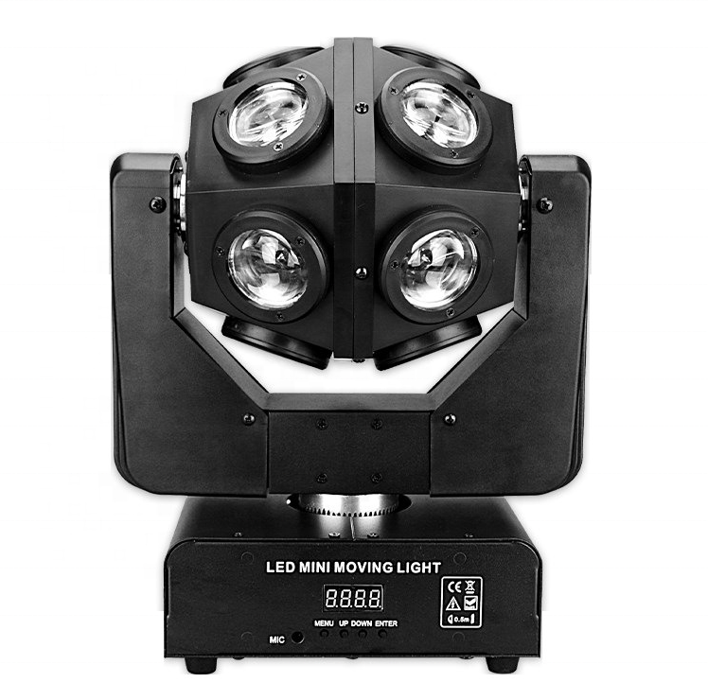
DJL11
Move Head Wash Lights
Input Voltage: AC 100-240V, 50-60HZ Material: PVC Reflector Beam Angle: 360 Degree Light Color: RGB +W (3 in 1) Red Laser: 100mw*2pcs Green Laser 500mw*2pcs Control mode: DMX512, Master/Slave, Auto, Sound Active IP: 20 Net Wight: 5.5 KG
Environment temp: -20℃-40℃
Lifespan:50000Hours
Item Number | Wattage | Led Quantity | Luminous Flux | Beam Angle | Size (mm)
DJL11 | 120w | 3W*16pcs | 15W*4pcs | 16/18 CH | 310*215*390
Modern Ceiling Light Material:Iron base+ PMMA Cover Input Voltage:AC85-265V Led Chip:2835SMD IP Rating:IP44 CRI>80 PF>0.9 Color Temperature:3000K/4500K/6000K Operating Temperature:-25℃ ~50℃ Life Span:50000hours Certificate:CE ROHS
Item Number | Wattage | LedQuantity | LuminousFlux | Beam Angle | Size (mm) | WIFI Control Remte control Switch control Dimmer control
CL-N00 | 24W | 48pcs2835SMD | 1920-2160lm | 120° | 350mm | Yes
 | 36W | 72pcs2835SMD | 2880-3240lm | 120° | 400mm
 | 40W | 80pcs2835SMD | 3200-3600lm | 120° | 450mm
Modern Ceiling Light Material:Iron base+ PMMA Cover Input Voltage:AC85-265V Led Chip:2835SMD IP Rating:IP44 CRI>80 PF>0.9 Color Temperature:3000K/4500K/6000K Operating Temperature:-25℃ ~50℃ Life Span:50000hours Certificate:CE ROHS
Item Number | Wattage | LedQuantity | LuminousFlux | Beam Angle | Size (mm) | WIFI Control Remte control Switch control Dimmer control
CL-N00 | 24W | 48pcs2835SMD | 1920-2160lm | 120° | 350mm | Yes
 | 36W | 72pcs2835SMD | 2880-3240lm | 120° | 400mm
 | 40W | 80pcs2835SMD | 3200-3600lm | 120° | 450mm
Modern Ceiling Light Material:Iron base+ PMMA Cover Input Voltage:AC85-265V Led Chip:2835SMD IP Rating:IP44 CRI>80 PF>0.9 Color Temperature:3000K/4500K/6000K Operating Temperature:-25℃ ~50℃ Life Span:50000hours Certificate:CE ROHS
Item Number | Wattage | LedQuantity | LuminousFlux | Beam Angle | Size (mm) | WIFI Control Remte control Switch control Dimmer control
CL-N00 | 24W | 48pcs2835SMD | 1920-2160lm | 120° | 350mm | Yes
 | 36W | 72pcs2835SMD | 2880-3240lm | 120° | 400mm
 | 40W | 80pcs2835SMD | 3200-3600lm | 120° | 450mm
Modern Ceiling Light Material:Iron base+ PMMA Cover Input Voltage:AC85-265V Led Chip:2835SMD IP Rating:IP44 CRI>80 PF>0.9 Color Temperature:3000K/4500K/6000K Operating Temperature:-25℃ ~50℃ Life Span:50000hours Certificate:CE ROHS
Item Number | Wattage | LedQuantity | LuminousFlux | Beam Angle | Size (mm) | WIFI Control Remte control Switch control Dimmer control
CL-N00 | 24W | 48pcs2835SMD | 1920-2160lm | 120° | 350mm | Yes
 | 36W | 72pcs2835SMD | 2880-3240lm | 120° | 400mm
 | 40W | 80pcs2835SMD | 3200-3600lm | 120° | 450mm

Slide 12
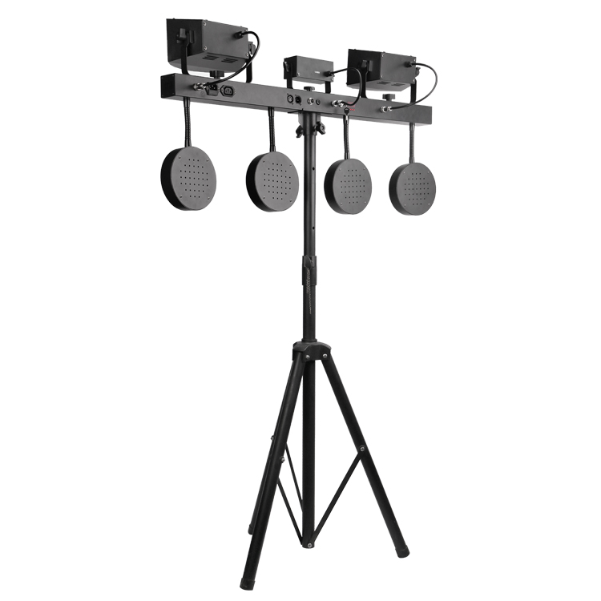
DJL13
Move Head Wash Lights
Input Voltage: AC 100-240V, 50-60HZ Material: PVC Reflector Beam Angle: 360 Degree Light Color: RGB +W (3 in 1) Red Laser: 100mw*2pcs Green Laser 500mw*2pcs Control mode: DMX512, Master/Slave, Auto, Sound Active IP: 20 Net Wight: 5.5 KG
Environment temp: -20℃-40℃
Lifespan:50000Hours
Item Number | Wattage | Led Quantity | Luminous Flux | Beam Angle | Size (mm)
DJL13 | 120w | 3W*16pcs | 15W*4pcs | 16/18 CH | 310*215*390
Modern Ceiling Light Material:Iron base+ PMMA Cover Input Voltage:AC85-265V Led Chip:2835SMD IP Rating:IP44 CRI>80 PF>0.9 Color Temperature:3000K/4500K/6000K Operating Temperature:-25℃ ~50℃ Life Span:50000hours Certificate:CE ROHS
Item Number | Wattage | LedQuantity | LuminousFlux | Beam Angle | Size (mm) | WIFI Control Remte control Switch control Dimmer control
CL-N00 | 24W | 48pcs2835SMD | 1920-2160lm | 120° | 350mm | Yes
 | 36W | 72pcs2835SMD | 2880-3240lm | 120° | 400mm
 | 40W | 80pcs2835SMD | 3200-3600lm | 120° | 450mm
Modern Ceiling Light Material:Iron base+ PMMA Cover Input Voltage:AC85-265V Led Chip:2835SMD IP Rating:IP44 CRI>80 PF>0.9 Color Temperature:3000K/4500K/6000K Operating Temperature:-25℃ ~50℃ Life Span:50000hours Certificate:CE ROHS
Item Number | Wattage | LedQuantity | LuminousFlux | Beam Angle | Size (mm) | WIFI Control Remte control Switch control Dimmer control
CL-N00 | 24W | 48pcs2835SMD | 1920-2160lm | 120° | 350mm | Yes
 | 36W | 72pcs2835SMD | 2880-3240lm | 120° | 400mm
 | 40W | 80pcs2835SMD | 3200-3600lm | 120° | 450mm
Modern Ceiling Light Material:Iron base+ PMMA Cover Input Voltage:AC85-265V Led Chip:2835SMD IP Rating:IP44 CRI>80 PF>0.9 Color Temperature:3000K/4500K/6000K Operating Temperature:-25℃ ~50℃ Life Span:50000hours Certificate:CE ROHS
Item Number | Wattage | LedQuantity | LuminousFlux | Beam Angle | Size (mm) | WIFI Control Remte control Switch control Dimmer control
CL-N00 | 24W | 48pcs2835SMD | 1920-2160lm | 120° | 350mm | Yes
 | 36W | 72pcs2835SMD | 2880-3240lm | 120° | 400mm
 | 40W | 80pcs2835SMD | 3200-3600lm | 120° | 450mm
Modern Ceiling Light Material:Iron base+ PMMA Cover Input Voltage:AC85-265V Led Chip:2835SMD IP Rating:IP44 CRI>80 PF>0.9 Color Temperature:3000K/4500K/6000K Operating Temperature:-25℃ ~50℃ Life Span:50000hours Certificate:CE ROHS
Item Number | Wattage | LedQuantity | LuminousFlux | Beam Angle | Size (mm) | WIFI Control Remte control Switch control Dimmer control
CL-N00 | 24W | 48pcs2835SMD | 1920-2160lm | 120° | 350mm | Yes
 | 36W | 72pcs2835SMD | 2880-3240lm | 120° | 400mm
 | 40W | 80pcs2835SMD | 3200-3600lm | 120° | 450mm

Slide 13
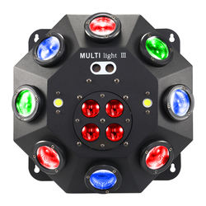
DJL14
Move Head Wash Lights
Input Voltage: AC 100-240V, 50-60HZ Material: PVC Reflector Beam Angle: 360 Degree Light Color: RGB +W (3 in 1) Red Laser: 100mw*2pcs Green Laser 500mw*2pcs Control mode: DMX512, Master/Slave, Auto, Sound Active IP: 20 Net Wight: 5.5 KG
Environment temp: -20℃-40℃
Lifespan:50000Hours
Item Number | Wattage | Led Quantity | Luminous Flux | Beam Angle | Size (mm)
DJL14 | 120w | 3W*16pcs | 15W*4pcs | 16/18 CH | 310*215*390
Modern Ceiling Light Material:Iron base+ PMMA Cover Input Voltage:AC85-265V Led Chip:2835SMD IP Rating:IP44 CRI>80 PF>0.9 Color Temperature:3000K/4500K/6000K Operating Temperature:-25℃ ~50℃ Life Span:50000hours Certificate:CE ROHS
Item Number | Wattage | LedQuantity | LuminousFlux | Beam Angle | Size (mm) | WIFI Control Remte control Switch control Dimmer control
CL-N00 | 24W | 48pcs2835SMD | 1920-2160lm | 120° | 350mm | Yes
 | 36W | 72pcs2835SMD | 2880-3240lm | 120° | 400mm
 | 40W | 80pcs2835SMD | 3200-3600lm | 120° | 450mm
Modern Ceiling Light Material:Iron base+ PMMA Cover Input Voltage:AC85-265V Led Chip:2835SMD IP Rating:IP44 CRI>80 PF>0.9 Color Temperature:3000K/4500K/6000K Operating Temperature:-25℃ ~50℃ Life Span:50000hours Certificate:CE ROHS
Item Number | Wattage | LedQuantity | LuminousFlux | Beam Angle | Size (mm) | WIFI Control Remte control Switch control Dimmer control
CL-N00 | 24W | 48pcs2835SMD | 1920-2160lm | 120° | 350mm | Yes
 | 36W | 72pcs2835SMD | 2880-3240lm | 120° | 400mm
 | 40W | 80pcs2835SMD | 3200-3600lm | 120° | 450mm
Modern Ceiling Light Material:Iron base+ PMMA Cover Input Voltage:AC85-265V Led Chip:2835SMD IP Rating:IP44 CRI>80 PF>0.9 Color Temperature:3000K/4500K/6000K Operating Temperature:-25℃ ~50℃ Life Span:50000hours Certificate:CE ROHS
Item Number | Wattage | LedQuantity | LuminousFlux | Beam Angle | Size (mm) | WIFI Control Remte control Switch control Dimmer control
CL-N00 | 24W | 48pcs2835SMD | 1920-2160lm | 120° | 350mm | Yes
 | 36W | 72pcs2835SMD | 2880-3240lm | 120° | 400mm
 | 40W | 80pcs2835SMD | 3200-3600lm | 120° | 450mm
Modern Ceiling Light Material:Iron base+ PMMA Cover Input Voltage:AC85-265V Led Chip:2835SMD IP Rating:IP44 CRI>80 PF>0.9 Color Temperature:3000K/4500K/6000K Operating Temperature:-25℃ ~50℃ Life Span:50000hours Certificate:CE ROHS
Item Number | Wattage | LedQuantity | LuminousFlux | Beam Angle | Size (mm) | WIFI Control Remte control Switch control Dimmer control
CL-N00 | 24W | 48pcs2835SMD | 1920-2160lm | 120° | 350mm | Yes
 | 36W | 72pcs2835SMD | 2880-3240lm | 120° | 400mm
 | 40W | 80pcs2835SMD | 3200-3600lm | 120° | 450mm

