Slide 1
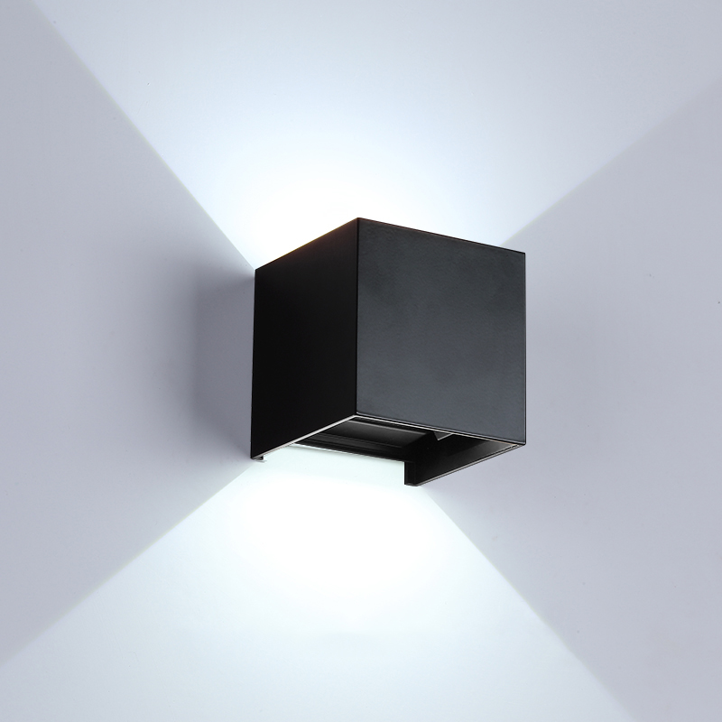
IWL01
Modern wall light
Input Voltage:AC85-265V
Led Chip:2835SMD
IP Rating:IP65 CRI>80 PF>0.9
Color Temperature:3000K/4500K/6000K
Operating Temperature:-25℃ ~50℃
Life Span:50000hours
Certificate:CE ROHS
Item Number | Wattage | Shell Material | Led Chip | Beam Angle | Luminous Flux | Warranty
IWL01 | 2*3W | Aluminum | COB/GU10 | 90° | 80-100LM/W | 2=yaer
 | 2*5W
 | 2*10W
Modern Ceiling Light Material:Iron base+ PMMA Cover Input Voltage:AC85-265V Led Chip:2835SMD IP Rating:IP44 CRI>80 PF>0.9 Color Temperature:3000K/4500K/6000K Operating Temperature:-25℃ ~50℃ Life Span:50000hours Certificate:CE ROHS
Item Number | Wattage | LedQuantity | LuminousFlux | Beam Angle | Size (mm) | WIFI Control Remte control Switch control Dimmer control
CL-N00 | 24W | 48pcs2835SMD | 1920-2160lm | 120° | 350mm | Yes
 | 36W | 72pcs2835SMD | 2880-3240lm | 120° | 400mm
 | 40W | 80pcs2835SMD | 3200-3600lm | 120° | 450mm
Modern Ceiling Light Material:Iron base+ PMMA Cover Input Voltage:AC85-265V Led Chip:2835SMD IP Rating:IP44 CRI>80 PF>0.9 Color Temperature:3000K/4500K/6000K Operating Temperature:-25℃ ~50℃ Life Span:50000hours Certificate:CE ROHS
Item Number | Wattage | LedQuantity | LuminousFlux | Beam Angle | Size (mm) | WIFI Control Remte control Switch control Dimmer control
CL-N00 | 24W | 48pcs2835SMD | 1920-2160lm | 120° | 350mm | Yes
 | 36W | 72pcs2835SMD | 2880-3240lm | 120° | 400mm
 | 40W | 80pcs2835SMD | 3200-3600lm | 120° | 450mm
Modern Ceiling Light Material:Iron base+ PMMA Cover Input Voltage:AC85-265V Led Chip:2835SMD IP Rating:IP44 CRI>80 PF>0.9 Color Temperature:3000K/4500K/6000K Operating Temperature:-25℃ ~50℃ Life Span:50000hours Certificate:CE ROHS
Item Number | Wattage | LedQuantity | LuminousFlux | Beam Angle | Size (mm) | WIFI Control Remte control Switch control Dimmer control
CL-N00 | 24W | 48pcs2835SMD | 1920-2160lm | 120° | 350mm | Yes
 | 36W | 72pcs2835SMD | 2880-3240lm | 120° | 400mm
 | 40W | 80pcs2835SMD | 3200-3600lm | 120° | 450mm
Modern Ceiling Light Material:Iron base+ PMMA Cover Input Voltage:AC85-265V Led Chip:2835SMD IP Rating:IP44 CRI>80 PF>0.9 Color Temperature:3000K/4500K/6000K Operating Temperature:-25℃ ~50℃ Life Span:50000hours Certificate:CE ROHS
Item Number | Wattage | LedQuantity | LuminousFlux | Beam Angle | Size (mm) | WIFI Control Remte control Switch control Dimmer control
CL-N00 | 24W | 48pcs2835SMD | 1920-2160lm | 120° | 350mm | Yes
 | 36W | 72pcs2835SMD | 2880-3240lm | 120° | 400mm
 | 40W | 80pcs2835SMD | 3200-3600lm | 120° | 450mm

Slide 2
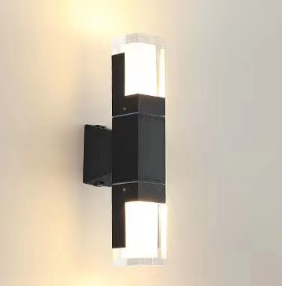
OIWL01
Voltage:AC85-265V/50-60 Hz IP Rating: IP65 CRI > 80 PF>0.90 Life Span: 50000Hours Working color: black and white Operating temperature: -25-50° Color temperature: 3000K/4000K/6000K Certification: CE ROHS CB FCC
Item NO. | Single and double head | Wattage | Shell Material | Luminous Flux | Luminous Flux Warranty | SIZE(COVER)
OWL01 | single head | 3w | Aluminum | 90-100LM/W | 2-years | 25*15*165mm
 | single head | 5w |  |  |  | 50*50*270mm
 | double head | 3w |  |  |  | 25*25*270mm
 | double head | 10w |  |  |  | 50*50*300mm
Modern Ceiling Light Material:Iron base+ PMMA Cover Input Voltage:AC85-265V Led Chip:2835SMD IP Rating:IP44 CRI>80 PF>0.9 Color Temperature:3000K/4500K/6000K Operating Temperature:-25℃ ~50℃ Life Span:50000hours Certificate:CE ROHS
Item Number | Wattage | LedQuantity | LuminousFlux | Beam Angle | Size (mm) | WIFI Control Remte control Switch control Dimmer control
CL-N00 | 24W | 48pcs2835SMD | 1920-2160lm | 120° | 350mm | Yes
 | 36W | 72pcs2835SMD | 2880-3240lm | 120° | 400mm
 | 40W | 80pcs2835SMD | 3200-3600lm | 120° | 450mm
Modern Ceiling Light Material:Iron base+ PMMA Cover Input Voltage:AC85-265V Led Chip:2835SMD IP Rating:IP44 CRI>80 PF>0.9 Color Temperature:3000K/4500K/6000K Operating Temperature:-25℃ ~50℃ Life Span:50000hours Certificate:CE ROHS
Item Number | Wattage | LedQuantity | LuminousFlux | Beam Angle | Size (mm) | WIFI Control Remte control Switch control Dimmer control
CL-N00 | 24W | 48pcs2835SMD | 1920-2160lm | 120° | 350mm | Yes
 | 36W | 72pcs2835SMD | 2880-3240lm | 120° | 400mm
 | 40W | 80pcs2835SMD | 3200-3600lm | 120° | 450mm
Modern Ceiling Light Material:Iron base+ PMMA Cover Input Voltage:AC85-265V Led Chip:2835SMD IP Rating:IP44 CRI>80 PF>0.9 Color Temperature:3000K/4500K/6000K Operating Temperature:-25℃ ~50℃ Life Span:50000hours Certificate:CE ROHS
Item Number | Wattage | LedQuantity | LuminousFlux | Beam Angle | Size (mm) | WIFI Control Remte control Switch control Dimmer control
CL-N00 | 24W | 48pcs2835SMD | 1920-2160lm | 120° | 350mm | Yes
 | 36W | 72pcs2835SMD | 2880-3240lm | 120° | 400mm
 | 40W | 80pcs2835SMD | 3200-3600lm | 120° | 450mm
Modern Ceiling Light Material:Iron base+ PMMA Cover Input Voltage:AC85-265V Led Chip:2835SMD IP Rating:IP44 CRI>80 PF>0.9 Color Temperature:3000K/4500K/6000K Operating Temperature:-25℃ ~50℃ Life Span:50000hours Certificate:CE ROHS
Item Number | Wattage | LedQuantity | LuminousFlux | Beam Angle | Size (mm) | WIFI Control Remte control Switch control Dimmer control
CL-N00 | 24W | 48pcs2835SMD | 1920-2160lm | 120° | 350mm | Yes
 | 36W | 72pcs2835SMD | 2880-3240lm | 120° | 400mm
 | 40W | 80pcs2835SMD | 3200-3600lm | 120° | 450mm

Slide 3
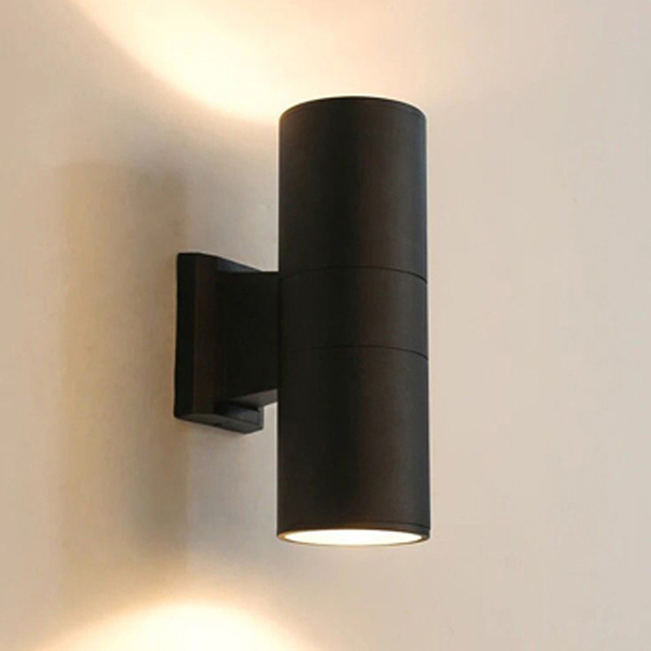
OIWL02
Voltage:AC85-265V/50-60 Hz IP Rating: IP65 CRI > 80 PF>0.90 Life Span: 50000Hours Working color: black and gray Operating temperature: -25-50° Color temperature: 3000K/4000K/6000K Certification: CE ROHS CB FCC
Item NO. | Single and double head | Wattage | Shell Material | Luminous Flux | Warranty | SIZE(COVER)
OWL02 | single head | 3W | Aluminum | 90-100LM/W | 2-years | φ65*H160mm
 | single head | 5w/6w |  |  |  | φ90*H160mm
 | single head | 9w/12w |  |  |  | φ108*H200mm
 | single head | 15w/18w/24w |  |  |  | φ145*H200mm
 | double head | 6w |  |  |  | φ65*H160mm
 | double head | 10w/12w |  |  |  | φ90*H260mm
 | double head | 18w/24w |  |  |  | φ108*H300mm
 | double head | 36w |  |  |  | φ145*H300mm
 | double head | 48w |  |  |  | φ160*H450mm
Modern Ceiling Light Material:Iron base+ PMMA Cover Input Voltage:AC85-265V Led Chip:2835SMD IP Rating:IP44 CRI>80 PF>0.9 Color Temperature:3000K/4500K/6000K Operating Temperature:-25℃ ~50℃ Life Span:50000hours Certificate:CE ROHS
Item Number | Wattage | LedQuantity | LuminousFlux | Beam Angle | Size (mm) | WIFI Control Remte control Switch control Dimmer control
CL-N00 | 24W | 48pcs2835SMD | 1920-2160lm | 120° | 350mm | Yes
 | 36W | 72pcs2835SMD | 2880-3240lm | 120° | 400mm
 | 40W | 80pcs2835SMD | 3200-3600lm | 120° | 450mm
Modern Ceiling Light Material:Iron base+ PMMA Cover Input Voltage:AC85-265V Led Chip:2835SMD IP Rating:IP44 CRI>80 PF>0.9 Color Temperature:3000K/4500K/6000K Operating Temperature:-25℃ ~50℃ Life Span:50000hours Certificate:CE ROHS
Item Number | Wattage | LedQuantity | LuminousFlux | Beam Angle | Size (mm) | WIFI Control Remte control Switch control Dimmer control
CL-N00 | 24W | 48pcs2835SMD | 1920-2160lm | 120° | 350mm | Yes
 | 36W | 72pcs2835SMD | 2880-3240lm | 120° | 400mm
 | 40W | 80pcs2835SMD | 3200-3600lm | 120° | 450mm
Modern Ceiling Light Material:Iron base+ PMMA Cover Input Voltage:AC85-265V Led Chip:2835SMD IP Rating:IP44 CRI>80 PF>0.9 Color Temperature:3000K/4500K/6000K Operating Temperature:-25℃ ~50℃ Life Span:50000hours Certificate:CE ROHS
Item Number | Wattage | LedQuantity | LuminousFlux | Beam Angle | Size (mm) | WIFI Control Remte control Switch control Dimmer control
CL-N00 | 24W | 48pcs2835SMD | 1920-2160lm | 120° | 350mm | Yes
 | 36W | 72pcs2835SMD | 2880-3240lm | 120° | 400mm
 | 40W | 80pcs2835SMD | 3200-3600lm | 120° | 450mm
Modern Ceiling Light Material:Iron base+ PMMA Cover Input Voltage:AC85-265V Led Chip:2835SMD IP Rating:IP44 CRI>80 PF>0.9 Color Temperature:3000K/4500K/6000K Operating Temperature:-25℃ ~50℃ Life Span:50000hours Certificate:CE ROHS
Item Number | Wattage | LedQuantity | LuminousFlux | Beam Angle | Size (mm) | WIFI Control Remte control Switch control Dimmer control
CL-N00 | 24W | 48pcs2835SMD | 1920-2160lm | 120° | 350mm | Yes
 | 36W | 72pcs2835SMD | 2880-3240lm | 120° | 400mm
 | 40W | 80pcs2835SMD | 3200-3600lm | 120° | 450mm

Slide 4
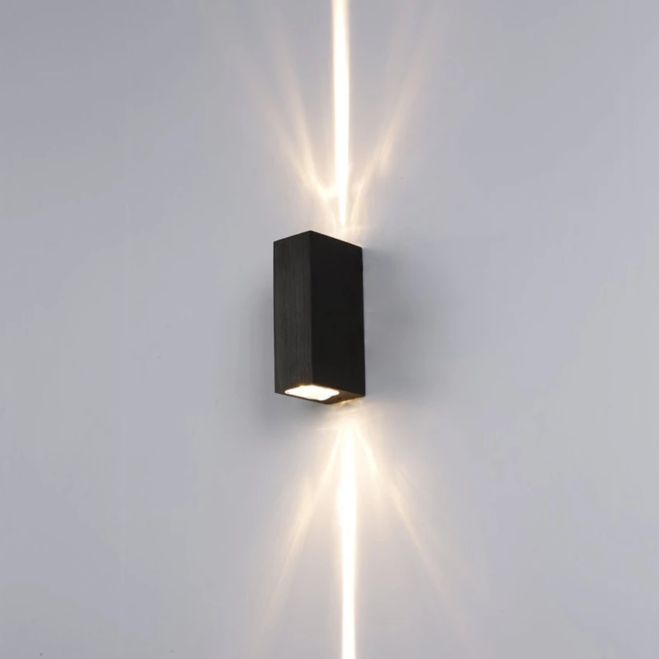
OIWL03
Voltage:AC 85-265V IP Rating: IP65 CRI > 80 PF>0.90 Life Span: 50000Hours Working temperature: -25-50° Color temperature: 3000K/4000K/6000K/RGB
Item NO. | Wattage | Materia | Warranty | Led quality | Luminous Flux | SIZE(COVER)
OWL03 | 5W | Aluminum+P C/Glass | 2-years | GU10/E27 | 90-100LM/W | 50*35*90mm
 | 10W |  |  |  |  | 60*40*120mm
 | 15W |  |  |  |  | 70*50*150mm
 | 20W |  |  |  |  | 80*55*180mm
Modern Ceiling Light Material:Iron base+ PMMA Cover Input Voltage:AC85-265V Led Chip:2835SMD IP Rating:IP44 CRI>80 PF>0.9 Color Temperature:3000K/4500K/6000K Operating Temperature:-25℃ ~50℃ Life Span:50000hours Certificate:CE ROHS
Item Number | Wattage | LedQuantity | LuminousFlux | Beam Angle | Size (mm) | WIFI Control Remte control Switch control Dimmer control
CL-N00 | 24W | 48pcs2835SMD | 1920-2160lm | 120° | 350mm | Yes
 | 36W | 72pcs2835SMD | 2880-3240lm | 120° | 400mm
 | 40W | 80pcs2835SMD | 3200-3600lm | 120° | 450mm
Modern Ceiling Light Material:Iron base+ PMMA Cover Input Voltage:AC85-265V Led Chip:2835SMD IP Rating:IP44 CRI>80 PF>0.9 Color Temperature:3000K/4500K/6000K Operating Temperature:-25℃ ~50℃ Life Span:50000hours Certificate:CE ROHS
Item Number | Wattage | LedQuantity | LuminousFlux | Beam Angle | Size (mm) | WIFI Control Remte control Switch control Dimmer control
CL-N00 | 24W | 48pcs2835SMD | 1920-2160lm | 120° | 350mm | Yes
 | 36W | 72pcs2835SMD | 2880-3240lm | 120° | 400mm
 | 40W | 80pcs2835SMD | 3200-3600lm | 120° | 450mm
Modern Ceiling Light Material:Iron base+ PMMA Cover Input Voltage:AC85-265V Led Chip:2835SMD IP Rating:IP44 CRI>80 PF>0.9 Color Temperature:3000K/4500K/6000K Operating Temperature:-25℃ ~50℃ Life Span:50000hours Certificate:CE ROHS
Item Number | Wattage | LedQuantity | LuminousFlux | Beam Angle | Size (mm) | WIFI Control Remte control Switch control Dimmer control
CL-N00 | 24W | 48pcs2835SMD | 1920-2160lm | 120° | 350mm | Yes
 | 36W | 72pcs2835SMD | 2880-3240lm | 120° | 400mm
 | 40W | 80pcs2835SMD | 3200-3600lm | 120° | 450mm
Modern Ceiling Light Material:Iron base+ PMMA Cover Input Voltage:AC85-265V Led Chip:2835SMD IP Rating:IP44 CRI>80 PF>0.9 Color Temperature:3000K/4500K/6000K Operating Temperature:-25℃ ~50℃ Life Span:50000hours Certificate:CE ROHS
Item Number | Wattage | LedQuantity | LuminousFlux | Beam Angle | Size (mm) | WIFI Control Remte control Switch control Dimmer control
CL-N00 | 24W | 48pcs2835SMD | 1920-2160lm | 120° | 350mm | Yes
 | 36W | 72pcs2835SMD | 2880-3240lm | 120° | 400mm
 | 40W | 80pcs2835SMD | 3200-3600lm | 120° | 450mm

Slide 5
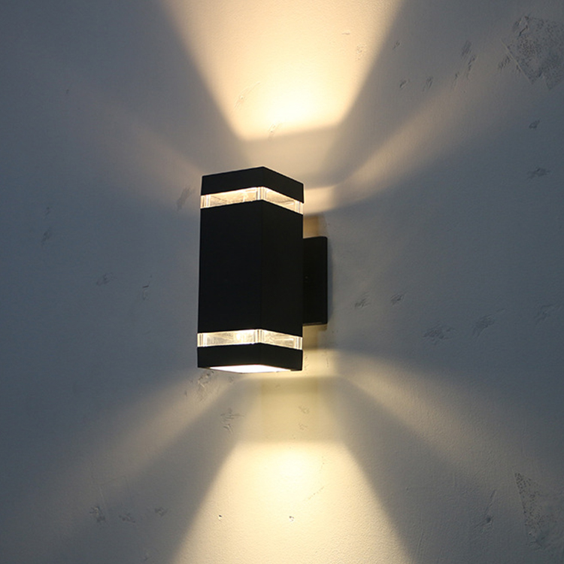
OIWL05
Voltage:AC 85-265V IP Rating: IP65 CRI > 80 PF>0.90 Life Span: 50000Hours Working temperature: -25-50° Color temperature: 3000K/4000K/6000K
Item NO. | Wattage | Materia | Warranty | Led quality | Luminous Flux | SIZE(COVER)
OWL05 | 2*3W | Aluminum/St ainless steel | 2-years | E27/GU10/MR16 | 90-100LM/W | 110*65*310mm
 | 2*5W
 | 2*5W
 | 2*5W
Modern Ceiling Light Material:Iron base+ PMMA Cover Input Voltage:AC85-265V Led Chip:2835SMD IP Rating:IP44 CRI>80 PF>0.9 Color Temperature:3000K/4500K/6000K Operating Temperature:-25℃ ~50℃ Life Span:50000hours Certificate:CE ROHS
Item Number | Wattage | LedQuantity | LuminousFlux | Beam Angle | Size (mm) | WIFI Control Remte control Switch control Dimmer control
CL-N00 | 24W | 48pcs2835SMD | 1920-2160lm | 120° | 350mm | Yes
 | 36W | 72pcs2835SMD | 2880-3240lm | 120° | 400mm
 | 40W | 80pcs2835SMD | 3200-3600lm | 120° | 450mm
Modern Ceiling Light Material:Iron base+ PMMA Cover Input Voltage:AC85-265V Led Chip:2835SMD IP Rating:IP44 CRI>80 PF>0.9 Color Temperature:3000K/4500K/6000K Operating Temperature:-25℃ ~50℃ Life Span:50000hours Certificate:CE ROHS
Item Number | Wattage | LedQuantity | LuminousFlux | Beam Angle | Size (mm) | WIFI Control Remte control Switch control Dimmer control
CL-N00 | 24W | 48pcs2835SMD | 1920-2160lm | 120° | 350mm | Yes
 | 36W | 72pcs2835SMD | 2880-3240lm | 120° | 400mm
 | 40W | 80pcs2835SMD | 3200-3600lm | 120° | 450mm
Modern Ceiling Light Material:Iron base+ PMMA Cover Input Voltage:AC85-265V Led Chip:2835SMD IP Rating:IP44 CRI>80 PF>0.9 Color Temperature:3000K/4500K/6000K Operating Temperature:-25℃ ~50℃ Life Span:50000hours Certificate:CE ROHS
Item Number | Wattage | LedQuantity | LuminousFlux | Beam Angle | Size (mm) | WIFI Control Remte control Switch control Dimmer control
CL-N00 | 24W | 48pcs2835SMD | 1920-2160lm | 120° | 350mm | Yes
 | 36W | 72pcs2835SMD | 2880-3240lm | 120° | 400mm
 | 40W | 80pcs2835SMD | 3200-3600lm | 120° | 450mm
Modern Ceiling Light Material:Iron base+ PMMA Cover Input Voltage:AC85-265V Led Chip:2835SMD IP Rating:IP44 CRI>80 PF>0.9 Color Temperature:3000K/4500K/6000K Operating Temperature:-25℃ ~50℃ Life Span:50000hours Certificate:CE ROHS
Item Number | Wattage | LedQuantity | LuminousFlux | Beam Angle | Size (mm) | WIFI Control Remte control Switch control Dimmer control
CL-N00 | 24W | 48pcs2835SMD | 1920-2160lm | 120° | 350mm | Yes
 | 36W | 72pcs2835SMD | 2880-3240lm | 120° | 400mm
 | 40W | 80pcs2835SMD | 3200-3600lm | 120° | 450mm

Slide 6
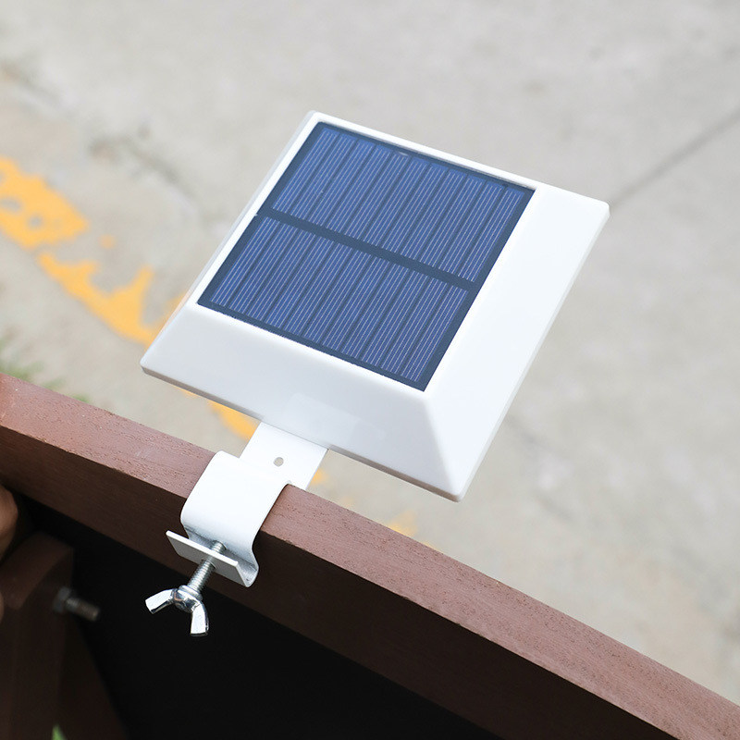
OIWL06
Voltage:DC5V IP Rating: IP65 CRI > 80 PF>0.90 Life Span: 50000Hours Working color: black and white Operating temperature: -25-50° Color temperature: 3000K/4000K/6000K Certification: CE ROHS CB FCC
Item NO. | Single and double head | Wattage | Shell Material | Luminous Flux | Luminous Flux Warranty | SIZE(COVER)
PL-N01 | 9W | 18pcs 2835SMD | 720-810lm | 120° | φ93 | 50-80
 | 18W | 36pcs 2835SMD | 1440-1620lm | 120° | φ123 | 50-110
 | 24W | 48pcs 2835SMD | 1920-2160lm | 120° | φ175 | 75-160
 | 36W | 72pcs 2835SMD | 2880-3240lm | 120° | φ228 | 75-210
Modern Ceiling Light Material:Iron base+ PMMA Cover Input Voltage:AC85-265V Led Chip:2835SMD IP Rating:IP44 CRI>80 PF>0.9 Color Temperature:3000K/4500K/6000K Operating Temperature:-25℃ ~50℃ Life Span:50000hours Certificate:CE ROHS
Item Number | Wattage | LedQuantity | LuminousFlux | Beam Angle | Size (mm) | WIFI Control Remte control Switch control Dimmer control
CL-N00 | 24W | 48pcs2835SMD | 1920-2160lm | 120° | 350mm | Yes
 | 36W | 72pcs2835SMD | 2880-3240lm | 120° | 400mm
 | 40W | 80pcs2835SMD | 3200-3600lm | 120° | 450mm
Modern Ceiling Light Material:Iron base+ PMMA Cover Input Voltage:AC85-265V Led Chip:2835SMD IP Rating:IP44 CRI>80 PF>0.9 Color Temperature:3000K/4500K/6000K Operating Temperature:-25℃ ~50℃ Life Span:50000hours Certificate:CE ROHS
Item Number | Wattage | LedQuantity | LuminousFlux | Beam Angle | Size (mm) | WIFI Control Remte control Switch control Dimmer control
CL-N00 | 24W | 48pcs2835SMD | 1920-2160lm | 120° | 350mm | Yes
 | 36W | 72pcs2835SMD | 2880-3240lm | 120° | 400mm
 | 40W | 80pcs2835SMD | 3200-3600lm | 120° | 450mm
Modern Ceiling Light Material:Iron base+ PMMA Cover Input Voltage:AC85-265V Led Chip:2835SMD IP Rating:IP44 CRI>80 PF>0.9 Color Temperature:3000K/4500K/6000K Operating Temperature:-25℃ ~50℃ Life Span:50000hours Certificate:CE ROHS
Item Number | Wattage | LedQuantity | LuminousFlux | Beam Angle | Size (mm) | WIFI Control Remte control Switch control Dimmer control
CL-N00 | 24W | 48pcs2835SMD | 1920-2160lm | 120° | 350mm | Yes
 | 36W | 72pcs2835SMD | 2880-3240lm | 120° | 400mm
 | 40W | 80pcs2835SMD | 3200-3600lm | 120° | 450mm
Modern Ceiling Light Material:Iron base+ PMMA Cover Input Voltage:AC85-265V Led Chip:2835SMD IP Rating:IP44 CRI>80 PF>0.9 Color Temperature:3000K/4500K/6000K Operating Temperature:-25℃ ~50℃ Life Span:50000hours Certificate:CE ROHS
Item Number | Wattage | LedQuantity | LuminousFlux | Beam Angle | Size (mm) | WIFI Control Remte control Switch control Dimmer control
CL-N00 | 24W | 48pcs2835SMD | 1920-2160lm | 120° | 350mm | Yes
 | 36W | 72pcs2835SMD | 2880-3240lm | 120° | 400mm
 | 40W | 80pcs2835SMD | 3200-3600lm | 120° | 450mm

Slide 7
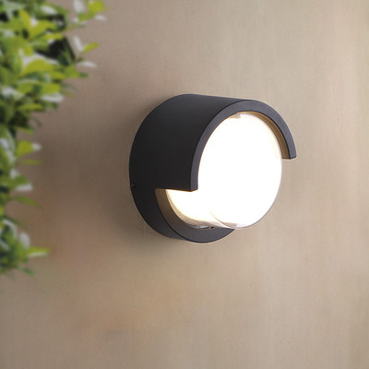
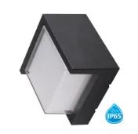
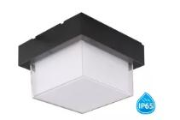
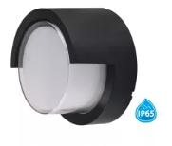
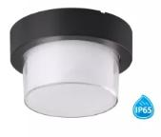
OIWL07
Voltage:AC85-265V/50-60 Hz IP Rating: IP65 CRI > 80 PF>0.90 Life Span: 50000Hours Working color: black and white Operating temperature: -25-50° Color temperature: 3000K/4000K/6000K Certification: CE ROHS CB FCC
Item NO. | Single and double head | Wattage | Shell Material | Luminous Flux | Luminous Flux Warranty | SIZE(COVER)
PL-N01 |  | 6w | Aluminum | 100-110LM/W | 2-years | 133*133*67mm
 |  | 12w |  |  |  | 60*160*100mm
 |  | 6w |  |  |  | 133*133*67mm
 |  | 12w |  |  |  | 160*160*100mm
 |  | 6w |  |  |  | Φ133*67mm
 |  | 12w |  |  |  | Φ169*100mm
 |  | 6w |  |  |  | Φ133*67mm
 |  | 12w |  |  |  | Φ169*100mm
Modern Ceiling Light Material:Iron base+ PMMA Cover Input Voltage:AC85-265V Led Chip:2835SMD IP Rating:IP44 CRI>80 PF>0.9 Color Temperature:3000K/4500K/6000K Operating Temperature:-25℃ ~50℃ Life Span:50000hours Certificate:CE ROHS
Item Number | Wattage | LedQuantity | LuminousFlux | Beam Angle | Size (mm) | WIFI Control Remte control Switch control Dimmer control
CL-N00 | 24W | 48pcs2835SMD | 1920-2160lm | 120° | 350mm | Yes
 | 36W | 72pcs2835SMD | 2880-3240lm | 120° | 400mm
 | 40W | 80pcs2835SMD | 3200-3600lm | 120° | 450mm
Modern Ceiling Light Material:Iron base+ PMMA Cover Input Voltage:AC85-265V Led Chip:2835SMD IP Rating:IP44 CRI>80 PF>0.9 Color Temperature:3000K/4500K/6000K Operating Temperature:-25℃ ~50℃ Life Span:50000hours Certificate:CE ROHS
Item Number | Wattage | LedQuantity | LuminousFlux | Beam Angle | Size (mm) | WIFI Control Remte control Switch control Dimmer control
CL-N00 | 24W | 48pcs2835SMD | 1920-2160lm | 120° | 350mm | Yes
 | 36W | 72pcs2835SMD | 2880-3240lm | 120° | 400mm
 | 40W | 80pcs2835SMD | 3200-3600lm | 120° | 450mm
Modern Ceiling Light Material:Iron base+ PMMA Cover Input Voltage:AC85-265V Led Chip:2835SMD IP Rating:IP44 CRI>80 PF>0.9 Color Temperature:3000K/4500K/6000K Operating Temperature:-25℃ ~50℃ Life Span:50000hours Certificate:CE ROHS
Item Number | Wattage | LedQuantity | LuminousFlux | Beam Angle | Size (mm) | WIFI Control Remte control Switch control Dimmer control
CL-N00 | 24W | 48pcs2835SMD | 1920-2160lm | 120° | 350mm | Yes
 | 36W | 72pcs2835SMD | 2880-3240lm | 120° | 400mm
 | 40W | 80pcs2835SMD | 3200-3600lm | 120° | 450mm
Modern Ceiling Light Material:Iron base+ PMMA Cover Input Voltage:AC85-265V Led Chip:2835SMD IP Rating:IP44 CRI>80 PF>0.9 Color Temperature:3000K/4500K/6000K Operating Temperature:-25℃ ~50℃ Life Span:50000hours Certificate:CE ROHS
Item Number | Wattage | LedQuantity | LuminousFlux | Beam Angle | Size (mm) | WIFI Control Remte control Switch control Dimmer control
CL-N00 | 24W | 48pcs2835SMD | 1920-2160lm | 120° | 350mm | Yes
 | 36W | 72pcs2835SMD | 2880-3240lm | 120° | 400mm
 | 40W | 80pcs2835SMD | 3200-3600lm | 120° | 450mm

Slide 8
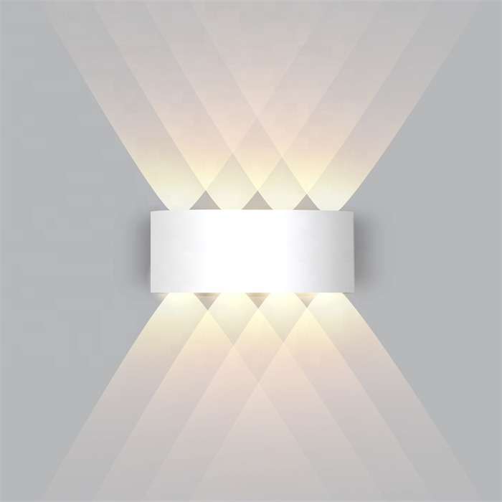
IWL02
Modern wall light
Input Voltage:AC85-265V
Led Chip:2835SMD
IP Rating:IP65 CRI>80 PF>0.9
Color Temperature:3000K/4500K/6000K
Operating Temperature:-25℃ ~50℃
Life Span:50000hours
Certificate:CE ROHS
Item Number | Wattage | Shell Material | Led Chip | Beam Angle | Luminous Flux | Size
IWL02 | 2W | Aluminum | COB/GU10 | 90° | 80-100LM/W | 80*78mm
 | 4W |  |  |  |  | 80*120mm
 | 6W |  |  |  |  | 80*168mm
 | 8W |  |  |  |  | 80*219mm
 | 10W |  |  |  |  | 80*270mm
 | 12W |  |  |  |  | 80*315mm
Modern Ceiling Light Material:Iron base+ PMMA Cover Input Voltage:AC85-265V Led Chip:2835SMD IP Rating:IP44 CRI>80 PF>0.9 Color Temperature:3000K/4500K/6000K Operating Temperature:-25℃ ~50℃ Life Span:50000hours Certificate:CE ROHS
Item Number | Wattage | LedQuantity | LuminousFlux | Beam Angle | Size (mm) | WIFI Control Remte control Switch control Dimmer control
CL-N00 | 24W | 48pcs2835SMD | 1920-2160lm | 120° | 350mm | Yes
 | 36W | 72pcs2835SMD | 2880-3240lm | 120° | 400mm
 | 40W | 80pcs2835SMD | 3200-3600lm | 120° | 450mm
Modern Ceiling Light Material:Iron base+ PMMA Cover Input Voltage:AC85-265V Led Chip:2835SMD IP Rating:IP44 CRI>80 PF>0.9 Color Temperature:3000K/4500K/6000K Operating Temperature:-25℃ ~50℃ Life Span:50000hours Certificate:CE ROHS
Item Number | Wattage | LedQuantity | LuminousFlux | Beam Angle | Size (mm) | WIFI Control Remte control Switch control Dimmer control
CL-N00 | 24W | 48pcs2835SMD | 1920-2160lm | 120° | 350mm | Yes
 | 36W | 72pcs2835SMD | 2880-3240lm | 120° | 400mm
 | 40W | 80pcs2835SMD | 3200-3600lm | 120° | 450mm
Modern Ceiling Light Material:Iron base+ PMMA Cover Input Voltage:AC85-265V Led Chip:2835SMD IP Rating:IP44 CRI>80 PF>0.9 Color Temperature:3000K/4500K/6000K Operating Temperature:-25℃ ~50℃ Life Span:50000hours Certificate:CE ROHS
Item Number | Wattage | LedQuantity | LuminousFlux | Beam Angle | Size (mm) | WIFI Control Remte control Switch control Dimmer control
CL-N00 | 24W | 48pcs2835SMD | 1920-2160lm | 120° | 350mm | Yes
 | 36W | 72pcs2835SMD | 2880-3240lm | 120° | 400mm
 | 40W | 80pcs2835SMD | 3200-3600lm | 120° | 450mm
Modern Ceiling Light Material:Iron base+ PMMA Cover Input Voltage:AC85-265V Led Chip:2835SMD IP Rating:IP44 CRI>80 PF>0.9 Color Temperature:3000K/4500K/6000K Operating Temperature:-25℃ ~50℃ Life Span:50000hours Certificate:CE ROHS
Item Number | Wattage | LedQuantity | LuminousFlux | Beam Angle | Size (mm) | WIFI Control Remte control Switch control Dimmer control
CL-N00 | 24W | 48pcs2835SMD | 1920-2160lm | 120° | 350mm | Yes
 | 36W | 72pcs2835SMD | 2880-3240lm | 120° | 400mm
 | 40W | 80pcs2835SMD | 3200-3600lm | 120° | 450mm

Slide 9
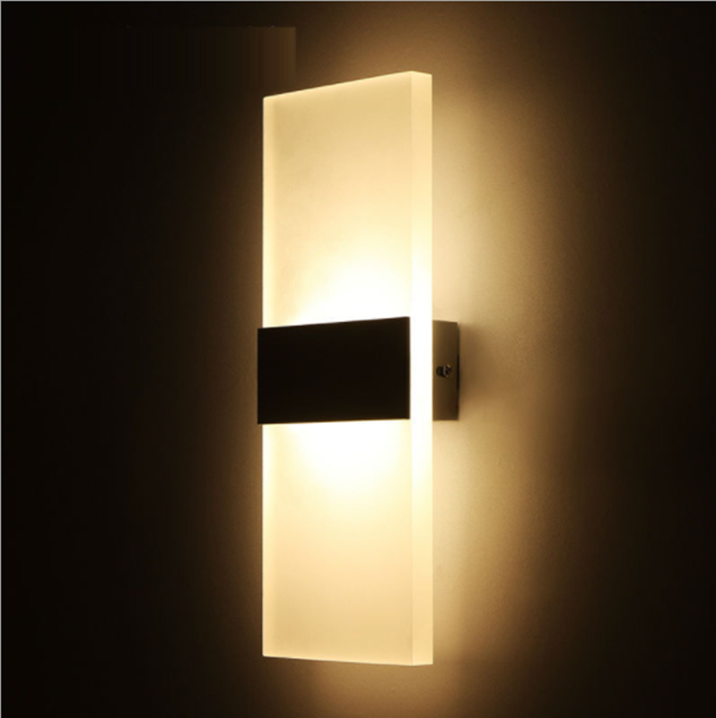
IWL03
Modern wall light
Input Voltage:AC85-265V
Led Chip:2835SMD
IP Rating:IP65 CRI>80 PF>0.9
Color Temperature:3000K/4500K/6000K
Operating Temperature:-25℃ ~50℃
Life Span:50000hours
Certificate:CE ROHS
Item Number | Wattage | Shell Material | Led Chip | Beam Angle | Luminous Flux | Size
IWL03 | 4W | Aluminum | COB/GU10 | 90° | 80-100LM/W | 270*100mm
 | 6W |  |  |  |  | 290*110mm
 | 12W |  |  |  |  | 400*150mm
Modern Ceiling Light Material:Iron base+ PMMA Cover Input Voltage:AC85-265V Led Chip:2835SMD IP Rating:IP44 CRI>80 PF>0.9 Color Temperature:3000K/4500K/6000K Operating Temperature:-25℃ ~50℃ Life Span:50000hours Certificate:CE ROHS
Item Number | Wattage | LedQuantity | LuminousFlux | Beam Angle | Size (mm) | WIFI Control Remte control Switch control Dimmer control
CL-N00 | 24W | 48pcs2835SMD | 1920-2160lm | 120° | 350mm | Yes
 | 36W | 72pcs2835SMD | 2880-3240lm | 120° | 400mm
 | 40W | 80pcs2835SMD | 3200-3600lm | 120° | 450mm
Modern Ceiling Light Material:Iron base+ PMMA Cover Input Voltage:AC85-265V Led Chip:2835SMD IP Rating:IP44 CRI>80 PF>0.9 Color Temperature:3000K/4500K/6000K Operating Temperature:-25℃ ~50℃ Life Span:50000hours Certificate:CE ROHS
Item Number | Wattage | LedQuantity | LuminousFlux | Beam Angle | Size (mm) | WIFI Control Remte control Switch control Dimmer control
CL-N00 | 24W | 48pcs2835SMD | 1920-2160lm | 120° | 350mm | Yes
 | 36W | 72pcs2835SMD | 2880-3240lm | 120° | 400mm
 | 40W | 80pcs2835SMD | 3200-3600lm | 120° | 450mm
Modern Ceiling Light Material:Iron base+ PMMA Cover Input Voltage:AC85-265V Led Chip:2835SMD IP Rating:IP44 CRI>80 PF>0.9 Color Temperature:3000K/4500K/6000K Operating Temperature:-25℃ ~50℃ Life Span:50000hours Certificate:CE ROHS
Item Number | Wattage | LedQuantity | LuminousFlux | Beam Angle | Size (mm) | WIFI Control Remte control Switch control Dimmer control
CL-N00 | 24W | 48pcs2835SMD | 1920-2160lm | 120° | 350mm | Yes
 | 36W | 72pcs2835SMD | 2880-3240lm | 120° | 400mm
 | 40W | 80pcs2835SMD | 3200-3600lm | 120° | 450mm
Modern Ceiling Light Material:Iron base+ PMMA Cover Input Voltage:AC85-265V Led Chip:2835SMD IP Rating:IP44 CRI>80 PF>0.9 Color Temperature:3000K/4500K/6000K Operating Temperature:-25℃ ~50℃ Life Span:50000hours Certificate:CE ROHS
Item Number | Wattage | LedQuantity | LuminousFlux | Beam Angle | Size (mm) | WIFI Control Remte control Switch control Dimmer control
CL-N00 | 24W | 48pcs2835SMD | 1920-2160lm | 120° | 350mm | Yes
 | 36W | 72pcs2835SMD | 2880-3240lm | 120° | 400mm
 | 40W | 80pcs2835SMD | 3200-3600lm | 120° | 450mm

Slide 10
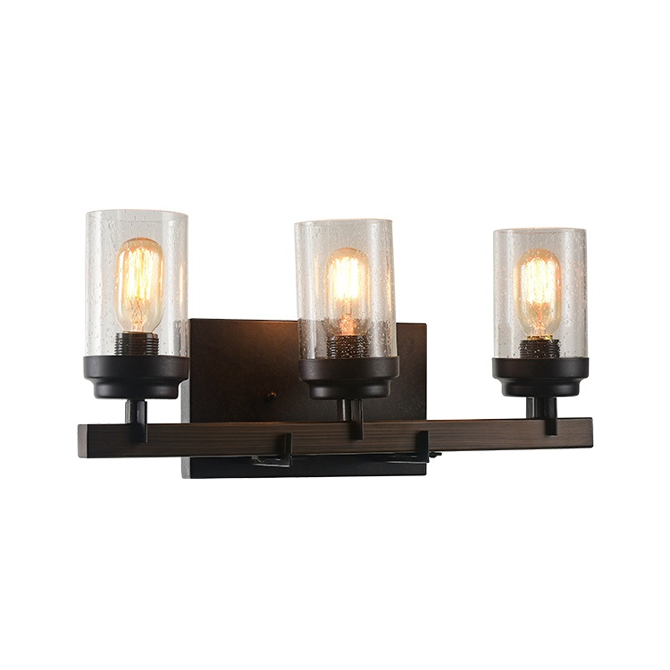
IWL05
Modern wall light
Input Voltage:AC85-265V
Led Chip:2835SMD
IP Rating:IP65 CRI>80 PF>0.9
Color Temperature:3000K/4500K/6000K
Operating Temperature:-25℃ ~50℃
Life Span:50000hours
Certificate:CE ROHS
Item Number | Wattage | Shell Material | Lamp holder | Luminous Flux | Luminous Flux | Warranty
IWL05 | Depend on bulb | Iron+wood+glass | E26/E27 | 80-100LM/W | 80-100LM/W | 2 years
Modern Ceiling Light Material:Iron base+ PMMA Cover Input Voltage:AC85-265V Led Chip:2835SMD IP Rating:IP44 CRI>80 PF>0.9 Color Temperature:3000K/4500K/6000K Operating Temperature:-25℃ ~50℃ Life Span:50000hours Certificate:CE ROHS
Item Number | Wattage | LedQuantity | LuminousFlux | Beam Angle | Size (mm) | WIFI Control Remte control Switch control Dimmer control
CL-N00 | 24W | 48pcs2835SMD | 1920-2160lm | 120° | 350mm | Yes
 | 36W | 72pcs2835SMD | 2880-3240lm | 120° | 400mm
 | 40W | 80pcs2835SMD | 3200-3600lm | 120° | 450mm
Modern Ceiling Light Material:Iron base+ PMMA Cover Input Voltage:AC85-265V Led Chip:2835SMD IP Rating:IP44 CRI>80 PF>0.9 Color Temperature:3000K/4500K/6000K Operating Temperature:-25℃ ~50℃ Life Span:50000hours Certificate:CE ROHS
Item Number | Wattage | LedQuantity | LuminousFlux | Beam Angle | Size (mm) | WIFI Control Remte control Switch control Dimmer control
CL-N00 | 24W | 48pcs2835SMD | 1920-2160lm | 120° | 350mm | Yes
 | 36W | 72pcs2835SMD | 2880-3240lm | 120° | 400mm
 | 40W | 80pcs2835SMD | 3200-3600lm | 120° | 450mm
Modern Ceiling Light Material:Iron base+ PMMA Cover Input Voltage:AC85-265V Led Chip:2835SMD IP Rating:IP44 CRI>80 PF>0.9 Color Temperature:3000K/4500K/6000K Operating Temperature:-25℃ ~50℃ Life Span:50000hours Certificate:CE ROHS
Item Number | Wattage | LedQuantity | LuminousFlux | Beam Angle | Size (mm) | WIFI Control Remte control Switch control Dimmer control
CL-N00 | 24W | 48pcs2835SMD | 1920-2160lm | 120° | 350mm | Yes
 | 36W | 72pcs2835SMD | 2880-3240lm | 120° | 400mm
 | 40W | 80pcs2835SMD | 3200-3600lm | 120° | 450mm
Modern Ceiling Light Material:Iron base+ PMMA Cover Input Voltage:AC85-265V Led Chip:2835SMD IP Rating:IP44 CRI>80 PF>0.9 Color Temperature:3000K/4500K/6000K Operating Temperature:-25℃ ~50℃ Life Span:50000hours Certificate:CE ROHS
Item Number | Wattage | LedQuantity | LuminousFlux | Beam Angle | Size (mm) | WIFI Control Remte control Switch control Dimmer control
CL-N00 | 24W | 48pcs2835SMD | 1920-2160lm | 120° | 350mm | Yes
 | 36W | 72pcs2835SMD | 2880-3240lm | 120° | 400mm
 | 40W | 80pcs2835SMD | 3200-3600lm | 120° | 450mm

Slide 11
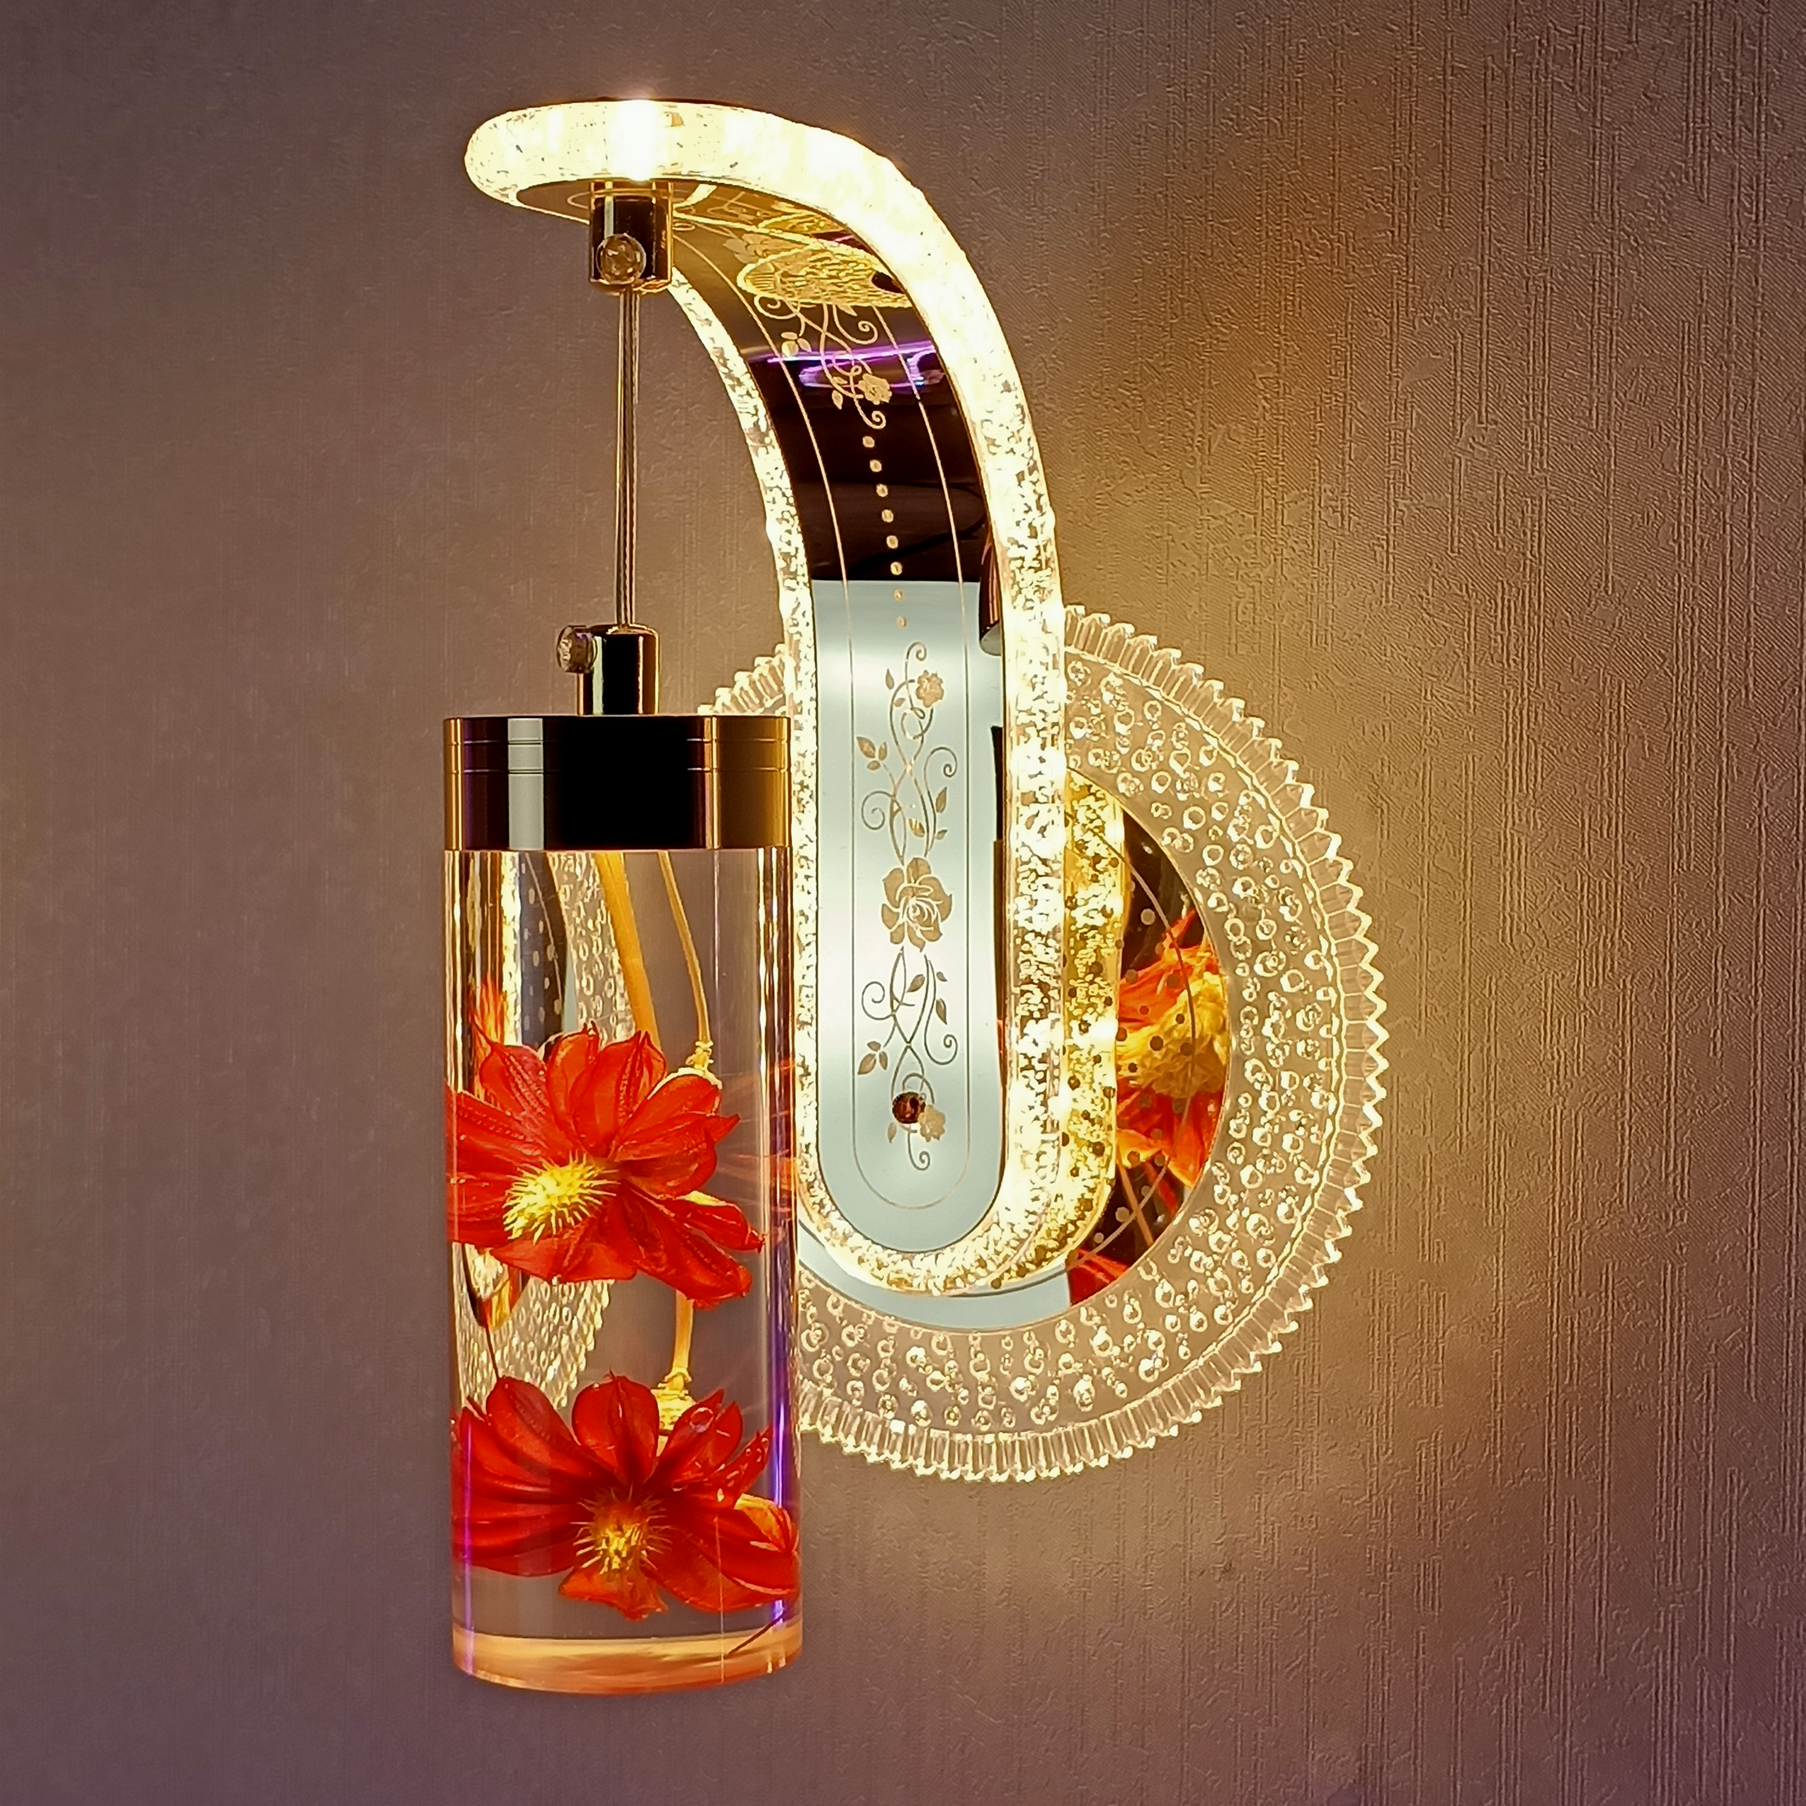
IWL06
Frameless panel light
Material:Aluminum+PMMA/PS/MS Cover
Input Voltage:AC85- 265V
Led Chip:2835SMD
Chip Brand :Epistar
IP Rating:IP44 CRI>80 PF>0.9
Color Temperature:3000K/4500K/6000K
Operating Temperature:-20℃ -50℃
Life Span：50000hours
Certificate：CE,ROHS
Item Number | Wattage | Shell Material | Light source | Beam Angle | Luminous Flux | Size
IWL06 | 16W | Aluminum+acrylic+dry flower | RGB | 90° | 80-100LM/W | H24xW12.5cm
Modern Ceiling Light Material:Iron base+ PMMA Cover Input Voltage:AC85-265V Led Chip:2835SMD IP Rating:IP44 CRI>80 PF>0.9 Color Temperature:3000K/4500K/6000K Operating Temperature:-25℃ ~50℃ Life Span:50000hours Certificate:CE ROHS
Item Number | Wattage | LedQuantity | LuminousFlux | Beam Angle | Size (mm) | WIFI Control Remte control Switch control Dimmer control
CL-N00 | 24W | 48pcs2835SMD | 1920-2160lm | 120° | 350mm | Yes
 | 36W | 72pcs2835SMD | 2880-3240lm | 120° | 400mm
 | 40W | 80pcs2835SMD | 3200-3600lm | 120° | 450mm
Modern Ceiling Light Material:Iron base+ PMMA Cover Input Voltage:AC85-265V Led Chip:2835SMD IP Rating:IP44 CRI>80 PF>0.9 Color Temperature:3000K/4500K/6000K Operating Temperature:-25℃ ~50℃ Life Span:50000hours Certificate:CE ROHS
Item Number | Wattage | LedQuantity | LuminousFlux | Beam Angle | Size (mm) | WIFI Control Remte control Switch control Dimmer control
CL-N00 | 24W | 48pcs2835SMD | 1920-2160lm | 120° | 350mm | Yes
 | 36W | 72pcs2835SMD | 2880-3240lm | 120° | 400mm
 | 40W | 80pcs2835SMD | 3200-3600lm | 120° | 450mm
Modern Ceiling Light Material:Iron base+ PMMA Cover Input Voltage:AC85-265V Led Chip:2835SMD IP Rating:IP44 CRI>80 PF>0.9 Color Temperature:3000K/4500K/6000K Operating Temperature:-25℃ ~50℃ Life Span:50000hours Certificate:CE ROHS
Item Number | Wattage | LedQuantity | LuminousFlux | Beam Angle | Size (mm) | WIFI Control Remte control Switch control Dimmer control
CL-N00 | 24W | 48pcs2835SMD | 1920-2160lm | 120° | 350mm | Yes
 | 36W | 72pcs2835SMD | 2880-3240lm | 120° | 400mm
 | 40W | 80pcs2835SMD | 3200-3600lm | 120° | 450mm
Modern Ceiling Light Material:Iron base+ PMMA Cover Input Voltage:AC85-265V Led Chip:2835SMD IP Rating:IP44 CRI>80 PF>0.9 Color Temperature:3000K/4500K/6000K Operating Temperature:-25℃ ~50℃ Life Span:50000hours Certificate:CE ROHS
Item Number | Wattage | LedQuantity | LuminousFlux | Beam Angle | Size (mm) | WIFI Control Remte control Switch control Dimmer control
CL-N00 | 24W | 48pcs2835SMD | 1920-2160lm | 120° | 350mm | Yes
 | 36W | 72pcs2835SMD | 2880-3240lm | 120° | 400mm
 | 40W | 80pcs2835SMD | 3200-3600lm | 120° | 450mm

Slide 12
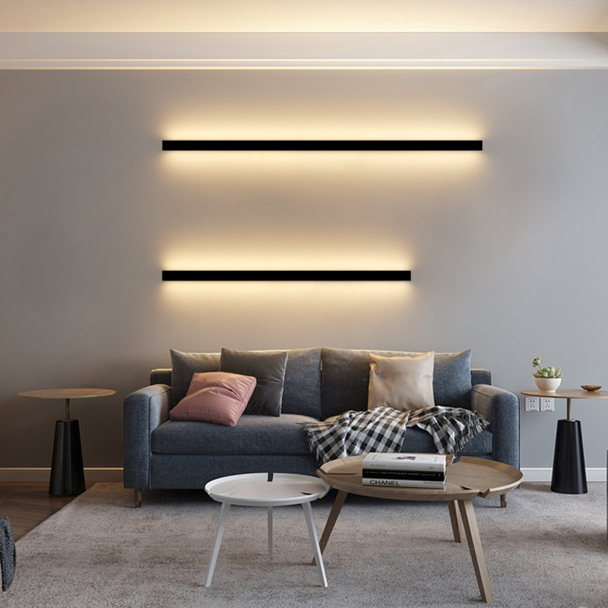
IWL07
Modern wall light
Input Voltage:AC85-265V
Led Chip:2835SMD
IP Rating:IP65 CRI>80 PF>0.9
Color Temperature:3000K/4500K/6000K
Operating Temperature:-25℃ ~50℃
Life Span:50000hours
Certificate:CE ROHS
Item Number | Wattage | Shell Material | Led Chip | Beam Angle | Luminous Flux | Length
IWL07 | 12W | Aluminum | 2835SMD | 90° | 80-100LM/W | 40CM
 | 14W |  |  |  |  | 60CM
 | 16W |  |  |  |  | 80CM
 | 20W |  |  |  |  | 100CM
 | 24W |  |  |  |  | 120CM
 | 30W |  |  |  |  | 150CM
Modern Ceiling Light Material:Iron base+ PMMA Cover Input Voltage:AC85-265V Led Chip:2835SMD IP Rating:IP44 CRI>80 PF>0.9 Color Temperature:3000K/4500K/6000K Operating Temperature:-25℃ ~50℃ Life Span:50000hours Certificate:CE ROHS
Item Number | Wattage | LedQuantity | LuminousFlux | Beam Angle | Size (mm) | WIFI Control Remte control Switch control Dimmer control
CL-N00 | 24W | 48pcs2835SMD | 1920-2160lm | 120° | 350mm | Yes
 | 36W | 72pcs2835SMD | 2880-3240lm | 120° | 400mm
 | 40W | 80pcs2835SMD | 3200-3600lm | 120° | 450mm
Modern Ceiling Light Material:Iron base+ PMMA Cover Input Voltage:AC85-265V Led Chip:2835SMD IP Rating:IP44 CRI>80 PF>0.9 Color Temperature:3000K/4500K/6000K Operating Temperature:-25℃ ~50℃ Life Span:50000hours Certificate:CE ROHS
Item Number | Wattage | LedQuantity | LuminousFlux | Beam Angle | Size (mm) | WIFI Control Remte control Switch control Dimmer control
CL-N00 | 24W | 48pcs2835SMD | 1920-2160lm | 120° | 350mm | Yes
 | 36W | 72pcs2835SMD | 2880-3240lm | 120° | 400mm
 | 40W | 80pcs2835SMD | 3200-3600lm | 120° | 450mm
Modern Ceiling Light Material:Iron base+ PMMA Cover Input Voltage:AC85-265V Led Chip:2835SMD IP Rating:IP44 CRI>80 PF>0.9 Color Temperature:3000K/4500K/6000K Operating Temperature:-25℃ ~50℃ Life Span:50000hours Certificate:CE ROHS
Item Number | Wattage | LedQuantity | LuminousFlux | Beam Angle | Size (mm) | WIFI Control Remte control Switch control Dimmer control
CL-N00 | 24W | 48pcs2835SMD | 1920-2160lm | 120° | 350mm | Yes
 | 36W | 72pcs2835SMD | 2880-3240lm | 120° | 400mm
 | 40W | 80pcs2835SMD | 3200-3600lm | 120° | 450mm
Modern Ceiling Light Material:Iron base+ PMMA Cover Input Voltage:AC85-265V Led Chip:2835SMD IP Rating:IP44 CRI>80 PF>0.9 Color Temperature:3000K/4500K/6000K Operating Temperature:-25℃ ~50℃ Life Span:50000hours Certificate:CE ROHS
Item Number | Wattage | LedQuantity | LuminousFlux | Beam Angle | Size (mm) | WIFI Control Remte control Switch control Dimmer control
CL-N00 | 24W | 48pcs2835SMD | 1920-2160lm | 120° | 350mm | Yes
 | 36W | 72pcs2835SMD | 2880-3240lm | 120° | 400mm
 | 40W | 80pcs2835SMD | 3200-3600lm | 120° | 450mm

Slide 13
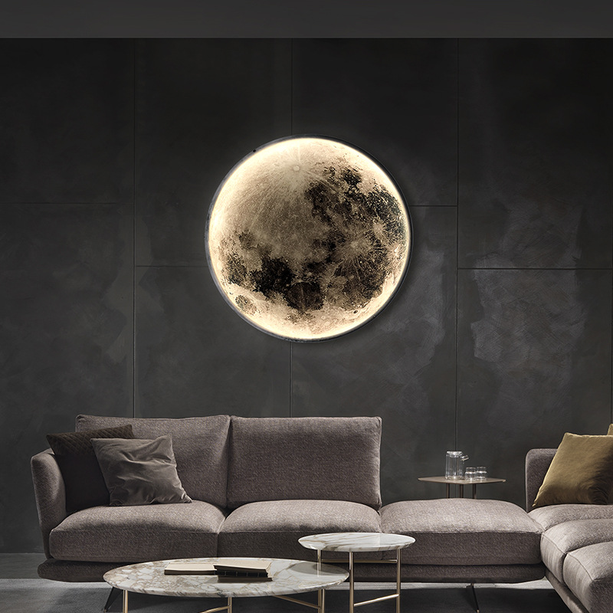
IWL08
Modern wall light
Input Voltage:AC85-265V
Led Chip:2835SMD
IP Rating:IP65 CRI>80 PF>0.9
Color Temperature:3000K/4500K/6000K
Operating Temperature:-25℃ ~50℃
Life Span:50000hours
Certificate:CE ROHS
Item Number | Wattage | Shell Material | Led Chip | Beam Angle | Luminous Flux | Size
IWL08 | 15W | Aluminum | 2835SMD | 90° | 80-100LM/W | Φ 240
 | 24W |  |  |  |  | Φ 500
 | 28W |  |  |  |  | Φ600
 | 38W |  |  |  |  | Φ 800
 | 47W |  |  |  |  | Φ 1000
Modern Ceiling Light Material:Iron base+ PMMA Cover Input Voltage:AC85-265V Led Chip:2835SMD IP Rating:IP44 CRI>80 PF>0.9 Color Temperature:3000K/4500K/6000K Operating Temperature:-25℃ ~50℃ Life Span:50000hours Certificate:CE ROHS
Item Number | Wattage | LedQuantity | LuminousFlux | Beam Angle | Size (mm) | WIFI Control Remte control Switch control Dimmer control
CL-N00 | 24W | 48pcs2835SMD | 1920-2160lm | 120° | 350mm | Yes
 | 36W | 72pcs2835SMD | 2880-3240lm | 120° | 400mm
 | 40W | 80pcs2835SMD | 3200-3600lm | 120° | 450mm
Modern Ceiling Light Material:Iron base+ PMMA Cover Input Voltage:AC85-265V Led Chip:2835SMD IP Rating:IP44 CRI>80 PF>0.9 Color Temperature:3000K/4500K/6000K Operating Temperature:-25℃ ~50℃ Life Span:50000hours Certificate:CE ROHS
Item Number | Wattage | LedQuantity | LuminousFlux | Beam Angle | Size (mm) | WIFI Control Remte control Switch control Dimmer control
CL-N00 | 24W | 48pcs2835SMD | 1920-2160lm | 120° | 350mm | Yes
 | 36W | 72pcs2835SMD | 2880-3240lm | 120° | 400mm
 | 40W | 80pcs2835SMD | 3200-3600lm | 120° | 450mm
Modern Ceiling Light Material:Iron base+ PMMA Cover Input Voltage:AC85-265V Led Chip:2835SMD IP Rating:IP44 CRI>80 PF>0.9 Color Temperature:3000K/4500K/6000K Operating Temperature:-25℃ ~50℃ Life Span:50000hours Certificate:CE ROHS
Item Number | Wattage | LedQuantity | LuminousFlux | Beam Angle | Size (mm) | WIFI Control Remte control Switch control Dimmer control
CL-N00 | 24W | 48pcs2835SMD | 1920-2160lm | 120° | 350mm | Yes
 | 36W | 72pcs2835SMD | 2880-3240lm | 120° | 400mm
 | 40W | 80pcs2835SMD | 3200-3600lm | 120° | 450mm
Modern Ceiling Light Material:Iron base+ PMMA Cover Input Voltage:AC85-265V Led Chip:2835SMD IP Rating:IP44 CRI>80 PF>0.9 Color Temperature:3000K/4500K/6000K Operating Temperature:-25℃ ~50℃ Life Span:50000hours Certificate:CE ROHS
Item Number | Wattage | LedQuantity | LuminousFlux | Beam Angle | Size (mm) | WIFI Control Remte control Switch control Dimmer control
CL-N00 | 24W | 48pcs2835SMD | 1920-2160lm | 120° | 350mm | Yes
 | 36W | 72pcs2835SMD | 2880-3240lm | 120° | 400mm
 | 40W | 80pcs2835SMD | 3200-3600lm | 120° | 450mm

Slide 14
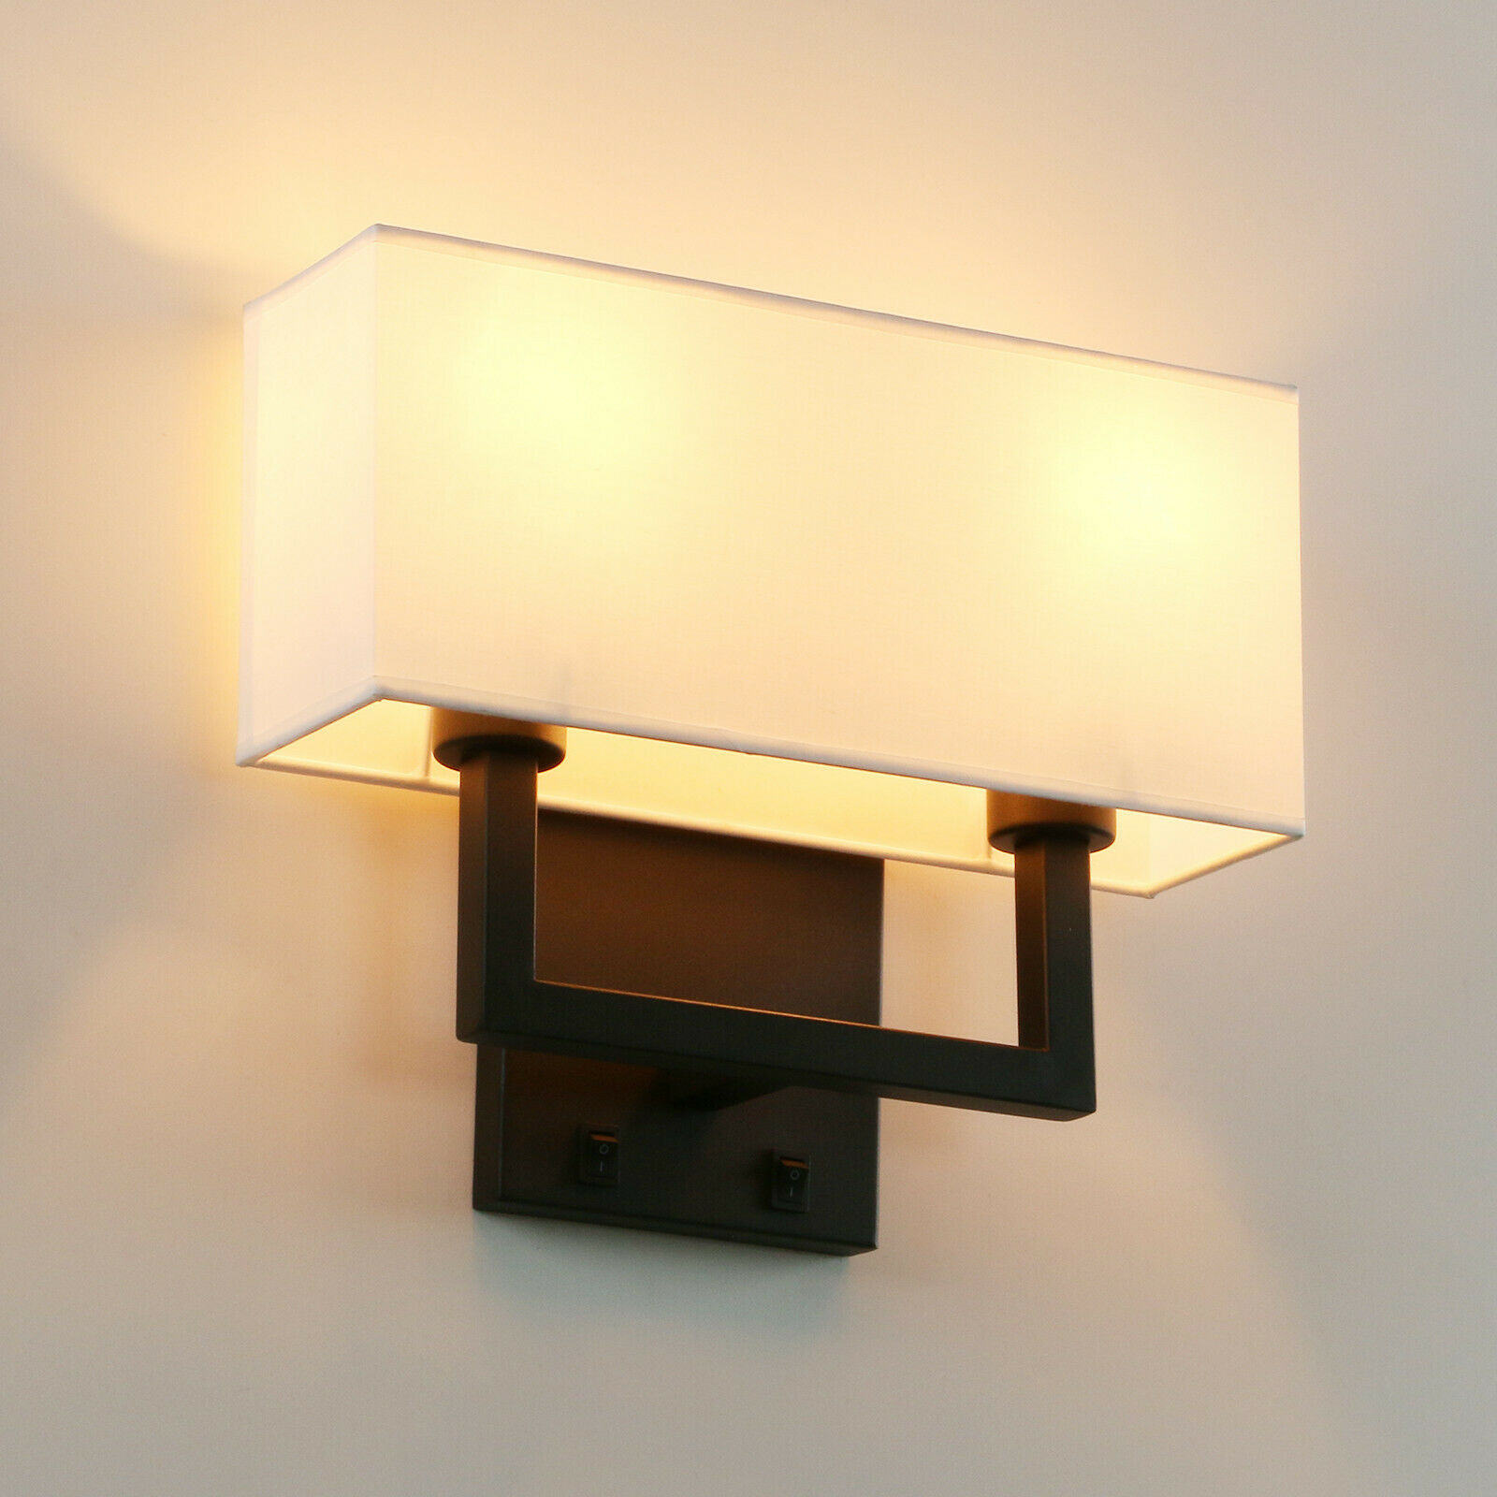
IWL09
Modern wall light
Input Voltage:AC85-265V
Led Chip:2835SMD
IP Rating:IP65 CRI>80 PF>0.9
Color Temperature:3000K/4500K/6000K
Operating Temperature:-25℃ ~50℃
Life Span:50000hours
Certificate:CE ROHS
Item Number | Wattage | Shell Material | Led Chip | Beam Angle | Luminous Flux | Warranty
IWL09 | 5W | Aluminum | 2835SMD | 90° | 80-100LM/W | 2-Years
Modern Ceiling Light Material:Iron base+ PMMA Cover Input Voltage:AC85-265V Led Chip:2835SMD IP Rating:IP44 CRI>80 PF>0.9 Color Temperature:3000K/4500K/6000K Operating Temperature:-25℃ ~50℃ Life Span:50000hours Certificate:CE ROHS
Item Number | Wattage | LedQuantity | LuminousFlux | Beam Angle | Size (mm) | WIFI Control Remte control Switch control Dimmer control
CL-N00 | 24W | 48pcs2835SMD | 1920-2160lm | 120° | 350mm | Yes
 | 36W | 72pcs2835SMD | 2880-3240lm | 120° | 400mm
 | 40W | 80pcs2835SMD | 3200-3600lm | 120° | 450mm
Modern Ceiling Light Material:Iron base+ PMMA Cover Input Voltage:AC85-265V Led Chip:2835SMD IP Rating:IP44 CRI>80 PF>0.9 Color Temperature:3000K/4500K/6000K Operating Temperature:-25℃ ~50℃ Life Span:50000hours Certificate:CE ROHS
Item Number | Wattage | LedQuantity | LuminousFlux | Beam Angle | Size (mm) | WIFI Control Remte control Switch control Dimmer control
CL-N00 | 24W | 48pcs2835SMD | 1920-2160lm | 120° | 350mm | Yes
 | 36W | 72pcs2835SMD | 2880-3240lm | 120° | 400mm
 | 40W | 80pcs2835SMD | 3200-3600lm | 120° | 450mm
Modern Ceiling Light Material:Iron base+ PMMA Cover Input Voltage:AC85-265V Led Chip:2835SMD IP Rating:IP44 CRI>80 PF>0.9 Color Temperature:3000K/4500K/6000K Operating Temperature:-25℃ ~50℃ Life Span:50000hours Certificate:CE ROHS
Item Number | Wattage | LedQuantity | LuminousFlux | Beam Angle | Size (mm) | WIFI Control Remte control Switch control Dimmer control
CL-N00 | 24W | 48pcs2835SMD | 1920-2160lm | 120° | 350mm | Yes
 | 36W | 72pcs2835SMD | 2880-3240lm | 120° | 400mm
 | 40W | 80pcs2835SMD | 3200-3600lm | 120° | 450mm
Modern Ceiling Light Material:Iron base+ PMMA Cover Input Voltage:AC85-265V Led Chip:2835SMD IP Rating:IP44 CRI>80 PF>0.9 Color Temperature:3000K/4500K/6000K Operating Temperature:-25℃ ~50℃ Life Span:50000hours Certificate:CE ROHS
Item Number | Wattage | LedQuantity | LuminousFlux | Beam Angle | Size (mm) | WIFI Control Remte control Switch control Dimmer control
CL-N00 | 24W | 48pcs2835SMD | 1920-2160lm | 120° | 350mm | Yes
 | 36W | 72pcs2835SMD | 2880-3240lm | 120° | 400mm
 | 40W | 80pcs2835SMD | 3200-3600lm | 120° | 450mm

Slide 15
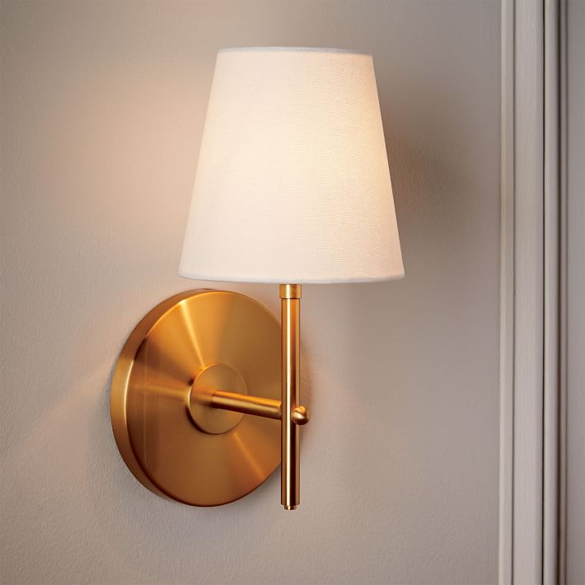
IWL10
Modern wall light
Input Voltage:AC85-265V
Led Chip:2835SMD
IP Rating:IP65 CRI>80 PF>0.9
Color Temperature:3000K/4500K/6000K
Operating Temperature:-25℃ ~50℃
Life Span:50000hours
Certificate:CE ROHS
Item Number | Wattage | Shell Material | Led Chip | Beam Angle | Luminous Flux | Warranty
IWL10 | 1-heads | Iron+Cloth | 2835SMD | 90° | 80-100LM/W | 2-Years
Modern Ceiling Light Material:Iron base+ PMMA Cover Input Voltage:AC85-265V Led Chip:2835SMD IP Rating:IP44 CRI>80 PF>0.9 Color Temperature:3000K/4500K/6000K Operating Temperature:-25℃ ~50℃ Life Span:50000hours Certificate:CE ROHS
Item Number | Wattage | LedQuantity | LuminousFlux | Beam Angle | Size (mm) | WIFI Control Remte control Switch control Dimmer control
CL-N00 | 24W | 48pcs2835SMD | 1920-2160lm | 120° | 350mm | Yes
 | 36W | 72pcs2835SMD | 2880-3240lm | 120° | 400mm
 | 40W | 80pcs2835SMD | 3200-3600lm | 120° | 450mm
Modern Ceiling Light Material:Iron base+ PMMA Cover Input Voltage:AC85-265V Led Chip:2835SMD IP Rating:IP44 CRI>80 PF>0.9 Color Temperature:3000K/4500K/6000K Operating Temperature:-25℃ ~50℃ Life Span:50000hours Certificate:CE ROHS
Item Number | Wattage | LedQuantity | LuminousFlux | Beam Angle | Size (mm) | WIFI Control Remte control Switch control Dimmer control
CL-N00 | 24W | 48pcs2835SMD | 1920-2160lm | 120° | 350mm | Yes
 | 36W | 72pcs2835SMD | 2880-3240lm | 120° | 400mm
 | 40W | 80pcs2835SMD | 3200-3600lm | 120° | 450mm
Modern Ceiling Light Material:Iron base+ PMMA Cover Input Voltage:AC85-265V Led Chip:2835SMD IP Rating:IP44 CRI>80 PF>0.9 Color Temperature:3000K/4500K/6000K Operating Temperature:-25℃ ~50℃ Life Span:50000hours Certificate:CE ROHS
Item Number | Wattage | LedQuantity | LuminousFlux | Beam Angle | Size (mm) | WIFI Control Remte control Switch control Dimmer control
CL-N00 | 24W | 48pcs2835SMD | 1920-2160lm | 120° | 350mm | Yes
 | 36W | 72pcs2835SMD | 2880-3240lm | 120° | 400mm
 | 40W | 80pcs2835SMD | 3200-3600lm | 120° | 450mm
Modern Ceiling Light Material:Iron base+ PMMA Cover Input Voltage:AC85-265V Led Chip:2835SMD IP Rating:IP44 CRI>80 PF>0.9 Color Temperature:3000K/4500K/6000K Operating Temperature:-25℃ ~50℃ Life Span:50000hours Certificate:CE ROHS
Item Number | Wattage | LedQuantity | LuminousFlux | Beam Angle | Size (mm) | WIFI Control Remte control Switch control Dimmer control
CL-N00 | 24W | 48pcs2835SMD | 1920-2160lm | 120° | 350mm | Yes
 | 36W | 72pcs2835SMD | 2880-3240lm | 120° | 400mm
 | 40W | 80pcs2835SMD | 3200-3600lm | 120° | 450mm

Slide 16
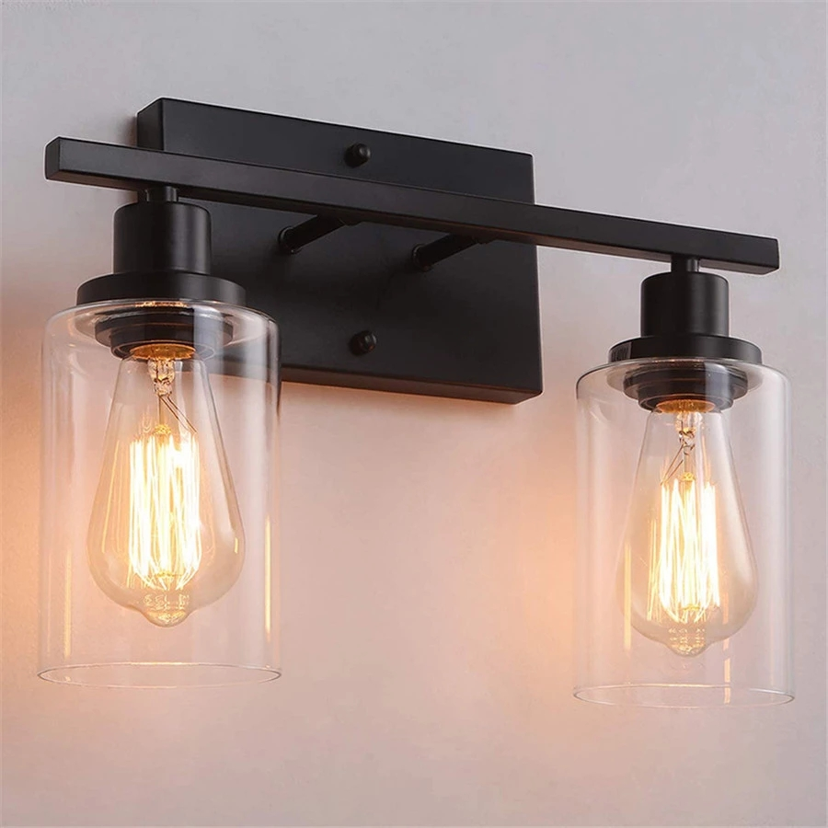
IWL11
Modern wall light
Input Voltage:AC85-265V
Led Chip:2835SMD
IP Rating:IP65 CRI>80 PF>0.9
Color Temperature:3000K/4500K/6000K
Operating Temperature:-25℃ ~50℃
Life Span:50000hours
Certificate:CE ROHS
Item Number | Wattage | Shell Material | Lamp holder | Beam Angle | Luminous Flux | Warranty
IWL11 | Depend on bulb | Iron+wood+glass | E26/E27 | 90° | 80-100LM/W | 2 years
Modern Ceiling Light Material:Iron base+ PMMA Cover Input Voltage:AC85-265V Led Chip:2835SMD IP Rating:IP44 CRI>80 PF>0.9 Color Temperature:3000K/4500K/6000K Operating Temperature:-25℃ ~50℃ Life Span:50000hours Certificate:CE ROHS
Item Number | Wattage | LedQuantity | LuminousFlux | Beam Angle | Size (mm) | WIFI Control Remte control Switch control Dimmer control
CL-N00 | 24W | 48pcs2835SMD | 1920-2160lm | 120° | 350mm | Yes
 | 36W | 72pcs2835SMD | 2880-3240lm | 120° | 400mm
 | 40W | 80pcs2835SMD | 3200-3600lm | 120° | 450mm
Modern Ceiling Light Material:Iron base+ PMMA Cover Input Voltage:AC85-265V Led Chip:2835SMD IP Rating:IP44 CRI>80 PF>0.9 Color Temperature:3000K/4500K/6000K Operating Temperature:-25℃ ~50℃ Life Span:50000hours Certificate:CE ROHS
Item Number | Wattage | LedQuantity | LuminousFlux | Beam Angle | Size (mm) | WIFI Control Remte control Switch control Dimmer control
CL-N00 | 24W | 48pcs2835SMD | 1920-2160lm | 120° | 350mm | Yes
 | 36W | 72pcs2835SMD | 2880-3240lm | 120° | 400mm
 | 40W | 80pcs2835SMD | 3200-3600lm | 120° | 450mm
Modern Ceiling Light Material:Iron base+ PMMA Cover Input Voltage:AC85-265V Led Chip:2835SMD IP Rating:IP44 CRI>80 PF>0.9 Color Temperature:3000K/4500K/6000K Operating Temperature:-25℃ ~50℃ Life Span:50000hours Certificate:CE ROHS
Item Number | Wattage | LedQuantity | LuminousFlux | Beam Angle | Size (mm) | WIFI Control Remte control Switch control Dimmer control
CL-N00 | 24W | 48pcs2835SMD | 1920-2160lm | 120° | 350mm | Yes
 | 36W | 72pcs2835SMD | 2880-3240lm | 120° | 400mm
 | 40W | 80pcs2835SMD | 3200-3600lm | 120° | 450mm
Modern Ceiling Light Material:Iron base+ PMMA Cover Input Voltage:AC85-265V Led Chip:2835SMD IP Rating:IP44 CRI>80 PF>0.9 Color Temperature:3000K/4500K/6000K Operating Temperature:-25℃ ~50℃ Life Span:50000hours Certificate:CE ROHS
Item Number | Wattage | LedQuantity | LuminousFlux | Beam Angle | Size (mm) | WIFI Control Remte control Switch control Dimmer control
CL-N00 | 24W | 48pcs2835SMD | 1920-2160lm | 120° | 350mm | Yes
 | 36W | 72pcs2835SMD | 2880-3240lm | 120° | 400mm
 | 40W | 80pcs2835SMD | 3200-3600lm | 120° | 450mm

Slide 17
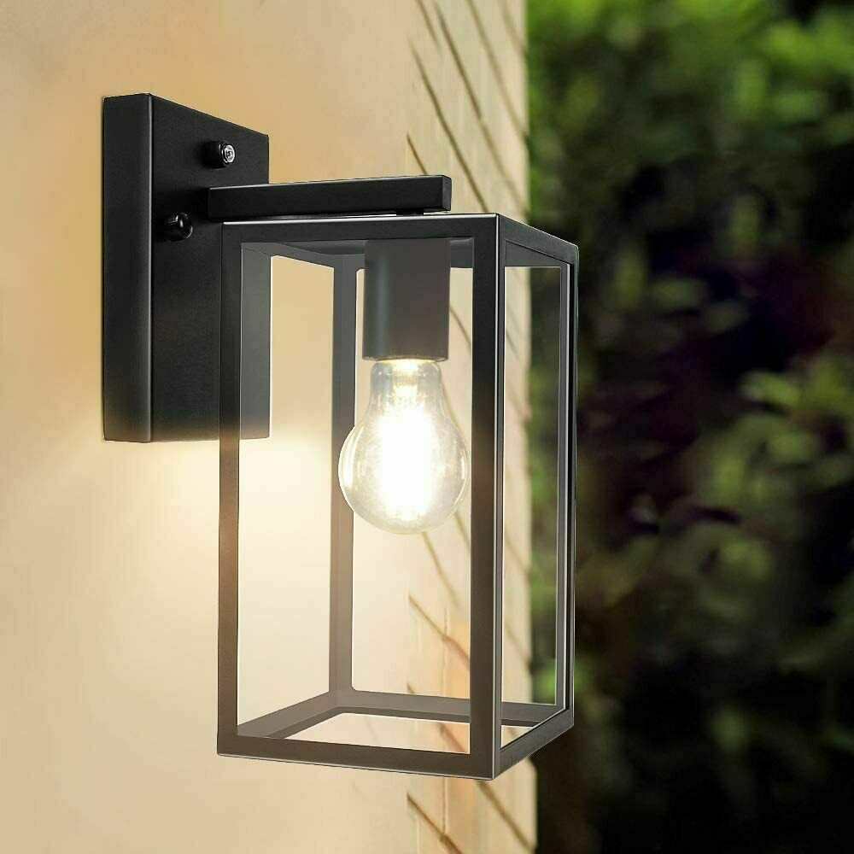
IWL12
Modern wall light
Input Voltage:AC85-265V
Led Chip:2835SMD
IP Rating:IP65 CRI>80 PF>0.9
Color Temperature:3000K/4500K/6000K
Operating Temperature:-25℃ ~50℃
Life Span:50000hours
Certificate:CE ROHS
Item Number | Wattage | Shell Material | Lamp holder | Beam Angle | Luminous Flux | Warranty
IWL12 | Depend on bulb | Iron+wood+glass | E26/E27 | 90° | 80-100LM/W | 2 years
Modern Ceiling Light Material:Iron base+ PMMA Cover Input Voltage:AC85-265V Led Chip:2835SMD IP Rating:IP44 CRI>80 PF>0.9 Color Temperature:3000K/4500K/6000K Operating Temperature:-25℃ ~50℃ Life Span:50000hours Certificate:CE ROHS
Item Number | Wattage | LedQuantity | LuminousFlux | Beam Angle | Size (mm) | WIFI Control Remte control Switch control Dimmer control
CL-N00 | 24W | 48pcs2835SMD | 1920-2160lm | 120° | 350mm | Yes
 | 36W | 72pcs2835SMD | 2880-3240lm | 120° | 400mm
 | 40W | 80pcs2835SMD | 3200-3600lm | 120° | 450mm
Modern Ceiling Light Material:Iron base+ PMMA Cover Input Voltage:AC85-265V Led Chip:2835SMD IP Rating:IP44 CRI>80 PF>0.9 Color Temperature:3000K/4500K/6000K Operating Temperature:-25℃ ~50℃ Life Span:50000hours Certificate:CE ROHS
Item Number | Wattage | LedQuantity | LuminousFlux | Beam Angle | Size (mm) | WIFI Control Remte control Switch control Dimmer control
CL-N00 | 24W | 48pcs2835SMD | 1920-2160lm | 120° | 350mm | Yes
 | 36W | 72pcs2835SMD | 2880-3240lm | 120° | 400mm
 | 40W | 80pcs2835SMD | 3200-3600lm | 120° | 450mm
Modern Ceiling Light Material:Iron base+ PMMA Cover Input Voltage:AC85-265V Led Chip:2835SMD IP Rating:IP44 CRI>80 PF>0.9 Color Temperature:3000K/4500K/6000K Operating Temperature:-25℃ ~50℃ Life Span:50000hours Certificate:CE ROHS
Item Number | Wattage | LedQuantity | LuminousFlux | Beam Angle | Size (mm) | WIFI Control Remte control Switch control Dimmer control
CL-N00 | 24W | 48pcs2835SMD | 1920-2160lm | 120° | 350mm | Yes
 | 36W | 72pcs2835SMD | 2880-3240lm | 120° | 400mm
 | 40W | 80pcs2835SMD | 3200-3600lm | 120° | 450mm
Modern Ceiling Light Material:Iron base+ PMMA Cover Input Voltage:AC85-265V Led Chip:2835SMD IP Rating:IP44 CRI>80 PF>0.9 Color Temperature:3000K/4500K/6000K Operating Temperature:-25℃ ~50℃ Life Span:50000hours Certificate:CE ROHS
Item Number | Wattage | LedQuantity | LuminousFlux | Beam Angle | Size (mm) | WIFI Control Remte control Switch control Dimmer control
CL-N00 | 24W | 48pcs2835SMD | 1920-2160lm | 120° | 350mm | Yes
 | 36W | 72pcs2835SMD | 2880-3240lm | 120° | 400mm
 | 40W | 80pcs2835SMD | 3200-3600lm | 120° | 450mm

Slide 18
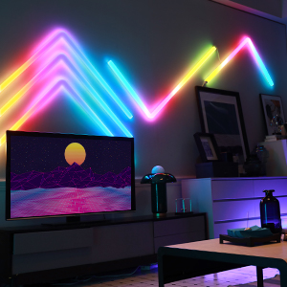
IWL13
Modern wall light
Input Voltage:DC24V
Led Chip:2835SMD
IP Rating:IP65 CRI>80 PF>0.9
Color Temperature:3000K/4500K/6000K
Operating Temperature:-25℃ ~50℃
Life Span:50000hours
Certificate:CE ROHS
Item Number | Wattage | Shell Material | Input Voltage | Beam Angle | Luminous Flux | Warranty
IWL13 | 24W | Flame Retarding V0 Class ABS | DC24V | 90° | 80-100LM/W | 2 years
Modern Ceiling Light Material:Iron base+ PMMA Cover Input Voltage:AC85-265V Led Chip:2835SMD IP Rating:IP44 CRI>80 PF>0.9 Color Temperature:3000K/4500K/6000K Operating Temperature:-25℃ ~50℃ Life Span:50000hours Certificate:CE ROHS
Item Number | Wattage | LedQuantity | LuminousFlux | Beam Angle | Size (mm) | WIFI Control Remte control Switch control Dimmer control
CL-N00 | 24W | 48pcs2835SMD | 1920-2160lm | 120° | 350mm | Yes
 | 36W | 72pcs2835SMD | 2880-3240lm | 120° | 400mm
 | 40W | 80pcs2835SMD | 3200-3600lm | 120° | 450mm
Modern Ceiling Light Material:Iron base+ PMMA Cover Input Voltage:AC85-265V Led Chip:2835SMD IP Rating:IP44 CRI>80 PF>0.9 Color Temperature:3000K/4500K/6000K Operating Temperature:-25℃ ~50℃ Life Span:50000hours Certificate:CE ROHS
Item Number | Wattage | LedQuantity | LuminousFlux | Beam Angle | Size (mm) | WIFI Control Remte control Switch control Dimmer control
CL-N00 | 24W | 48pcs2835SMD | 1920-2160lm | 120° | 350mm | Yes
 | 36W | 72pcs2835SMD | 2880-3240lm | 120° | 400mm
 | 40W | 80pcs2835SMD | 3200-3600lm | 120° | 450mm
Modern Ceiling Light Material:Iron base+ PMMA Cover Input Voltage:AC85-265V Led Chip:2835SMD IP Rating:IP44 CRI>80 PF>0.9 Color Temperature:3000K/4500K/6000K Operating Temperature:-25℃ ~50℃ Life Span:50000hours Certificate:CE ROHS
Item Number | Wattage | LedQuantity | LuminousFlux | Beam Angle | Size (mm) | WIFI Control Remte control Switch control Dimmer control
CL-N00 | 24W | 48pcs2835SMD | 1920-2160lm | 120° | 350mm | Yes
 | 36W | 72pcs2835SMD | 2880-3240lm | 120° | 400mm
 | 40W | 80pcs2835SMD | 3200-3600lm | 120° | 450mm
Modern Ceiling Light Material:Iron base+ PMMA Cover Input Voltage:AC85-265V Led Chip:2835SMD IP Rating:IP44 CRI>80 PF>0.9 Color Temperature:3000K/4500K/6000K Operating Temperature:-25℃ ~50℃ Life Span:50000hours Certificate:CE ROHS
Item Number | Wattage | LedQuantity | LuminousFlux | Beam Angle | Size (mm) | WIFI Control Remte control Switch control Dimmer control
CL-N00 | 24W | 48pcs2835SMD | 1920-2160lm | 120° | 350mm | Yes
 | 36W | 72pcs2835SMD | 2880-3240lm | 120° | 400mm
 | 40W | 80pcs2835SMD | 3200-3600lm | 120° | 450mm

Slide 19
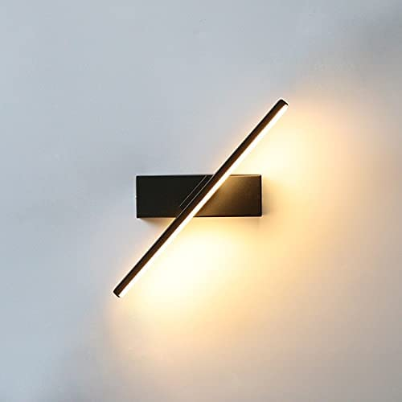
IWL15
Modern wall light
Input Voltage:AC85-265V
Led Chip:2835SMD
IP Rating:IP65 CRI>80 PF>0.9
Color Temperature:3000K/4500K/6000K
Operating Temperature:-25℃ ~50℃
Life Span:50000hours
Certificate:CE ROHS
Item Number | Wattage | Shell Material | Input Voltage | Beam Angle | Luminous Flux | Warranty
IWL15 | 6W | Aluminum | AC85-265V | 90° | 80-100LM/W | 2 years
Modern Ceiling Light Material:Iron base+ PMMA Cover Input Voltage:AC85-265V Led Chip:2835SMD IP Rating:IP44 CRI>80 PF>0.9 Color Temperature:3000K/4500K/6000K Operating Temperature:-25℃ ~50℃ Life Span:50000hours Certificate:CE ROHS
Item Number | Wattage | LedQuantity | LuminousFlux | Beam Angle | Size (mm) | WIFI Control Remte control Switch control Dimmer control
CL-N00 | 24W | 48pcs2835SMD | 1920-2160lm | 120° | 350mm | Yes
 | 36W | 72pcs2835SMD | 2880-3240lm | 120° | 400mm
 | 40W | 80pcs2835SMD | 3200-3600lm | 120° | 450mm
Modern Ceiling Light Material:Iron base+ PMMA Cover Input Voltage:AC85-265V Led Chip:2835SMD IP Rating:IP44 CRI>80 PF>0.9 Color Temperature:3000K/4500K/6000K Operating Temperature:-25℃ ~50℃ Life Span:50000hours Certificate:CE ROHS
Item Number | Wattage | LedQuantity | LuminousFlux | Beam Angle | Size (mm) | WIFI Control Remte control Switch control Dimmer control
CL-N00 | 24W | 48pcs2835SMD | 1920-2160lm | 120° | 350mm | Yes
 | 36W | 72pcs2835SMD | 2880-3240lm | 120° | 400mm
 | 40W | 80pcs2835SMD | 3200-3600lm | 120° | 450mm
Modern Ceiling Light Material:Iron base+ PMMA Cover Input Voltage:AC85-265V Led Chip:2835SMD IP Rating:IP44 CRI>80 PF>0.9 Color Temperature:3000K/4500K/6000K Operating Temperature:-25℃ ~50℃ Life Span:50000hours Certificate:CE ROHS
Item Number | Wattage | LedQuantity | LuminousFlux | Beam Angle | Size (mm) | WIFI Control Remte control Switch control Dimmer control
CL-N00 | 24W | 48pcs2835SMD | 1920-2160lm | 120° | 350mm | Yes
 | 36W | 72pcs2835SMD | 2880-3240lm | 120° | 400mm
 | 40W | 80pcs2835SMD | 3200-3600lm | 120° | 450mm
Modern Ceiling Light Material:Iron base+ PMMA Cover Input Voltage:AC85-265V Led Chip:2835SMD IP Rating:IP44 CRI>80 PF>0.9 Color Temperature:3000K/4500K/6000K Operating Temperature:-25℃ ~50℃ Life Span:50000hours Certificate:CE ROHS
Item Number | Wattage | LedQuantity | LuminousFlux | Beam Angle | Size (mm) | WIFI Control Remte control Switch control Dimmer control
CL-N00 | 24W | 48pcs2835SMD | 1920-2160lm | 120° | 350mm | Yes
 | 36W | 72pcs2835SMD | 2880-3240lm | 120° | 400mm
 | 40W | 80pcs2835SMD | 3200-3600lm | 120° | 450mm

Slide 20
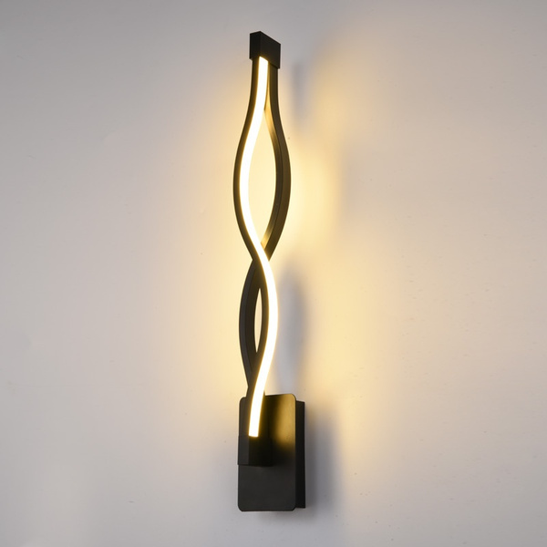
IWL16
Modern wall light
Input Voltage:AC85-265V
Led Chip:2835SMD
IP Rating:IP65 CRI>80 PF>0.9
Color Temperature:3000K/4500K/6000K
Operating Temperature:-25℃ ~50℃
Life Span:50000hours
Certificate:CE ROHS
Item Number | Design | Shell Material | Input Voltage | Beam Angle | Luminous Flux | Warranty
IWL16 | Shape 8 | Aluminum | AC85-265V | 120° | 80-100LM/W | 2 years
 | Wave
 | Twist
Modern Ceiling Light Material:Iron base+ PMMA Cover Input Voltage:AC85-265V Led Chip:2835SMD IP Rating:IP44 CRI>80 PF>0.9 Color Temperature:3000K/4500K/6000K Operating Temperature:-25℃ ~50℃ Life Span:50000hours Certificate:CE ROHS
Item Number | Wattage | LedQuantity | LuminousFlux | Beam Angle | Size (mm) | WIFI Control Remte control Switch control Dimmer control
CL-N00 | 24W | 48pcs2835SMD | 1920-2160lm | 120° | 350mm | Yes
 | 36W | 72pcs2835SMD | 2880-3240lm | 120° | 400mm
 | 40W | 80pcs2835SMD | 3200-3600lm | 120° | 450mm
Modern Ceiling Light Material:Iron base+ PMMA Cover Input Voltage:AC85-265V Led Chip:2835SMD IP Rating:IP44 CRI>80 PF>0.9 Color Temperature:3000K/4500K/6000K Operating Temperature:-25℃ ~50℃ Life Span:50000hours Certificate:CE ROHS
Item Number | Wattage | LedQuantity | LuminousFlux | Beam Angle | Size (mm) | WIFI Control Remte control Switch control Dimmer control
CL-N00 | 24W | 48pcs2835SMD | 1920-2160lm | 120° | 350mm | Yes
 | 36W | 72pcs2835SMD | 2880-3240lm | 120° | 400mm
 | 40W | 80pcs2835SMD | 3200-3600lm | 120° | 450mm
Modern Ceiling Light Material:Iron base+ PMMA Cover Input Voltage:AC85-265V Led Chip:2835SMD IP Rating:IP44 CRI>80 PF>0.9 Color Temperature:3000K/4500K/6000K Operating Temperature:-25℃ ~50℃ Life Span:50000hours Certificate:CE ROHS
Item Number | Wattage | LedQuantity | LuminousFlux | Beam Angle | Size (mm) | WIFI Control Remte control Switch control Dimmer control
CL-N00 | 24W | 48pcs2835SMD | 1920-2160lm | 120° | 350mm | Yes
 | 36W | 72pcs2835SMD | 2880-3240lm | 120° | 400mm
 | 40W | 80pcs2835SMD | 3200-3600lm | 120° | 450mm
Modern Ceiling Light Material:Iron base+ PMMA Cover Input Voltage:AC85-265V Led Chip:2835SMD IP Rating:IP44 CRI>80 PF>0.9 Color Temperature:3000K/4500K/6000K Operating Temperature:-25℃ ~50℃ Life Span:50000hours Certificate:CE ROHS
Item Number | Wattage | LedQuantity | LuminousFlux | Beam Angle | Size (mm) | WIFI Control Remte control Switch control Dimmer control
CL-N00 | 24W | 48pcs2835SMD | 1920-2160lm | 120° | 350mm | Yes
 | 36W | 72pcs2835SMD | 2880-3240lm | 120° | 400mm
 | 40W | 80pcs2835SMD | 3200-3600lm | 120° | 450mm

Slide 21
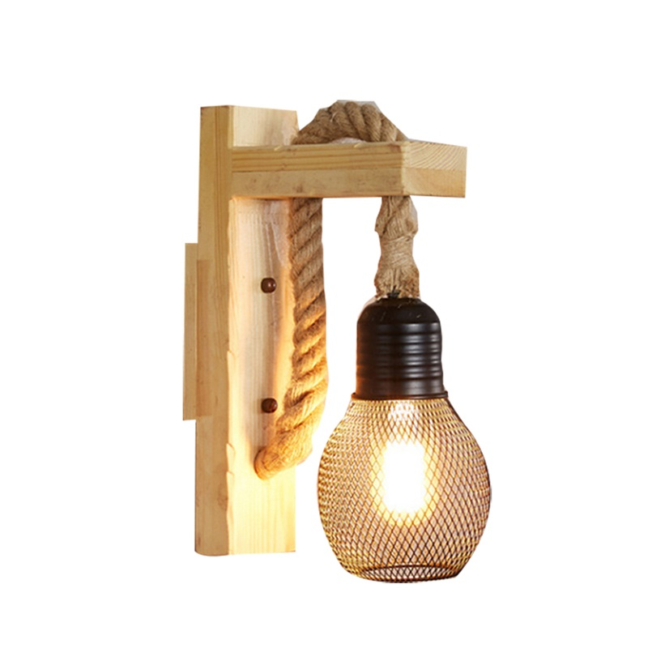
IWL17
Modern wall light
Input Voltage:AC85-265V
Led Chip:2835SMD
IP Rating:IP65 CRI>80 PF>0.9
Color Temperature:3000K/4500K/6000K
Operating Temperature:-25℃ ~50℃
Life Span:50000hours
Certificate:CE ROHS
Item Number | Wattage | Shell Material | Lamp holder | Beam Angle | Luminous Flux | Warranty
IWL17 | Depend on bulb | Iron+wood+glass | E26/E27 | 90° | 80-100LM/W | 2 years
Modern Ceiling Light Material:Iron base+ PMMA Cover Input Voltage:AC85-265V Led Chip:2835SMD IP Rating:IP44 CRI>80 PF>0.9 Color Temperature:3000K/4500K/6000K Operating Temperature:-25℃ ~50℃ Life Span:50000hours Certificate:CE ROHS
Item Number | Wattage | LedQuantity | LuminousFlux | Beam Angle | Size (mm) | WIFI Control Remte control Switch control Dimmer control
CL-N00 | 24W | 48pcs2835SMD | 1920-2160lm | 120° | 350mm | Yes
 | 36W | 72pcs2835SMD | 2880-3240lm | 120° | 400mm
 | 40W | 80pcs2835SMD | 3200-3600lm | 120° | 450mm
Modern Ceiling Light Material:Iron base+ PMMA Cover Input Voltage:AC85-265V Led Chip:2835SMD IP Rating:IP44 CRI>80 PF>0.9 Color Temperature:3000K/4500K/6000K Operating Temperature:-25℃ ~50℃ Life Span:50000hours Certificate:CE ROHS
Item Number | Wattage | LedQuantity | LuminousFlux | Beam Angle | Size (mm) | WIFI Control Remte control Switch control Dimmer control
CL-N00 | 24W | 48pcs2835SMD | 1920-2160lm | 120° | 350mm | Yes
 | 36W | 72pcs2835SMD | 2880-3240lm | 120° | 400mm
 | 40W | 80pcs2835SMD | 3200-3600lm | 120° | 450mm
Modern Ceiling Light Material:Iron base+ PMMA Cover Input Voltage:AC85-265V Led Chip:2835SMD IP Rating:IP44 CRI>80 PF>0.9 Color Temperature:3000K/4500K/6000K Operating Temperature:-25℃ ~50℃ Life Span:50000hours Certificate:CE ROHS
Item Number | Wattage | LedQuantity | LuminousFlux | Beam Angle | Size (mm) | WIFI Control Remte control Switch control Dimmer control
CL-N00 | 24W | 48pcs2835SMD | 1920-2160lm | 120° | 350mm | Yes
 | 36W | 72pcs2835SMD | 2880-3240lm | 120° | 400mm
 | 40W | 80pcs2835SMD | 3200-3600lm | 120° | 450mm
Modern Ceiling Light Material:Iron base+ PMMA Cover Input Voltage:AC85-265V Led Chip:2835SMD IP Rating:IP44 CRI>80 PF>0.9 Color Temperature:3000K/4500K/6000K Operating Temperature:-25℃ ~50℃ Life Span:50000hours Certificate:CE ROHS
Item Number | Wattage | LedQuantity | LuminousFlux | Beam Angle | Size (mm) | WIFI Control Remte control Switch control Dimmer control
CL-N00 | 24W | 48pcs2835SMD | 1920-2160lm | 120° | 350mm | Yes
 | 36W | 72pcs2835SMD | 2880-3240lm | 120° | 400mm
 | 40W | 80pcs2835SMD | 3200-3600lm | 120° | 450mm

Slide 22
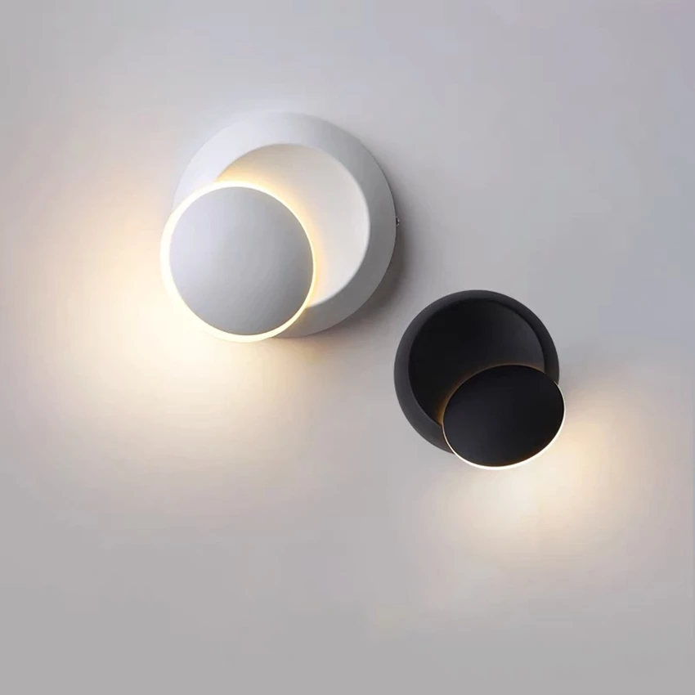
IWL18
Modern wall light
Input Voltage:AC85-265V
Led Chip:2835SMD
IP Rating:IP65 CRI>80 PF>0.9
Color Temperature:3000K/4500K/6000K
Operating Temperature:-25℃ ~50℃
Life Span:50000hours
Certificate:CE ROHS
Item Number | Wattage | Shell Material | Led Chip | Beam Angle | Luminous Flux | Warranty
IWL18 | 5W | Aluminum | 2835SMD | 90° | 80-100LM/W | 2-Years
Modern Ceiling Light Material:Iron base+ PMMA Cover Input Voltage:AC85-265V Led Chip:2835SMD IP Rating:IP44 CRI>80 PF>0.9 Color Temperature:3000K/4500K/6000K Operating Temperature:-25℃ ~50℃ Life Span:50000hours Certificate:CE ROHS
Item Number | Wattage | LedQuantity | LuminousFlux | Beam Angle | Size (mm) | WIFI Control Remte control Switch control Dimmer control
CL-N00 | 24W | 48pcs2835SMD | 1920-2160lm | 120° | 350mm | Yes
 | 36W | 72pcs2835SMD | 2880-3240lm | 120° | 400mm
 | 40W | 80pcs2835SMD | 3200-3600lm | 120° | 450mm
Modern Ceiling Light Material:Iron base+ PMMA Cover Input Voltage:AC85-265V Led Chip:2835SMD IP Rating:IP44 CRI>80 PF>0.9 Color Temperature:3000K/4500K/6000K Operating Temperature:-25℃ ~50℃ Life Span:50000hours Certificate:CE ROHS
Item Number | Wattage | LedQuantity | LuminousFlux | Beam Angle | Size (mm) | WIFI Control Remte control Switch control Dimmer control
CL-N00 | 24W | 48pcs2835SMD | 1920-2160lm | 120° | 350mm | Yes
 | 36W | 72pcs2835SMD | 2880-3240lm | 120° | 400mm
 | 40W | 80pcs2835SMD | 3200-3600lm | 120° | 450mm
Modern Ceiling Light Material:Iron base+ PMMA Cover Input Voltage:AC85-265V Led Chip:2835SMD IP Rating:IP44 CRI>80 PF>0.9 Color Temperature:3000K/4500K/6000K Operating Temperature:-25℃ ~50℃ Life Span:50000hours Certificate:CE ROHS
Item Number | Wattage | LedQuantity | LuminousFlux | Beam Angle | Size (mm) | WIFI Control Remte control Switch control Dimmer control
CL-N00 | 24W | 48pcs2835SMD | 1920-2160lm | 120° | 350mm | Yes
 | 36W | 72pcs2835SMD | 2880-3240lm | 120° | 400mm
 | 40W | 80pcs2835SMD | 3200-3600lm | 120° | 450mm
Modern Ceiling Light Material:Iron base+ PMMA Cover Input Voltage:AC85-265V Led Chip:2835SMD IP Rating:IP44 CRI>80 PF>0.9 Color Temperature:3000K/4500K/6000K Operating Temperature:-25℃ ~50℃ Life Span:50000hours Certificate:CE ROHS
Item Number | Wattage | LedQuantity | LuminousFlux | Beam Angle | Size (mm) | WIFI Control Remte control Switch control Dimmer control
CL-N00 | 24W | 48pcs2835SMD | 1920-2160lm | 120° | 350mm | Yes
 | 36W | 72pcs2835SMD | 2880-3240lm | 120° | 400mm
 | 40W | 80pcs2835SMD | 3200-3600lm | 120° | 450mm

Slide 23
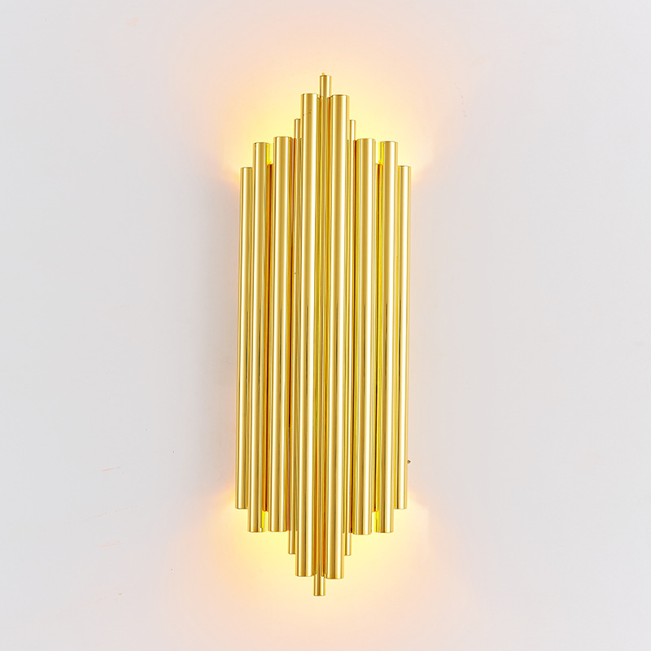
IWL19
Modern wall light
Input Voltage:AC85-265V
Led Chip:2835SMD
IP Rating:IP65 CRI>80 PF>0.9
Color Temperature:3000K/4500K/6000K
Operating Temperature:-25℃ ~50℃
Life Span:50000hours
Certificate:CE ROHS
Item Number | Wattage | Shell Material | Led Chip | Beam Angle | Luminous Flux | Size
IWL19 | 5W | Hardware plating | 2835SMD | 90° | 80-100LM/W | 58*27*16cm
Modern Ceiling Light Material:Iron base+ PMMA Cover Input Voltage:AC85-265V Led Chip:2835SMD IP Rating:IP44 CRI>80 PF>0.9 Color Temperature:3000K/4500K/6000K Operating Temperature:-25℃ ~50℃ Life Span:50000hours Certificate:CE ROHS
Item Number | Wattage | LedQuantity | LuminousFlux | Beam Angle | Size (mm) | WIFI Control Remte control Switch control Dimmer control
CL-N00 | 24W | 48pcs2835SMD | 1920-2160lm | 120° | 350mm | Yes
 | 36W | 72pcs2835SMD | 2880-3240lm | 120° | 400mm
 | 40W | 80pcs2835SMD | 3200-3600lm | 120° | 450mm
Modern Ceiling Light Material:Iron base+ PMMA Cover Input Voltage:AC85-265V Led Chip:2835SMD IP Rating:IP44 CRI>80 PF>0.9 Color Temperature:3000K/4500K/6000K Operating Temperature:-25℃ ~50℃ Life Span:50000hours Certificate:CE ROHS
Item Number | Wattage | LedQuantity | LuminousFlux | Beam Angle | Size (mm) | WIFI Control Remte control Switch control Dimmer control
CL-N00 | 24W | 48pcs2835SMD | 1920-2160lm | 120° | 350mm | Yes
 | 36W | 72pcs2835SMD | 2880-3240lm | 120° | 400mm
 | 40W | 80pcs2835SMD | 3200-3600lm | 120° | 450mm
Modern Ceiling Light Material:Iron base+ PMMA Cover Input Voltage:AC85-265V Led Chip:2835SMD IP Rating:IP44 CRI>80 PF>0.9 Color Temperature:3000K/4500K/6000K Operating Temperature:-25℃ ~50℃ Life Span:50000hours Certificate:CE ROHS
Item Number | Wattage | LedQuantity | LuminousFlux | Beam Angle | Size (mm) | WIFI Control Remte control Switch control Dimmer control
CL-N00 | 24W | 48pcs2835SMD | 1920-2160lm | 120° | 350mm | Yes
 | 36W | 72pcs2835SMD | 2880-3240lm | 120° | 400mm
 | 40W | 80pcs2835SMD | 3200-3600lm | 120° | 450mm
Modern Ceiling Light Material:Iron base+ PMMA Cover Input Voltage:AC85-265V Led Chip:2835SMD IP Rating:IP44 CRI>80 PF>0.9 Color Temperature:3000K/4500K/6000K Operating Temperature:-25℃ ~50℃ Life Span:50000hours Certificate:CE ROHS
Item Number | Wattage | LedQuantity | LuminousFlux | Beam Angle | Size (mm) | WIFI Control Remte control Switch control Dimmer control
CL-N00 | 24W | 48pcs2835SMD | 1920-2160lm | 120° | 350mm | Yes
 | 36W | 72pcs2835SMD | 2880-3240lm | 120° | 400mm
 | 40W | 80pcs2835SMD | 3200-3600lm | 120° | 450mm

Slide 24
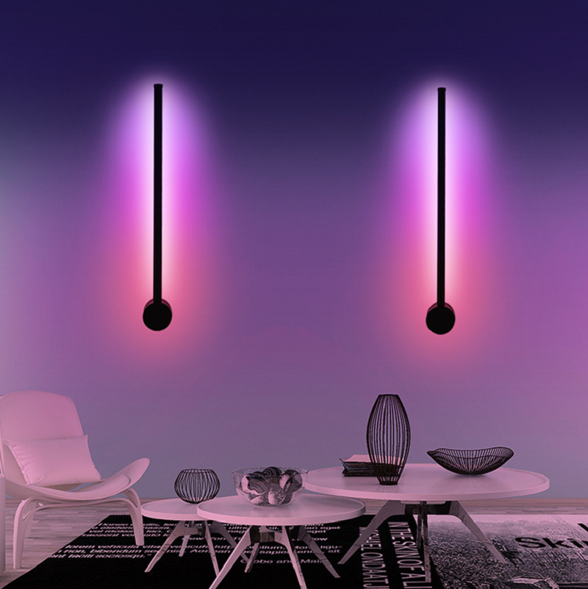
IWL20
Modern wall light
Input Voltage:AC85-265V
Led Chip:2835SMD
IP Rating:IP65 CRI>80 PF>0.9
Color Temperature:3000K/4500K/6000K
Operating Temperature:-25℃ ~50℃
Life Span:50000hours
Certificate:CE ROHS
Item Number | Wattage | Shell Material | Led Chip | Beam Angle | Luminous Flux | Size
IWL20 | 5W | Metal | 2835SMD | 90° | 80-100LM/W | D16cm*60cm
 | 6W |  |  |  |  | D16cm*80cm
 | 8W |  |  |  |  | D16cm*100cm
Modern Ceiling Light Material:Iron base+ PMMA Cover Input Voltage:AC85-265V Led Chip:2835SMD IP Rating:IP44 CRI>80 PF>0.9 Color Temperature:3000K/4500K/6000K Operating Temperature:-25℃ ~50℃ Life Span:50000hours Certificate:CE ROHS
Item Number | Wattage | LedQuantity | LuminousFlux | Beam Angle | Size (mm) | WIFI Control Remte control Switch control Dimmer control
CL-N00 | 24W | 48pcs2835SMD | 1920-2160lm | 120° | 350mm | Yes
 | 36W | 72pcs2835SMD | 2880-3240lm | 120° | 400mm
 | 40W | 80pcs2835SMD | 3200-3600lm | 120° | 450mm
Modern Ceiling Light Material:Iron base+ PMMA Cover Input Voltage:AC85-265V Led Chip:2835SMD IP Rating:IP44 CRI>80 PF>0.9 Color Temperature:3000K/4500K/6000K Operating Temperature:-25℃ ~50℃ Life Span:50000hours Certificate:CE ROHS
Item Number | Wattage | LedQuantity | LuminousFlux | Beam Angle | Size (mm) | WIFI Control Remte control Switch control Dimmer control
CL-N00 | 24W | 48pcs2835SMD | 1920-2160lm | 120° | 350mm | Yes
 | 36W | 72pcs2835SMD | 2880-3240lm | 120° | 400mm
 | 40W | 80pcs2835SMD | 3200-3600lm | 120° | 450mm
Modern Ceiling Light Material:Iron base+ PMMA Cover Input Voltage:AC85-265V Led Chip:2835SMD IP Rating:IP44 CRI>80 PF>0.9 Color Temperature:3000K/4500K/6000K Operating Temperature:-25℃ ~50℃ Life Span:50000hours Certificate:CE ROHS
Item Number | Wattage | LedQuantity | LuminousFlux | Beam Angle | Size (mm) | WIFI Control Remte control Switch control Dimmer control
CL-N00 | 24W | 48pcs2835SMD | 1920-2160lm | 120° | 350mm | Yes
 | 36W | 72pcs2835SMD | 2880-3240lm | 120° | 400mm
 | 40W | 80pcs2835SMD | 3200-3600lm | 120° | 450mm
Modern Ceiling Light Material:Iron base+ PMMA Cover Input Voltage:AC85-265V Led Chip:2835SMD IP Rating:IP44 CRI>80 PF>0.9 Color Temperature:3000K/4500K/6000K Operating Temperature:-25℃ ~50℃ Life Span:50000hours Certificate:CE ROHS
Item Number | Wattage | LedQuantity | LuminousFlux | Beam Angle | Size (mm) | WIFI Control Remte control Switch control Dimmer control
CL-N00 | 24W | 48pcs2835SMD | 1920-2160lm | 120° | 350mm | Yes
 | 36W | 72pcs2835SMD | 2880-3240lm | 120° | 400mm
 | 40W | 80pcs2835SMD | 3200-3600lm | 120° | 450mm

